Slide 1
A Feasibility Investigation for Developing Artificial Beachrocks: A Potential Measure for Coastal Protection in Southeast Yogyakarta Coast, Indonesia
Lutfian R. Daryono^{1*}, Kazunori Nakashima², Satoru Kawasaki², Koichi Suzuki³, Anastasia D. Titisari⁴, Didit H. Barianto⁴, Imam Suyanto⁵, and Arief Rahmadi⁵
1Laboratory of Biotechnology for Resource Engineering, Division of Sustainable Resources Engineering, Grad. School of Engineering, Hokkaido University, Japan
2Laboratory of Biotechnology for Resource Engineering, Division of Sustainable Resources Engineering, Faculty of Engineering, Hokkaido University, Japan
3Laboratory of Global Resources and Environmental System, Division of Sustainable Resources Engineering, Faculty of Engineering, Hokkaido University, Japan
4Department of Geological Engineering, Faculty of Engineering, Universitas Gadjah Mada, Yogyakarta, Indonesia
5Sub-department of Geophysics, Faculty of Mathematics and Sciences, Universitas Gadjah Mada, Yogyakarta, Indonesia

Slide 2
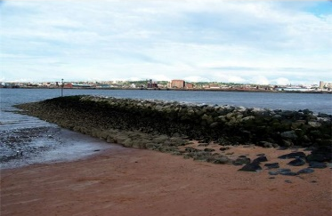
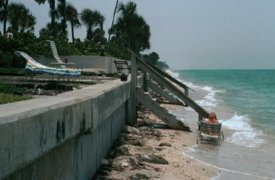
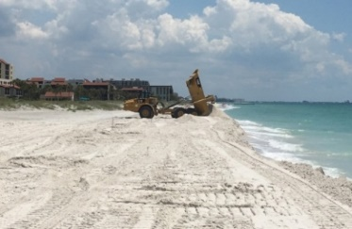
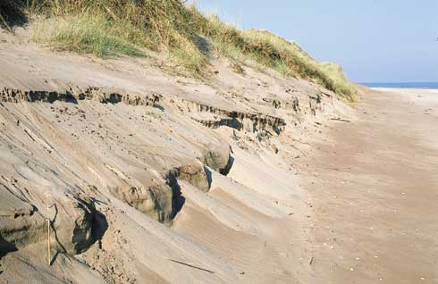
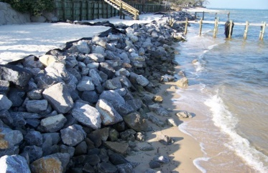
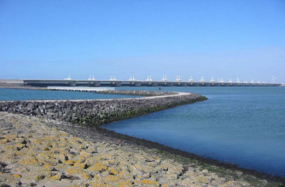
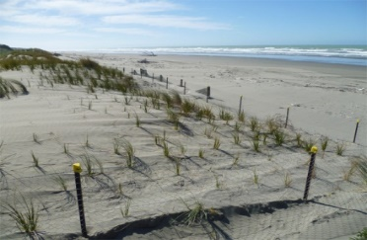
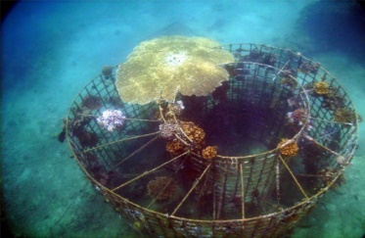
Introduction
Lab. Biotechnology for Resources
Coastal erosion is a natural process which poses serious problems to coastal communities worldwide.
Conventional engineering solutions have succeeded in combatting the erosion problem over decades.
However, they are associated with numerous problems as mentioned below.
Hard engineering solutions
Soft engineering solutions
Sea groyne
Seawall
Nourishment
Sand dunes
Revetment
Breakwater
Green belts
Artificial corals
Expensive, short lived, not environmentally friendly, large visual impact, interfere local wave hydrodynamics
Need periodic maintenance
In need of more ecofriendly, inexpensive novel approaches
Notes:
Continual and costly maintenance work
Large visual impact
Downdrift erosion in the presence of alongshore currents

Slide 3
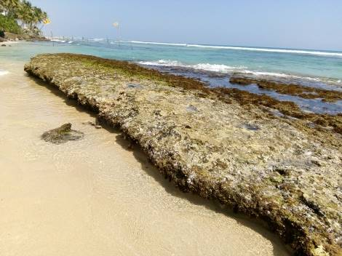
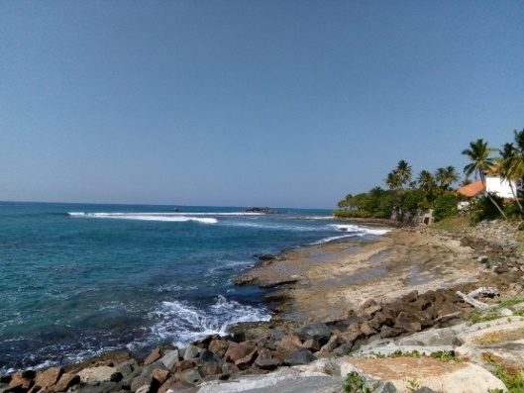
Natural beachrock as a model: A Lesson learnt from nature
Lab. Biotechnology for Resources
Introduction
Beachrocks are sedimentary formations resulted from lithification of beach sediments by carbonate cementation
They have been identified as a natural barrier against coastal erosion
?
Artificial beachrocks
Region of concern
Natural beachrock
Buried
Outcrops
Submerged
Buried
Outcrops
Notes:
At the same time

Slide 4
Biotechnology background
Biotechnology is a scientiﬁc and engineering knowledge on the use of microorganisms or their products in large-scale industrial processes.
Construction Biotechnology
Biotechnology for Construction Materials
Biotechnology for Construction Processes
Construction Bioplastics
Biocementation
Biocrusting
Microbial additions to cement, mortars, and grouts
Bioclogging
Biocoating
Microbial cements, mortars, and grouts
Biodesaturation
Bioremediation
Bioaggregation

Slide 5
Microbiologically-influenced
Biocorrosion and biodeterioration caused by microbial activity
For example, pigeon poo blamed for bridge collapse at Minnesota bridge (2007) which killed 13 people.
${NH}_{4}^{+}+2 O_{2} → {NO}_{3}^{−}+ {2H}^{+}+ H_{2}O$
Nitric Acid

Slide 6
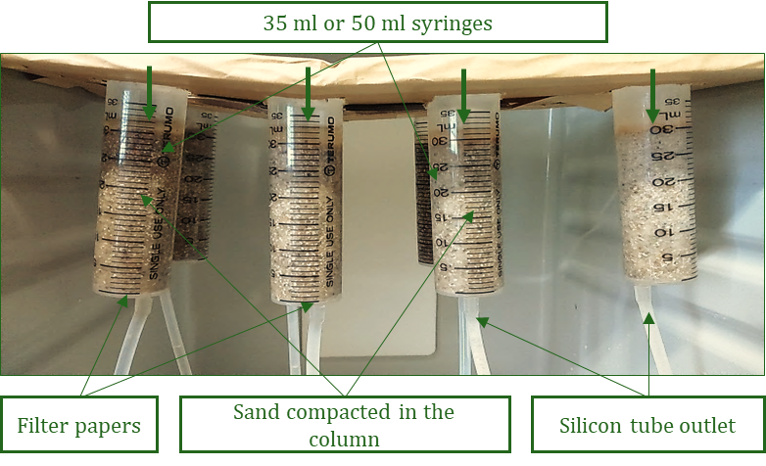
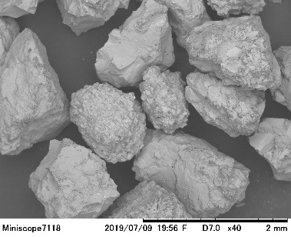
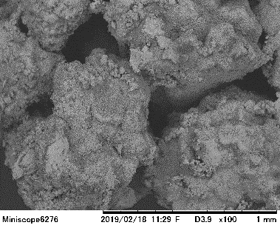
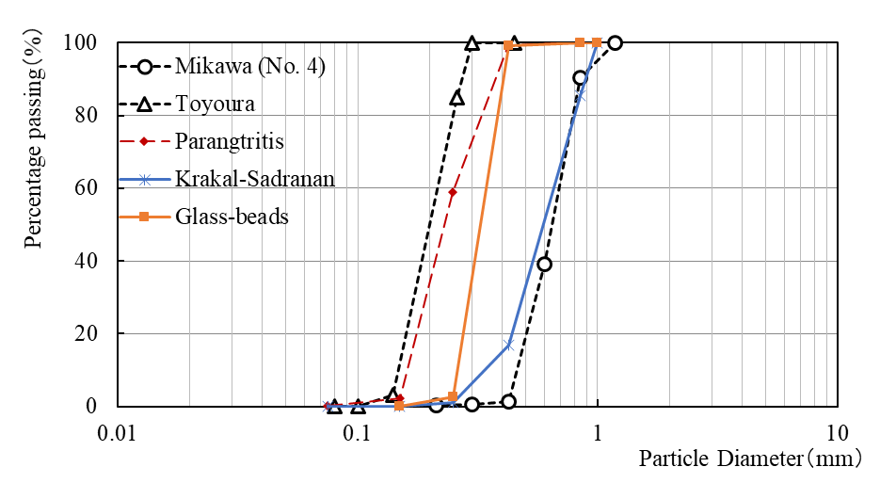
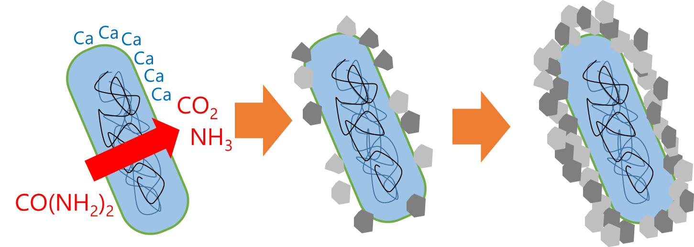
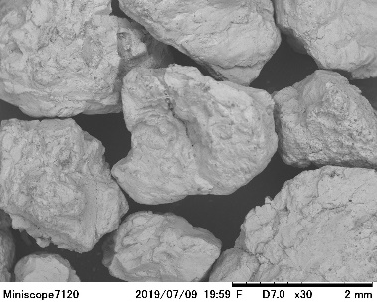
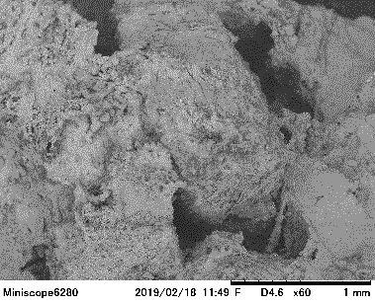
Laboratory of Biotechnology for Resources
Microbial Induced Carbonate Precipitation
Urea is hydrolysed by microbial urease which causes calcium carbonate to precipitate in the presence of a calcium source.
$$CO(NH_{2}{\left) \right.}_{2}＋ {2 H}_{2}O\underset{→}{Urease}2 NH_{3}+ H_{2}CO_{3}$$
$${Cell−Ca}^{2+}+ CO3^{2−} \underset{→}{Urease}Cell−CaCO3$$
Bacterial cells acting as nucleation sites
Overall cementation
Loose sand grains are then bound together by the resulting calcium carbonate biocement.

Slide 7
Lab. Biotechnology for Resources
AIMS AND OBJECTIVES
Aim
Assessing the feasibility of natural beachrock sedimentation to develop bioaugmentation as an eco friendly alternative against coastal erosion.
Objectives
Understand the coastal evolved sedimentary carbonate toward beachrock phenomena and examine the relations among the operation parameters
Address mechanical behavior and microstructure of the natural beachrock for based information to develop artificial rocks

Slide 8
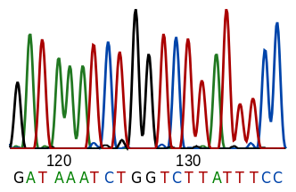
METHODOLOGY
Isolation and Identification of ureolytic bacteria
1 ml
1 ml
1 ml
1 ml
1 ml
Culture medium
Land bacteria – NH₄-YE
Sea bacteria – Zobell 2216E
5g beachrock/ beach sand 45 ml of distilled water
50 μl from each dilution
10⁻¹
10⁻²
10⁻³
10⁻⁴
10⁻⁵
Original inoculum
Serial dilutions (9 ml of distilled water in each case)
Plating
24 hrs
24 hrs
24 hrs
45°C
Separation
Screening
Isolation
Urease activity test
DNA extraction and identification of bacteria

Slide 9
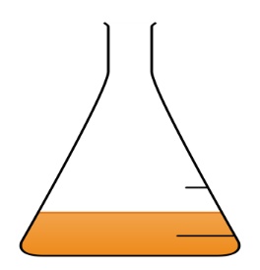
METHODOLOGY
Determining bacterial cell growth and urease activity
24 hrs,
160 rpm
1 ml for urease activity test by Indopheneol method
Cell growth in terms of OD at 600 nm
Bacteria in solid culture medium
5 ml of
pre-culture
100 ml of main culture
Composition of culture medium
ZoBell2216E medium (5.0 /L hipolypeptone , 1.0 g/L FePO4 and 1.0 g/L yeast extract)
Urease activity test by Indophenol method
1 ml of bacteria culture is added to 0.1 M urea solution in 0.1 M sodium phosphate buffer. The resulting NH₄⁺ ions react with added phenol in the presence of hypochlorite and forms a blue colored indophenol.
The intensity of the blue color which is proportional to [NH₄⁺] is measured using UV-Vis spectrophotometer. The rate of urea hydrolysis is calculated using a calibration curve.

Slide 10
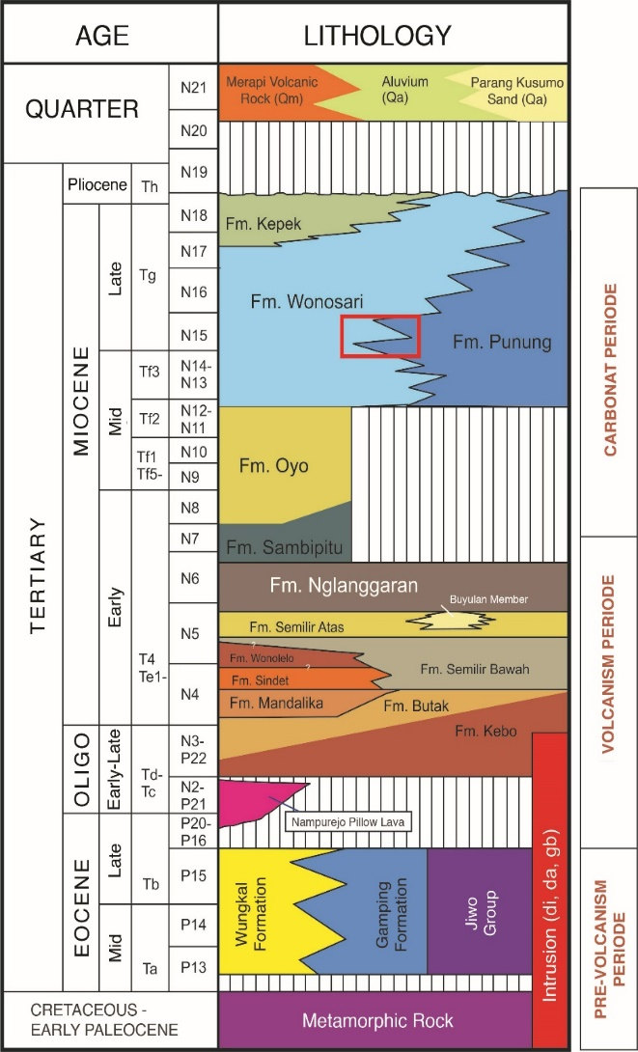
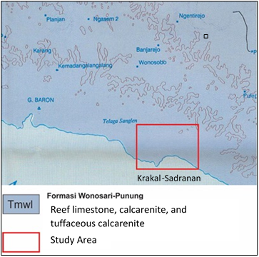
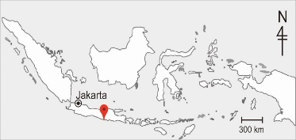
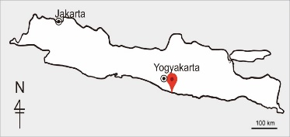
STUDY AREA
Lab. Biotechnology for Resources
Most prone to erosion of sandy slopes due to strong waves created by South Western monsoon
Krakal-Sadranan Beachrock UAV Drone Mapping
α-location

Slide 11
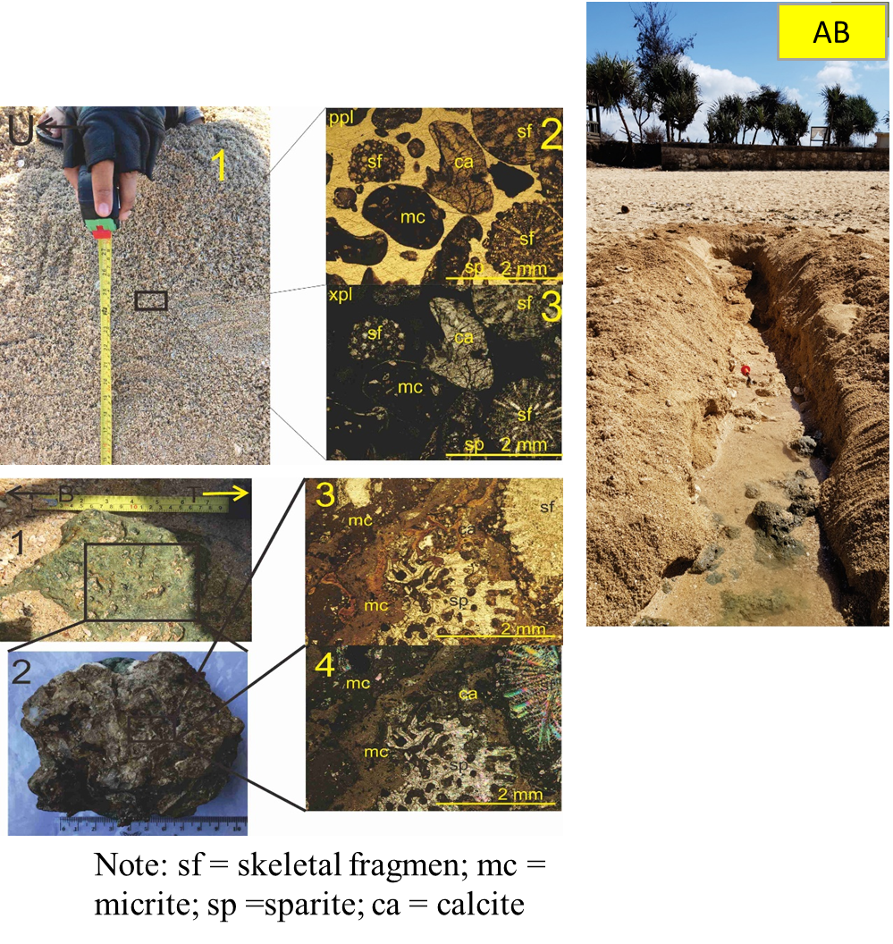
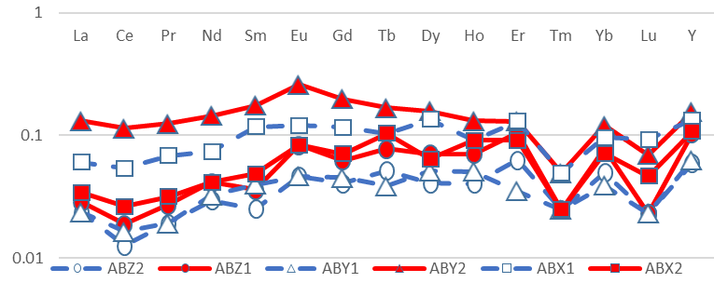
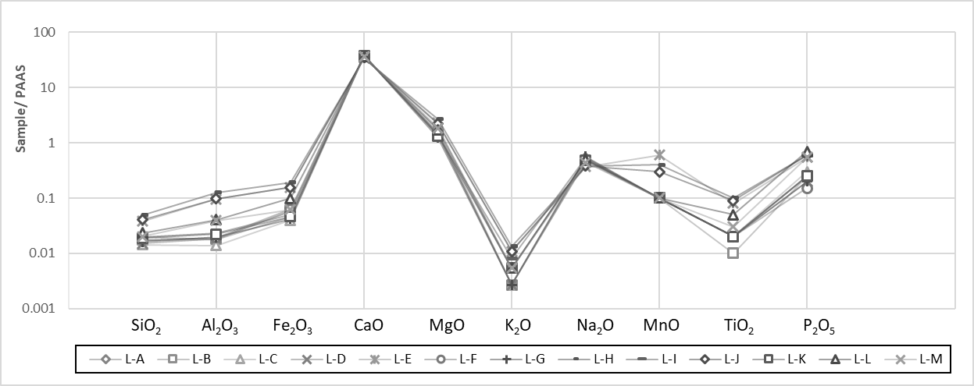
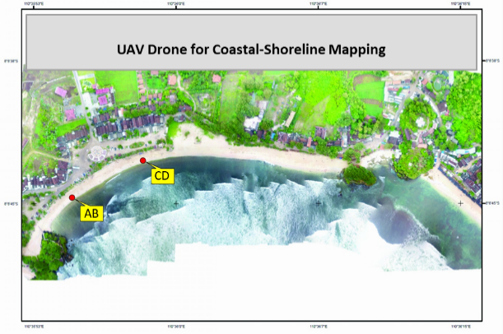
RESULTS AND DISCUSSION I
Lab. Biotechnology for Resources
Beachrock
Carbonate Sands
Three important Major Oxide Element formed Beachrock Solidification, whereas CaO, MgO, and Na2O

Slide 12
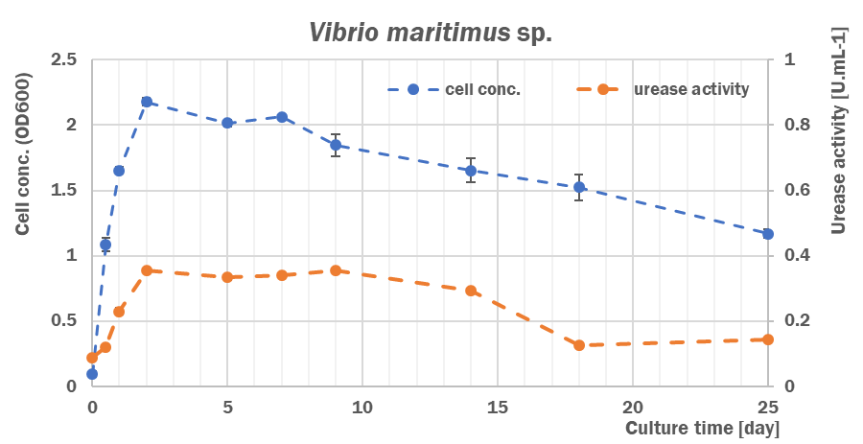
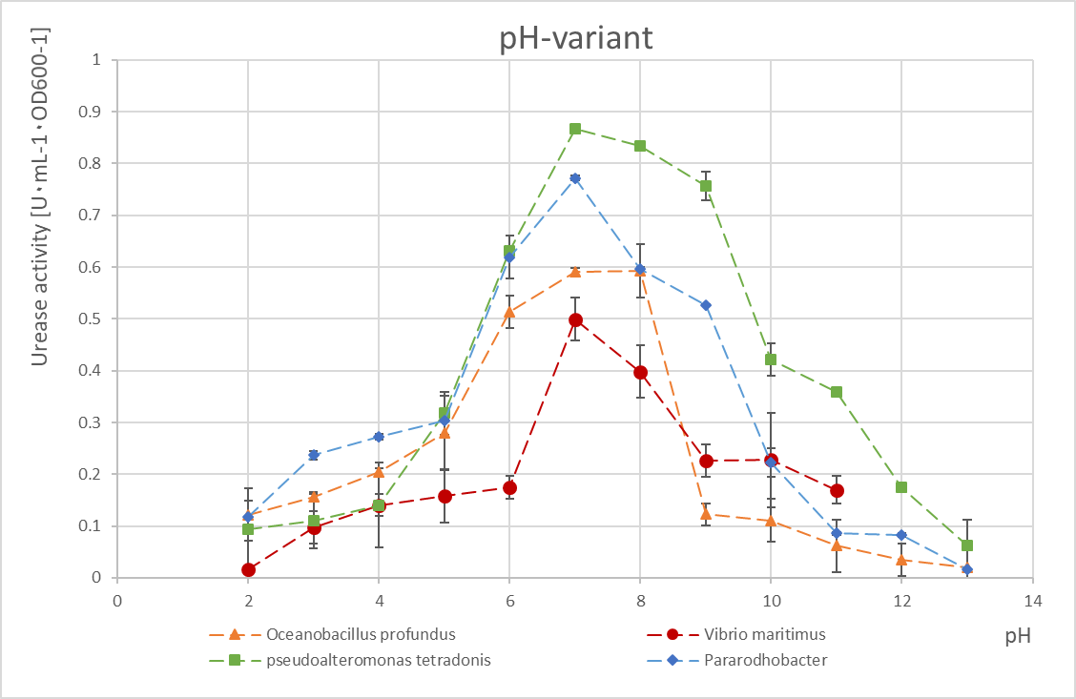
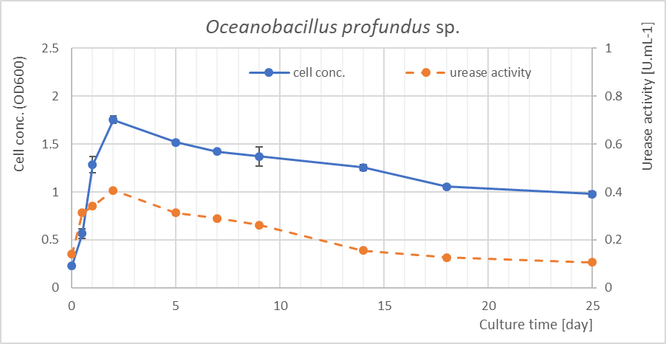
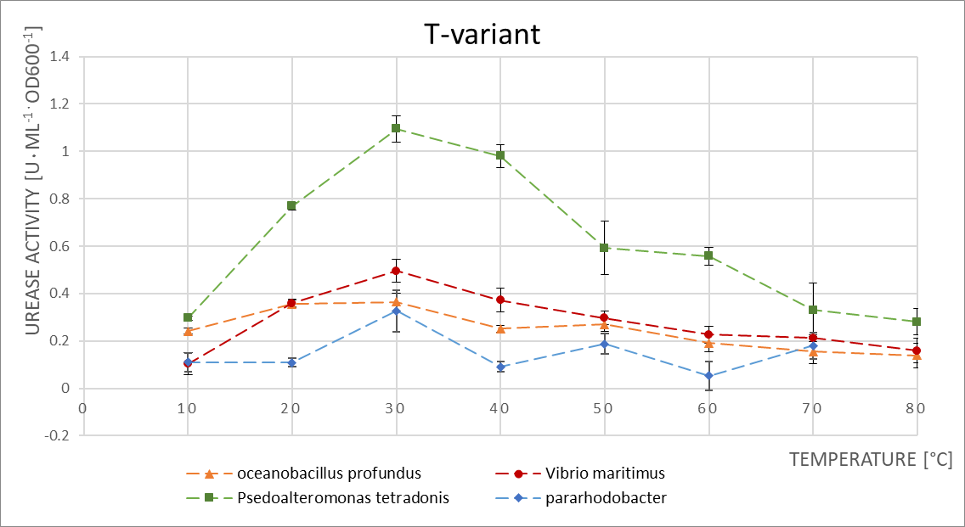
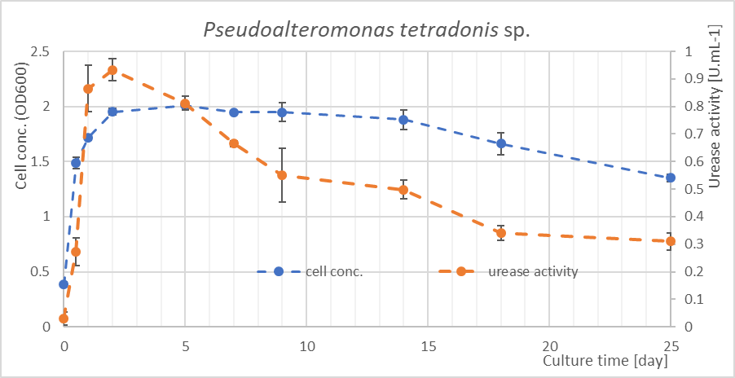
Laboratory of Biotechnology for Resources
Results and discussion I
Evaluation of the efficiency MICP using local strain bacteria
Vibrio maritimus sp.
Oceanobacillus profundus sp.
Pseudoalteromonas tetradonis sp.

Slide 13
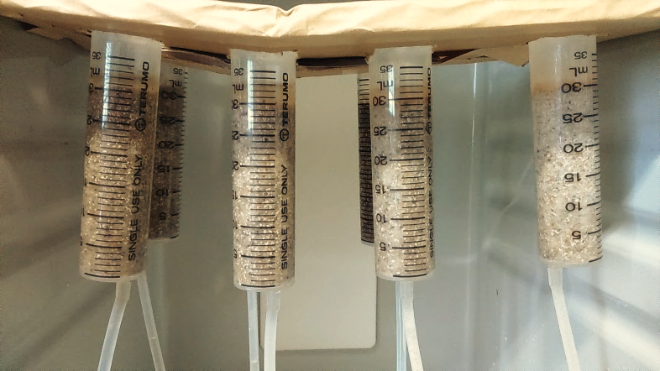
SMALL SCALE SAND SOLIDIFICATION TEST
35 ml or 50 ml syringes
Phase 1
Phase 2
Bacteria suspension
OD₆₀₀ = 2.0-2.5
Cementation solution
Bacteria Fixation
Filter papers
Sand compacted in the column
Silicon tube outlet
1.0 M Ca²⁺ cementation solution (g/l)
CaCl₂ | 55.49
Urea | 30.03
Nutrient broth | 3.0
Saturated
condition
Two phase injection: cycles of batch treatment of bacteria suspension and cementation solution

Slide 14
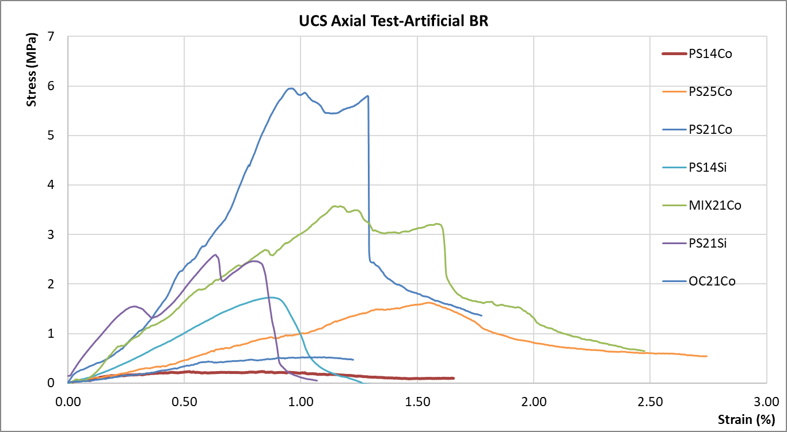
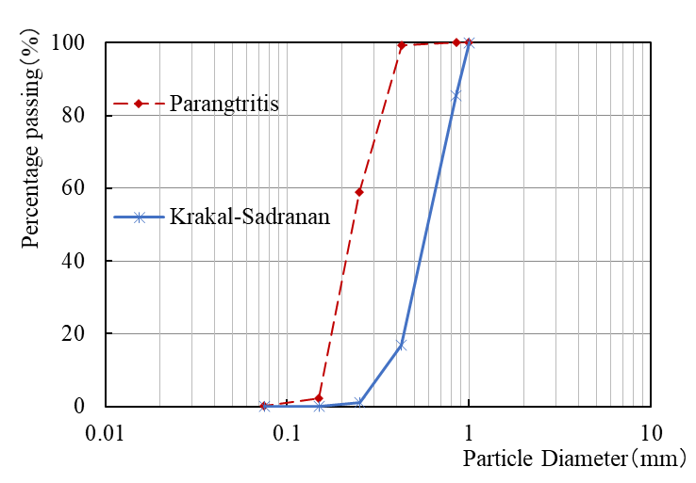
Laboratory of Biotechnology for Resources
Results and discussion II
Evaluation of the efficiency MICP using local strain bacteria
Vibrio maritimus sp.
Biosafety level 1
Psedoalteromonas sp.
Mix bacteria between
psedoalteromonas and oceanobacillus
Pathogenic
Oceanobacillus profundus sp.
Biosafety level 1
Oceanobacillus sp.
Weak solidification
Pseudoalteromonas tetradonis sp.
Control
Biosafety level 1
Coarse Sand
Fine Silica Sand

Slide 15
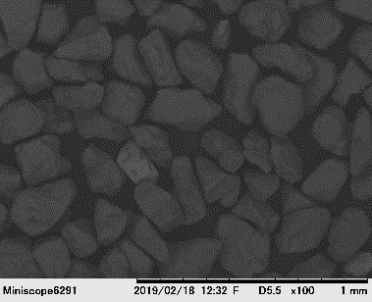
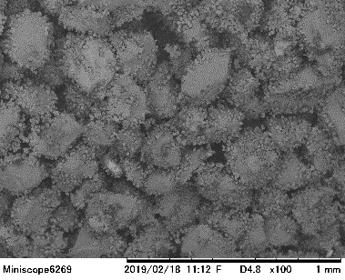
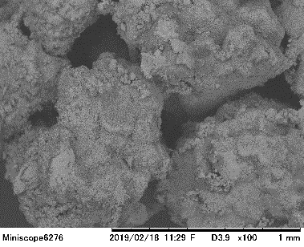
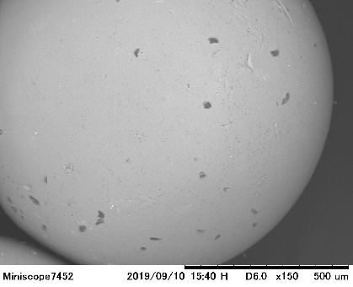
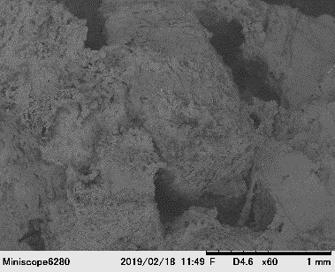
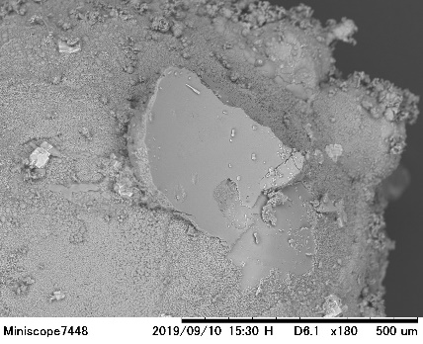
Effect of Grain Size Distribution on Sand Solidification by MICP
Height of the column (cm)
8
(a)
6
4
(b)
0
Toyoura
(D₅₀ =
0.2 mm)
Mikawa
(D₅₀ = 0.87 mm)
Silica Beach sand
(D₅₀ =
0.3 mm)
Coarse Beach sand
(D₅₀ =
0.57 mm)
(c)

Slide 16
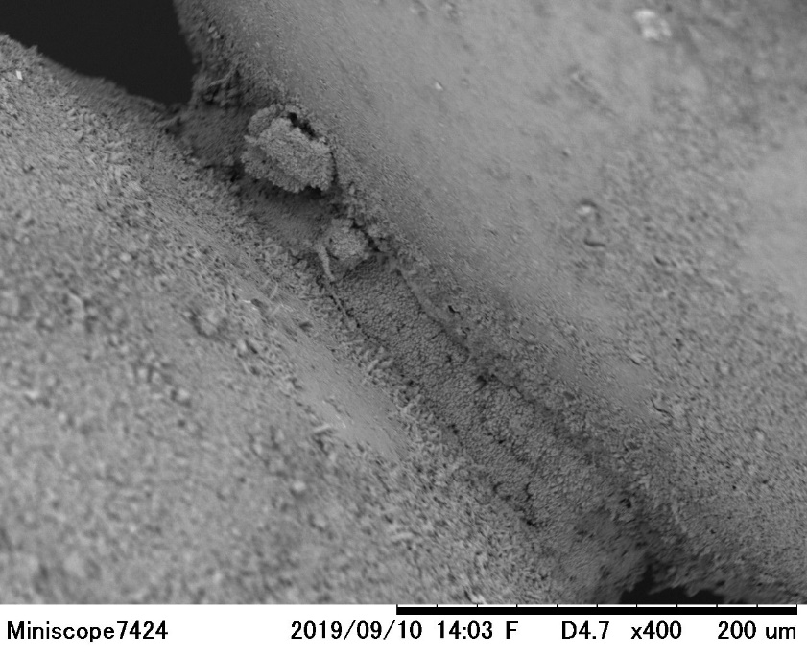
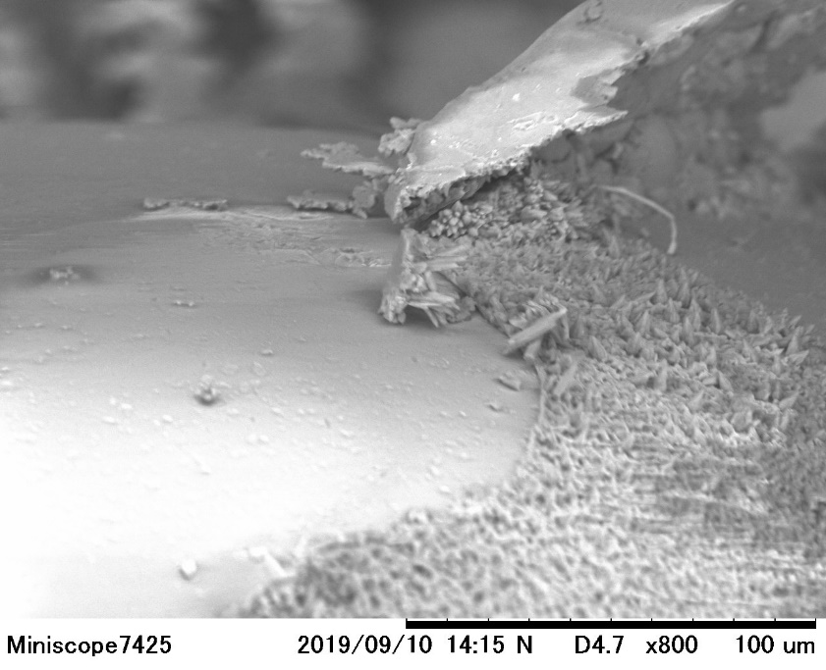
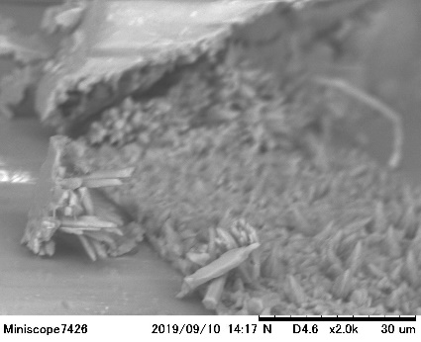
MORPHOLOGY OF THE CaCO₃ CRYSTALS
CaCO₃ bond
Glass Beads grain
Glass Beads grain
Cladding on sand grains
Rhombohedral calcite crystals were dominant in all cases

Slide 17
PROPOSED METHODOLOGY based on MICP
Conceptual Design
Insight into the Benefits of MICP
Should follow the topology of natural beachrocks
Should be permeable enough to allow seawater flow
Should resist abrasion and scouring
In-situ stabilization of loose beach sand with minimum disturbance to the local hydrodynamics
Self-recovering capability of the biocemented layer by dissolution and re-precipitation of carbonate minerals
Environmentally friendly
Low energy consumption
Relatively cheaper in long run
Should be economically feasible
Should be environmentally friendly
Should have sufficient strength
Surface zone sand stabilized by MICP
Implications for the Target Application
Requirement for treatment of hazardous ammonium by-products
Long term durability of the structure under wave action
Limited applications for fine grained soils
GWL
MHT
MLT
Vertically exaggerated
Region of concern
End of slides

