Slide 1
A multi-tiered methane analytic framework for constraining budgets, point source attribution, and anomalous event detection
Daniel Cusworth¹, Riley M. Duren^{2,1}, Vineet Yadav¹, Andrew K. Thorpe¹, Natasha Stavros¹, and Charles E. Miller¹
¹Jet Propulsion Laboratory, California Institute of Technology, ²University of Arizona
© 2020. All rights reserved

Slide 2
To get a clear picture of methane emissions, we need measurement and analytics strategies at all measurement scales.
Satellites:
- Regional scale
- Targeted point source
Tall tower networks
Airborne surveys
- e.g., AVIRIS-NG
On-road surveys
On-site surveys

Slide 3
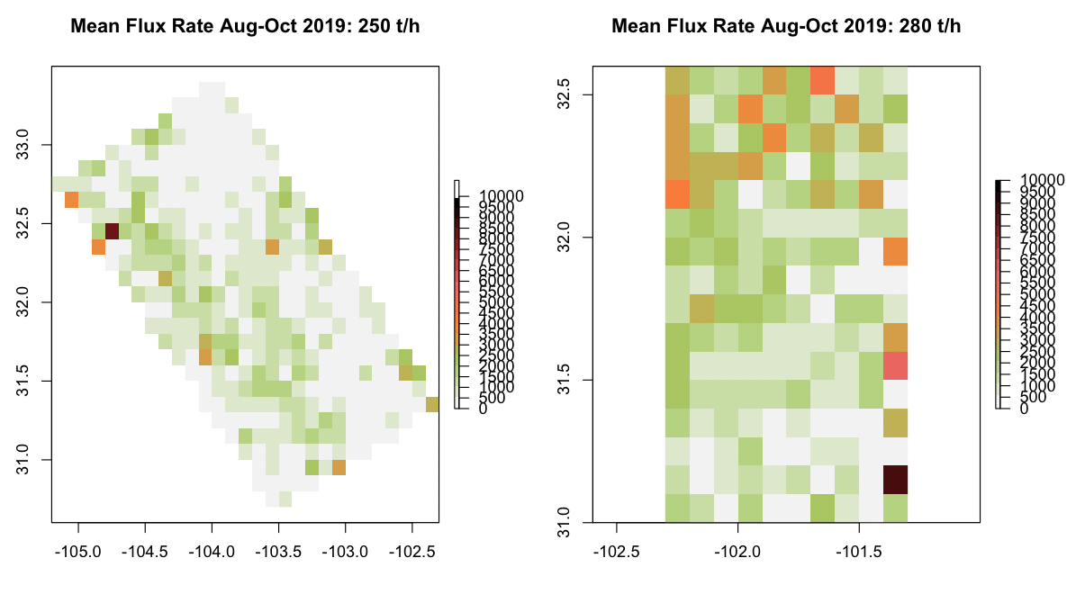
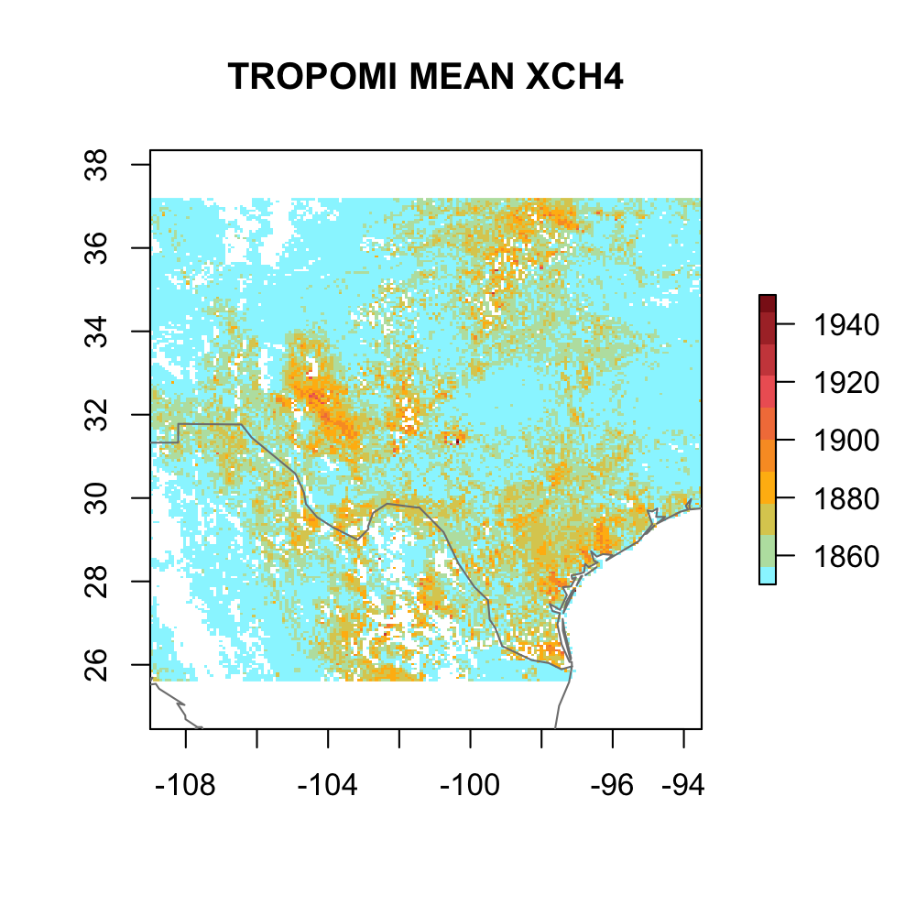
Satellite monitoring and data assimilation with the TROPOMI satellite instrument allows for sub-basin scale quantification of methane emissions.
10
7.5
5.0
2.5
0
TROPOMI XCH4 over TX, NM, OK
Emission Flux rate (t/h)
Flux inversion
Delaware Permian Basin
XCH4 (ppb)
Duren, Cusworth, Thorpe, et al. in prep

Slide 4
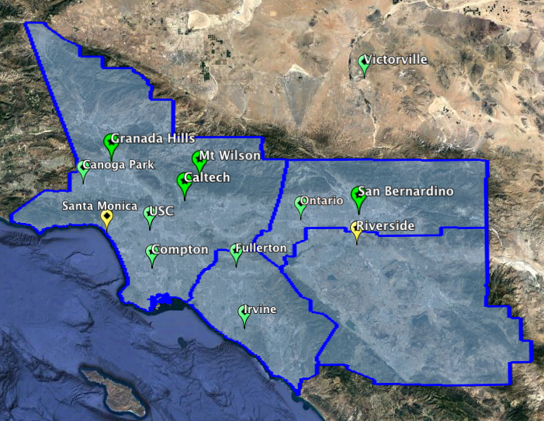
A well-spaced system of tower sites also allows for basin-scale emissions monitoring.
Results of flux inversion
Los Angeles Megacities Carbon Network
Inverse results sensitive to two major events:
(1) Aliso Canyon blowout (2) Closing of Puente Hills Landfill
Yadav et al., JGR, 2019
Notes:
Example of methane flux inversion (emission map) from persistent regional monitoring from the LA Megacities surface network. In this case, this is a WRF-STIL inversion for 2015 and 2016 at 3km resolution, 4 day time step (interpolated here). The redder contours show higher emitting areas with some notes about major infrastructure. The scale on this plot is the entire LA basin – about 100km x 100km. While uncertainties are large in single grid cell emission estimates we can split the basin in 5 zones/bins and compare the inversion posterior results with prior emission inventories.

Slide 5
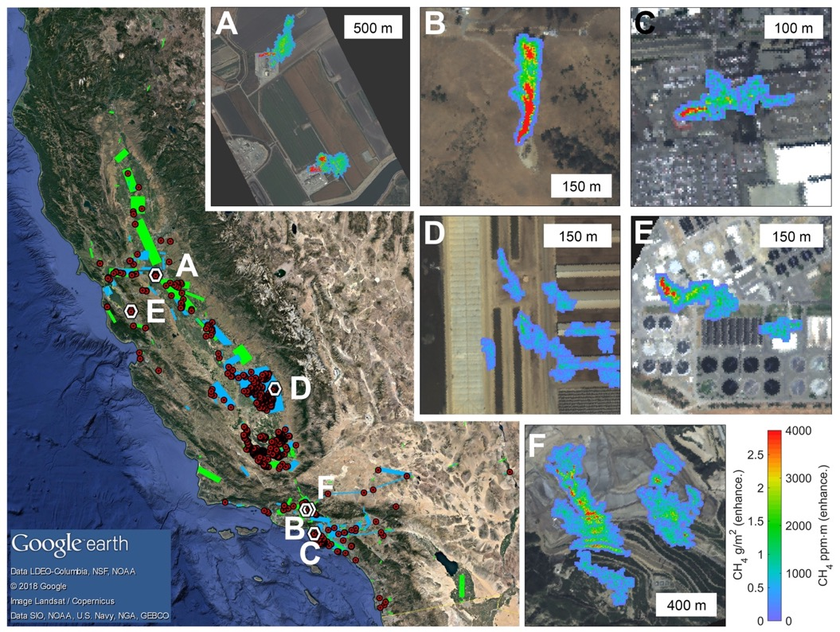
Airborne surveys capture a key ingredient missing from regional flux inversions – direct attribution of point source emissions.
California Methane Survey
AVIRIS-NG imaging spectrometer:
- Detection of point sources 5-10 kg h⁻¹
- Gives 3 m spatial maps of plumes
Anomalous super-emitters at <0.2% of infrastructure are responsible for 35-43% of California CH₄ inventory (0.541-0.674 TgCH4 y⁻¹, 95% CI)
Duren et al., Nature, 2019
Notes:
5 months of flights 2016-2018; repeat overflights of >272,000 facilities and components; 562 sources

Slide 6
Moving from disparate single-tiered systems to a multi-tiered system:
How do we leverage all this information into one data system?
Cusworth et al., GRL, 2020

Slide 7
How do we combine these data streams together?
Multi-tier data assimilation
Towers
CLARS-FTS
TROPOMI
Flight planning
Validation
Independent point source flux quantification
AVIRIS-NG

Slide 8
Total basin sensitivity to emissions depends on type of instrument and spatial/temporal density
Footprints (∂F/ ∂x) simulated using HRRR-STILT tracer-transport model
Though TROPOMI is less sensitive to surface emissions, it has greater spatial coverage throughout the basin.

Slide 9
All observations and footprints can be brought together in an inverse modeling framework to optimize gridded flux emissions:
San Gabriel Mountains
Sunshine Canyon Landfill, Aliso Canyon oil/gas
Sunset/Hunington beach oil/gas fields

Slide 10
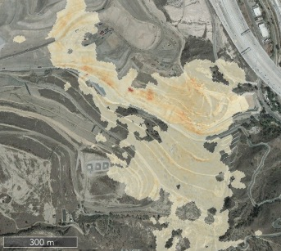
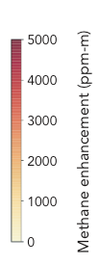

We can use the inverse result to target specific areas. Case study: Sunshine Canyon Landfill
$\hat{x}$ March-April 2017
AVIRIS-NG Sunshine Canyon Landfill
Emissions around Sunshine Canyon higher than EPA prior early in study period
This tells us where to go fly AVIRIS-NG
Massive methane plumes emanating from intermediate slopes.

Slide 11
Sunshine Canyon then underwent expensive infrastructure investments to reduce these emissions.
Feb 2017
PosiShell
ClosureTurf
June 2017
Compacted cover
Feb 2019
Solution: Apply ClosureTurf (e.g., artificial grass), PosiShell (cement, bentonite, fiber spray mix), or compacted vegetative cover to problematic slopes.

Slide 12
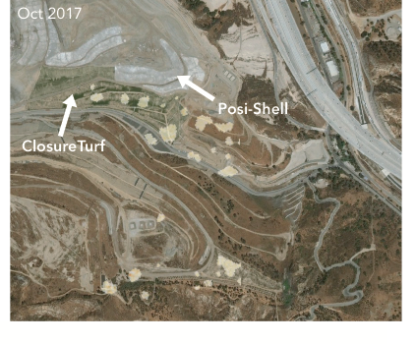
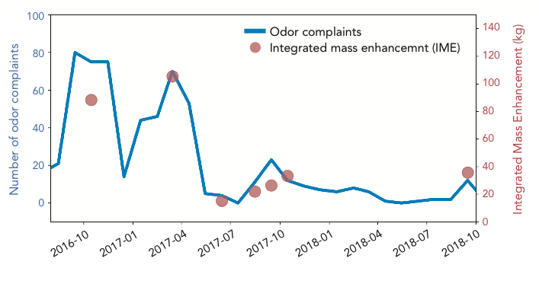
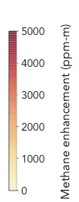
Improvements were validated by AVIRIS-NG. Odor complaints were reduced as well!
Methane plumes after infrastructure improvements
Trend in intermediate slope IME and odor complaints
IME: Measure of excess methane plume mass retrieved by AVIRIS-NG
Cusworth et al., ERL, 2020

Slide 13

This reduction in emissions was also observed from the multi-tiered inversion.
Trend in Sunshine Canyon methane emission rate
$\hat{x}$ in 3 km grid containing Sunshine Canyon
March-April 2017
AVIRIS-NG derived emission rate
March-April 2018

Slide 14
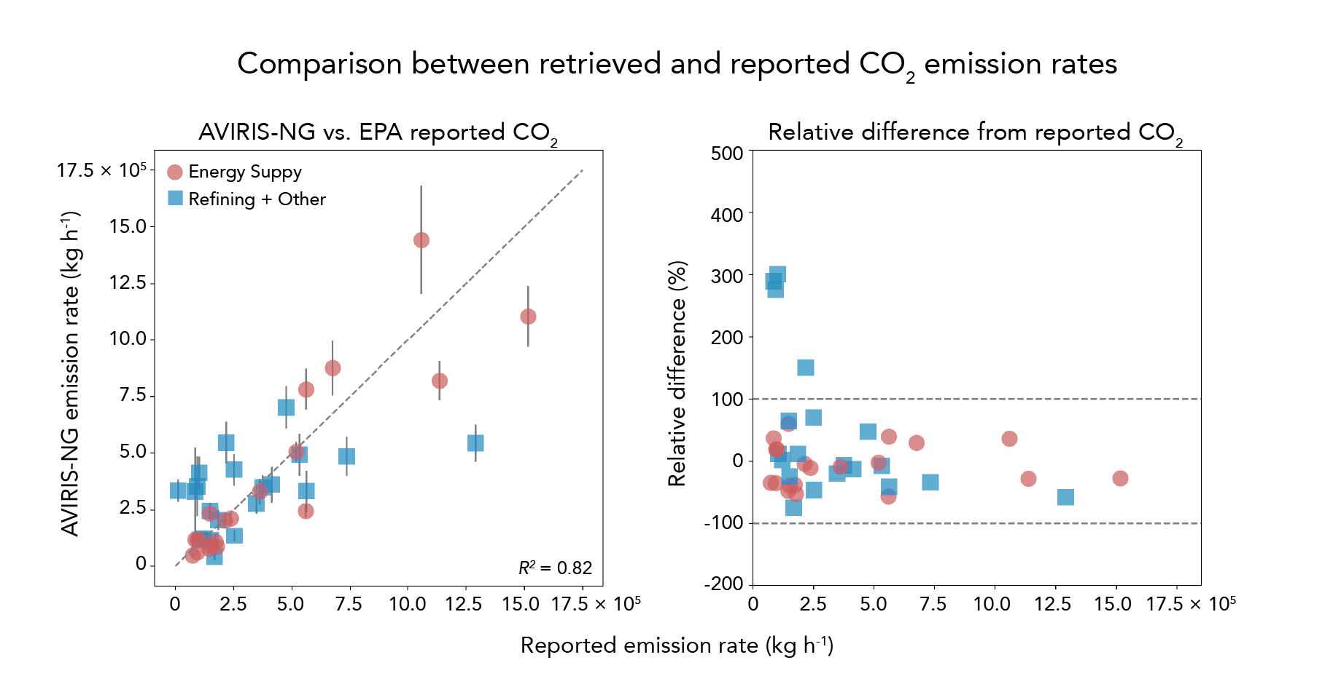
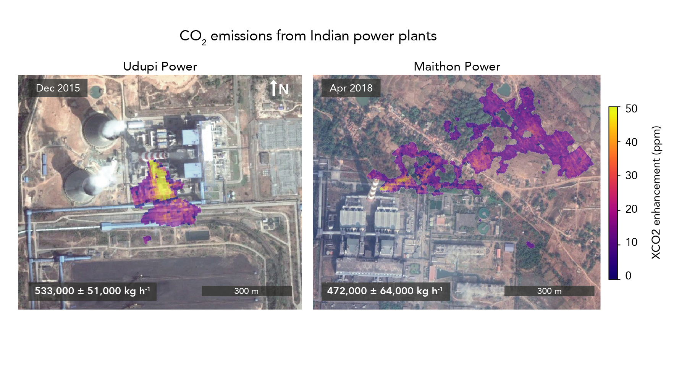
This type of system can be readily expanded to cover CO2 sources.
AVIRIS-NG CO2 retrievals shows close correspondence with bottom-up reporting.
Udupi Power, India
Extensible to countries where little bottom-up reporting exists.
Cusworth et al., in prep

Slide 15
Conclusions
Multiple independent methane observations can be synthesized on a regional scale via a data assimilation / lagrangian transport model system.
Independent AVIRIS-NG flights at Sunshine Canyon Landfill corroborated inverse fluxes from the multi-tiered inverse system.
Future spaceborne imaging spectrometers will be able to detect very large methane sources.
This approach is readily extensible to CO2 monitoring

