Slide 1
Equatorial atmospheric zonal circulation changes over India Ocean during recent decades
Sahil Sharma^{1,2} and Kyung-Ja Ha^{1,2,3}
¹Center for Climate Physics, Institute of Basic Science, Busan, South Korea
²Department of Climate System, Pusan National University, Busan, South Korea
³Department of Atmospheric Sciences, Pusan National University, Busan, South Korea
Contact: sahils@pusan.ac.kr / kjha@pusan.ac.kr

Slide 2
Abstract
The equatorial zonal asymmetric (Walker) circulation causes changes in the tropical rainfall pattern which induces devastation flood and drought that considerably impact the lives of millions of people. However, understanding of changes in zonal circulation is not yet certain. Here we examine the robustness of changes in Indian Walker Circulation (IWC) characteristics using different reanalysis and observation datasets in terms of the linear trends of IWC. The meridional (5ºS:5ºN) averaged vertical velocity using different datasets are used to precisely locate the ascending (94ºE:104ºE, eastern) and descending (35ºE:45ºE, western) branch of IWC. We analyzed the zonal sea level pressure (SLP) gradient, velocity potential (VP) at 850 and 200 hpa, surface zonal wind (SZW) and zonal mass stream function (ZMSF) anomalies over the period of 1980–2017. We found that the magnitude of ZMSF representing anticlockwise circulation has an increasing trend in all the datasets. This kind of change is physically in agreement with the changes of SLP and SZW (an increasing trend in westerlies over the central IO) while the VP shows the decreasing trend which is in agreement with the strengthening of IWC during the recent decades. JRA55 is the most reliable which shows the significant and highest trend among all other datasets. The attribution of this strengthening can be examined using the CMIP5 datasets to determine the relative contribution of anthropogenic warming and natural variability.

Slide 3
Introduction
The equatorial zonal asymmetric (Walker) circulation causes changes in the tropical rainfall pattern which induces devastation flood and drought that considerably impact the lives of millions of people.
However, understanding of changes in zonal circulation is not yet certain
Here we examine the robustness of changes in Indian Walker Circulation (IWC) characteristics using different reanalysis and observation datasets in terms of the linear trends of IWC.
Ensemble simulations with different climate models participating in CMIP5 to determine attribution of strengthening/weakening seen in the reanalysis and the relative contribution of anthropogenic warming and natural variability during the same period of time

Slide 4
Introduction: Criteria for defining IWC
The meridional (5S:5N) averaged vertical velocity using different datasets are used to precisely locate the ascending (94E:104E, eastern) and descending (35E:45E, western) branch of IWC. We analyzed the zonal sea level pressure (SLP) gradient, velocity potential (VP) at 850 and 200 hpa, surface zonal wind (SZW) and zonal mass stream function (ZMSF) anomalies and trend over the period of 1980–2017 to determine the changes in IWC.

Slide 5
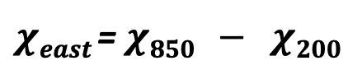
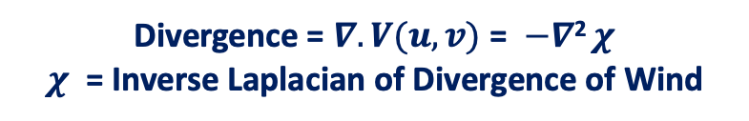
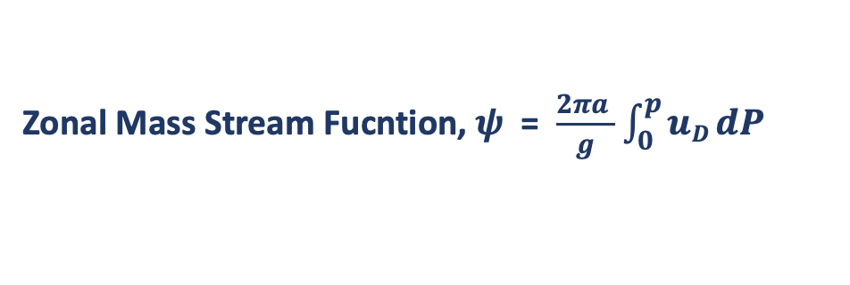

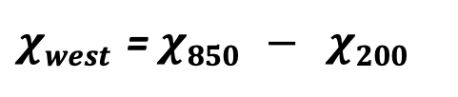
Different Indexes used for the analysis
Divergence = $∇. V(u,v)$ = $−∇$² $χ$
$χ$ = Inverse Laplacian of Divergence of Wind
Zonal Mass Stream Fucntion, $ψ$ = $\frac{2πa }{g}$ $\int_{0}^{p}{uD dP }$
Sea Level Pressure Index
Surface Zonal Wind Index
Velocity Potential Index
ZMSF Index
SLP _{index.} = SLP_{west} - SLP_{east}
$χeast$= $χ850$ $− χ200$
$χwest$= $χ850$ $− χ200$
$VPindex$= $χwest$ $− χeast$
SZW _{index.} = Area Average of SZW _{(5S – 5N : 50E: 100E)}
ZMSF _{index.} = Vertical Mean (700:300hpa) of ZMSF_{(5S – 5N : 50E: 100E)}
Key Points:
Sea Level Pressure (SLP) gradient in the Indian ocean is used as a proxy of walker circulation intensity and also a good measure of equatorial trade winds.
Surface Zonal Winds (SZW) provides the information of only the surface wind component of walker circulation.
Velocity Potential at 850 and 200 hpa determines the convergence/divergence at the lower and upper level of walker circulation.
Zonal Mass Stream Function (ZMSF) is calculated by vertically integrating divergent component of zonal wind meridionally average between 5S to 5N from 700 to 300 hpa.

Slide 6
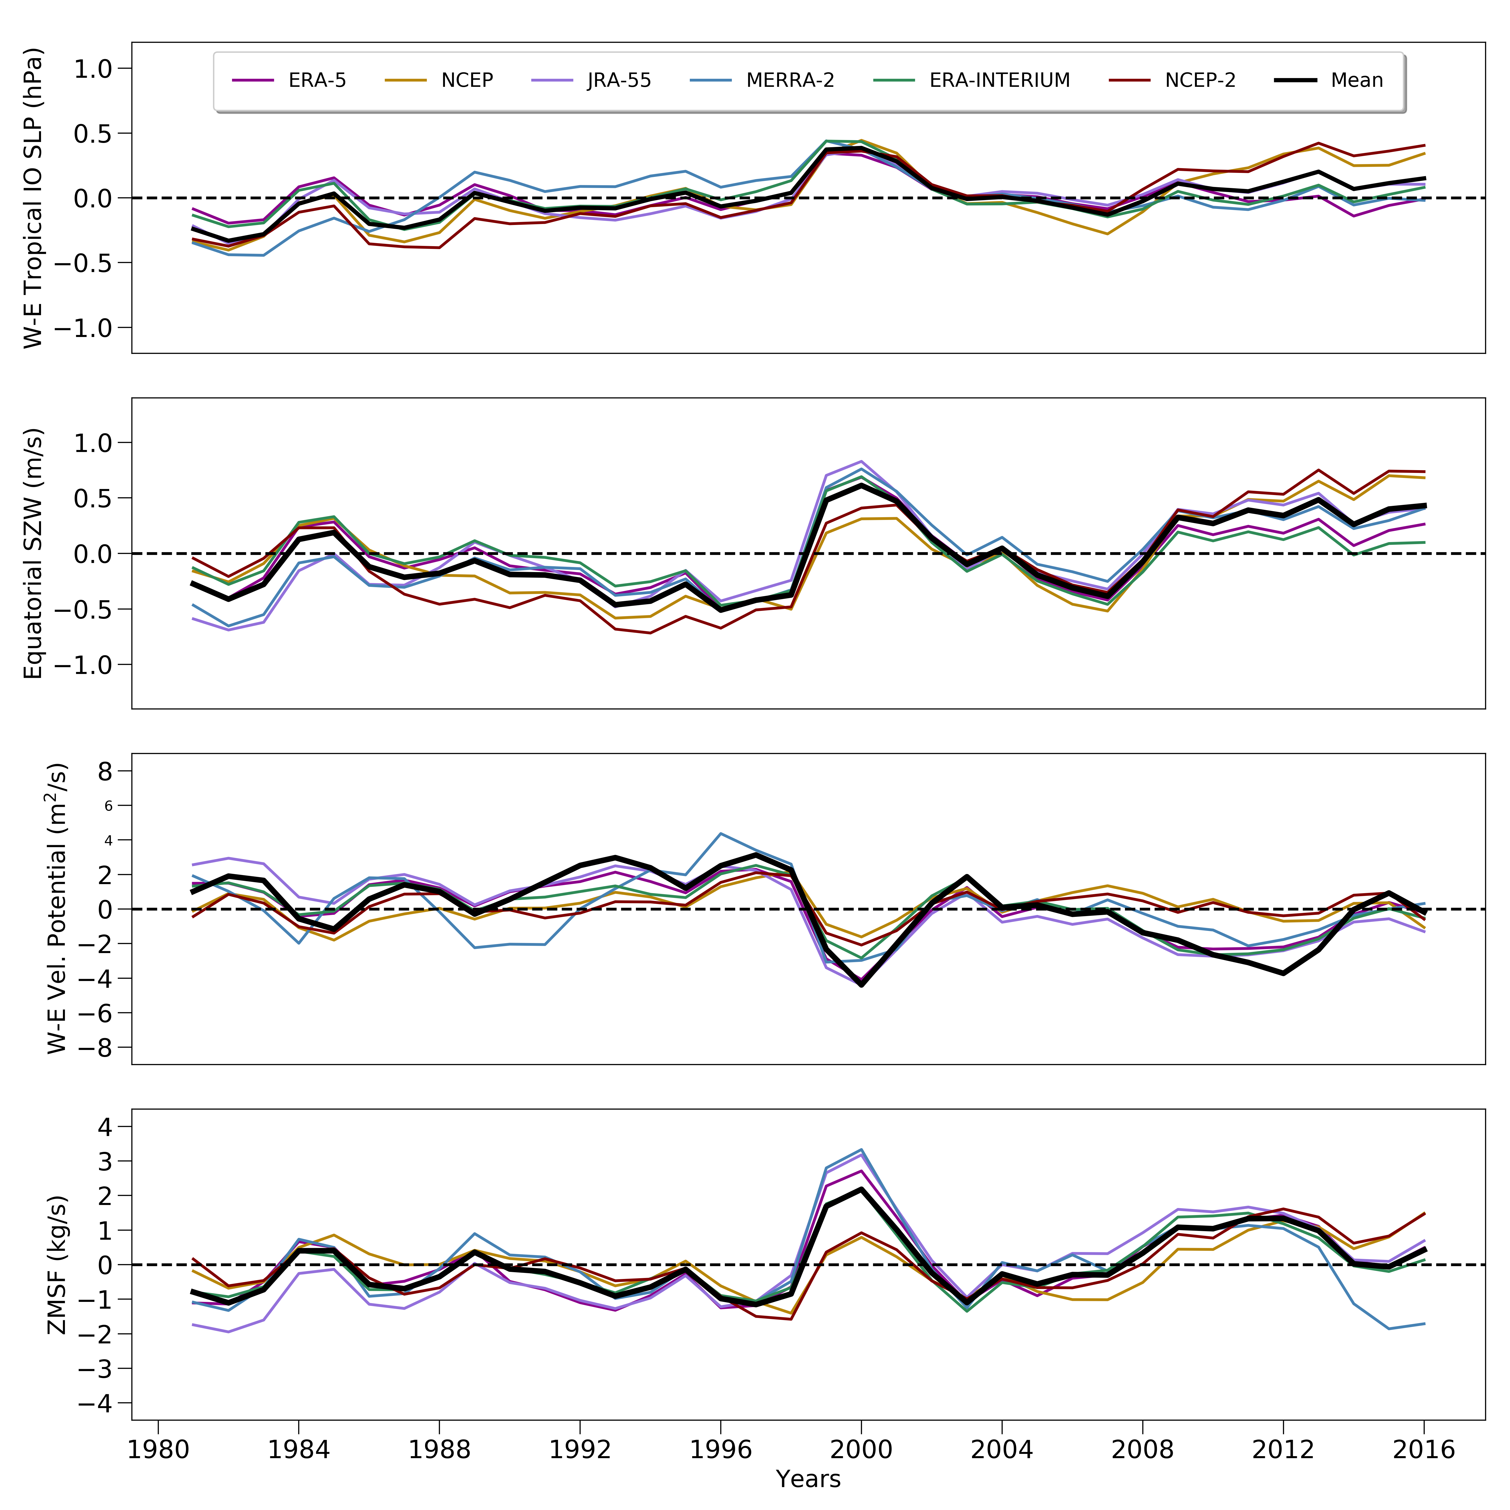
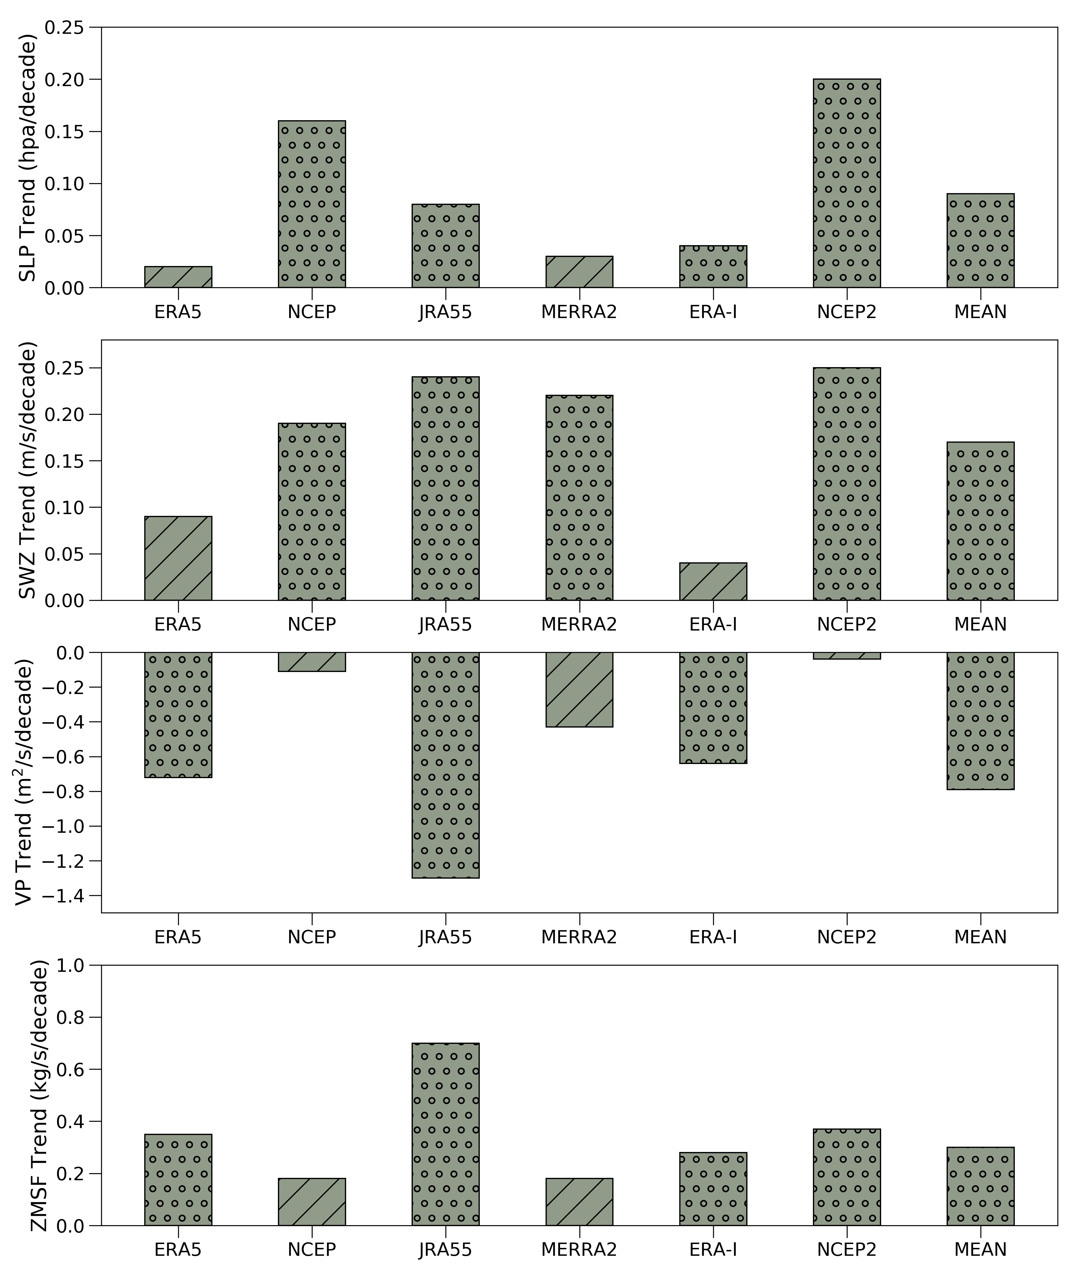
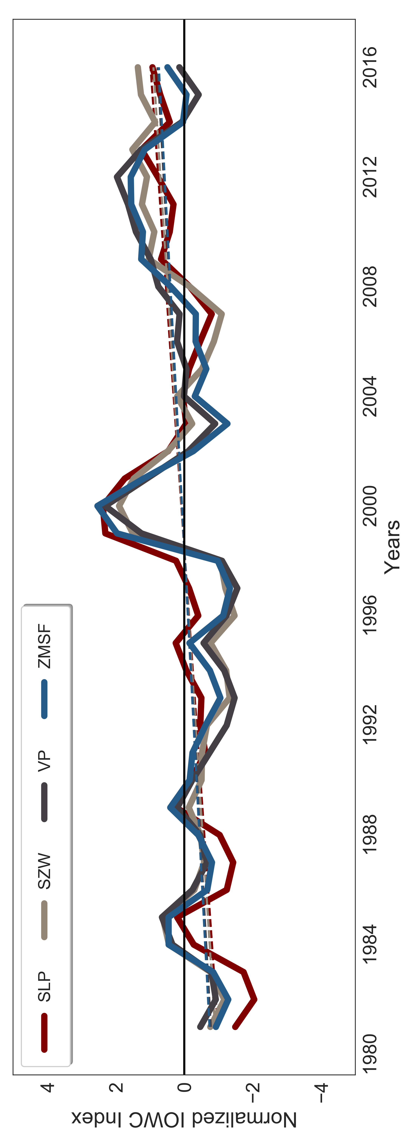
(a)
(b)
(c)
Figure
It represents the 3-year running mean of zonal sea level pressure (SLP) gradient, Velocity potential (VP) difference at 850 and 200 hpa, surface zonal Wind (SZW) and zonal mass stream function (ZMSF) anomalies over the period of 1980–2017.
Figure
It represents the Trend of zonal sea level pressure (SLP) gradient, Velocity potential (VP) difference at 850 and 200 hpa, surface zonal Wind (SZW) and zonal mass stream function (ZMSF) anomalies over the period of 1980–2017.
Figure
It represents the 3-year Normalized running mean of mean of all dataset for zonal SLP gradient, VP difference at 850 and 200 hpa, SZW and ZMSF anomalies over the period of 1980–2017.
Key Points
The SLP shows and increasing trend in all the datasets for IWC. This kind of change is physically in agreement with the changes of ZMSF and SZW (increasing trend westerlies over the central IO) while the VP shows the decreasing trend which is in agreement with the strengthening of IWC during the recent decades.

Slide 7
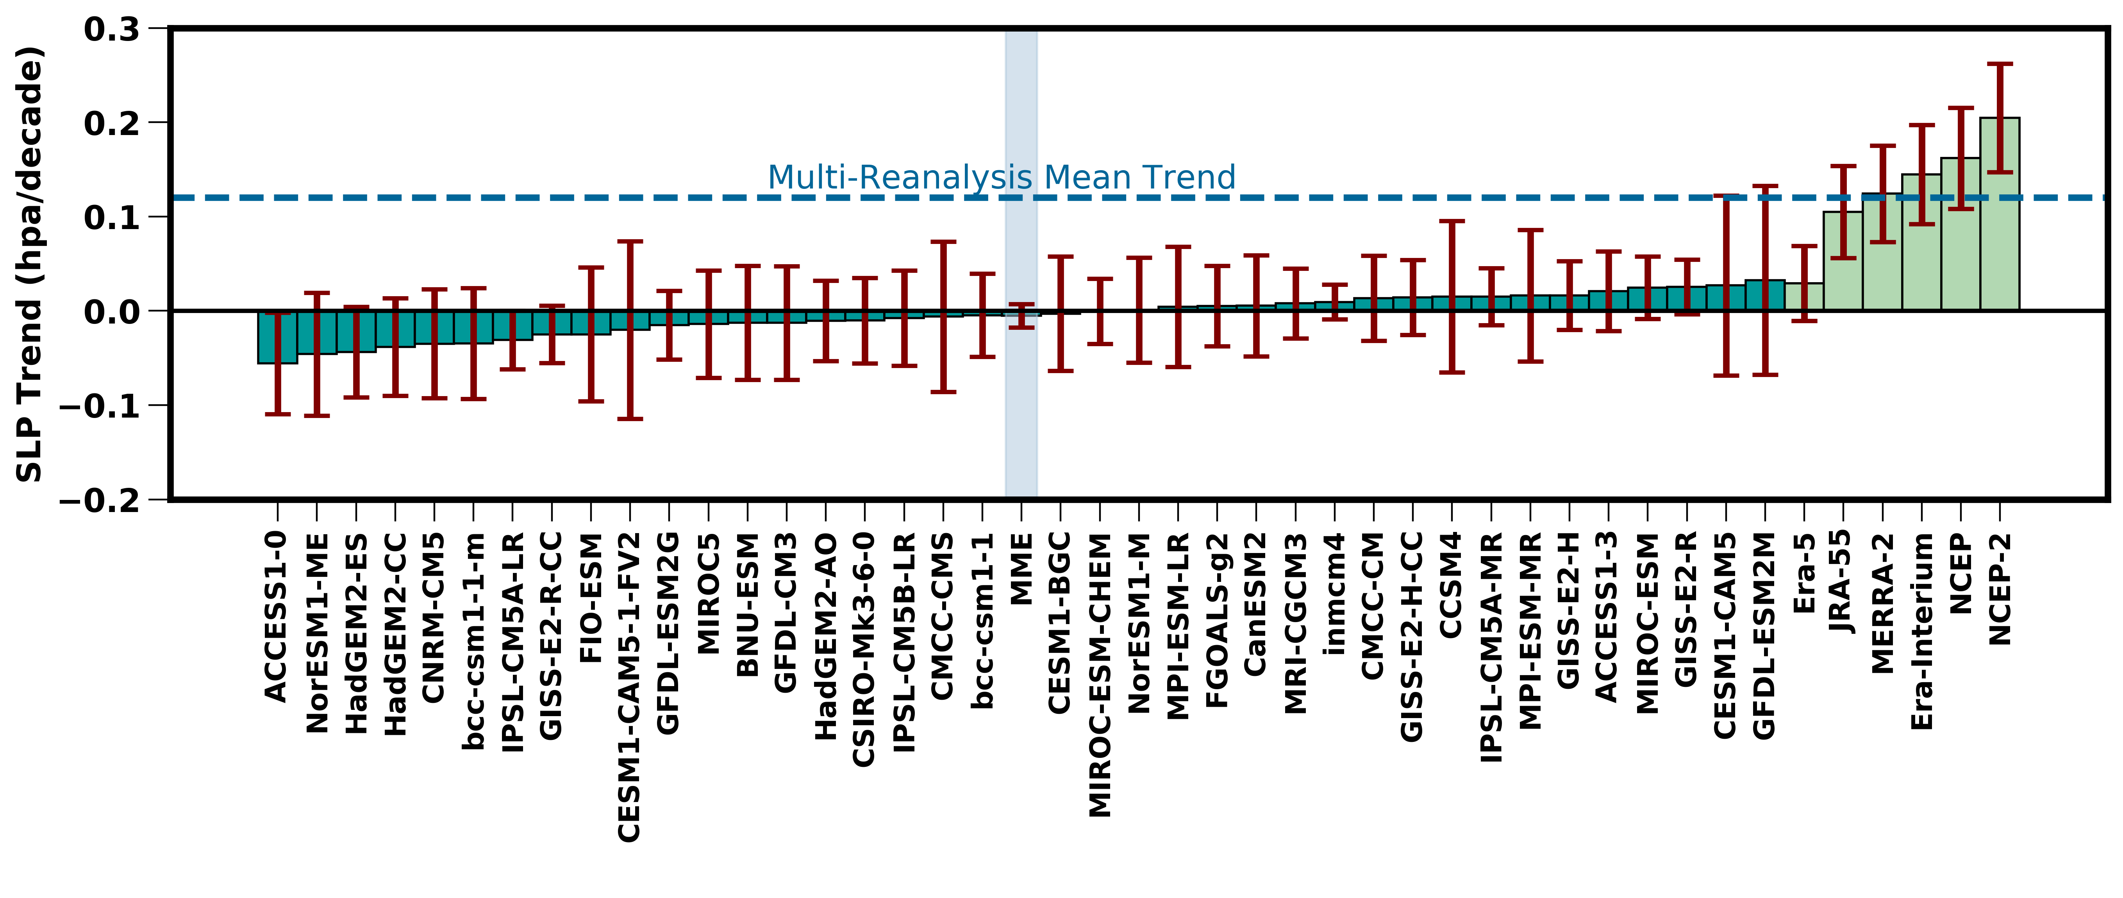
Comparison of SLP gradient in CMIP5 and Reanalysis
Increasing Trend
Decreasing Trend
Figure:
The bars represents the linear trend zonal SLP gradient (proxy for IWC intensity) in 38 CMIP5 models along with Multi Model Ensemble (MEE) of 38 models and 6 observational datasets over the time period 1980-2017. All historical run is extended from 2005 to 2016 using RCP45 data. The blue dashed line represents the multi reanalysis mean trend. The error bars represent the standard error of zonal SLP gradient of each individual model.
Key Points:
More than half of the CMIP5 models show the opposite trend of the SLP gradient when compared to the reanalysis dataset for IWC.
The MME for IWC is very small as compared to the reanalysis dataset and also shows the opposite trend.
It is also noted that in reanalysis ERA-5 show lowest trend as compared to the other reanalysis dataset.

Slide 8
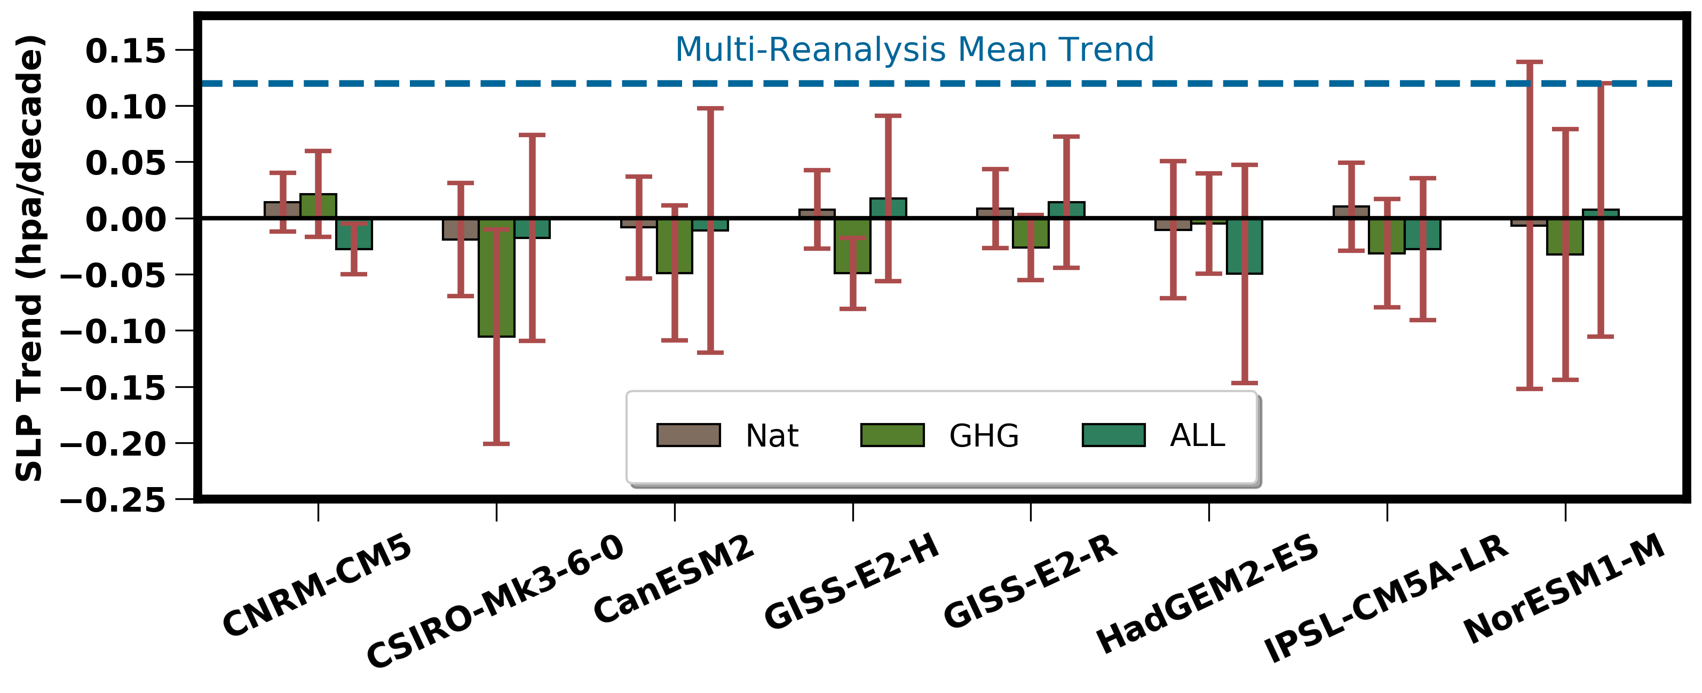
Determination of Attribution changes in IWC using CMIP5 simulations
Figure:
The bars represents the linear trend zonal SLP gradient CMIP5 historical (1980-2017), historicalGHG (1980-2012), and historicalNat (1980-2012) experiments. The error bars represent the 95% confidence interval for each individual model. The blue dashed line represents the multi reanalysis mean trend.
Key points:
Almost, all of the models show a large decreasing trend in the GHG scenario as compared to Natural forcing and historical scenarios for IWC.
None of the models for IWC in each scenario show a large increasing trend as seen in the multi reanalysis mean trend

Slide 9
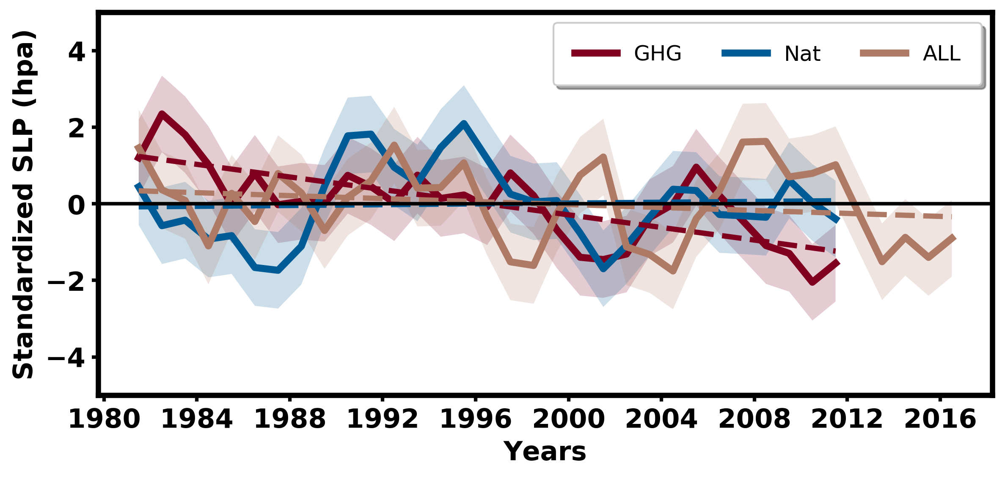
Zonal SLP gradient in different scenario
Figure:
Time series of zonal SLP gradient anomalies for CMIP5 historical (1980-2017), historicalGHG (1980-2012), and historicalNat (1980-2012) experiments. Shading area represents the 1 standard deviation for each individual scenario.
Trend (hpa/decade) | GHG | NAT | ALL
IWC | − 0.035 | 0.003 | − 0.015

Slide 10
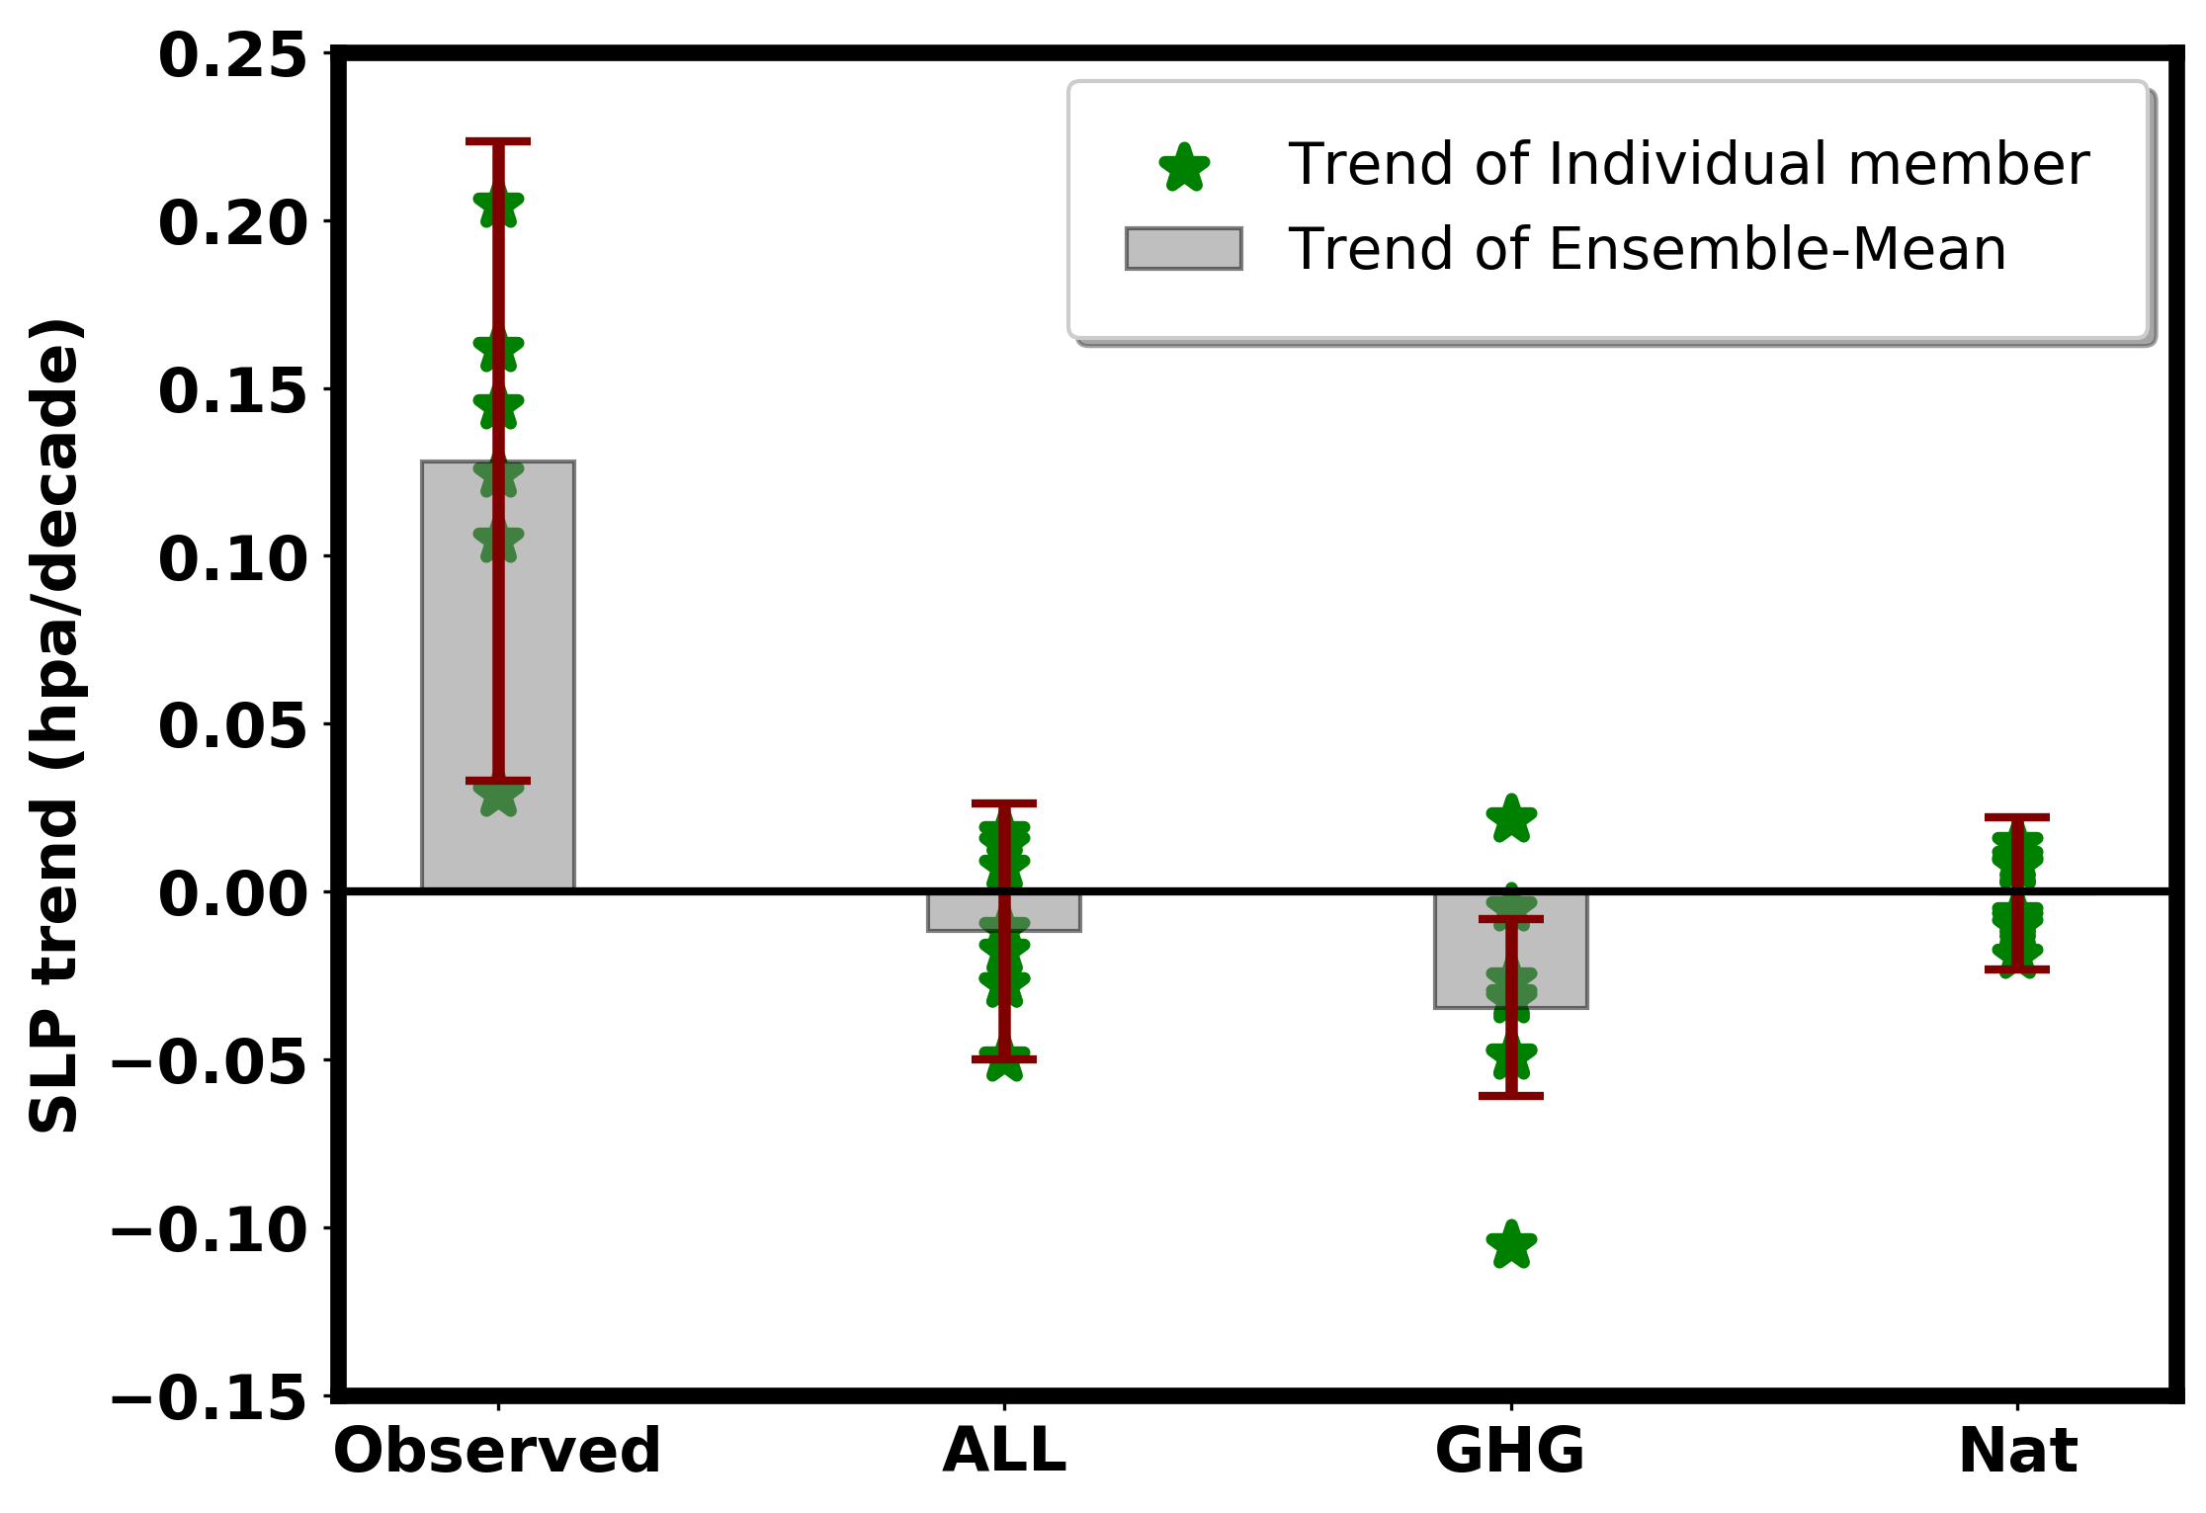
MME of zonal SLP gradient for observed and CMIP5
Figure
The bars represents the linear trend MME of zonal SLP gradient for observed (1980-2017), CMIP5 historical (1980-2017), historicalGHG (1980-2012), and historicalNat (1980-2012) experiments. The green stars shows the trend of individual member of models and different reanalysis dataset. The error bars represents the 95% confidence interval for ensemble of all scenario.
Key Points:
It is seen that for IWC there are some factors other than anthropogenic warming and natural variability that control the observed recent strengthening seen in the reanalysis.
IWC strengthening in the observed datasets can't be determine by the natural variability and anthropogenic warming. The factors that control IWC strengthening during the recent decades are still uncertain.

Slide 11
References
Bayr, T., D. Dommenget, T. Martin, and S. B. Power, 2014: The eastward shift of the Walker Circulation in response to global warming and its relationship to ENSO variability. Climate Dyn., 43, 2747–2763
Chung, E., Timmermann, A., Soden, B.J. et al. Reconciling opposing Walker circulation trends in observations and model projections.Nat. Clim. Chang. 9, 405–412 (2019).https://doi.org/10.1038/s41558-019-0446-4
DiNezio, P. N., G. A. Vecchi, and A. C. Clement, 2013: Detectability of changes in the Walker circulation in response to global warming. J. Climate, 26, 4038–404
England, M. H. et al. Recent intensification of wind-driven circulation in the Pacific and the ongoing warming hiatus. Nat. Clim. Change 4, 222–227 (2014).
Kociuba, G. & Power, S. B. Inability of CMIP5 models to simulate recent strengthening of the Walker circulation: implications for projections. J. Clim. 28, 20–35 (2015).
L’Heureux, M., Lee, S. & Lyon, B. Recent multidecadal strengthening of the Walker circulation across the tropical Pacific. Nature Clim Change 3, 571–576 (2013). https://doi.org/10.1038/nclimate1840
McGregor, S. et al. Recent Walker circulation strengthening and Pacific cooling amplified by Atlantic warming. Nat. Clim. Change 4, 888–892 (2014).
Meng, Q. et al. Twentieth century walker circulation change: Data analysis and model experiments. Clim. Dynam. 38, 1757–1773 (2012).
Mohtadi, M., Prange, M., Schefuß, E. et al. Late Holocene slowdown of the Indian Ocean Walker circulation. Nat Commun 8, 1015 (2017).https://doi.org/10.1038/s41467-017-00855-3
Plesca, E., Grützun, V. & Buehler, S. A. How robust is the weakening of the Pacific Walker circulation in CMIP5 idealized transient climate simulations? J. Clim. 31, 81–97 (2018)
Power, S. B. & Kociuba, G. What caused the observed twentieth-century weakening of the Walker circulation? J. Clim. 24, 6501–6514 (2011).
Sandeep, S., Stordal, F., Sardeshmukh, P.D. et al. Pacific Walker Circulation variability in coupled and uncoupled climate models. Clim Dyn 43, 103–117 (2014).
Vecchi, G. A., B. J. Soden, A. T. Wittenberg, I. A. Held, A. Leetma, and M. J. Harrison, 2006: Weakening of tropical Pacific atmospheric circulation due to anthropogenic forcing. Nature, 441
Vecchi, G. A. & Soden, B. J. Global warming and the weakening of the tropical circulation. J. Clim. 20, 4316–4340 (2007).
Vecchi, G. A., and B. J. Soden, 2007: Global warming and the weakening of the tropical circulation. J. Climate, 20, 4316–4340
Zhao, X., & Allen, R. J. (2019). Strengthening of the Walker Circulation in recent decades and the role of natural sea surface temperature variability. Environmental Research Communications.

