Slide 1
Characteristics of Conrad Discontinuity in the Northern Margin of Tibet Plateau Using Regional Seismic Data
Biao Yang, Yanbin Wang
Department of Geophysics, School of Earth and Space Sciences, Peking University, Beijing, 100871 China

Slide 2
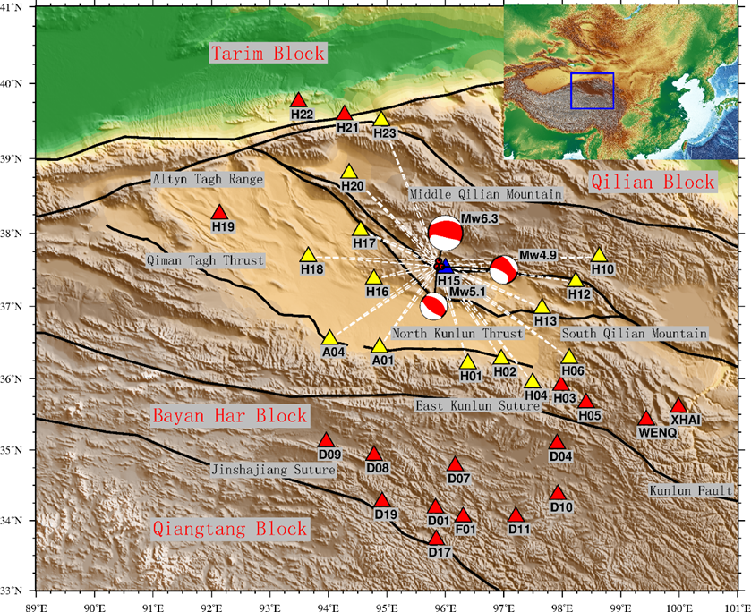
introduction
Location:
the northern margin of the Tibetan Plateau in northwestern China.
Surrounding blocks:
Tarim block , Qilian block and Bayan Har block.
Boundaries:
Altyn Tagh Range , Qiman Tagh Thrust, North Kunlun Thrust and Qilian Mountains.
Figure 1. Tectonic setting and distributions of earthquakes and stations in the Qaidam Basin region
Notes:
The blue triangle represents the station used to constrain the velocity of the upper crust, while the yellow triangles represent the stations used to constrain the velocity of the lower crust and the depth of the Conrad discontinuity, and red triangles represent the stations used to constrain the velocity of the upper mantle and the depth of the Moho discontinuity. Tectonic blocks and sutures refer to Zhang et al. (2005).

Slide 3
Table1. Information of earthquakes used in this study.
Origin Time | Lon.° | Lat.° | Magnitude (Mw) | Depth(km) | Focal Mechanism (GCMT)
 |  |  |  |  | Mrr | Mtt | Mff | Mrt | Mrf | Mtf | exp
2008.11.10 | 95.8853 | 37.6199 | 6.3 | 27.2 | 2.510 | -3.480 | 0.974 | 2.490 | -0.993 | 0.201 | 25
2008.11.11 | 95.8587 | 37.5426 | 5.1 | 23.9 | 2.070 | -0.955 | -1.120 | 3.330 | -1.260 | 4.030 | 23
2008.11.12 | 95.933 | 37.544 | 4.9 | 21.6 | 2.420 | -1.550 | -0.869 | 0.541 | -0.477 | 1.430 | 23
Notes:
On November 10, 2008, there was an earthquake of magnitude Mw6.3 occurred in the northern margin of the Qaidam Basin. The earthquake, together with two moderate aftershocks were recorded by the broadband seismic network deployed by the INDEPTH IV Project since 2007 (Zhao et al., 2008). We use the broadband records of these earthquakes in this study. Table 1 Provides the information of the three earthquakes with focal mechanism solutions from the GCMT catalog (https://www.globalcmt.org, last accessed March 10, 2020). Due to favorable epicentral distances, Conrad phases can easily be identified on most of the records.

Slide 4
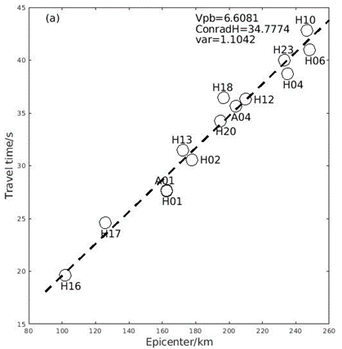
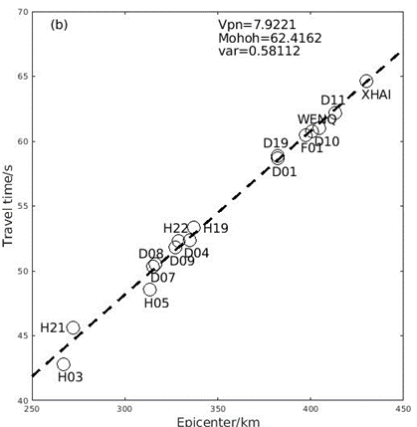
Two-layered model
Notes:
By fitting the travel-time curves of P* and Pn with the least-squares criterion, we obtain the average velocities of the lower crust and the upper mantle. Then, based on the average velocities, we can calculate the refraction angles of P* and Pn at the Conrad and Moho, respectively, and estimate the depths of the discontinuities.

Slide 5
Figure 6. Comparison between vertical records (black solid lines) and corresponding synthetics (black dashed lines).
Straight color lines are travel-time curves for crustal phases Pg (red), P* (yellow), PdP (green), Pn (blue) and PmP (purple), calculated by the TauP Toolkit.
The time axis is the reduced time with t=0 aligned by the arrival time corresponding to a wave speed of 6 km/s.
The record and synthetic at each station are normalized by the maximum amplitude (cm/s) of the record, whose value is given in the beginning of the waveform
Comparison for stations H06, H23, H12, H20, H13, A01, H17 and H16 of the main shock.
(b) Comparison for stations H10, H04, A04, H18, H02 and H01 of the main shock.
Notes:
In Figures 6, we compare the recorded and synthetic waveforms in a time window from 2 s before and 8 s after the arrival time corresponding to a wave speed of 6 km/s.
On the whole, the theoretical and observed waveforms fit well. The discrepancies between the arrival times in theoretical and recorded waveforms at some stations reflect the inhomogeneity of the internal structure of the crust. The synthetic waveforms show that the amplitudes of the refracted phases P* and Pn are smaller and the frequencies are lower than those of the reflected phases, PmP and PdP, while the amplitude and frequency of Pg are in the between. Because the focal depth of the mainshock is close to the Conrad discontinuity, it is difficult to distinguish the Conrad-reflected phase PdP from the direct arrival Pg. However, these two arrivals can be distinguished in the synthetics for the aftershocks, in which the amplitudes of the reflected phase PdP are larger than those of the direct arrival Pg.
Another factor that we need to consider is the source radiation pattern, since the stations are located in a wide range of azimuth. The effect of radiation pattern can be seen clearly in the synthetics. The amplitudes of P* in the synthetic seismograms at stations H12, H13, H18, H20 and H23 are too small to be seen clearly because those stations are in the nodal direction of the radiation pattern. Likewise, no signal can be seen near the theoretical P* arrival time. On the other hand, the arrival times of PdP are in good agreement with the travel-time curve, indicating a good performance by the two-layer crustal model.
The earlier arrivals of P* in the records at stations H01, H02 and H04 indicate that the depth of Conrad discontinuity along those source-station paths is shallower than the model. The deviations in the first-arrival times at stations H23 and H20 may be due to the variation of the depth of Moho discontinuity and/or the P wave velocity under Qilian mountain.
The first arrivals from the main shock at stations H18 and H10 show large time delays (>2 s) with respect to the travel-time curve. However, the same is not true for the aftershocks at station H10, which may be interpreted as the error in measurement of epicenter distance. The delay at station H18 may be interpreted by the effect of sediments because the arrival times of Pg phase are in good agreement with the travel-time curve.

Slide 6
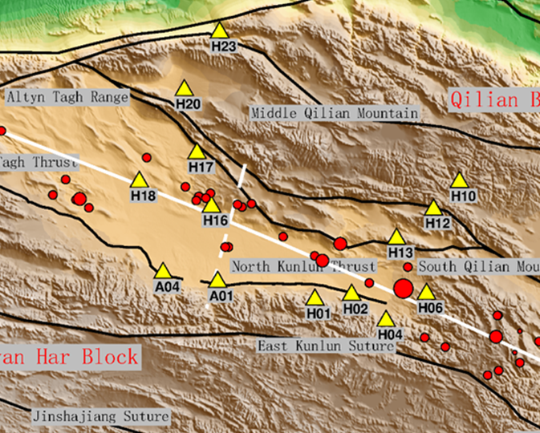
Depth variation of Conrad Discontinuity
The station locations
Figure 7. (a), (b) and (c) Estimated Conrad discontinuity depths at individual stations obtained from the Mw 6.3 main shock and the Mw 5.1 and Mw 4.9 aftershocks, respectively.
Notes:
The variations in the depth of the Conrad discontinuity shown in Figure 7 have clear regional pattern. The depths of Conrad discontinuity from the earthquakes to the southeast part of the basin stations (H01, H02, H04 and H06) are ~30km which is obviously shallower than the other areas, while the overall depth is ~33km.

Slide 7
Table 2. Comparison of Conrad discontinuity depths (in km) obtained in this study with previous results
Station | H01 | H02 | A01 | A04 | H13 | H17 | H20 | H23
This study | 29.0 | 31.8 | 33.2 | 36.0 | 35.3 | 35.1 | 35.8 | 34.6
Wang et al.（2005） |  |  |  |  | 36 | 36 | 36 | 36
Cui et al.（1997） |  |  | 34 | 34
Xia et al.（2001） | 30 | 30
Notes:
Several previous studies focusing on different regions of the Qaidam Basin (Cui et al., 1995; Xia et al., 2001; Wang et al., 2005) have shown that the depth of Conrad discontinuity ranges between 30 km and 36 km, and that there exists a low-velocity layer above the discontinuity. The propagation paths for stations H13, H17, H20 and H23 are close to the study area of Wang et al. (2005), the paths for stations A01 and A04 are close to the study areas of Cui et al. (1995) and the paths for stations H01 and H02 stations are close to the study area of Xia et al. (2001). The comparison in Table 2 shows a good agreement between our results and those from previous studies.

Slide 8

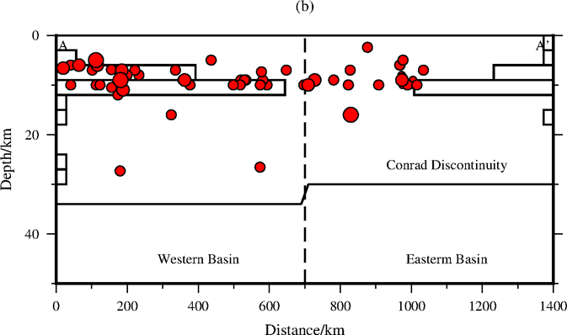
Vertical profile of hypocenters
Figure 8. (a) Topography map of the region around the Qaidam Basin. The white line AA' shows the central dividing line of the basin. Red dots are 66 epicenters of earthquakes occurred between May 2012 and November 2019 within 60 km from the dividing line. The size of the circles is proportional to the earthquake magnitude. (b) Vertical profile along AA' showing the projections of hypocenters
Notes:
Figure 8(a) shows the distribution of earthquake within 60 km of the central dividing line of the Qaidam Basin. All of the earthquakes occurred in the brittle upper crust, as shown in Figure 8(b). There are few earthquakes around the depth of 20km and none under the Conrad discontinuity, indicating that the strength of the crust is drastically weakened below 20-km depth. Figure 8(b) shows the histogram of the focal depths of earthquakes in the eastern and western parts of the basin. There seems to be a difference in the depth distributions in the two parts of the basin. Earthquakes in the western part of the basin reach a greater depth than in the eastern part.

Slide 9
Discussion
Figure 9.
(A)shortening of upper crust led to the crustal thickening, which resulted in the deeper Conrad Discontinuity
(B)Shortening of lower curst in the Eastern Basin
Yin An, Dang Y.Q., Chen X.H., et al., 2007.Cenozoic Evolution and Tectonic Reconstruction of the Qaidam Basin:Evidence from Seimic Profiles (in Chinese)[J]. Journal of Geomechanics, 2007,13(3):193-210
Notes:
Across the Qaidam Basin, the relative shortening of the upper crust decreases from more than 48% in the west to less than 1% in the east, which suggests a shift of crustal shortening from the upper crust to the lower crust (Yin et al., 2007). Because the materials at the depths of lower crust and upper mantle under the Qaidam Basin are relatively rigid, as indicated by relatively high velocity and Q value (Teng et al., 2012), so the crustal thickening in eastern Qaidam Basin is probably the result of repeated thrusting in the lower crust (Yin et al., 2007).

Slide 10
Thank You

