Slide 1
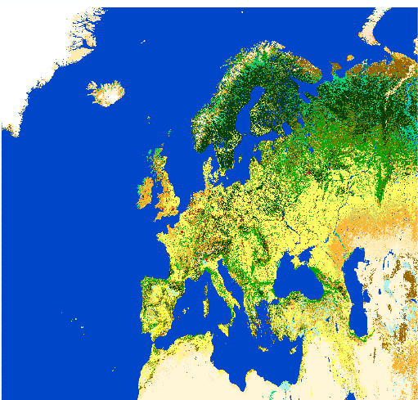
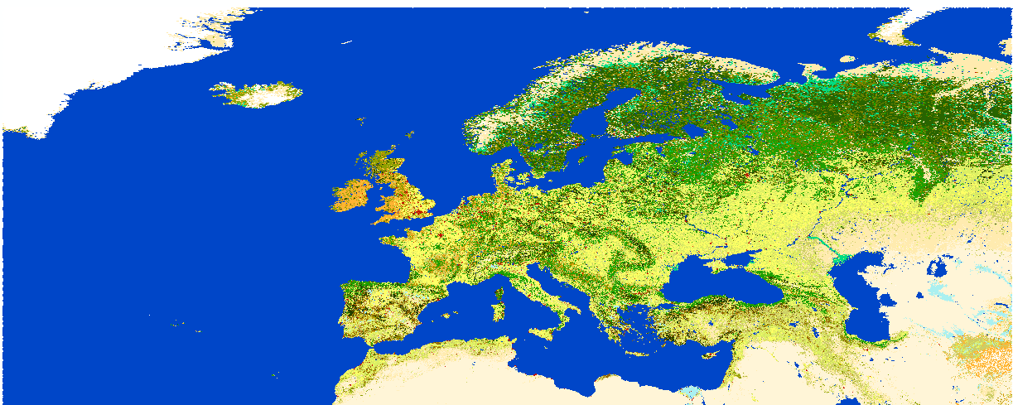
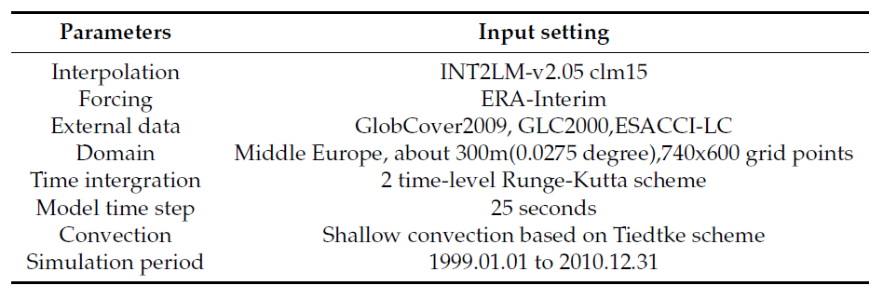
Sensitivity study of different land cover data sets in regional climate simulations over Europe
Mingyue Zhang¹, Jürgen Helmert², Eva Nowatzki¹, Elena Xoplaki^{1,4}, Merja Tölle¹ and Jürg Luterbacher^{1,3,4}
¹:Department of Geography, Climatology, Climate Dynamics and Climate Change, Justus-Liebig University of Giessen,Germany
²:Deutscher Wetterdienst(DWD,German Meteorological Service), Offenbach, Germany
³:Science and Innovation Department, World Meteorological Organization (WMO), Geneva, Switzerland
⁴:Centre of International Development and Environmental Research, Justus Liebig University of Giessen, Germany}
Abstract
Land cover plays an important role in regional climate via influencing the heat, moisture, and momentum transfer, chemical composition of the atmosphere. But how different land cover fractions and distributions contribute to the earth’s water and energy cycles, further on regional climate is still under research. In this study, we used three different land cover data sets which are GlobCover 2009, GLC2000 and ESACCI-LC to generate external parameter sets for regional climate modelling.And incorporate this three difference external parameter sets into the regional climate model COSMO-CLM(v5.0) to perform simulations over CORDEX-EURO area. Convection-permitting simulations with the three different land cover data sets are performed at 0.0275-degree horizontal resolution over Europe for the time period from 1999 to 2000. Further, the impacts on the regional and local climate addressed by different land cover fractions and distributions are compared between three simulations. For validate the simulation results, it is also compared with the observational data. Overall, the simulation results show comparable agreement to observations. Even though the land cover is classified into the same types, the difference in LC distribution and fraction leads to variations in climate simulation results.
Data
(a)
(b)
(c)
Figure 1: (a)GLobCover 2009, (b)ESACCI-LC, (c)GLC2000
GlobCover 2009 land cover data. It is a high horizontal resolution land surface product and it has been used in many different publications. For instance, it has been used to compare the affects of different land cover types in atmospheric circulation. It is also the reference input land cover data of the German weather service center to do climate simulation and serve for the weather prediction system.
GLC2000 land cover data. It is produced through the Global Land Cover 2000 Project(GLC2000) which aims at providing information to the International Conventions on Climate Change. The daily SPOT4 Vegetation sensor data is the basic input data of this land cover product. PFTs are created based on physical, phylogenetic and phonological characteristics such as the Leaf Area Index (LAI), roughness length (z0), root depth, and others. Leaf area index(LAI) as a dimensionless quantity which could characterizes plant canopies.
ESACCI-LC land cover data, which is at 300 m spatial resolution on an annual basis from 1992 to 2017. The Coordinate Reference System used for the global land cover database is a geographic coordinate system (GCS) based on the World Geodetic System 84 (WGS84) reference ellipsoid. It contains 37 land cover types. It is produced based on the view of as much as possible compatible with GLC2000, GlobCover 2009 as well as PFTs.
Model description
The COSMO model version 5.0
CLM version 15 (COSMO-CLM v5.0-clm15)
The Interpolation is done with INT2LM in version 2.05 with CLM version 1 (INT2LM-v2.05 clm1).
The time-integration is the two time-level Runge-Kutta scheme and the model time step is 25 seconds.
simulation domain
According to the setup of the WCRP Coordinated Regional Downscaling Experiment (CORDEX) in its European realization (EURO-CORDEX).
760 x 600 grid cells computational domain
Horizontal resolution of 0.0275-degree (about 300m) in a rotated grid, the left bottom point geographical coordinates is longitude: -7.6050973 degree and latitude: 34.4874324 degree.
Experiment
Step 1: External parameter generation(based on EXTPAR, Table 1)
Step 2: Simulations based on COSMO-CLM v5.0-clm15 (Table 2, 3)
Table 4: Differences between different lands cover data sets
Table 1: Input parameters for start EXTPAR software
Table 3: COSMO-CLM simulations set up
Table 2: Performed simulations
Table 3: Performed simultions

Slide 2
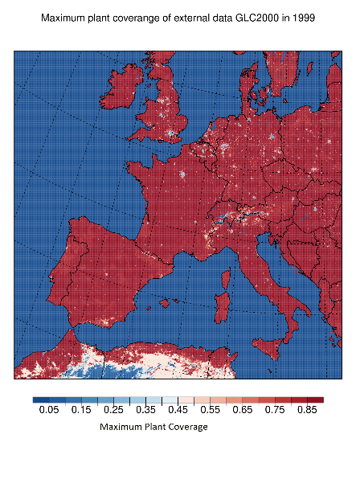
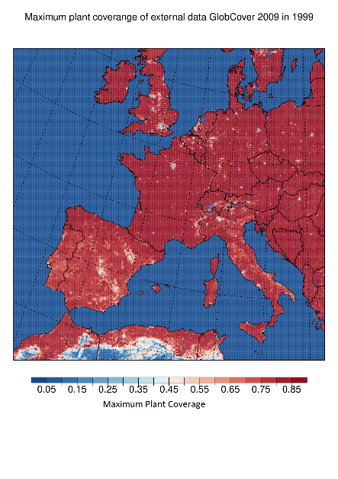
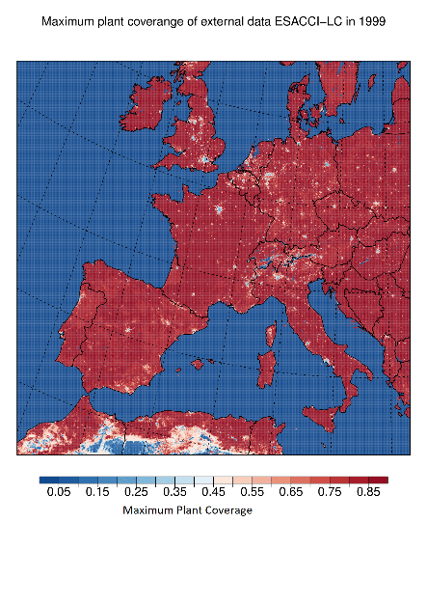
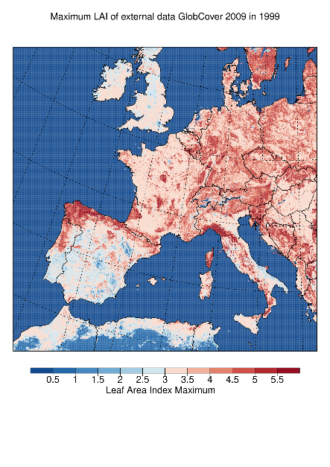
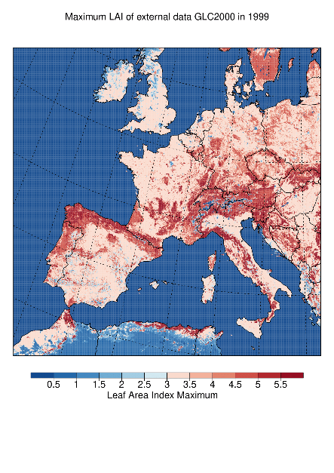
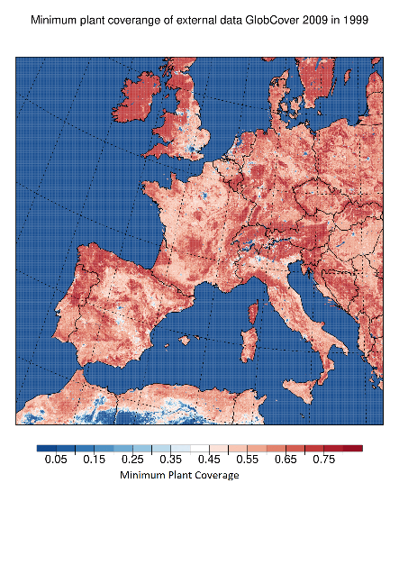
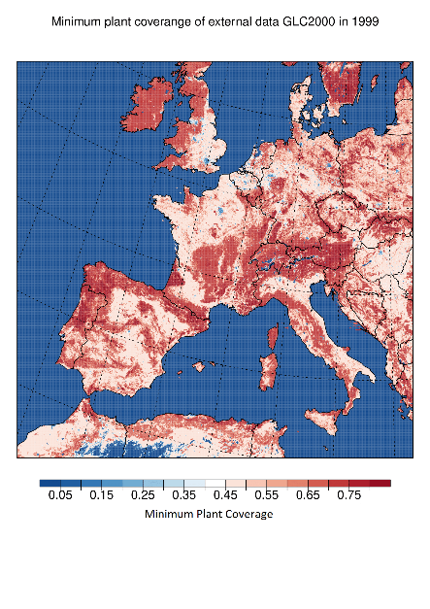
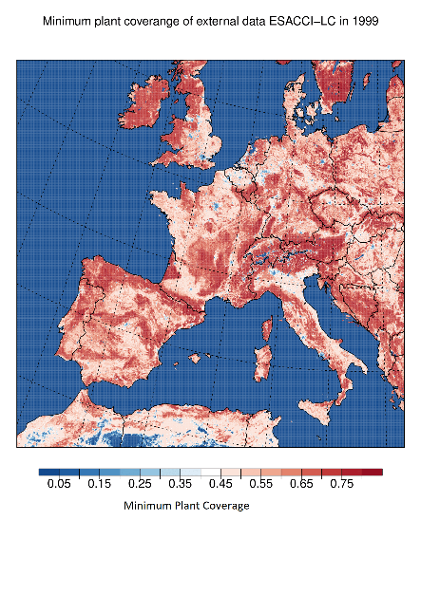
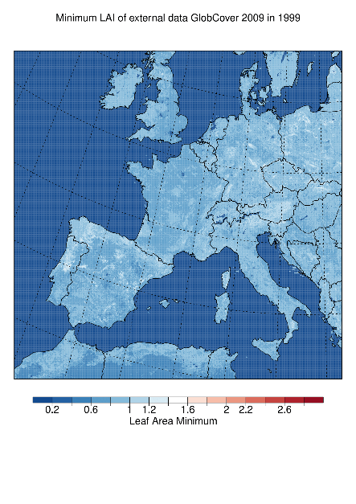
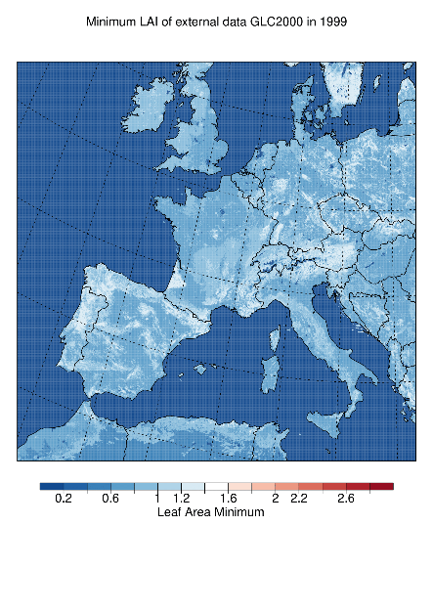
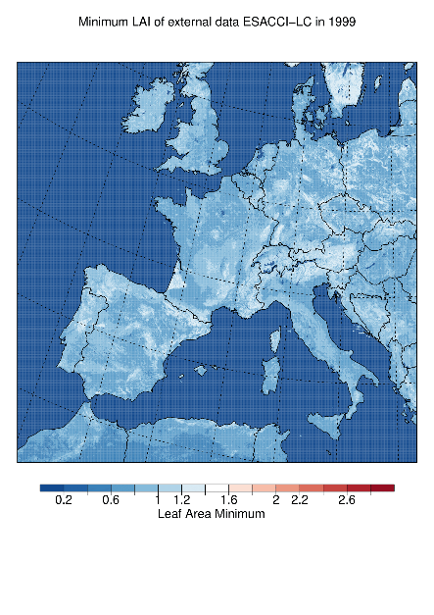
Results and Discussion
Impacts of different land cover types in external parameters
Figure 2: External parameters, maximum and minimum plant coverage and LAI based on three different land cover product

Slide 3
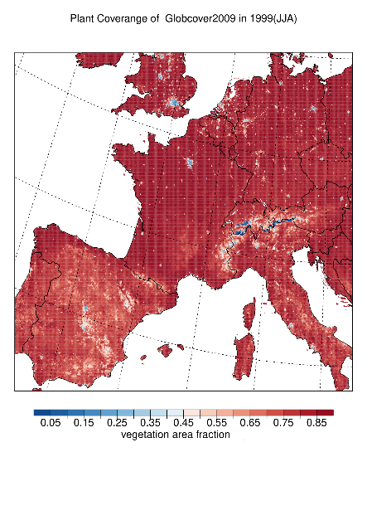
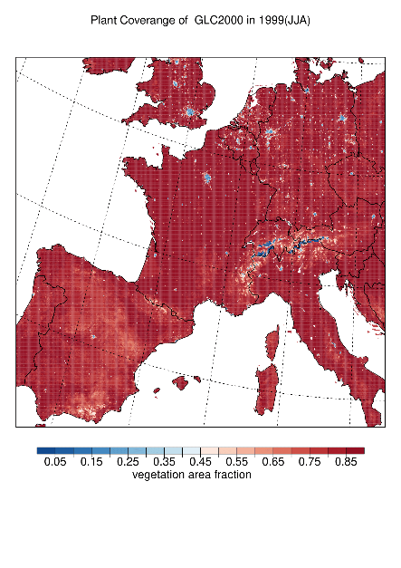
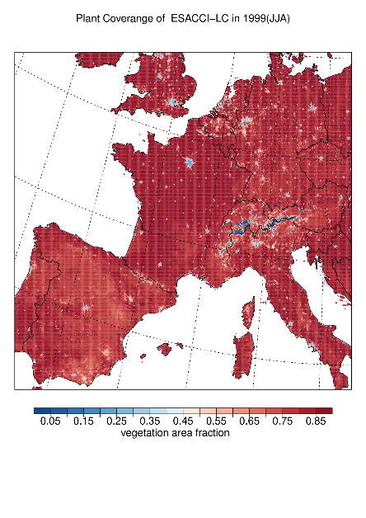
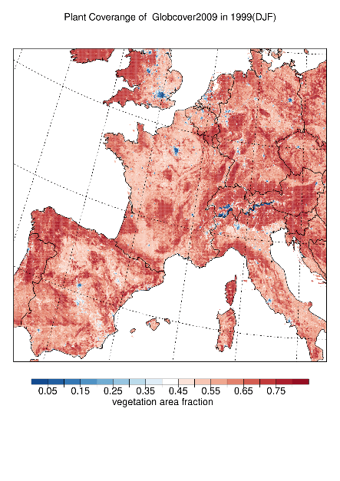
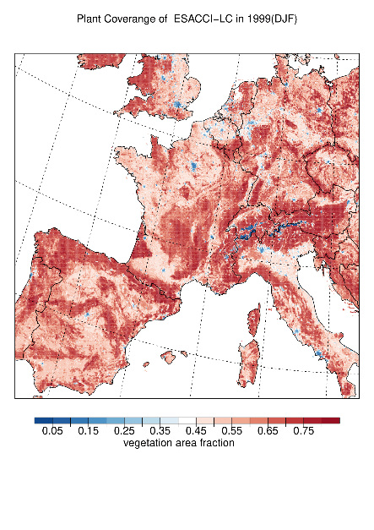
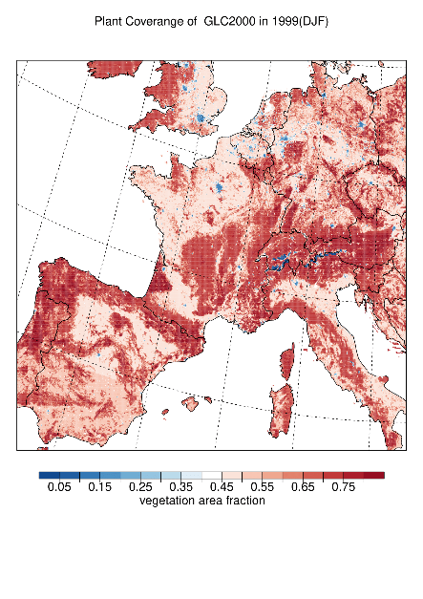
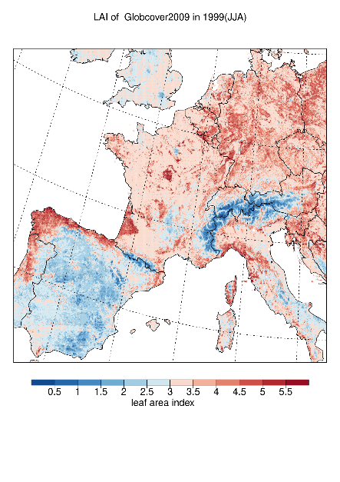
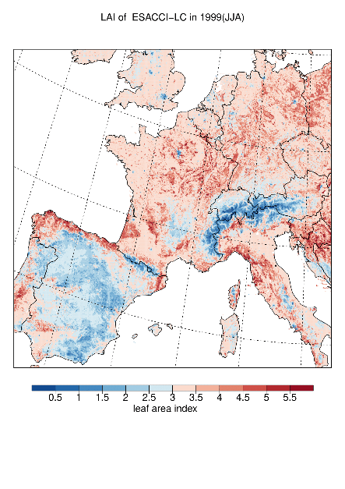
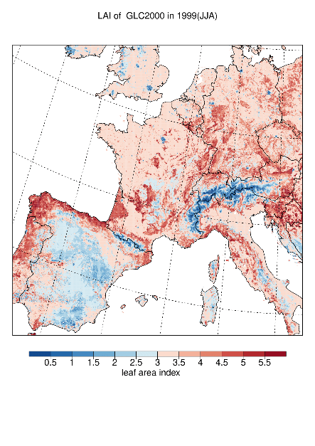
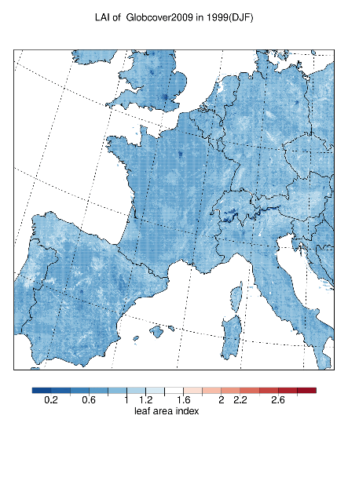
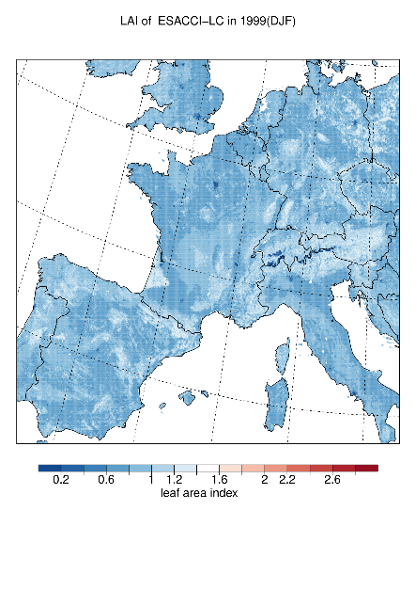
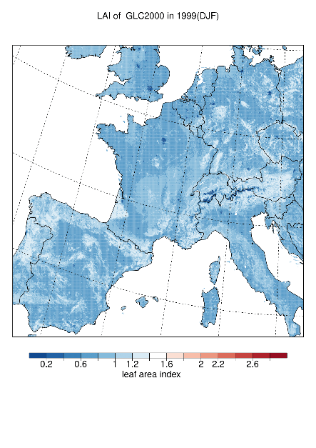
Impacts of different land cover types in LAI and plant coverage
Figure 3: Simulation results of summer and winter, Plant coverage and LAI based on three different land cover product

Slide 4
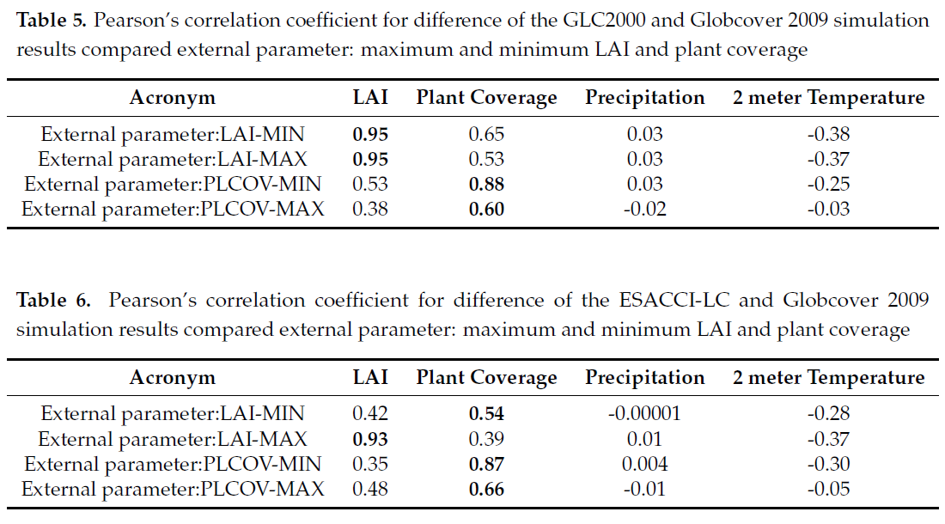
Correlation between external parameter differences and simulation differences
In Figure 2 and Figure 3 we showed the comparison of the simulation results between three land cover sets
The simulated plant coverage based on three different external parameters(three difference land cover sets) is shown for summer(June,July and August in 1999) and winter(December in 1999 and January, Feberary in 2000) separately.
In summer, generally all three simulations show similar plant coverage, while in the area of Spain and the Alps area shows slight differences. In Spain, with the simulation based on GlobCover 2009, plant coverage is lower compare to the other two simulations. Comparing the land cover types and fractions of different land cover data sets, which might be related to "close to open shrub land" or "Mosaic Grassland, Forest shrubland".
While in ESACCI-LC, the area in Spain is classified as tree cover in a different fraction. In the GLC2000 land cover product, this area is covered by "sparse herbaceous or sparse shrub cover" and "tree cover with different types". But the agreement is well across the three models and the other European regions, this might because that in the whole Europe at 300m horizontal resolution, these three land cover data sets do not have crucial differences. In some part, the land cover shows differences in land cover type, fractions and distributions, but the land cover is still in a frame of same big class.
In winter the plant coverage is more homogeneous in GlobCover2009 simulation result compared to GLC2000 and ESACCI-LC. A major difference can be found for the Alpine area, where the simulation results show dynamic variation, mainly due to the high range of elevation and forest type vegetation in this area. Because of the vegetation diversity in the forest and the land cover classification system varies from one land cover product to another, the area of Alps is covered by different sub-class vegetation in different land cover types. To validate this hypothesis, we studied the relationship between the simulation results and external parameters. The Pearson correlation index was calculate between external parameters(maximum and minimum LAI, maximum and minimum plant coverage) and simulation results(LAI, plant coverage, Precipitation and temperature).
The simulated LAI is strongly related to external parameters: maximum and minimum LAI
Plant coverage relies more on minimum plant coverage with the Pearson's value of 0.875.
Simulated temperature and precipitation is not heavily relied on the external LAI and plant coverage.
In Table 6 similar correlations are shown regarding ESACCI-LC and GlobCover2009.
Simulated LAI difference of ESACCI-LC and GlobCover2009 are strongly related to maximum external LAI difference of it
The minimum LAI doesn't have a strong effect on simulated LAI.
The difference in external parameter-LAI will effect the simulated LAI.
Similarly, the differences in external parameter-plant coverage will affect the simulated plant coverage.
The differences in external parameter-LAI and plant coverage do not have many effects in simulated temperature and precipitation.

Slide 5
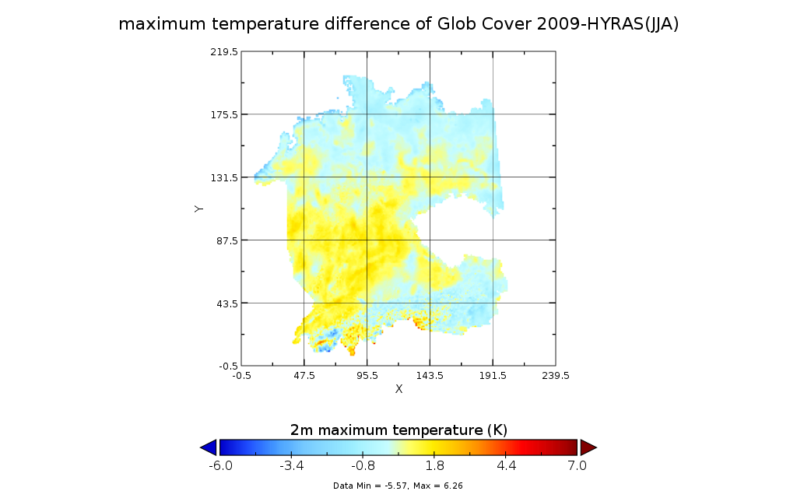
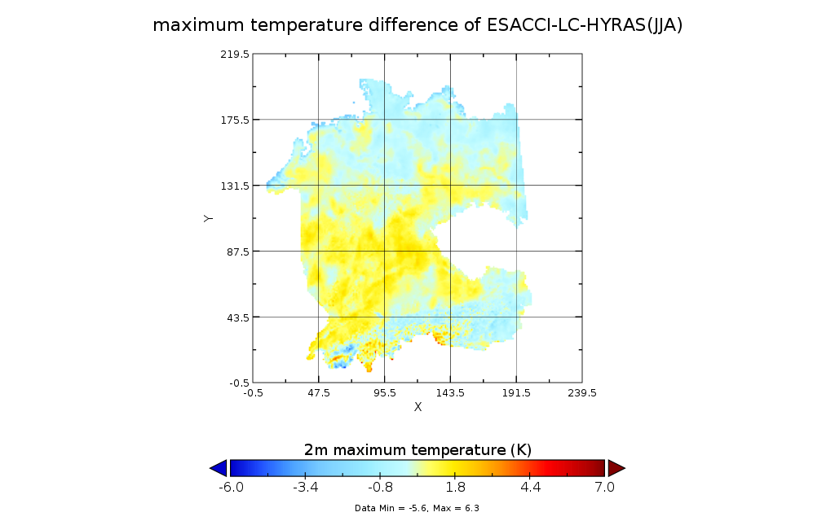
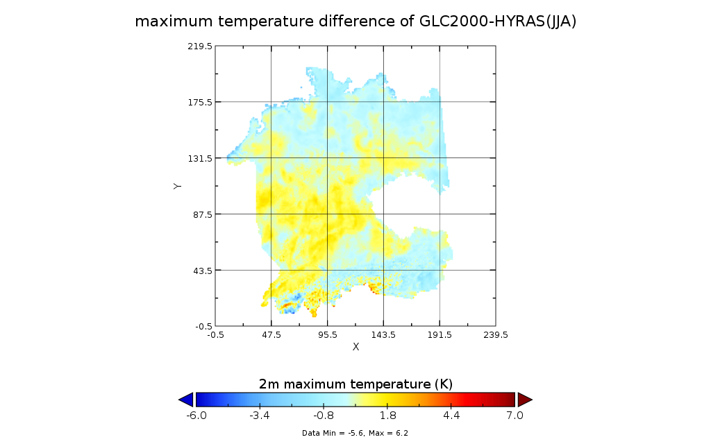
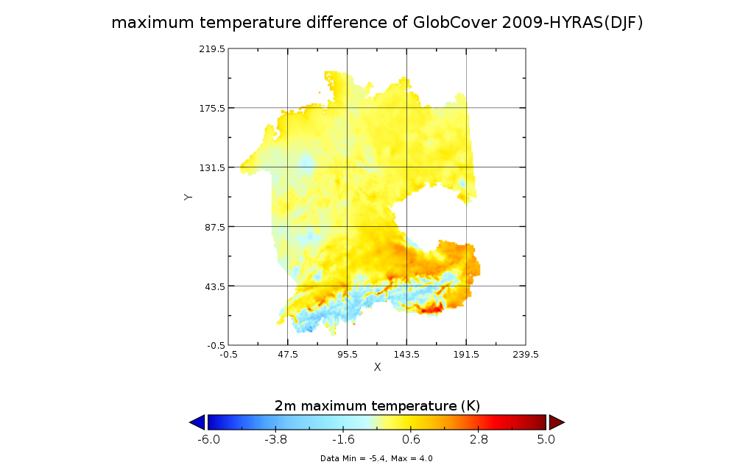
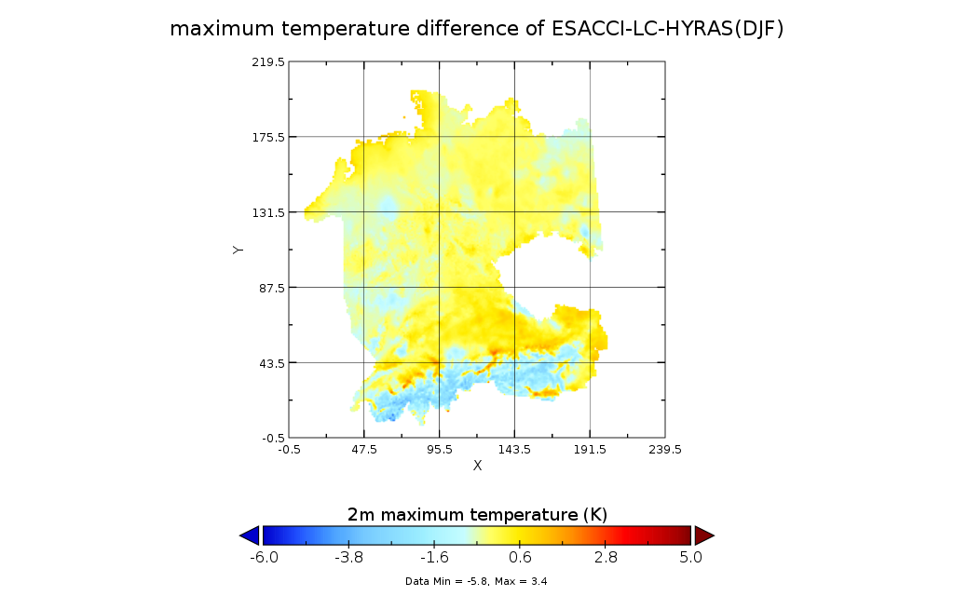
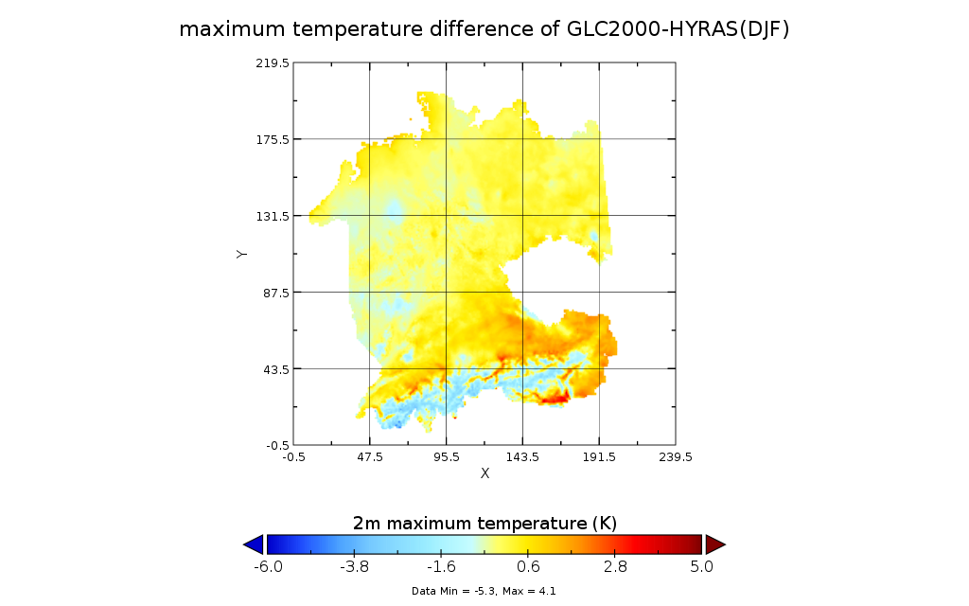
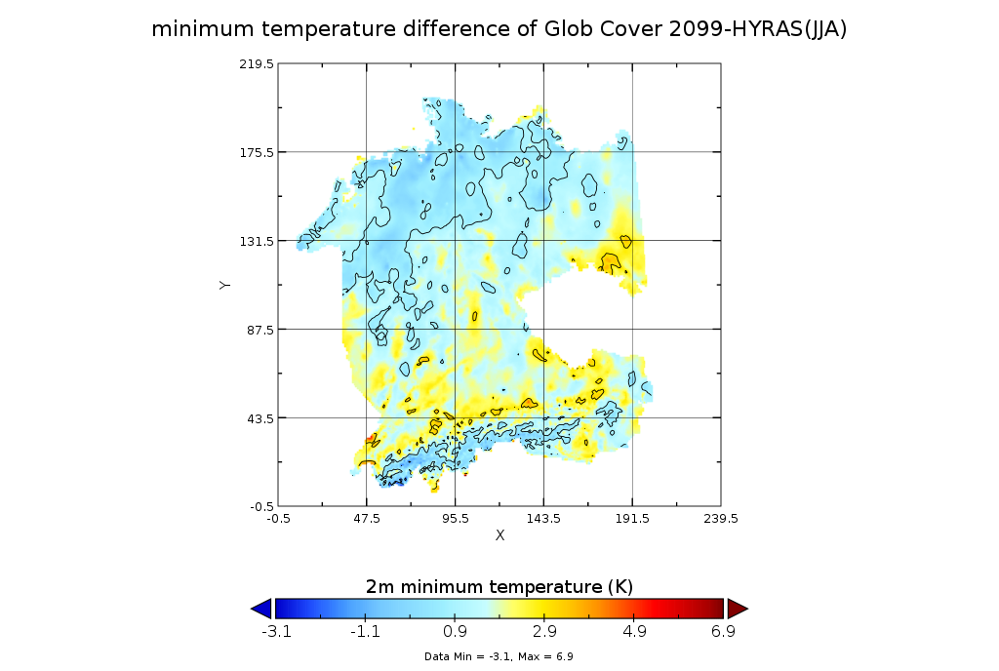
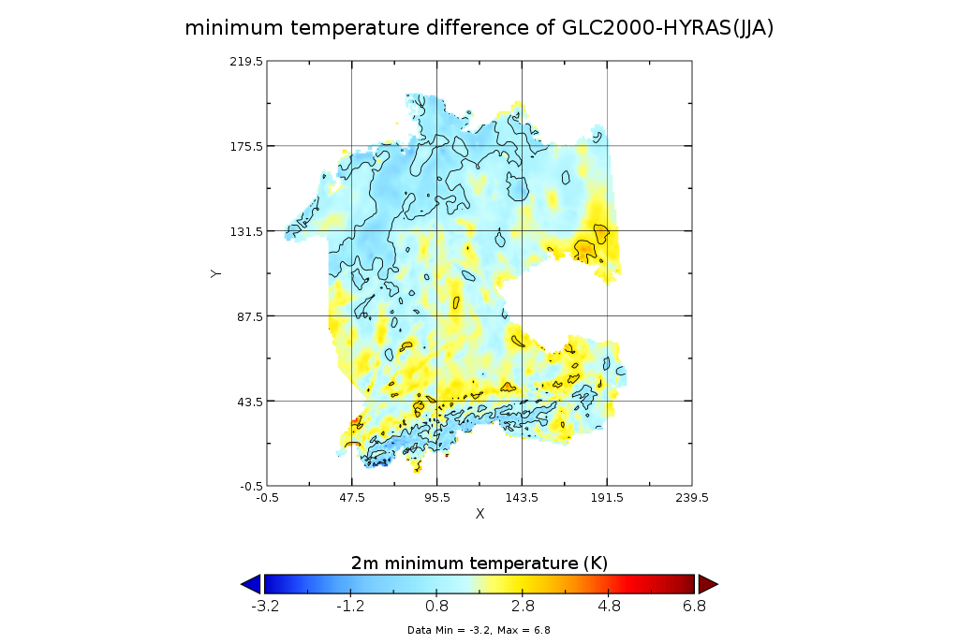
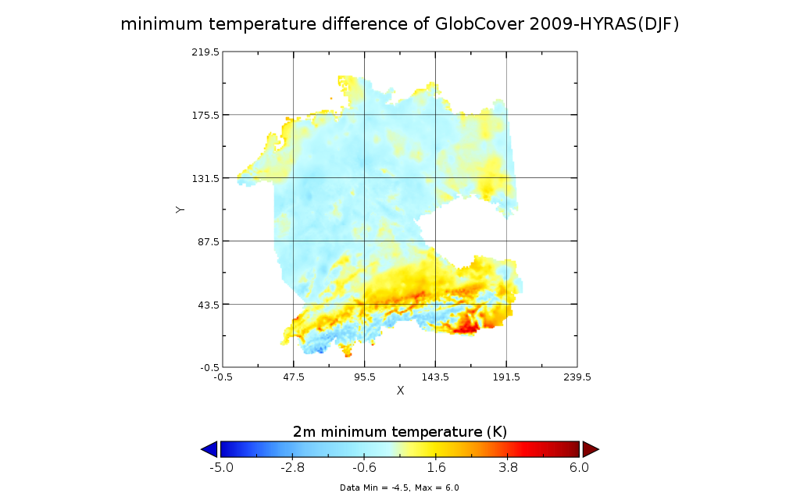
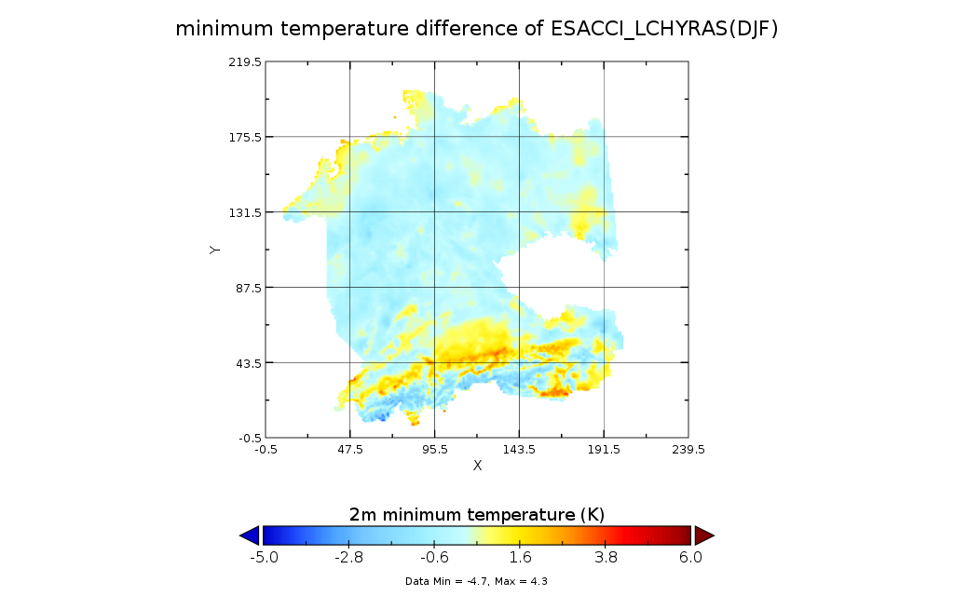
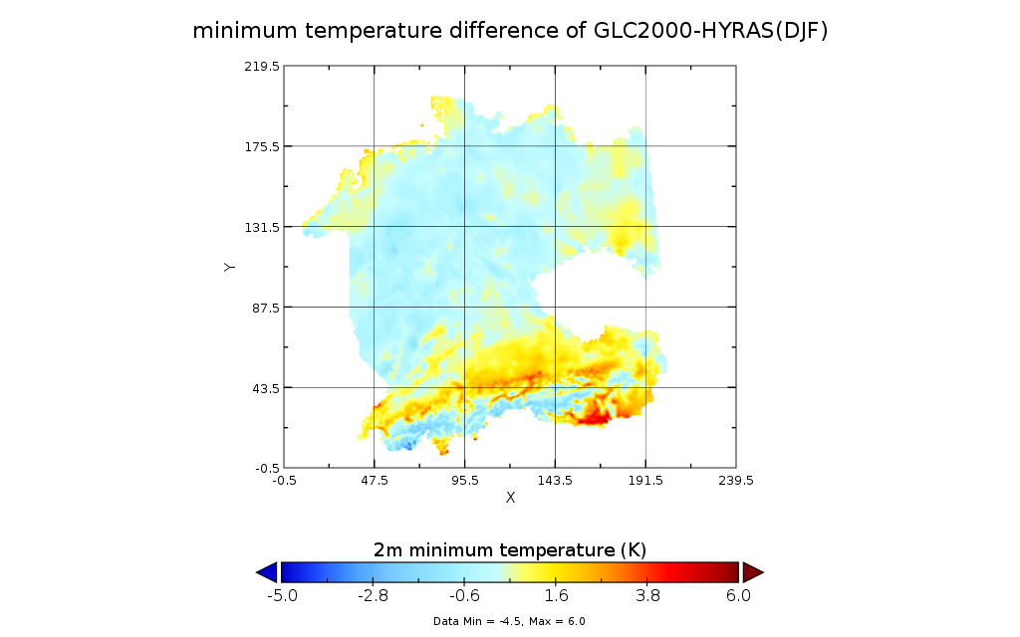
Validation of Observations
Figure 4: Comparison with observational data, maximum and minimum temperature in summer and winter
Discussion
The simulation results like LAI, temperature, latent and sensible heat flux are strongly related to land cover types. Furthermore, it will affect the accuracy of the climate prediction system. The external parameters will change based on different land cover data sets. Different land cover fractions and distributions will affect the maximum and minimum LAI as well as plant coverage.
From the analyzing of the simulation result, we can get a conclusion that the differences in external parameters will affect the simulation result, as the external parameter is based on different land cover data set. We could also say that the simulation result is effected by the land cover fraction and distribution.
The result shows that all the simulations show reliable results compare to the observational data. But it shows differences with different land cover data sets. Generally, the ESACCI-LC simulation result shows higher accordance with the observational data. Area which is covered by forest with complex land cover combination shows highly sensitivities related to different land cover fractions and distributions.
Reference
Pielke, Roger A., et al. "Interactions between the atmosphere and terrestrial ecosystems: influence on weather and climate." Global change biology 4.5 (1998): 461-475.
Wang, Sufen, et al. "Modelling hydrological response to different land‐use and climate change scenarios in the Zamu River basin of northwest China." Hydrological Processes: An International Journal 22.14 (2008): 2502-2510.
Tölle, Merja H., Lukas Schefczyk, and Oliver Gutjahr. "Scale dependency of regional climate modeling of current and future climate extremes in Germany." Theoretical and applied climatology 134.3-4 (2018): 829-848.

