Slide 1
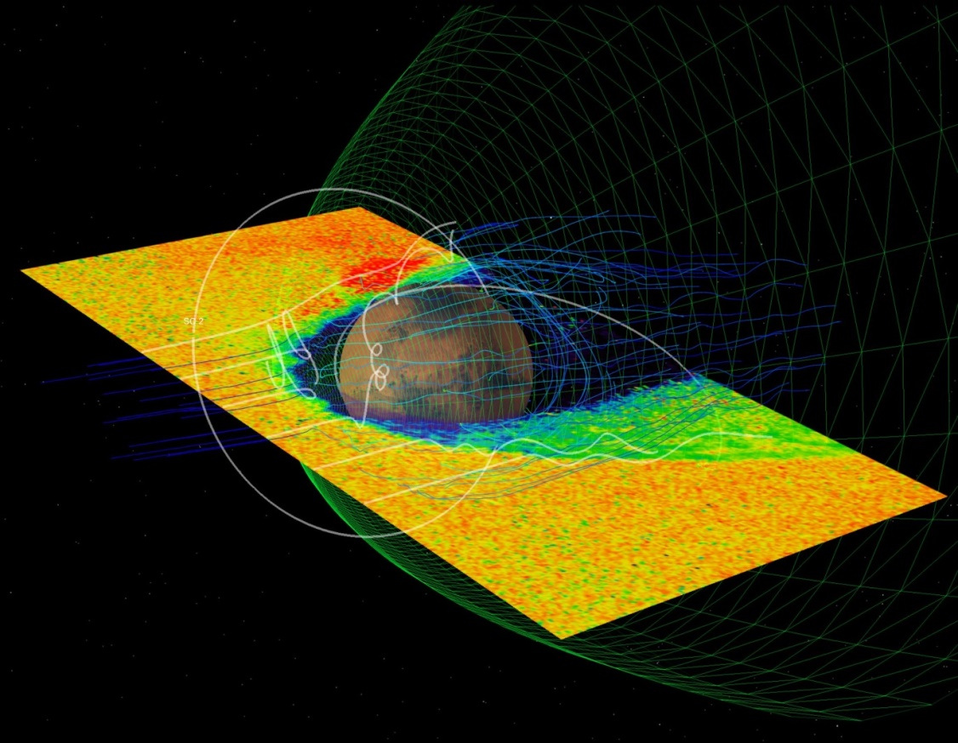
ESCAPADE
Escape, Plasma and Acceleration Dynamics Explorers
Rob Lillis, Shannon Curry, Janet Luhmann, Aroh Barjatya, Davin Larson, Christopher Russell, Roberto Livi, Phyllis Whittlesey, Yingjuan Ma, Ronan Modolo, Yuki Harada, David Brain, Paul Withers, Christopher Fowler, Shaosui Xu, and Ed Thiemann
EGU Virtual meeting, May 5, 2020
* I won’t be awake for the chat so please email me with any questions: rlillis@berkeley.edu
1
Notes:
The last several talks showcased the rich array of plasma processes occurring in the Mars magnetosphere, and form a great motivation for my talk. I’ll talk about the science case for ESCAPADE, as well as our mission for the mission including instruments, spacecraft, and mission design

Slide 2
ESCAPADE 30-second summary
What is it? Two identical smallsats, measuring plasma conditions from coordinated elliptical Mars orbits.
Why? Understand how solar wind energy and momentum are transferred through the Martian magnetosphere, and the consequences for plasma-related atmospheric escape.
How? Selected as part of the SIMPLEX-II program. Ride-share with the Psyche mission. Electric propulsion + aerobraking.
When? Launch 08/22, Science 07/24-07/25.
How much? < $55 million

Slide 3
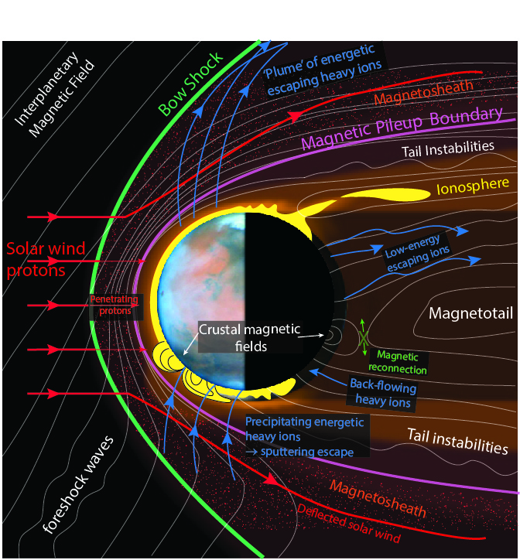
The Martian plasma environment: why do we care?
Understand structure, composition, variability and dynamics of a unique hybrid magnetosphere.
Atmospheric Escape Processes: ion and sputtering escape are important the evolution of Mars’ climate.

Slide 4
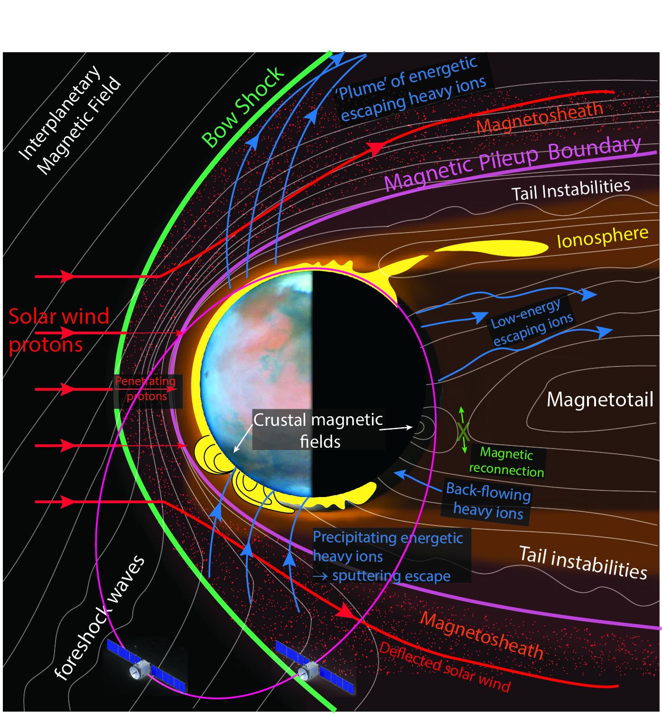
Q: Why ESCAPADE?
A: A single measurement platform leaves major questions unanswered
spatial and temporal plasma variations cannot be distinguished
responses of magnetosphere & escape to changing heliospheric conditions (~1 minute) can only be measured with a time-lag of an hour or (much) more
Multi-point in situ observations from coordinated orbits are required to untangle spatial from temporal variability and characterize real-time response to heliospheric drivers.
Notes:
The figure on the bottom shows the evolving orbit of MAVEN in MSO coordinates, or with respect to the sun, showing the nominal location of the various plasma regions and boundaries. Black is the undisturbed solar wind, behind which is the bow shock and the magnetosheath region where the solar wind plasma slows down, heats up, becomes turbulent and diverts around the conducting obstacle of the ionosphere. The yellow region is where the interplanetary magnetic field piles up and drapes around the planet. The blue region is the wake where the double-lobed magnetotail trips behind the planet. This is a highly simplistic representation of a very complex picture that displays enormous variability as the properties of the solar wind change: density, velocity, IMF magnitude and IMF cone and clock angle.

Slide 5
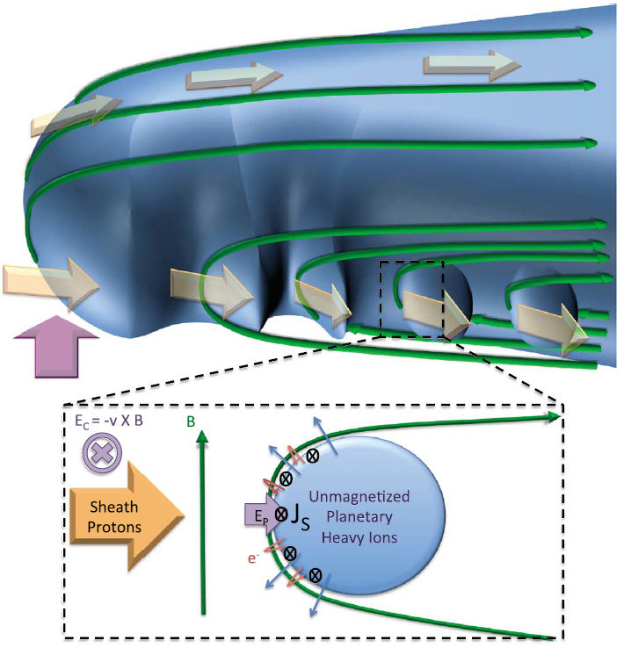
Spatial-Temporal Ambiguity
Boundary Processes:
Snowplow Bulk Plasma Loss on the IMB [Halekas et al., 2015, 2016].
Kelvin-Helmholtz Instabilities [Ruhunusiri et al., 2017]
Bow shock motion.
3-D structures evolving in time:
Flux Ropes [Hara et al] & plasmoids.
Field-aligned potentials:
Double layers & Inverted-V signatures [Xu et al., 2019].
Ionospheric processes:
Irregularities [e.g. Fowler et al., 2018] & ion heating
Magnetic Cusp influences.
Electron precipitation
Notes:
The interaction of unmagnetized planetary heavy ions with magnetized sheath protons results in polarization electric fields at the edges of the unmagnetized bubble as ions try to freely propagate, and resulting shielding currents which pile up the magnetic field in a snowplow effect. The structure is likely dynamic in space and time , and ions are accelerated to different energies, resulting in energy dispersion.
All these features of the Mars-SW interaction are likely dynamic in space and time. Multi-point observations will untangle space & time and elucidate these processes.

Slide 6
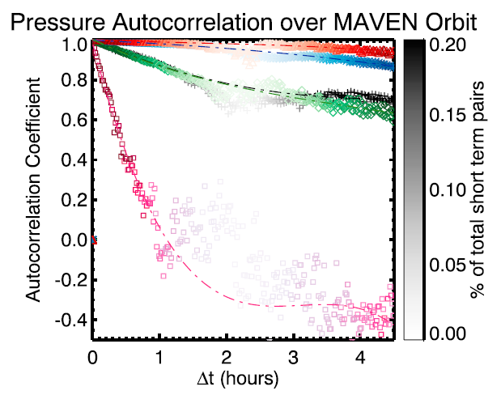
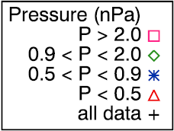
Response to solar wind conditions
Categorizing ion loss or precipitation by SW/IMF conditions relies on once-per-orbit proxies or assuming SW conditions are steady over 1-3 hours.
Bad assumption when pressures exceed 1-2 nPa.
Real-time response to impulsive events cannot be characterized.
Dubinin et al., 2017
Marquette et al., 2018

Slide 7
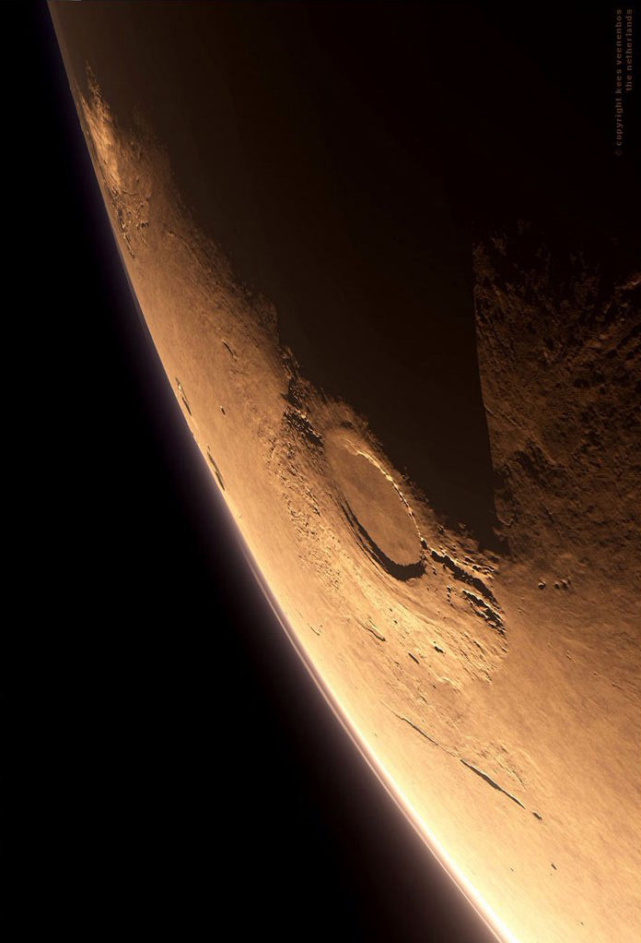
ESCAPADE
ESCAPADE is a twin-spacecraft Class D mission dedicated to studying the transfer of solar wind energy and momentum through Mars’ unique hybrid magnetosphere and how it drives ion and sputtering escape.
Builds on MAVEN’s legacy for a fraction of the cost.
In June 2019, ESCAPADE was selected for Phase A&B funding as part of the NASA SIMPLEX program.

Slide 8
ESCAPADE Goals & Objectives
Goal A. Understand the processes controlling the structure of Mars’ hybrid magnetosphere and how it guides ion flows. A1. Determine magnetic structure and plasma flows in Mars’ magnetotail and how they vary spatially, temporally, and with respect to solar wind conditions. A2. Determine structure in Mars’ ion escape plume and how it varies spatially, temporally and with respect to solar wind conditions. | Goal B. Understand how energy and momentum is transported from the solar wind through Mars’ magnetosphere. B1. Measure the flow of mass and energy from the solar wind across Mars’ bow shock to the magnetosheath. B2. Measure the flow of mass and energy within Mars’ magnetosheath and from it across the magnetic pileup boundary into the upper ionosphere. B3. Measure the flow of mass and energy between day and night in the upper ionosphere. B4. Measure the flow of mass and energy from Mars’ magnetosheath across the flanks into the magnetotail. | Goal C. Understand the processes controlling the flow of energy and matter into and out of the collisional atmosphere. C1. Measure plasma outflow and precipitation in Mars’ upper ionosphere, and how they vary spatially, temporally and with respect to solar wind conditions and crustal magnetic fields.

Slide 9
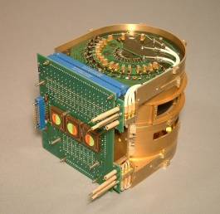
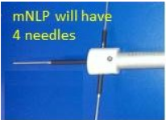
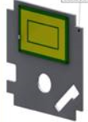
Measurements & Instruments
Magnetic Fields (DC) | Suprathermal Ions | Suprathermal Electrons | Thermal Plasma Density | Solar EUV flux (55-130 nm)
Range: 0 - 10³ nT Magnitude Accuracy: 0.5 nT Direction Accuracy: 20°, |B| > 1 nT Cadence < 1 s (< 1000 km) < 2 s (> 1000 km) | Energy: 2 eV - 20 keV (25% ΔE/E) Angles: 2.8π (30° x 30°) Mass: M ≤ 4, M ≥ 16 Eflux: 3x10⁵-10¹⁰±30% Cadence: < 20 s (< 1000 km) < 40 s (> 1000 km) | Energy: 3 eV - 10 keV (25% ΔE/E) Pitch angle: 20 - 160°, 30° resolution Eflux:10⁴-5x10⁹ ±30% Cadence: < 20 s (< 1000 km) < 40 s (> 1000 km) | Range: 20-3x10⁴ cm⁻³ Accuracy: 30% Cadence: < 20 s (< 1000 km) < 40 s (> 1000 km) | Flux: 0.005-0.02 W/m² Relative accuracy: 10% Cadence: <1 hour
EMAG (UCLA) Lead: C. Russell | EESA-i (UCB-SSL) Lead: R. Livi | EESA-e (UCB-SSL) Lead: P. Whittlesey | ELP-mNLP (ERAU) Lead: A. Barjatya | ELP-PIP (ERAU) Lead: A. Barjatya
Threshold Mission
Notes:
Instrument trades are underway already.

Slide 10
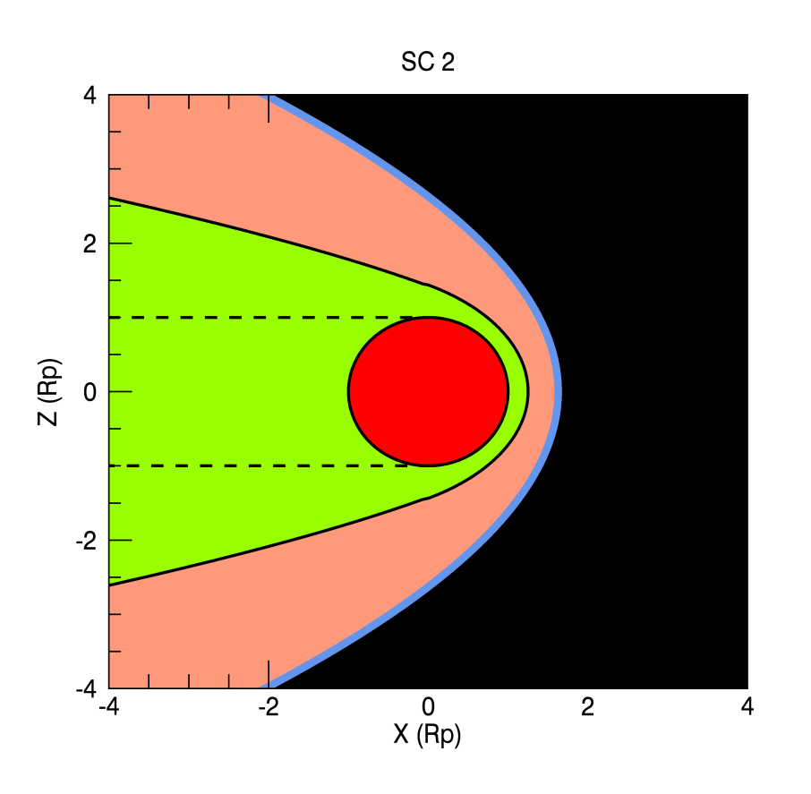
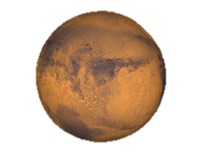
Science Drives Spatial/Temporal separation
Magnetosheath
Bow Shock
Tail
Night
Day
Ionosphere
Magnetic Pileup Boundary
Solar wind

Slide 11
Science Drives Spatial/Temporal separation
Magnetosheath
Bow Shock
Tail
Night
Day
Ionosphere
Magnetic Pileup Boundary
Solar wind

Slide 12
Science Drives Spatial/Temporal separation
Magnetosheath
Bow Shock
Tail
Night
Day
Ionosphere
Magnetic Pileup Boundary
Solar wind

Slide 13
Science Drives Spatial/Temporal separation
Magnetosheath
Bow Shock
Tail
Night
Day
Ionosphere
Magnetic Pileup Boundary
Solar wind

Slide 14
ESCAPADE Science Phase
Science Campaign A
7/1/24 – 1/1/25
Science Campaign B
2/1/25 – 8/1/25
Periapse altitude: | 200 | km
Apoapse altitude: | 7000 | km
Inclination: | 60 | deg
Period: | 4.9 | hours
Periapse altitudes: | 200, | 200 | km
Apoapse altitudes: | 8600, | 5600 | km
Inclinations: | 60, | 60 | deg
Periods: | 4.24, | 5.85 | hrs

Slide 15
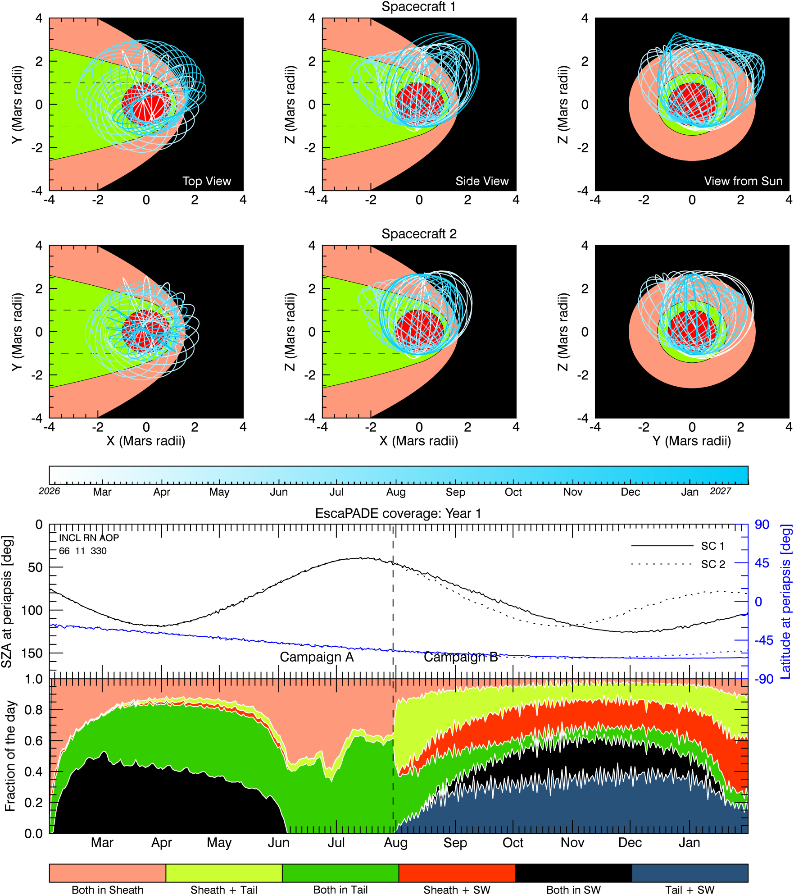
Orbital Evolution

Slide 16
Orbital Evolution

Slide 17
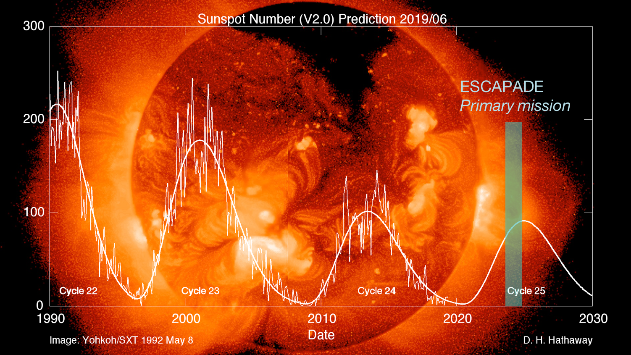
ESCAPADE is Timely

Slide 18
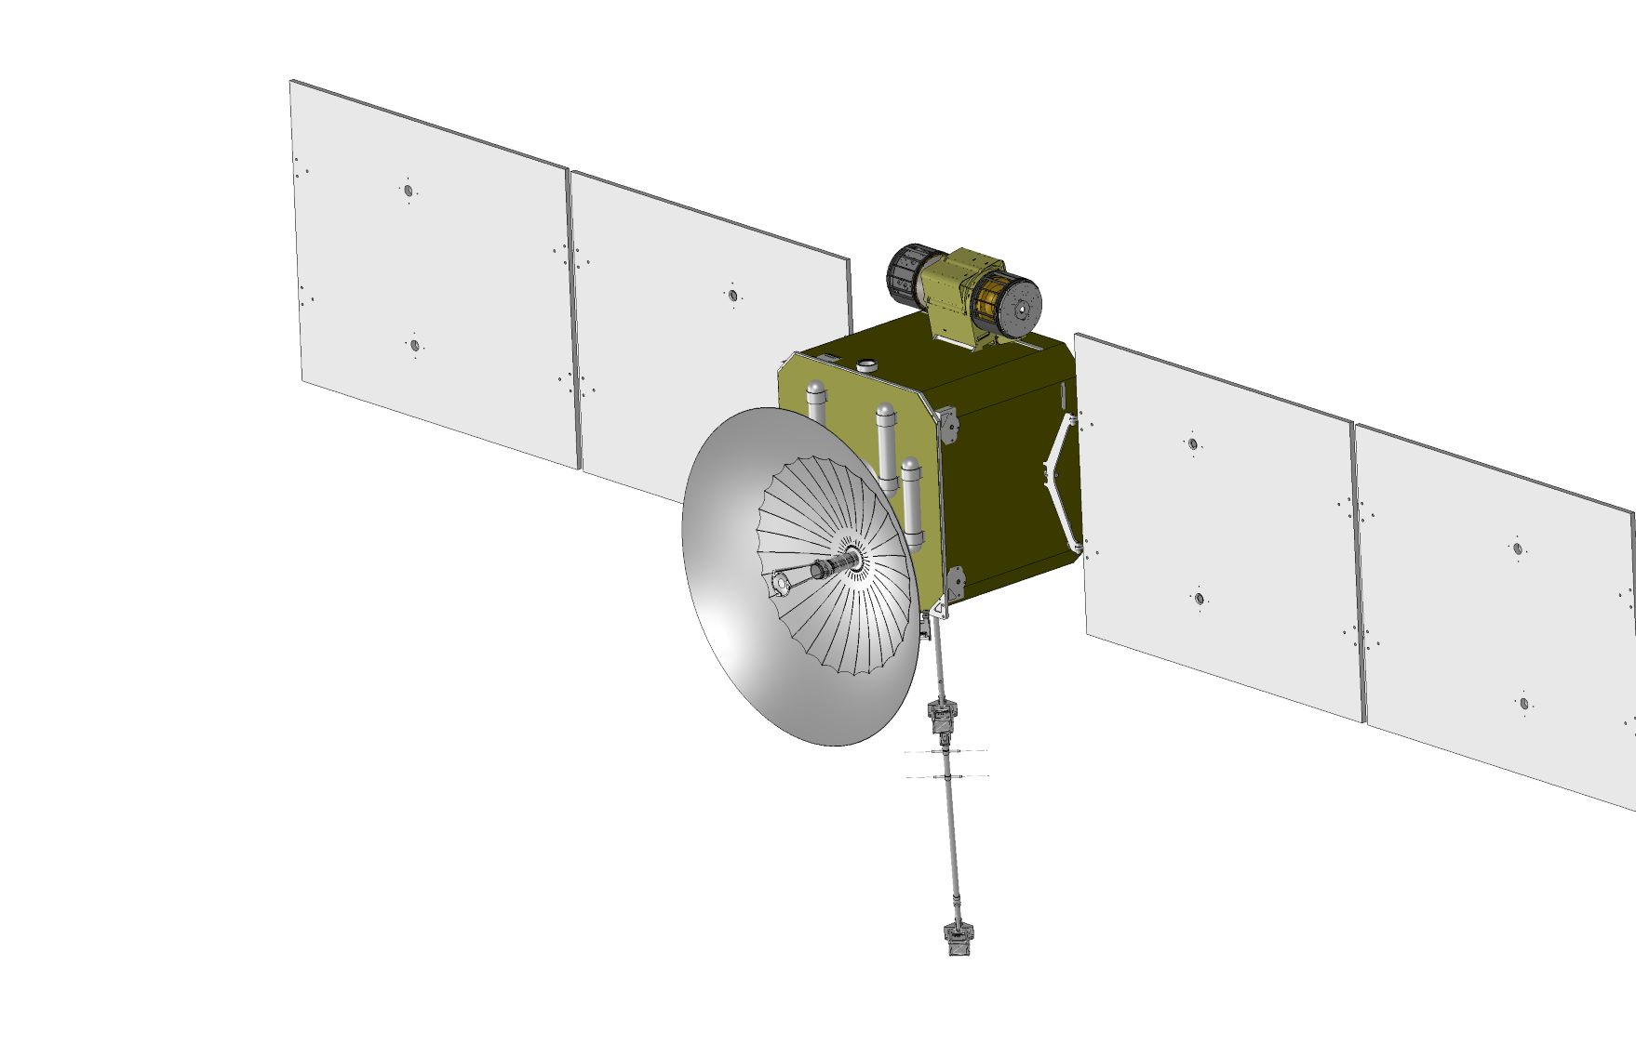
ESCAPADE Spacecraft (x2)
EESA-ions
EESA-electrons
EMAG
ELP

Slide 19
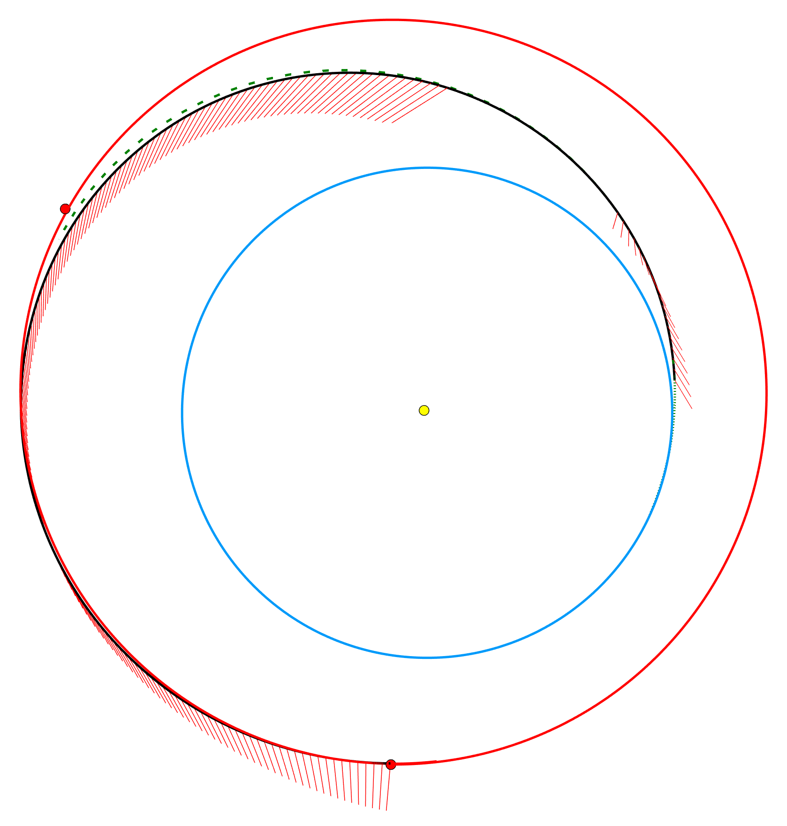
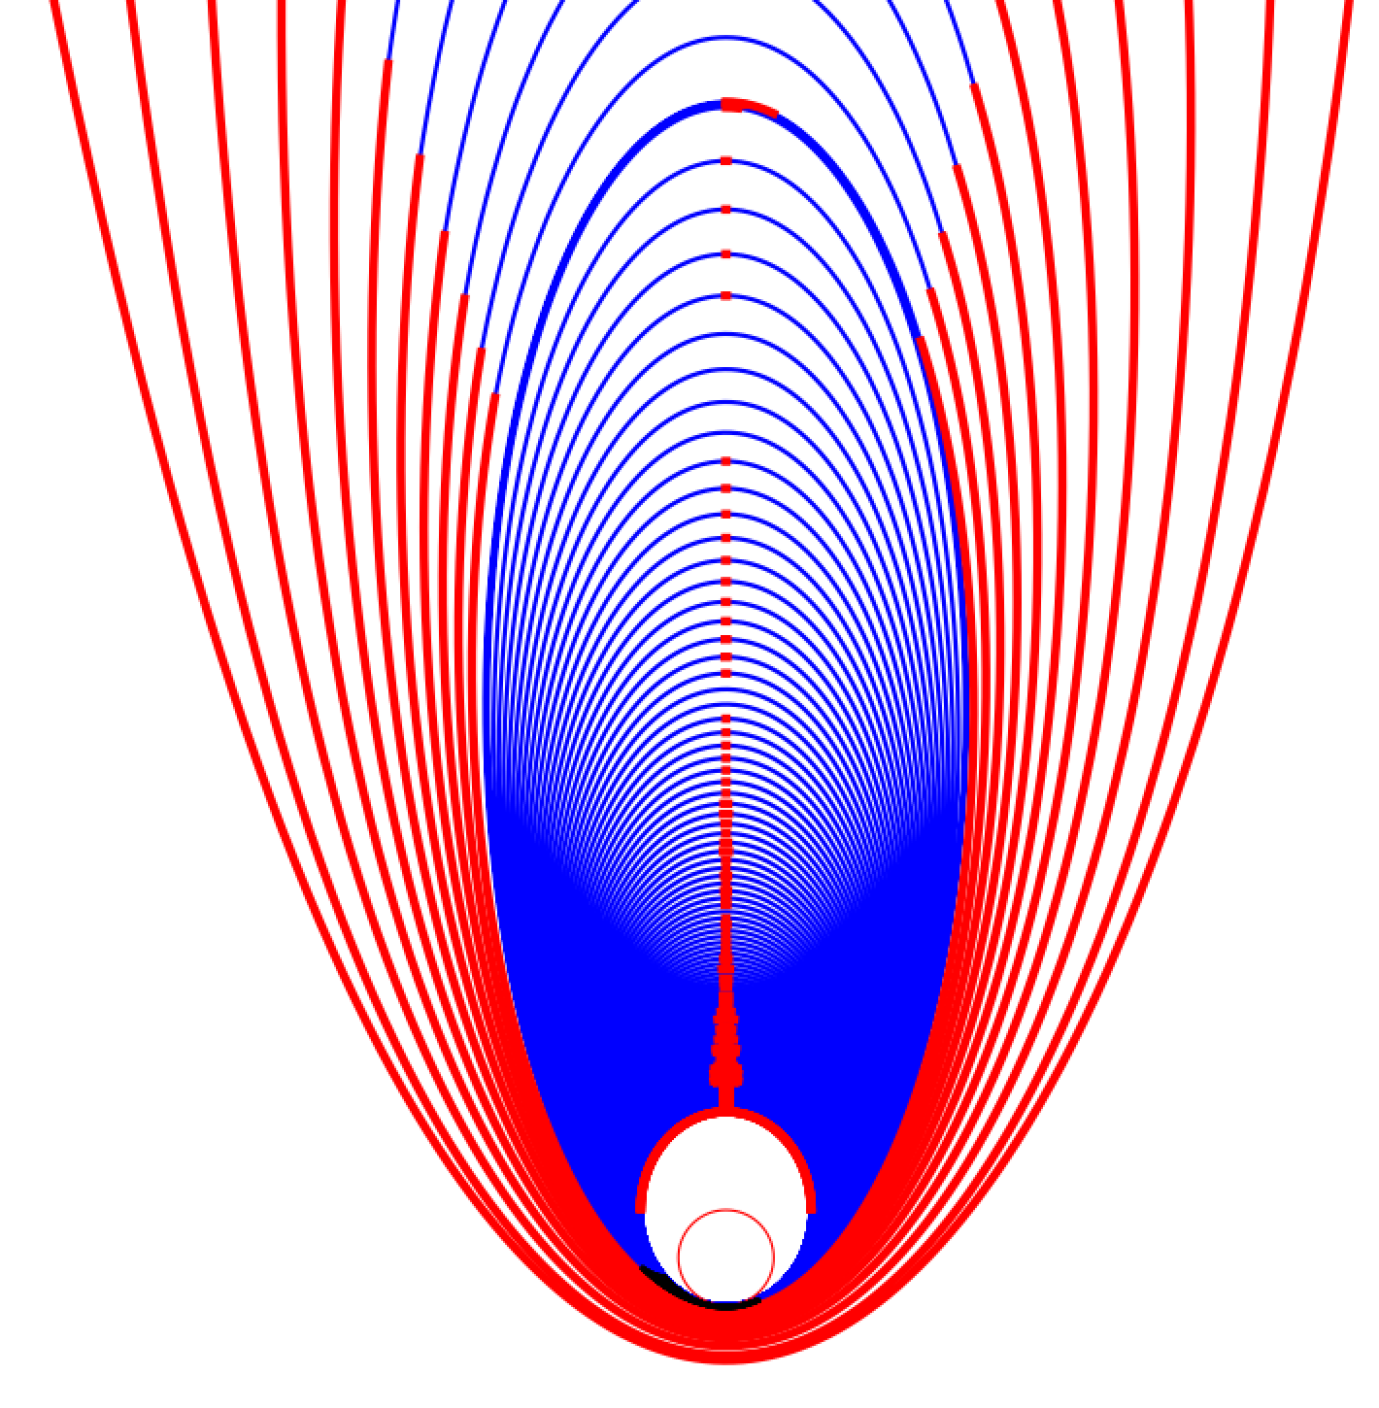
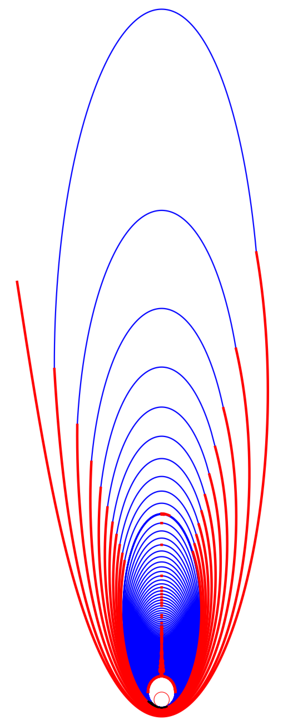
ESCAPADE Mission Design
Extended mission
Psyche’s Trajectory (dashed)
4. Coast
1st captured orbit
Psyche’s Mars Flyby: 5/2023
9. Aerobraking Walk-In 4/1/2024
ESCAPADE thrust vectors
3. Initial Thrust
2nd orbit
5. Cruise
Active SEP
Sun
7. Mars Arrival
2. Spacecraft Checkout
3rd
4th
10. Aerobraking Main Phase
1. Launch:
Psyche launch
Date: 8/(6-26)/2022
C3: 14.53 km²/s²
RLA: 72.96 deg
DLA: 1.783 deg
Maximum available effective thrust
6. Mars Rendezvous
1/29/2024
11. Aerobraking Exit
Modeled effective thrust (mN)
8. Active Orbit Reduction
12. Spiral to Science
Modeled effective thrust: 85% duty cycle
8. Active Orbit Reduction
Thrust arcs in red
10. Science Orbit
7/1/2024
30

Slide 20
ESCAPADE Team
Leadership/PM/SE
PI: R. Lillis
DPI: J. Luhmann
PS: S. Curry
PM: D. Curtis
MSE: E. Taylor
ISE: S. Courtade
Spacecraft – Tyvak LLC
UCB Space Sciences Lab
Lead: B. Williams
Science Team
EMAG - UCLA
ELP – Embry Riddle
D. Brain (LASP)
Y. Harada (U. Kyoto)
R. Modolo (CNRS)
C. Fowler (UCB)
S. Xu (UCB)
EESA
Lead: C. Russell
Deputy: Y. Ma
Lead: A. Barjatya
Lead: D. Larson
EESA-e: P. Whittlesey
EESA-i: R. Livi
Ops
Mission Design – Advanced Space LLC
Lead: M. Lewis
Nav: D. Cosgrove
Lead: J. Parker

Slide 21
ESCAPADE Status/Timeline
Phase B underway. Funded by NASA Heliophysics Division. Not in competition.
Reviews completed:
Requirements peer review.
Mission Design peer review
Instruments peer review
Reviews coming up
Spacecraft peer-review May.
Operations peer-review early June.
Formal Planetary Design Review July 21-22nd.
NASA Confirmation Review & KDP-C August 2020.
Launch mid-August 2022, rideshare with Psyche.

Slide 22
Summary
ESCAPADE’s multi-point measurements are the only way to separate spatial and temporal variability & unravel cause-and-effect in Mars’ solar wind interaction and plasma-related escape.
ESCAPADE’s instrument suite and mission design enable this groundbreaking science.
The team is excited to move towards a detailed design and PDR in summer 2020 and prove that high-value science can be done for low/moderate cost.

Slide 23
Backup slides

Slide 24
SIMPLEX Programmatics
Three Selections from 12 Proposals.
All 3 managed by PMPO at MSFC.
Heliophysics Division (HPD) funding ESCAPADE Phase A/B. Prog. Sci. and Exec. From HPD.
Not a competition as of September 4.
Funded by different divisions (HPD, PSD, LDEP)
Evaluated Separately
Same SRB (mostly) will evaluate all three.

Slide 25
Science Enhancement Options
Radio Occultation (P. Withers)
Baseline is direct to Earth. Similar to MAVEN occurrence (x2).
Examining SC to SC (looking unlikely due to radio hardware limitations)
Lower Altitude Periapsis:
~200 km periapsis (like MAVEN post-09/2020) is adequate to characterize ion flows in the magnetosphere.
~150 km periapsis requires more nav/ops support ($$).

Slide 26
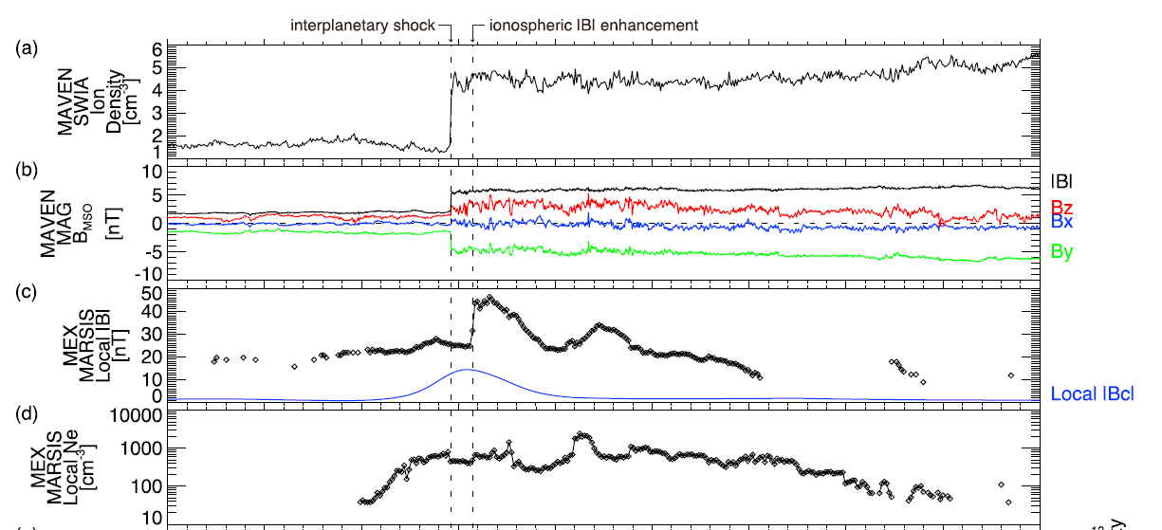
Response to solar wind conditions (1)
Harada et al., 2017
How does the system respond in real-time to disturbances like SIR/CIRs & heliospheric current sheet crossings?
Examples exist but they are fortuitous.

Slide 27
ESCAPADE cooperation with MAVEN
Assuming MAVEN is healthy ~late 2022, ESCAPADE:
Could tweak science orbits during cruise (power constraints notwithstanding) to maximize coordination.
Could extend Science Campaign A (pair-of-pearls on string).
Science team is a) 100% MAVEN folks, b) very small (v. limited $$)
ESCAPADE won’t be able to afford analysis to make full use of data. Need to work across missions to develop tools for multi-point analysis.
If/when ESCAPADE confirmed, makes sense to invite others to science team meetings to develop multi-point data analysis techniques to prepare for data.

Slide 28
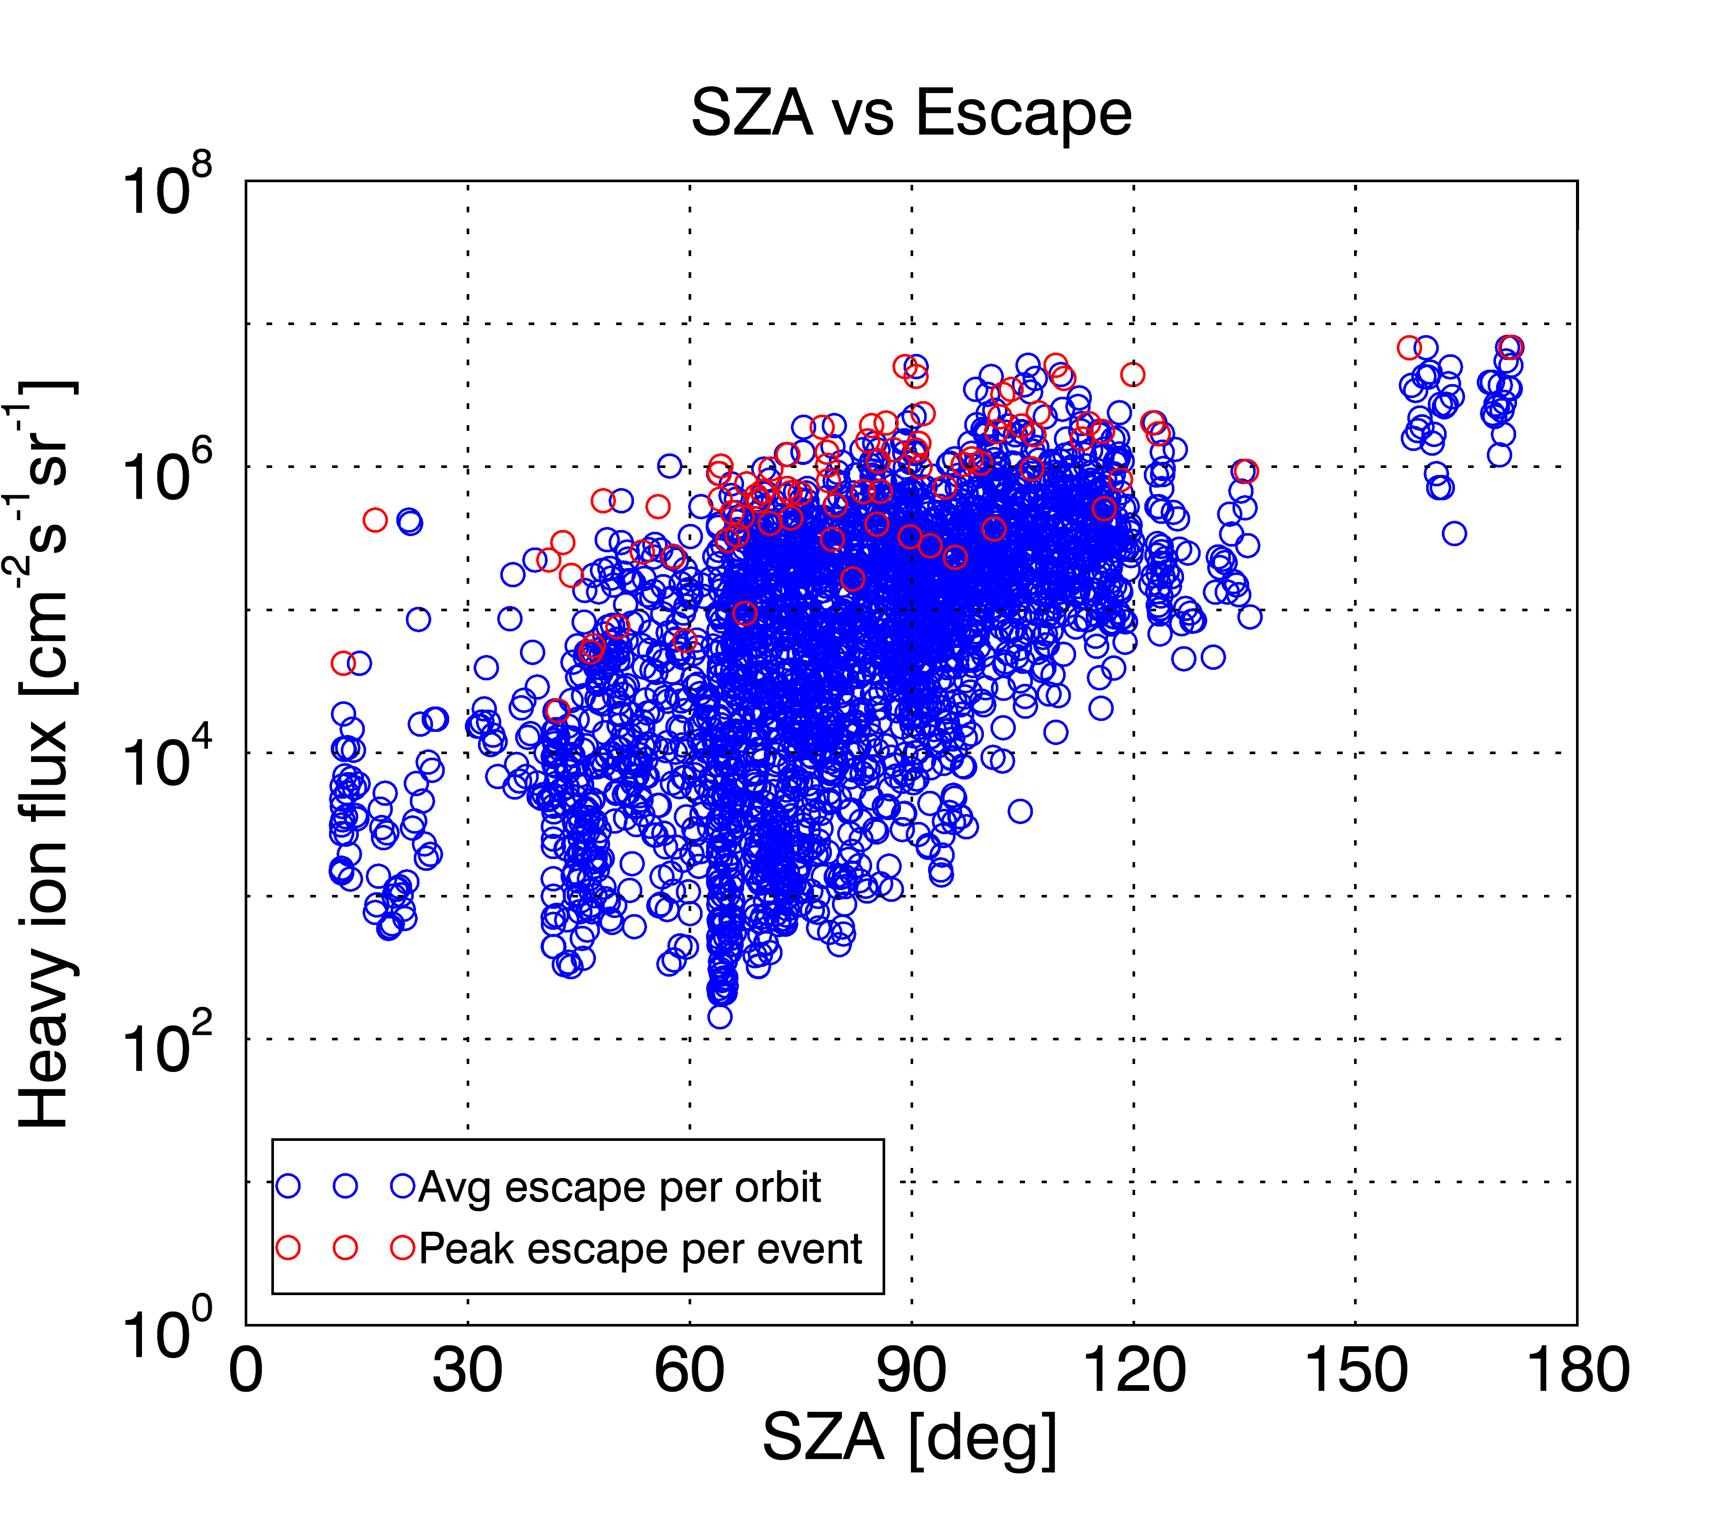
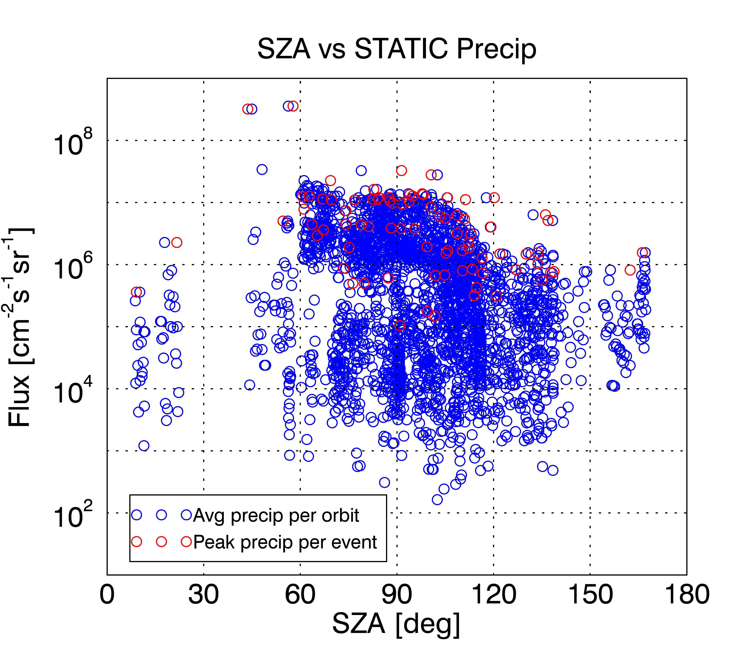
Response to Solar Storms
Curry et al., 2019 (in review)
Notes:
Somewhat related

