Slide 1
Electrical conductivity of omphacite and garnet in eclogite: implications for water recycling in the mantle
Hanyong Liu, Xiaozhi Yang*
Nanjing University
May 2020, EGU

Slide 2
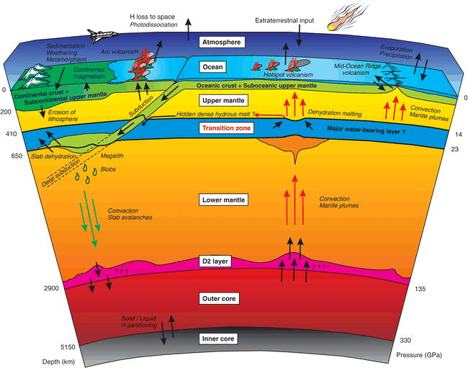
Motivation
Water exchanges actively between Earth interior and surface through subduction and volcanism.
However, the amount of water recycling into the deep Earth through subduction is still in controversy.

Slide 3
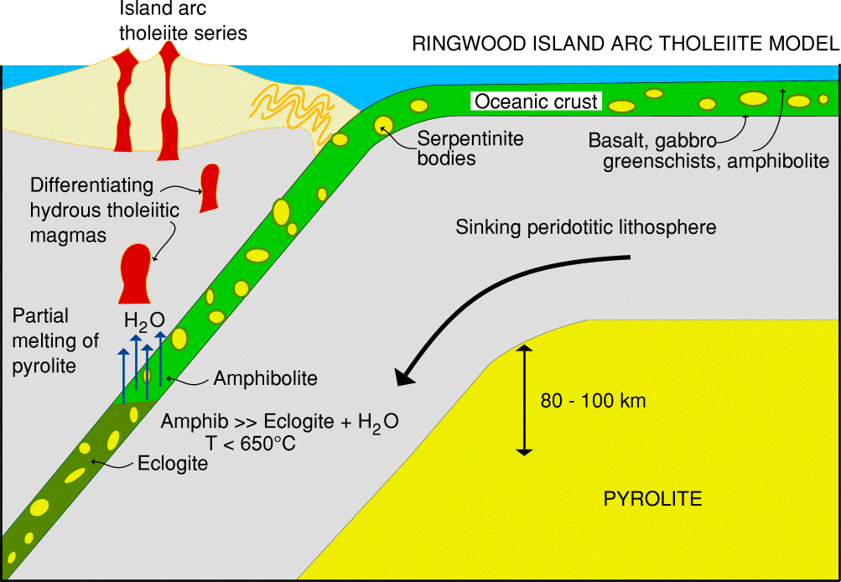
Motivation
Eclogite, consisting mainly of omphacite and garnet, is an important portion of the subducted slab
Water contents in omp and grt are very high (e.g., >1500 ppm H₂O)
Omp and grt are supposed to be important water carrier in the subducting process.
Electrical conductivity is very sensitive to water content in NAMs.
Then what can we learn from the electrical conductivities of omp and grt in eclogite, especially water recycling?

Slide 4
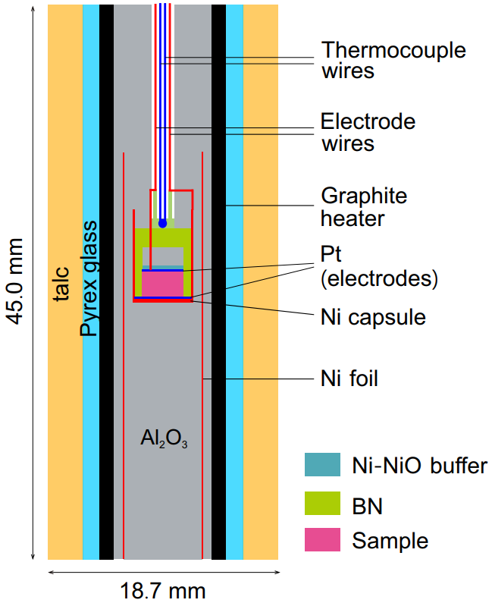
Methods
Experimental strategy
Sample prepqration：
Starting materials: fresh eclogite
Separation of omp and grt grains
1-3.5GPa / 650-700 °C/Ni-NiO (samples with various ppm H₂O)
Experimental conditions：
Impedance spectrascopy (10⁶-1 Hz)
200-800 °C / Ni-NiO
1 GPa
Experimental facilities：
piston–cylinder press
EPMA, chemical composition
FTRI, water content
Cell design

Slide 5
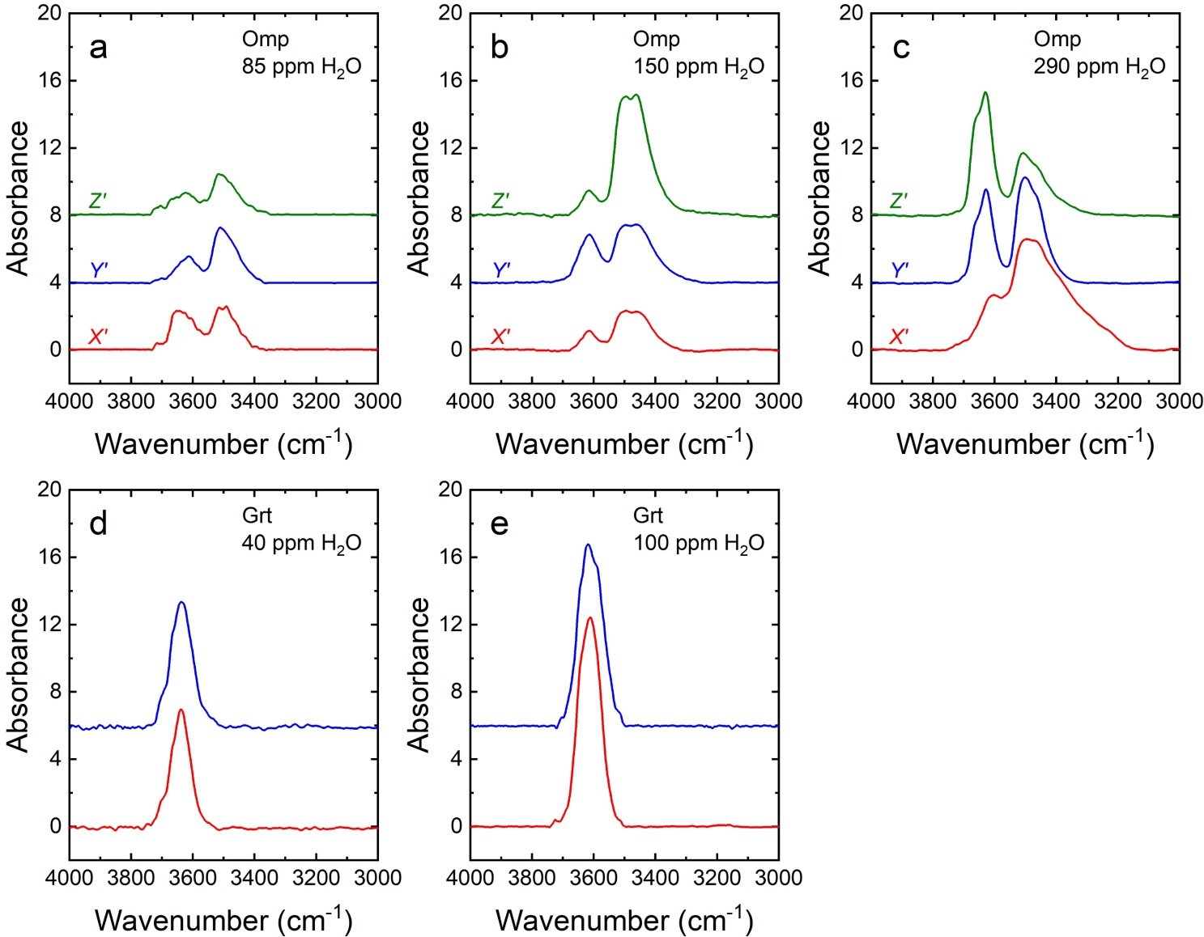
Results
IR spectra and water content

Slide 6
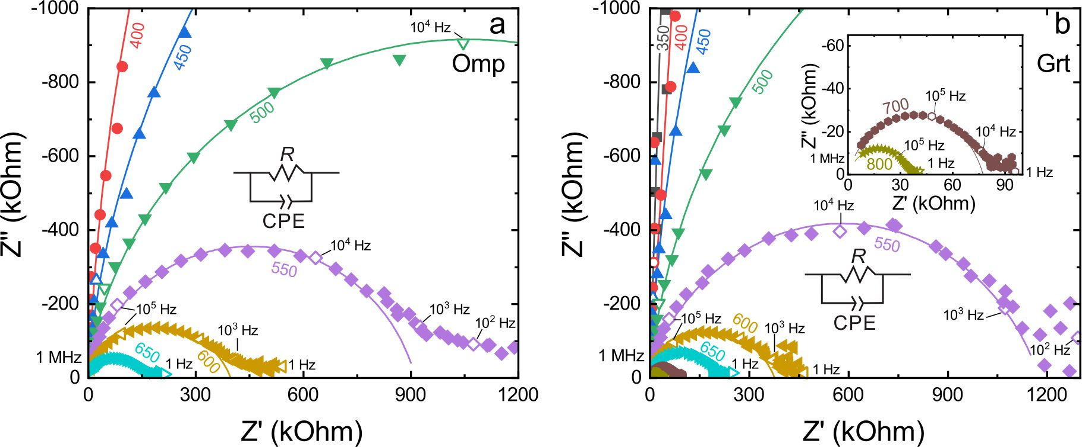
Results
Represent IS
The resistances (R) of sample were obtained by fitting the spectra

Slide 7
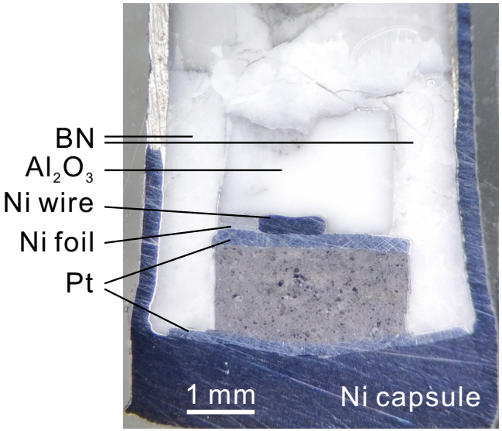
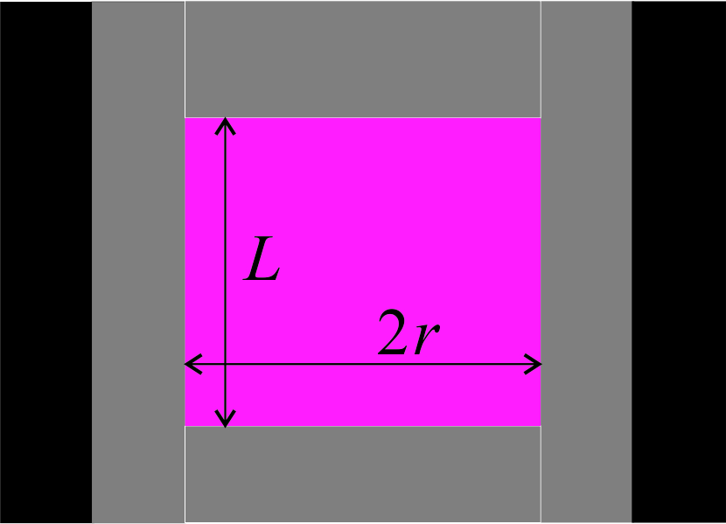
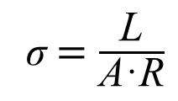
Results
σ$=\frac{\text{L}}{\text{A}\text{·}\text{R}}$
A=πr²
σ: conductivity L: Length
A: cross-sectional area R: Resistance
Recovered sample

Slide 8
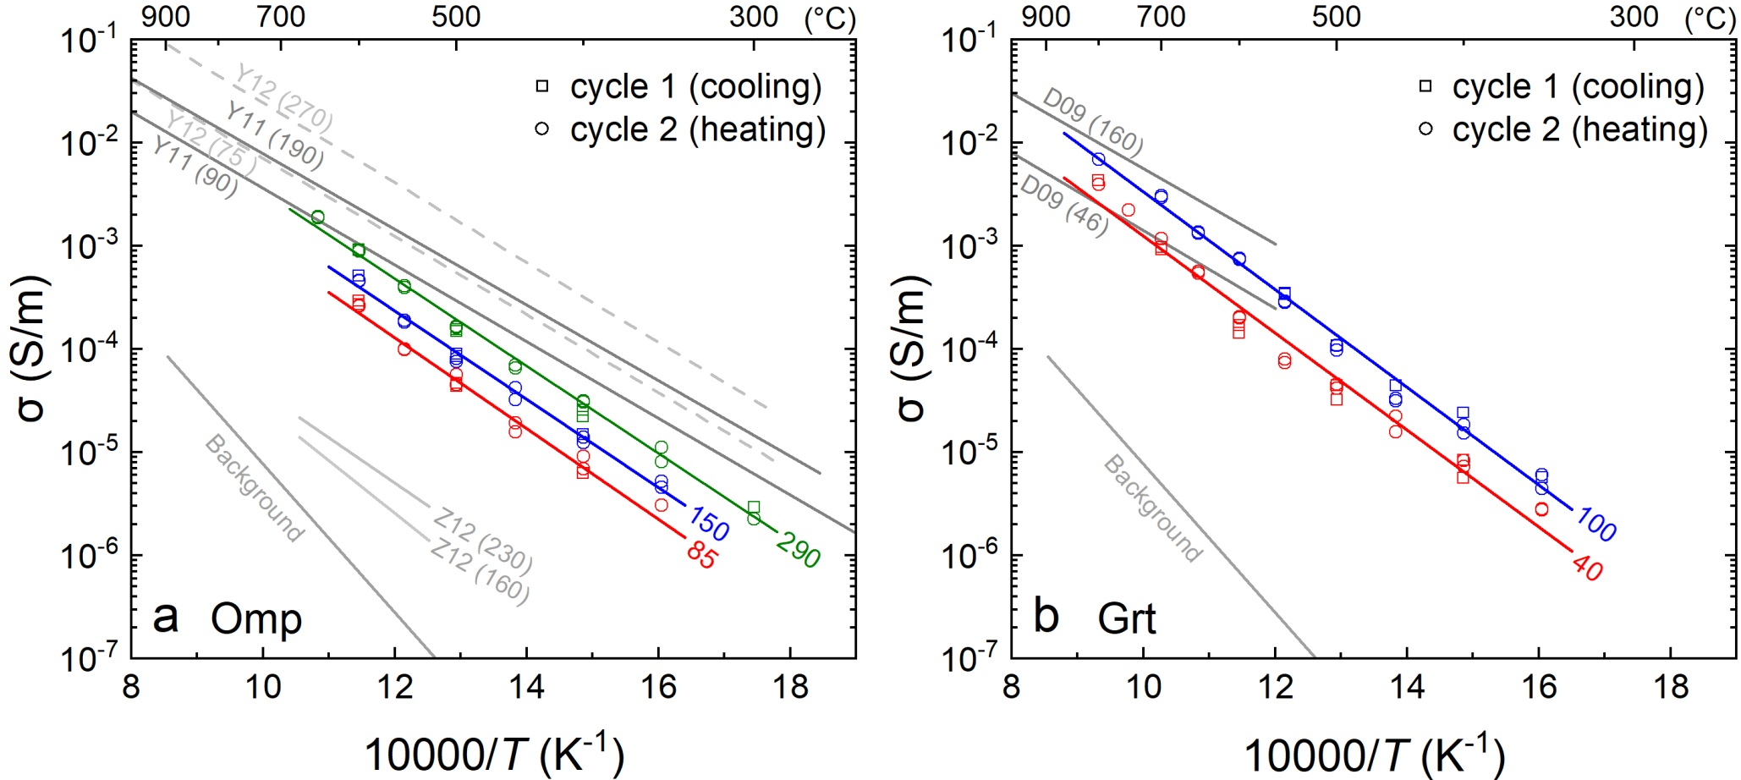
Results
Electrical conductivity
r=~1。 ΔH_{omp}=~82 kJ/mol, ΔH_{grt}=~90 kJ/mol
Proton (H⁺) conduction

Slide 9
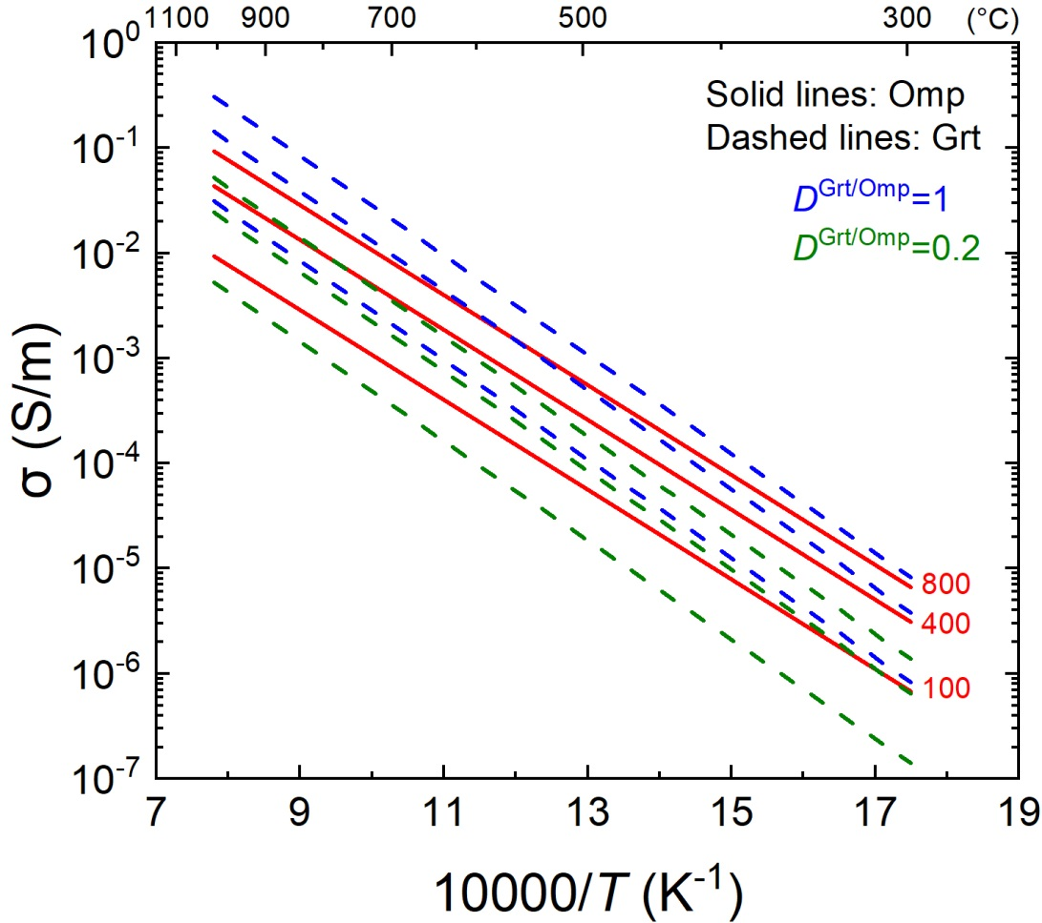
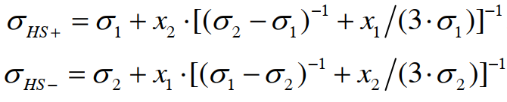
Geophysical implications
Hashin-Shtrikman upper and lower bounds
Bulk conductivity of eclogite

Slide 10
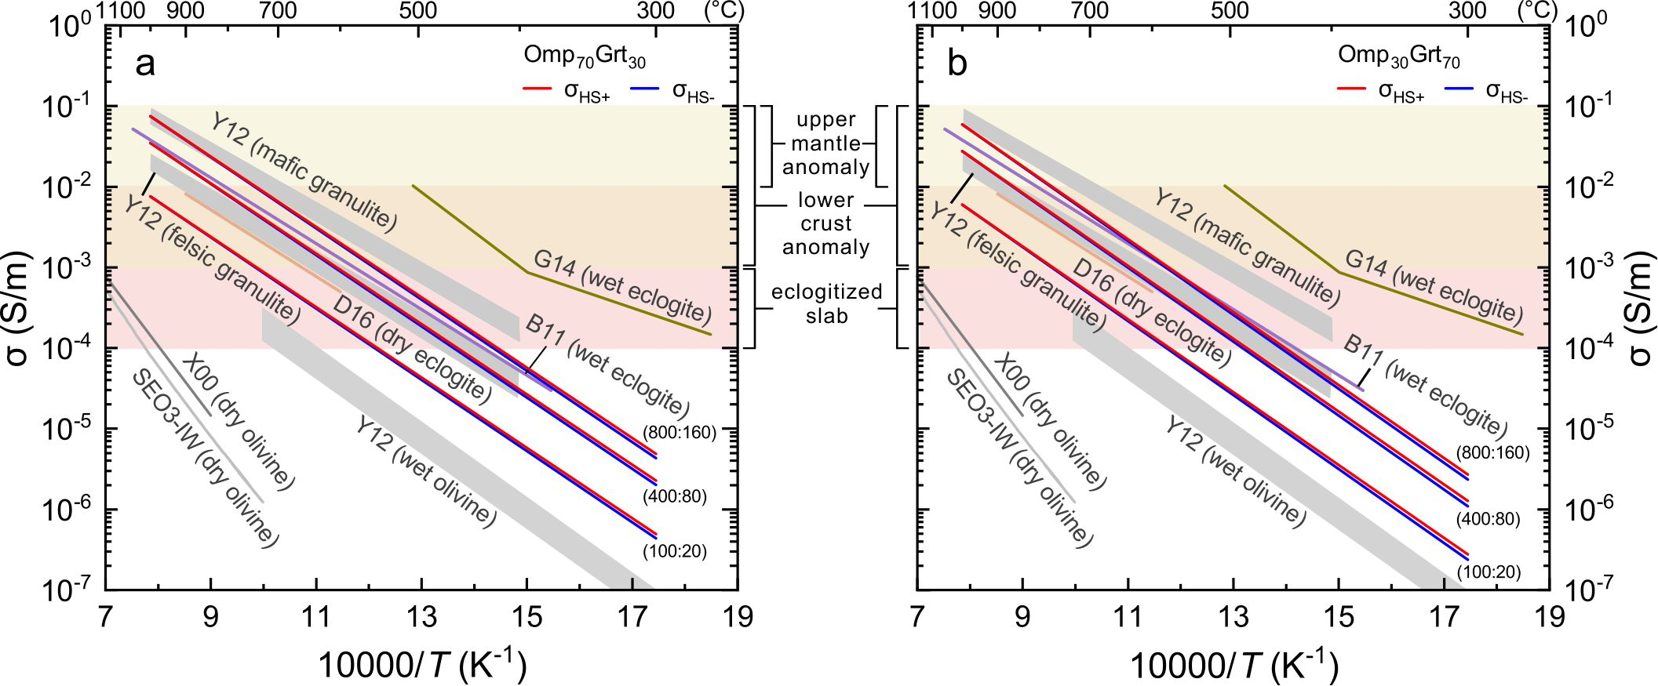
Geophysical implications
Bulk conductivity of eclogite
Eclogite and granulite have similar electrical conductivity at continental lower crust depth
Conductivity of eclogite is higher than peridotite at identical condition

Slide 11
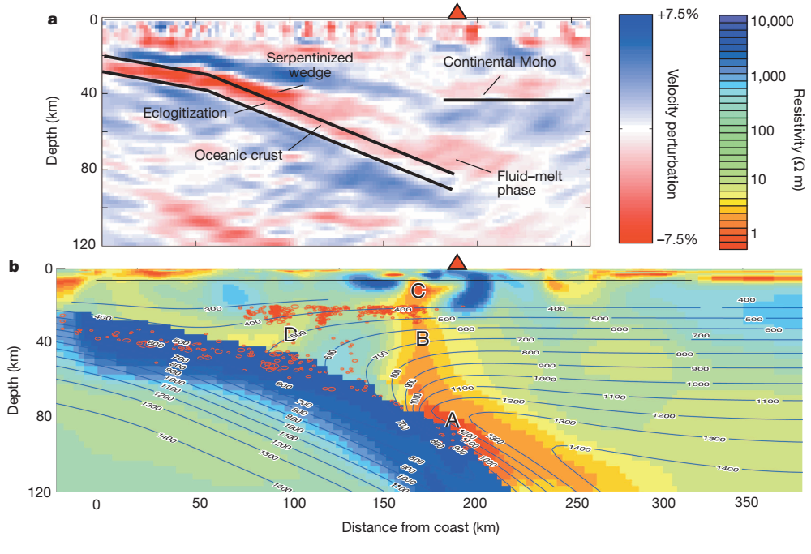
Geological implications
Conductivity of the eclogitized slab: 10⁻⁴-10⁻³ S/m
low conductivity of the eclogitized slab in the mantle depth implies low water content of omp and grt in the eclogite (e.g., <400 ppm in omp and <80 ppm in grt)
The water recycling capacity of omp and grt in eclogite is limited
McGary et al., 2014 nature
Implication for the water recycling

Slide 12
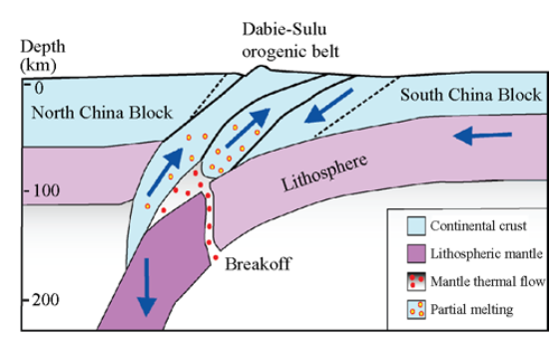
Geological implications
The high H₂O contents of omphacite and garnet in terrane eclogites may have been produced by later H enrichments during their exhumation to the surface, e.g., by exchange with surrounding fluids.
Zheng, 2008
The source of water in terrane eclogite

Slide 13
Conclusions
The electrical conductivity of eclogite is similar with granulite but higher than peridotite at identical conditions.
In the subduction zone, the conductivity of the eclogitezed crust is obviously lower than the surrounding mantle.
The recycling of water into the deep mantle by omphacite and garnet in subducted eclogites is not that efficient as considered previously

Slide 14
Thanks for your attention

