Slide 1
pinning
Dislocation nucleation at nanoscale fluid inclusions:
Direct observation from atom probe tomography data
of naturally deformed pyrite
Renelle Dubosq (Ottawa)
Anna Rogowitz (Vienna)
Kevin Schweinar (Düsseldorf)
Baptiste Gault (Düsseldorf)
David A. Schneider (Ottawa)

Slide 2
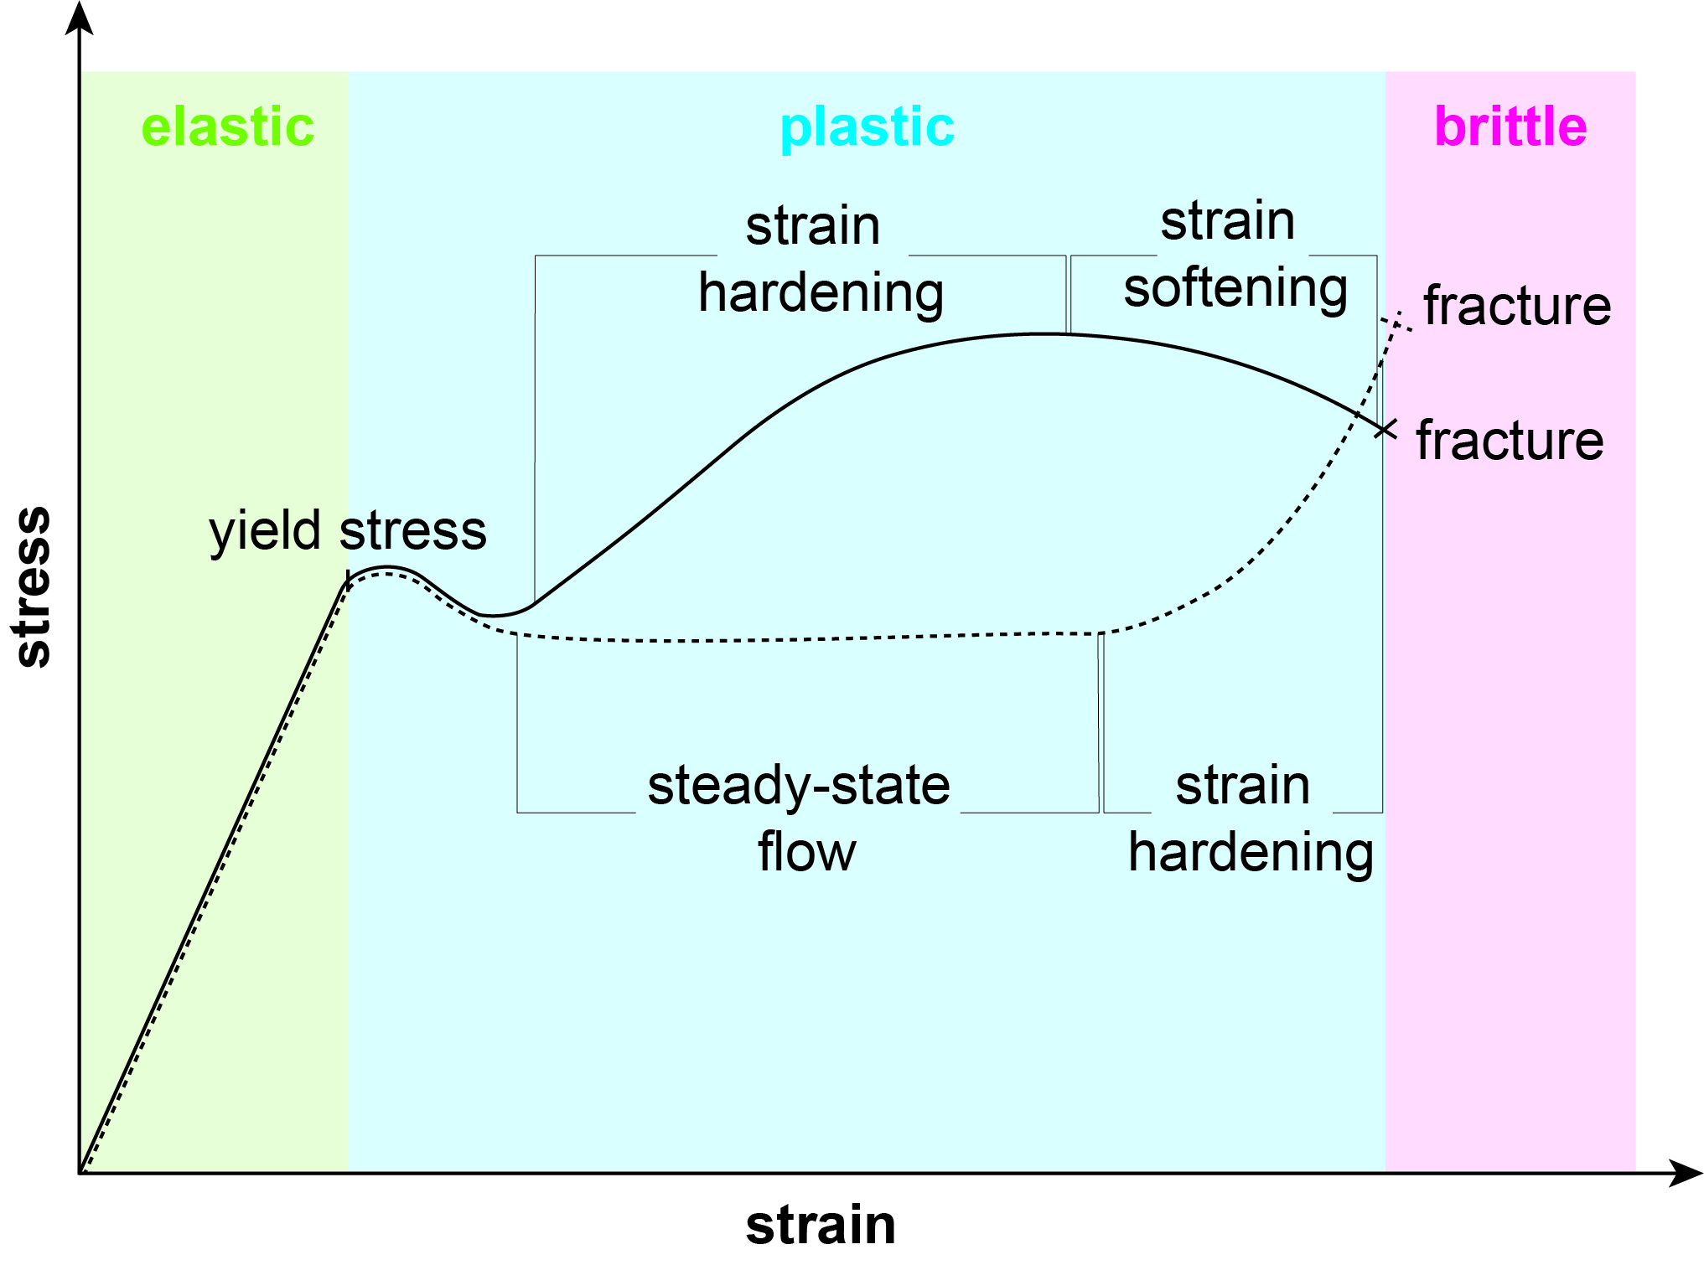

Mineral rheology
A mineral’s response to stress is dependent on dislocation activity
steady-state
continued generation and migration of dislocations
strain hardening
obstruction of dislocation movement by dislocation entanglement or pinning
strain softening
localization of deformation in shear zones of brittle slip planes
*segregation of trace element in dislocations can obstruct its movement

Slide 3
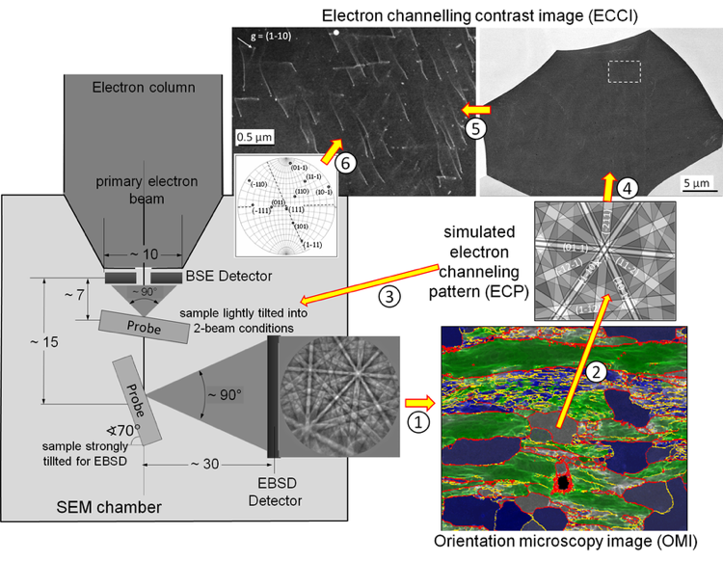
Approach
We have combined 2D and 3D micro- and nano-analytical techniques on naturally deformed pyrite to investigate the interaction between crystal-defects and trace elements during deformation and its impact on mineral rheology.
2D microstructural analysis
2D & 3D nanostructural and chemical analysis
-Electron backscatter diffraction (EBSD)
-Electron channeling contrast imaging (ECCI)
-Atom probe tomography (APT)
-Scanning transmission electron microscopy (STEM)
(https://www.mpie.de/3079126/ECCI)
(https://ccem.mcmaster.ca/atom-probe-tomography/)

Slide 4
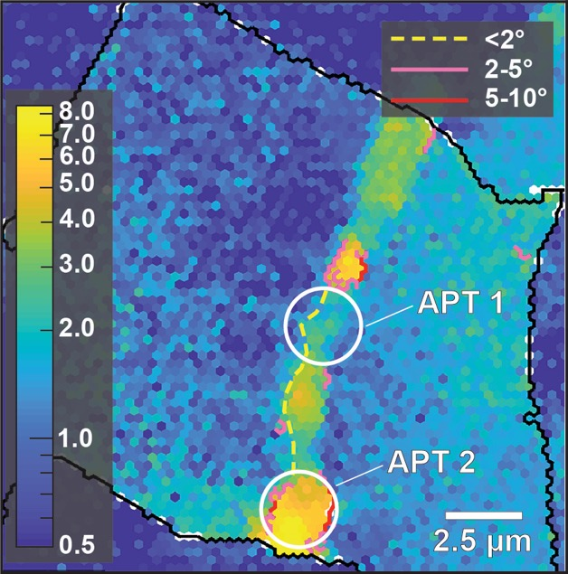
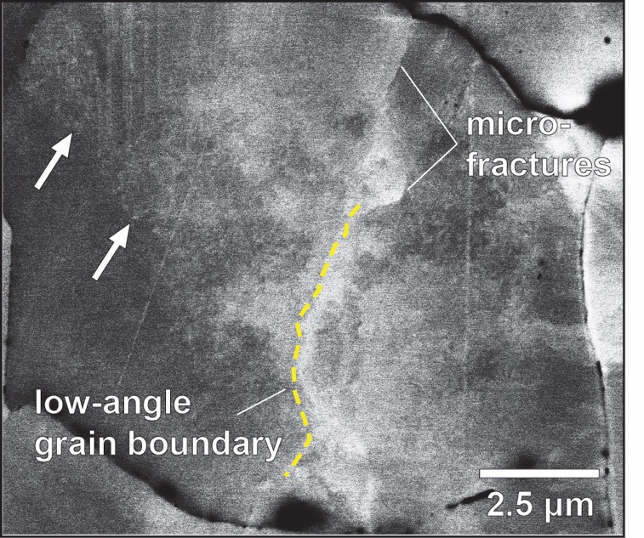
2D microstructures
EBSD misorientation and grain boundary map
ECC image
dislocation
low angle
grain boundary
low-angle grain boundary
• heterogeneous misorientation pattern
• maximum misorientation ~8°
• ‘apparent’ low-angle grain boundary development at higher strain domains
• high-dislocation density
• low-angle grain boundary development
at tip of microfractures

Slide 5
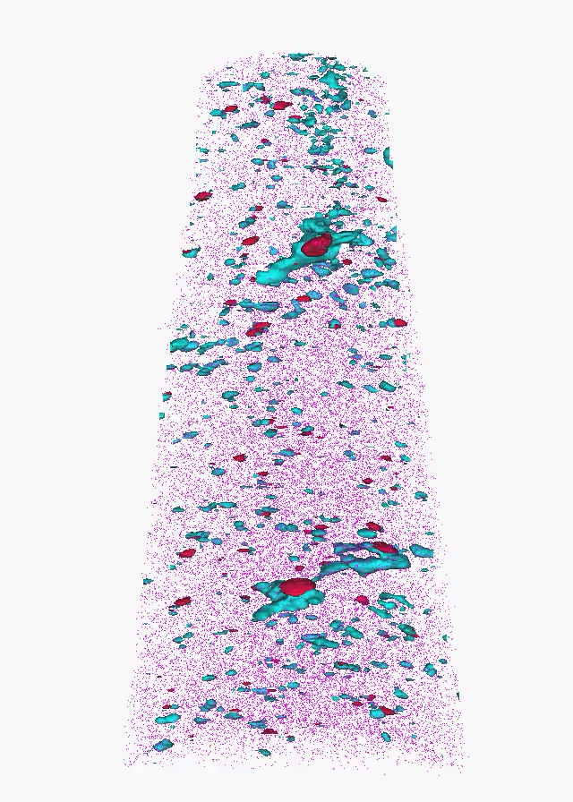
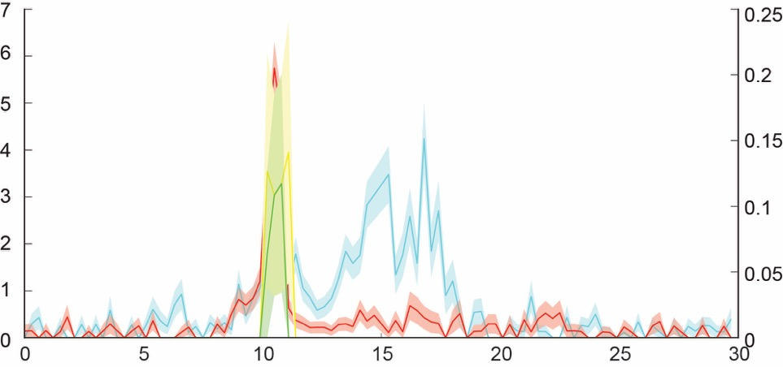
3D nanostructures: specimen 1
2D contour plot of structure 1
APT reconstruction
dislocation
As
O
Fe
X
X’
fluid inclusion
250 nm
X
X’
As
O
Na
K
structure 1
Composition [As; O; at%]
Composition [Na; K; at%]
Distance (nm)

Slide 6
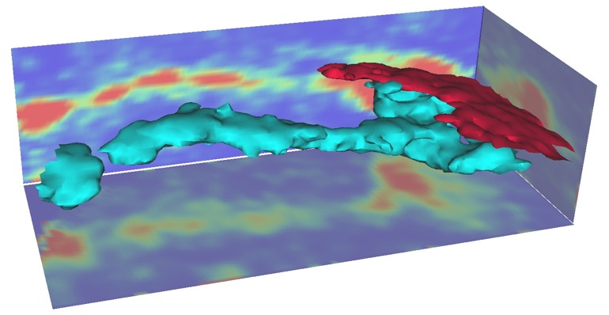
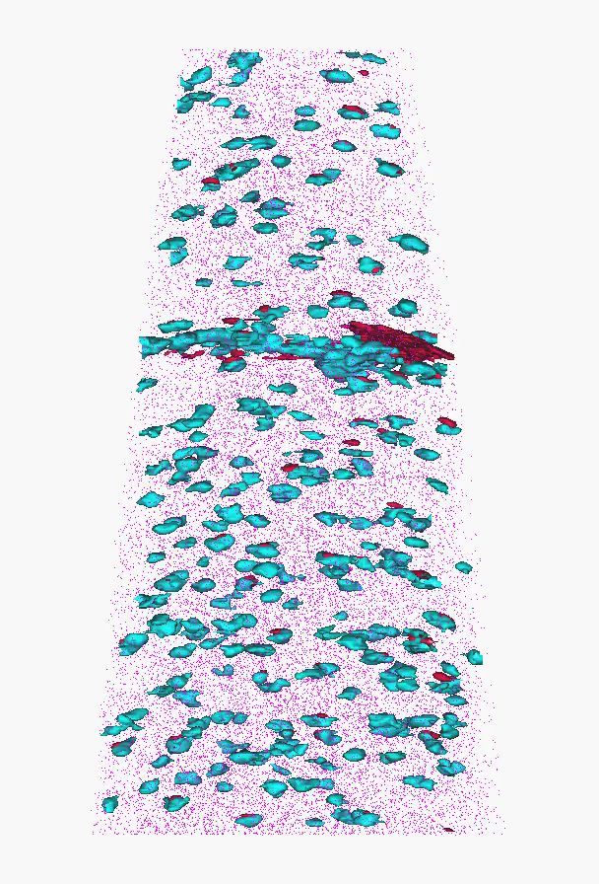
3D nanostructures: specimen 2
2D contour plot of structure 1
APT reconstruction
dislocation
1.0
0.0
As
O
Fe
at% [As]
structure 1
fluid inclusion
240 nm
Fluid inclusions are defined by apparent As-rich clusters topped by O-rich discs (confirmed with numerical modeling in Dubosq et al. 2020, Ultramicroscopy)
Dislocations are defined by As-rich linear structures
Dislocations are linked to 1 or 2 fluid inclusion(s)
50 nm

Slide 7
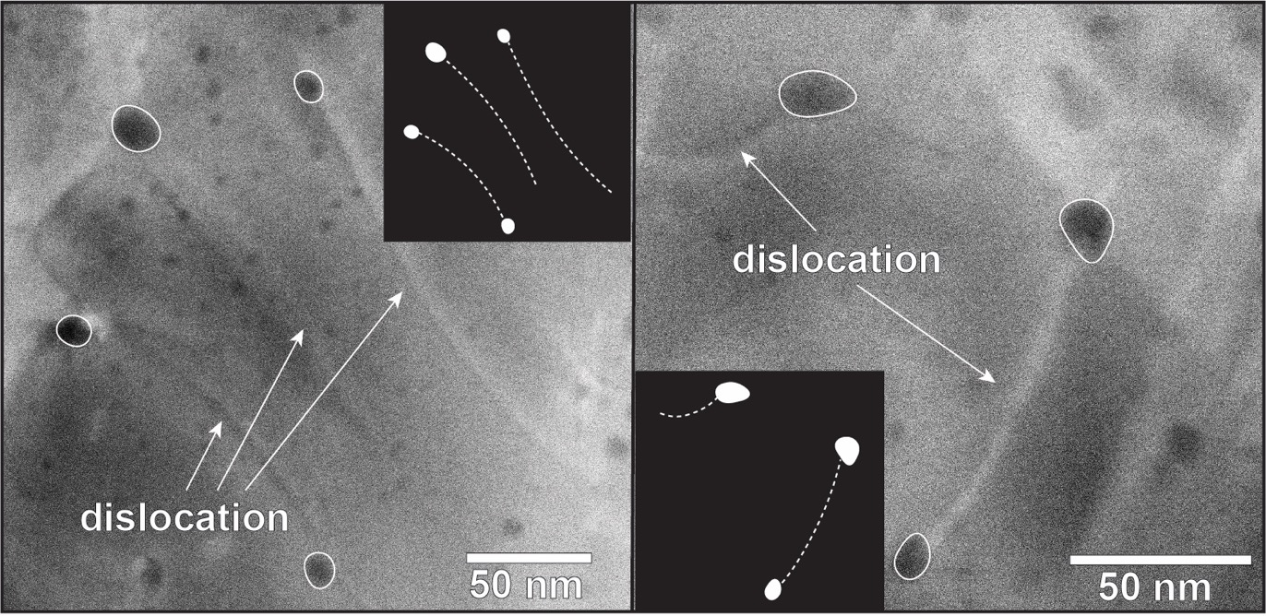
2D nanostructures
STEM images
Fluid inclusions are defined by dark spherical features
Dislocations are defined by discrete curved (”bowed”) line segments
Dislocations are linked to 1 or 2 fluid inclusion(s)
fluid inclusion

Slide 8
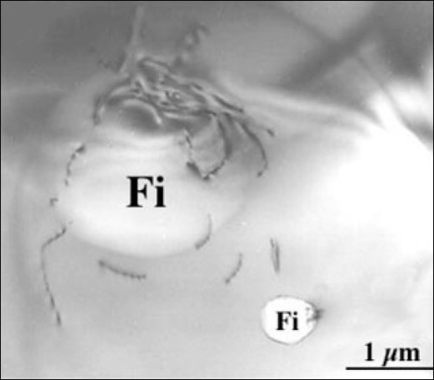
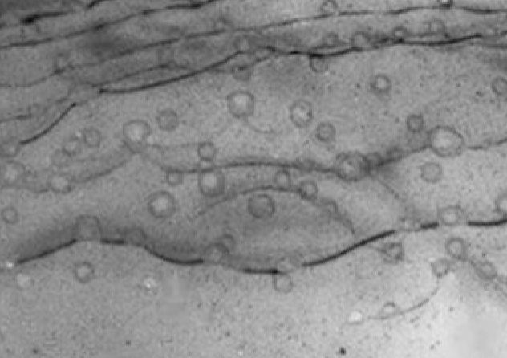
Dislocation dilemma
Are dislocations nucleating in the local stress field of fluid inclusions (Fi) or are they being pinned by them?
dislocation nucleation
dislocation pinning
Dislocations nucleated at fluid inclusions and migrating away by dislocation glide
Dislocations pinned at fluid inclusions and middle segments migrating away by dislocation glide forming bowed configuration
Fi
dislocation
dislocation
(modified from Vitik et al. 2000)
(modified from Vitik et al. 2000)
Based on previous observations, we propose that the dislocations in our sample are being pinned by fluid inclusions rather than being nucleated at their local stress field since we only observe single dislocations linked to fluid inclusion with a bowed configuration and none that have migrated away from the inclusions.

Slide 9
Summary
The investigated sample was deformed in the brittle to brittle-plastic regime
Our data reveal ubiquitous fluid inclusions defined by As-, O-, Na-, and K-rich element clusters
Dislocations are enriched in As and are linked to fluid inclusions
Dislocations were pinned at the stress field of fluid inclusions, which initiated the pipe diffusion of As from the fluid inclusions into the dislocation cores
Dislocations pinned at fluid inclusions could be potential source for Frank-Read dislocation generation sites

Slide 10
Implications for mineral rheology
The way a mineral responds to an applied stress depends on two competing processes:
1) continued generation and migration of dislocations
2) pinning and entanglement of dislocations
vs
plastic regime
brittle regime
In our sample, dislocation pinning at fluid inclusions, which was further enhanced by trace element segregation in dislocation cores through pipe diffusion, resulted in a brittle dominated deformation regime confirmed by EBSD and ECCI data.
Nanostructural analysis can help predict a material’s physical properties and rheology

