Slide 1




Medved I.V., Koulakov I.Yu. and Buslov M.M.
Novosibirsk, Russia
Zabelirina@yandex.ru
DIFFERENT CAUSES OF THE DELAMINATION ON THE EXAMPLE OF CAUCASUS AND KYRGYZ TIEN SHAN COLLISION ZONES
The reported study was funded by RFBR, project number 19-35-60002
EGU2020

Slide 2
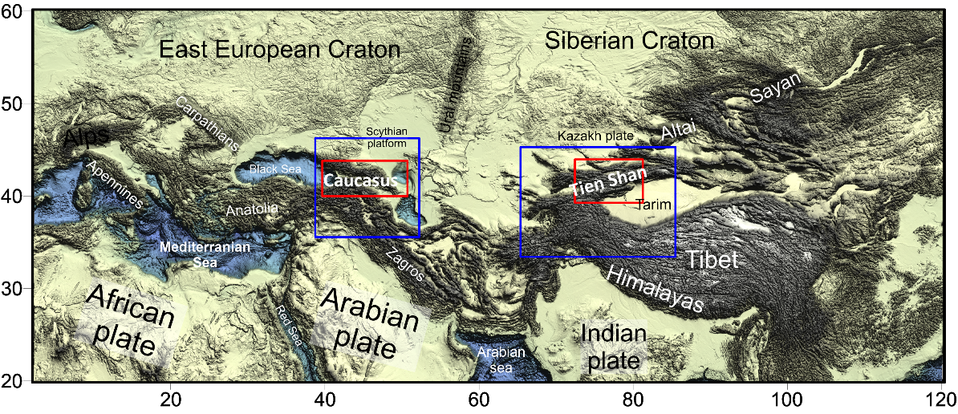
Study regions
Red rectangle – region is stydied using local tomography method; blue rectangle – region is studied using region tomography method
Main goal is to obtain velocity models of deep structure of continental collision using two different observation schemes (local and regional) and to study mechanisms under collision zones.

Slide 3
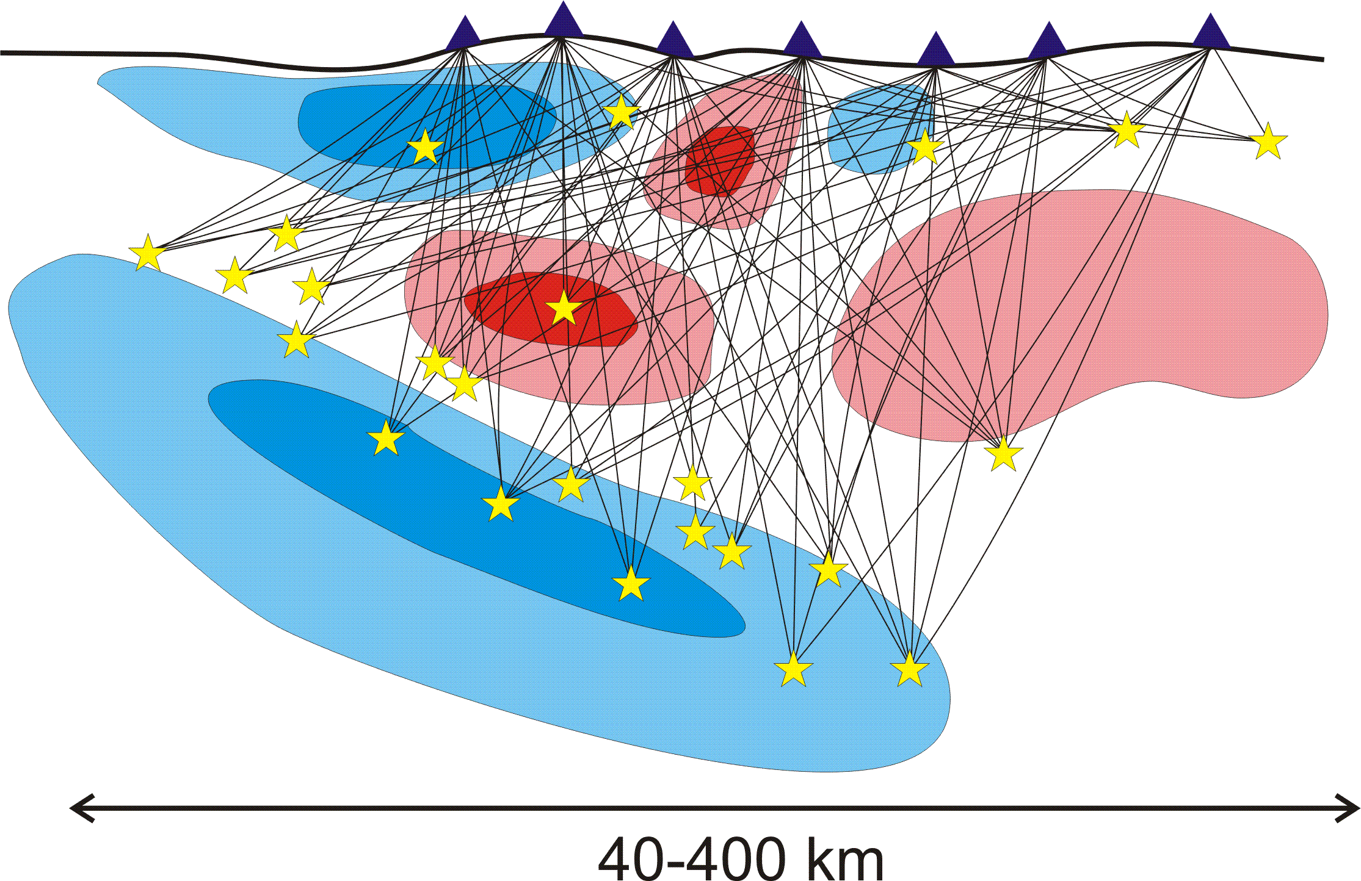
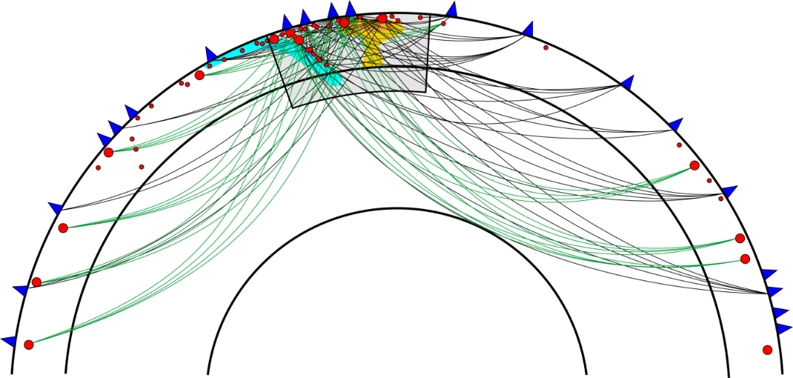
Methods
LOTOS (Local Tomography Software)
(Koulakov, 2009)
Regional tomography
  (Koulakov, Sobolev, 2006)
The local scheme involves data on seismic rays for which both the sources and the receivers are located within the study
area.
Obtained models: 3D local models to a depth of ~ 80 km
The regional scheme, used to study the upper-mantle structure, was based on global data (ISC). It utilized all the data on waves which at least partly travel within the studied volume according to two schemes: (1) those from regional earthquakes recorded by world stations and (2) teleseisms recorded by local stations.
Obtained models:
3D models of global depth scales from 50 to 800-900 km

Slide 4
Results of the local tomography (Kyrgyz Tien Shan)
Interpretation
The western low-velocity anomaly corresponds to the Fergana basin.
The linear low-velocity anomaly coincides with a suture zone between the Kazakhstan Plate and Tien Shan.
The high-velocity anomalies in the central Tien Shan have a linear shape and are oriented in the E–W direction. Apparently, the latitudinal alternation of crustal structures is due to the tectonic compression of the crust in the Tien Shan from the south.
Section 3 runs along another low-velocity anomaly in the north, which appears to dip from north to south to a depth of ~40 km. This fact reflects the general direction of plate interaction during the collision and indicates the southward underthrusting of the Kazakhstan Plate underneath the northern Tien Shan.

Slide 5
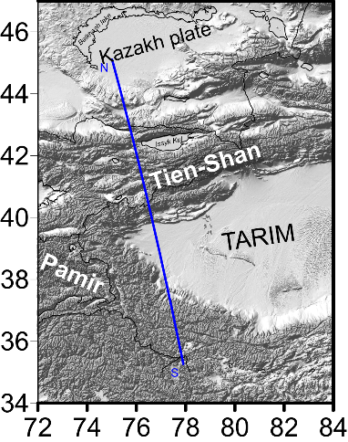
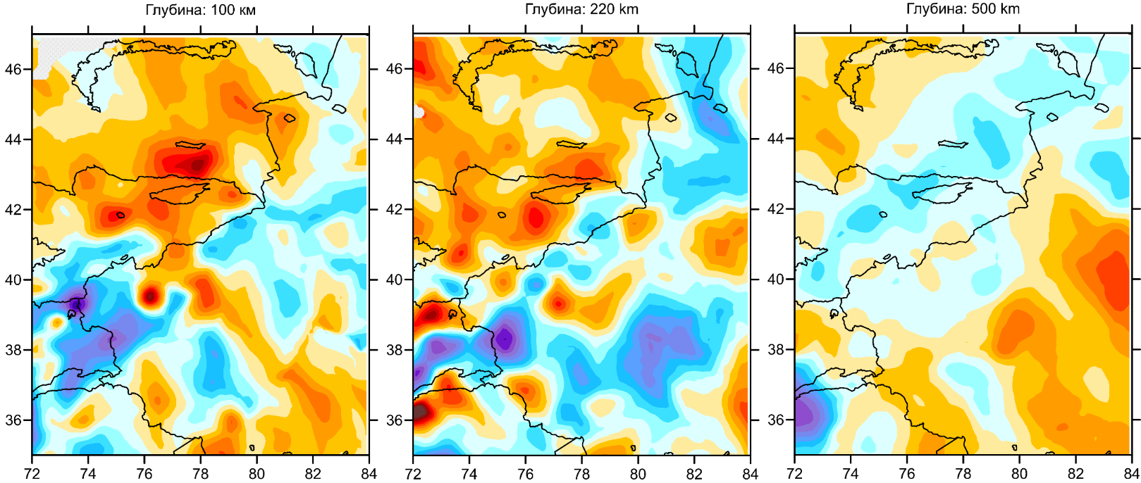
Results of the regional tomography (Kyrgyz Tien Shan)
Depth: 100 км
Depth: 220 км
Depth: 500 км
Interpretation
The high-velocity anomaly dipping from the north beneath the Tien Shan to a depth of ~150 km represents the Kazakhstan Plate;
The inhomogeneous seismic structure with predominant low velocities in the mantle beneath the Kyrgyz Tien Shan suggests the small thickness or lack of mantle lithosphere;
The flat high-velocity anomaly, which dips southward across the Tien Shan–Tarim boundary to a depth of ~500 km, represents a detached part of the Tarim mantle lithosphere. The lack of the mantle part in the Tien Shan lowers the lithospheric rigidity and leads to active deformation and rapid orogeny in this collision area;
In the deep seismic structure, a part of the Indian Plate is observed beneath Tarim as an inclined high-velocity anomaly ~150 km thick, which extends to depths of 300 km.
One of the mechanisms for explaining the observed heterogeneities in the mantle under the Tien Shan is delamination.
Scheme of orogeny in the Tien Shan. 1, Indian Plate; microcontinents: 1, Tarim; 2, Kazakhstan.
Zabelina, I. V., I. Yu. Koulakov, and M. M. Buslov (2013). Deep mechanisms in the Kyrgyz Tien Shan orogen (from results of seismic tomography), Russ. Geol. Geophys. 54, 695–706. https://doi.org/10.1016/j.rgg.2013.06.005

Slide 6
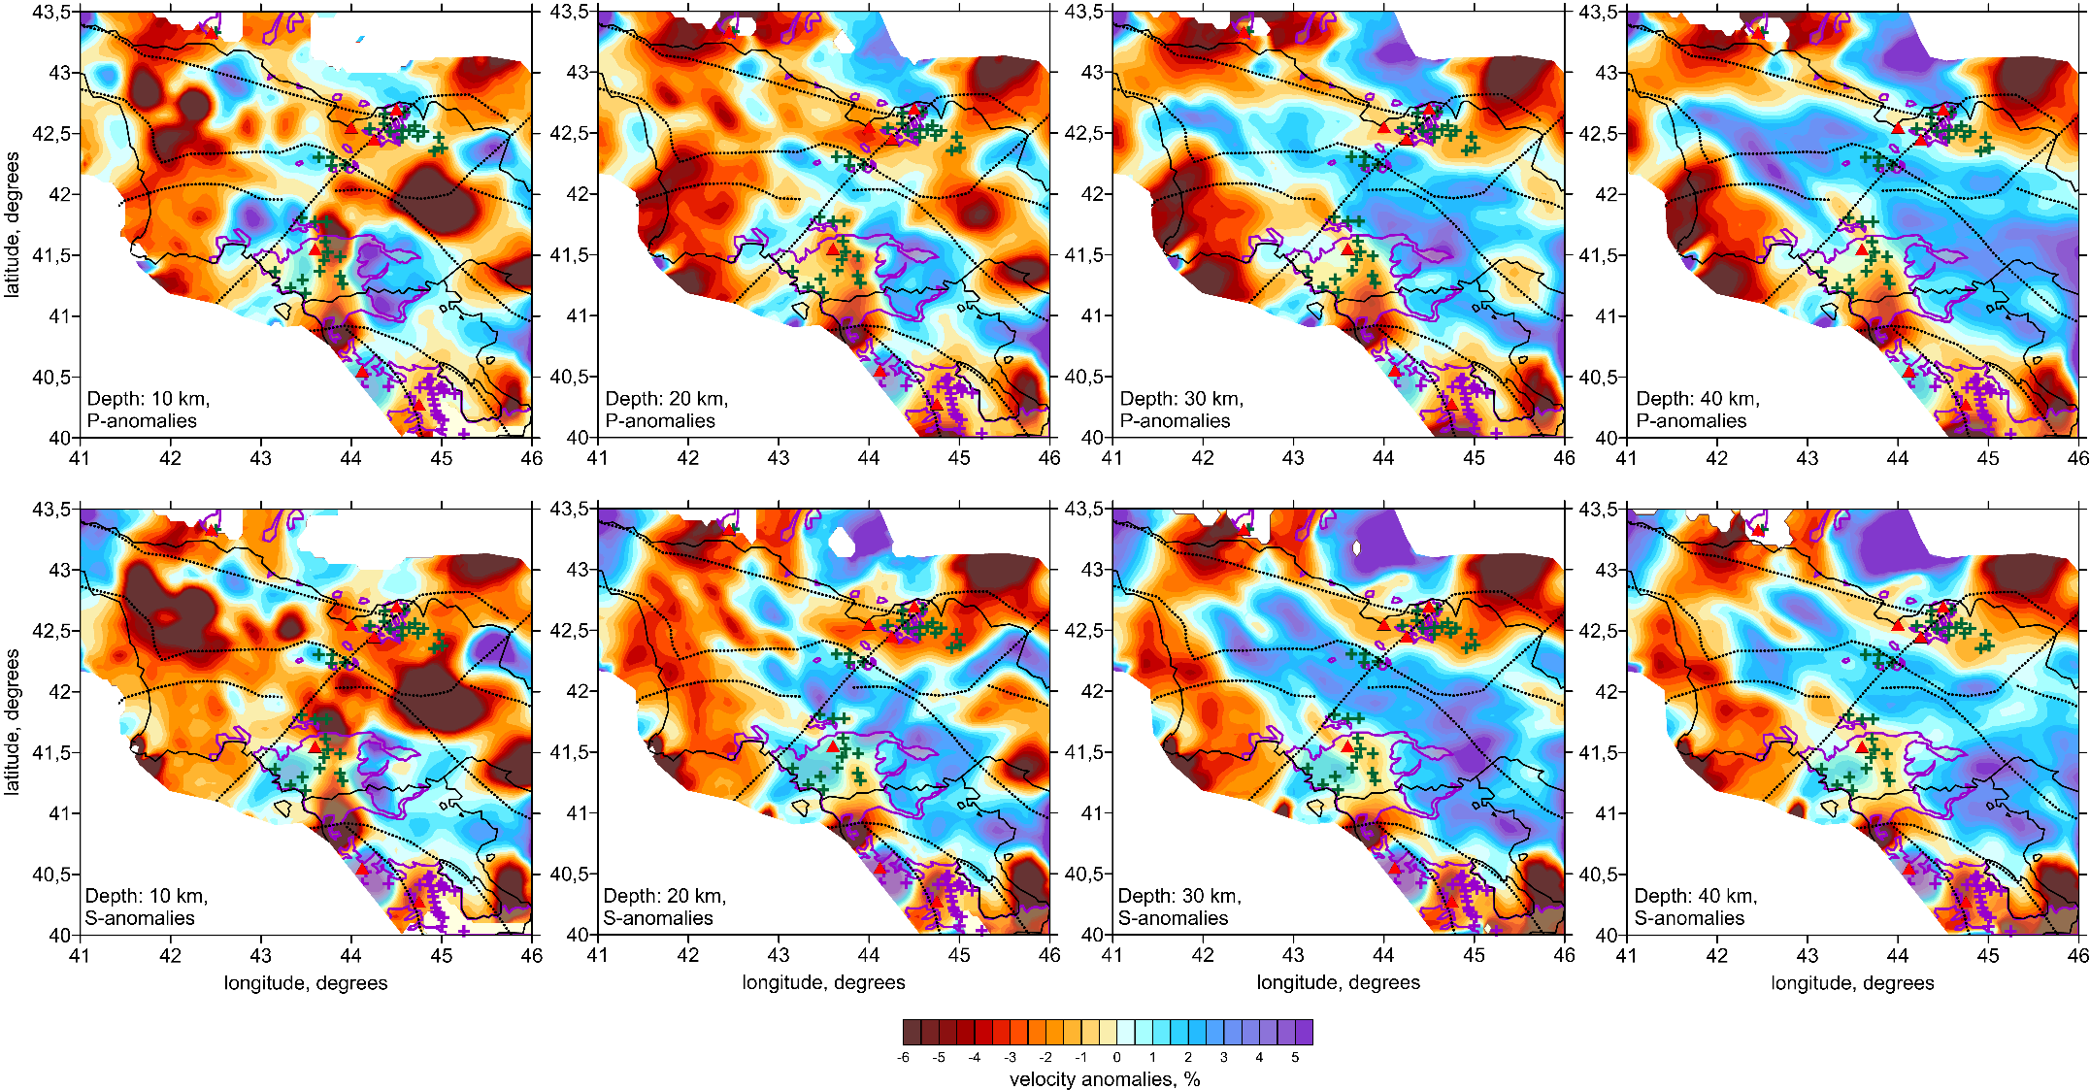
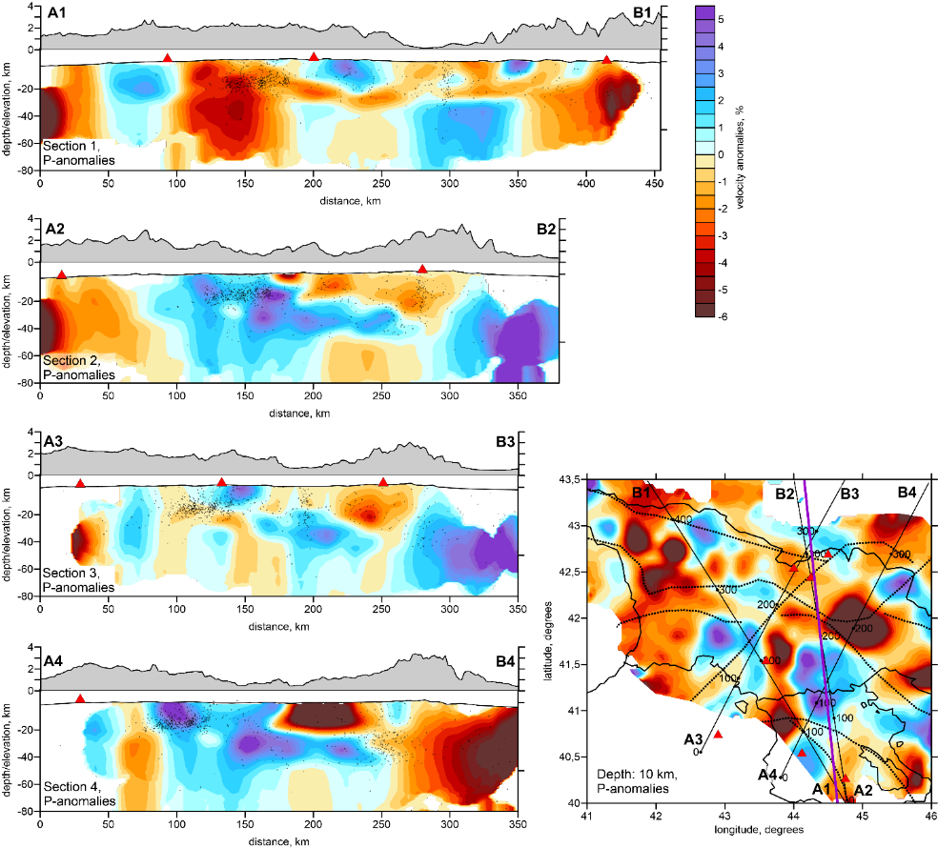
Results of the local tomography (Caucasus)
Interpretation
The tomographic model shows clear separation of the crust in
several tectonic units:
High-velocity anomaly at the north delineate the southern margin of the Scythian Plate;
The low-velocity patterns are mostly associated with mountain ranges of the Great and Lesser Caucasus.
In vertical sections, the Transcaucasian high-velocity microplate seems to gently underthrust northward underneath the Great Caucasus. This microplate is a remnant of oceanic lithosphere.
Most of areas of Quaternary volcanism in Great and Lesser Caucasus match to the locations of low-velocities in the P- and S-seismic models. Only one volcano group, Aragats in Armenia, is centered inside the high-velocity anomaly that is possibly related to the lack of activity since more than half a million years and cooling of the crust.
Zabelina I., Koulakov I., Amanatashvili I., Khrepy S., Nassir A, (2016), Seismic structure of the crust and uppermost mantle beneath Caucasus based on regional earthquake tomography, Journal of Asian Earth Sciences, 119, p. 87–99. https://doi.org/10.1016/j.jseaes.2016.01.010

Slide 7
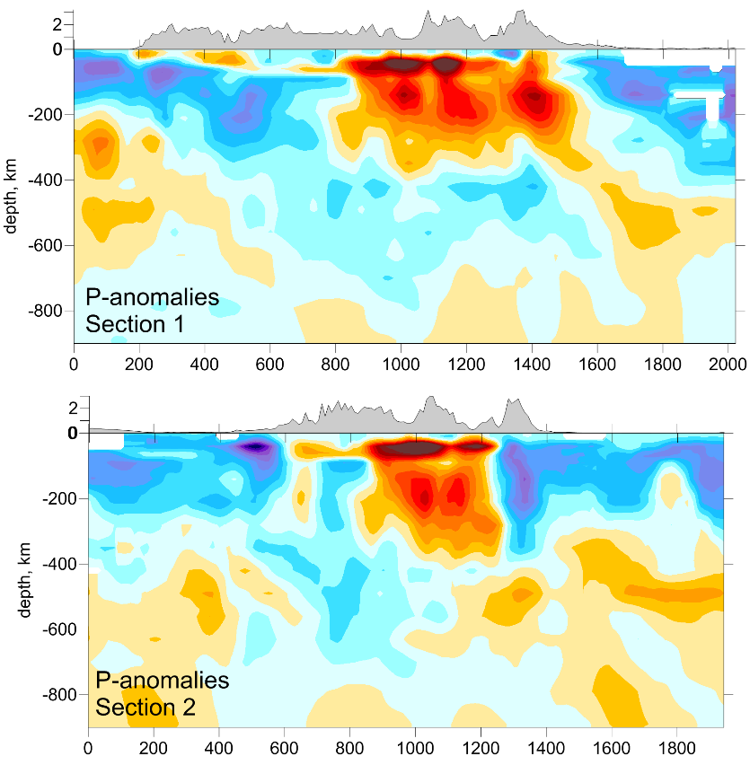
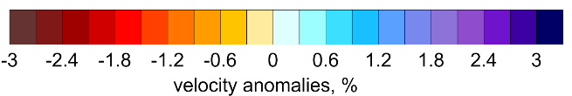
Results of the regional tomography
(Kyrgyz Tien Shan)
Interpretation
The higher P and S velocities associated to the south with the Arabian plate and to the north with the European Plate
The existence of low-velocity anomaly can be suggest that mantle lithosphere beneath the collision zone of Caucasus and surrounding areas is very thin or absent
Main mechanism in the mantle under Caucasus region is delamination.
Koulakov, I., Zabelina, I., Amanatashvili, I., Meskhia, V., (2012). Nature of orogenesis and volcanism in the Caucasus region based on results of regional tomography. Solid Earth 3, 327–337.

Slide 8
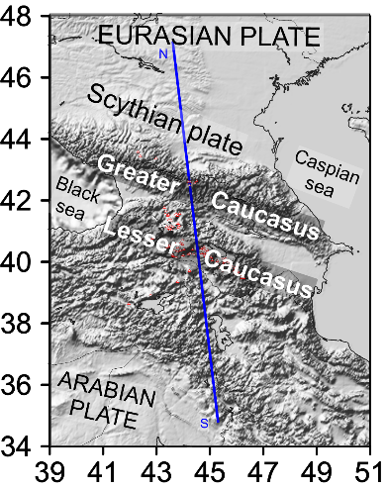
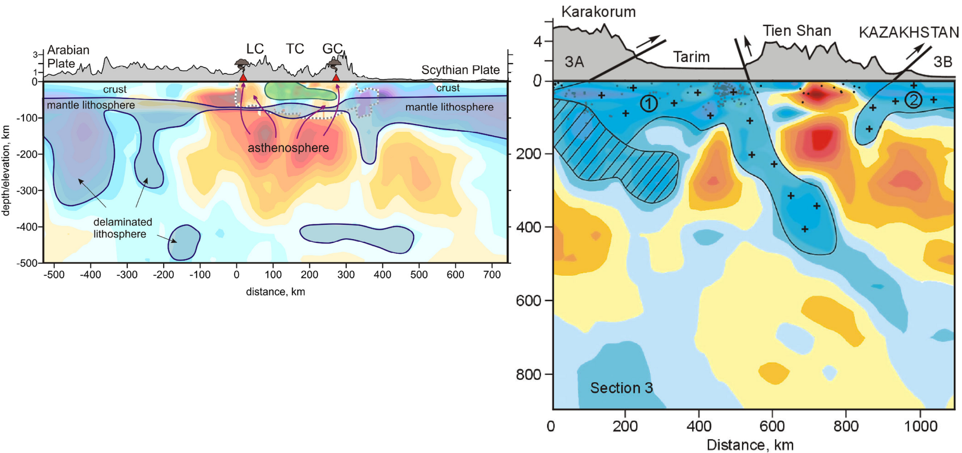
Comparison of results
There are similarities between the obtained models of the Caucasus and the Tien Shan region.

Slide 9
Comparison of results
Similarities:
High-velocity anomalies are mantle parts of lithosphere.

Slide 10
Comparison of results
Общее:
Высокоскоростные аномалии – мантийная часть литосферы
Similarities:
High-velocity anomalies are mantle parts of lithosphere.
High-velocity anomalies are sinking under the collision zone into the mantle

Slide 11
Comparison of results
Общее:
Высокоскоростные аномалии – мантийная часть литосферы
Similarities:
High-velocity anomalies are mantle parts of lithosphere.
High-velocity anomalies are sinking under the collision zone to the mantle
There is a low-velocity anomaly under collision zone

Slide 12
Comparison of results
200 km
500 km
Общее:
Высокоскоростные аномалии – мантийная часть литосферы
Similarities:
High velocity anomalies are mantle parts of lithosphere.
High-velocity anomalies are sinking under the collision zone to the mantle
There is a low-velocity anomaly under collision zone
Differences:
The size of low-velocity anomaly under collision zone

Slide 13
Comparison of results
Общее:
Высокоскоростные аномалии – мантийная часть литосферы
Similarities:
High velocity anomalies are mantle parts of lithosphere.
High-velocity anomalies are sinking under the collision zone to the mantle
There is a low velocity anomaly under collision zone
Differences:
The size of low-velocity anomaly under collision zone
The nature of the behavior of sinking anomalies: steep under Caucasus and flat under Tien-Shan

Slide 14
Delamination
is a process of the detachment of the mantle lithosphere and its sinking into the mantle [Kay and Kay, 1993]
[Ueda, K., T. V. Gerya, and J.-P. Burg , 2012]
When the plates collide, the crust thickens in the shortening areas between these plates.
In this case, the root of the crust appears at greater depth. This leads to thermal and phase changes, as well as changes in composition. As a result, the root of the immersed crust becomes more dense than the underlying lithospheric mantle. The largest part of negative buoyancy located at the boundary between the upper part of the upper mantle and the lower part of the crust.
[Molnar, Tapponier, 1977]

Slide 15
Different causes of delamination
1) The critical compression level [England and Houseman (1989), Kay and Kay, 1993]. The mantle lithosphere becomes gravitationally unstable with lateral compression (collision). The underlying asthenosphere is the most stable, so the mantle tends to return to a state of stability. Thus, it will be immersed in large volumes. The rate of compression thickening of the cortex and the presence of fluid are very important [Houseman et al., 1981; McKenzie and O’Nions, 1983].
2) Eclogitization [Austrheim, 1990, Bird, 1988, M. Leech, 2001]. Continental collision causes considerable crustal thickening. In process of shortening the lower (basalt) part of the crust transforms into high-density eclogite at high pressure and temperature.
[Göğüş O. H., Pysklywec R. N. 2008]
The eclogite drops begin to subside rapidly and entrain the material of the mantle lithosphere, having reached a certain critical mass. This process triggers the detachment of the mantle lithosphere and its sinking into the mantle. Delamination can occur as the breakoff of isometric drops. Eclogitization process occurs only with a crust with more than 50 km thickness.

Slide 16
Different causes of delamination
3) Advection of the hot asthenosphere. The advection (under collision zone) is the consequence of large masses subsidence of mantle lithosphere and release large space under the collision zone, which is filled with hot material asthenosphere [Kay and Kay, 1993].
4) The previous subduction[Harris N. B. W., et al., 1986, Dewey, 2017, Toussaint G., Burov E., Jolivet L. 2004]. After closing the subduction zone, the denser and heavier oceanic crust, sinking into the mantle, entrains a part of the mantle lithosphere of the continental plate.
5) The presence of mantle plume under the collision zone [Burov et al., 2007, 2004, 2010].
[Ueda et. al., 2012]
[Toussaint G., Burov E., Jolivet L. 2004.]
[Burov E., Cloetingh., 2012]

Slide 17
Possible causes of delamination under study areas
Caucasus
Kyrgyz Tien Shan
Eclogitization procces
- (thickness of the crust <45 km [Zor, 2003])
+ (thickness of the crust > 60 km [Vinnik et al., 2004] )
Advection of the hot asthenosphere
+
+
[Ueda et. al., 2012]
The previous subduction
+ (recent subduction processes occurred in the Miocene; the presence of an oceanic remnant; vertical subsidence of the mantle part of the lithosphere)
- (recent subduction processes occurred ~300-400 Ma, low-sloped subsidence of the mantle part of the lithosphere)
[Toussaint G., Burov E., Jolivet L. 2004.]
Плюм
+?
+?
[Sharkov et. al., 2014]
[Vinnik et al., 2004; Lei et al., 2002; Kumar et al., 2005; Xu et al. 2002].
[Burov E., Cloetingh., 2012]

Slide 18
Summary
In the collision zones of the Caucasus and the Kyrgyz Tien Shan, the mantle part of the lithosphere detached. The delamination process predominates.
2) The causes of the delamination in each region is different:
The main cause of delamination in Caucasus region is the previous subduction;
The main cause of delamination in Kyrgyz Tien Shan region is the process of eclogitization;
The difference between causes of delamination are due to features of the evolution history of the regions.
Мат. Моделирование коллизионных процессов.
[Faccenda M., Minelli G., Gerya T. V., 2009]

Slide 19

Thank you for your attention!

