Slide 1
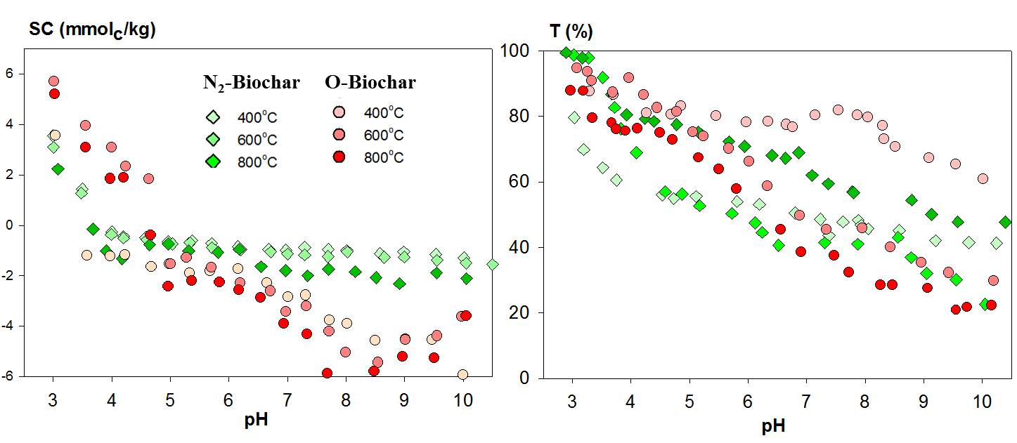
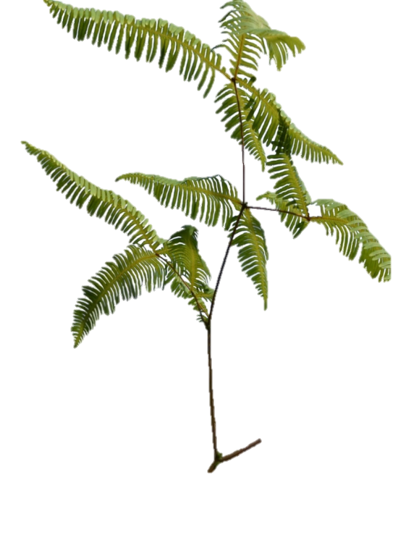
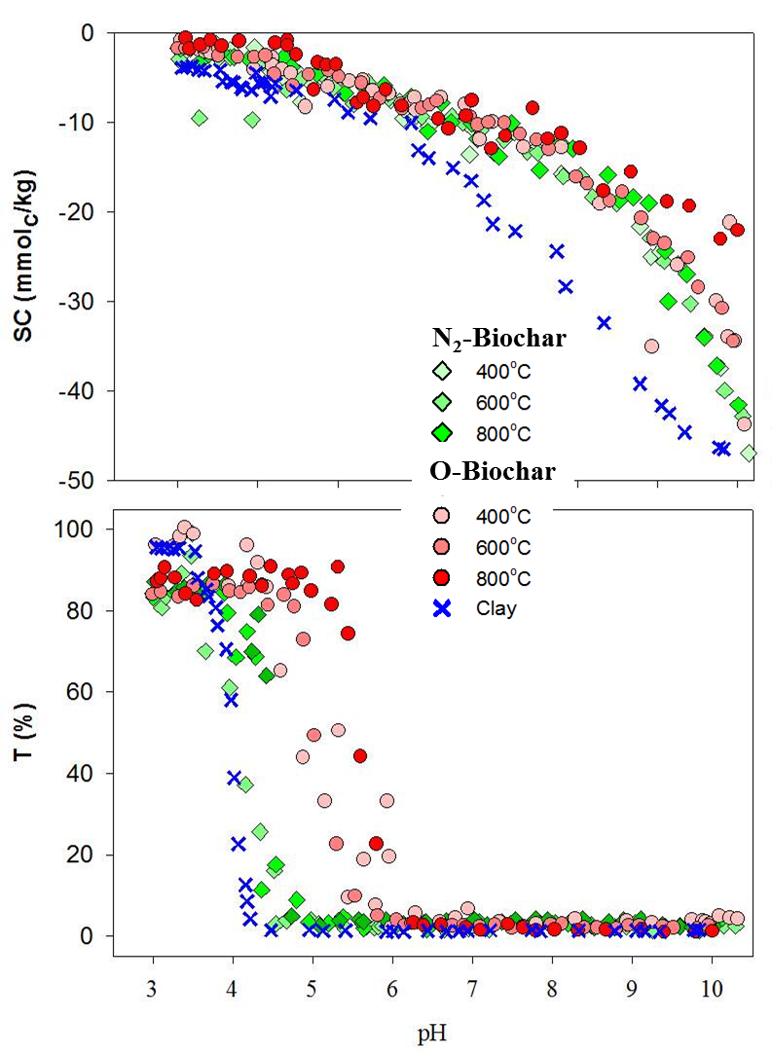
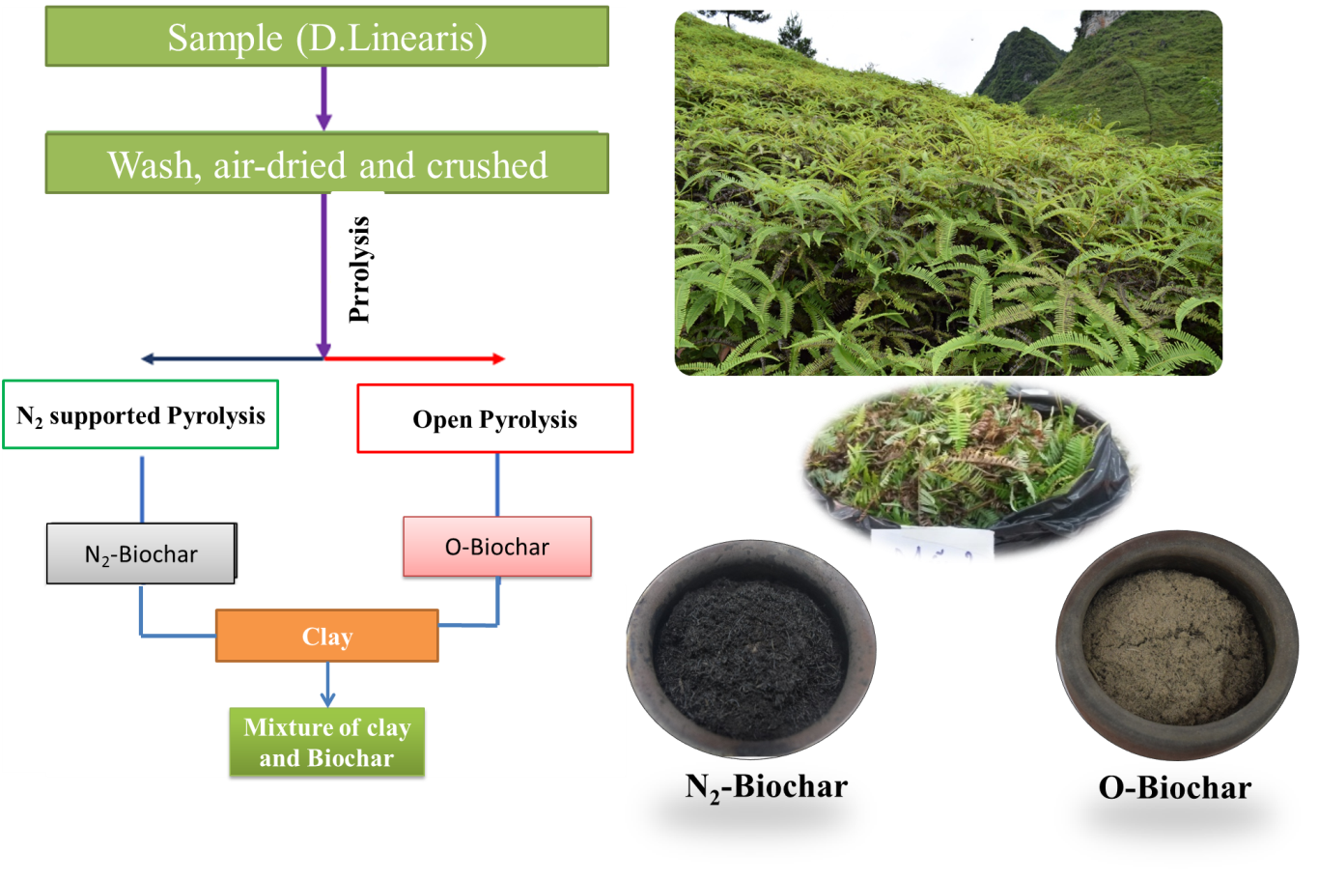
Colloidal dynamics of soil clay under the effect of fine-sized biochars: Implication for biochar amendment towards preventing clay loss and soil erosion
Nga T. Mai^{1,2,*}, Nga T.T. Pham^{1,3}, Anh T.Q. Nguyen^{1,4}, Anh T.N. Nguyen¹, Anh M. Nguyen¹, Nhung T.H. Bach¹, Chi L. Do¹, Thom T. Nguyen¹, Nam H. Nguyen⁵, Stefan Dultz⁶, Minh N. Nguyen¹
¹University of Science, Vietnam National University, Hanoi (VNU). ²Ha Tay Community College. ³Institute for Agricultural Environment. ⁴Thai Nguyen University of Education. ⁵University of Science and Technology of Hanoi. ⁶Leibniz Universität Hannover.
Corresponding author: Minh N. Nguyen (E-mail address: minhnn@vnu.edu.vn)
I. Background
Application of biochar for soil has been widely encouraged to improve soil physio-chemical properties such as structure, bulk density, water storage, ion exchange capacity, nutrient transport, pollutant encapsulation. However, the impact of biochar on the fate and transport of soil colloid-sized particles has got limited attention of researchers.
When buried in the soil, the abiotic oxidation and biological make biochar surface increases the oxygen-containing functional groups, resulting biochar becomes more negative. This suggests that the addition of biochar to soil and its aging could make soil SC more negative, favoring electrostatic repulsion and increasing the dispersion of colloidal soil.
In this study, the effect of engineered micro-sized biochar amendment on surface charge (SC) and colloidal dynamics of the clay fraction of a kaolinite-rich soil in different conditions (pH, pryrolysis,…) was determined. The advanced knowledge of the colloidal properties of biochar and its stimulation to dispersibility of soil clay fraction will first re-evaluate the ability of biochar to increase the dispersibility of clay minerals and, second, provide a premise to develop sustainable practices for sustainable application of biochar.
IV. Results
* Morphology analysis
Fig. 4. Surface charge (SC) properties in relation to colloidal dynamics of biochars as a function of pH: (a) transmission (T%), (b) SC represents dispersibility of biochars.
II. Materials
* Surface charge and colloidal dynamic of clay-biochar mixture
* Clay
Fig. 3. Fern D. linearis's biochar: (a) tomographic images showing leaf; 3D images showing internal (b) organic carbon phase (colored in green) in leaf, (c) silica phase (colored in pink) in leaf; SEM images of biochars prepared at 600°C under: (d) open pyrolysis and (e) N₂-supported pyrolysis.
Fig. 5a shows the pH dependence of SC and colloidal properties of clay with respect to its mixtures with biochars prepared at different conditions. Decreases of SC values with an increase in pH were a general trend. For the colloidal dynamic experiments as shown in Fig. 5b, biochars represented their significant effects on the dispersibility of the biochar-clay mixtures. The T% curves of the mixtures of clay and N₂-biochars were close to that of clay, indicating low effectivity of the N₂-biochars for colloidal properties of the clay suspension. In contrast, the open-heating biochars shifted the T₅₀ points toward higher pH values, which implies that the O-biochars facilitated aggregation.
Clay sample was separated from a soil sample (containing ~40% of clay fraction) collected from the surface horizon (0–25 cm depth) of highly weathered soil pedon at a tea-growing hill in northern Vietnam (21°26′ N lat, 105°15′ E long). The clay fraction is rich in Fe and composed primarily of lattice-like kaolinite particles
Fig. 3a shows tomographic cross-section images captured for leaves of D. linearis. The biomass contains ~44% of organic matter (Fig. 3b), while inorganic compounds such as internal biogenic silica comprises ~3.6% (Fig. 3c).
Under open and N₂-supported pyrolysis conditions, D. linearis’s biomass was converted to either ‘poorer-organic biochar’ or ‘richer-organic biochar’ and their structural and chemical properties were obviously distinctive (Fig. 3d-e). These two biochars showed their different surface morphological properties that are related to the decomposition degree of organic matter.
* Biochars
Dicranopteris linearis (D. linearis) sample was collected and treated by non-biochar-oriented or biochar-oriented pyrolysis (i.e., open and N₂-supported), and the obtained biochars were correspondingly named as 'O-biochar' and 'N₂-biochar'. The pyrolysis process was set up at a heating rate of 10°C min⁻¹ and maintained at different temperatures (400, 600 and 800 °C)
* Fern’s biochars characterization .
Table 1. Physio-chemical properties and chemical composition of biochars
Temp. (ºC) | Biochar | Fixed C (%) | Ash (%) | SSA (m² g⁻¹) | pH | Soluble ions (mg g⁻¹)
 |  |  |  |  |  | Si | Al | Ca | Mg | K | Na
400 | O | 48.7 | 11.9 | 40 | 8.17 | 0.47 | 0.22 | 0.43 | 0.11 | 2.66 | 0.25
 | N₂ | 65.1 | 8.9 | 12 | 7.64 | 0.54 | 0.02 | 0.50 | 0.05 | 0.77 | 0.11
600 | O | 57.5 | 19.0 | 137 | 8.92 | 0.61 | 0.52 | 0.51 | 0.08 | 2.72 | 0.23
 | N₂ | 75.3 | 12.4 | 387 | 8.73 | 0.67 | 0.11 | 0.52 | 0.06 | 1.10 | 0.10
800 | O | 52.8 | 23.1 | 66 | 9.10 | 0.54 | 0.45 | 0.56 | 0.11 | 3.43 | 0.23
 | N₂ | 72.9 | 17.2 | 701 | 8.54 | 0.65 | 0.12 | 1.16 | 0.08 | 1.22 | 0.13
Fig. 1. The process of biochar preparation
III. Methodology
Fig. 5. Surface charge (SC) properties in relation to colloidal dynamics of the mixtures of biochar-clay (1:1) as a function of pH: (a) transmission (T%) and (b) SC represents dispersibility of the biochar-clay mixtures as a function of pH.
* Examination of colloidal dynamics
Examination of colloidal dynamic was followed the protocol of Lagaly et al. (1997). From the preliminary experiments in a wide mass ratio range, the 1:1 ratio was selected for further investigations. Suspensions of biochar and clay were prepared at the same ionic strength 0.01 M by using 0.01 M HCl or NaCl solution to obtain different targeted pH values
V. Conclusion
It was demonstrated that biochars affect clay colloidal dynamics by their ability to drive solution chemistry rather than by their SC properties via governing electrostatic interactions. Pyrolysis temperature can significantly alter biochar’s properties thereby changing their ability to stimulate dispersion of clay
Fig. 2. The process of colloidal dynamics examination
Acknowledgement
This research is supported by VinTech Fund, a grant for applied research managed by VinTech City.
from 3 to 10. The suspensions were dispersed by vortexing for 30 s and then held statically for 2 h. The transmittance (T%) was determined using a UV-VIS spectrophotometer (Shimadzu, UV-2101PC) at a wavelength of 600 nm. T₅₀ values, which is corresponded to a transmission of 50% at which the suspension is transited from dispersion to aggregation state (Nguyen et al., 2009), was also used to evaluate the effects of biochars on colloidal dynamics of clay-biochar mixtures.
* Surface properties of biochars
Fig. 4a shows the pH dependence of SC in which impacts of each pyrolysis method on SC properties of the resulting biochars can be clearly recognized. In general, SC became more negative when pH increased. Open pyrolysis and higher pyrolysis temperatures resulted in more negative SC.
References
Cheng C-H, Lehmann J, Engelhard MH. Natural oxidation of black carbon in soils: Changes in molecular form and surface charge along a climosequence. Geochimica et Cosmochimica Acta 2008; 72: 1598-1610.
Chew J, Zhu L, Nielsen S, Graber E, Mitchell DRG, Horvat J, et al. Biochar-based fertilizer: Supercharging root membrane potential and biomass yield of rice. Science of The Total Environment 2020; 713: 136431
Lagaly G, Schulz O, Ziemehl R. Dispersionen und emulsionen: Eine Einführung in die Kolloidik feinverteilter Stoffe einschließlich der Tonminerale. Steinkopff Verlag, Darmstadt. 1997.
Yu H, Zou W, Chen J, Chen H, Yu Z, Huang J, et al. Biochar amendment improves crop production in problem soils: A review. Journal of Environmental Management 2019; 232: 8-21.
* Quantification of surface charge
The SC of biochars obtained from different pyrolysis methods was quantified by polyelectrolyte titration in a particle-charge detector (PCD 05, Mütek, Herrsching, Germany). The titration with the polycation, i.e., PolyDADMAC (positive), were terminated at the point of zero charge, where the electrokinetic potential is zero.
Colloidal dynamics of the O- and N₂-biochars were described in Fig. 4b, in which dispersion state is represented by low T% values (i.e., < 5%), aggregation state is attributed by higher T% values (i.e., > 80%) and transition state is described by the T% values from 5 to 80%. In general, decreases of T% values were along with an increase in pH.

