Slide 1


Ground Motions Prediction Equations (GMPE) from a stochastic simulation approach for in-slab intermediate-depth earthquakes of the Hellenic subduction zone
Ch.Kkallas¹, C.Papazachos¹, D.Vamvakaris¹,
¹Aristotle Univ. Thessaloniki

Slide 2
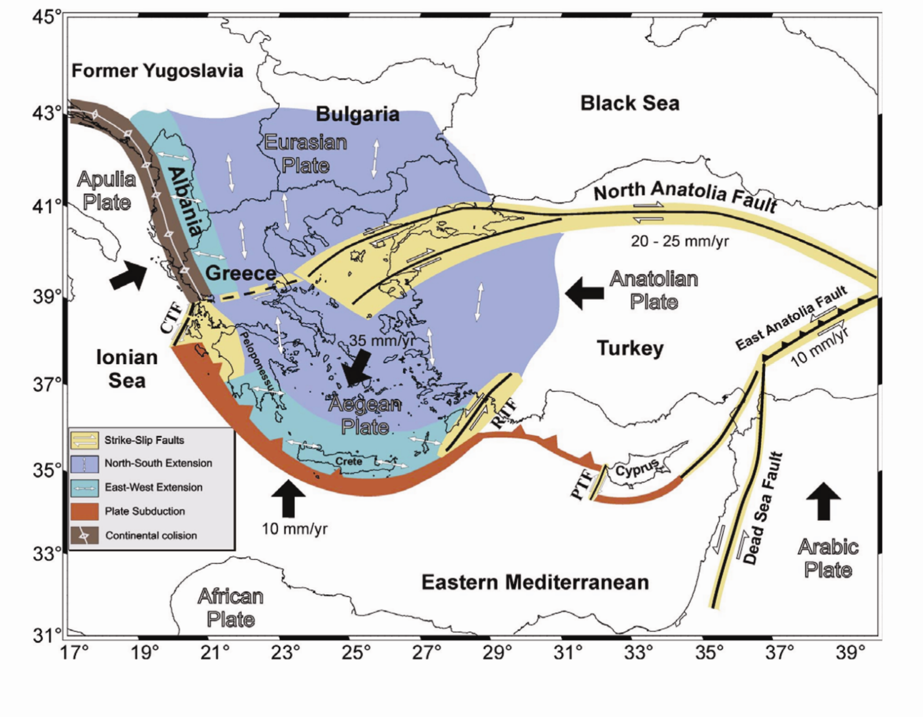
The most important feature in the Aegean region is the westward movement of the Anatolia plate along the North Anatolia fault, as well as the subduction of the eastern Mediterranean plate under the microplate of Aegean.
Papazachos and Papazachou (2003)

Slide 3
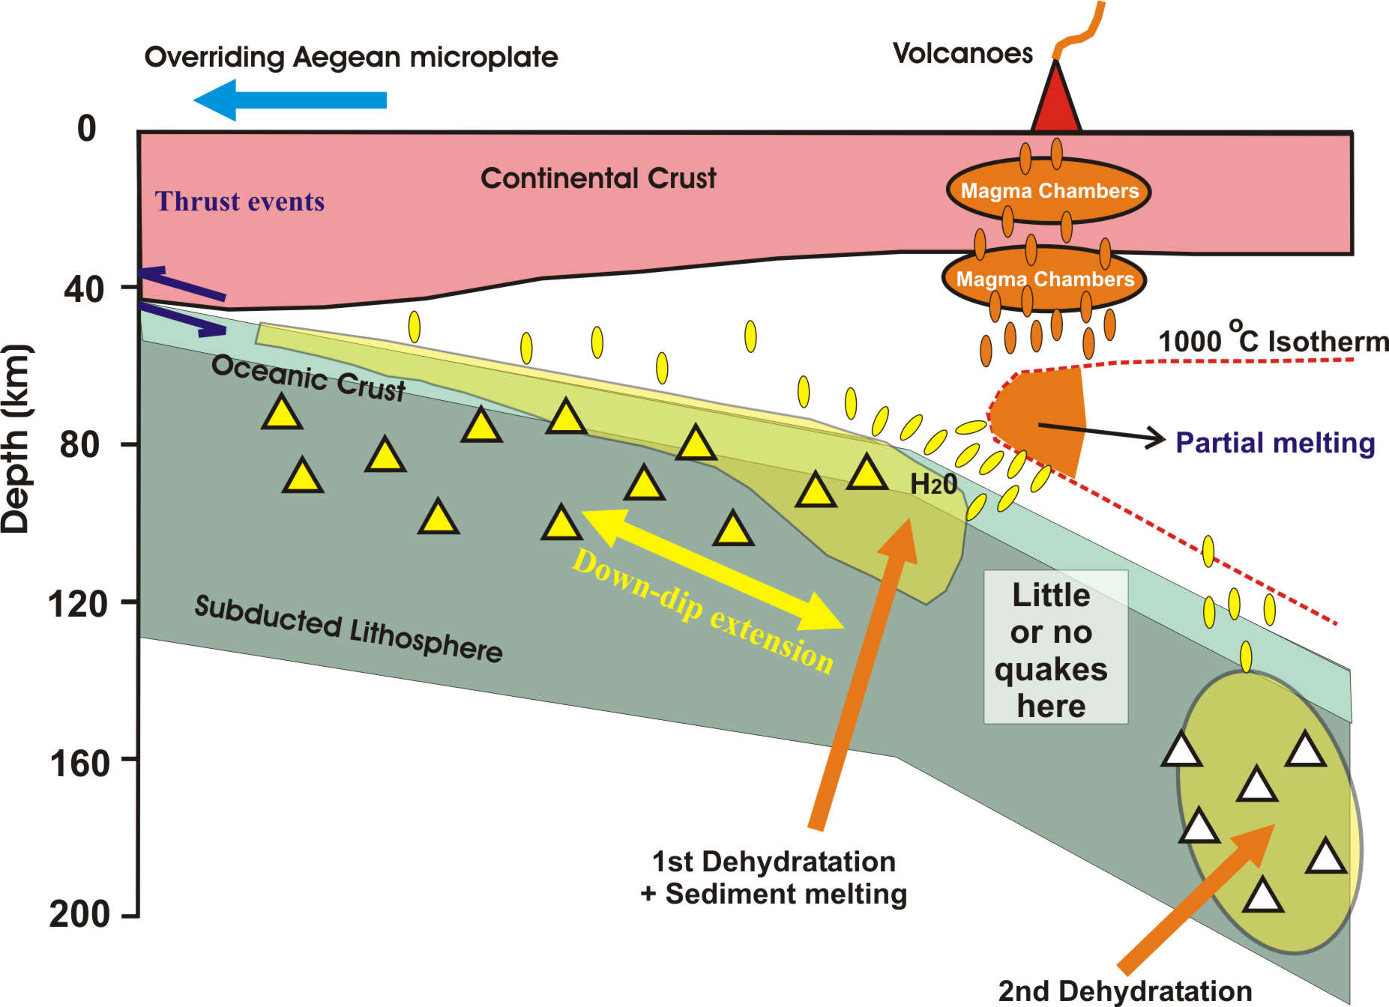
High V_{p} / V_{s}
Q_{p} / Q_{s}
Papazachos et al. (1995)
High V_{p} /V_{s}
Q_{p}/Q_{s}
Several tomographic studies revealed the presence of a low body-wave velocity and quality factor (high attenuation) region at the depth of ∼60–90 km beneath the volcanic arc. This pattern is usually attributed to the subduction process, which results in the presence of partial melt and/or significant volatile content in the high-temperature mantle wedge above the subducting eastern Mediterranean plate.

Slide 4
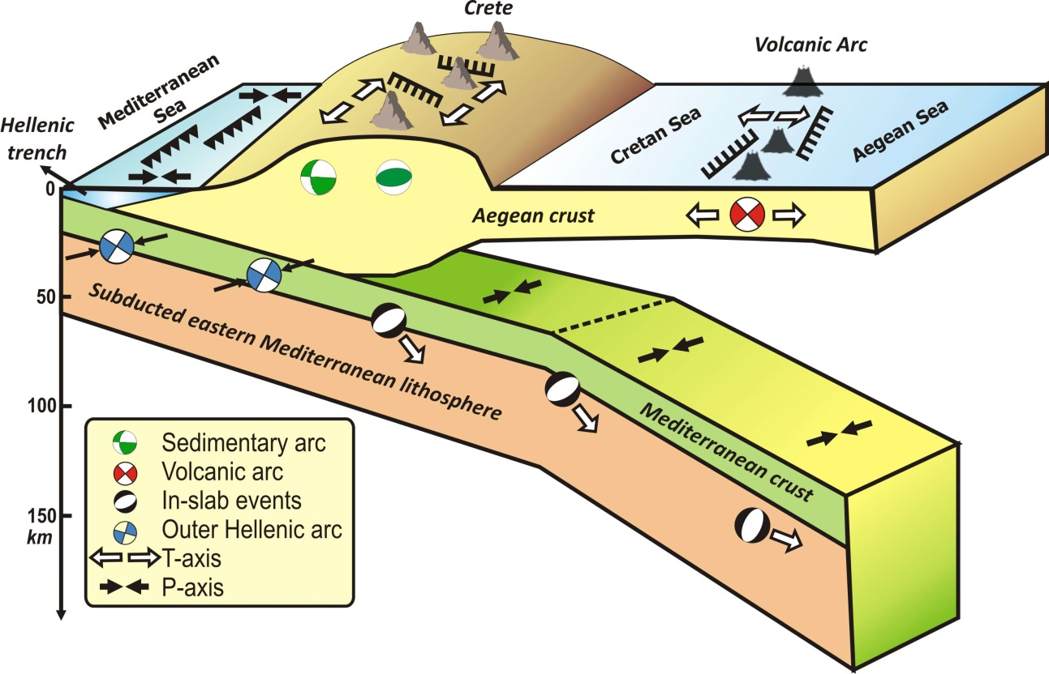
Schematic 3D seismotectonic cross-section of the Southern Aegean Sea subduction area.
interface
inslab
3D schmatic seismotectonic setting of the Southern Aegean subduction area: Different types of faulting (and stress regime) are observed for various depth ranges. This is typically observed along the volcanic arc, where the shallow (crustal) normal-faulting seismicity is clearly different than the intermediate-depth, trans-pressional events along the subducting slab (depths >100km).

Slide 5
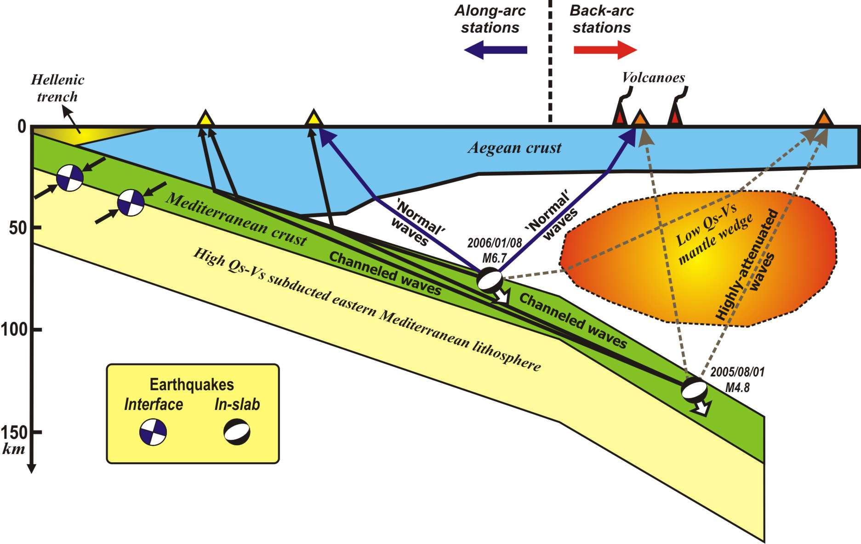
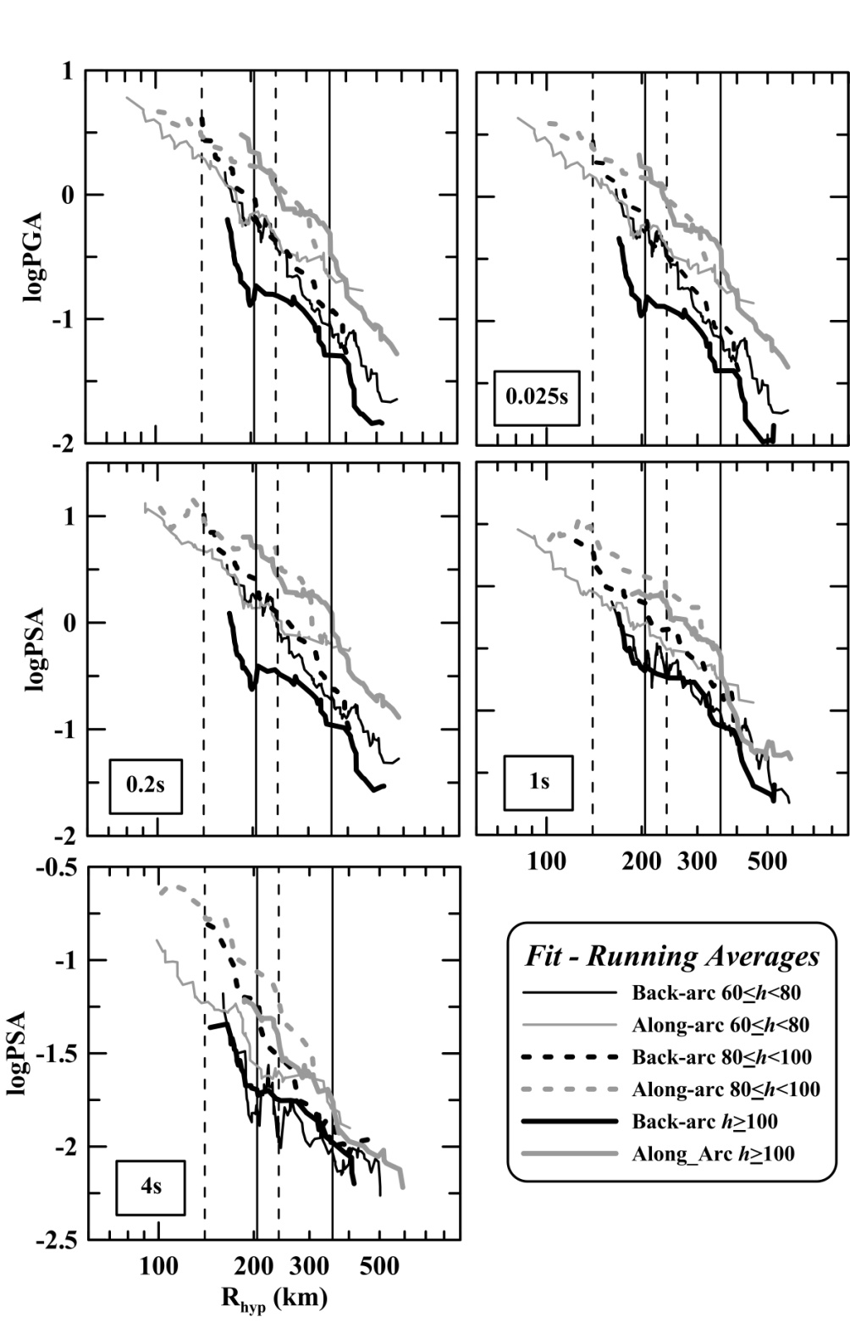
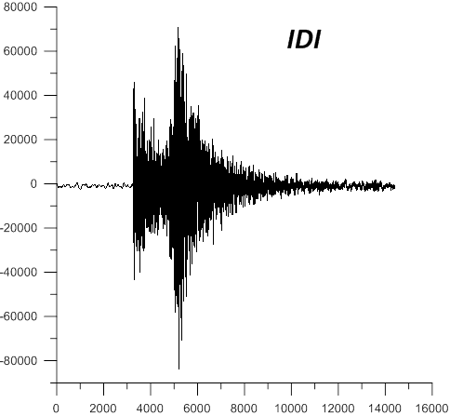
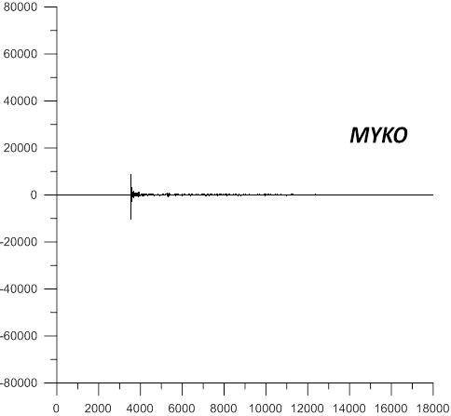
A second important observation for subduction zone is the observed strong-motion distance-decay pattern: The along-arc stations for events with depths h≥100km exhibit much higher PGAs than the corresponding values for back-arc sites. The top-left figure shows a schematic presentation of a cross-section of the Hellenic-arc subduction, with the high Q_{S}–V_{S} eastern Mediterranean slab subducting under the Aegean lithosphere, developing a low Q_{S} (high attenuation) mantle wedge under the volcanic arc.
amplification/Attenuation
Skarlatoudis et al. (2013)
(PGA for h > 100km)
Δ-PGA ~ 4-5
ΔΙ ~ 2-3

Slide 6
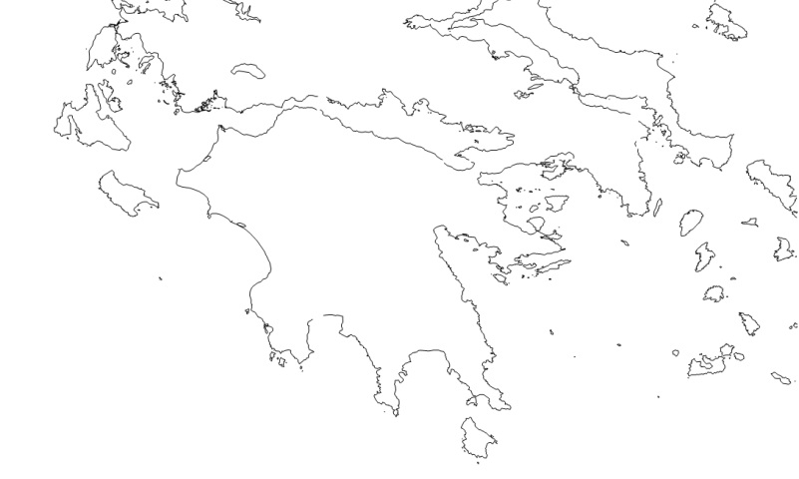
As a result, waves from intermediate-depth (h>100km) historical and instrumental events, such as the 1964/07/17 Athens aftershock, are strongly attenuated in the back-arc area. On the contrary, waves propagating along the high-Q_{S} subducting slab result in significant damage at large epicentral distances along the fore-arc (eg. Kynigos village, SW Peloponessus), in comparison to back-arc stations at shorter epicentral distances.
Athens (17/7/1964, h~155km) M_{S}: 6.0
III-IV
Amplification
VI
Attenuation
Papazachos et al. (1982)

Slide 7
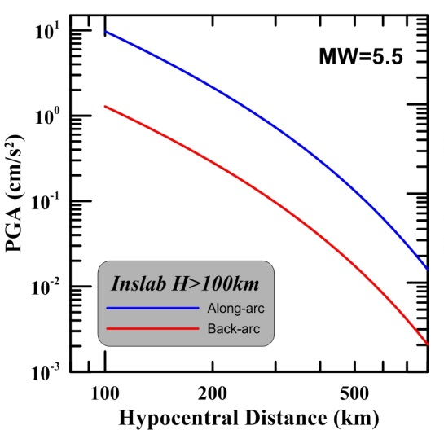
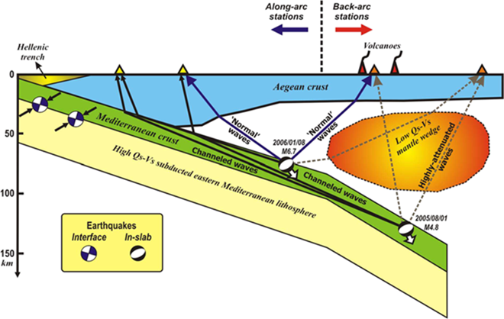

Skarlatoudis et al. (2013) proposed new ground-motion prediction equations (GMPEs) for intermediate-depth earthquakes of the southern Aegean Sea area for Mw≤6.7 and depth>45km.
Interface - earthquakes (depths ∼45-60km)
Inslab - earthquakes (depths >60km)
EXAMPLE
Interface
Inslab
Skarlatoudis et al. (2013)

Slide 8
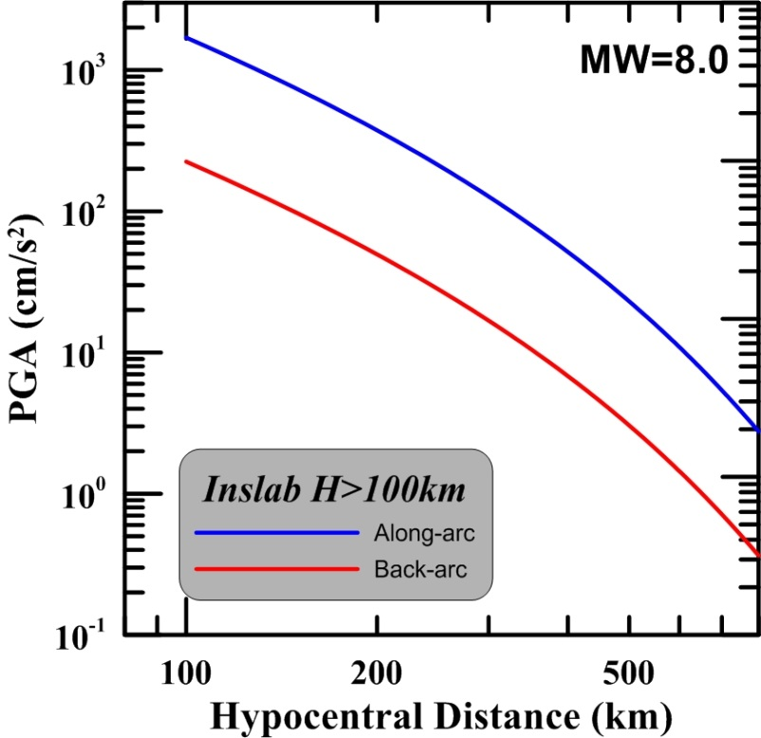

Main target
Adapt the Ground Motion Prediction Equations (GMPEs) of Skarlatoudis et al. (2013) to be valid for large intermediate-depth events (i.e. M~6.8-8.0)
✗
✓
Adopted approach:
Generate a large number of synthetic seismic records from intermediate-depth earthquakes (earthquakes whose foci are located at depths h=45-150 km from the earth’s surface) with moment magnitudes of M>6.5, using an appropriately adapted stochastic simulation model.

Slide 9

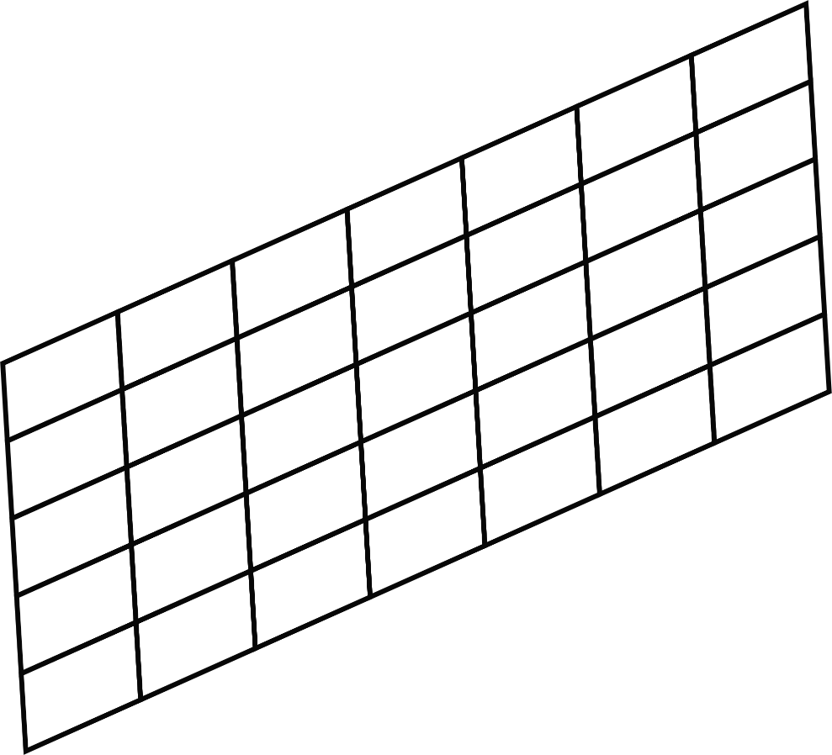

Stochastic simulation modeling parameters for intermediate-depth events: We followed the approach developed in our previous work (Kkallas et al., 2018, Kea18), where we used the anelastic attenuation from the GMPE modeling developed by Sea13 to constrain the different attenuation/amplification patterns and properties for the back-arc and fore-arc area.
Exsim Code
Dynamic Corner Frequency (Motazedian and Atkinson, 2005)
Finite-Fault Source
Rectangular plane

Slide 10
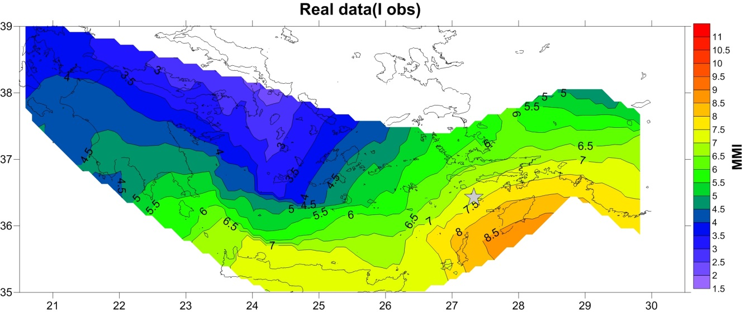
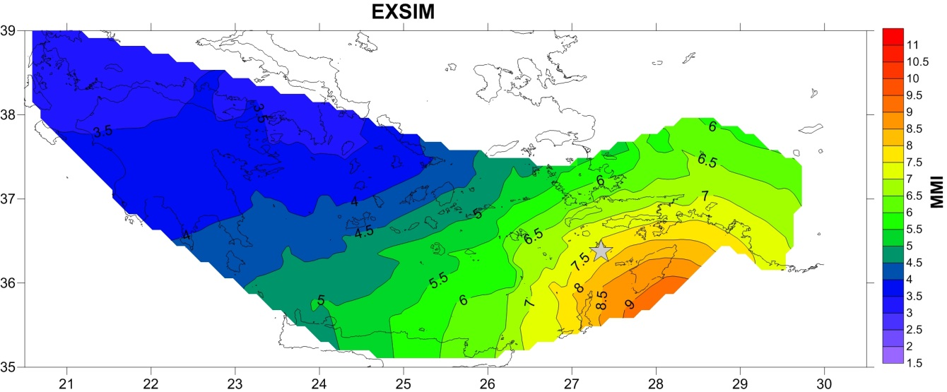
Example from Kea18
(Kkallas et al., 2018)
Rhodes (26/6/1926, h~100km)
Real IMM
Synthetic IMM
Spatial distribution of the observed and simulated IMM distributions of the 1926 Rhodes earthquake.

Slide 11
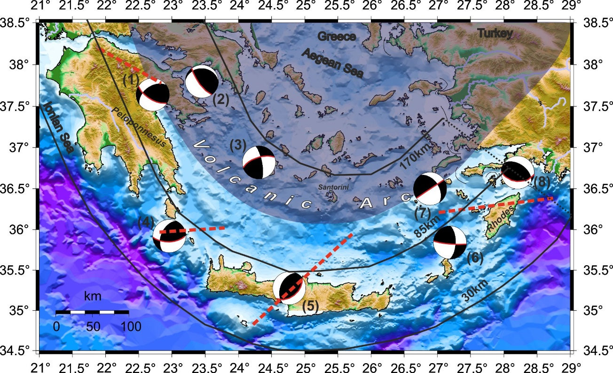
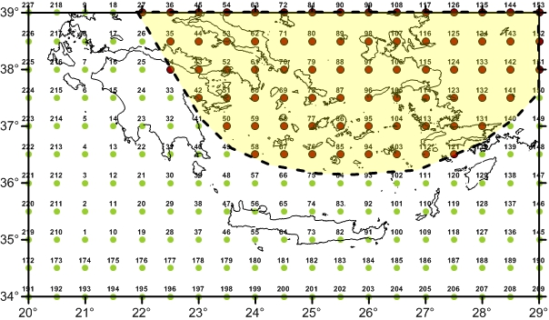
In the present work, we simulate ground motions for several strong intermediate- depth earthquakes, located in the southern Aegean subduction, with moment-magnitudes between 6.0 and 8.5 (step 0.1).
All simulations were performed for a dense grid of virtual receivers that cover the broader study area.
Virtual grid of 228 receivers covering
the S. Aegean subduction area

Slide 12
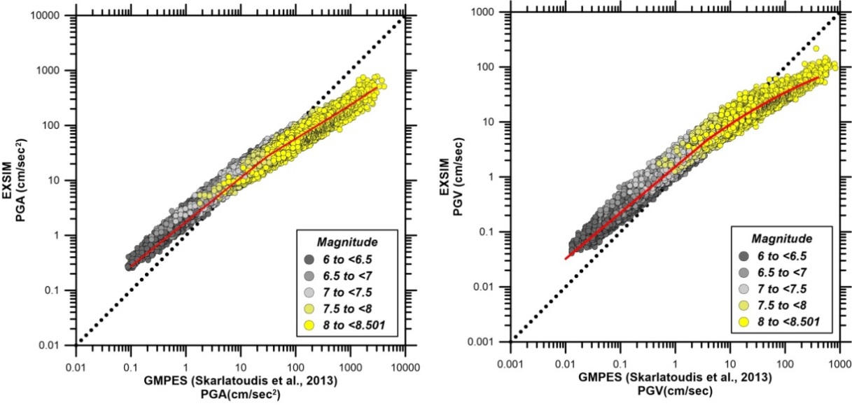
Comparison of the GMPE predicted PGA and PGV values (Skarlatoudis et al., 2013), against Stochastic simulations (Exsim) for the considered earthquake scenarios.
GMPE
PGA
GMPE
PGV
The red curves depict the new (modified) GMPE for magnitudes M>6.0

Slide 13
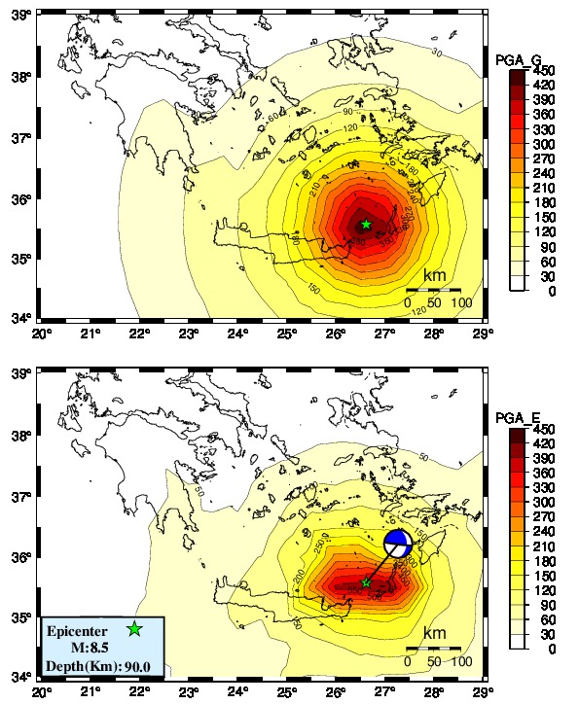
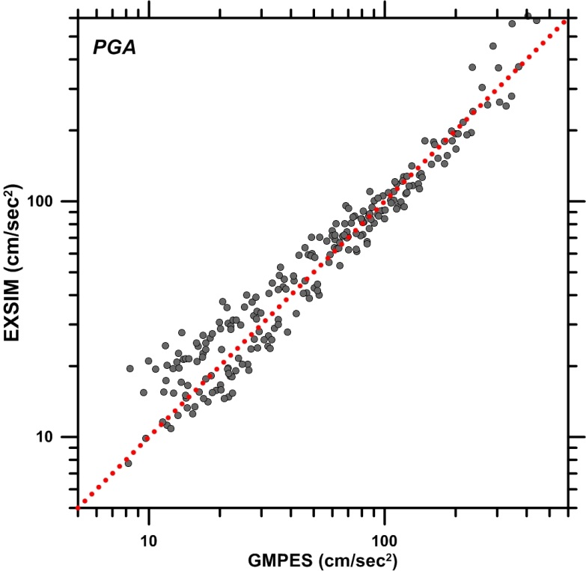
Results from the Modified GMPEs
Modified GMPEs
Stochastic simulation (EXSIM)
Comparison of the modelled PGA (from EXSIM – lower figure), against the adapted GMPEs PGA values, for a typical earthquake scenario near Rhodes (depth h=90km). A good agreement between synthetics and adapted GMPE predictions is observed.

Slide 14


Summary
From the performed simulations, it can be suggested that the stochastic simulation using the EXSIM code can enrich the strong-motion predictions (original GMPE) for the Aegean Sea subduction intermediate-depth events with realistic spatial distributions of PGA and PGV for magnitudes M>6.7.

Slide 15
Summary
The very good agreement between synthetic (Exsim) and the new GMPEs predictions for an M = 8.5 scenario event, suggests that the proposed GMPEs can adequately reproduce the damage pattern of very large intermediate-depth earthquakes in the Hellenic subduction.

Slide 16
Thank you

