Slide 1
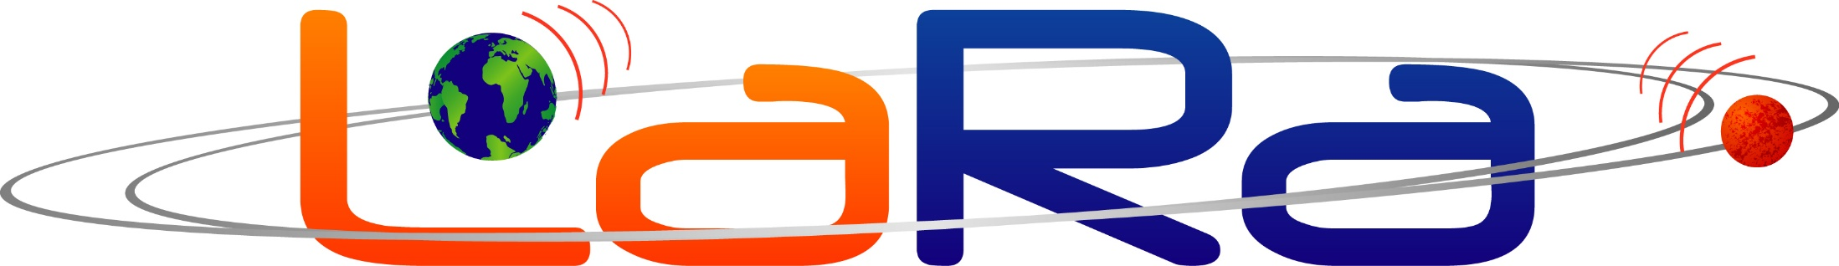
Lander Radioscience (LaRa) in ExoMars 2020 to obtain the rotation and orientation of Mars.
EGU2020-6566
2022
Véronique Dehant¹, Rose-Marie Baland¹, Sébastien Le Maistre¹, Ozgur Karatekin¹, Marie-Julie Péters¹, Attilio Rivoldini¹, Ertan Ümit¹, Tim Van Hoolst¹, Marie Yseboodt¹, William M Folkner² and Alexander Kosov³
(1) Royal Observatory of Belgium, Brussels, Belgium,
(2) Jet Propulsion Laboratory, United States,
(3) IKI Space Research Institute of the Russian Academy of Sciences, Moscow, Russia

Slide 2
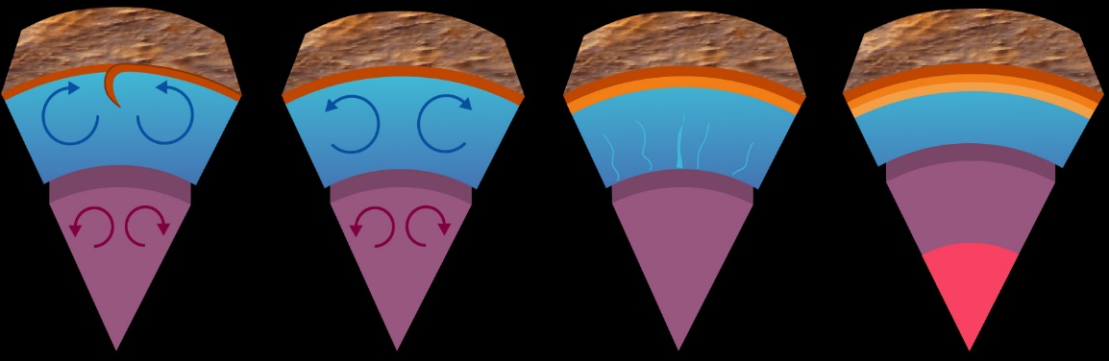
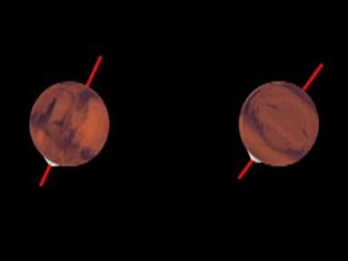
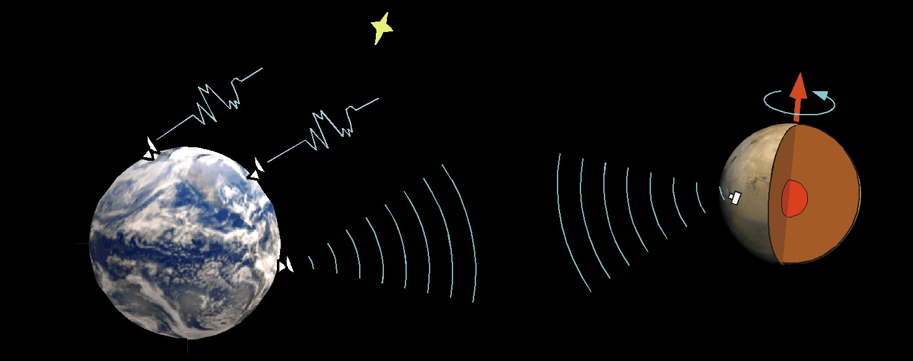
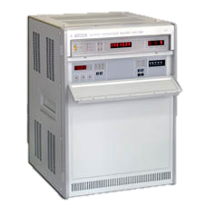

EGU2020-6566
Objectives of LaRa:
Rotation and interior of Mars
and habitability
Past
Present?
Present? or future?
liquid core
X-band radiolink
Uplink in [7.145,7.190] GHz
Coherent
transponder
Downlink in [8.400,8.450] GHz
maser

Slide 3
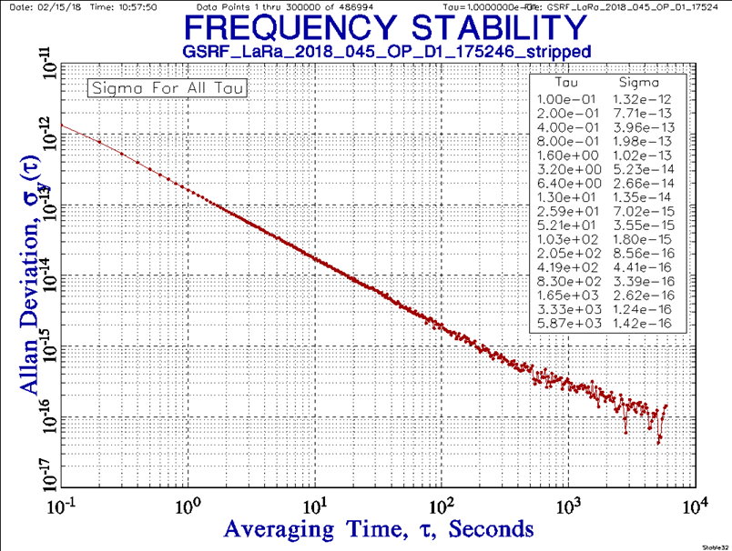
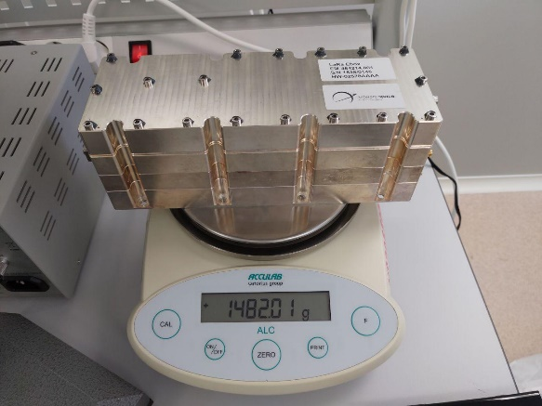
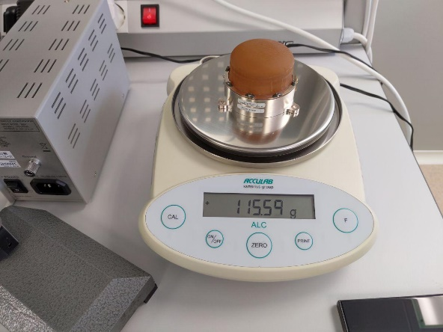
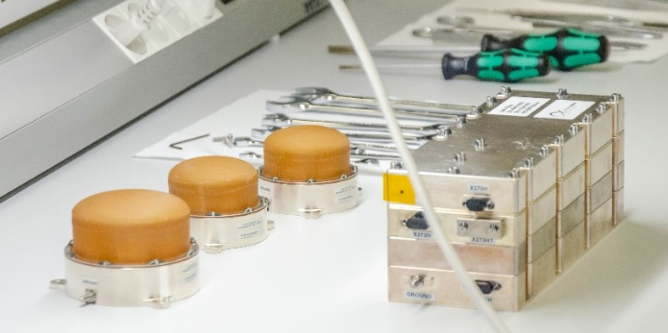
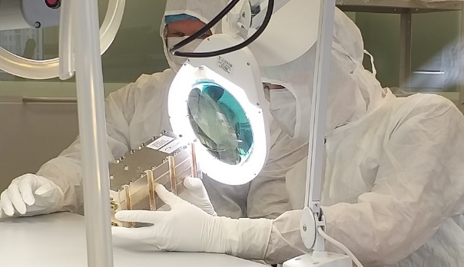
1. LaRa development status report
EGU2020-6566
targeted value
PDR 2017, CDR 2018
Compatibility tests at ESOC 2018:
Excellent ADEV performance!
Delivery 2019
obtained value
Notes:
Perfo one order of mag

Slide 4
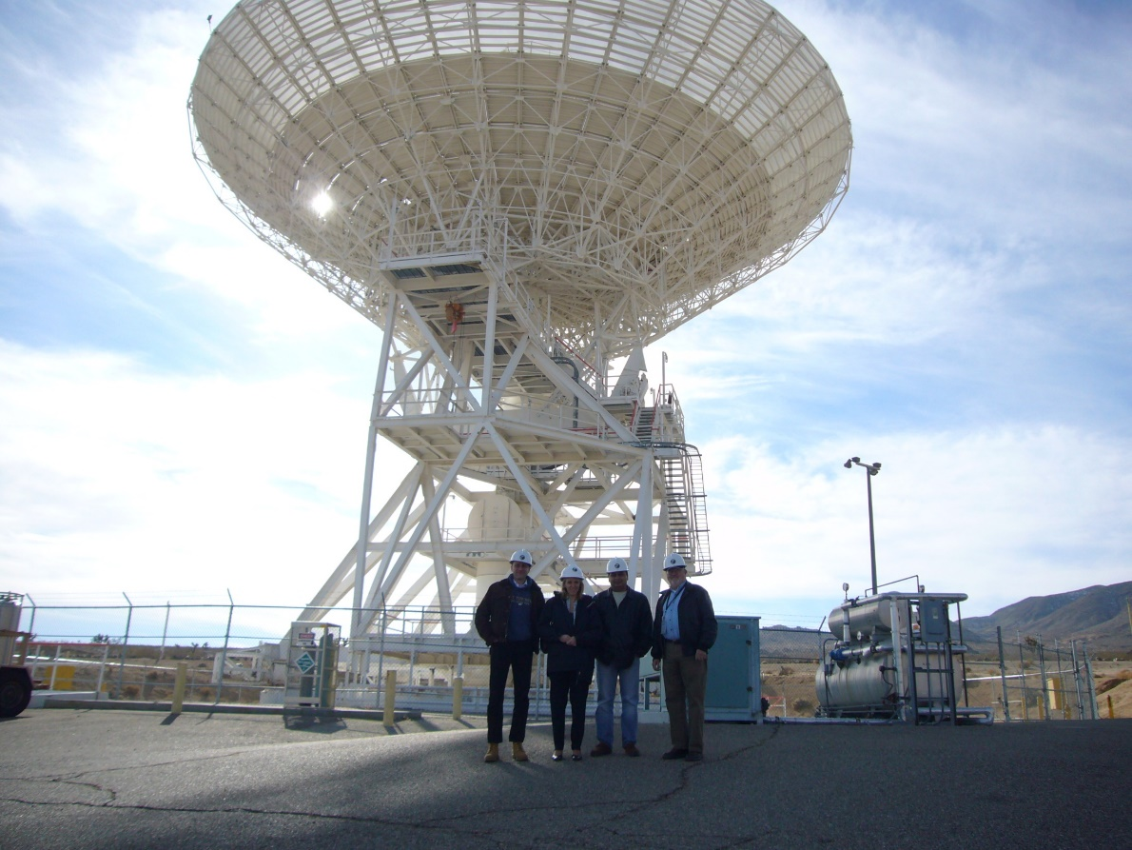
2. Ground stations
EGU2020-6566
Baseline ground stations to close link with LaRa (5 Watt out) is NASA DSN – 70m antennas
Operational needs: twice a week for one hour
Notes:
Explain while we need all three.
Requirement docu to be sent to PRODEX

Slide 5
3. Mission geometry
EGU2020-6566
SEP = Sun-Earth-Probe angle (elongation)
Time (years)
Pink boxes: Small Sun-Earth-Probe angle (= elongation), meaning a larger noise on the data
Grey boxes: Small Earth declination
Notes:
Define declination
The gray boxes for the Earth declination correspond to time intervals where the Earth declination is smaller than 10°, which means that the sensitivity to Mars spin axis motion in space is smaller at that time.
The InSight nominal mission lifetime is shown with the orange bar.
The black part of the curve being the points where the SEP angle < 15°, corresponding to data with a large noise due to the solar plasma. This corresponds to the interval July-October 2019.
Pink box = Doppler data noise increased near conjunction: here for SEP angle less than 15°

Slide 6
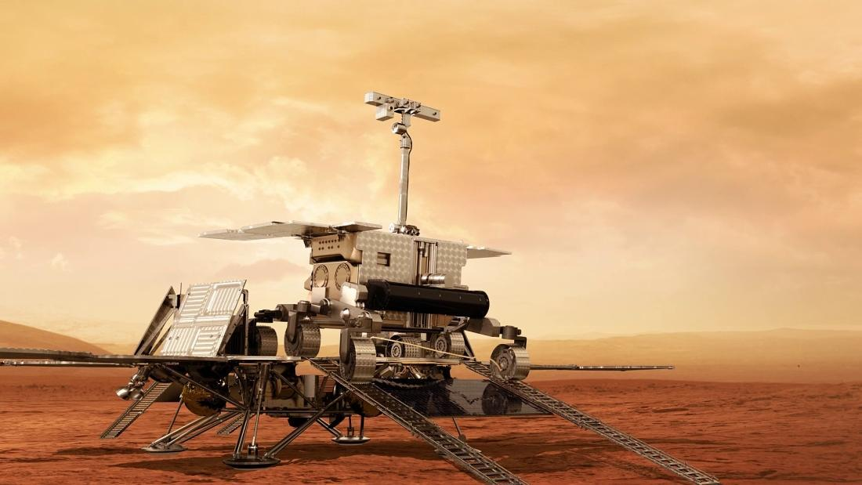
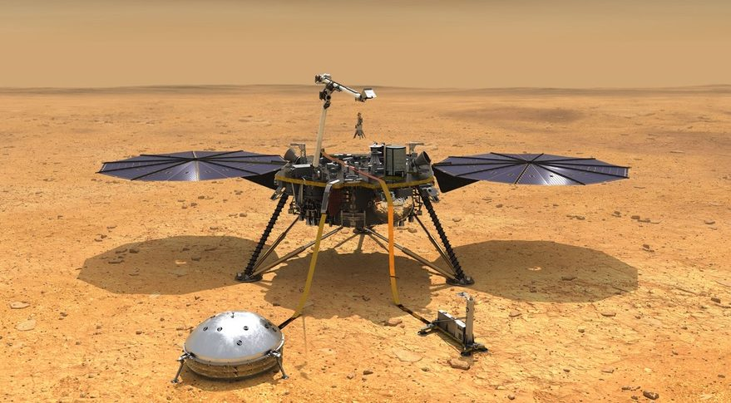
4. Expectations
EGU2020-6566
LaRa is a Belgian instrument selected on the ExoMars surface platform of Roscosmos/ESA mission.
LaRa will provide information on interior of Mars, its evolution, as well as CO₂ sublimation/ condensation process between the atmosphere and the ice caps.
synergies between InSight / RISE and LaRa are very valuable;
synergies with all atmospheric data are very valuable too.

Slide 7
5. Expected results (1)
EGU2020-6566
Mars Orientation Parameters (MOP) | Model | Max. MOP amplitude | Max. change in the lander position | Geophysical Properties
Nutation in obliquity (δε) | Trigonometric series (annual, ½, 1/3, …) | 10 m | 10 m | C_{f} (Mars core moment of inertia) Core state, core size, core density
Nutation in longitude (δψ) | Trigonometric series (annual, ½, 1/3, …) | 30 m | 12 m
Liquid Core effect | Liquid core amplification in the nutations | 0.7 m on dψ, 0.4 m on dε | 0.4 m
Precession Rate (uncertainty of 2 mas/y) | Rate | 0.8 m | 0.8 m | C (Mars moment of inertia)
Length-of-day (LOD) variations | Trigonometric series (annual, 1/2, 1/3, …) | 12 m | 12 m | Atmosphere and ice caps dynamics
Polar motion (PM) | Trigonometric series | 1.2 m | 1.2 m
Notes:
Since the Free-Core-Nutation (FCN) periods of the Mars models lie between the periods of the retrograde semi-annual and ter-annual rigid nutations (-343.5 days, -229 days), those nutations are the most affected by the liquid core.

Slide 8
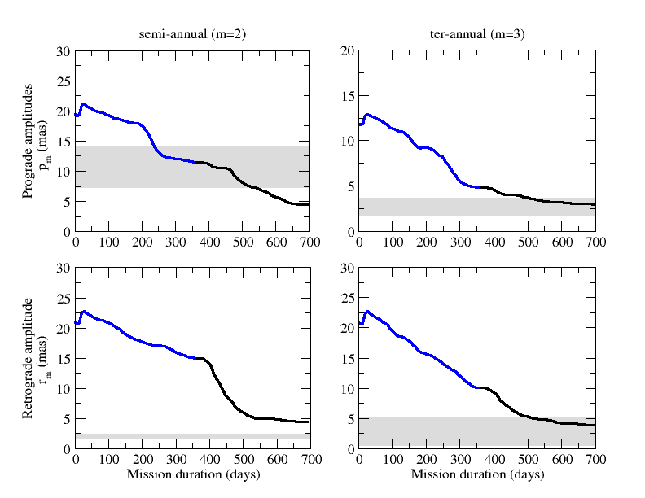
5. Expected results (2): Nutation estimates
EGU2020-6566
Estimated uncertainties on the amplitudes of the semi-annual prograde nutation and ter-annual retrograde nutation as a function of the mission duration.
The uncertainties are superimposed with the expected effect that a planet with a liquid core would have on those nutations (grey boxes).
These predicted uncertainties will be further reduced when combining LaRa’s data with InSight-RISE data.

Slide 9
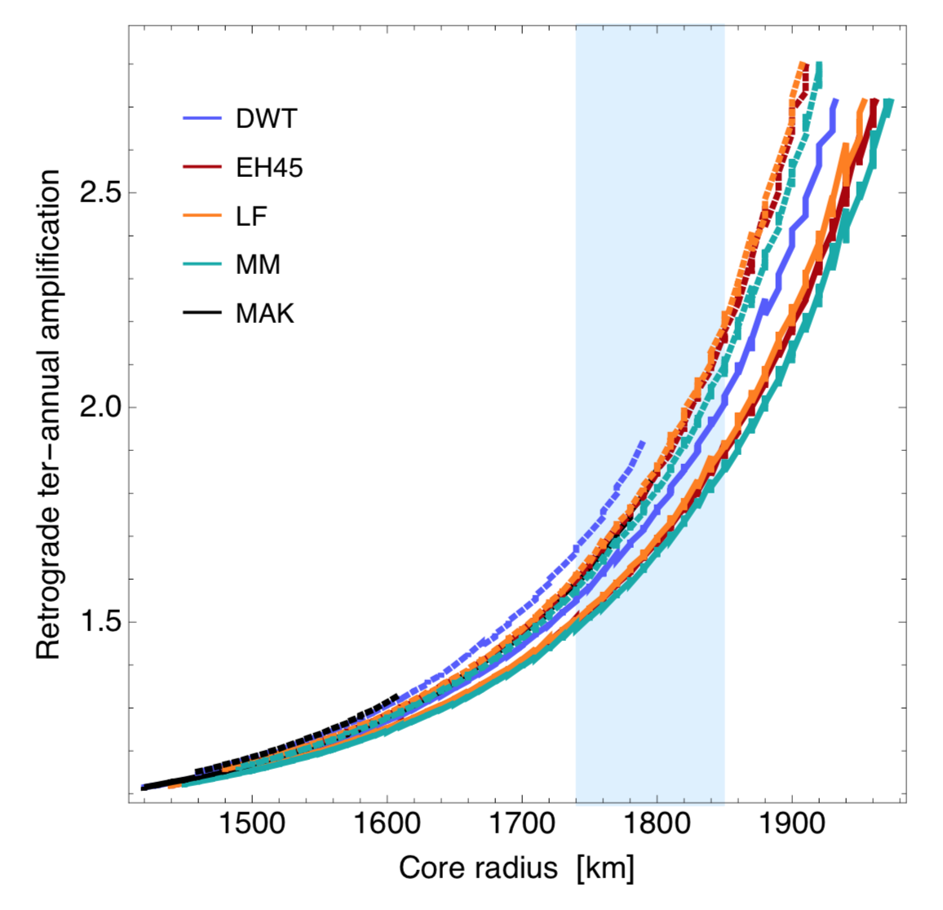
5. Expected results (3): Nutation estimates
EGU2020-6566
Measurement of the nutation parameters (in particular the ter-annual retrograde amplitude) will allow us to constrain the size of the Martian core as well as its moment of inertia and flattening.

Slide 10
6. Determination of the position of the lander
EGU2020-6566
LaRa alone can be used to estimate the coordinates (including Z) of the ExoMars 2020 Surface Platform (SP) at the level of tens of meters after only two days of DTE Doppler tracking operations.
Notes:
An early estimate of the lander location will certainly improve the quality of the science analysis (for instance by making easier the recognition of the geological features seen on the lander's pictures) and allow high resolution cameras from spacecraft to correctly target
the lander.

Slide 11


Thank you for your interest!!!!
Acknowledgements
EGU2020-6566
This work was financially supported by the Belgian PRODEX program managed by the European Space Agency in collaboration with the Belgian Federal Science Policy Office.

