Slide 1
Pollution trace gas distributions in the Asian monsoon UTLS derived from measurements of the airborne imaging limb sounder GLORIA during the StratoClim campaign
Sören Johansson ¹, Michael Höpfner ¹, Felix Friedl-Vallon ¹, Jörn Ungermann², Oliver Kirner³, Silvia Bucci⁴, Bernard Legras⁴, Ingo Wohltmann⁵, Gerald Wetzel ¹, Norbert Glatthor ¹, and Erik Kretschmer¹ 1.Institute of Meteorology and Climate Research, Karlsruhe Institute of Technology, Karlsruhe, Germany 2. Institut für Energie und Klimaforschung, Stratosphäre, IEK-7, Forschungszentrum Jülich, Jülich, Germany 3. Steinbuch Centre for Computing, Karlsruhe Institute of Technology, Karlsruhe, Germany 4. Laboratoire de Météorologie Dynamique, UMR8539, IPSL, CNRS/PSL-ENS/Sorbonne Université/École polytechnique, Paris, France 5. Alfred Wegener Institute, Helmholtz Center for Polar and Marine Research, Potsdam, Germany

Slide 2
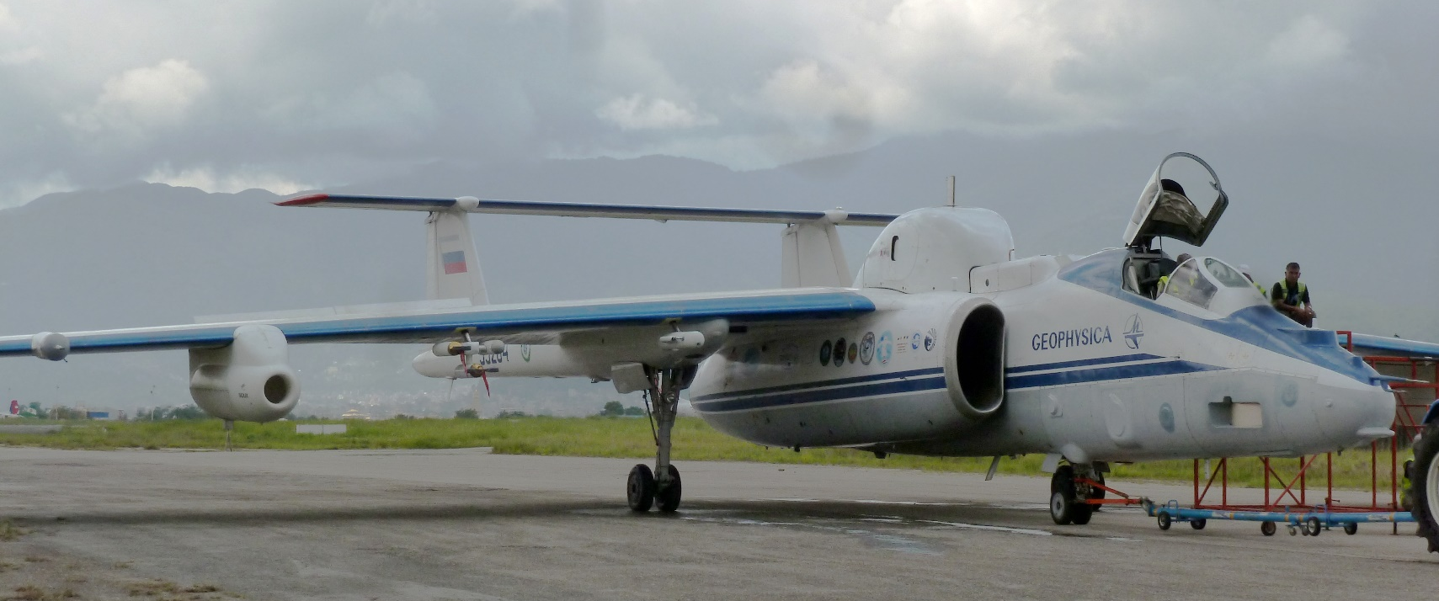
Outline
The GLORIA Instrument during the StratoClim campaign
GLORIA measurements of pollution trace gases C₂H₂, HCOOH and PAN
Model comparison
EMAC model sensitivity study
Trajectory analyses
The content of this EGU contribution (including figures) has been submitted to the ACP journal

Slide 3
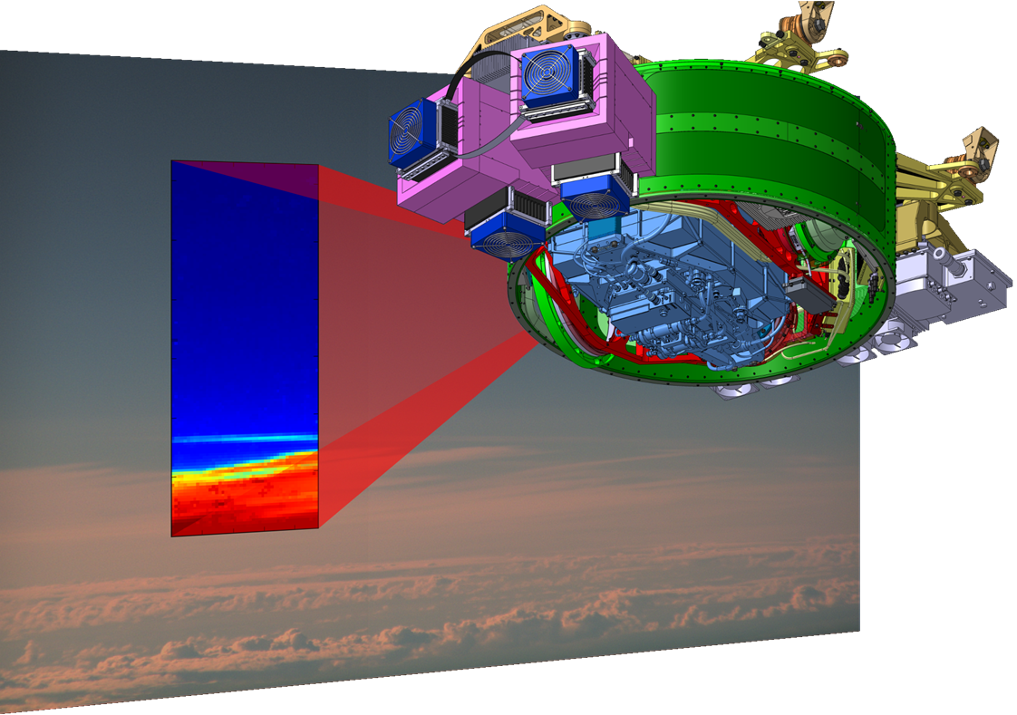
GLORIA: Gimballed Limb Observer for Radiance Imaging of the Atmosphere
Instrument consists of
Imaging Fourier-Transform Spectrometer: simultaneous measurement of 127x48 IR spectra
Gimballed frame: active line of sight control
Two external blackbodies: in-flight radiometric calibration
Unique iFTS for atmospheric limb-sounding
Riese et al. (AMT 2014)
Friedl-Vallon et al. (AMT 2014)

Slide 4
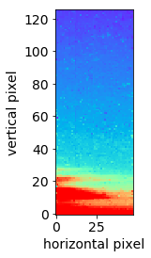
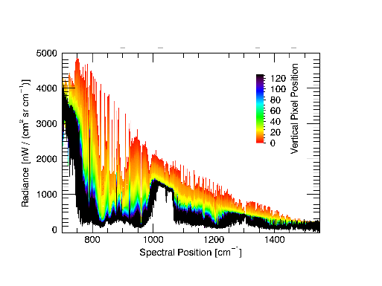
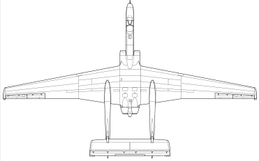
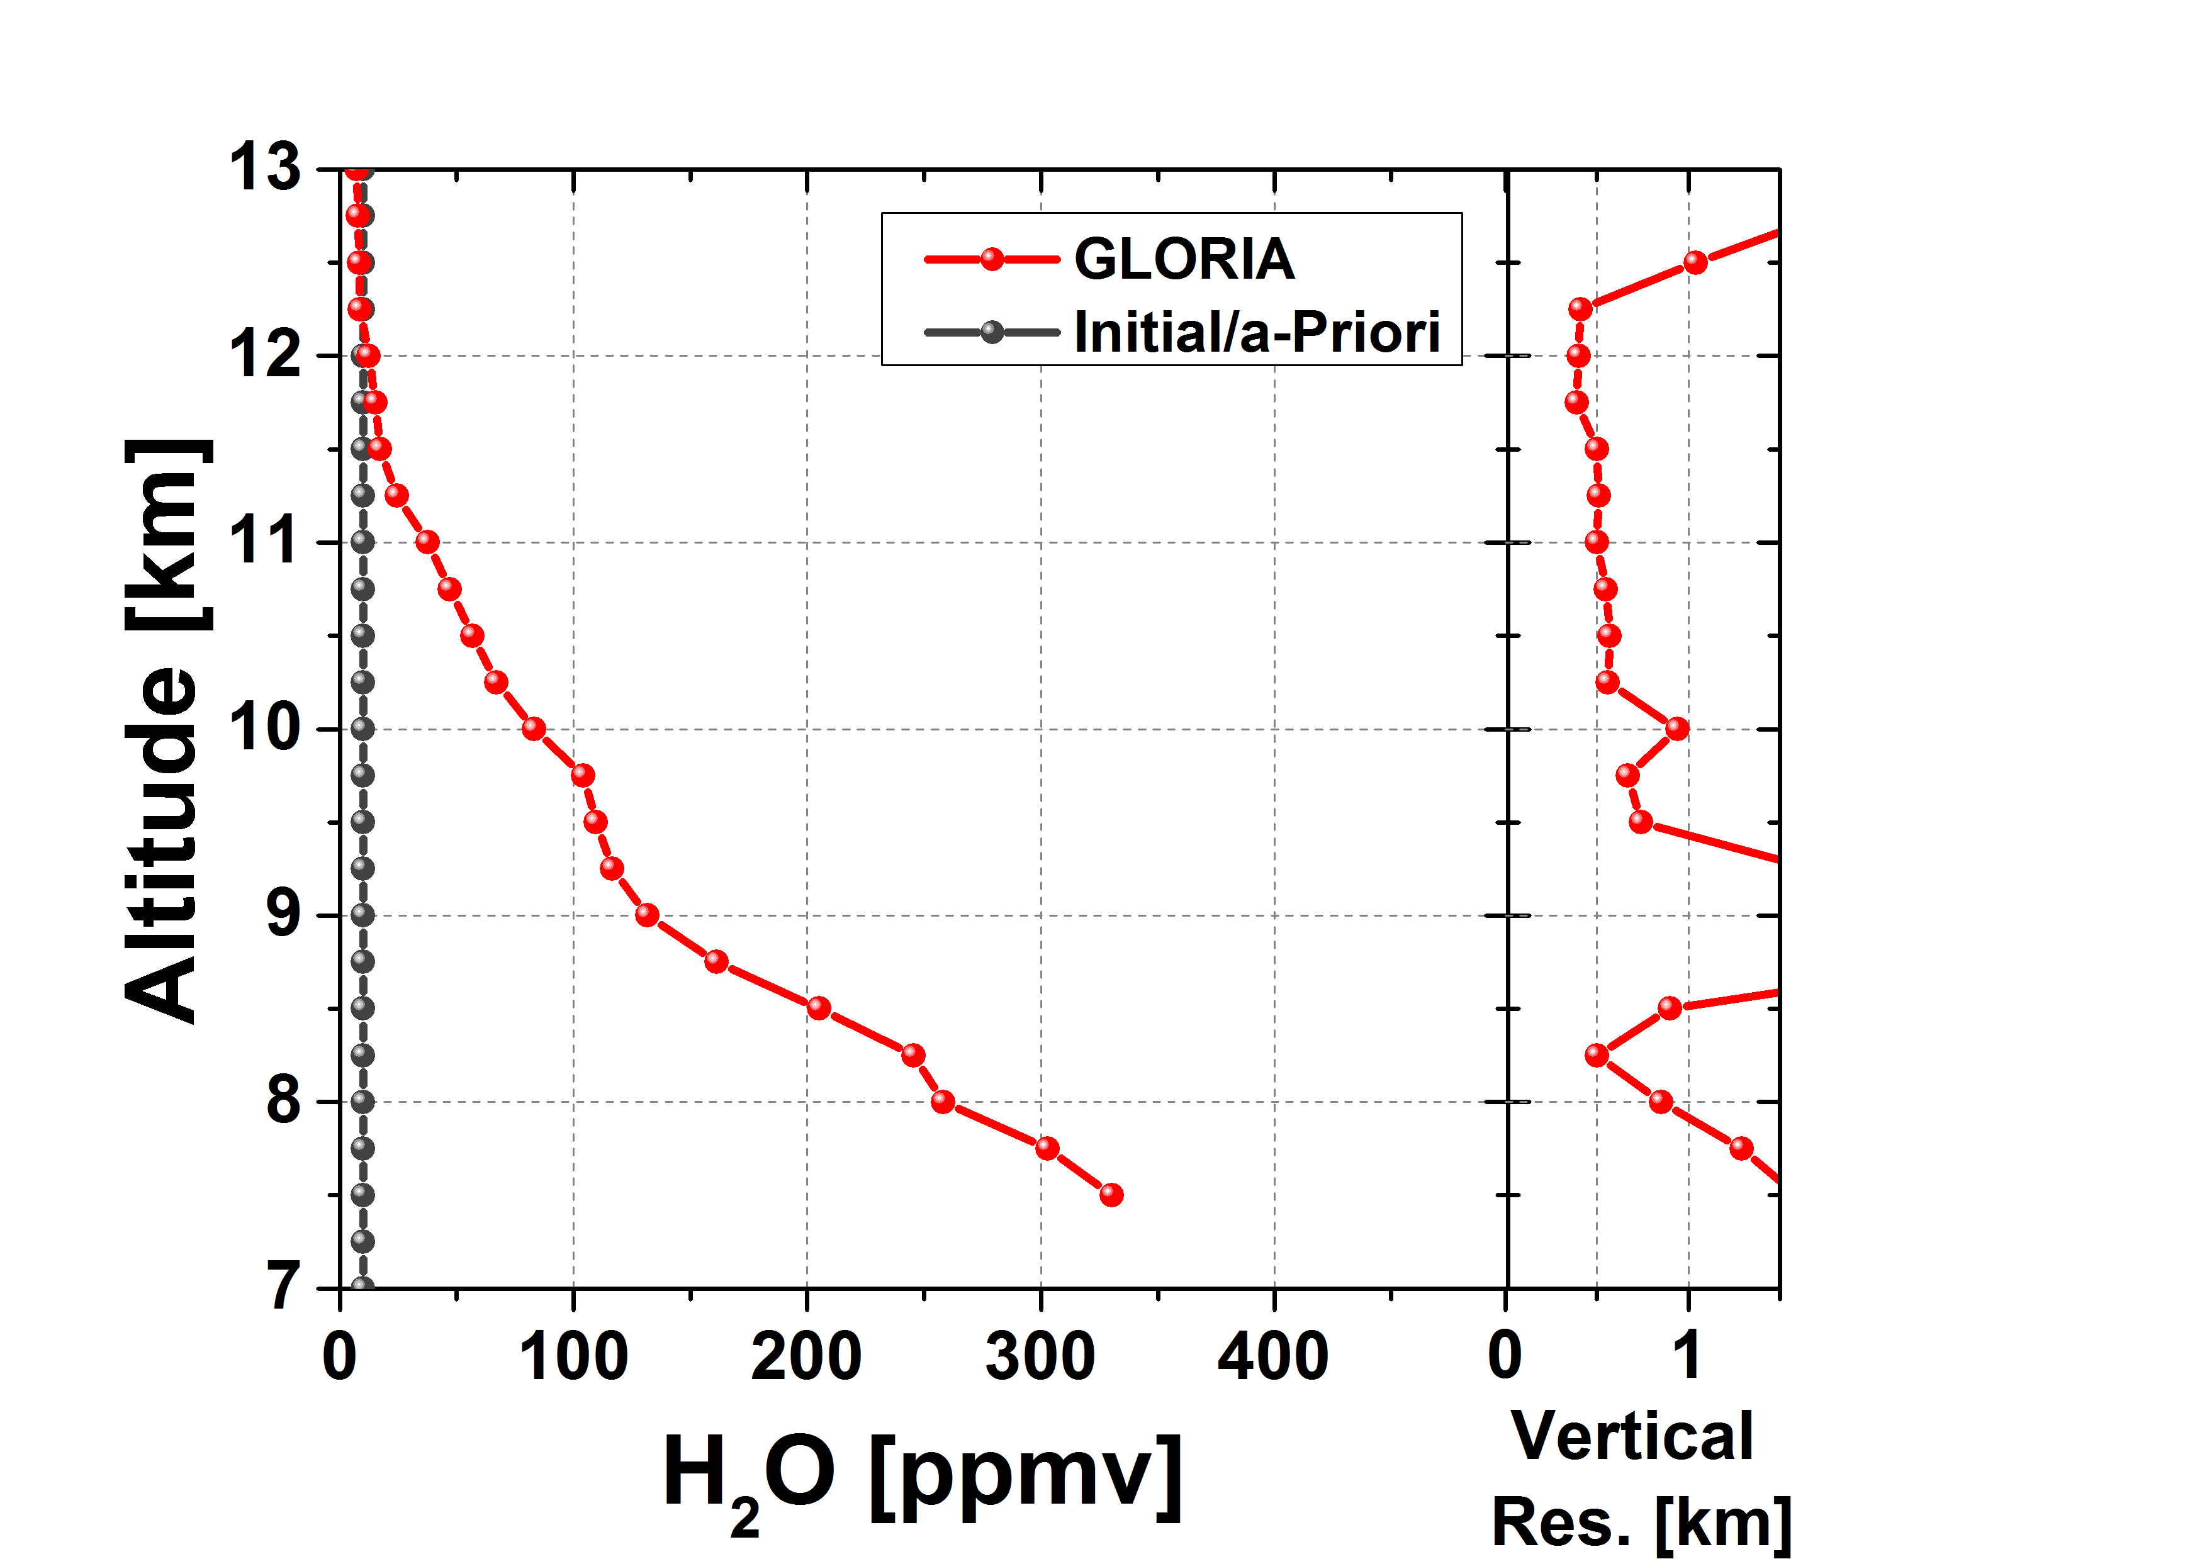
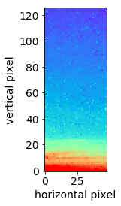
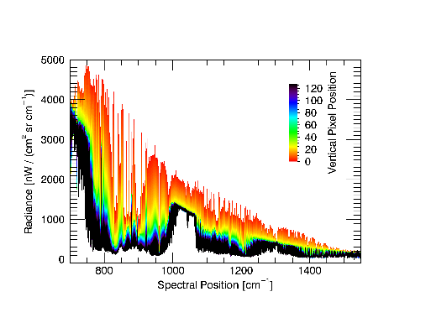
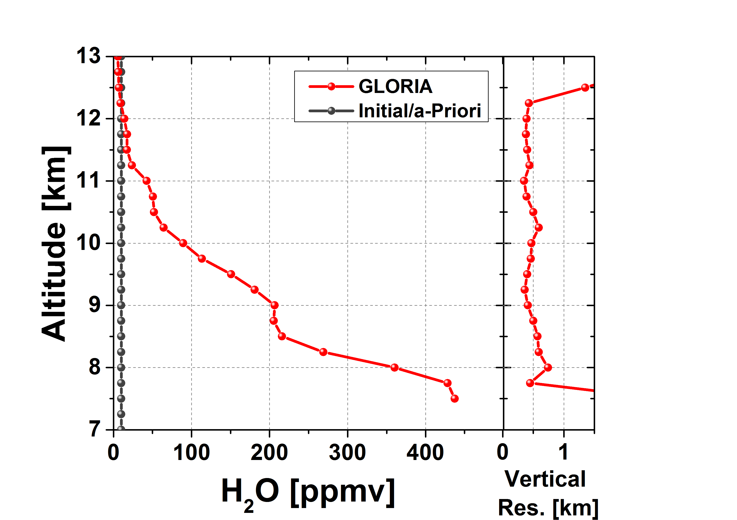
GLORIA sampling and processing
Measurements from all infrared spectra of one GLORIA image are used
Radiometric calibration using blackbodies and upward measurements
Constrained nonlinear least-squares fit
Typical vertical resolutions of 0.6-1.0 km (0.25 km retrieval grid)
Observer
Limb-images
= data cubes
Spectra
Parameter profiles
09:00:28
3 km
09:00:15
3 km
Level-1 Processing
Level-2 Processing
1 image = 128x48 pixels
1 interferogram per pixel
➔128x48 individual spectra
binning ➔ 128 spectra
➔1 profile of O₃, H₂O,
HNO₃, … per image
➔cross-sections of
O₃, H₂O, HNO₃, …
Slide courtesy: W. Woiwode, KIT

Slide 5
StratoClim aircraft campaign
Chemical and micro‐physical structure of the AMA, the LS, the TTL, and the Stratosphere
Exchange processes between all relevant atmospheric domains (UT, TTL, LMS, S).
Vertical transport by large scale ascent vs. convective transport.
Chemical transformation of trace gases and their products upon transport.
Micro‐physically relevant trace gases and their products and New Particle Formation (NPF).
Redistribution of (processed) trace gases and aerosol particles in the different domains.
http://stratoclim.org/
Russian M55 Geophysica research aircraft
Altitude up to 21 km
Range up to 3000 km
3 remote sensing instruments
11 in-situ instruments
10 particle instruments

Slide 6
Flights with GLORIA

Slide 7
Pollution trace gases: PAN
PAN (peroxyacetyl nitrate, CH₃COO₂NO₂)
Sources: Oxidation or photolysis of non-methane volatile organic compounds
Sinks: thermal decomposition
Lifetime: 1 h at 298 K, 5 months at 250 K

Slide 8
Pollution trace gases: C₂H₂ and HCOOH
C₂H₂ (acetylene or ethyne)
Sources: biomass burning, biomass and fossil fuel
Sinks: reaction with OH
Lifetime: ~2 weeks
HCOOH (formic acid)
Sources: biogenic emissions, biomass burning and fossil fuel combustion
Sinks: wet and dry deposition; reaction with OH
Lifetime: ~days-weeks (troposphere)

Slide 9
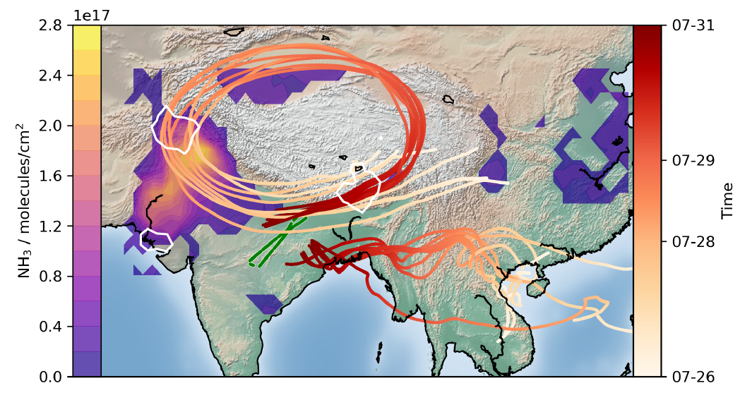
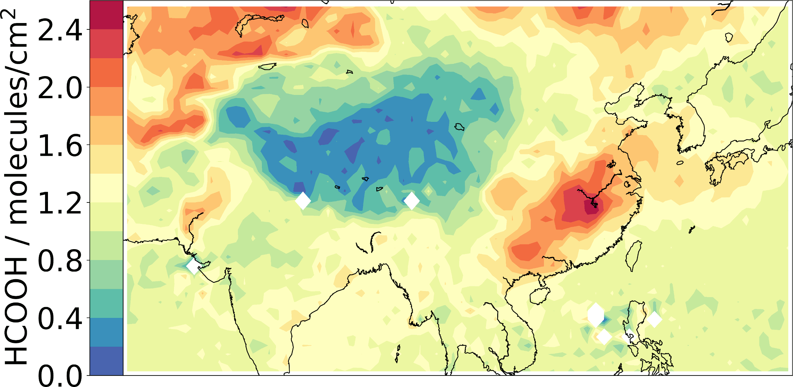
HCOOH and NH₃
HCOOH has a minimum, where C₂H₂ and PAN show constantly high VMRs
Same locations as enhancement in NH₃ (see Höpfner et al.)
IASI shows enhancements at estimated source region of NH₃
Indicates more efficient wash-out process for HCOOH than for NH₃
Höpfner et al., Nat. Geosc., 2019, 10.1038/s41561-019-0385-8 and EGU contribution D2763 | EGU2020-7585

Slide 10
Model comparison
CAMS (Copernicus Atmosphere Monitoring Service) Reanalysis
T255 resolution (80 km); 60 vertical levels; 3 h temporal resolution
Same meteorological input as for ERA-5
No stratospheric chemistry
GLORIA data averaged over 100 km to better match the model horizontal resolution
EMAC (ECHAM / MESSy Atmospheric Chemistry)
T106 resolution (1.1°× 1.1°); 90 vertical levels; 4 min. internal time steps, 5 h temporal output
Nudged to ERA-Interim
Chemistry: troposphere to mesosphere with expanded chemistry scheme to better simulate PAN chemistry
Sensitivity simulations with 100% increased NMVOC emissions

Slide 11
Model comparison: CAMS
PAN
First part of the flight: Large differences (due to strong convective influence not resolved by meteorological fields?)
Second part: orange maximum and blue minimum reproduced, but too low absolute values.
Cyan maximum only towards end of flight
HCOOH
Not reproduced by CAMS

Slide 12
Model comparison: EMAC
First part of the flight: Large differences in all gases due to strong convective influence not resolved by meteorological fields?
PAN
Orange maximum and blue minimum reproduced, but too low absolute values.
Cyan maximum only towards end of flight
C₂H₂
Not reproduced by EMAC
HCOOH
Orange maximum and blue minimum reproduced, but too low absolute values.

Slide 13
EMAC sensitivity simulation
Doubled NMVOC emissions
No change of structure in VMR distributions
Maximum VMRs better reproduced, but still too low for C₂H₂ and HCOOH
Background VMRs are simulated too high for PAN and HCOOH

Slide 14
Backward trajectory analysis
TRACZILLA Alfred
Release of 1000 back-trajectories based on ERA-5 per measurement geolocation
0.25°×0.25° resolution
137 levels
1 h temp. resolution,
10°W to 160°E, and 0°N to 50°N spatial domain
Diffusion coefficient D=0.1 m²/s
Convection probability along trajectories based on brightness temperature of MSG1 and Himawari satellites
ATLAS (Alfred Wegener InsTitute LAgrangian Chemistry/Transport System)
Release of 1000 back-trajectories based on ERA-5 per measurement geolocation
1.125°×1.125° resolution
137 levels
3 h temporal resolution
global domain
Diffusion coefficient D=0.1 m²/s
Stochastic parameterization of convective transport driven by ERA-5 convective mass fluxes and detrainment rates

Slide 15
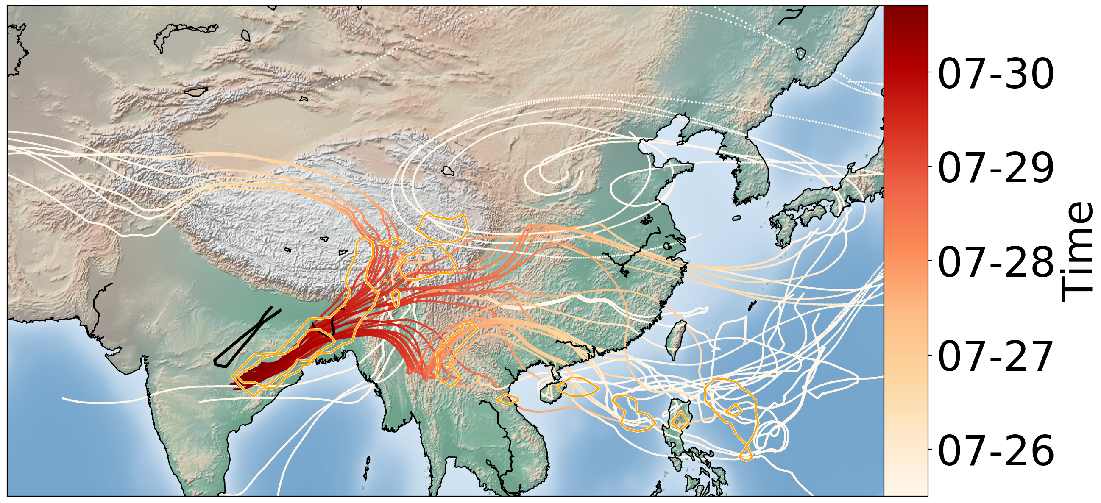
Origin of pollution gases
Regions of interest as marked in the GLORIA measurements
Backward trajectories from measurement geolocations
Convection events along trajectories
Density of convective events are shown with iso-lines (threshold: 0.1%, 1.0%, and 10% of convective events of all released trajectories per 1°x1°)
Comparison to OMI NO₂ tropospheric column

Slide 16
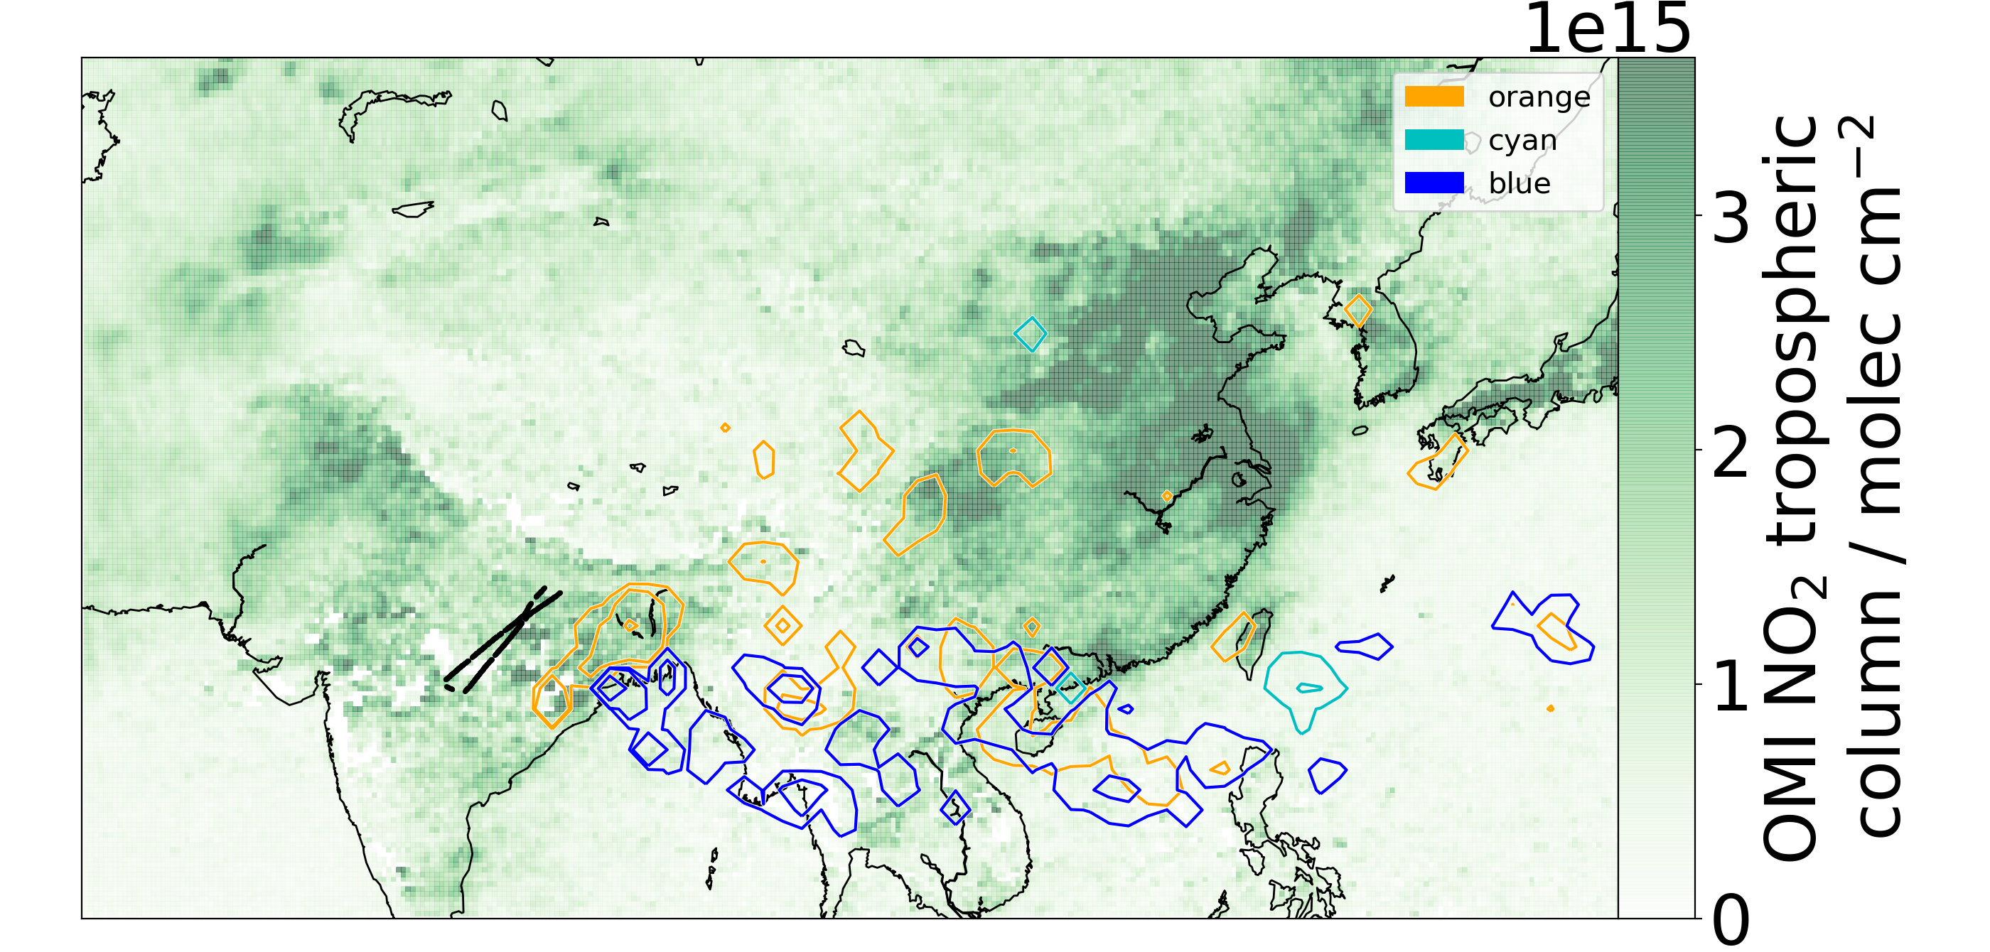
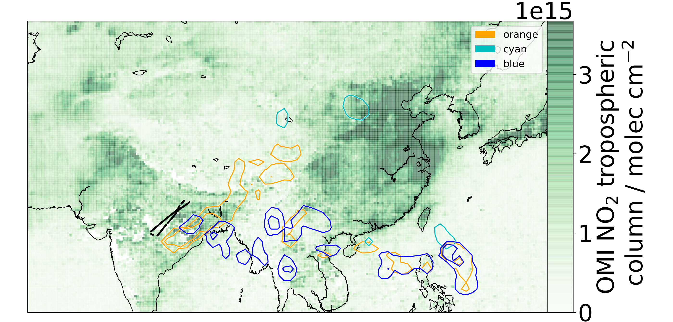
Origin of pollution gases
TRACZILLA
ATLAS

Slide 17
Origin of pollution gases
TRACZILLA
ATLAS

Slide 18
Origin of pollution gases
TRACZILLA
ATLAS

Slide 19
Conclusions
First measurements of PAN, C₂H₂ and HCOOH in high resolution in the center of the Asian Monsoon
Model Comparison
First flight part: difficult to reproduce by CAMS and EMAC due to high convective influence not resolved by meteorological fields
Second flight part shows similar structures in models, but too low maximum VMRs
Backward trajectory analysis
Local emissions from India contribute to enhanced PAN, C₂H₂ and HCOOH, measured in the upper troposphere
Our paper has been submitted to ACPD!

