Slide 1


The Efficiency of Upward Wave Propagation
Near the Tropopause
Israel Weinberger
EGU online 2020
Israel Weinberger, Chaim Garfinkel, and Thomas Birner

Slide 2
Motivation
  Not all periods with anomalous heat flux at 100hPa were preceded by anomalous heat flux in the troposphere (Birner and Alberts 2017; White et al 2019; Camara et al 2019)
  The goal of this work is to understand the factors that govern the efficiency of upward wave propagation near the tropopause.

Slide 3
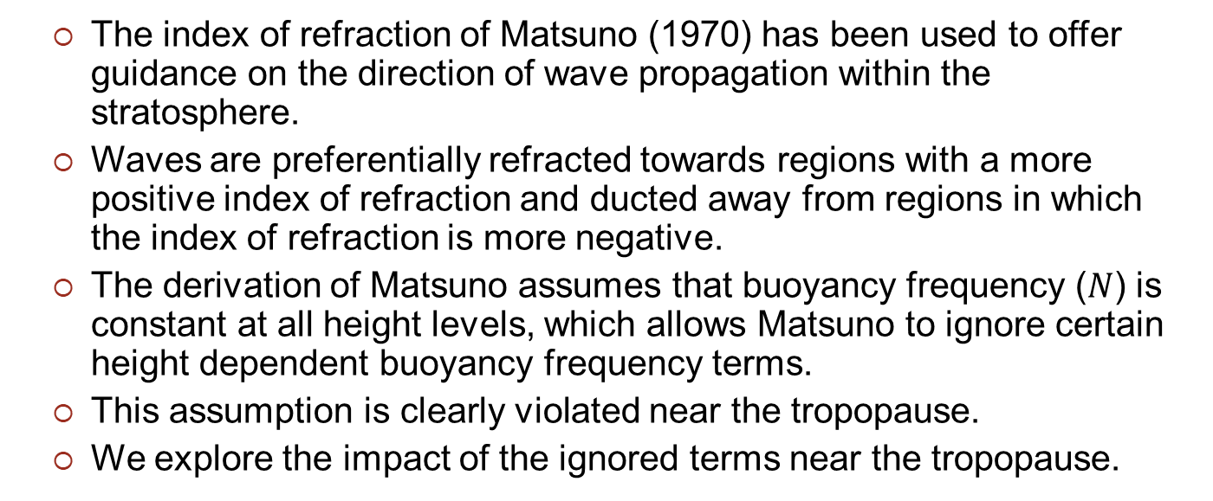
Introduction
  The index of refraction of Matsuno (1970) has been used to offer guidance on the direction of wave propagation within the stratosphere.
  Waves are preferentially refracted towards regions with a more positive index of refraction and ducted away from regions in which the index of refraction is more negative.
  The derivation of Matsuno assumes that buoyancy frequency ($N$) is constant at all height levels, which allows Matsuno to ignore certain height dependent buoyancy frequency terms.
  This assumption is clearly violated near the tropopause.
  We explore the impact of the ignored terms near the tropopause.
Notes:
$N$varies with height - see Figure 5 lower row panels

Slide 4
Method
  The European Center for Medium-Range Weather Forecasts Reanalysis version 5 (ERA5) dataset covering 1979 to 2018
  We defined two events composites - more efficient (‘transmitting’) and less efficient (‘decaying’) upward propagation
    Transmitting – the standardized heatflux anomaly at 100hPa is stronger than the standardized anomaly at 300hPa by at least 2 STD.
    Decaying - the standardized heatflux anomaly at 100hPa is smaller than the standardized anomaly at 300hPa by at least 2 STD

Slide 5

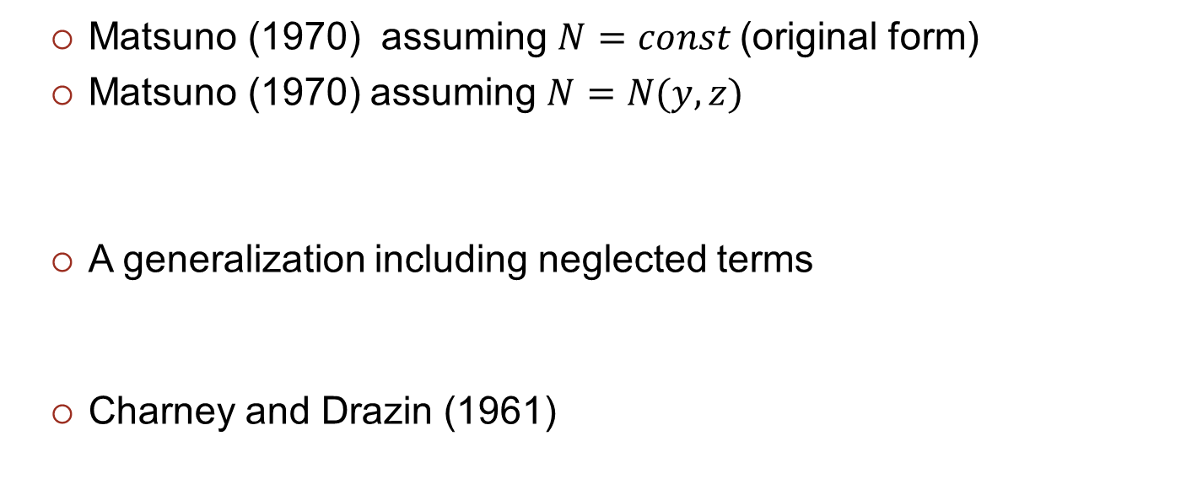
Four refractive indices
  Matsuno (1970) assuming $N=const$(original form)
  Matsuno (1970) assuming $N=N(y,z)$
  A generalization including neglected terms
  Charney and Drazin (1961)
Notes:
1 M70 - The Matsuno (1970) in the form in Andrews et al section 5.3 page 240 eq.(5.3.7)
2
3
4

Slide 6
The index of refraction climatology
  Near the tropopause, the additional z dependent terms are not negligible
  The generalized refractive indices are negative near the tropopause

Slide 7
Transmitting vs Decaying
The index of refraction composite means
  There are more negative values in the decaying composite near the tropopause for all four.

Slide 8
Transmitting vs Decaying
The index of refraction transmitting minus decaying
  There are more negative values in the decaying composite near the tropopause

Slide 9
Summary
  Near the tropopause, the additional z dependent terms are leading order.
  There are more negative values in the decaying composite near the tropopause.

