Slide 1
Biological lability of dissolved organic matter released by the diatom Phaeodactylum tricornutum
Bachi G.¹, Morelli E. ¹, Gonnelli M. ¹, Casotti R. ², Vestri S. ¹, Balestra C. ², Santinelli C. ¹
¹ CNR – Istituto di Biofisica, Pisa, Italy
² SZN – Stazione zoologica Anton Dohrn, Napoli, Italy

Slide 2
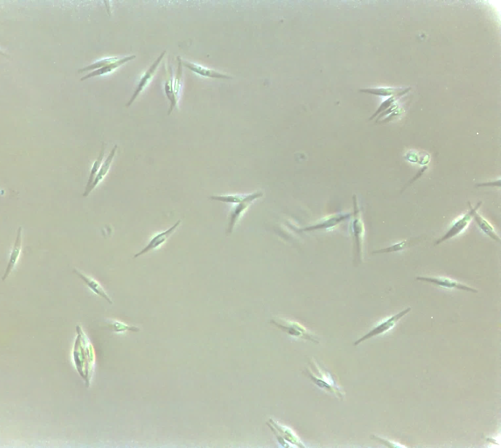
Experimental strategy
DOM release from cultures of P. tricornutum
P. tricornutum cells
Cultures of P. tricornutum
Cultures in exponential phase
Analysis:
Cell density (absorbance at 680 nm)
DOC (High Temperature Catalitic Oxidation)
FDOM (Excitation Emission Matrices)

Slide 3
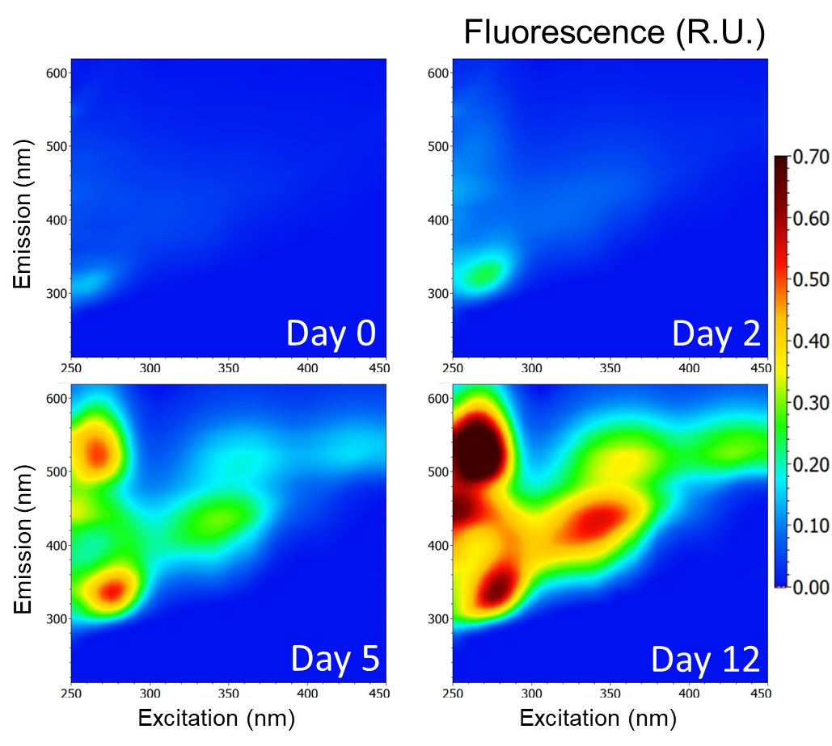
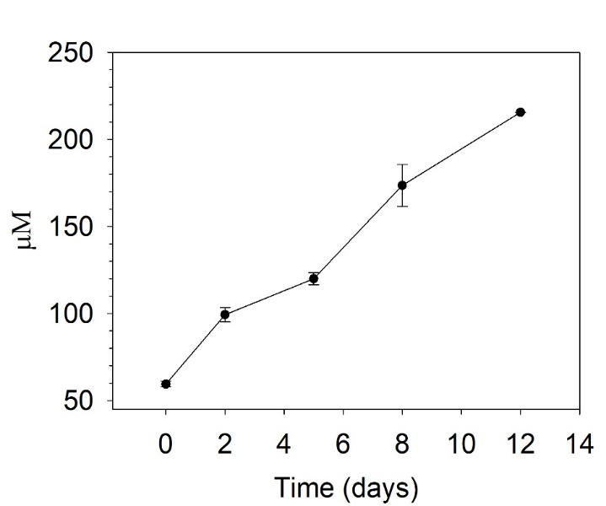
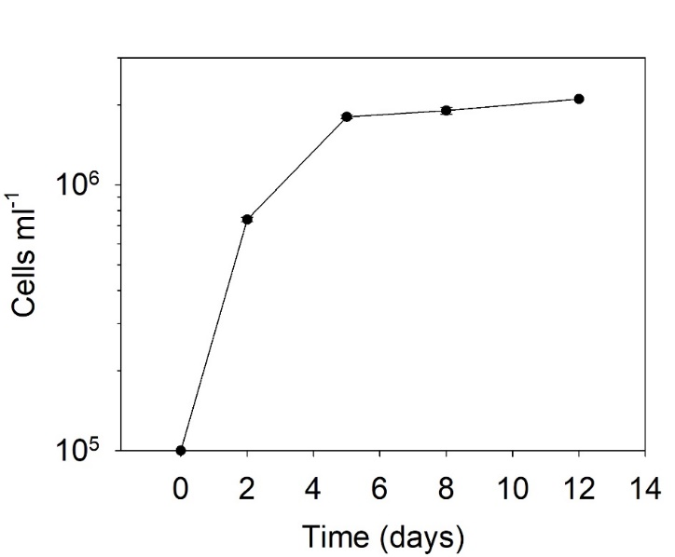
DOM release during P. tricornutum growth
DOC
Protein-like
Cell density
Flavin-like
Flavin-like
Humic-like
Humic-like
Protein-like
Protein-like
Time (Days)

Slide 4
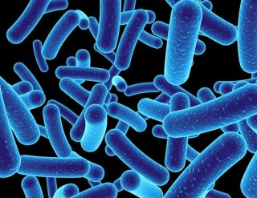
Experimental strategy
Incubation experiments with exudates from P. tricornutum cultures
Marine surface (~1 m) microbial community
0.8 µm
Analysis:
DOC
FDOM
Bacterial abundance (flow citometry)
0.2 L
Retentate
(High Molecular Weight)
>3k Da
Exudates DOM
1.8 L
Permeate
(Low Molecular Weight)
<3k Da
Cultures of P. tricornutum
Exudates collected at 12 days (stationary phase)
24 days of incubation
Separation Amicon Ultra

Slide 5
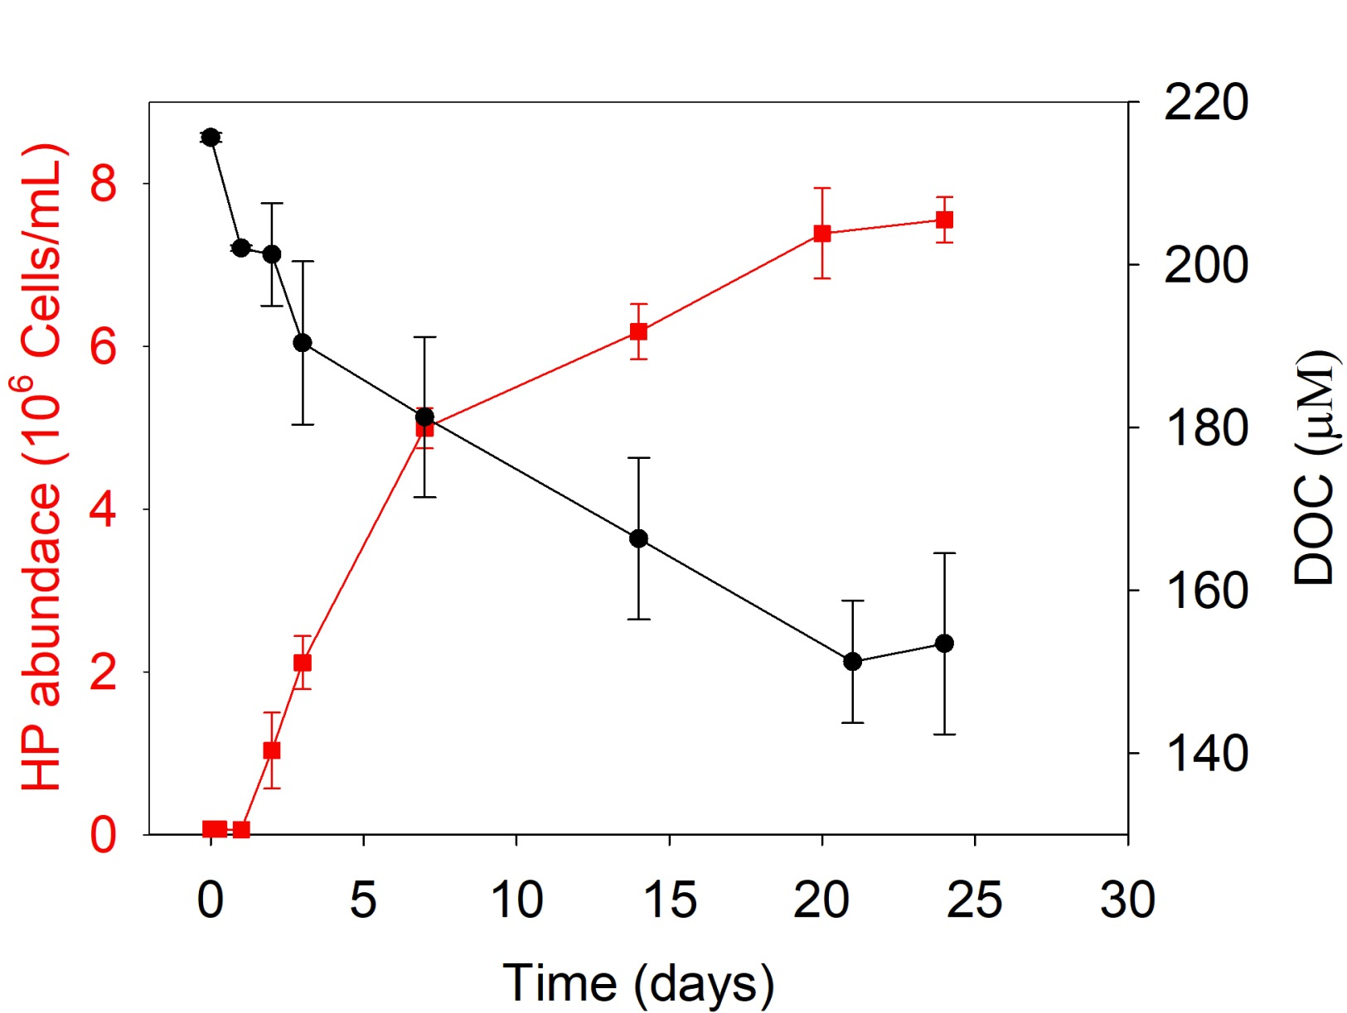
Heterotrophic abundance and DOC trend (total exudate)

Slide 6
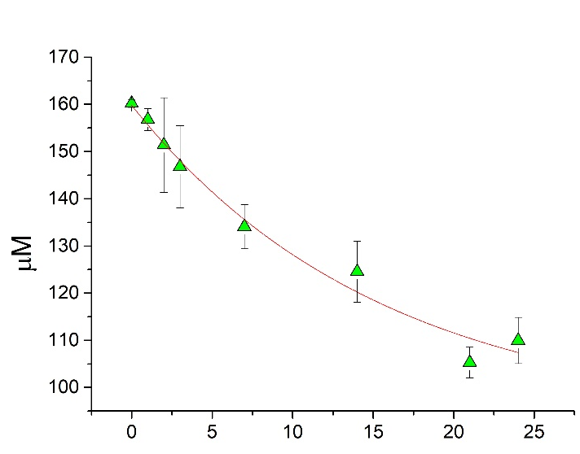
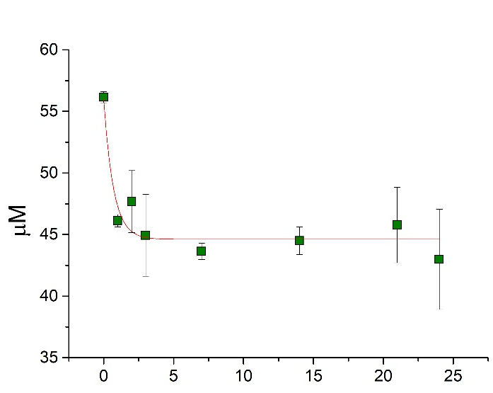
DOC trend in the Permeate (LMW) and Retentate (HMW)
Permeate (LMW)
Retentate (HMW)
Time (Days)
Time (Days)
At t0 75% of the DOC pool was in the Permete (LMW) and 25% in the Retentate (HMW)

Slide 7
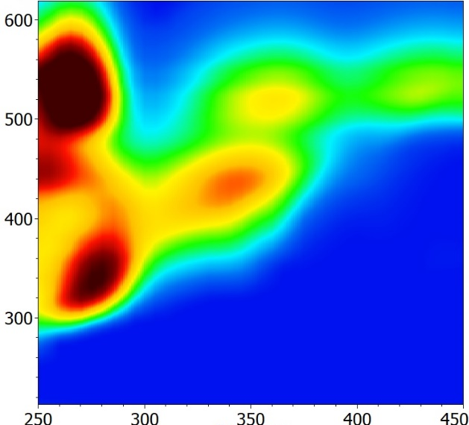
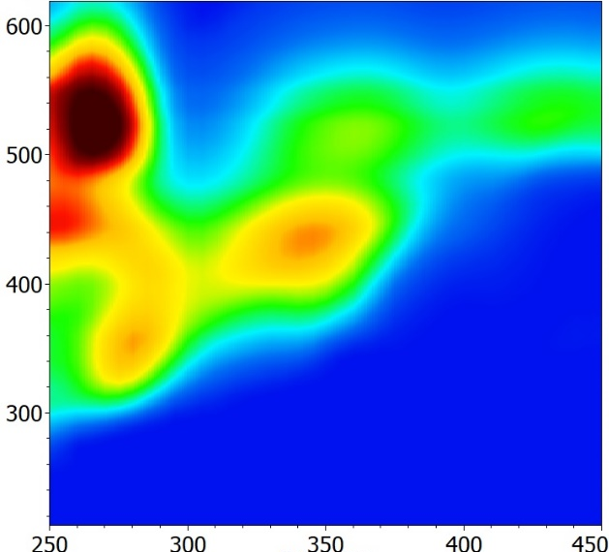
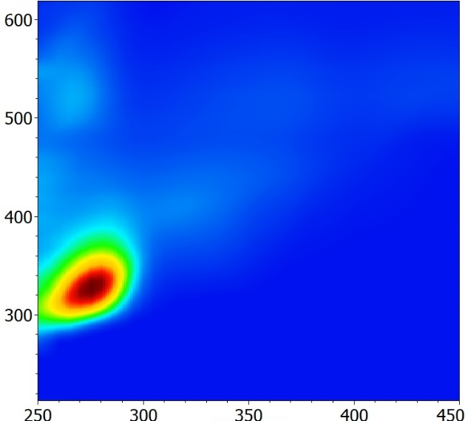
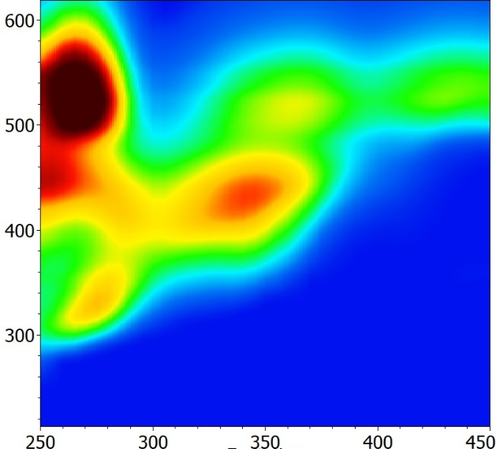
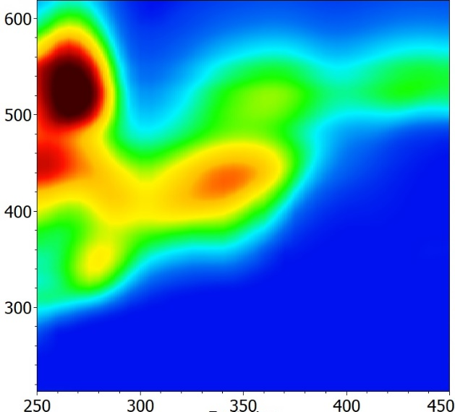
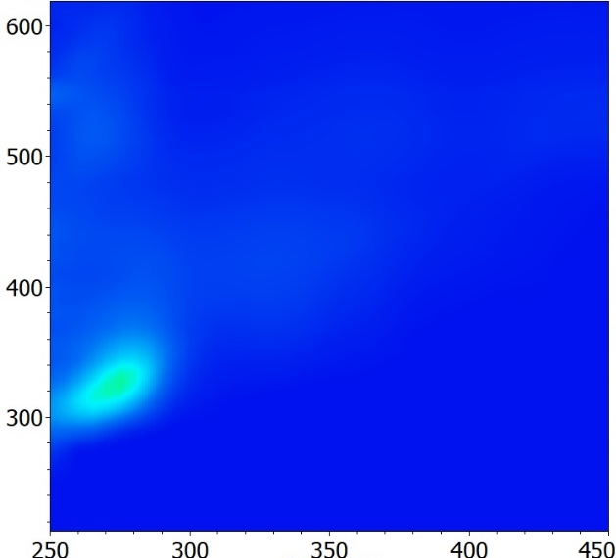
Fluorescence at day 0 and at 24
Total Exudate
Permeate (<3k Da)
Retentate (>3k Da)
0 Day
Emission (nm)
24 Day
Emission (nm)
Excitation (nm)
Excitation (nm)
Excitation (nm)
The retentate is characterized by proteins bigger than 3k Da, the permeate contains all the humic-like and flavin-like material and small peptides

Slide 8
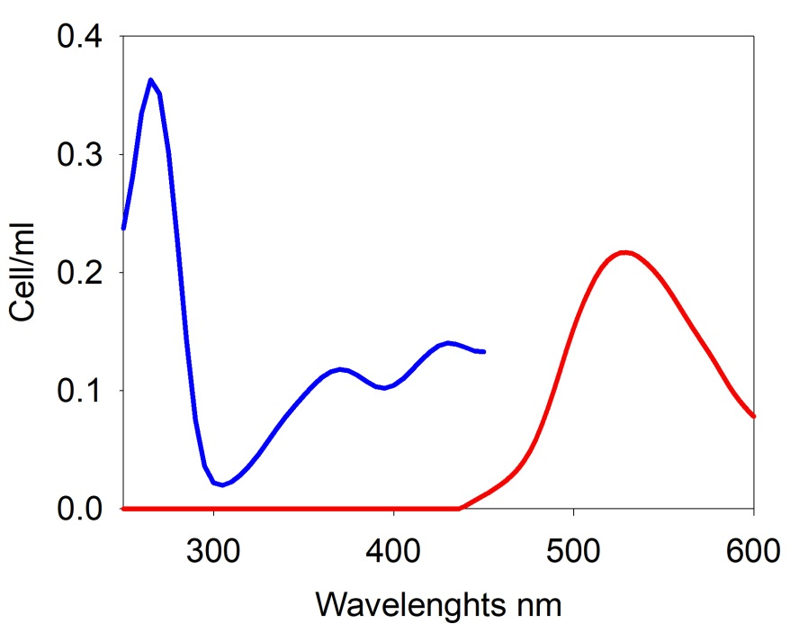
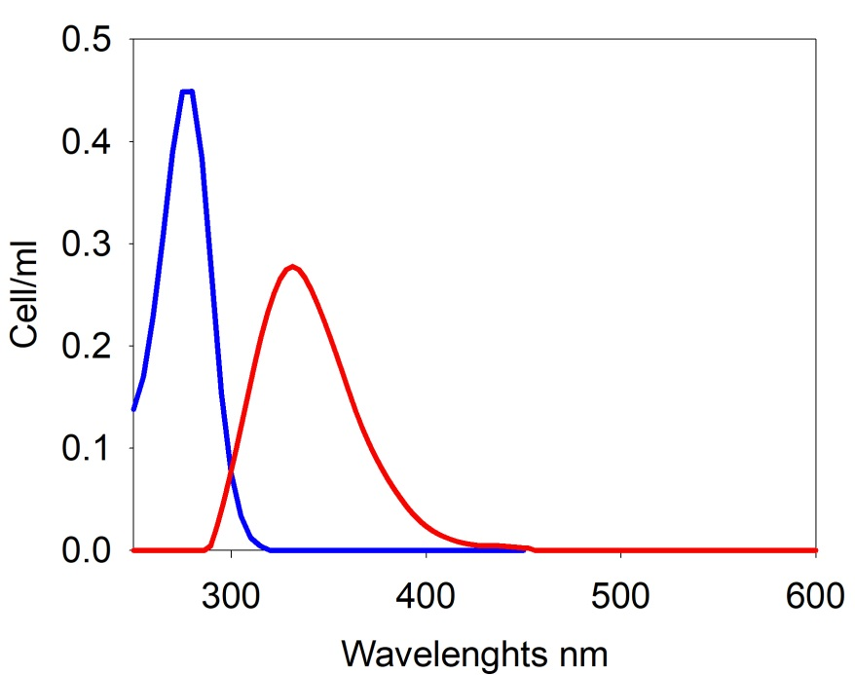
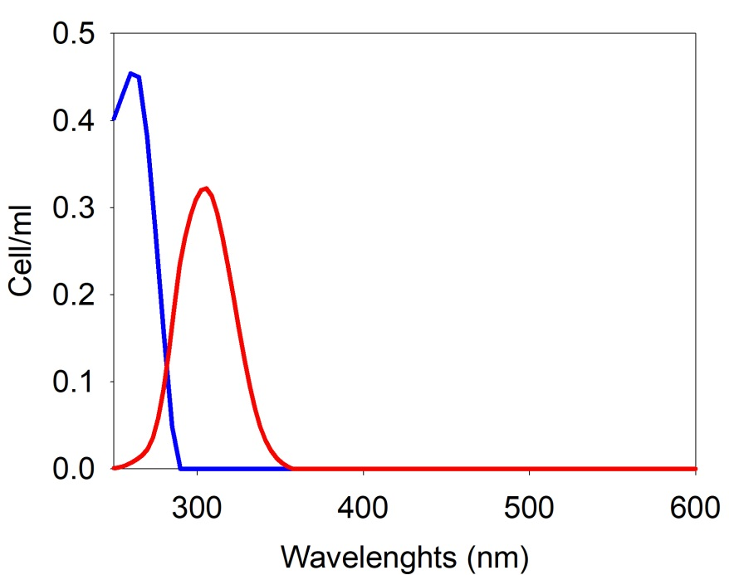
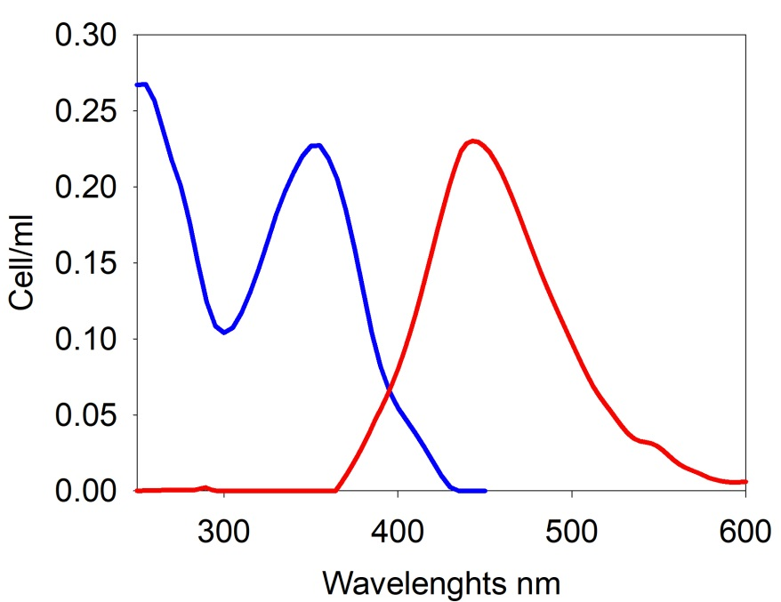
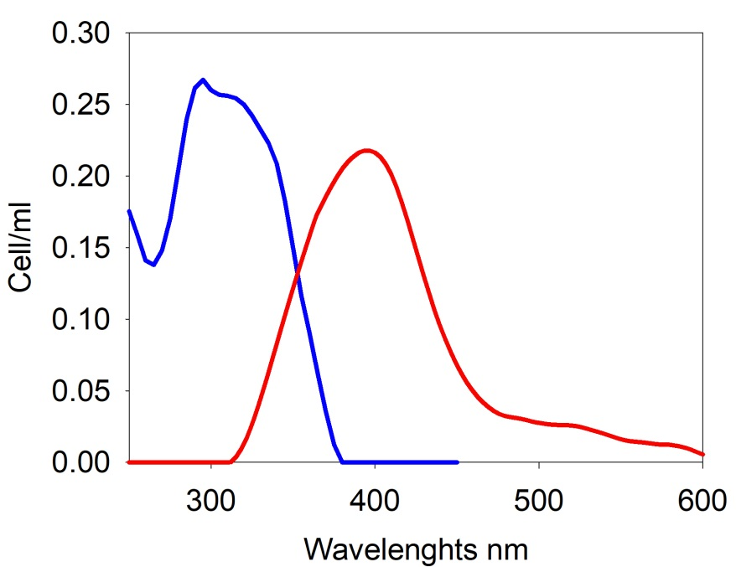
PARAFAC analysis: validation of a 5-component model
280
C1 Flavin-like
275
C2 Tryptophan-like
Excitation
Emission
528
340
Loadings
430
Loadings
370
260
C5 Tyrosin-like
305
Loadings
255
C3 Humic₁-like
295
C4 Humic₂-like
355
442
396
Loadings
Loadings
Identification by using OpenFluor online database (TCC>0.95) https://openfluor.lablicate.com/

Slide 9
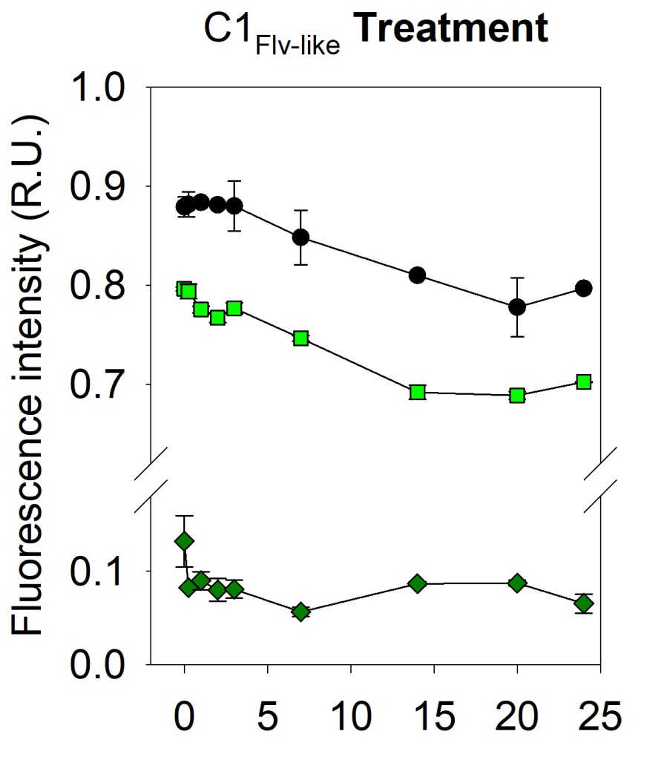
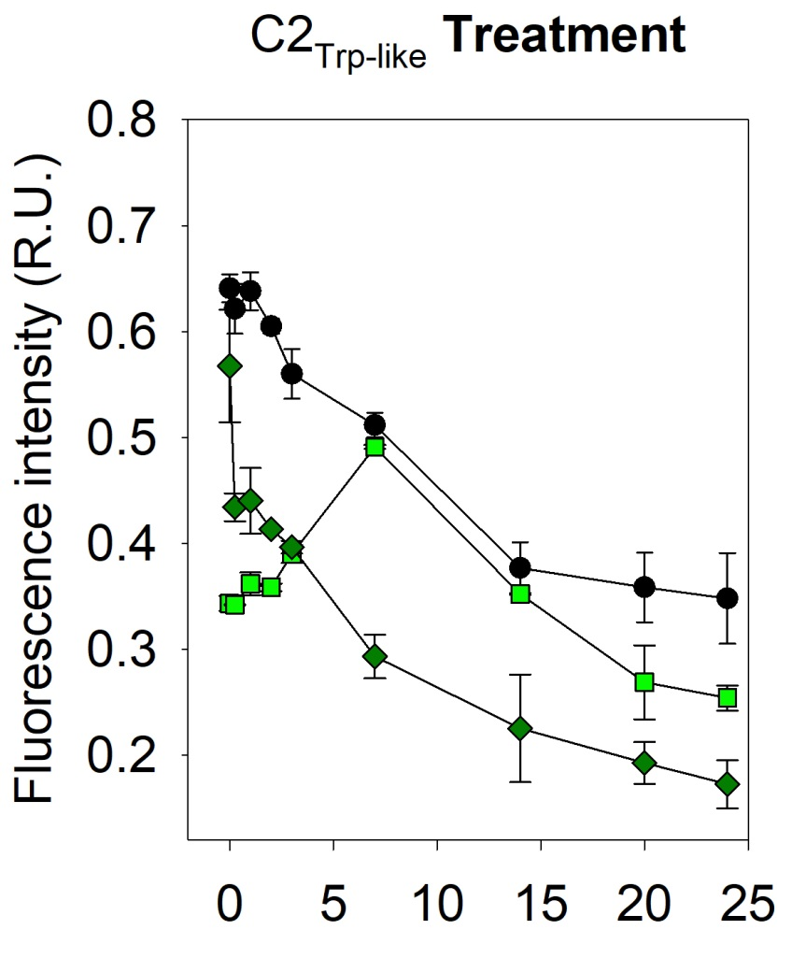
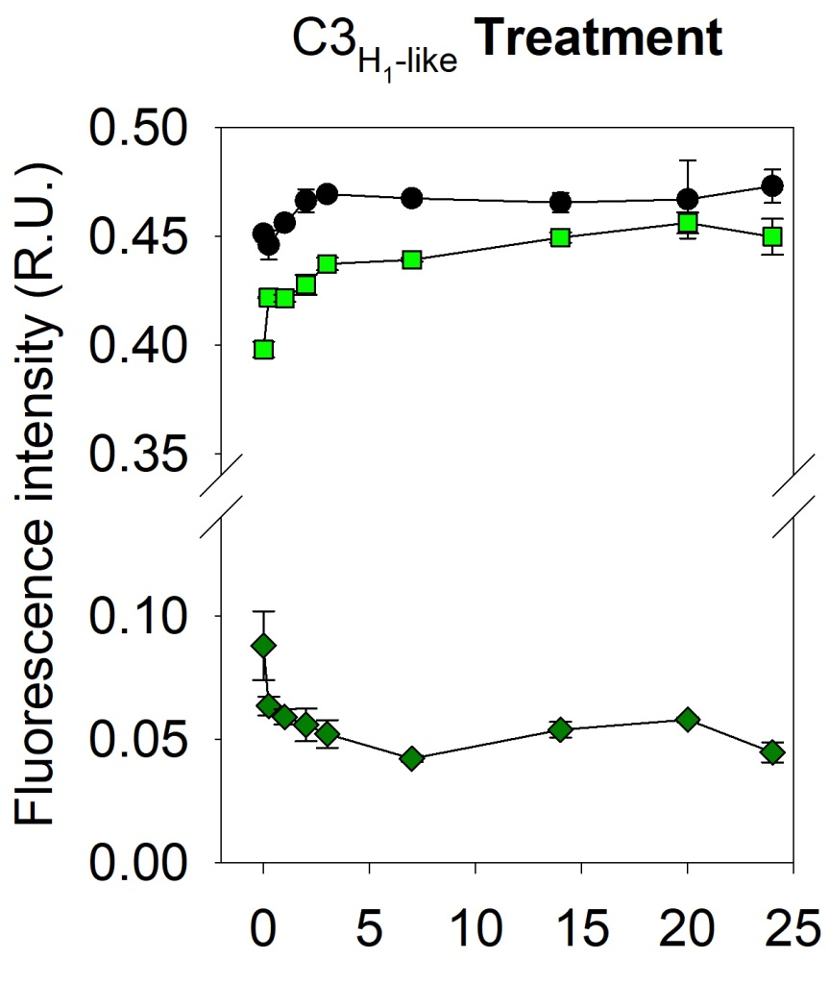
FDOM trend in the Total exudate, Retentate (HMW) and Permeate (LMW)
C1 Flavin-like
C2 Protein-like
C3 Humic-like
Time (Days)
Time (Days)
Time (Days)
Total exudate
Slight decrease of flavin-like after 3 days
Marked removal of protein-like substances
Degradation of proteins bigger than 3k Da into smaller peptides during the first 7 days
Permeate
Retentate

