Slide 1
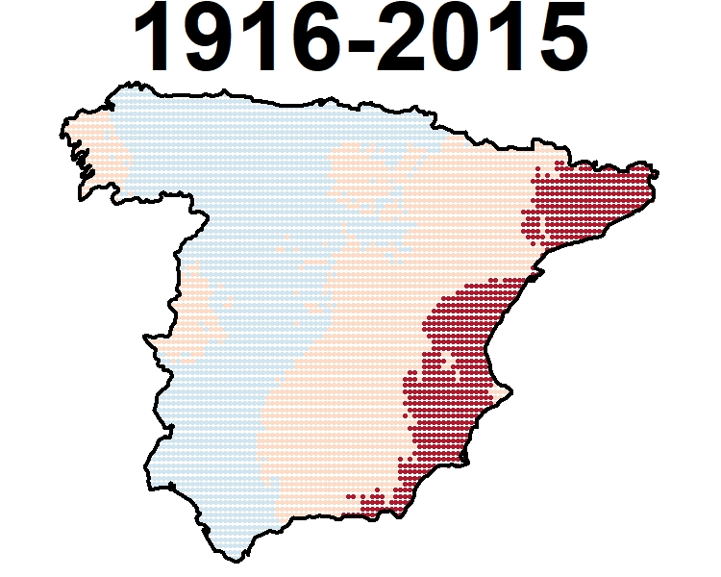
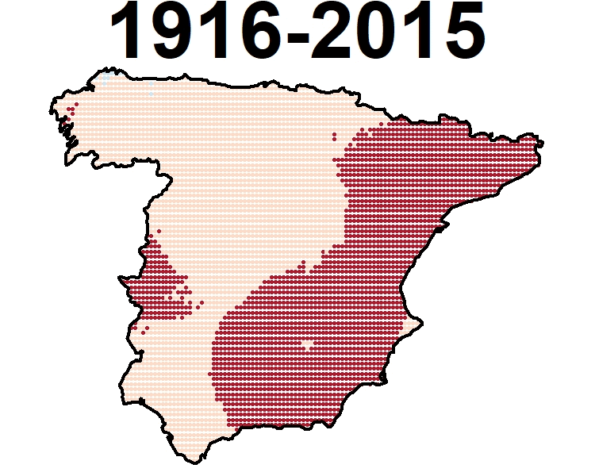
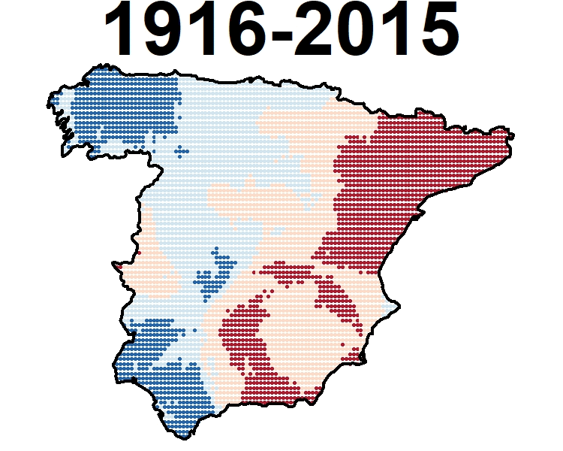
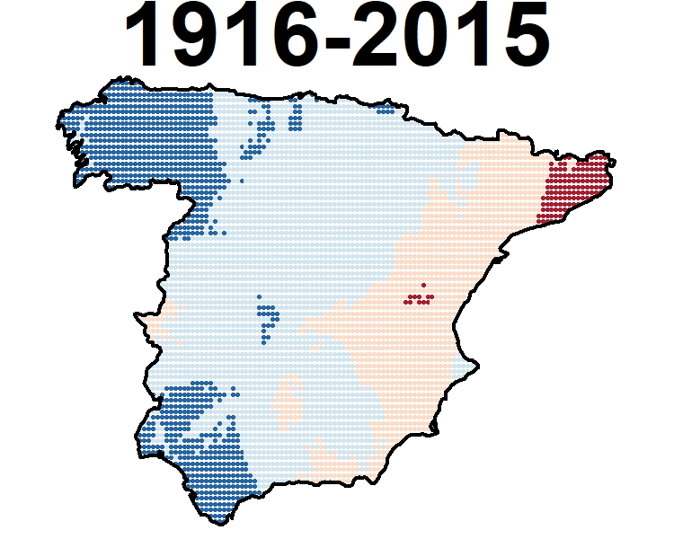
EGU General Assembly 2020, Vienna, Austria
Thermal amplitude (Winter)
Thermal amplitude
(Spring)
Thermal amplitude
(Summer)
Thermal amplitude
(Autumn)
MOTEDAS Century Database
Thermal amplitude trends in Spanish mainland (1916-2015)
Instituto Pirenaico de Ecología, CSIC, Zaragoza, SPAIN (dpang@unizar.es)
University of Zaragoza, Geography, Zaragoza, Spain (leiresandonis@unizar.es; jcgh@unizar.es)
Institute of Atmospheric Sciences and Climate (ISAC-CNR), Bologna, Italy (m.brunetti@isap.cnr.it)
Estación Experiemental Aula Dei, CSIC, Zaragoza, Spain (sbegueria@eead.csic.es)
Proyecto “CLICES”, El clima del último siglo en la España Peninsular” (CGL2014-83866-C3-1-R ,CGL2014-83866-C3-3-R). AEI/FEDER, UE. Ministerio de Economía y Competitividad de España. Gobierno Regional de Aragón DGA-FSE
Grupo de Investigación Consolidado ‘Clima, Agua, Cambio Global y Sistemas Naturales’.
Visit clices.unizar.es

Slide 2
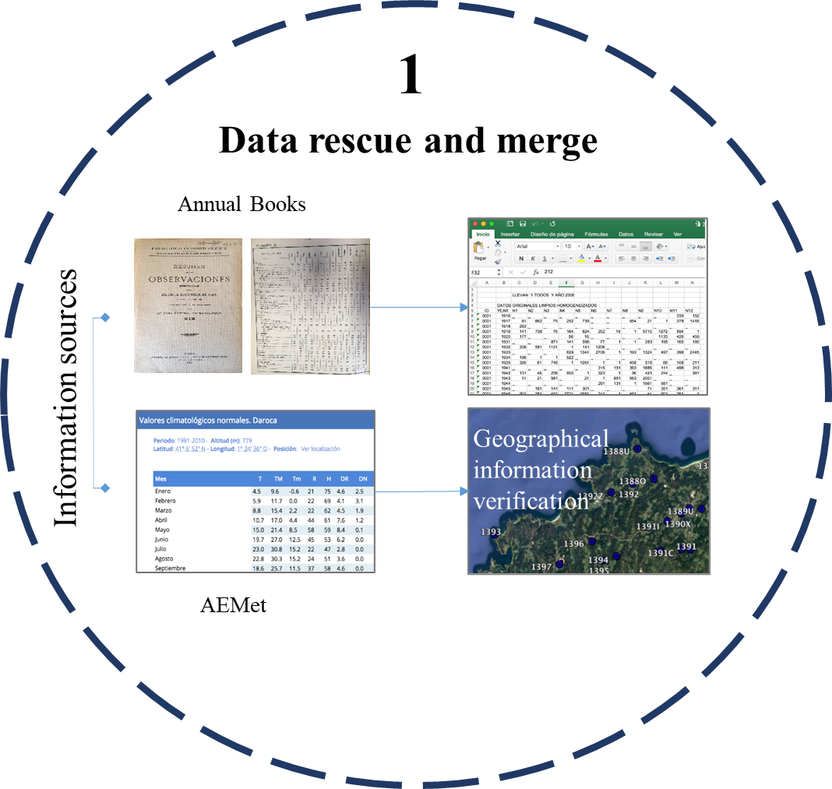
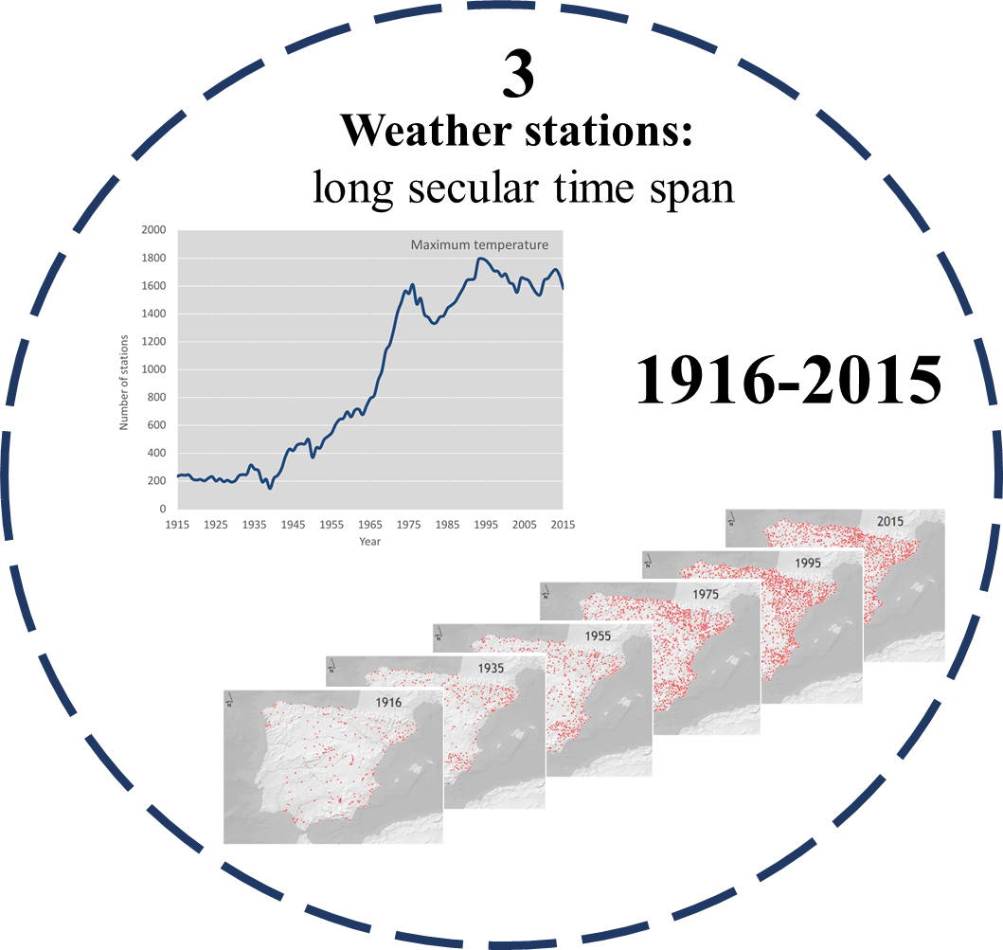
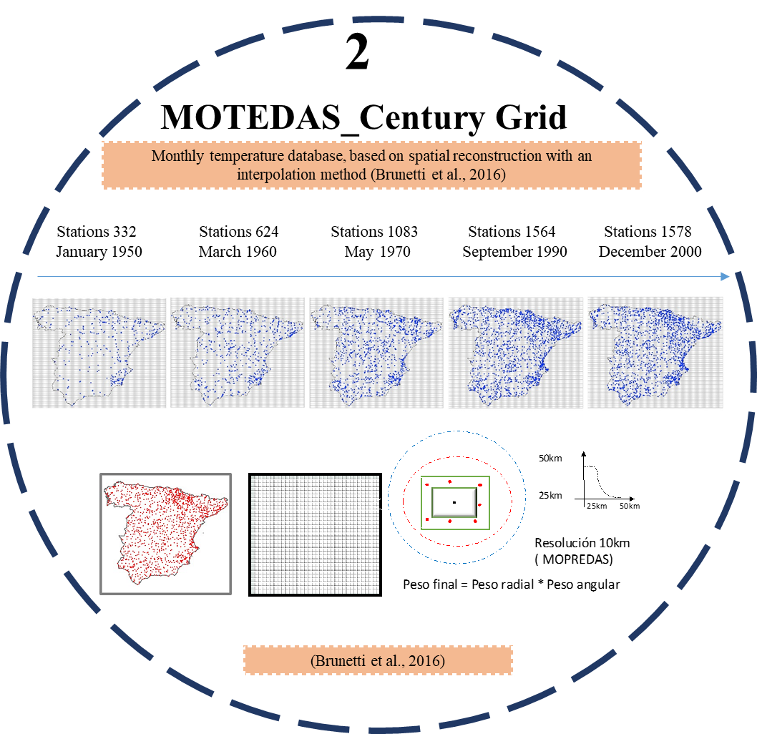
MOTEDAS Century
We have been able to obtain the thermal amplitude evolution from the early 20th century (1916) to nowadays (2015).
The main objective of this poster is to analyse the spatial distribution of thermal amplitude in MOTEDAS_Century grid along the 20th century.

Slide 3
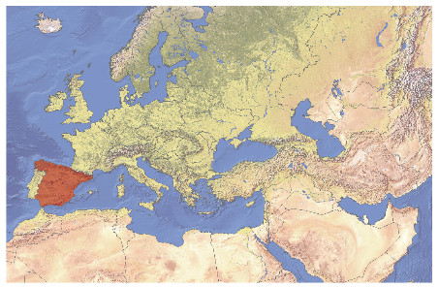
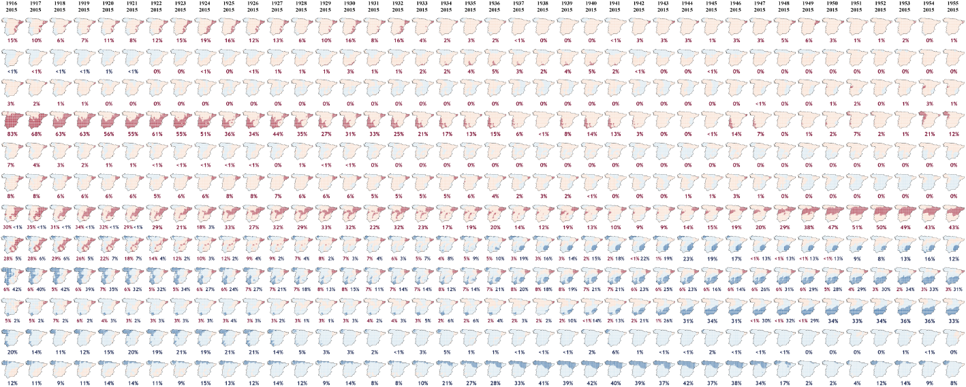
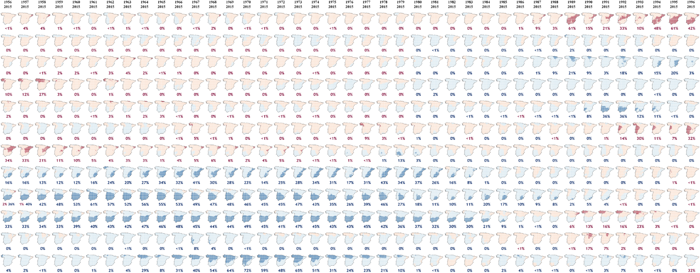
MOTEDAS Century Database
Thermal amplitude trends in Spanish mainland (1916-2015)
Instituto Pirenaico de Ecología, CSIC, Zaragoza, SPAIN (dpang@unizar.es)
University of Zaragoza, Geography, Zaragoza, Spain (leiresandonis@unizar.es; jcgh@unizar.es)
Institute of Atmospheric Sciences and Climate (ISAC-CNR), Bologna, Italy (m.brunetti@isap.cnr.it)
Estación Experiemental Aula Dei, CSIC, Zaragoza, Spain (sbegueria@eead.csic.es)
González-Hidalgo, J.C. ⁽²⁾, Sandonís-Pozo, L.⁽²⁾, Peña-Angulo, D. ⁽¹⁾, Brunetti, M. ⁽³⁾, Beguería. S.⁽⁴⁾
Proyecto “CLICES” El clima del último siglo en la España Peninsular” (CGL2017-83866-C3-1-R, CGL2017-83866-C3-3-R). AEI/FEDER, UE Ministerio de Economía y Competitividad de España. Gobierno Regional de Aragón DGA-FSE Grupo de Investigación Consolidado ‘Clima, Agua, Cambio Global y Sistemas Naturales’.
INTRODUCTION AND OBJECTIVES
General speaking it has been accepted that until the 1980´s the trend of the thermal amplitude has been negative and then changes to positive sign.
Nevertheless there exist high variability in regional analysis on thermal amplitude, sometimes related to land use changes.
The main objective of this poster is to analyse the thermal amplitude in MOTEDAS_Century grid along the 20th century
HOW TO READ THE MAP COLLECTION AND AREAL FIGURES
Maps show a decreasing length period from 1916-2015 to 1996-2015. They show signal of trend by colour (positive red, negative blue). The significance level of probability of Mann Kendall test is given by intensity of colour (p value <0.05).
METHODOLOGY
We have applied the moving window approach to analyse temporal changes of trends of monthly thermal amplitude in the new secular grid of MOTEDAS Century dataset, Spanish mainland.
The signal and significance (p<0.05) of trends accordingly to a pre-whitened Mann-Kendall test was identified. By using decreasing temporal windows of varying length, from 1916-2015 (100 years) to 1996-2015 (20 years).
Visit clices.unizar.es
D
J
F
M
A
M
J
J
A
S
O
N
RESULTS
No generally trend has been detected at monthly scale.
Monthly termal amplitude only show significant positive trend during the whole period in March, and also in June, July in the Southern- Easthern coastland.
During the recently decades the only significant trend detected correspond to December (Easthern coast), and May (Central inland).
Along the century, termal amplitude trend has been negative and significant mostly in middle south and East coastland in warmest months.
CONCLUSIONS
The analysis shows that Tmax and Tmin evolution at monthly and seasonal scale, have differed highly along the studied period (1916-2015).
Furthermore, the spatial differences in the signal and significance, shows that Tmin trend >Tmax trend in warmest months from June to September, and mostly affected the Southern and the Easthern coastland.
During the recent decades no significant trend is detected except in December and May but in opposite areas.
EGU General Assembly 2020, Vienna, Austria

Slide 4
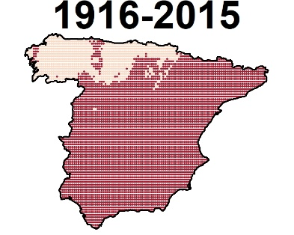
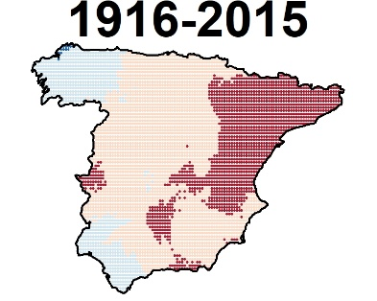
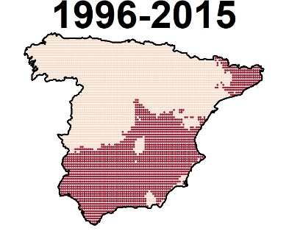
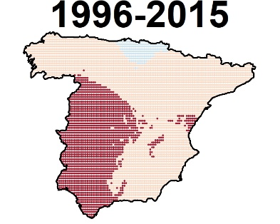
Results
D
J
F
M
A
M
J
J
A
S
O
N
No generally trend has been detected at monthly scale.
Monthly termal amplitude only show significant positive trend in March and June in the Southern- Easthern coastland.
March
June
During the recently decades the only significant trend detected correspond to December (Easthern coast), and May (Central inland).
Along the century, termal amplitude trend has been negative and significant mostly in middle south and East coastland in warmest months.
December
May
EGU General Assembly 2020, Vienna, Austria

Slide 5
Conclusions
The analysis shows that Tmax and Tmin evolution at monthly and seasonal scale, have differed highly along the studied period (1916-2015)
Furthermore, the spatial differences in the signal and significance, shows that Tmin trend >Tmax trend in warmest months from June to September, and mostly affected the Southern and the Easthern coastland.
During the recent decades no significant trend is detected except in December and May but in opposite areas.
In the following slides you can find the poster figures in more detail.
EGU General Assembly 2020, Vienna, Austria

Slide 6
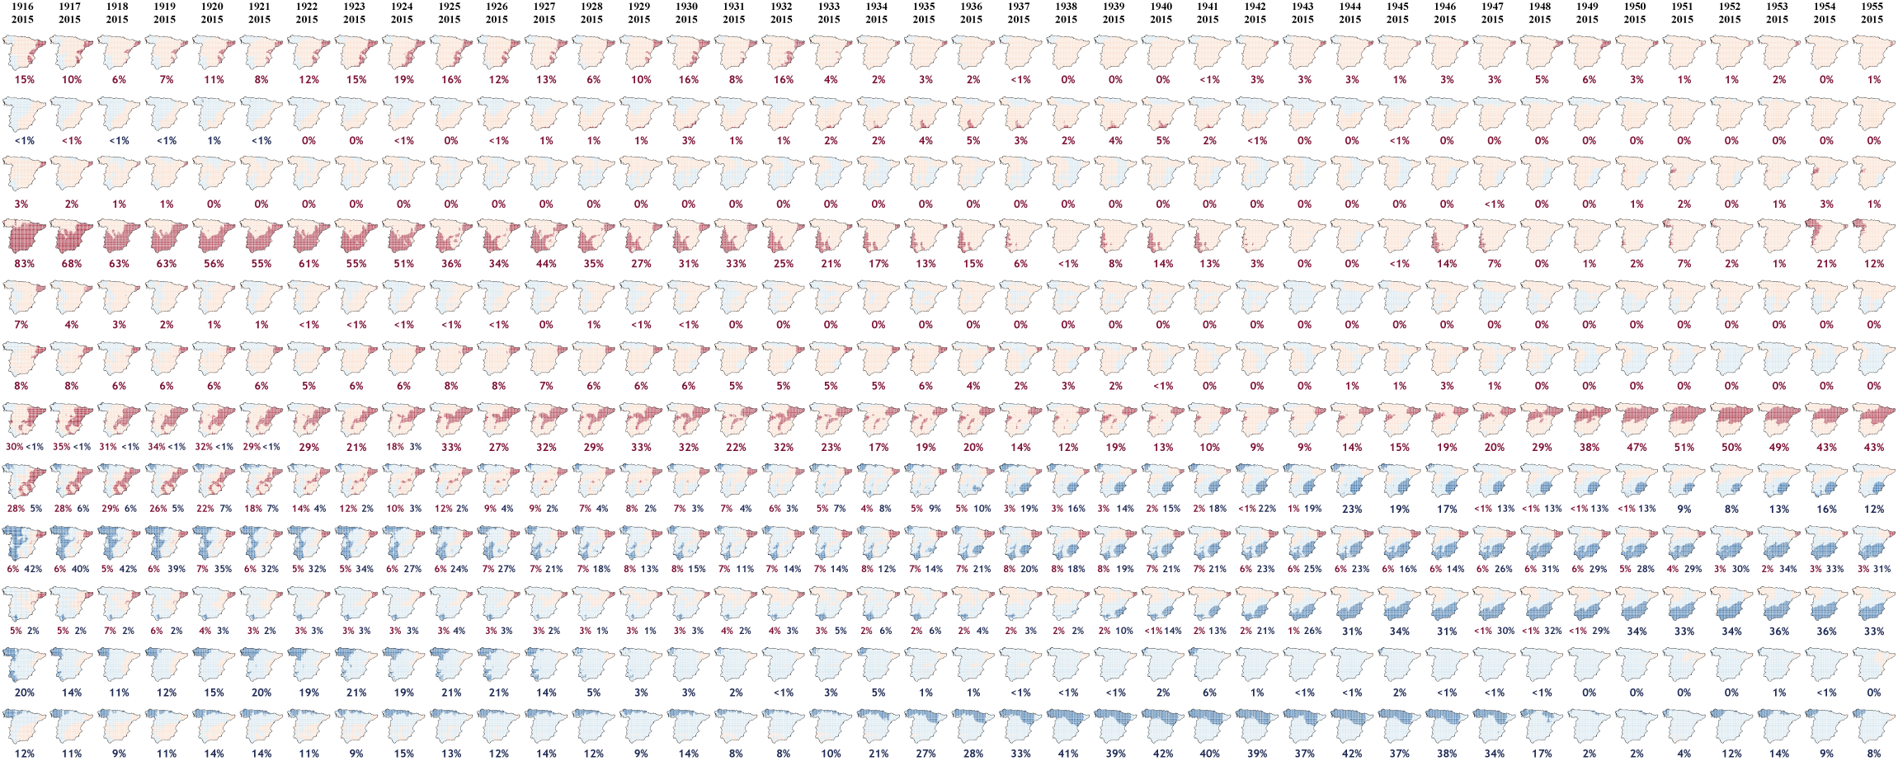
Thermal amplitude: part 1
D
J
F
M
A
M
J
J
A
S
O
N
Compendium of moving windows (1916-1955)
EGU General Assembly 2020, Vienna, Austria

Slide 7
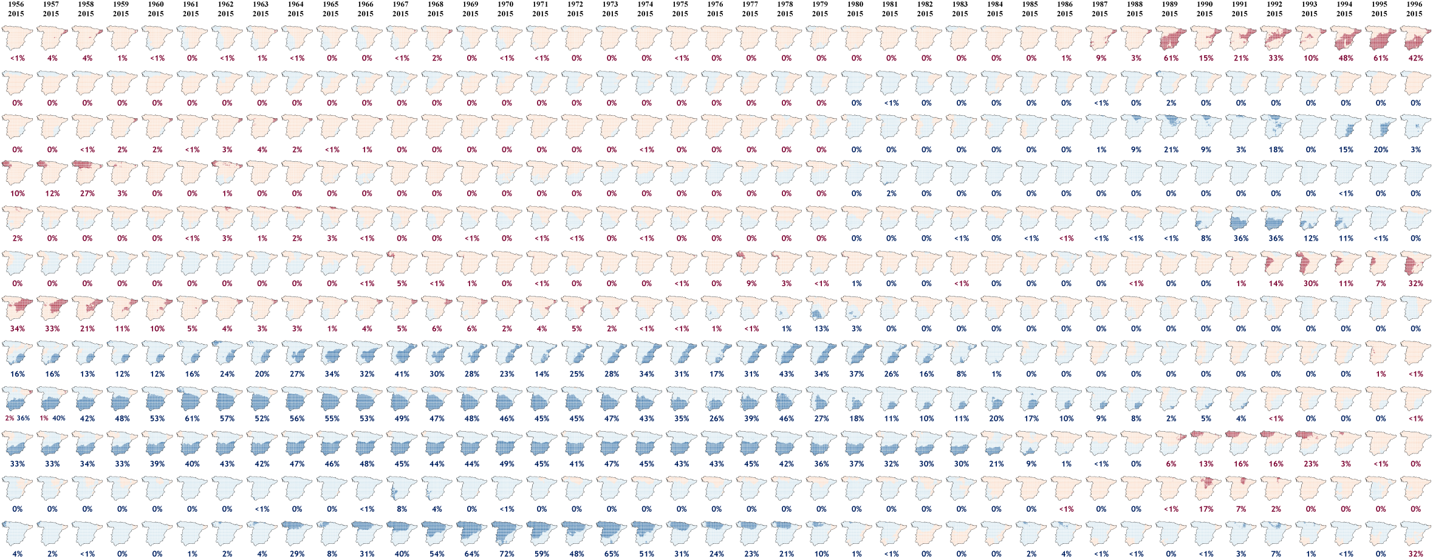
Thermal amplitude: part 2
D
J
F
M
A
M
J
J
A
S
O
N
Compendium of moving windows (1956-1996)
EGU General Assembly 2020, Vienna, Austria

Slide 8
Visit clices.unizar.es

Slide 9
EGU General Assembly 2020, Vienna, Austria
Thermal amplitude (Winter)
Thermal amplitude
(Spring)
Thermal amplitude
(Summer)
Thermal amplitude
(Autumn)
¡¡¡Thank you for attention!!!
leiresandonis@unizar.es
Instituto Pirenaico de Ecología, CSIC, Zaragoza, SPAIN (dpang@unizar.es)
University of Zaragoza, Geography, Zaragoza, Spain (leiresandonis@unizar.es; jcgh@unizar.es)
Institute of Atmospheric Sciences and Climate (ISAC-CNR), Bologna, Italy (m.brunetti@isap.cnr.it)
Estación Experiemental Aula Dei, CSIC, Zaragoza, Spain (sbegueria@eead.csic.es)
Proyecto “CLICES”, El clima del último siglo en la España Peninsular” (CGL2014-83866-C3-1-R ,CGL2014-83866-C3-3-R). AEI/FEDER, UE. Ministerio de Economía y Competitividad de España. Gobierno Regional de Aragón DGA-FSE
Grupo de Investigación Consolidado ‘Clima, Agua, Cambio Global y Sistemas Naturales’.

