Slide 1
RELATIVE CONTRIBUTION OF AGGREGATED SOIL CARBON TO SOIL ORGANIC CARBON POOL IN AN ULTISOL, SOUTHEASTERN NIGERIA
Onunwa, A.O.
Department of Soil Science and Land Resources Management
Nnamdi Azikiwe University, Awka, Nigeria

Slide 2
INTRODUCTION
The rise in the atmospheric concentration of greenhouse gases as a result of human activities is currently a global concern
Carbon sequestration consequently aims at:
increasing organic carbon density in the soil
improving depth distribution of SOC and
stabilizing SOC by encapsulating it within stable micro aggregates so that carbon is protected from microbial actions.
It is noteworthy that carbon sequestration does not just mitigate greenhouse gas concentration. It also results in:
increased soil fertility
Increased productivity of agro-ecosystems
improved soil aggregate stability
reduced and ameliorated land degradation
amelioration of climate change and global warming

Slide 3
Concentration of SOC is however a function of the prevailing land use and management choices
To ensure increased SOC in the Ultisols of the humid tropics and the attendant improvement in environmental health and sustainability it is important to determine:
the impacts of different cropping systems on SOC
the relative effects of different organic manure sources on SOC
the proportion of the SOC that is contributed by aggregate-associated carbon – a more persistent portion of the SOC pool

Slide 4
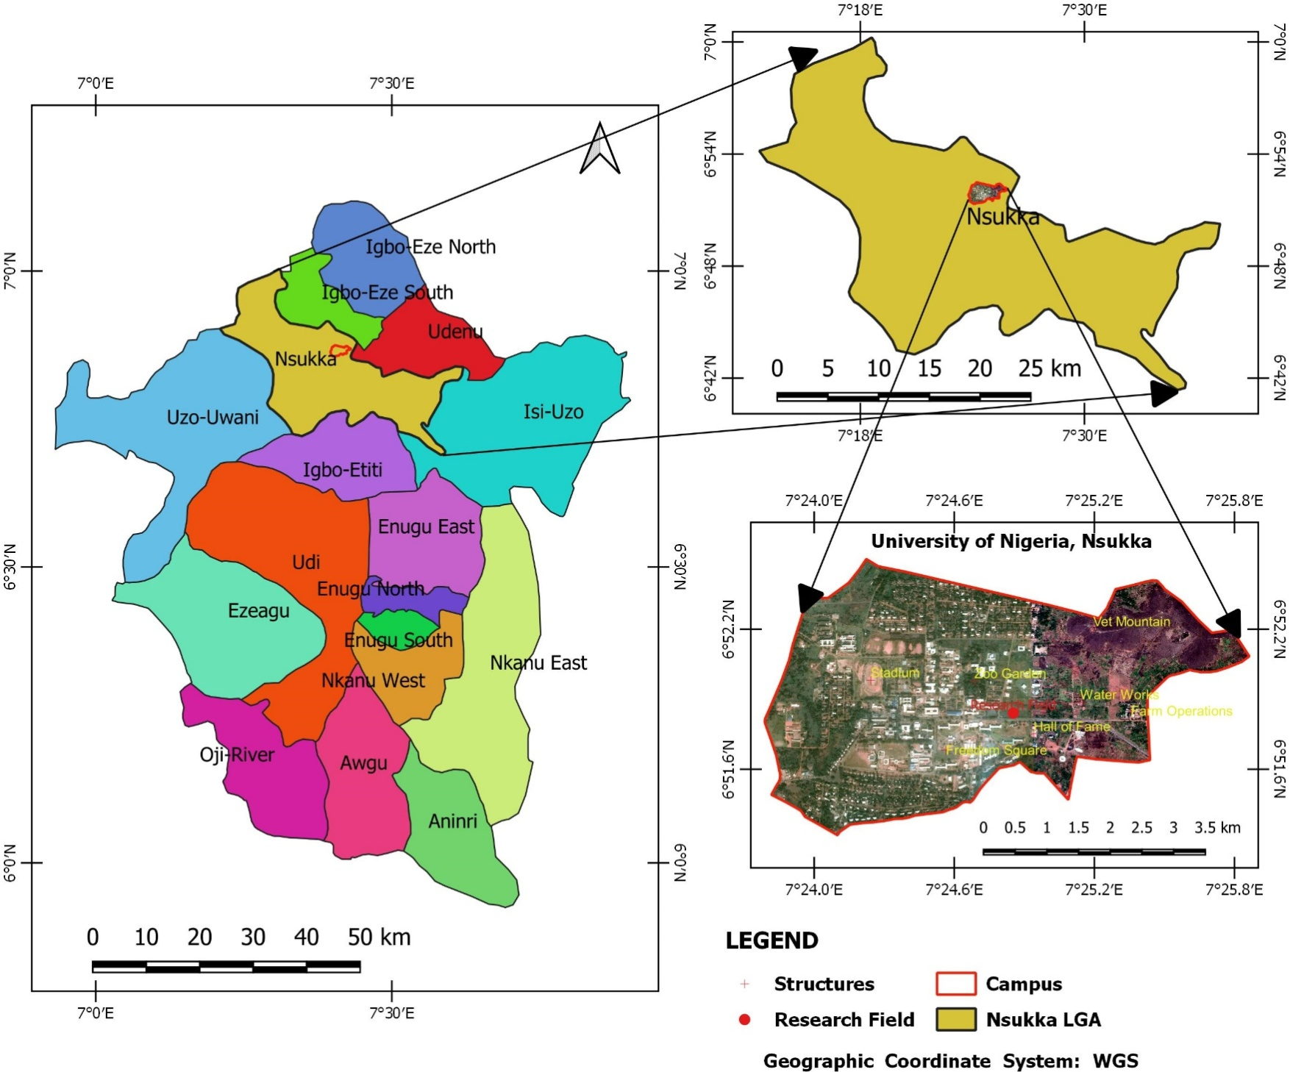
MATERIALS AND METHODS
Experimental Site
Altitude: 400m asl
Soil: Well drained, sandy loam surface texture, Nkpologu series Ultisols
Rainfall: Bimodal, ranging from 1655 – 2000mm/yr.
Mean Temperature: 29ºC - 31ºC
Relative Humidity: 69 - 79 %
Agro-ecological Zone: Derived savanna, with 60 – 70% grasses (Humid tropics)

Slide 5
Experimental Field Layout
Plot Area: 0.1125ha
Experimental Design: split-split plot in RCBD
Main Plot: divided into 2 plots (conventional tillage (CT) & minimum tillage/No Till (NT)
Plots: each divided into 4 split plots (amendments – cassava peels, poultry droppings, pig waste and no amendment [control])
Split Plots: each divided into 3 split-split plots (test crops – maize (Zea mays), local cowpea (Vigna unquiculata) & maize-cowpea intercrop)
Replication: each replicated 3 times; total of 72 split-split plots

Slide 6
Composted amendments applied 3 WAP
Soil samples collected from the site at the end of planting season at 0 - 30 cm depth
Experiment repeated on exact plots in 2011 & 2012
Residual effect of amendments assessed in 2013 (the same experimental design and replications)

Slide 7
Laboratory Studies
Soil samples were air dried, passed through 4.75mm and 2mm sieves
The samples > 2mm were used to determine:
water stable aggregate (WSA)
aggregate associated soil organic carbon (C_{WSA}) &
mean weight diameter (MWD)
The samples < 2mm were used to determine
particle sizes distribution (hydrometer method)
deionized water was used to determine water dispersible clay & silt.
The micro-aggregate indices were calculated as:
Dispersion Ratio (DR) = [% silt + % clay (H₂O)]/[% silt + % clay (dispersed by calgon)]
Aggregated Silt & Clay (ASC) = [% clay + % silt (dispersed by calgon)] – [% clay + % silt (H₂O)]
Clay Flocculation Index (CFI) = [% clay(dispersed) - % clay (H₂O)/ % clay (dispersed)] x 100
Clay Dispersion Index (CDI) = [% clay (H₂O)/ % clay (dispersed by calgon)] x 100
Bulk density assessed using the cylindrical core method as described by Blake and Hartge (1986)
Water stable aggregate (WSA) & Mean weight diameter (MWD) determined using method described by Kemper & Rosenau (1986)

Slide 8
Soil organic carbon [SOC] content of the whole soil (< 2.00mm)
Aggregated soil carbon[ASC] (>2mm, 2.00 - 1.00mm, 1.00 - 0.50mm, 0.50 -0.25mm, and < 0.25mm)
SOC & ASC quantified using Walkley and Black wet oxidation method
Soil organic carbon (SOC) pool was calculated using the following equation:
Mg C ha⁻¹ = [% C x modified BD x d x 10⁴ m²] / 100 (Lal et al., 1998)
(Where Mg C ha⁻¹ = mega gram carbon per hectare, % C = percentage of carbon, BD = soil bulk density (Mg m⁻³), d = depth in meters)
Relative contribution (RC) of aggregated soil carbon (ASC or C_{WSA}) to the soil organic carbon pool was calculated using:
RC = X/P x 100/1
where
X = m_{i}/M_{i} x OCm_{i} and
P = ∑ m_{i}/M_{i} x OCm_{i}
(Where m_{i} = mass of the aggregate sized carbon, M_{i} = mass of the whole soil carbon, OCm_{i} = mass of the organic carbon per aggregate size, X = Proportion of organic carbon contributed by _{i}th aggregate fraction, P = Summation of the proportion of organic carbon contributed by _{i}th aggregate fraction, RC = Relative contribution of carbon in the aggregate size fractions to soil organic carbon)

Slide 9
Data Analysis
Data collected were subjected to analysis of variance (ANOVA) following the routine procedure for split-split plot in RCBD
GENSTAT Version: release 7.22 DE (GENSTAT, 2008) was used for the analysis.

Slide 10
RESULTS AND DISCUSSIONS
Relative Contribution (RC) of Aggregated Soil Carbon under Different Cropping Systems to SOC Pool - 2011
RC was higher in aggregate sizes 1.0-0.5mm, 0.5-0.25mm & < 0.25mm
Cowpea had higher impact on the RC of >2.0mm & 2.0-1.0mm
Maize had the highest impact on 0.5-0.25mm
Intercrop had the highest impact on 1.0-0.5mm & <0.25mm
Stat. Test: There was no significant difference in RC as a result of cropping systems
 | > 2.0mm |  | 2.0 - 1.0mm |  | 1.0 - 0.5mm |  | 0.5 - 0.25mm |  | < 0.25mm
Cropping System | %OC | RC (%) | %OC | RC (%) | %OC | RC (%) | %OC | RC (%) | %OC | RC (%)
Cowpea (C) | 1.57 | 8.87 | 1.50 | 11.68 | 1.47 | 24.65 | 1.19 | 28.47 | 1.10 | 26.35
M+C | 1.72 | 4.53 | 1.63 | 10.99 | 1.53 | 27.85 | 1.05 | 29.10 | 0.94 | 27.54
Maize (M) | 2.00 | 4.03 | 1.85 | 10.21 | 1.82 | 27.80 | 1.27 | 31.57 | 1.01 | 26.41

Slide 11
Relative Contribution (RC) of Aggregated Soil Carbon Under Different Soil Tillage Practices to SOC Pool - 2011
RC was higher in aggregate sizes 1.0-0.5mm, 0.5-0.25mm & < 0.25mm
Conventional tillage had higher impact on the RC of 1.0-0.5mm
Minimum tillage (No Till) had the higher impact on all other aggregate sizes
Stat. Test: There was no significant difference in RC as a result of tillage practices
 | > 2mm |  | 2 - 1mm |  | 1 - 0.5mm |  | 0.5 - 0.25mm |  | < 0.25mm
Tillage Practice | %OC | RC (%) | %OC | RC (%) | %OC | RC (%) | %OC | RC (%) | %OC | RC (%)
Conventional Till | 1.80 | 5.13 | 1.69 | 10.77 | 1.60 | 28.35 | 1.13 | 29.49 | 1.01 | 26.27
No Till | 1.73 | 6.49 | 1.63 | 11.14 | 1.61 | 25.18 | 1.22 | 29.94 | 1.02 | 27.26

Slide 12
Relative Contribution (RC) of Aggregated Soil Carbon Under Different Organic Amendments to SOC Pool - 2011
RC was higher in aggregate sizes 1.0-0.5mm, 0.5-0.25mm & < 0.25mm
Pig waste had higher impact on the RC of >2.0mm
Poultry droppings had the highest impact on 2.0-1.0mm & 0.5-0.25mm
The control had the highest impact on 1.0-0.5mm & <0.25mm
Stat. Test: There was no significant difference in RC as a result of app. of Organic Amendments
 | > 2mm |  | 2 - 1mm |  | 1 - 0.5mm |  | 0.5 - 0.25mm |  | < 0.25mm
Organic Manure | %OC | RC (%) | %OC | RC (%) | %OC | RC (%) | %OC | RC (%) | %OC | RC (%)
Control | 1.61 | 3.46 | 1.66 | 10.59 | 1.77 | 29.34 | 1.10 | 28.31 | 1.03 | 28.31
Cassava Peels | 1.80 | 4.18 | 1.55 | 10.32 | 1.58 | 27.95 | 1.13 | 30.67 | 0.97 | 26.90
Poultry Dropping | 1.86 | 5.89 | 1.74 | 11.59 | 1.50 | 25.74 | 1.22 | 30.78 | 1.02 | 26.02
Pig Waste | 1.79 | 9.71 | 1.70 | 11.34 | 1.58 | 24.03 | 1.25 | 29.09 | 1.06 | 25.84

Slide 13
Relative Contribution (RC) of Aggregated Soil Carbon under Different Cropping Systems to SOC Pool - 2012
RC was higher in aggregate sizes 1.0-0.5mm, 0.5-0.25mm & < 0.25mm
Cowpea had higher impact on the RC of >2.0mm
Maize had the highest impact on 0.5-0.25mm & <0.25mm
Intercrop had the highest impact on 2.0-1.0mm & 1.0-0.5mm
Stat. Test: There was no significant difference in RC as a result of cropping systems
 | > 2.0mm |  | 2.0 - 1.0mm |  | 1.0 - 0.5mm |  | 0.5 - 0.25mm |  | < 0.25mm
Cropping System | %OC | RC (%) | %OC | RC (%) | %OC | RC (%) | %OC | RC (%) | %OC | RC (%)
Cowpea (C) | 2.55 | 5.04 | 2.09 | 10.97 | 2.10 | 29.27 | 1.39 | 30.65 | 1.07 | 24.08
M+C | 2.08 | 3.79 | 2.03 | 12.10 | 1.99 | 29.95 | 1.30 | 30.20 | 1.03 | 23.97
Maize (M) | 2.49 | 3.45 | 2.19 | 9.58 | 2.17 | 25.10 | 1.87 | 34.90 | 1.31 | 26.92

Slide 14
Relative Contribution (RC) of Aggregated Soil Carbon Under Different Soil Tillage Practices to SOC Pool - 2012
RC was higher in aggregate sizes 1.0-0.5mm, 0.5-0.25mm & < 0.25mm
Conventional tillage had higher impact on the RC of >2.0mm, 2.0-1.0mm & 1.0-0.5mm
Minimum tillage (No Till) had the higher impact on the RC of 0.5-0.25mm and <0.25mm
Stat. Test: There was no significant difference in RC as a result of tillage practices
 | > 2.0mm |  | 2.0 - 1.0mm |  | 1.0 - 0.5mm |  | 0.5 - 0.25mm |  | < 0.25mm
Tillage Practice | %OC | RC (%) | %OC | RC (%) | %OC | RC (%) | %OC | RC (%) | %OC | RC (%)
Conventional Till | 2.45 | 4.39 | 2.15 | 11.12 | 2.11 | 28.72 | 1.55 | 31.78 | 1.18 | 24.00
No Till | 2.29 | 3.80 | 2.05 | 10.65 | 2.06 | 27.49 | 1.49 | 32.05 | 1.09 | 25.98

Slide 15
Relative Contribution (RC) of Aggregated Soil Carbon Under Different Organic Amendments to SOC Pool - 2012
RC was higher in aggregate sizes 1.0-0.5mm, 0.5-0.25mm & < 0.25mm
Pig waste had higher impact on the RC of >2.0mm & 2.0-1.0mm
Poultry droppings had the highest impact on 1.0-0.5mm
Cassava peels had the highest impact on 0.5-0.25mm
The control had the highest impact on <0.25mm
Stat. Test: There was no significant difference in RC as a result of application of Organic Amendments
 | > 2.0mm |  | 2.0 - 1.0mm |  | 1.0 - 0.5mm |  | 0.5 - 0.25mm |  | < 0.25mm
Organic Manure | %OC | RC (%) | %OC | RC (%) | %OC | RC (%) | %OC | RC (%) | %OC | RC (%)
Control | 1.76 | 2.35 | 1.83 | 9.71 | 1.95 | 27.17 | 1.47 | 32.49 | 1.07 | 28.22
Cassava Peels | 2.21 | 3.14 | 1.82 | 9.56 | 2.01 | 28.14 | 1.51 | 34.66 | 1.01 | 24.51
Poultry Dropping | 2.17 | 2.89 | 2.09 | 11.41 | 2.03 | 30.08 | 1.38 | 31.90 | 1.02 | 23.72
Pig Waste | 3.35 | 8.00 | 2.67 | 12.85 | 2.35 | 27.03 | 1.72 | 28.61 | 1.44 | 23.52

Slide 16
Relative Contribution (RC) of Aggregated Soil Carbon under Different Cropping Systems to SOC Pool - 2013
RC was higher in aggregate sizes 1.0-0.5mm, 0.5-0.25mm & < 0.25mm
Cowpea had higher impact on the RC of >2.0mm, 2.0-1.0mm & 0.5-0.25mm
Maize had the highest impact on 1.0-0.5mm
Intercrop had the highest impact on <0.25mm
Stat. Test: There was no significant difference in RC as a result of cropping systems
 | > 2.0mm |  | 2.0 - 1.0mm |  | 1.0 - 0.5mm |  | 0.5 - 0.25mm |  | < 0.25mm
Cropping System | %OC | RC (%) | %OC | RC (%) | %OC | RC (%) | %OC | RC (%) | %OC | RC (%)
Cowpea (C) | 2.02 | 3.26 | 1.93 | 11.67 | 1.69 | 30.31 | 1.01 | 29.33 | 0.81 | 25.45
M+C | 1.81 | 2.93 | 1.94 | 10.92 | 1.82 | 31.16 | 0.96 | 27.74 | 0.83 | 27.27
Maize (M) | 1.74 | 3.05 | 1.86 | 11.19 | 1.81 | 31.28 | 0.96 | 28.18 | 0.81 | 26.32

Slide 17
Relative Contribution (RC) of Aggregated Soil Carbon Under Different Soil Tillage Practices to SOC Pool - 2013
RC was higher in aggregate sizes 1.0-0.5mm, 0.5-0.25mm & < 0.25mm
Conventional tillage had higher impact on all size fractions, except <0.25mm
May be due to redistribution of organic carbon in larger aggregates by conventional tillage
Stat. Test: There was no significant difference in RC as a result of tillage practices
 | > 2.0mm |  | 2.0 - 1.0mm |  | 1.0 - 0.5mm |  | 0.5 - 0.25mm |  | < 0.25mm
Tillage Practice | %OC | RC (%) | %OC | RC (%) | %OC | RC (%) | %OC | RC (%) | %OC | RC (%)
Conventional Till | 2.26 | 3.71 | 2.16 | 12.02 | 1.97 | 31.21 | 1.13 | 28.50 | 0.92 | 24.58
No Till | 1.46 | 2.45 | 1.67 | 10.50 | 1.58 | 30.61 | 0.83 | 28.33 | 0.72 | 28.12

Slide 18
Relative Contribution (RC) of Aggregated Soil Carbon Under Different Organic Amendments to SOC Pool - 2013
RC was higher in aggregate sizes 1.0-0.5mm, 0.5-0.25mm & < 0.25mm
Pig waste had higher impact on the RC of >2.0mm & 2.0-1.0mm
Poultry droppings had the highest impact on 1.0-0.5mm & 0.5-0.25mm
Control had the highest RC for <0.25mm
Stat. Test: There was no significant difference in RC resulting from the application of organic Amendments
 | > 2mm |  | 2 - 1mm |  | 1 - 0.5mm |  | 0.5 - 0.25mm |  | < 0.25mm
Organic Manure | %OC | RC (%) | %OC | RC (%) | %OC | RC (%) | %OC | RC (%) | %OC | RC (%)
Control | 1.7 | 2.4 | 1.7 | 10.1 | 1.7 | 29.7 | 0.9 | 26.7 | 0.9 | 31.1
Cassava Peels | 1.6 | 3.5 | 1.7 | 11.5 | 1.8 | 32.3 | 0.9 | 27.9 | 0.7 | 24.9
Poultry Dropping | 1.7 | 1.6 | 1.9 | 10.7 | 1.8 | 32.6 | 1.0 | 30.6 | 0.8 | 24.5
Pig Waste | 2.4 | 4.9 | 2.4 | 12.7 | 1.8 | 29.1 | 1.1 | 28.4 | 0.9 | 24.9

Slide 19
CONCLUSION
The residual effect of pig waste on SOC was relatively higher than that of other tested organic amendments. The concentration of SOC in soils treated with pig waste was higher for the 2nd and 3rd years
Contrary to expectation, conventional tillage seemed to promote greater retention of SOC. This may be attributed to the redistribution of organic matter into deeper horizons and their incorporation into the soil aggregates where it is protected from rapid decomposition
It was expected that cowpea would promote increased soil organic matter due to the nitrogen fixing properties associated with legumes (and its attendant promotion of luxuriant vegetative growth), maize tended to have greater impact on SOC. This may be attributed to the greater biomass (stalk and cobs) left behind after maize harvest
Though overall variation in crop did not seem to have a significant effect on SOC, on the long run, the residual effect of cowpea was greater as evidence that soil organic matter was gradually improving beyond that of maize

Slide 20
For all the treatments, the relative contribution (RC) of aggregated soil carbon to SOC was greatest in aggregate sizes: 1.0-0.5mm, 0.5-0.25mm and < 0.25mm
It may then be concluded that soil aggregates less than 1.0mm would play a more prominent role in carbon sequestration as they protect a more considerable proportion of SOC from decomposition by microorganisms
Variation in crop type and system did not significantly influence RC.
However, cowpea tended to increase the RC in macro-aggregates (1.0 – >2.0 mm), while maize tended to predominate in micro-aggregates (<1.0mm). On the long run, the intercrop may be a more holistic approach
Pig waste had significantly higher residual effects on RC, particularly for aggregate size fractions between >2mm and 0.25mm . This may be due to greater resistance to decomposition, resulting in its persistence in the soil for longer duration
The residual effect of conventional tillage on RC was greater than that of minimum tillage, especially for aggregate size fractions between >2mm and 0.5mm. This may be attributed to the redistribution of surface SOC to deeper soil horizons and its incorporation into soil aggregates

Slide 21
RECOMMENDATIONS
The organic manure of choice for carbon sequestration projects is pig waste
Intercrops of maize and cowpea may be the best choice of crops for ventures interested in increasing agricultural productivity and carbon sequestration on the long run
Though conventional tillage may be discouraged in certain circumstances, especially when excessive; periodic turnover of the soil to incorporate organic matter into deeper horizons and aggregates may be necessary
Cultural practices that target increased soil organic carbon in aggregate size fractions below 2.0mm should be encouraged as this would yield a more persistent increase in SOC pool

Slide 22
THANK YOU…

