Slide 1
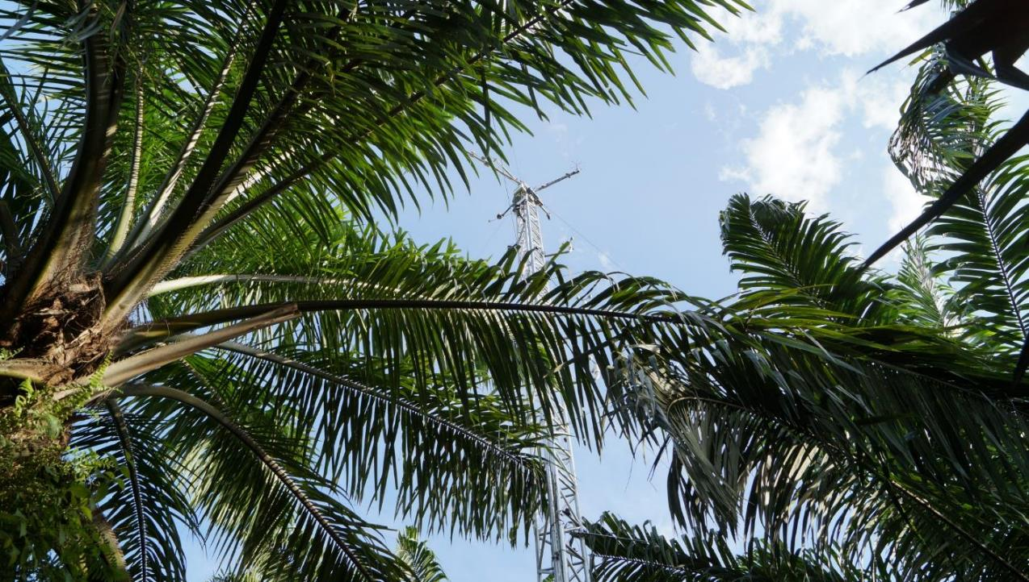



Air mixing and sub-canopy advection in an oil palm plantation in Indonesia
Christian Stiegler⁽¹⁾, Tania June⁽²⁾, Alexander Knohl⁽¹⁾ EGU2020-6796
⁽¹⁾ Bioclimatology, University of Göttingen, Göttingen, Germany
⁽²⁾ Department of Geophysics and Meteorology, Bogor Agricultural University, Bogor, Indonesia

Slide 2


Outline
Introduction and study aim
  Decoupling of above- and below-canopy air mass flow, horizontal advection, drainage flows.
  Implications of decoupling on estimates of the biosphere-atmosphere exchange rates.
  Why study oil palm?
Materials and Methods
  Study site
  Data collection & data processing, identification of decoupling and flux filtering
Results and Discussion
  Wind speed & direction
  Friction velocity (u*)
  Standard deviation of the vertical wind (σ_{w})
  Wind direction difference (ΔWD)
  CO₂ fluxes based on flux filtering approaches (u*, σ_{w}, ΔWD)
Summary, conclusion and take-home message
Oil palm (Elaeis guineensis Jacq.).
2

Slide 3
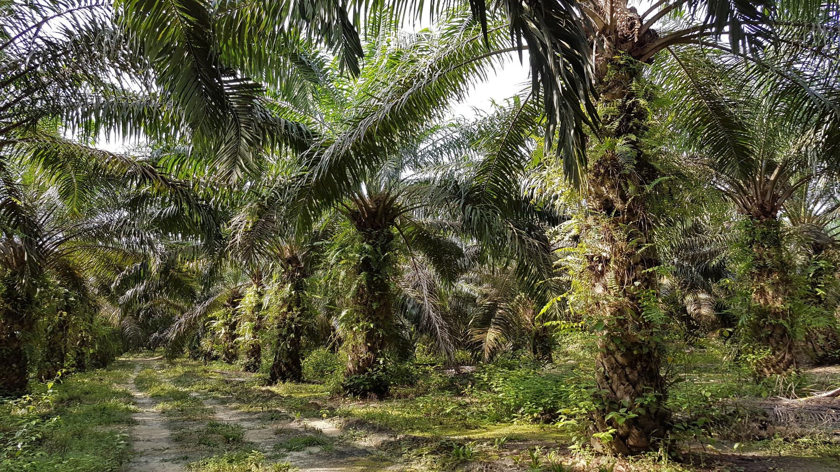
Introduction & study aim

Slide 4
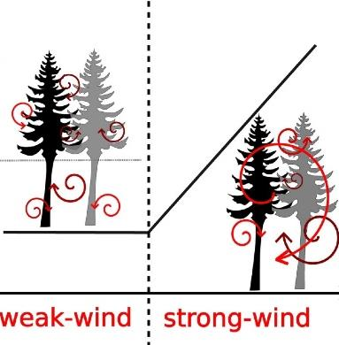
Decoupling
Schematic representation of air mixing within tall vegetation canopies
Especially during night, calm weather conditions in tall vegetation canopies, such as forest or oil palm, may result in the formation of an isolated layer near the surface, which is decoupled from the above-canopy air layer.
Below-canopy air flow can be influenced by the local topography and thereby cause below-canopy horizontal exchange and drainage flow.
Horizontal
advection
Decoupled layer
Adapted from Freundorfer et al., 2019,
Agricultural and Forest Meteorology 279.
4

Slide 5
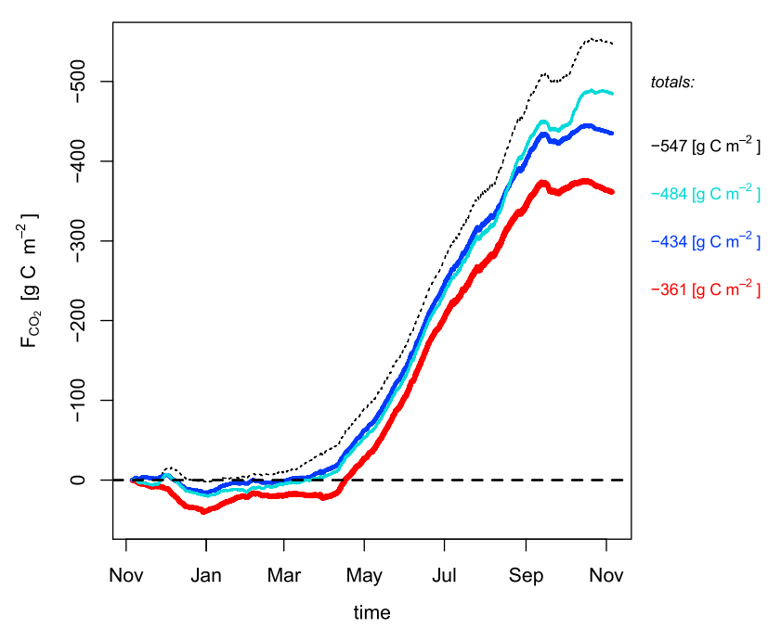
Implications of decoupling
CO₂ flux estimates in a Scots pine forest using different criteria for decoupling-detection
When decoupling and below-canopy horizontal air flow occurs, there is a high potential that above-canopy measured carbon dioxide (CO₂) fluxes (net ecosystem exchange) based on eddy covariance (EC) measurements might not represent the true ecosystem CO₂ flux as below-canopy respiration might be undetected by the EC system.
EC data are frequently used as reference for fluxes of tall vegetation or for modelling approaches. It is therefore important to have accurate information on air mixing, decoupling and sub-canopy drainage flow.
Cumulative gap-filled CO₂ fluxes (F_{CO2}).
Color coded according to the F_{CO2} filtering (black dashed line: unfiltered; cyan: u*-filtered; blue: quality filtered; red: q_σ_{w}-filtered). Jocher et al., 2018, Biogeosciences 123.
5

Slide 6
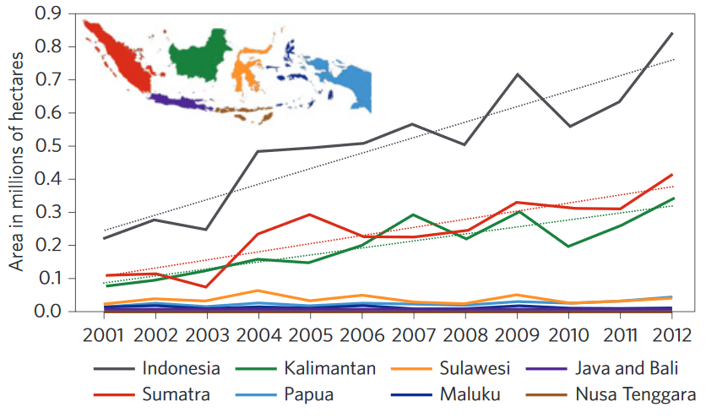
Why study oil palm?
Substantial loss of primary forest cover in Indonesia
  → 2000-2012: total loss ~6.02 Mha (25% of UK)
Strong expected future increase of areas covered by oil palm plantations, with increasing impact on environmental processes such as CO₂ exchange.
Annual primary forest cover loss, 2000–2012, for Indonesia as a whole and by island group
Indonesian palm oil production and export statistics (2016 = estimate)
Indonesian Palm Oil Producers Association (Gapki)
& Indonesian Ministry of Agriculture.
Margono et al., 2014, Nature Climate Change 4.
6

Slide 7
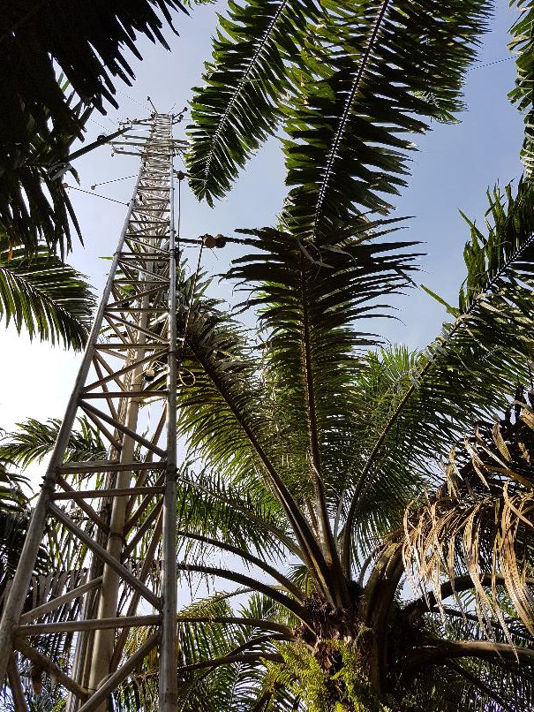
Study aim
Investigate wind dynamics of a mature oil palm (Elaeis guineensis) plantation in tropical lowland Jambi Province (Sumatra, Indonesia).
Assess the strength of turbulent mixing as an estimator for the degree of above- and below-canopy coupling by using eddy covariance (EC) measurements.
Explore the potential implications of decoupling and horizontal below-canopy flow on the above-canopy derived net ecosystem exchange (NEE).
EC-tower within the studied oil palm plantation.
7

Slide 8
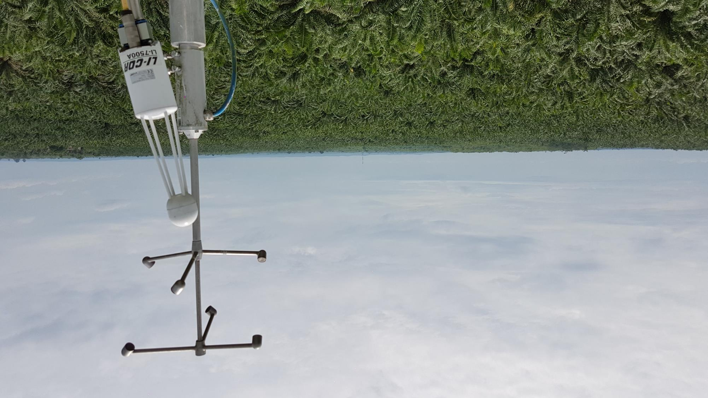
Results & Discussion
Materials & Methods

Slide 9
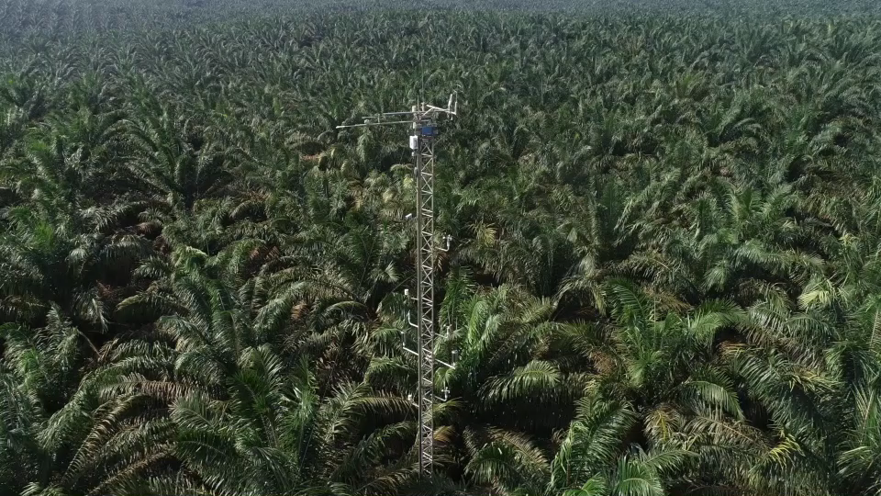
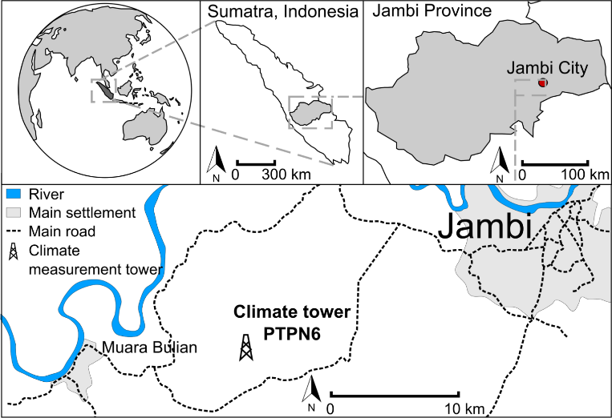
Study site
Our study has been conducted in a mature commercial oil palm plantation in tropical lowland Jambi Province (Sumatra, Indonesia). Palms were planted in 2002, with 156 palms per hectare, and reach an average height of 12 meters.
Study location
Stiegler et al., 2019, Biogeosciences 16.
Drescher et al., 2016, Phil. Trans. R. Soc. B 371.
Video of oil palm plantation and measurement tower.
Clough et al., 2016, Nature Communications 7.
9

Slide 10
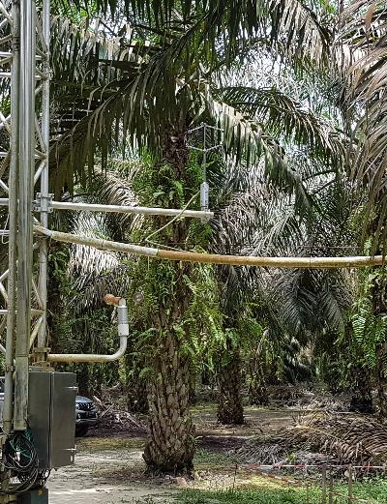
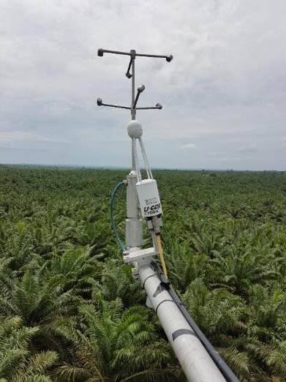
Data collection & processing; Identification of decoupling & flux filtering
Flux data were obtained from July 2017 to April 2019 by two eddy covariance (EC) systems:
  The first system was installed above the oil palm canopy in 22 m height and consisted of a gas analyzer (LI7500A, LI-COR Inc. Lincoln, USA) and a sonic anemometer (Metek uSonic-3 Scientific, Metek, Elmshorn, Germany). The second system was installed below the oil palm canopy in 2 m height and consisted of one sonic anemometer (Metek uSonic-3 Scientific). Fluxes and winds were calculated with EddyPro software (LI7500A, LI-COR Inc. Lincoln, USA).
We applied three approaches based on EC derived wind measurements to identify decoupling:
  Threshold based on friction velocity (u*).
  Threshold based on the correlation between the standard deviation of below vs. above-canopy vertical wind speed (σ_{w}).
  Threshold based on above- vs. below-canopy wind direction difference (ΔWD).
Above-canopy EC system
Below-canopy EC system
Stiegler et al., 2019, Biogeosciences 16.
Meijide et al., 2017, Agric. For. Meteorol. 239.
Thresholds were derived with R-package ”strucchange”. Filtered EC-data was gapfilled using REddyProc (MPI Jena, Germany) to derive cumulative CO₂ fluxes.
10

Slide 11
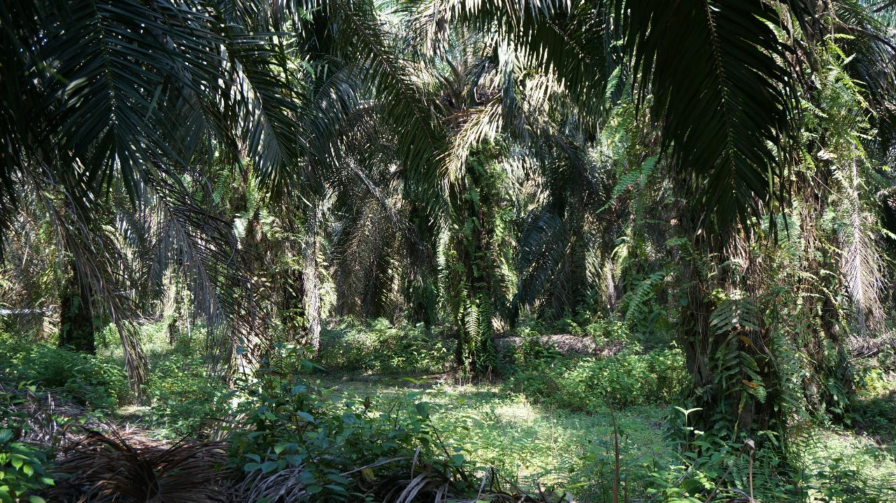
Results & Discussion

Slide 12
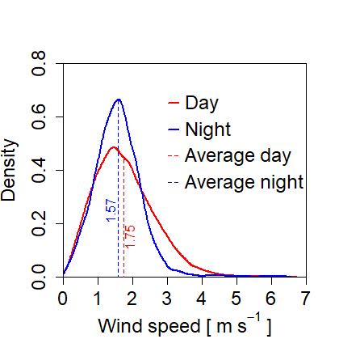
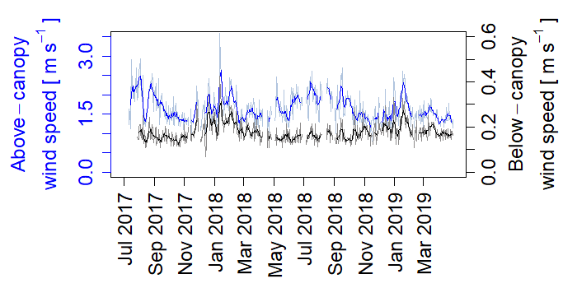
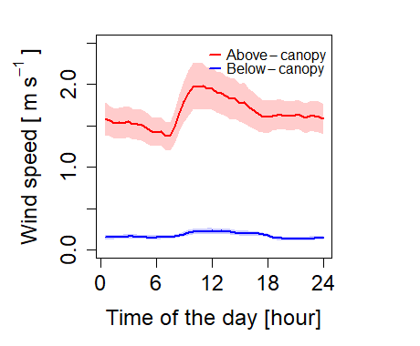
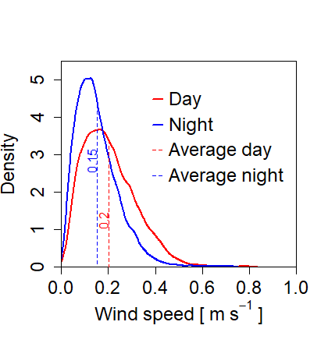
Wind speed
Above-canopy wind speed
Wind speed is generally low in the oil palm plantation. Winds peak around noon and reach their minima shortly before sunrise.
Below the oil palm canopy, calm conditions dominate, especially during night.
Daily average wind speed
Diel wind speed
Below-canopy wind speed
Daily average (semi-transparent) and 7-day moving average (solid line) of above-canopy (blue), and below-canopy wind speed (black).
Diel behavior of above-canopy (red) and below-canopy (blue) wind speed. Shaded areas represent 95 % confidence limits.
Density of above-canopy (upper) and below-canopy (lower) wind speed during day and night.
12

Slide 13
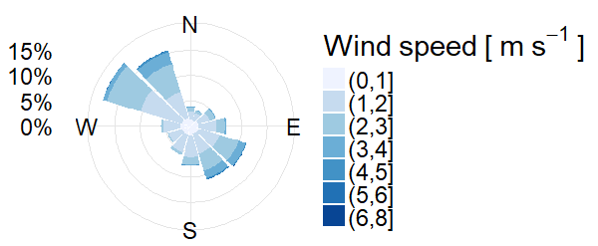
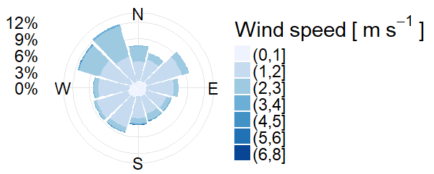
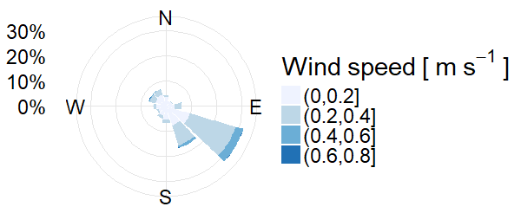
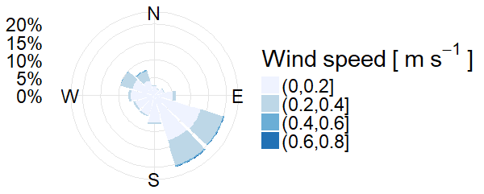
Wind direction
Above-canopy, day
Above-canopy, night
Above-canopy:
During day, winds from northwestern and southeastern directions dominate.
During night, winds are evenly distributed from all directions.
Below-canopy:
Winds from southeastern directions dominate during both day and night.
Below-canopy, day
Below-canopy, night
Wind rose of above-canopy (upper) and below-canopy (lower) wind speed during day (left) and night (right).
13

Slide 14
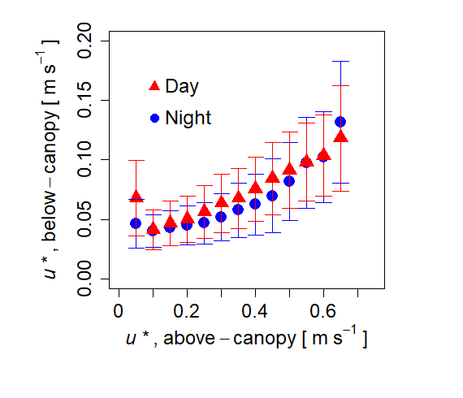
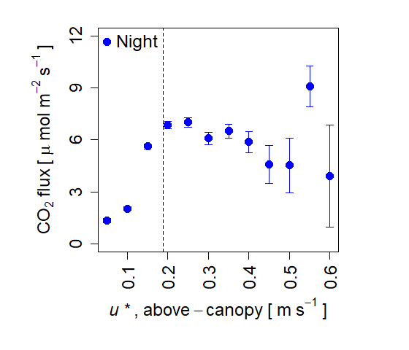
Friction velocity (u*)
Friction velocities (u*) above and below the canopy follow a similar pattern during both day and night.
At higher nocturnal above-canopy turbulence strength (u* > 0.19 m s⁻¹) nocturnal above-canopy CO₂ flux levels off.
Above- and below-canopy u*
Nocturnal above-canopy u* and CO₂ flux
0.19
Nocturnal above-canopy friction velocity (u*) and CO₂ flux. The dashed vertical line marks the u* threshold of 0.19 m s⁻¹, which is used for the u* filtering in this study. Error bars mark standard error.
Comparison of above- and below-canopy friction velocity (u*) during day (red) and night (blue). Error bars mark standard deviation.
14

Slide 15
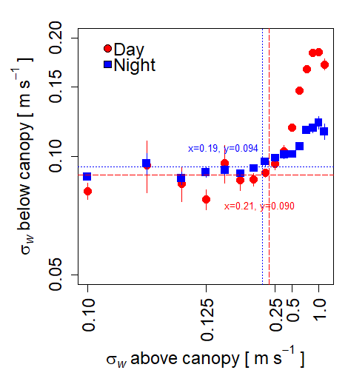
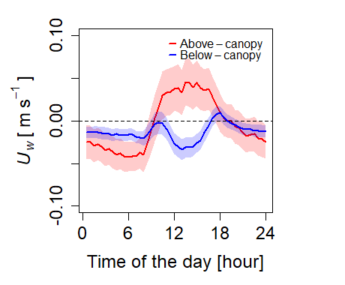
Correlation between the standard deviation of below- vs. above-canopy vertical wind speed (σ_{w})
Above the oil palm canopy, downdraft winds dominate during night and updraft winds dominate during most of the day, while below the canopy, downdraft winds dominate for both day and night.
The correlation between above- and below-canopy σ_{w} breaks down at thresholds of ~0.20 m s⁻¹ and ~0.092 m s⁻¹, respectively, indicating possible transition between decoupling to coupling between the two measurement heights at these thresholds.
Standard deviation of vertical wind speed
Vertical wind speed
updraft
downdraft
Standard deviation of the vertical wind speed (σ_{w}) above and below the canopy during day (red) and night (blue) binned in 16 classes of the 30 min σ_{w} averages. The crossing points of the dotted red and blue lines indicate the proposed transition point from decoupling to coupling between the two measurement heights.
Diel trend of above-canopy (red) and below-canopy (blue) updraft (positive) and downdraft (negative) wind speed. Shaded areas represent 95 % confidence limits.
15

Slide 16
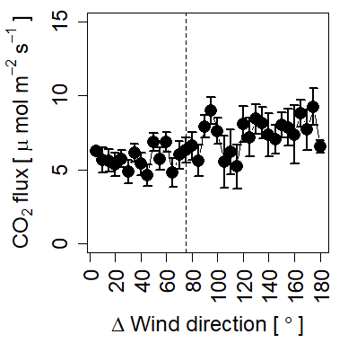
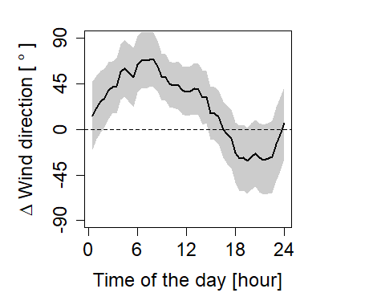
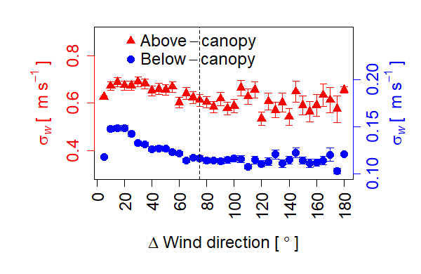
Above- vs. below-canopy wind direction difference (ΔWD)
The difference between above- and below-canopy wind directions is most pronounced around sunrise and after sunset.
There is a clear saturating, negative trend between ΔWD, σ_{w} and nocturnal CO₂ flux, indicating that the interaction between above- and below-canopy layers becomes weaker at ~75° ΔWD. Therefore, we propose <75° ΔWD as coupled and >75° ΔWD as decoupled.
Nocturnal CO₂ flux in relation to wind direction difference
75°
Diel difference in wind direction
σ_{w} vs. ΔWind direction
75°
Bin-averages of CO₂ flux with standard deviations vs. wind direction difference (ΔWD) between above- and below canopy wind direction during night. Error bars mark standard error.
Diel behavior of above- and below-canopy wind direction difference. Shaded areas represent 95 % confidence limits.
Above-canopy (red) and below-canopy (blue) standard deviation of the vertical wind velocity (σ_{w}) versus difference between above- and below-canopy wind direction (ΔWind direction). Error bars mark standard error.
16

Slide 17
Overview CO₂ flux filtering approaches
Differences in average CO₂ fluxes between the applied filtering approaches are relatively small. In general, filtering resulted in slightly higher daytime CO₂ fluxes compared to the original data set.
On average, ~30% of CO₂ fluxes were removed due to filtering and more than 50% of nocturnal data were removed in u* filter and σ_{w} filter, respectively.
Filtering approach | Used threshold | Average CO₂ flux ± standard deviation [µmol m⁻² s⁻¹] | Average daytime CO₂ flux ± standard deviation [µmol m⁻² s⁻¹] | Average nocturnal CO₂ flux ± standard deviation [µmol m⁻² s⁻¹] | % of daytime CO₂ fluxes removed from original data | % of nocturnal CO₂ fluxes removed from original data | % of CO₂ fluxes removed from original data
Original data | - | -3.40 ± 13.15 | -12.96 ± 12.06 | 6.12 ± 5.01 | - | - | -
u* (friction velocity) | u* < 0.19 m s⁻¹ | -3.55 ± 13.10 | -13.24 ± 11.81 | 6.21 ± 4.41 | 17.6 | 59.8 | 33.5
σ_{w} (standard deviation of the vertical wind speed) | σ_{w} < 0.20 (above-canopy), σ_{w} < 0.092 (below-canopy) | -3.82 ± 12.90 | -13.32 ± 11.68 | 5.76 ± 4.38 | 18.1 | 56.4 | 32.5
ΔWD (wind direction difference) | ΔWD >75° | -3.64 ± 12.85 | -13.03 ± 11.74 | 5.76 ± 4.47 | 30.2 | 30.7 | 30.4
Overview CO₂ flux filtering approaches.
17

Slide 18
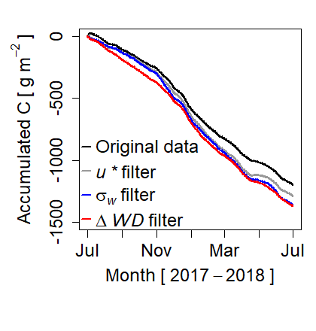
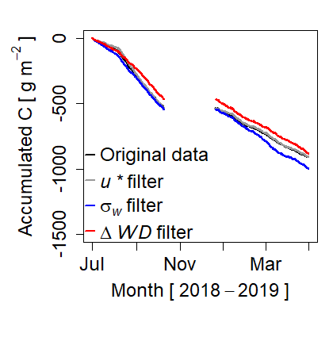
Cumulative CO₂ fluxes based on flux filtering approaches
In the first year, ΔWD filter and σ_{w} filter yielded highest accumulated C compared to u* filter and non-filtered data. Differences in accumulated C between the different filtering approaches are up to 173 gC m⁻².
In the second year, ΔWD filter yielded lowest accumulated C and both u* filter and σ_{w} filter showed similar results.
Accumulated carbon first year
Accumulated carbon second year
No data
-884.7 ± 27.8 gC m⁻²
-910.6 ± 28.6 gC m⁻²
-1197.2 ± 38.7 gC m⁻²
-910.9 ± 28.6 gC m⁻²
-1289.0 ± 38.4 gC m⁻²
-1001.1 ± 27.9 gC m⁻²
-1361.0 ± 38.1 gC m⁻²
-1370.3 ± 37.9 gC m⁻²
Accumulated carbon during the period Jul. 2017 to Jun. 2018 based on different filtering approaches. Data has been gapfilled using REddyProc (MPI Jena, Germany).
Accumulated carbon during the period Jul. 2018 to April 2019 based on different filtering approaches. Data has been gapfilled using REddyProc (MPI Jena, Germany).
18

Slide 19
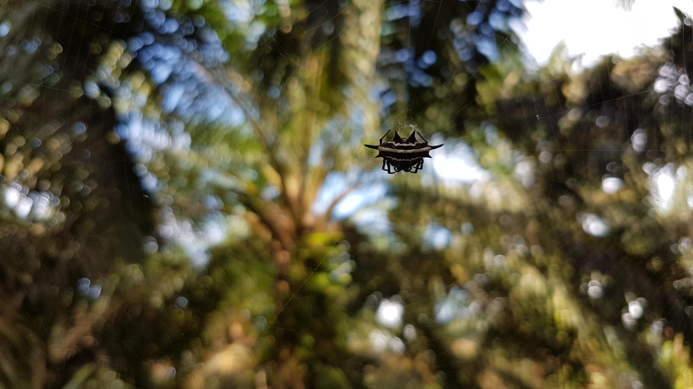
Summary & conclusion

Slide 20
Summary & conclusion
Wind speeds above and below the oil palm canopy are generally low.
We applied three approaches based on eddy covariance (EC) wind measurements to identify possible decoupling:
  u* threshold: nocturnal CO₂ fluxes level off at u* > 0.19 m s⁻¹, indicating sufficient development of turbulence strength above this threshold
  σ_{w} threshold: possible transition between decoupling to coupling at ~0.20 m s⁻¹ (above-canopy σ_{w}) and ~0.092 m s⁻¹ (below-canopy σ_{w})
  ΔWD threshold: interaction between wind direction, CO₂ flux and σ_{w} weakens at ~75° wind direction difference (ΔWD) between above- and below-canopy winds, indicating transition to decoupling
Threshold analyses showed that during night, decoupling may occur frequently and up to 50% of measured nocturnal CO₂ fluxes fall within such decoupling periods.
Based on the applied threshold filtering, annual accumulated carbon fluxes showed differences of up to 12.6% (173 gC m⁻²).
Decoupling of above- and below-canopy air layers needs to be investigated and considered, especially when EC-data is used as reference for fluxes of tall vegetation or for modelling approaches.
20

Slide 21


Take-home message
Decoupling of above- and below-canopy air layers needs to be investigated and considered, especially when eddy covariance data is used as reference for fluxes of tall vegetation or for modelling approaches.
Follow us!
        @stiegler_chr Christian Stiegler
        @BioclimGoe Bioclimatology Group at University of Göttingen
        @efforts_crc990 Collaborative Research Centre 990: Ecological and Socioeconomic Functions of Tropical Lowland Rainforest Transformation Systems (Sumatra, Indonesia)
        Christian Stiegler: christian.stiegler@biologie.uni-goettingen.de
        Tania June: tania.june@yahoo.com
        Alexander Knohl: aknohl@uni-goettingen.de
20

