Slide 1
AS5.24: Advances in emission estimation based on observations and inversion techniques
Developing High-Resolution Air Quality Reanalysis Dataset over China for Years 2013 – 2018 Base on Ensemble Kalman Filter and Surface Observations from CNEMC
Lei Kong^{1,2}, Xiao Tang^{1,2}, Jiang Zhu^{1,2}, Zifa Wang^{1,2}, Huangjian Wu^{1,3}, Jianjun Li⁴
¹LAPC & ICCES, Institute of Atmospheric Physics, Chinese Academy of Sciences, China
²College of Earth and Planetary Sciences, University of Chinese Academy of Sciences, China
³Guanghua School of Management, Peking University, China
⁴China National Environmental Monitoring Centre, China
04/05/2020

Slide 2
Background
The China’s air pollution has changed substantially since 2013
The effects of such changes on the human health and environment has been an increasingly hot topic in many scientific fields
There is still no long-term air quality dataset in China of high accuracy and spatiotemporal resolutions
 | CAMSRA | CIRA | MACC | MERR Aero | MERRA-2 | Miyazaki et al, 2015 | Miyazaki et al, 2020 | JRAero | Ozone MSR
Temporal coverage | 2003 – 2016 | 2003 - present | 2003 – 2012 | 2002 – 2015 | 1980 - present | 2005 – 2012 | 2005–2018 | 2011 – 2015 | 1970 – 2012
Spatial coverage | Global | Global | Global | Global | Global | Global | Global | Global | Global
Spatial resolution | 80km | 110km | 80km | 0.5°$×$ 0.625° | 0.5°$×$ 0.625° | 2.8° | 1.1°$×$1.1° | 1.1°$×$1.1° | 0.5°$×$0.5°
Assimilated retrievals | satellite | satellite | satellite | satellite | satellite | satellite | satellites | satellite | satellite
Country/ Region | Europe | Europe | Europe | USA | USA | Japan | Japan | Japan | Netherlands

Slide 3
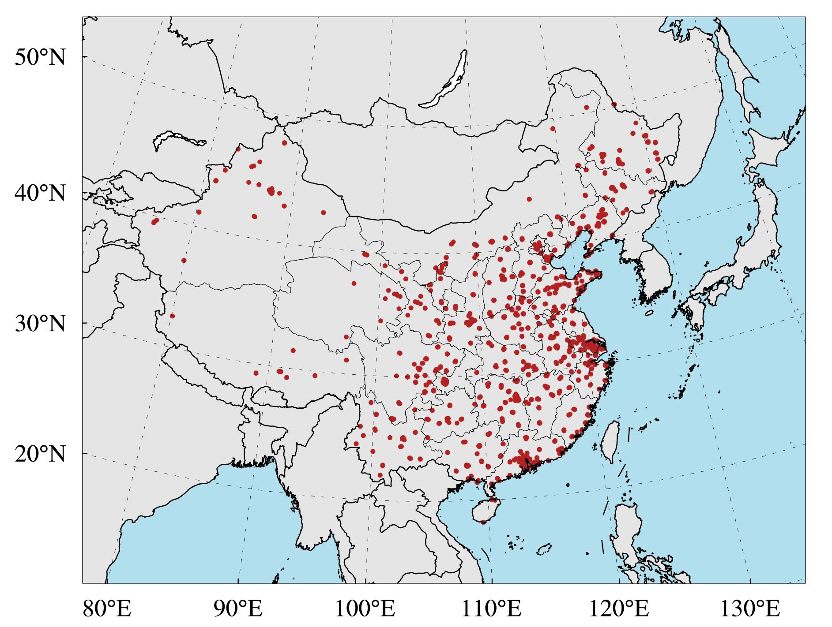
China National Air Quality Monitoring Network
Since 2012, The China National Environmental Monitoring Centre (CNEMC) has established a national air quality monitoring network, which covers 1436 sites and routinely monitors the hourly concentrations of PM_{2.5}, PM₁₀, SO₂, NO₂, CO and O_{3.}

Slide 4
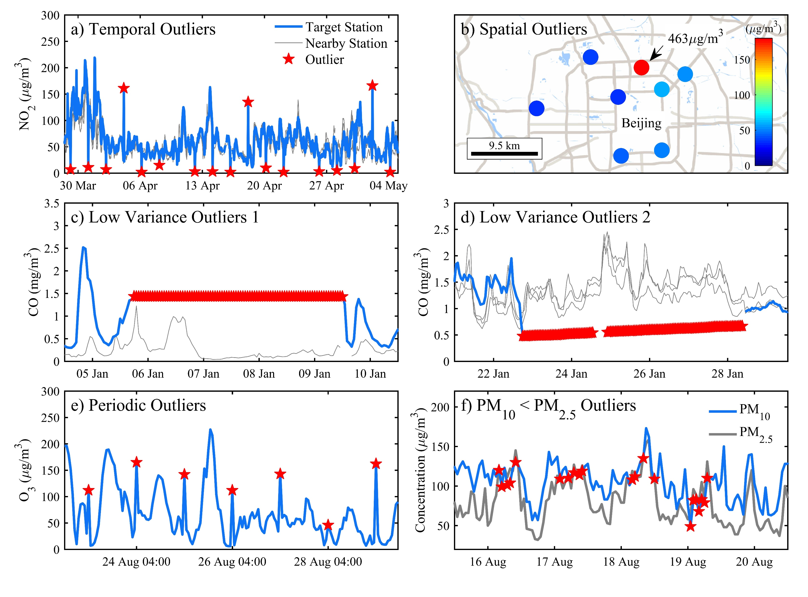
Probabilistic Automatic Outlier Detection Method
Before assimilation, we developed a automatic outlier detection method to filter out the outliers of observations.
This technique detects outliers based on the probability of residuals, which integrates several statistical methods, including median filter, low pass filter, spatial regression and so on.
Wu et al., 2018, AAS

Slide 5
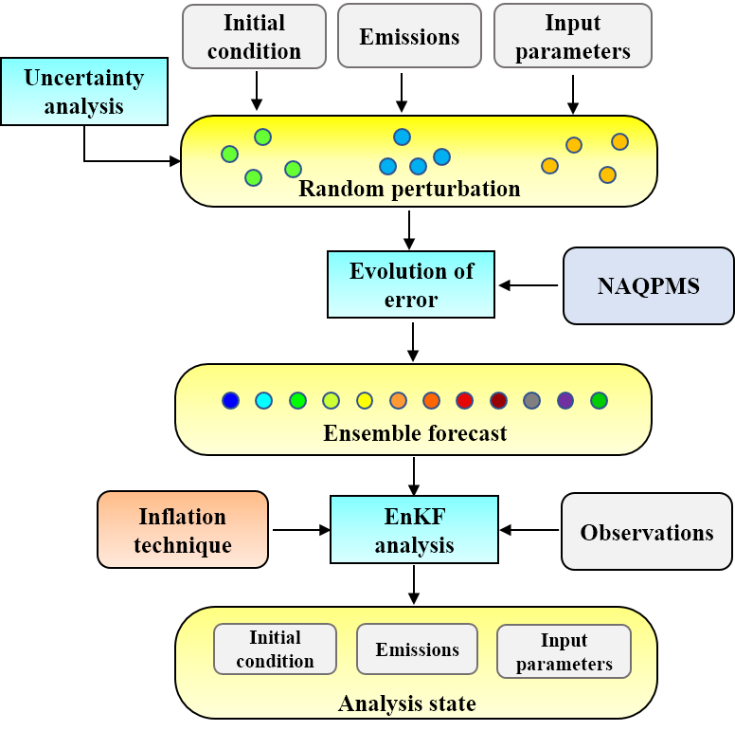
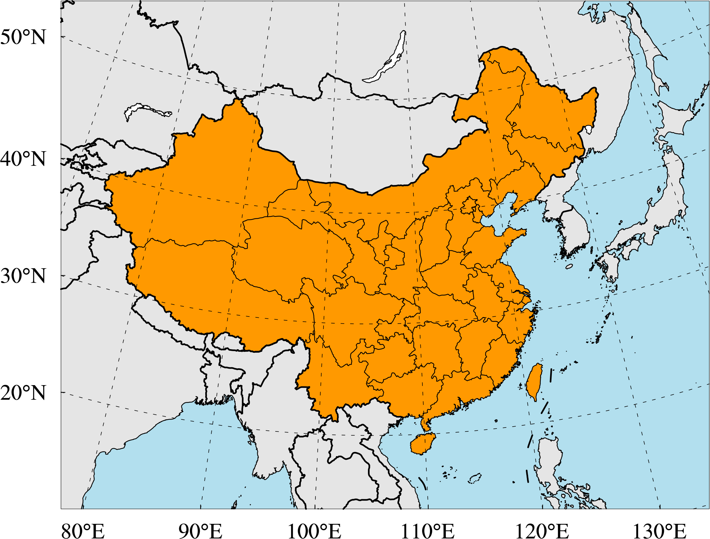
Chemical data assimilation system (ChemDAS) at IAP
Assimilation method: Ensemble Kalman Filter
Inflation technique: Wang and Bishop, 2003
Assimilation window: 1 hour
Localization Scale: 80km
Ensemble size: 50
Chemical transport model: NAQPMS
Meteorological model：WRF
Horizontal resolution: 15km$×$15km
Emission inventory: HTAP_v2.2
Experiment period: Jan, 2013–Dec, 2018
Modeling domain

Slide 6
Assimilation scheme
Offline analysis scheme:
Species | SO₂ | NO_{x} | CO | NMVOC | NH₃ | PM₁₀ | PM_{2.5} | BC | OC
Emission Uncertainty | $±$12 | $±$31 | $±$70 | $±$68 | $±$53 | $±$132 | $±$130 | $±$208 | $±$258
(unit: %, Zhang et al. 2009; streets et al. 2001)
Analysis scheme (LETKF):
Inflation technique (Wang and Bishop 2003):
$\overline{x^{a}}=\overline{x^{b}}+X^{b}{\overline{w}}^{a}$
${\overline{w}}^{a}={\tilde{P}}^{a}{\left(HX^{b}\right)}^{T}R^{−1}(y^{o}−H\overline{x^{b}})$
${\tilde{P}}^{a}={\left[\frac{\left(N_{ens}−1\right)I}{1+λ}+{\left(HX^{b}\right)}^{T}R^{−1}\left(HX^{b}\right)\right]}^{−1}$
$\overline{x^{b}}=\frac{1}{N_{ens}}\sum_{i=1}^{N_{ens}}{x_{i}^{b}};X_{i}^{b}=\frac{1}{\sqrt{N−1}}\left(x_{i}^{b}−\overline{x^{b}}\right)$
$λ=\frac{{\left(R^{−1/2}d\right)}^{T}R^{−1/2}d−p}{trace\left\{R^{−1/2}HP^{b}{\left(R^{−1/2}H\right)}^{T}\right\}}$
$d=y^{o}−H\overline{x^{b}}$
$P^{b}=X^{b}{\left(X^{b}\right)}^{T}$

Slide 7
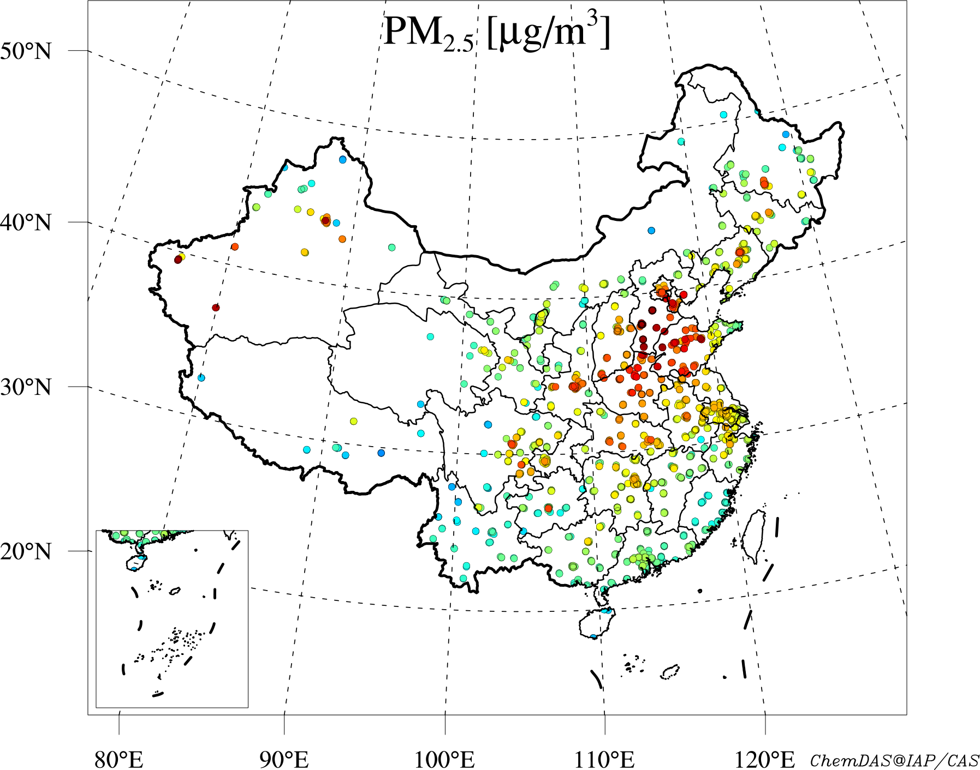
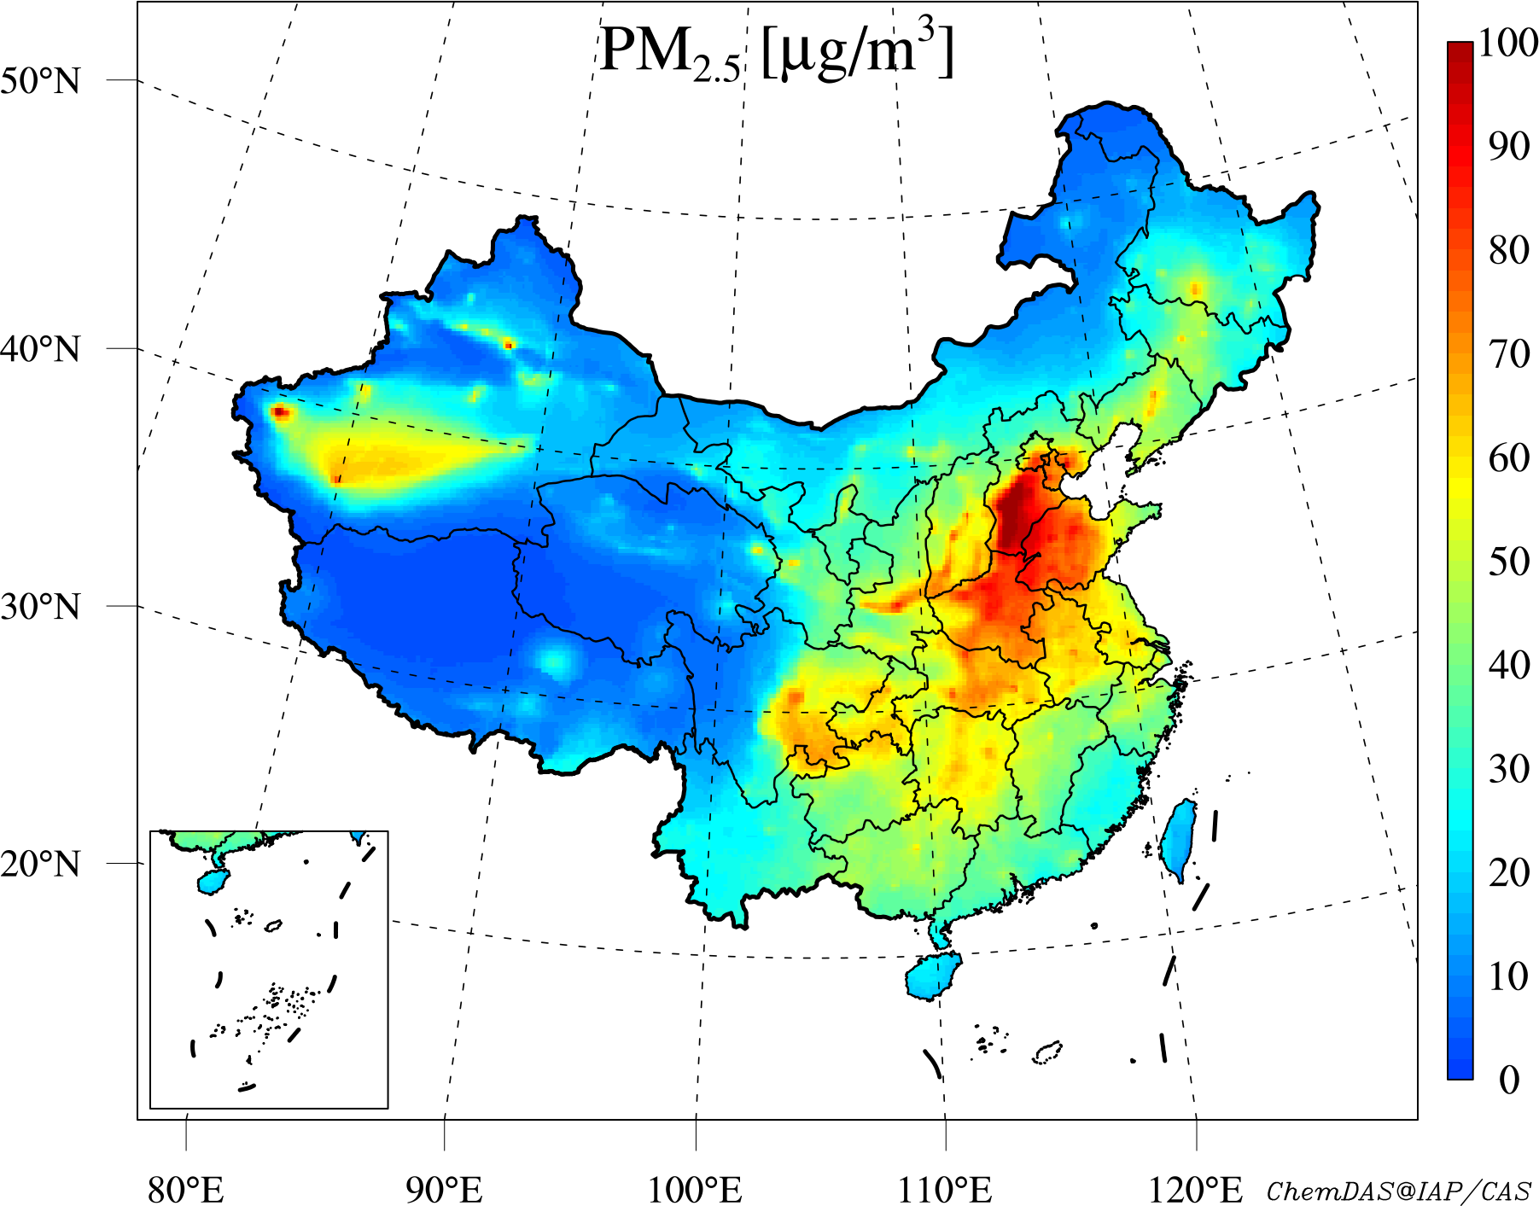
The Chinese Air Quality Reanalysis dataset (CAQRA)
Observation
Basic descriptions:
Temporal Coverage: 2013.1 – 2018.12
Temporal Resolution: Hourly
Spatial Coverage: China
Spatial resolution: 15km×15km
Species: PM_{2.5}, PM₁₀, SO₂, NO₂, CO and O₃
Reanalysis

Slide 8
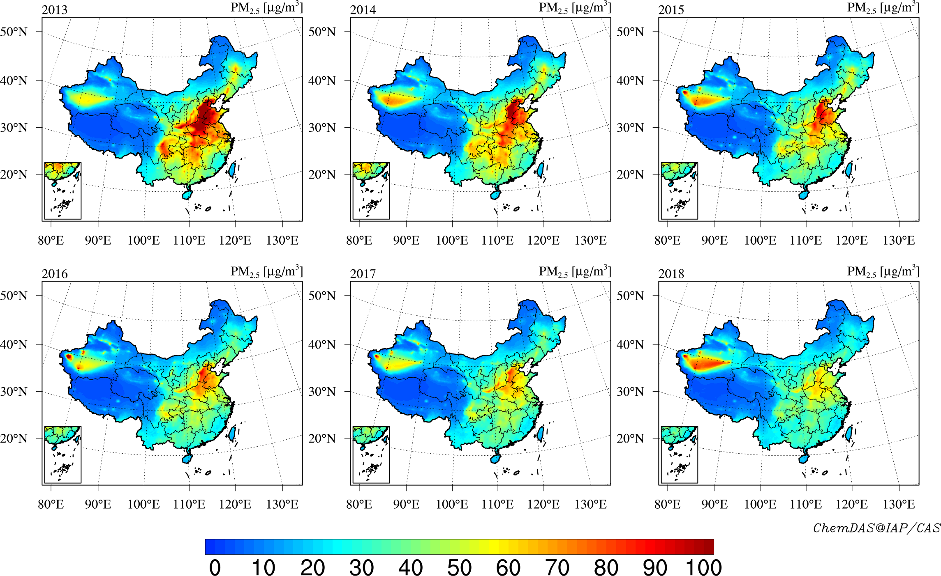
The Chinese Air Quality Reanalysis dataset (CAQRA)

Slide 9
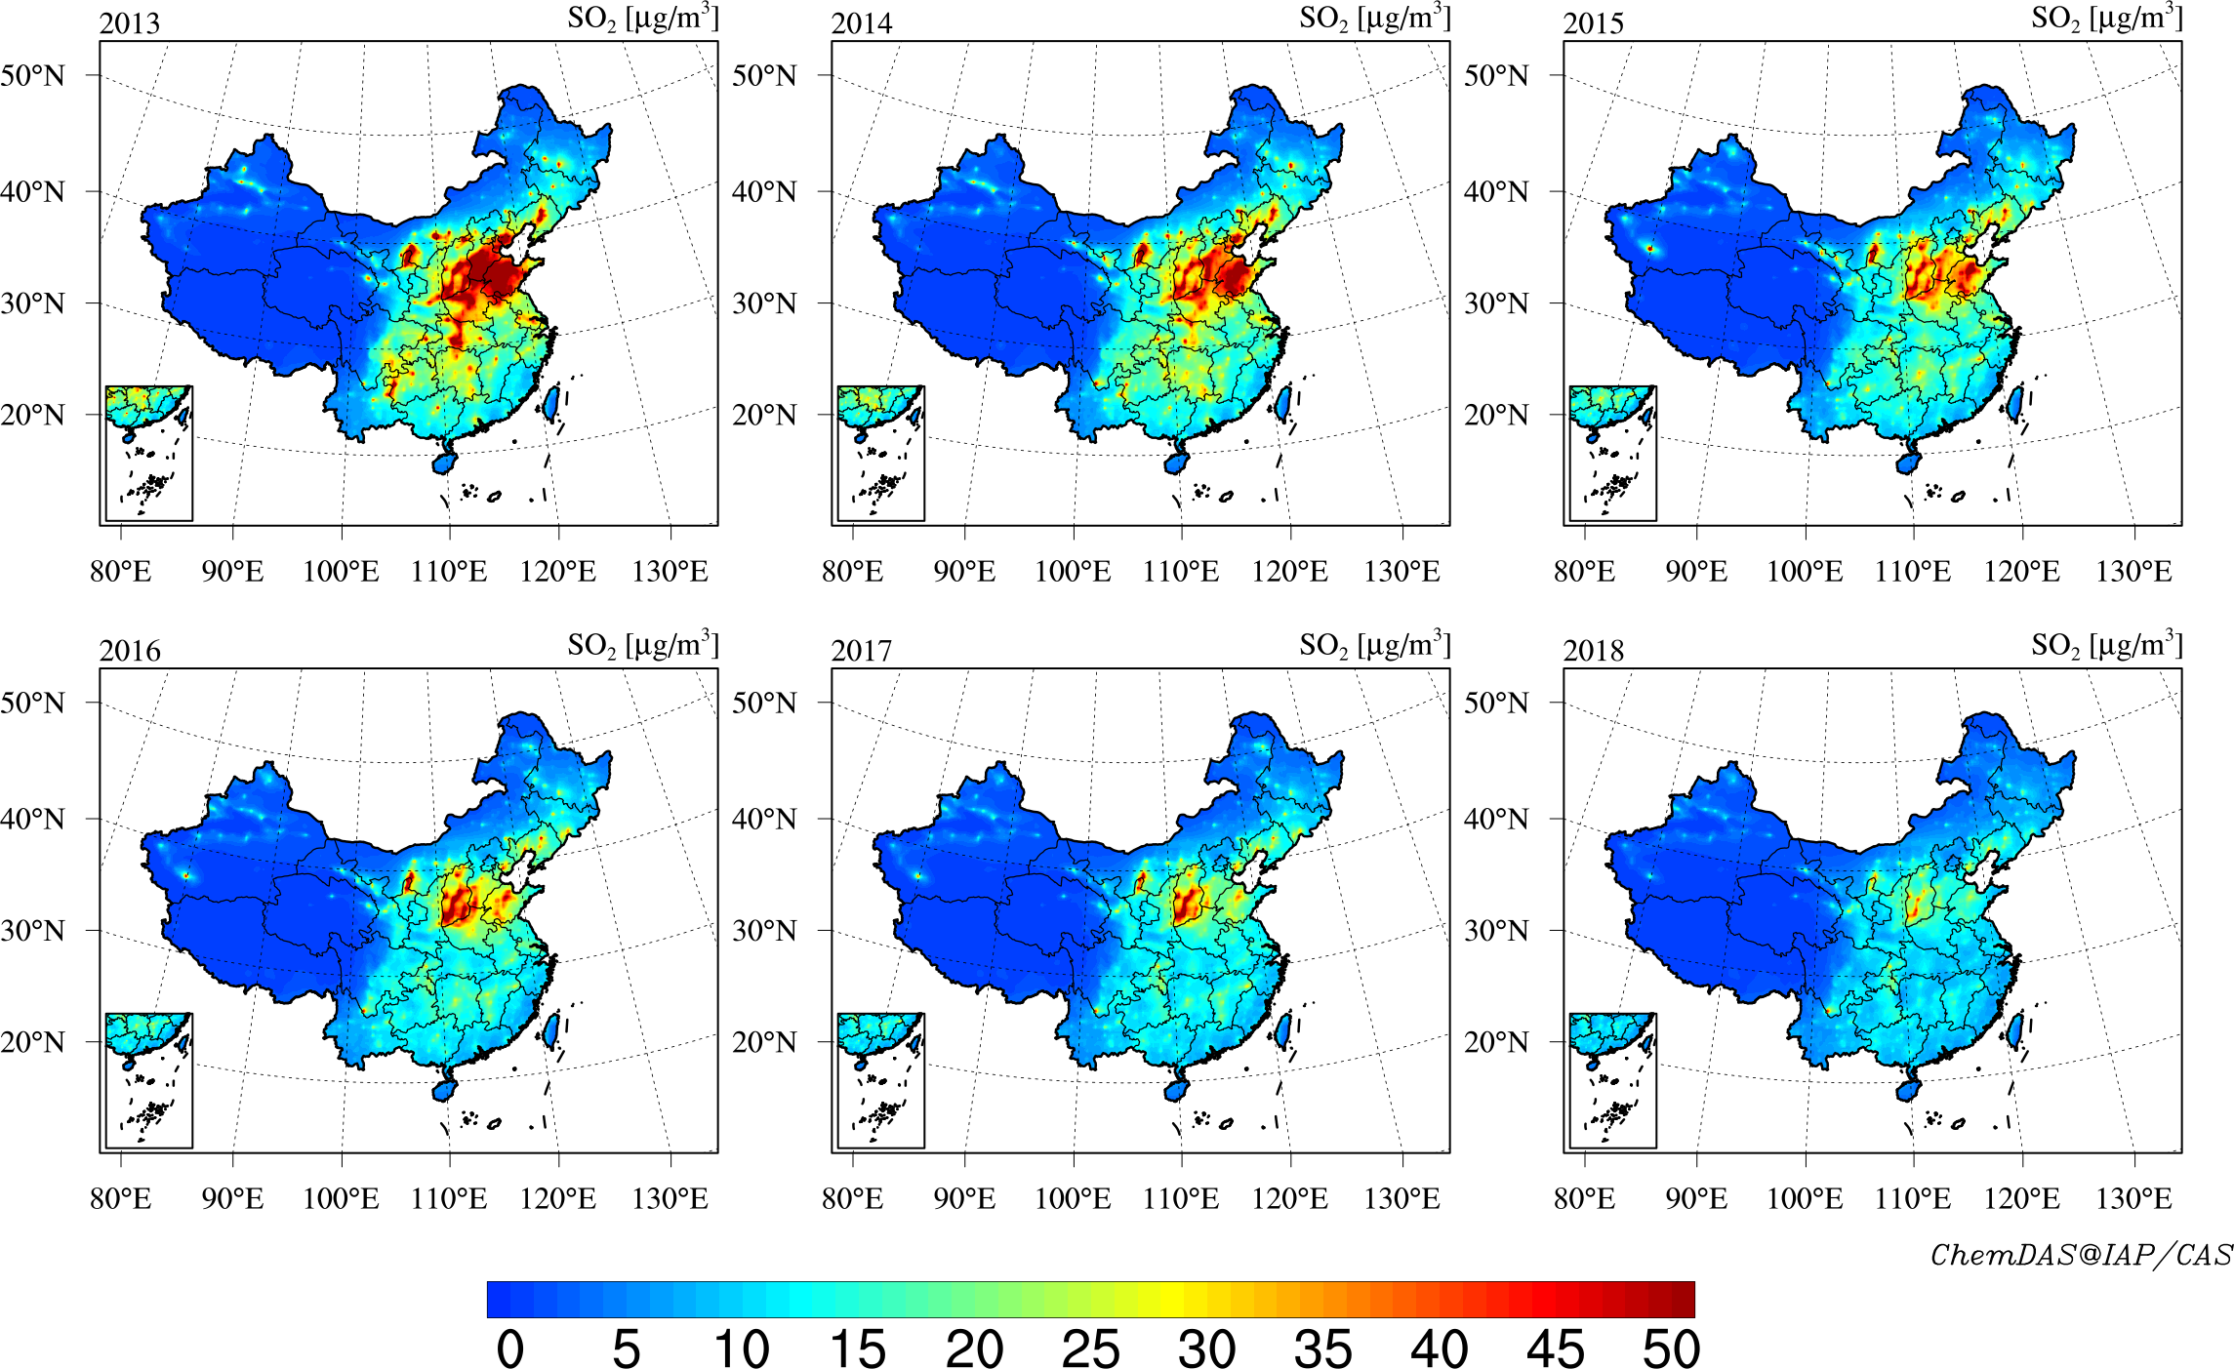
The Chinese Air Quality Reanalysis dataset (CAQRA)

Slide 10
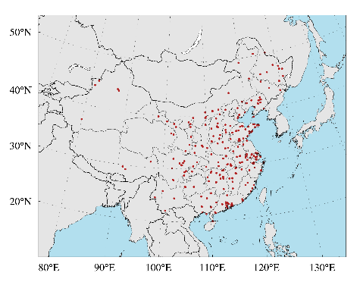
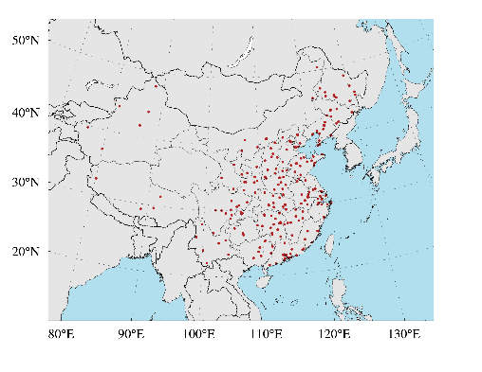
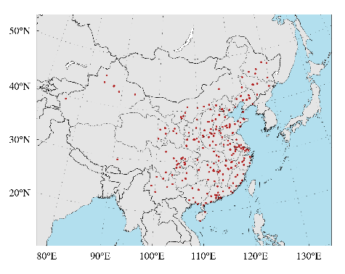
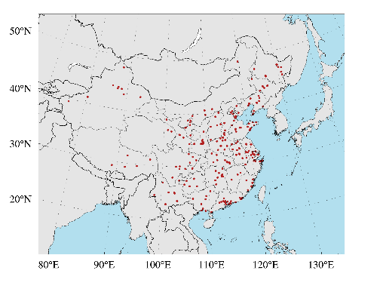
Accuracy of the CAQRA
Using cross validation approach
Observation sites divided into five groups
One group of observation sites was withheld from the data assimilation and used to validate the reanalysis results
Repeat five times until all site observations are used to validate independently.
group 1
group 2
group 3
group 4
group 5

Slide 11
Cross validation results
Metrics | Species
 | PM_{2.5} | PM₁₀ | SO₂ | NO₂ | CO | O₃
R² | 0.81 | 0.72 | 0.52 | 0.61 | 0.55 | 0.76
Mean Bias($μg/m^{3})$ | -2.6 | -6.8 | -2.0 | -2.3 | -60 | -2.3
Root Mean Square Error$(μg/m^{3})$ | 21.3 | 39.3 | 17.5 | 16.4 | 540 | 21.9

Slide 12
Cross validation results for the diurnal variation of O₃
Diurnal profile of national mean O₃
concentrations in China
Diurnal profile of the MBE
of O₃ reanalysis data
Diurnal profile of the RMSE
of O₃ reanalysis data
The CAQRA has good performance in representing the diurnal variations of O₃ concentrations in China
There were small negative biases in the O₃ reanalysis, ranging from -0.3 to -3.0 $μg/m^{3}$;
The RMSE value ranges from -17.5 to 23.3 $μg/m^{3}$

Slide 13
Comparisons with satellite estimates of PM_{2.5} concentrations
Reference | spatial resolution | temporal resolution | temporal coverage | CV-R² | CV-RMSE | Method
This study | 15km$×15$km | hourly | 2013–2018 | 0.81 | 21.3 | EnKF
 |  | daily | 2013–2018 | 0.86 | 15.1 | EnKF
(Ma et al., 2016) | 0.1$°×$0.1$°$ | daily | 2004–2013 | 0.79 | 27.4 | LME + GAM
(Xue et al., 2019) | 0.1$°×$0.1$°$ | daily | 2000–2016 | 0.56 | 30.2 | CTM + HD-expansion + GAM
(Xue et al., 2017) | 0.1$°×$0.1$°$ | daily | 2014 | 0.72 | 23.0 | CTM + LME + Spatiotemporal Kriging
(Chen et al., 2018) | 0.1$°×$0.1$°$ | daily | 2005–2016 | 0.83 | 18.1 | RF
(Lin et al., 2018) | 1km$×1$km | daily | 2001 – 2015 | 0.78ª | 19.3ª | semi-empirical
(Chen et al., 2019) | 3km$×$3km | daily | 2014 – 2015 | 0.86 | 15.0 | XGBoost + NELRM
(Yao et al., 2019) | 6km$×$6km | daily | 2014 | 0.60 | 21.8 | TEFR + GWR
(You et al., 2016) | 0.1$°×$0.1$°$ | daily | 2014 | 0.79 | 18.6 | GWR
(Zhan et al., 2017) | 0.5$°×$0.5$°$ | daily | 2014 | 0.76 | 23.0 | GW-GBM
(Li et al., 2017b) | 0.1$°×$0.1$°$ | daily | 2015 | 0.82 | 16.4 | Geoi-DBN
(Liu et al., 2019) | 0.125$°×$0.125$°$ | hourly | 2016 | 0.86 | 17.3 | RF
LME: Linear Mixed Effect model
GWR: Geographically Weighted Regression model
GAM: Generalized Additive model
HD-expansion: High dimensional expansion
RF: Random Forest
XGBoost: The Extreme Gradient Boosting
NELRM: Non-linear Exposure-lag-response model
TEFR: Time Fixed Effects Regression model
GW-GBM: Geographically-Weighted Gradient Boosting Machine
Geoi-DBN: Geographically Deep Belief Network

Slide 14
Comparisons with CAMSRA with regards to the gaseous air pollutants
In order to further evaluate the accuracy of our reanalysis dataset for the gaseous air pollutants, the CAMS reanalysis (CAMSRA) produced by the ECMWF (Inness et al., 2019) are employed as a reference to compare with our reanalysis dataset.
The CAMSRA is the latest global reanalysis dataset of atmospheric compositions, which assimilates the satellite retrievals of O₃, CO, NO₂ and AOD.
 | CAQRA |  |  |  | CAMSRA
 | SO₂ ($μg/m^{3})$ | NO₂ ($μg/m^{3})$ | CO (m$g/m^{3})$ | O₃ ($μg/m^{3})$ | SO₂ ($μg/m^{3})$ | NO₂ ($μg/m^{3})$ | CO (m$g/m^{3})$ | O₃ ($μg/m^{3})$
R² | 0.53 | 0.61 | 0.55 | 0.77 | 0.04 | 0.23 | 0.13 | 0.00
MBE | -2.0 | -2.3 | -0.1 | -2.3 | 19.4 | 1.7 | -0.2 | 30.6
NMB (%) | -8.5 | -6.9 | -6.1 | -4.0 | 81.2 | 5.2 | -17.5 | 52.1
RMSE | 24.8 | 16.4 | 0.5 | 21.9 | 54.5 | 27.3 | 0.9 | 55.2

Slide 15
This dataset has been submitted to the Earth System Science Data (ESSD) and the full data can be freely downloaded at the website ScienceDB at DOI: 10.11922/sciencedb.00053
Thanks for your attention!
konglei@mai.iap.ac.cn

