Slide 1
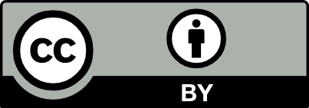
Watch and Learn: Promoting Student Autonomy and Competence in the Field with Just-in-Time Knowledge Clips
EGU2020-7048
João P. Trabucho Alexandre (correspondence: J.Trabucho@uu.nl), Hans de Bresser, Andrea Cuesta Cano, and Yorick P. Veenma
Department of Earth Sciences, Universiteit Utrecht, P.O. Box 80115, 3508 TC Utrecht

Slide 2
Background
The ultimate aim of field courses should be to enable students to work autonomously in the field. We should therefore organize learning activities during which students work autonomously in the field.
Student- and problem-centered approaches to learning in the field afford students much autonomy, but have so far required that students spend a significant amount of time working without access to supervision.
Unless students are competent enough to experience proficiency and a feeling of controlling the quality of their own work, such autonomy is detrimental to student motivation.

Slide 3
Our Project
The aim of this project is to develop short, just-in-time knowledge clips that meet the immediate need of a student exactly when it arises.
At the moment, we are making the first version of knowledge clips (see slides 7–10). We will test these during a field course in May 2021.
The feedback provided by students and instructors will be used to reflect on their usefulness.
Eventually, we will make new, professionally recorded versions of the knowledge clips.

Slide 4
Knowledge Clips
Knowledge clips can (a) provide further information and insights into a key question; (b) complement students’ background knowledge and help refresh their memory on important concepts; and/or (c) demonstrate techniques needed to acquire field data successfully. Knowledge clips are, thus, an interesting form of blended learning that promotes student autonomy and competence.

Slide 5
Intended Outcome
In the future, students will no longer need to wait to get the contact time they need to move on with their work: they can watch (a knowledge clip) and learn just-in-time.
Face-to-face time in the field with an instructor can then be used to achieve higher-order learning outcomes, focusing not on acquiring knowledge but on gaining insight and understanding.

Slide 6
The Utrecht Companion to the Earth is a knowledge-based tutoring system that allows an integrated asynchronous online supervision of students’ field activities. Our aim is to make available just-in-time learning materials in different formats, such as (1) maps, (2) checklists, (3) knowledge clips, (4) infographics, and (5) AR. These materials will help students acquire the knowledge and skills they need to solve their own questions as soon as they emerge without having to wait for face-to-face time with an instructor.

Slide 7
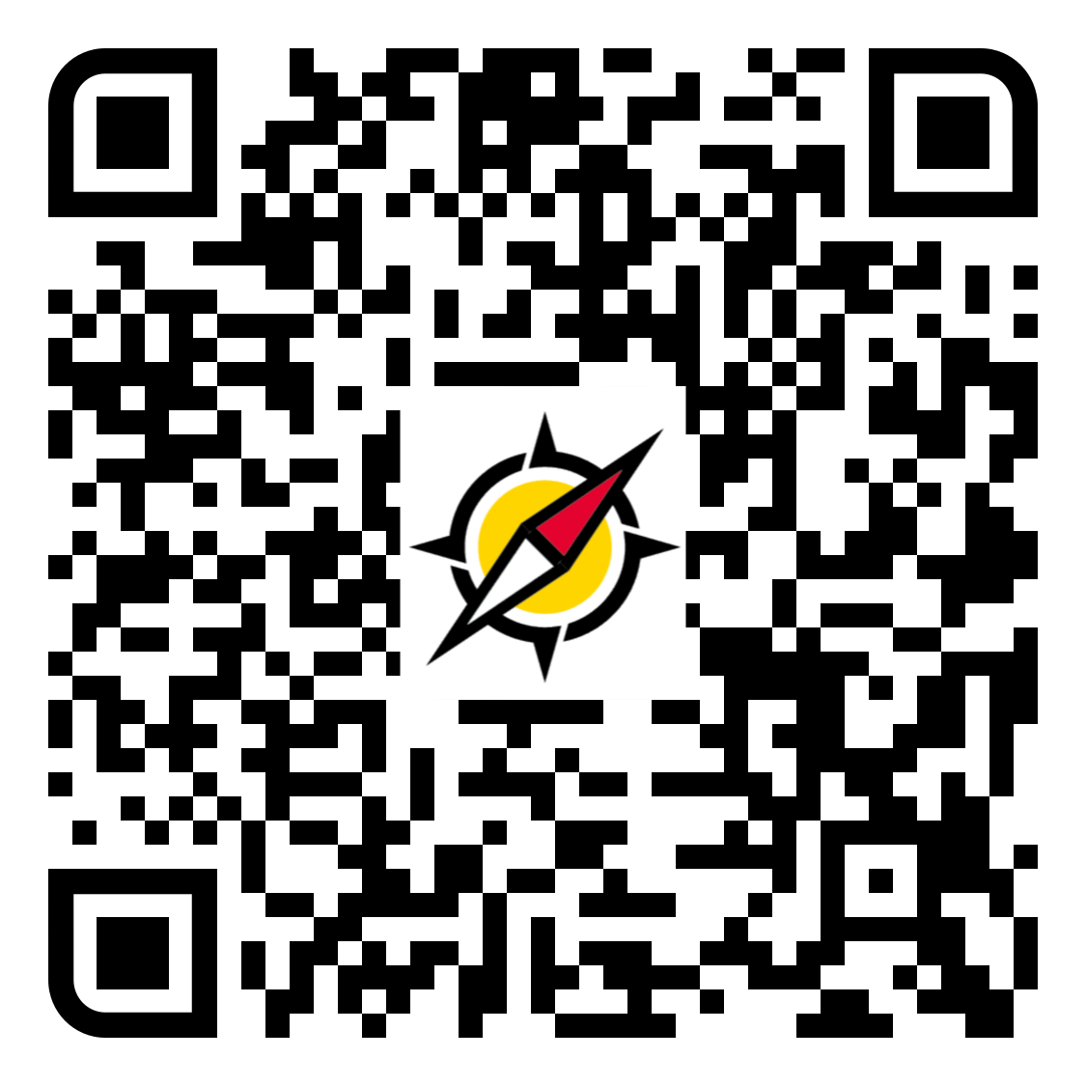
Measuring Planes
After a while not going out into the field, students can struggle with using their compasses again to acquire data. In this knowledge clip, we show how to measure a plane using a Suunto compass.

Slide 8
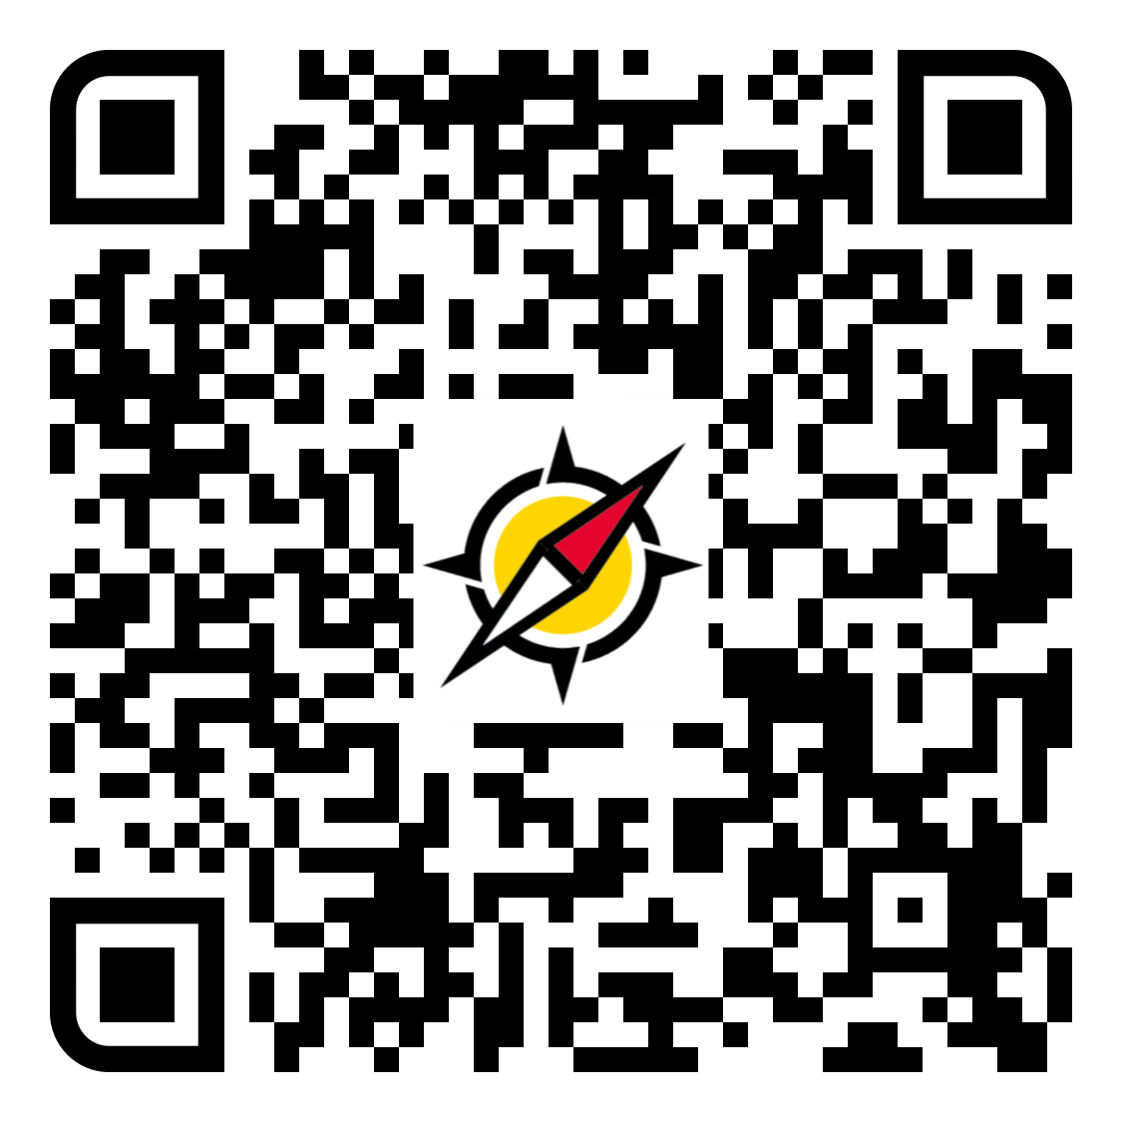
Notations for Measurements
There are several ways of documenting measurements of planes, and students are not aware of all of them. This situation can lead to misinterpretation of explanations from instructors and/or field notes from other students. In this video, each notation is explained and the student is encouraged to choose one and make their choice clear in their field notes.

Slide 9
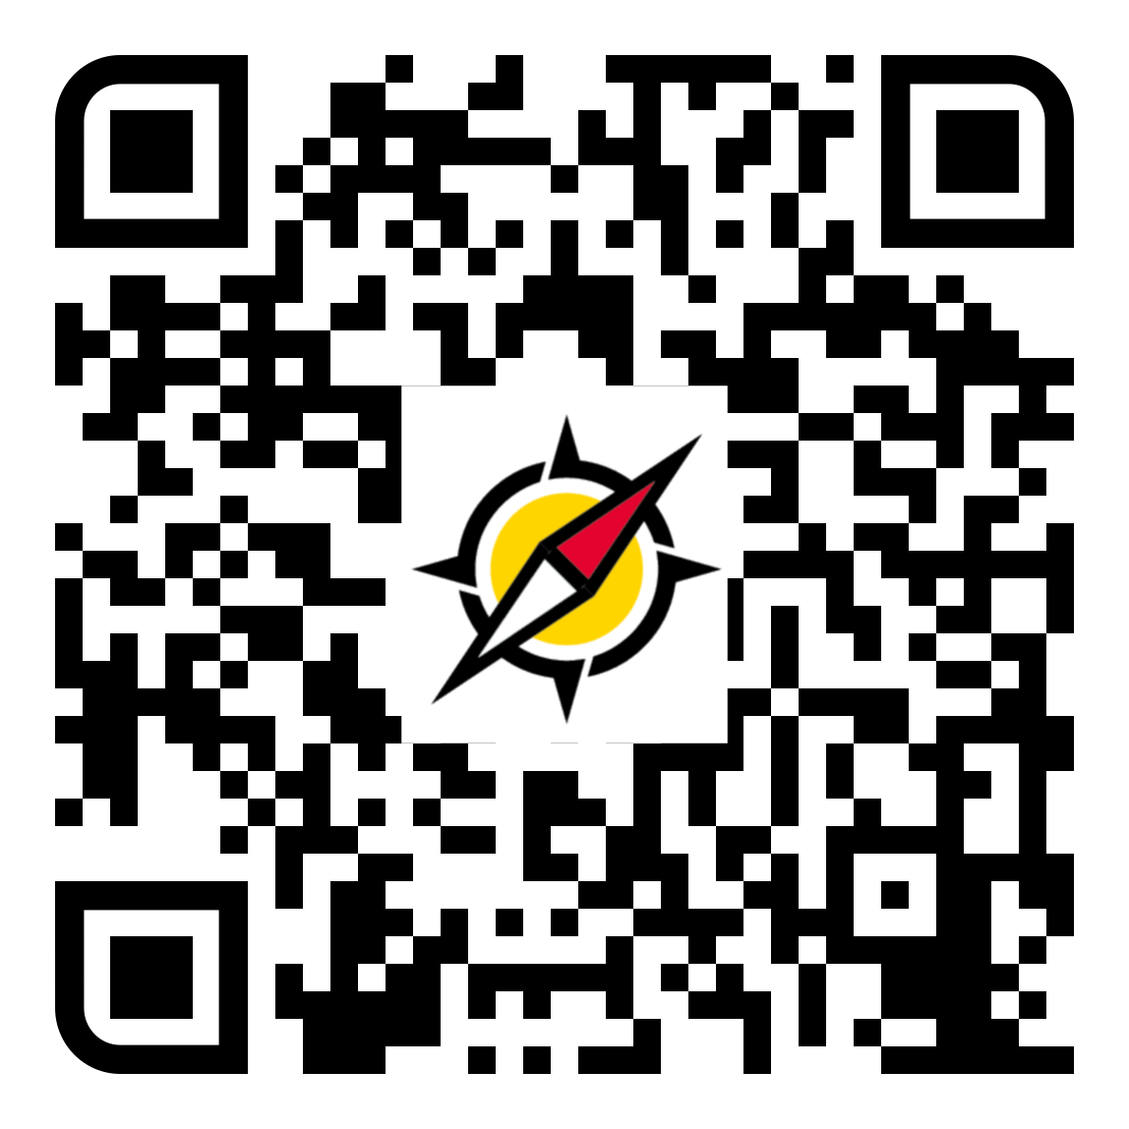
Correction for Tectonic Tilt
Measurements taken at the outcrop often do not represent primary paleogeographic data due to deformation. Correction of such measurements is crucial to make meaningful interpretations. Students are aware of the need for correction, but remember the procedure only vaguely. We use an example to refresh their knowledge on how to correct planes for tectonic tilt.

Slide 10
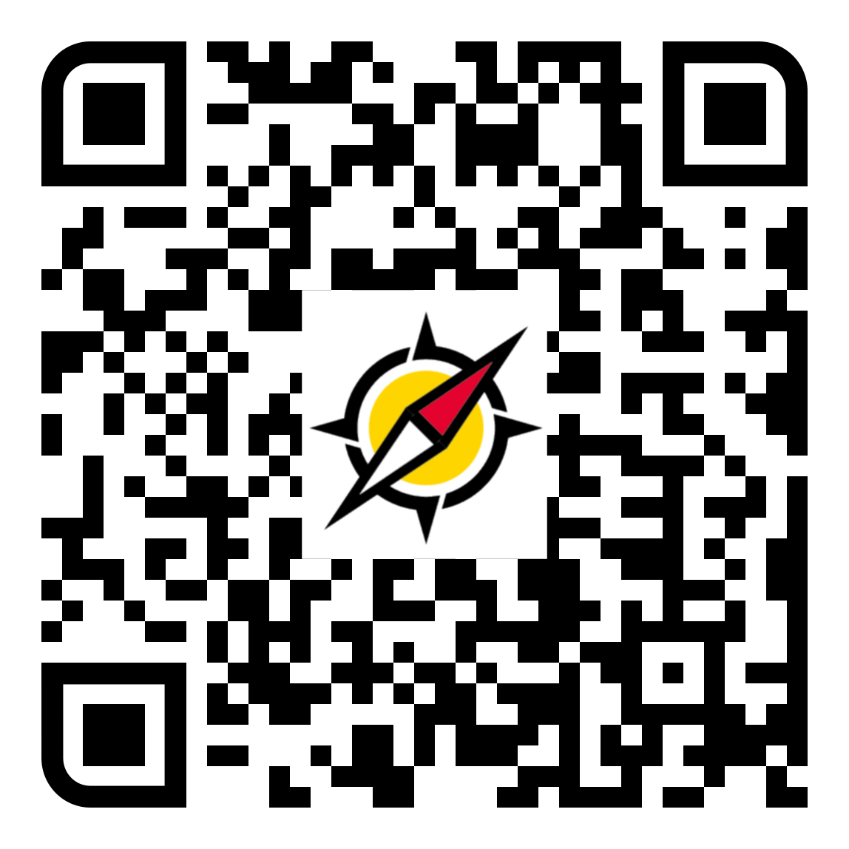
Rose Diagrams
The most useful way to draw conclusions from directional data is by visualizing data as plots. Students are familiar with rose diagrams, but they often struggle with creating appropriate diagrams, because they do not recall the correct procedure. This knowledge clip shows how to construct a rose diagram.

Slide 11
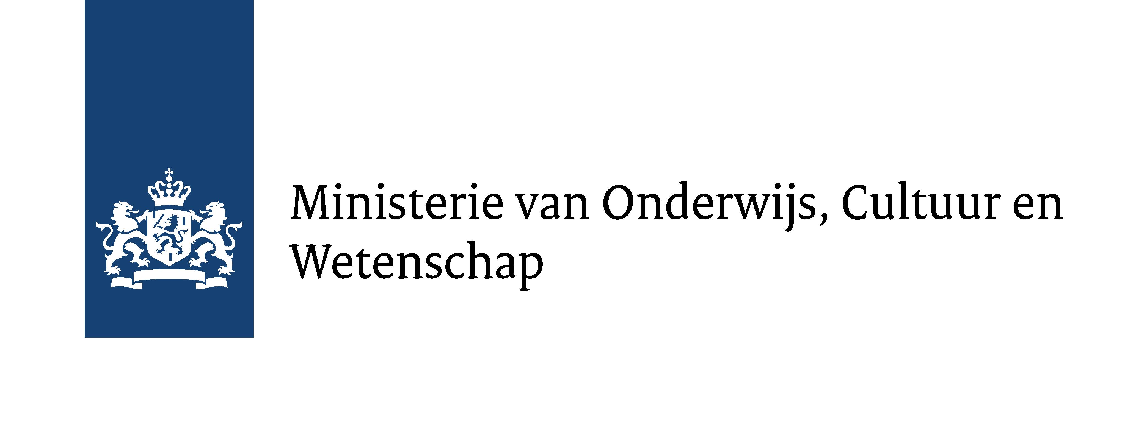
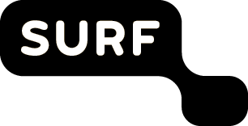
Acknowledgements
This work is supported by the Dutch Ministry of Education, Culture, and Science, Regeling open en online hoger onderwijs 2018–2022, grant OO19-07 to JPTA, and by the Faculty of Geosciences of Universiteit Utrecht.

