Slide 1

Simulating multiple wave
human dispersals out of Africa
Jiaoyang Ruan & Axel Timmermann
IBS Center for Climate Physics, South Korea

Slide 2
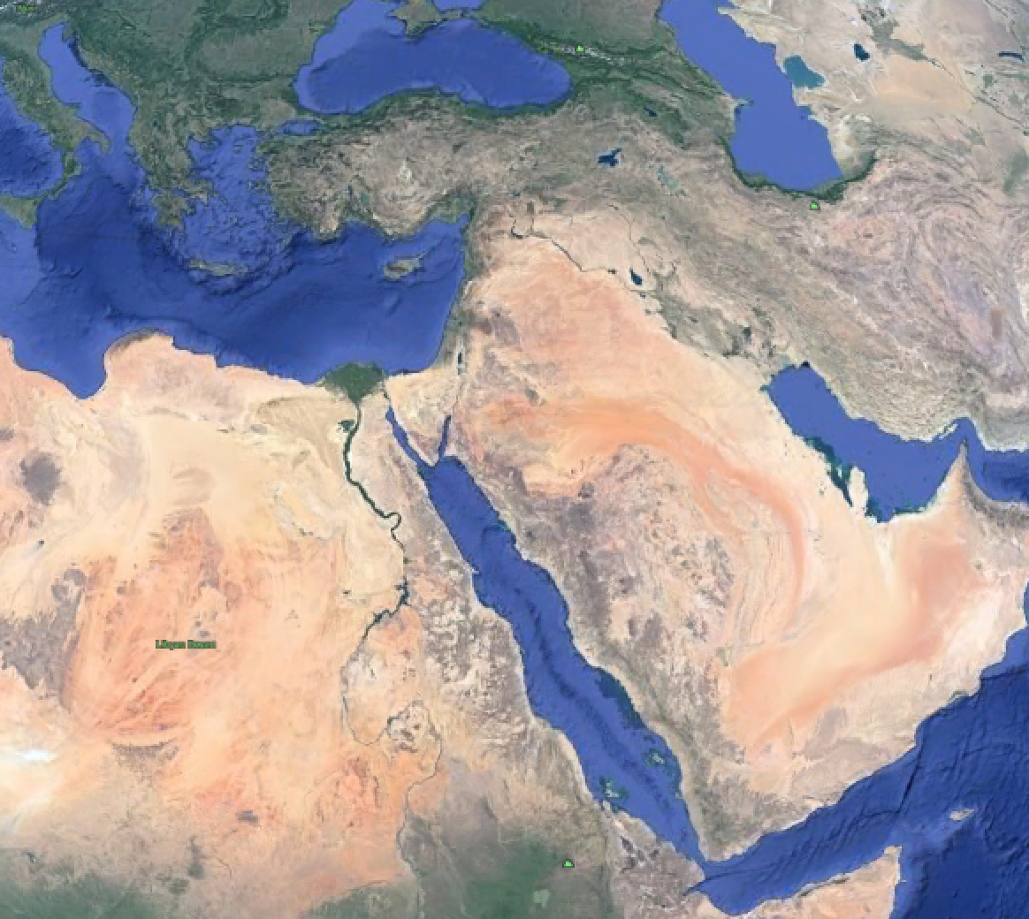
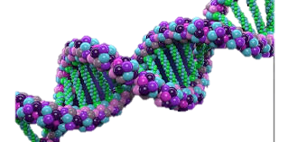

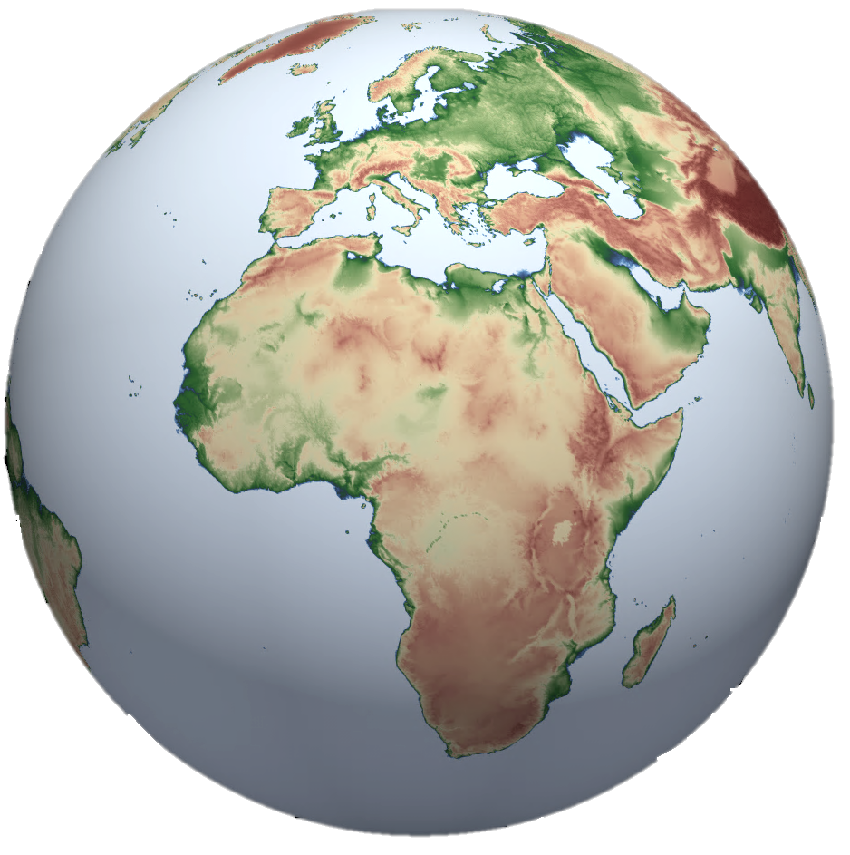

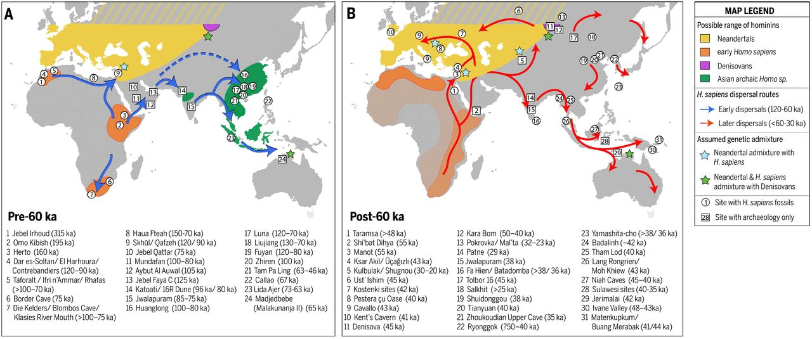
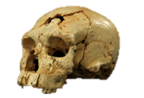
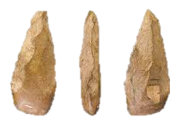
Motivation & Questions
Out of Africa
When ?
Where ?
What happened
on-routes ?
Levant
India
Europe
Australia
China
Bae, et al. Science (2017)

Slide 3
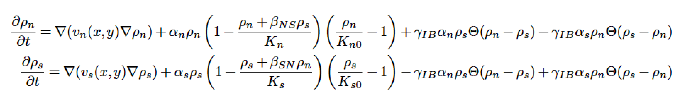








Hominin dispersal model, version 2
Coupled Reaction-Diffusion Equations
Diffusion
Resource Competition
Interbreeding
Climate Forcing
a. LOVECLIM climate model output &
b. Millennial regression patterns from proxies
For more model details:
Timmermann, QSR (2020)
10.1101/2020.04.19.049734
Configuration & Sensitivity Experiments
Homo Neanderthals
Initial time: 100ka
Two dispersal labels
pre-60ka D 1
post-60ka D 2
Eurasia
post-60ka dispersal 2
pre-60ka dispersal 1
W/ & w/o DO events
Competition = 0 - 4
Interbreeding = 0 - 0.6
Africa
Homo Sapiens
Today
dark: this study
light: ongoing study
100k
60k
20k

Slide 4
The spatio-temporal evolution of two dispersal waves
100ka
78ka
68ka
D1 exodus
58ka
48ka
38ka
D2 exodus
D1 exodus
Interaction zone
(assimilation D1 into D2)
28ka
18ka
1ka

Slide 5
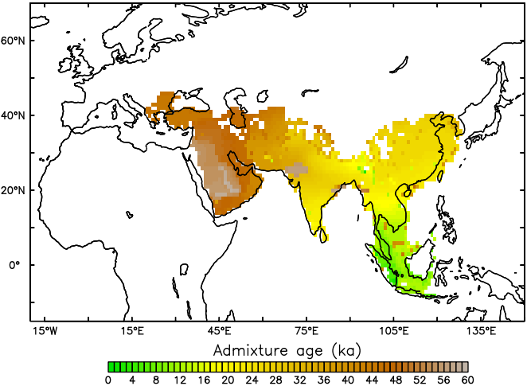



East-west gradient in admixture of two dispersal waves
Our model simulates a characteristic east-west gradient in admixture of two dispersal waves across Eurasia.
The simulated longer and later admixture in the east is consistent with latest genetic datasets which reveal a faint signal of pre-60ka dispersal waves in E-Asia and Oceania.
~65ka
~60ka
~80ka
~65ka
Start point
~70-80ka
Genetic divergence age
~95ka

Slide 6
Effects of climate, resource competition & interbreeding
W/ vs W/O DO events
DO events have led to an earlier admixture and assimilation of pre-
60ka migrants by up to 15ka.
Interbreeding and resource competition have had regionally specific effects on early human dispersal and survival.
Competition 3 vs 1
Interbreeding 0.1 vs 0

Slide 7
Preliminary conclusions & ongoing analyses
Early modern humans dispersed from Africa into Asia by southern routes prior to 60ka, while the post-60ka dispersal occurred both by southern and northern routes.
DO events, interbreeding and resource competition have had significant and regionally specific effects on early human dispersal and survival.
We are currently coding up new equations to include the Neanderthals and their interbreeding history back to 125ka in order to explain the different genetic diversity and hominin ancestry in present-day Eurasians.
~65ka
~60ka
~80ka
Interbreeding
Neanderthals
~65ka
~70-80ka
~95ka

