Slide 1



Impacts of land cover changes and global warming on climate in Colombia using the regional climate model WRF
Astrid Manciu, Andreas Krause, Anja Rammig and Benjamin Quesada
Please start the presentation from the beginning and then lay back and enjoy! :D

Slide 2
COLOMBIA has it all ...
Jungle
Mountains
Oceans
Even Glaciers and deserts!
Own photo

Slide 3
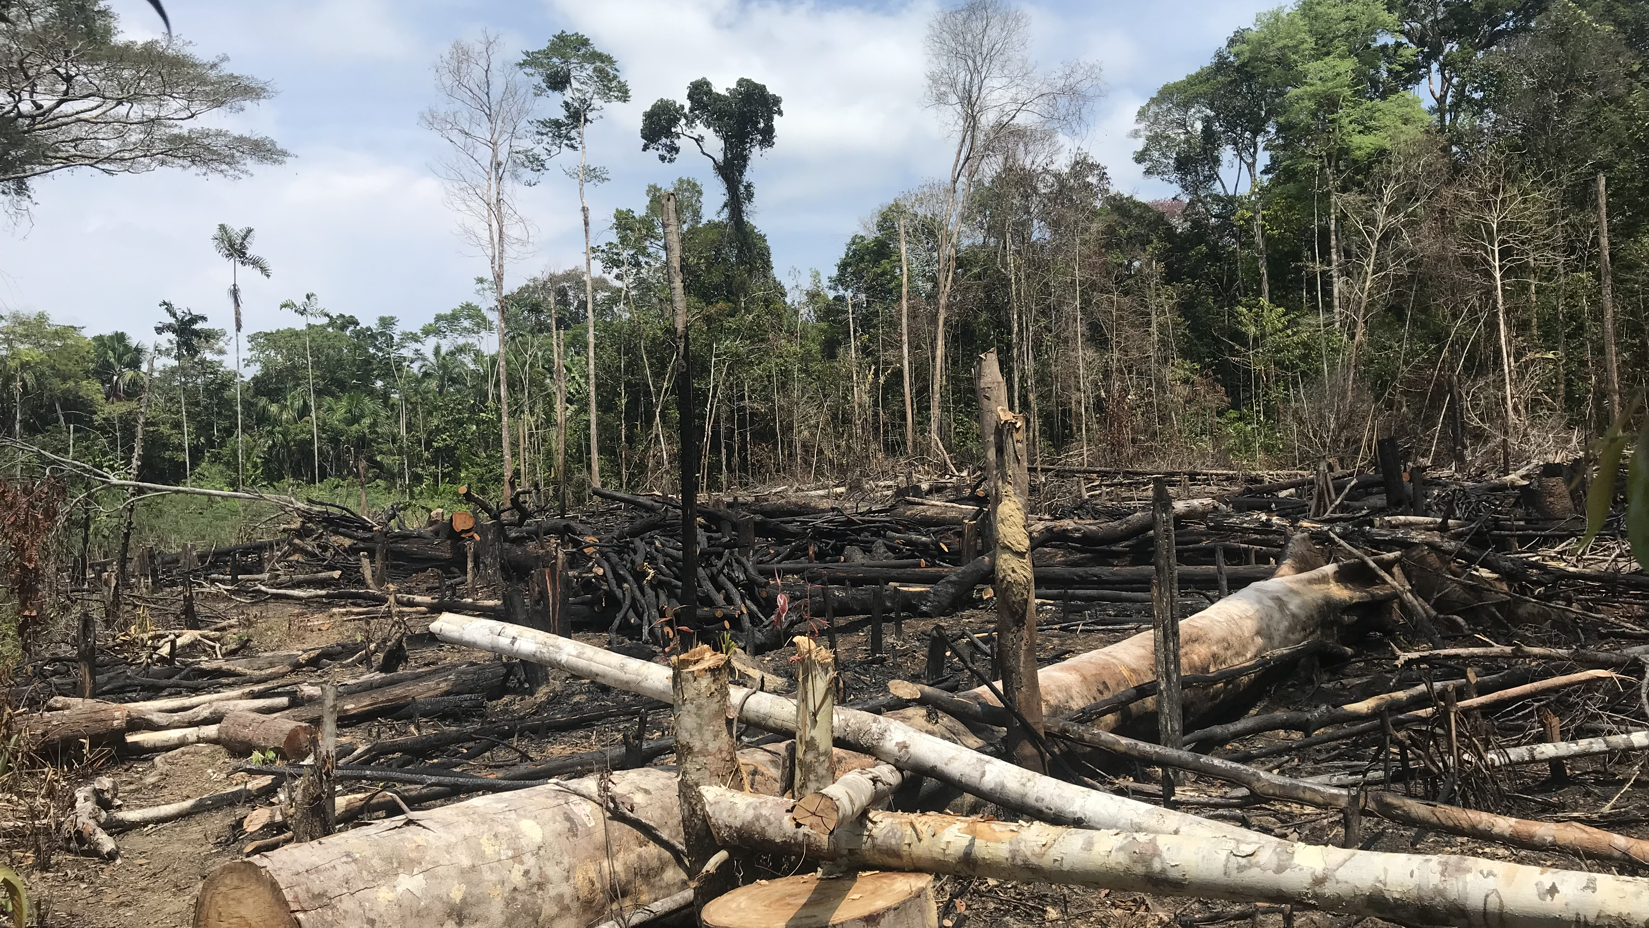
But it is also troubled
By deforestation...
Own photo

Slide 4
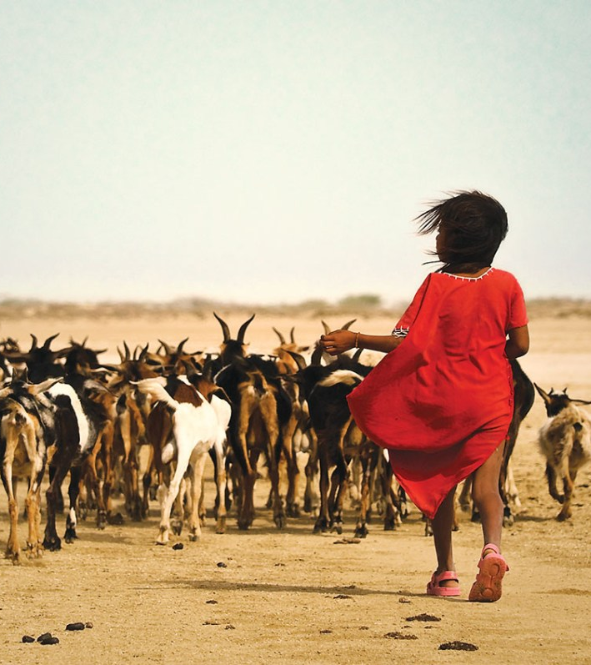
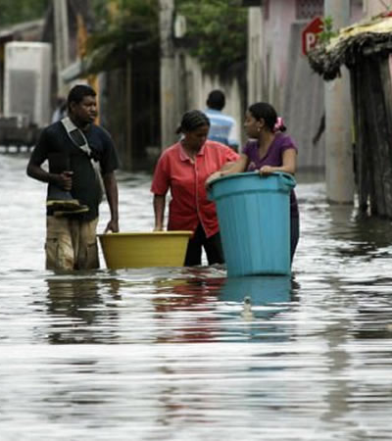
And extreme weather events associated to the EL Niño-Southern Oscillation (ENSO)...
... with El Niño, bringing unusually warm and dry weather...
... and La Niña, bringing unusually cold and wet weather.
Photo: ©Juan Paulo Vargas. All rights reserved.
© Photo: https://www.colombia.com/actualidad/nacionales/sdi/137088/se-viene-el-fenomeno-de-la-nina-y-colombia-no-esta-lista. All rights reserved

Slide 5

And needless to say,
by Climate Change...
Photo by Markus Spiske on Unsplash
Notes:
And of course climate change

Slide 6

We used the Weather Research and Forecasting Model (WRF)
… the most widely used regional climate model
... Forced by ERA-Interim Reanalysis Data throughout the 2009 – 2011, comprising a major El Niño and La Niña event
... In two sensitivity experiments to analyze the historical LCC and CC effect on regional climate in Colombia
Photo by Émile Perron on Unsplash

Slide 7
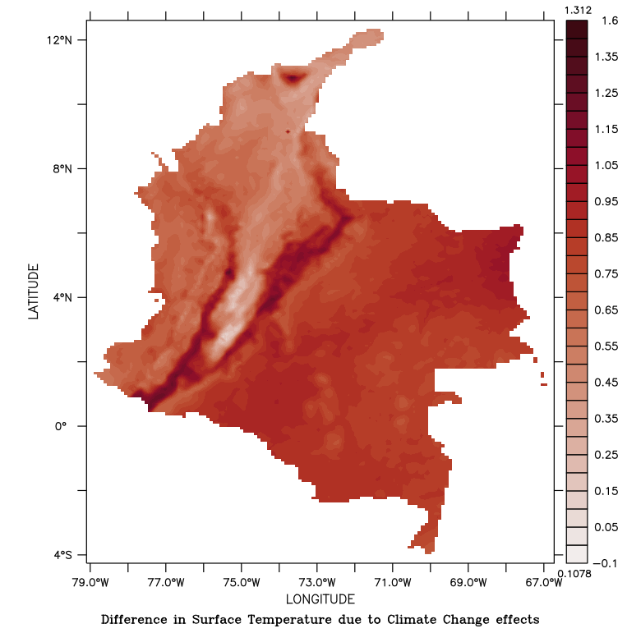
Let’s start with historical CC effects!
temperature increase of +0.77°C
precipitation rise of +8%
The effect is more enhanced in high elevation areas
especially during La Niña

Slide 8
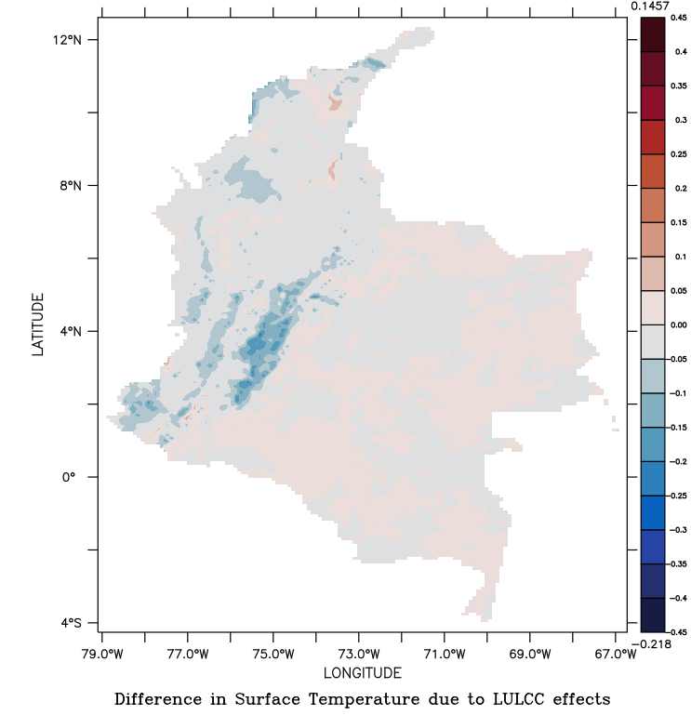
What about historical LCC?
mean temperature change:
-0.01°C
mean precipitation change:
– 0.7% (0.08 mm/day)
The effect is more enhanced over deforested areas, where rainforest was supposedly cleared for agriculture and livestock
EL Niño tends to dampen the effect, La Niña tends to enhance it

Slide 9

But why would the model project cooling after deforestation?
Is deforestation the solution to stop global warming?
Photo by Allie Smith on Unsplash

Slide 10

We have found 2 answers to that:
Changes in albedo-driven cooling are overestimated by a factor of 3.5
B. Changes is evapotranspiration- driven warming are underestimated by a factor of 0.4
Photo on Pixabay

Slide 11
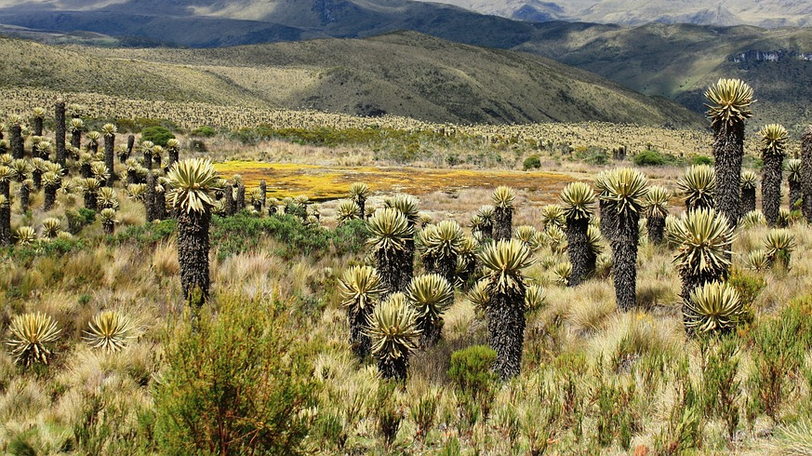
Take home messages
Climate Change is more dominant than LCC
CC increases temperature and precipitation almost everywhere
LCC decreases precipitation and temperature, esp. over deforested areas
Albedo-driven cooling overestimated, evapotranspiration-driven warming underestimated
Photo on pixabay

Slide 12

Gracias for reading until here and see you on the live chat!
Or contact me:
astrid.manciu@tum.de
Own photo

