Slide 1
Localization of Rockfalls at Dolomieu Crater, La Réunion, through Simulation of Seismic Waves on Real Topography
Julian Kuehnert (1), Anne Mangeney (1,2), Yann Capdeville (3), Emmanuel Chaljub (4), Eleonore Stutzmann (1), Jean-Pierre Vilotte (1)
(1) Institut de Physique du Globe de Paris (IPGP), France; (2) Universite Paris-Diderot, France; (3) Laboratoire de Planetologie et Geodynamique de Nantes, France; (4) Univ. Grenoble Alpes, ISTerre, Grenoble, France
Find a hands-on Jupyter notebook of the localization algorithm here:
https://github.com/Jubeku/RF_localization

Slide 2
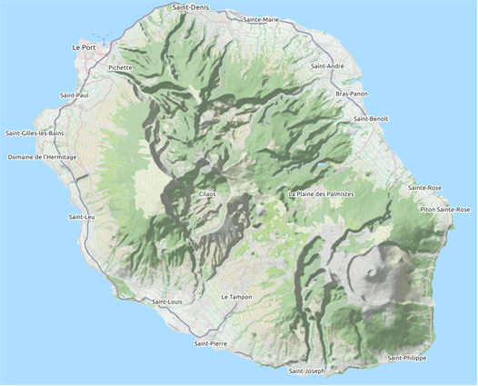
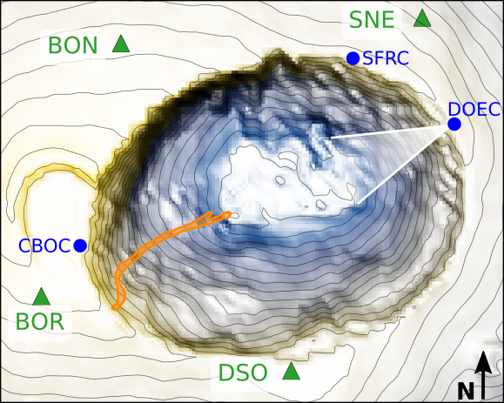
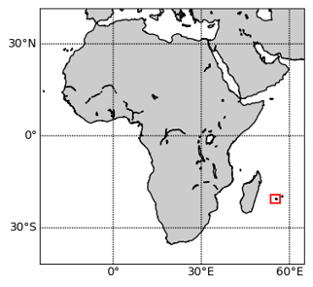
Rockfalls at Dolomieu crater
Rockfall from December 13, 2016
La Réunion
Dolomieu crater
Piton des
Neiges
Piton de la Fournaise

Slide 3
Rockfall generated seismic signals

Slide 4
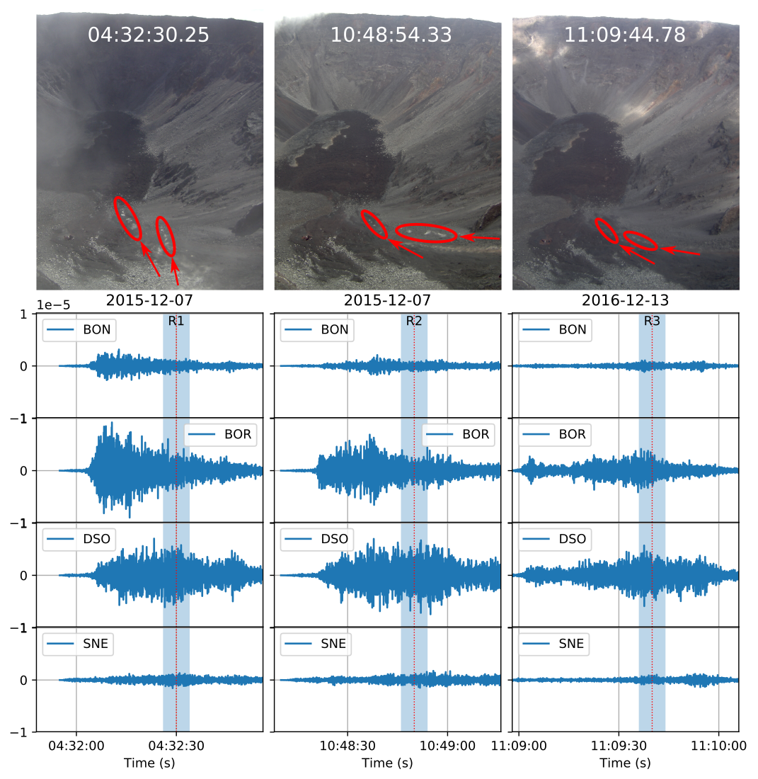
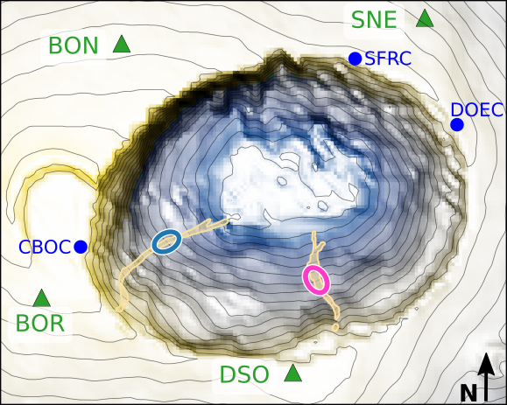
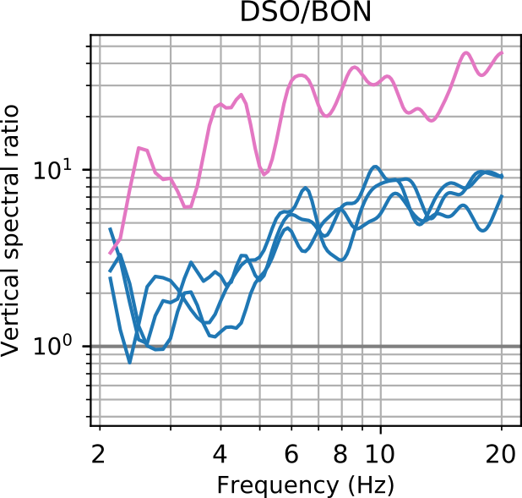
Comparison of multiple rockfalls at similar positions
Spectral station ratios calculated in small time windows are shown to be characteristic for rockfall position.
from time windows
R1, R2 & R3
Kuehnert et al. (2020, in review)

Slide 5
Principle of localization algorithm
Idea:
Build a database of characteristic station ratios which can be used to localize rockfalls!
Spectral station ratios calculated in small time windows are shown to be characteristic for rockfall position.
→ Database from synthetic Green‘s functions
from time windows
R1, R2 & R3
Kuehnert et al. (2020, in review)

Slide 6
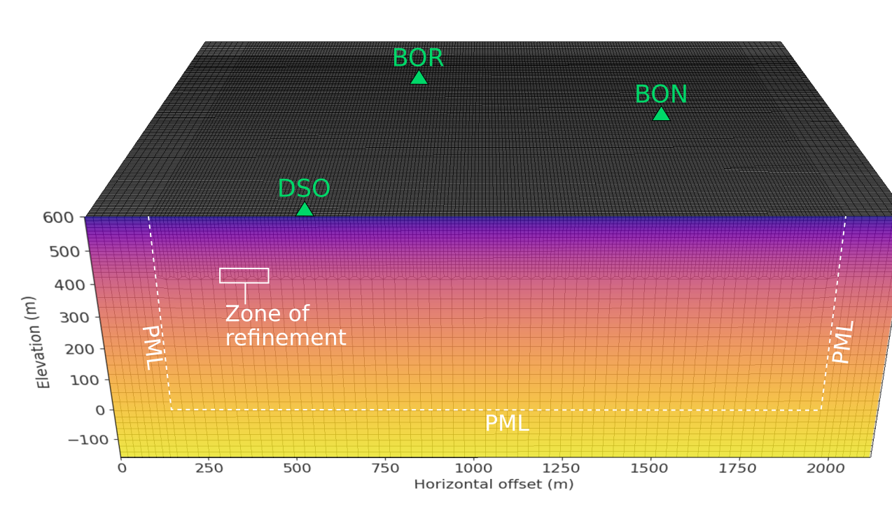
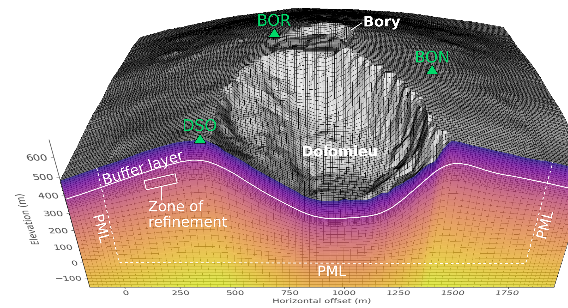
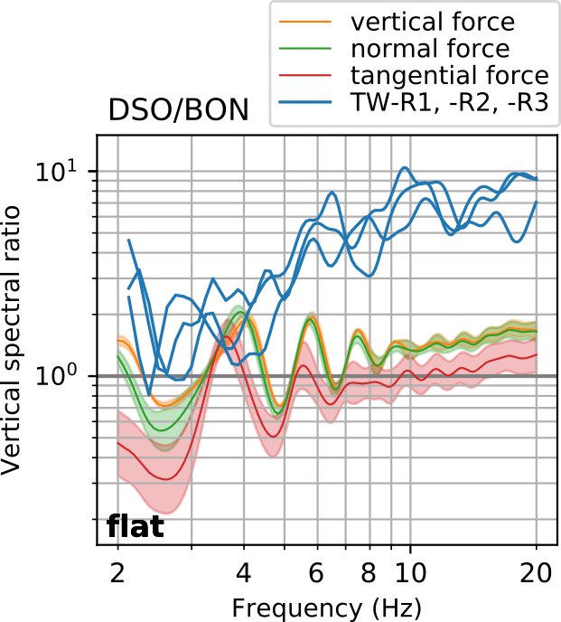
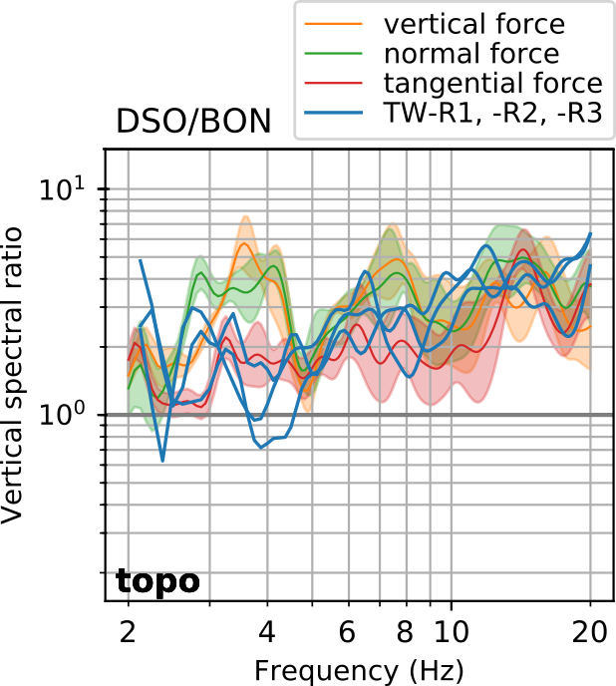
Reproduction of spectral ratios from numerical simulations
Model with flat surface
Model with topography
After
testing different source directions,
accounting for topography,
considering site-specific amplification,
findings suggest that
propagation along topogrphy dominates over source direction,
successful reproduction of observed spectral ratios
Kuehnert et al. (2020, in review)

Slide 7
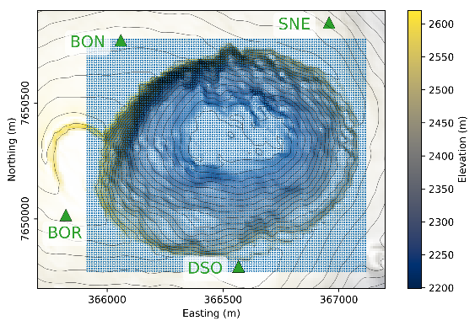
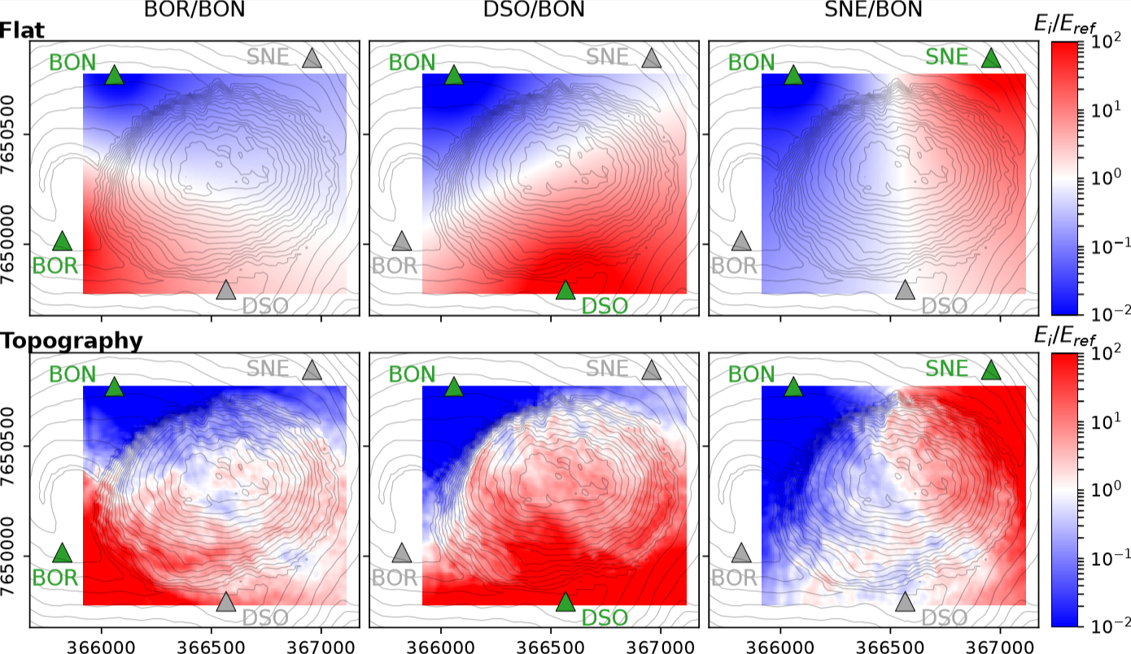
Building a database of characteristic inter-station energy ratios
Reciprocal simulations
Seismic energy ratios calculated in frequency band 13-17Hz:
Sampled area: 1.2 x 1km
Sampling: 10m
No. stations: 12221
Localization algorithm
Database
Optimization
Observed signal in sliding time window

Slide 8
Localization from sliding time windows - Rockfall on 2016-12-13
Sliding time window
Source location probability

Slide 9
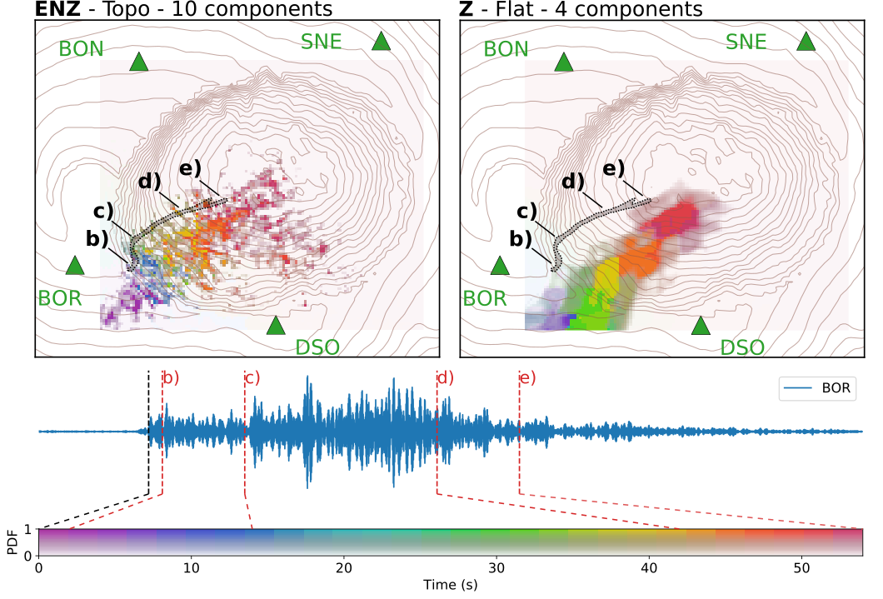
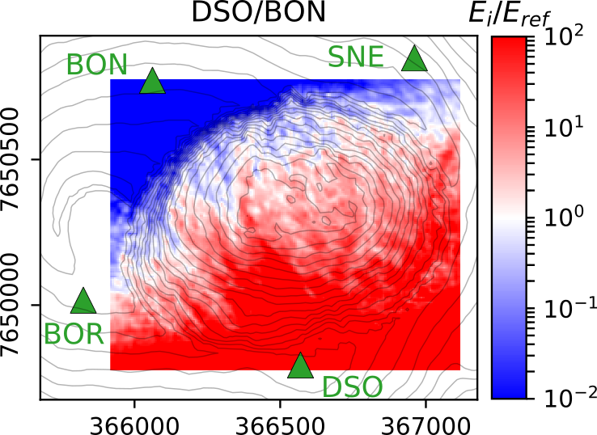
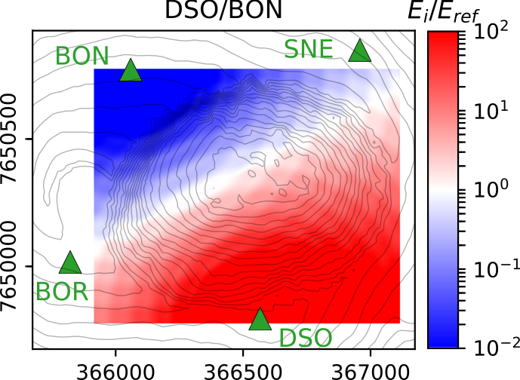
Mapping the whole trajectory - Rockfall on 2016-12-13
Considering topography
Not considering topography
Better localization when surface topography is taken into account.

Slide 10
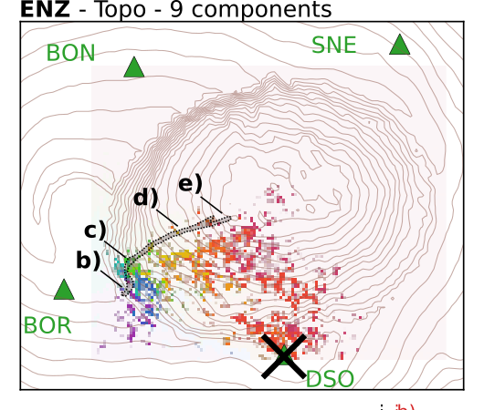
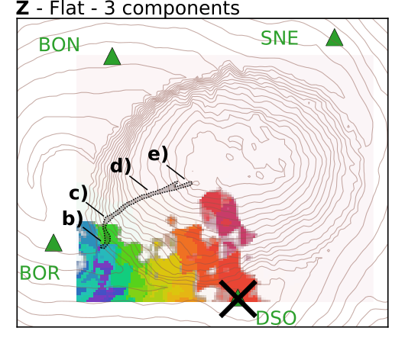
Mapping the whole trajectory - Rockfall on 2016-12-13
Considering topography
Not considering topography
Assuming that station DSO is not available.
Having fewer stations availabe, taking topography into account becomes more crucial.

Slide 11
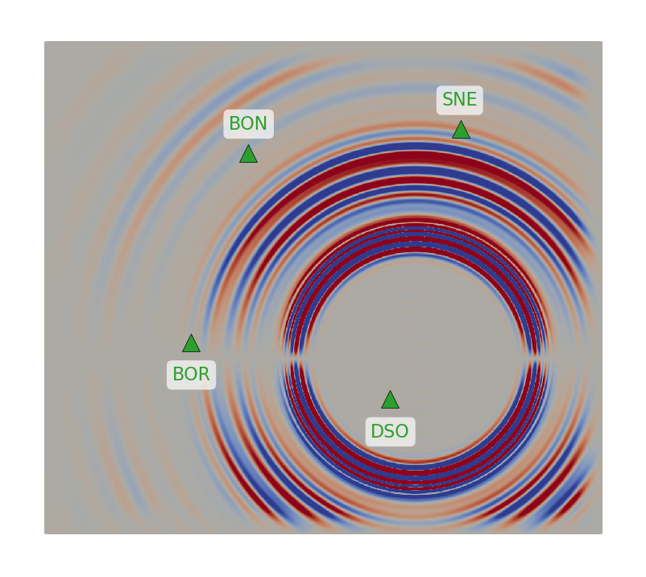
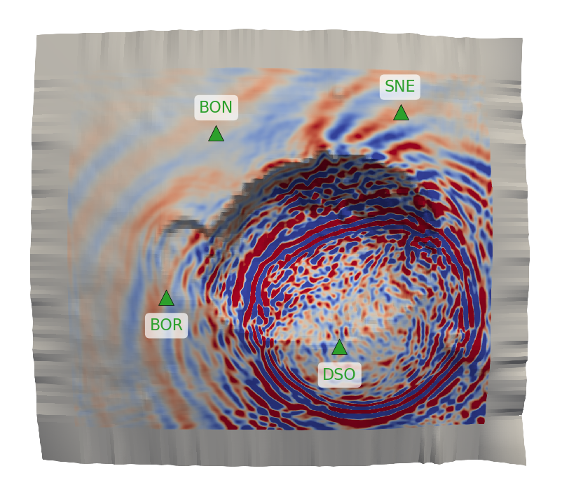
Conclusions & Perspectives
Radiation patterns
Benefits of proposed localization method:
Straightforward implementation (no precise picking needed)
Sliding time window allows real-time monitoring
Considering topography allows to exploit all components
Flat
Topo
(due to radiation patterns)
Current developments:
Combination of different frequency bands:
Testing on various sites with
… different elevations
… different station geometries

Slide 12
Please feel free to play with the localization algorithm yourself!
Find the hands-on Jupyter notebook here:
https://github.com/Jubeku/RF_localization
Relevant publications:
Kuehnert, J., Mangeney, A., Capdeville, Y., Métaxian, J.P., Bonilla, L.F., Stutzmann, E., Chaljub, E., Boissier, P., Brunet, C., Kowalski, P., Lauret, F., Hibert, C. (2020). Simulation of rockfall generated seismic signals and the influence of surface topography. Journal of Geophysical Research: Solid Earth (under review)
Kuehnert, J., Mangeney, A., Capdeville, Y., Vilotte, J.P., Stutzmann, E., Chaljub, E., Boissier, P., Brunet, C., Kowalski, P., Lauret, F. (2020, in submission). Simulation of rockfall generated seismic signals and the influence of surface topography. Journal of Geophysical Research: Earth Surface (in submission)
Julian Kuehnert
kuehnert@ipgp.fr

