Slide 1
Statistical study of coherent turbulent structures properties observed by a Doppler lidar over Paris during two months
I. Cheliotis¹, E. Dieudonné¹, H. Delbarre¹, A. Sokolov¹, E. Dimitriev², P. Augustin¹, M. Fourmentin¹, F. Ravetta³ & J. Pelon³
¹ Laboratory for Physico-Chemistry of the Atmosphere (LPCA), University of the Littoral Opal Coast (ULCO), Dunkirk, France
² Institute of Numerical Mathematics, Russian Academy of Sciences, Moscow, Russia
³Laboratory Atmosphere, Backgrounds, Space Observations (LATMOS) / Pierre Simon Laplace Institute (IPSL), Sorbonne University / CNRS, Paris, France

Slide 2
Presentation overview
Experimental set-up
Classification of the turbulent structures
Classification method
Classified turbulent structures
Classification results
Physical parameters of the turbulent structures
Atmospheric boundary layer height
Horizontal sizes of the structures
Aspect ratio (AR)
Conclusions & perspectives
Notes:
Methodology is very large compared to the others, add subsection?
AS: Yes, It is better with subsection. Classification process using machine learning -> Classification using supervised machine learning

Slide 3
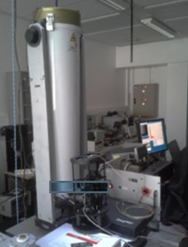
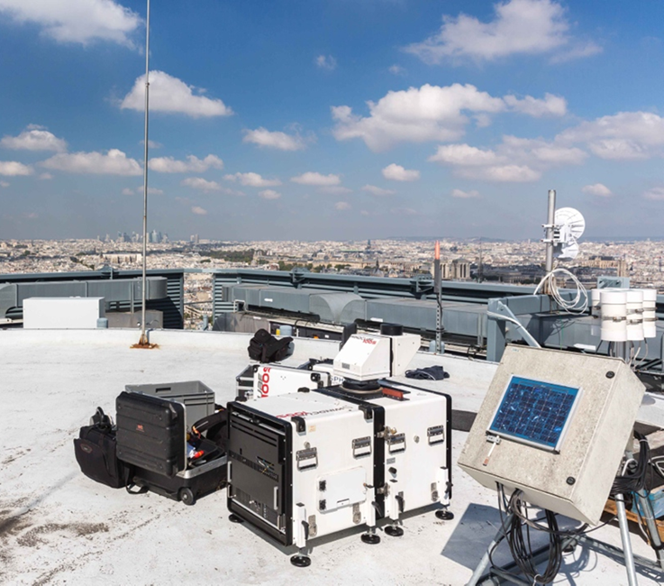
1. Experimental set-up
Aerosol lidar
Doppler wind lidar
Two months campaign over Paris (low orography):
04/09/2014 – 06/11/2014
VEGILOT project
(Klein et al., Atmos. Environ., 2019)
Jussieu site
© Google map
Doppler lidar (Leosphere WLS100)
Scan methods: | PPI, RHI, LOS, DBS | Number of total scans: | >10000
Altitude of lidar: | 70 m a.g.l. | Spatial resolution: | 50 m
Maximum range: | 5 km | Minimum range: | 100 m
Radial wind accuracy: | 0.1 m/s | Radial wind speed range: | -30 to 30 m/s
Accumulation time: | 1 sec/beam | Laser wavelength: | 1.543 µm
Can we conduct a statistical study of the physical parameters of the turbulent structures based on observations from a single Doppler wind lidar?

Slide 4
2. Classification of the turbulent structures

Slide 5
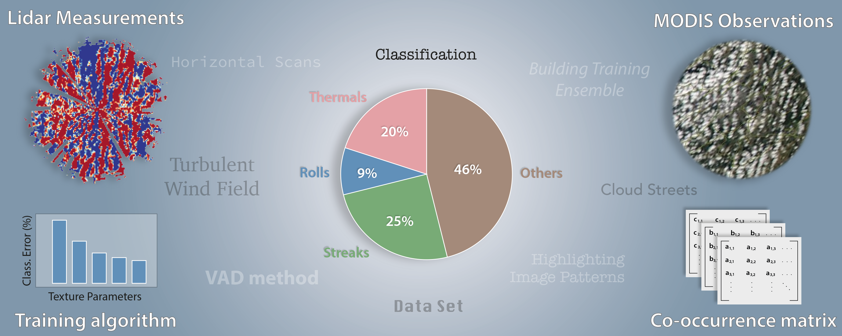
2.a. Classification method
Full methodology showcased at the paper under review in the Atmospheric Measurements Technique journal (https://doi.org/10.5194/amt-2020-82) & at the AGU Fall Meeting 2019, San Francisco.
Notes:
AS: IMHO this figure should be also modified. I have some suggestions. Point of interest is not a good term here.

Slide 6
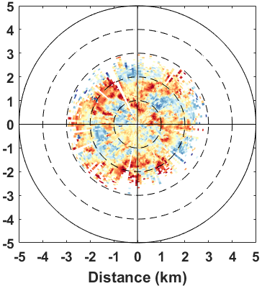
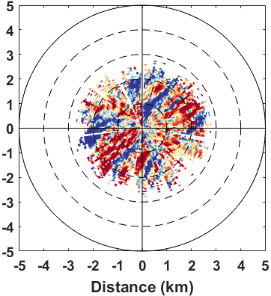
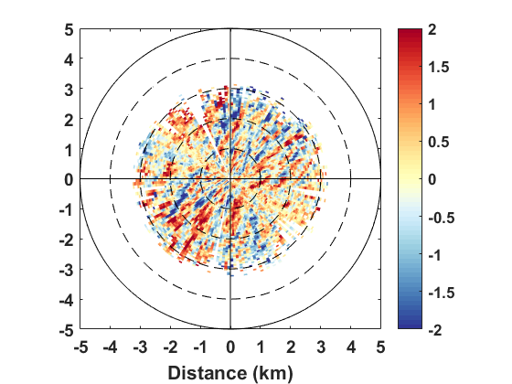
2.b. Classified turbulent structures
The turbulent radial wind fields were computed from the radial wind fields obtained by quasi-horizontal PPI scans (1° elevation) by utilizing the Velocity Azimuth Display (VAD) method Lhermitte, R. M. (J. Atmos. Sci., 1962); Browning, K. A. & R. Wexler (J. Appl. Meteorol., 1968); Drobinski et al. (J. Atmos. Sci., 2004).
Unaligned Thermals
Rolls
Streaks
16 Sept. 12:52 UTC
13 Oct. 12:52 UTC
9 sept. 20:49 UTC
Radial wind speed (m/s)
Turbulent radial wind field (m/s)
Notes:
Source of the image?

Slide 7
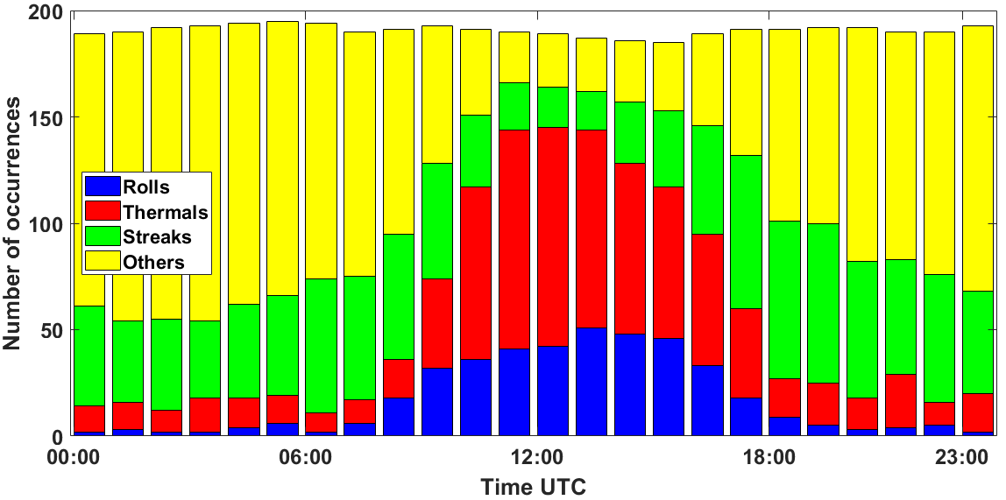
2.c. Classification results
Streaks are mainly associated with mechanical turbulence during night, whereas rolls are mainly associated with thermals during day.
Few cases of rolls and thermals are classified during night due to the classification error of the algorithm (9.2 % see paper for details). These cases are reclassified in the “others” category.
Notes:
Source of the image?

Slide 8
3. Physical parameters of the turbulent structures

Slide 9
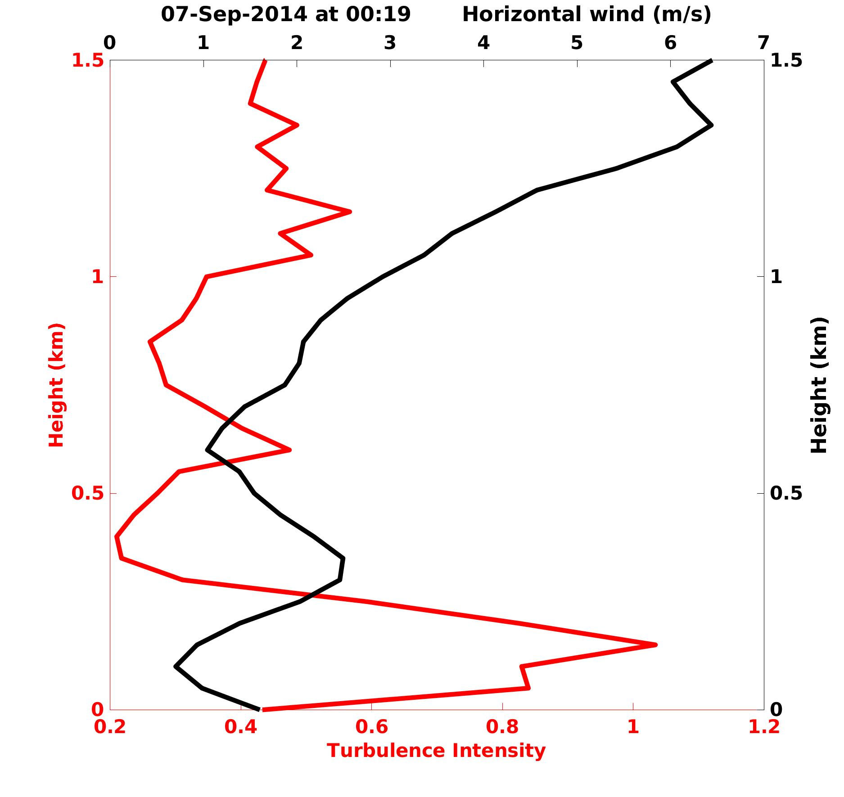
3.a. Atmospheric boundary layer height
Nocturnal ABL height – RHI scans
Diurnal ABL height – Aerosol lidar
08-Sep-2014 at 13:18 Signal range corrected Pr2 avg
ABL Height
ABL Height
Notes:
Constructed from subtracting the cosine function
AS: For me the images are not well arranged. I’ll suggest some modifications…

Slide 10
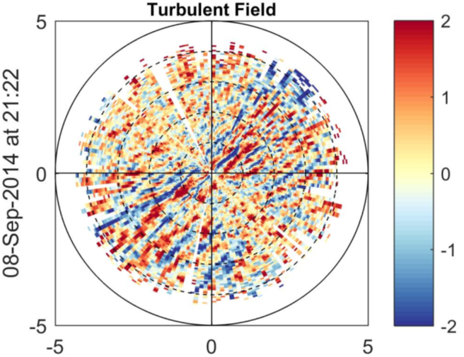
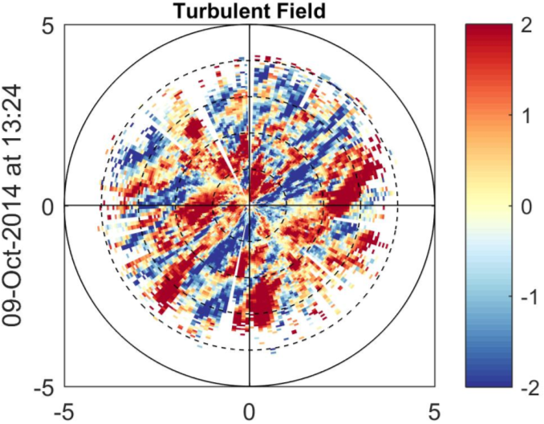
3.b. Horizontal sizes of the structures
Streaks
Rolls
The black arrow represents the wind direction and the dotted line the transverse direction.
Turbulent radial wind field (m/s)
Turbulent radial wind field (m/s)
For the rolls we are interested in periodicities larger than one km in the transverse direction (beams perpendicular to the wind direction).
Structure
For the streaks we are interested in periodicities of few hundred m in the transverse direction (beams perpendicular to the wind direction).
Structures

Slide 11
3.c. Aspect Ratio (AR)
By computing the ABL height and the size of the horizontal periodicity of the structures, it is possible to retrieve the $AR=\frac{ABL height}{Horizontal size of the periodicity of the structure}$ in order to examine their dependence.
Examples:
Streaks
Rolls
09-Sep-2014 at 21:02 Horizontal wind (m/s)
02-Nov-2014 at 12:52 Signal range corrected Pr2 avg
AR ~ 0.5
AR ~ 0.4
Notes:
Didn’t we try 4 classification methods? We should mention it, even if we only present the results for one method.
The confusion matrix should be on the next slide, while the classification error plot should be on this slide.
It would be easier to rotate the whole figure 90°
Why are the first (most significant parameters) not the same on the scatter plot and the classification error plot?
AS: In my opinion, we should sell our approach first with one algorithm. Other we will sell it separately afterwards. Otherwise Elsa could have a lot of questions on SML.
ML should be first represented by a scheme with inputs, training step and classification step.
Some basis of the KNN algorithms could be presented (on the next slide) with the classification error and the confusion matrix.

Slide 12
Conclusions
Preliminary results show streaks sizes of few hundred m and rolls sizes larger than a km.
The AR for the tested cases so far is ranging from 0.3 to 0.5 for both streaks and rolls.
Perspectives
Correlate the physical parameters to the structures for the whole 2-months dataset. Can we observe subcategories of the structures?
Include more physical parameters, such as vertical motions.
Compute the probability for the structures’ persistence and transition to other structures (Markov chain)
Acknowledgments to the CPER research project IRenE and CLIMIBIO. The work is supported by the CaPPA project funded by the French National Research Agency (ANR) through the PIA (Programme d'Investissement d'Avenir) and by the Regional Council “ Nord-Pas de Calais » and the "European Funds for Regional Economic Development (FEDER). Experiments presented in this study were carried out using the CALCULCO computing platform, supported by SCoSI/ULCO (Service COmmun du Système d’Information de l’Université du Littoral Côte d’Opale).
Notes:
Second conclusion should be changed…
Third … which correspond to our estimations.
Future work:
- Normally roman numbers are for the highest level.
1. III Application of more sophisticated SML techniques
2. – I do not understand this item…

