Slide 1
Comprehensive Analysis of the Magnetic Signatures of
Small‐Scale Traveling Ionospheric Disturbances
as Observed by Swarm
Fan Yin¹, Hermann Lühr², aeheung Park^{3,4}, and Ling Wang¹
Department of Space Physics, Electronic Information School, Wuhan University,
Wuhan, China
GFZ, German Research Centre for Geosciences, Telegrafenberg,
14473 Potsdam, Germany
Korea Astronomy and Space Science Institute, Daejeon, SouthKorea
Department of Astronomy and SpaceScience, University of Science and Technology,
Daejeon,Korea
ST3.2, 7175
1
8 May 2020, 14:00-15:45

Slide 2
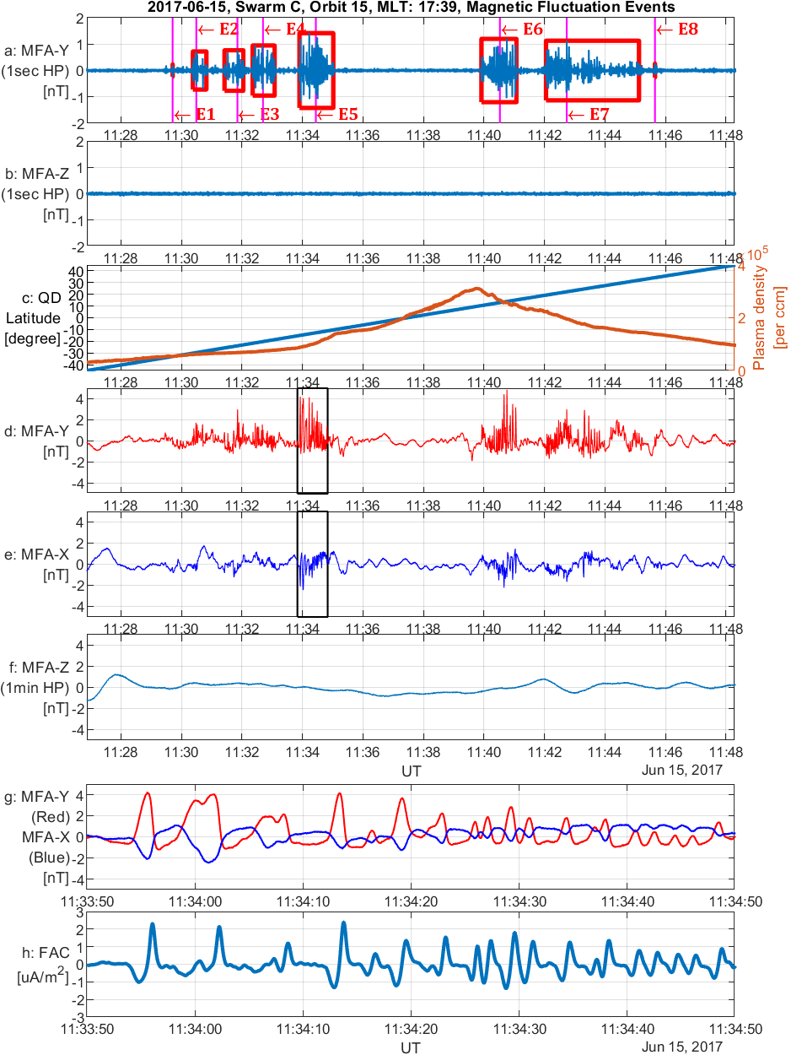
SSTID Event on 2017-06-15: Swarm C
LSTID, MSTID, SSTID?
magnetic fluctuations in ⊥ the mean field
no fluctuations in ∥ the mean field
no significant plasma density irregularities accompanied
conjugated
An example of SSTID events at dusk.
(a)(b) 1Hz high-pass filtered y and z components of magnetic field in MFA coordinates. Red boxes in (a) mark the detected events;
(c) Plasma density measured by Swarm/EFI and QD latitude of the satellite position;
(d)(e)(f) y, x components and 1min high-pass filtered z component in MFA frame;
(g) Zoomed details of the event marked by the black box in (d) and (e);
(h) The estimates FACs.
ST3.2, 7175
2
8 May 2020, 14:00-15:45

Slide 3
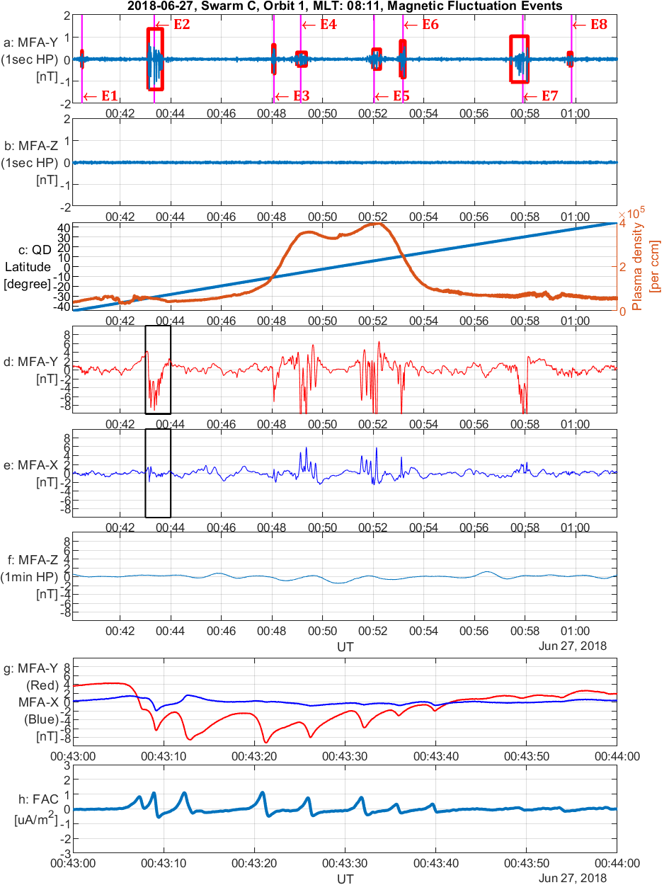
SSTID Event on 2018-06-27: Swarm C
An example of SSTID events in prenoon
ST3.2, 7175
3
8 May 2020, 14:00-15:45

Slide 4
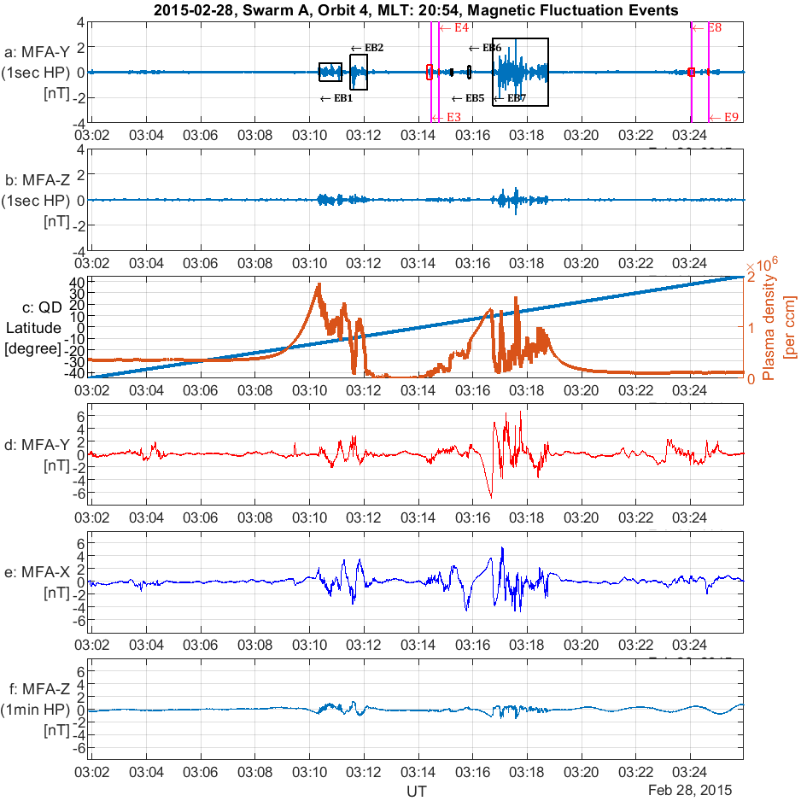
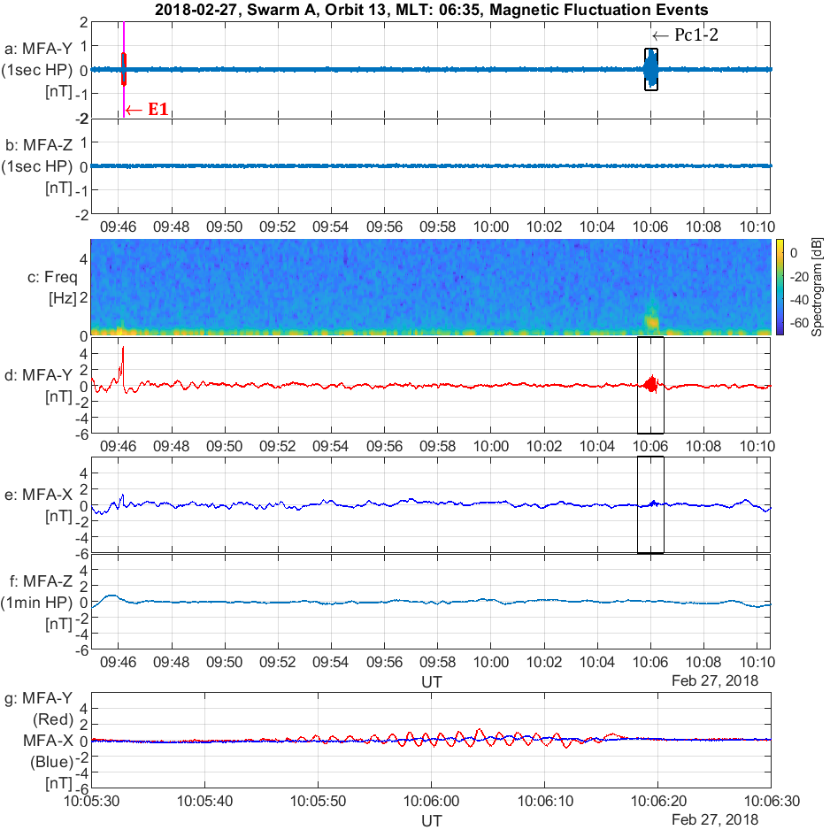
EPB event and Pc1 event excluded
ST3.2, 7175
4
8 May 2020, 14:00-15:45

Slide 5
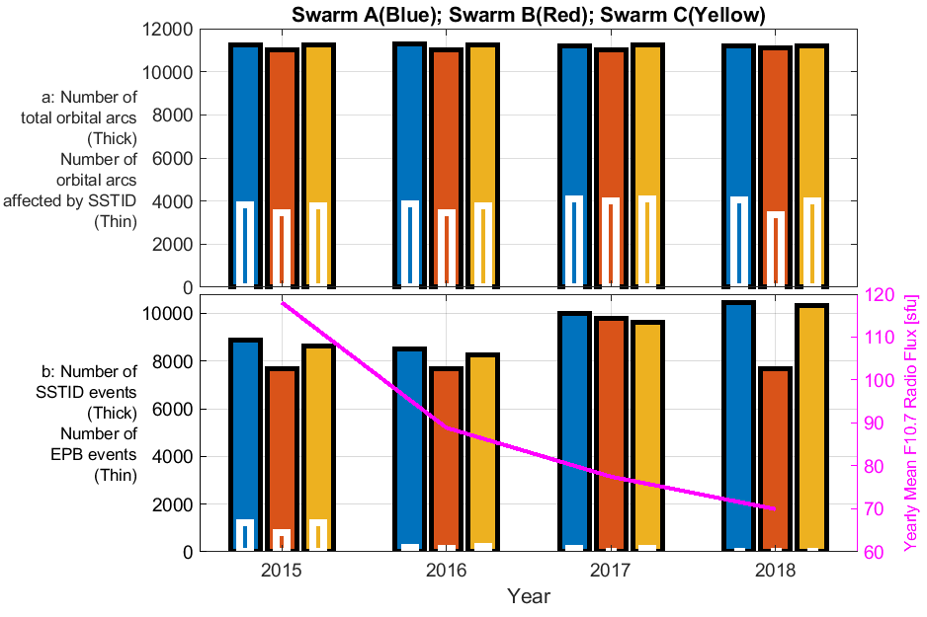
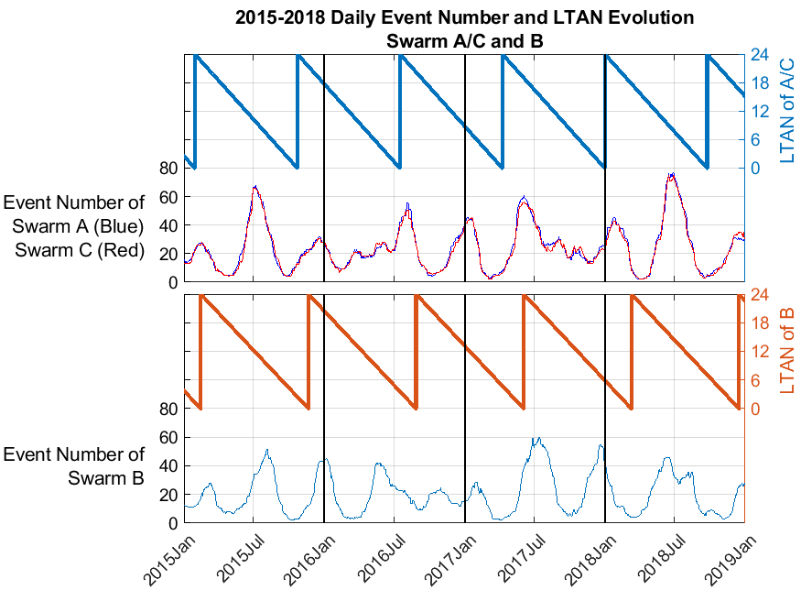
Statistical analysis of SSTIDs
SSTIDs no dependency on solar activity, but modulated by local time, season or some other factors.
The number of events detected by the B satellite (higher orbit) is about 10% less than that of the A / C satellite (lower orbit)
ST3.2, 7175
5
8 May 2020, 14:00-15:45

Slide 6
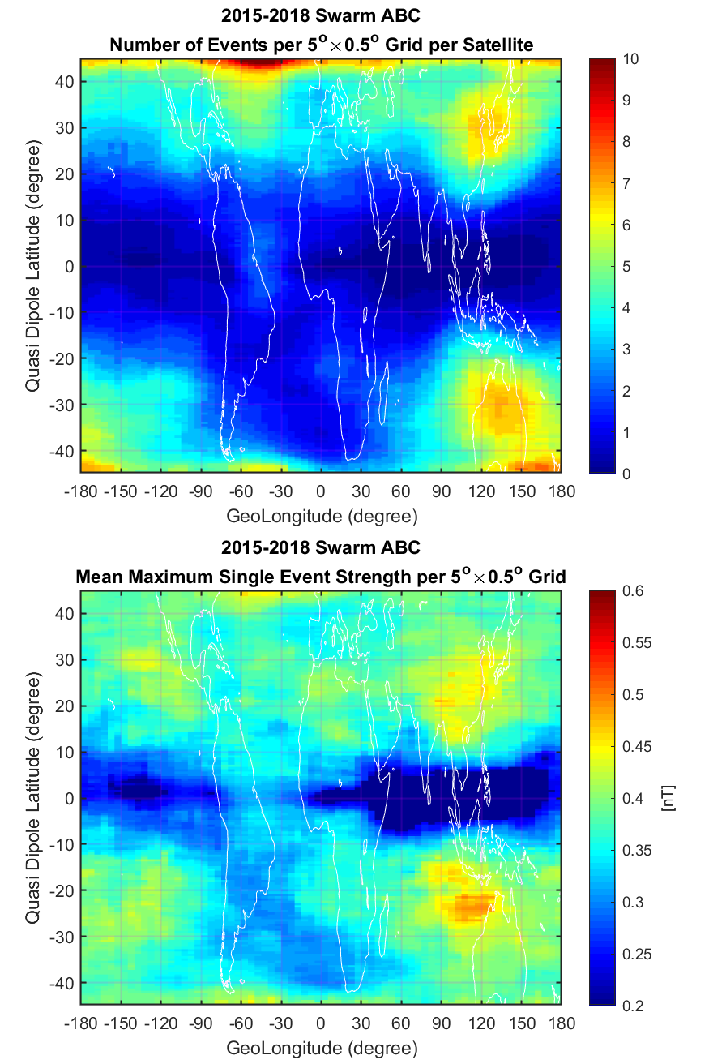
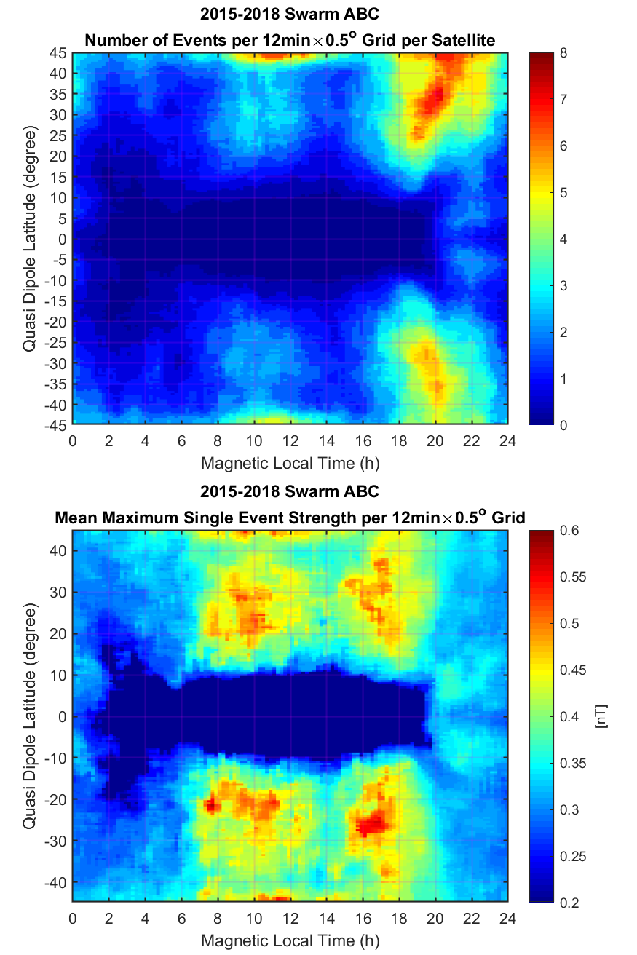
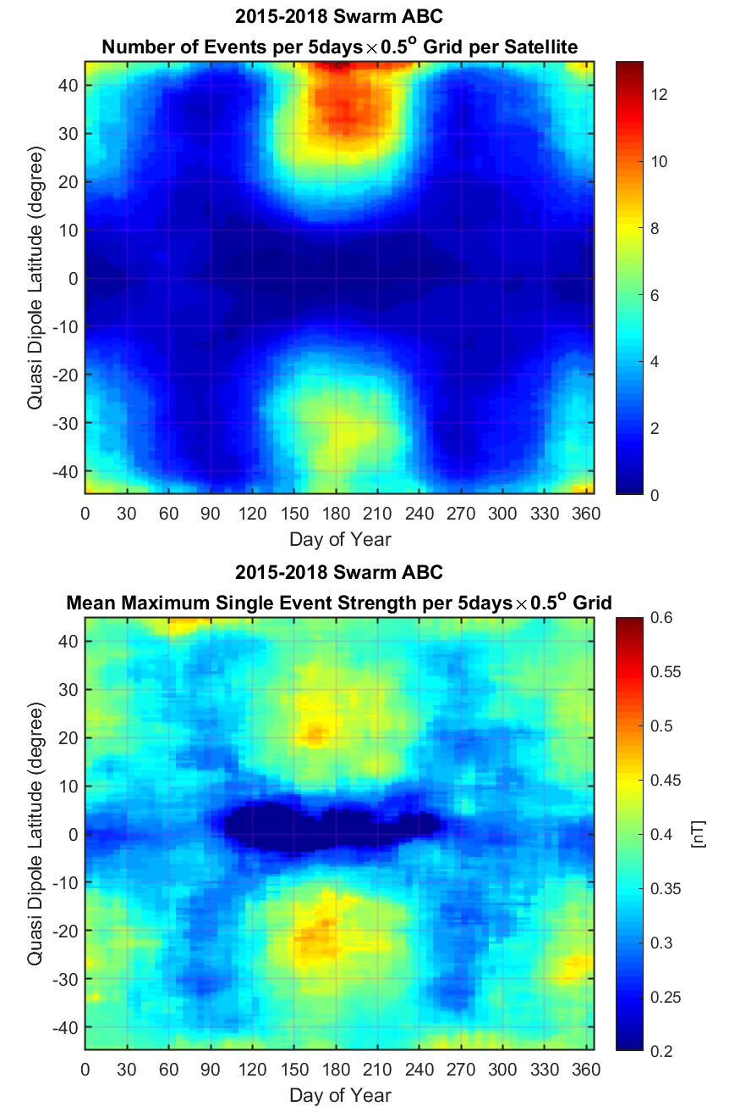
Statistical analysis of SSTIDs
ST3.2, 7175
6
8 May 2020, 14:00-15:45

Slide 7
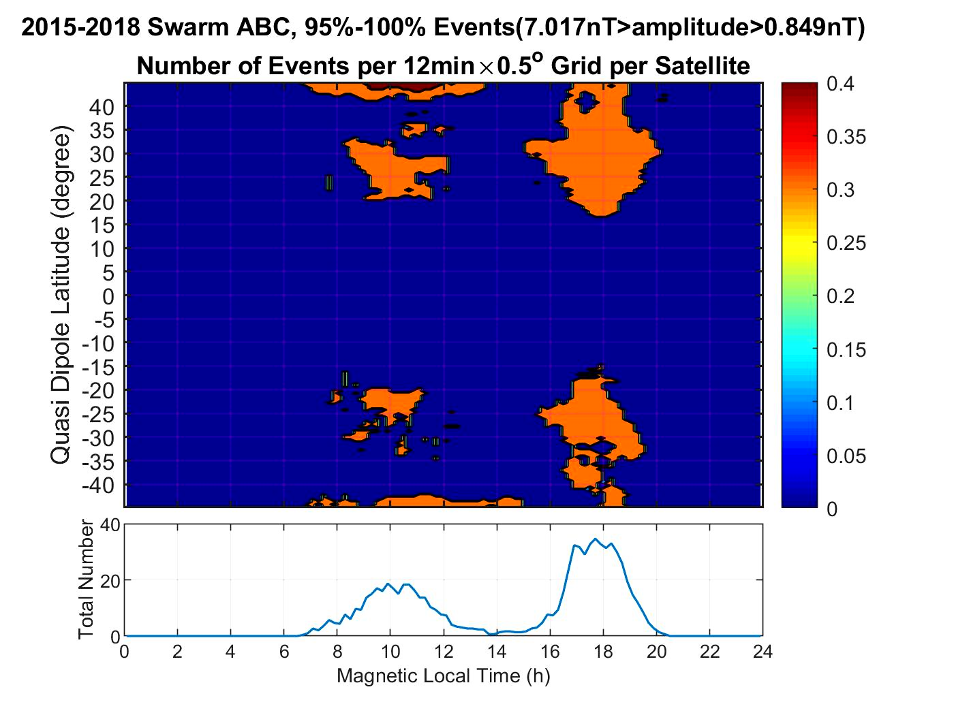
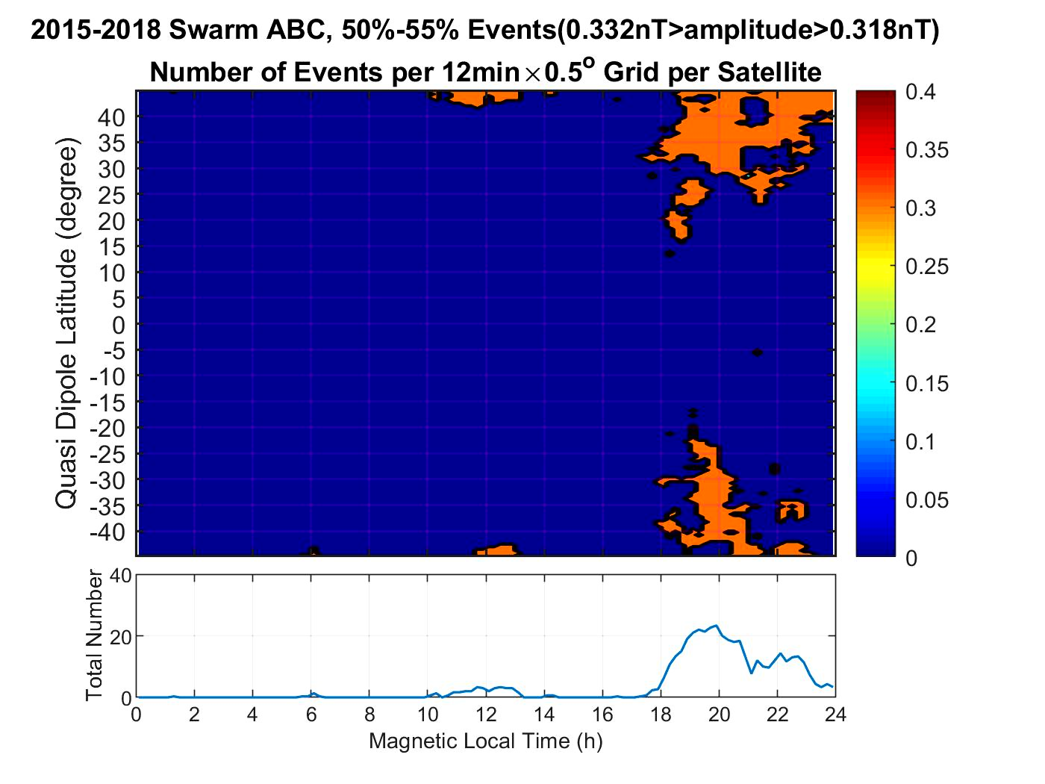
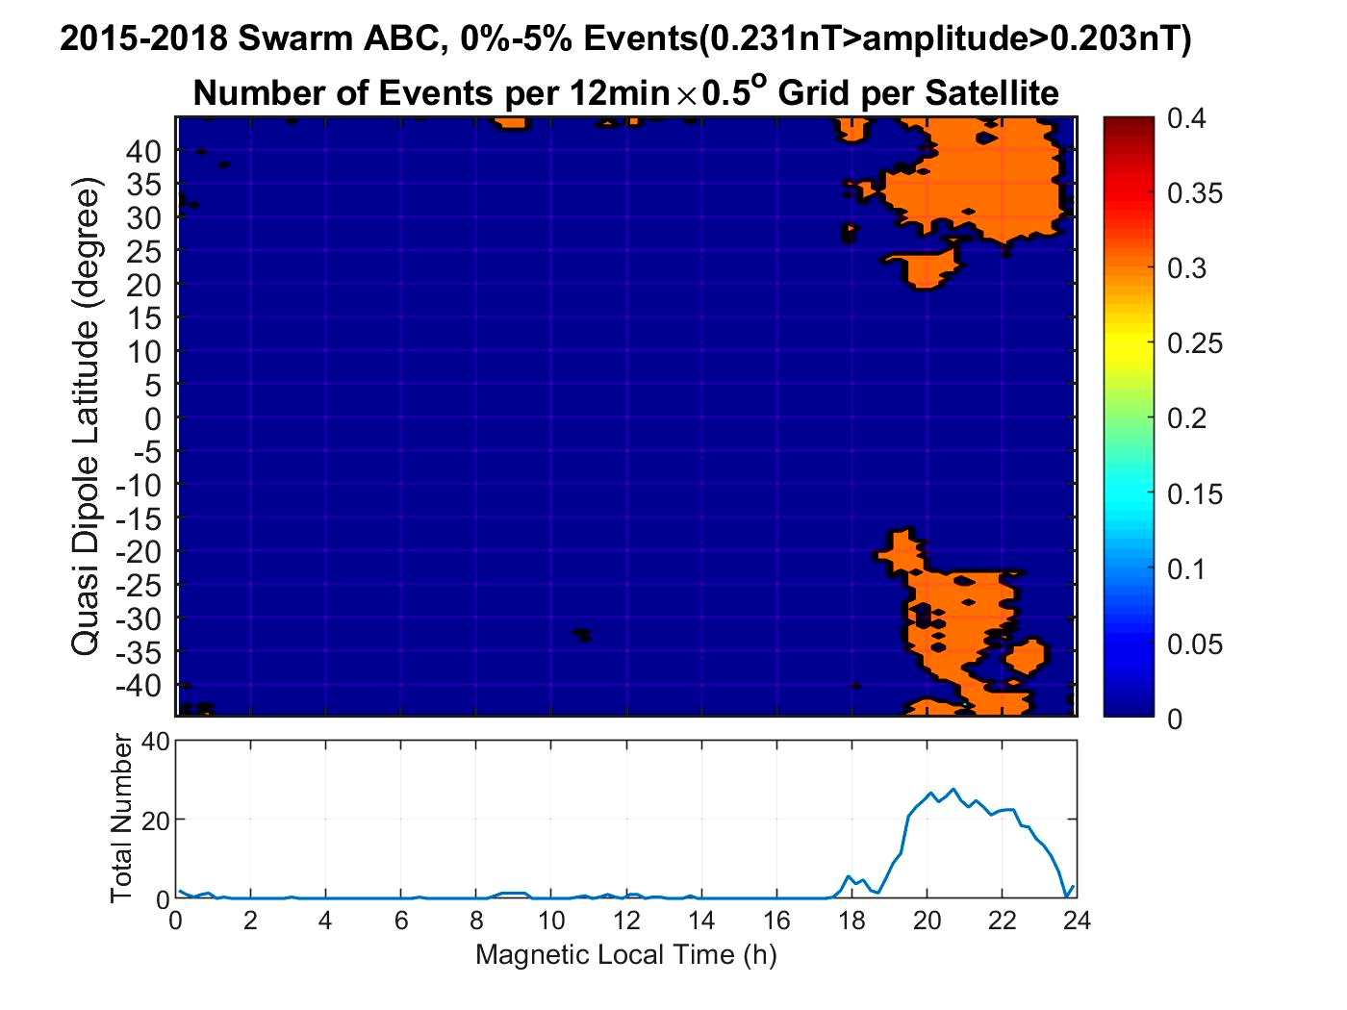
Time evolution of nighttime SSTIDs and daytime SSTIDs
ST3.2, 7175
7
8 May 2020, 14:00-15:45

Slide 8
Summary
Our small-scale (<10 km) magnetic fluctuations are deflections perpendicular to the mean field, mainly in east/west direction, without accompanying significant plasma density irregularities at Swarm altitudes. Overall, the characteristics are much the same at all three satellites. At the higher altitude of Swarm B, the event number is just a little (10%) lower than at Swarm A&C altitude.
SSTIDs occur frequently around ±30°QD-Lat, with a tendency of magnetically conjugate appearance in the northern and southern hemispheres. But equatorward of ±10°QD-Lat there are hardly any events detected.
Largest event numbers are found in the East Asian/Australian sector. A secondary occurrence peak appears over the North Atlantic. There are practically no events observed in the region of the SAA.
Largest event numbers are detected from sunset to midnight. A somewhat smaller occurrence rate is found around prenoon hours.
The seasonal dependence reveals an overwhelming number of events around June solstice in the northern hemisphere. During December months the smaller occurrence rate is comparable in both hemispheres. The small-scale fluctuations seem to prefer solstice summer conditions. There are very few events detected around equinoxes.
The average characteristics of our nighttime SSTIDs agree very well with those published for nighttime MSTIDs. We suggest that our small structures are just a part of their evolution, but are daytime SSTIDs the same thing of nightime SSTIDs
Ref: Yin, F., Lühr, H., Park, J., & Wang, L.(2019). Comprehensive analysis of the magnetic signatures of small‐scale traveling ionospheric disturbances, as observed by Swarm. Journal of Geophysical Research: Space Physics, 124. https://doi.org/10.1029/2019JA027523
ST3.2, 7175
8
8 May 2020, 14:00-15:45

