Slide 1
Shallow structural setting of an active normal fault zone in the 30 October 2016 Mw 6.5 central Italy earthquake region imaged through a multidisciplinary geophysical approach.
Fabio Villani¹, Stefano Maraio², Pier Paolo Bruno³, Lisa Serri², Vincenzo Sapia¹, Luigi Improta¹
1 Istituto Nazionale di Geofisica e Vulcanologia, Italy; 2 Centro di Geotecnologie – Università di Siena – Italy; 3 Università Federico II, Napoli – Italy
EGU General Assembly 2020
SM7.1 7242

Slide 2
Outline
The 2016-2017 seismic sequence in central Italy
Surface faulting of the 30 October 2016 Mw 6.5 Norcia earthquake
The Pian Grande di Castelluccio Basin (PGC) and its relations with the Norcia earthquake
High-resolution geophysical surveys across an active fault splay

Slide 3
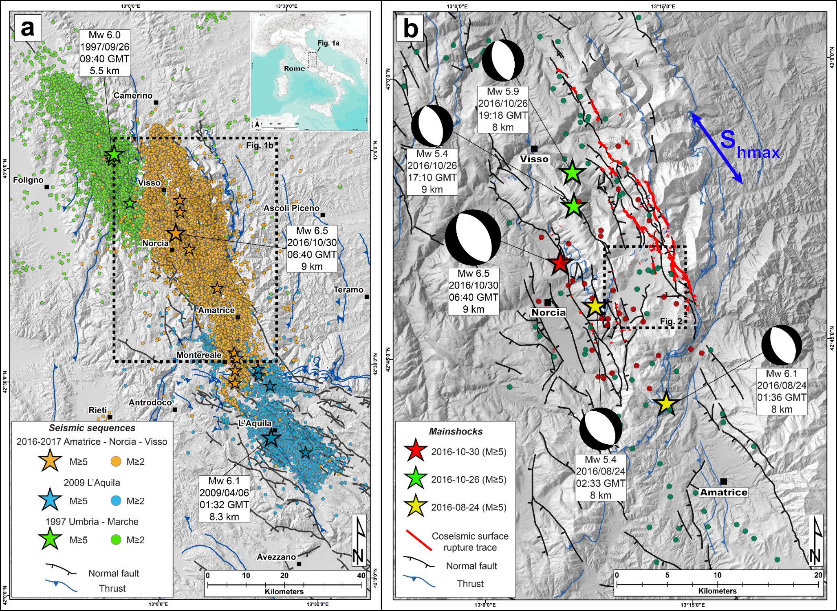
The central Italy 2016-2017 seismic sequence and the study area
Three major seismic sequence hit the central Apennines in the past twenty years (Colfiorito sequence, 1997, M 6.0; L'Aquila sequence, 2009, M 6.1; Amatrice-Visso-Norcia sequence, 2016, M 6.0, 5.9 and 6.5).
Seismological evidence of in-cascade activation of several adjacent NW-trending normal fault-systems.
The 2016-2017 Amatrice-Visso-Norcia seismic sequence was caused by the ~25 km-long Mt. Vettore – Mt. Bove normal fault-system (VBFS, hereinafter) to the northwest, and the ~30 km-long Laga Mts. fault-system, to the southeast.
The 30 October 2016 MW 6.5 Norcia earthquake caused a > 22 km-long
system of surface ruptures, with an
average dip-slip of ~0.45 m and local
peaks >2 m along the Mt. Vettore
fault (Villani et al., 2018).
The red square encloses our study area.

Slide 4
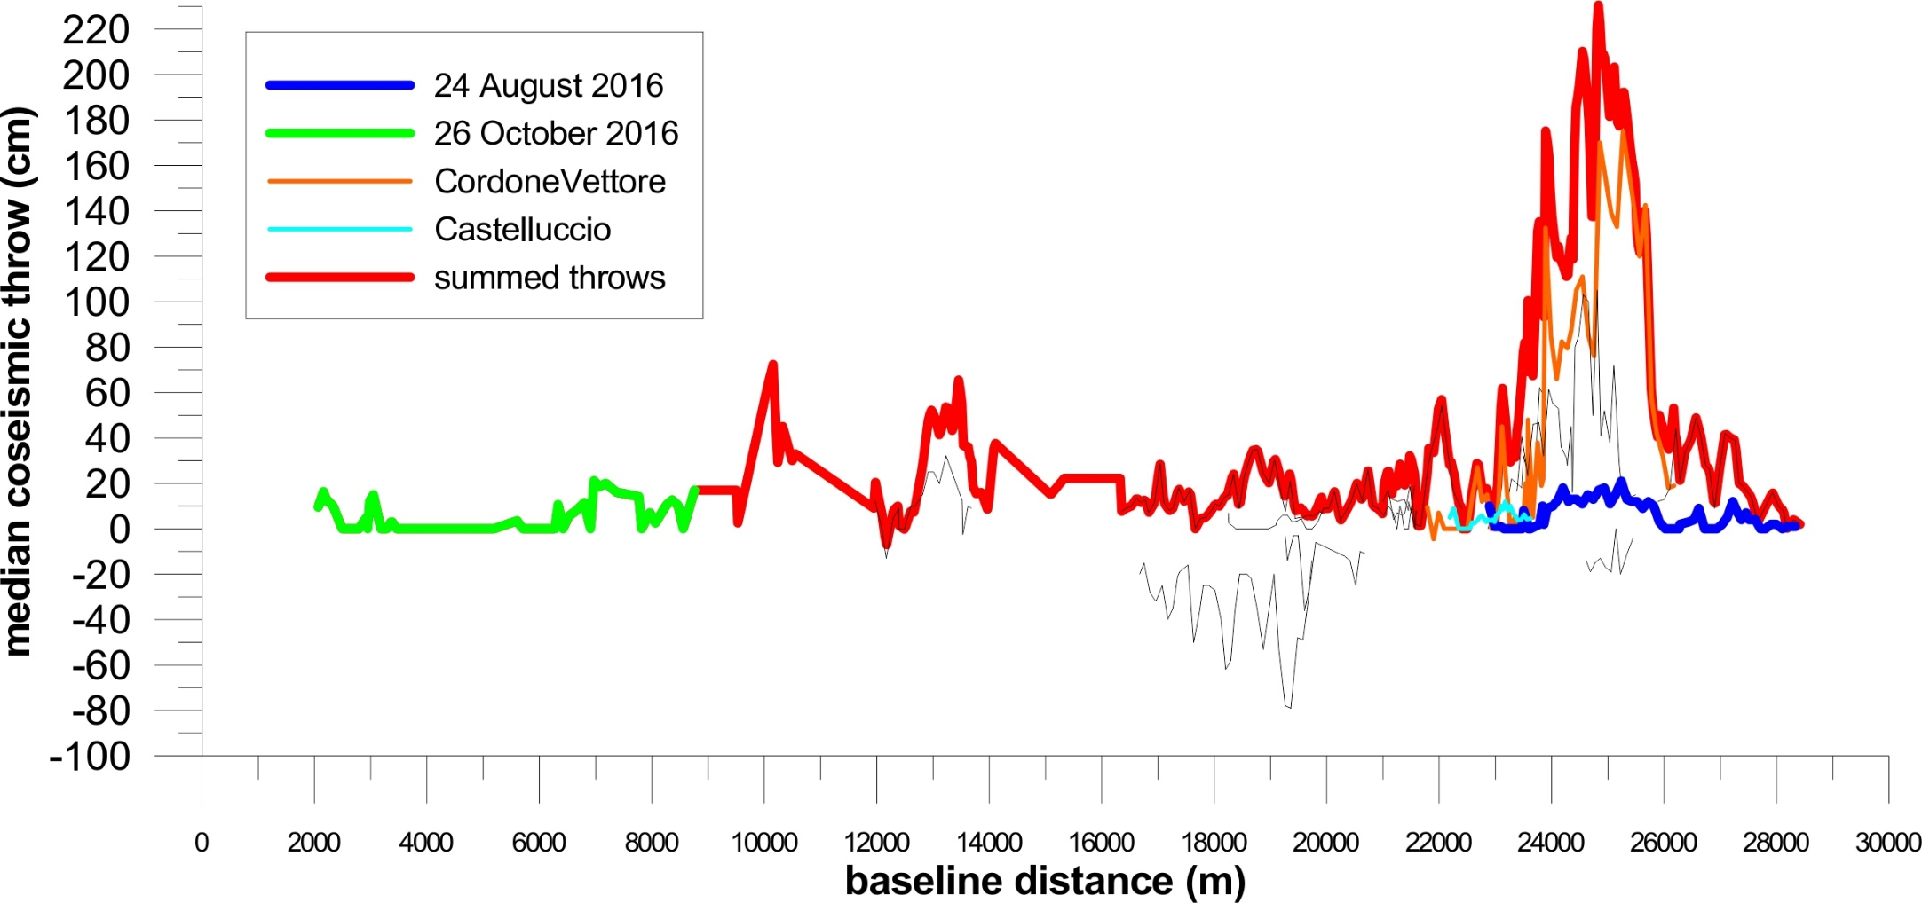
Coseismic surface faulting of the 24 August (Mw 6.1), 26 October (Mw 5.9) and 30 October 2016 (Mw 6.5) earthquakes:
integrated contribution from multiple active splays of the Mt. Vettore - Mt. Bove normal fault-system (VBFS)
Surface faulting characterized the 3 mainshocks of the sequence, and the largest amount of surface slip is related to the 30 October Norcia event. Just a very small fraction of the total slip is given by a 2 km-long fault splay affecting the Castelluccio basin (pale blue line). This small rupture is of utmost importance, since it crosses a Quaternary depocenter (Pian Grande di Castelluccio basin - PGC).
In order to understand the long-term behaviour of the VBFS, it is necessary to explore the subsurface structure of the Castelluccio basin (PGC).
Coseismic slip in the PGC basin
Villani et al., (2018)

Slide 5
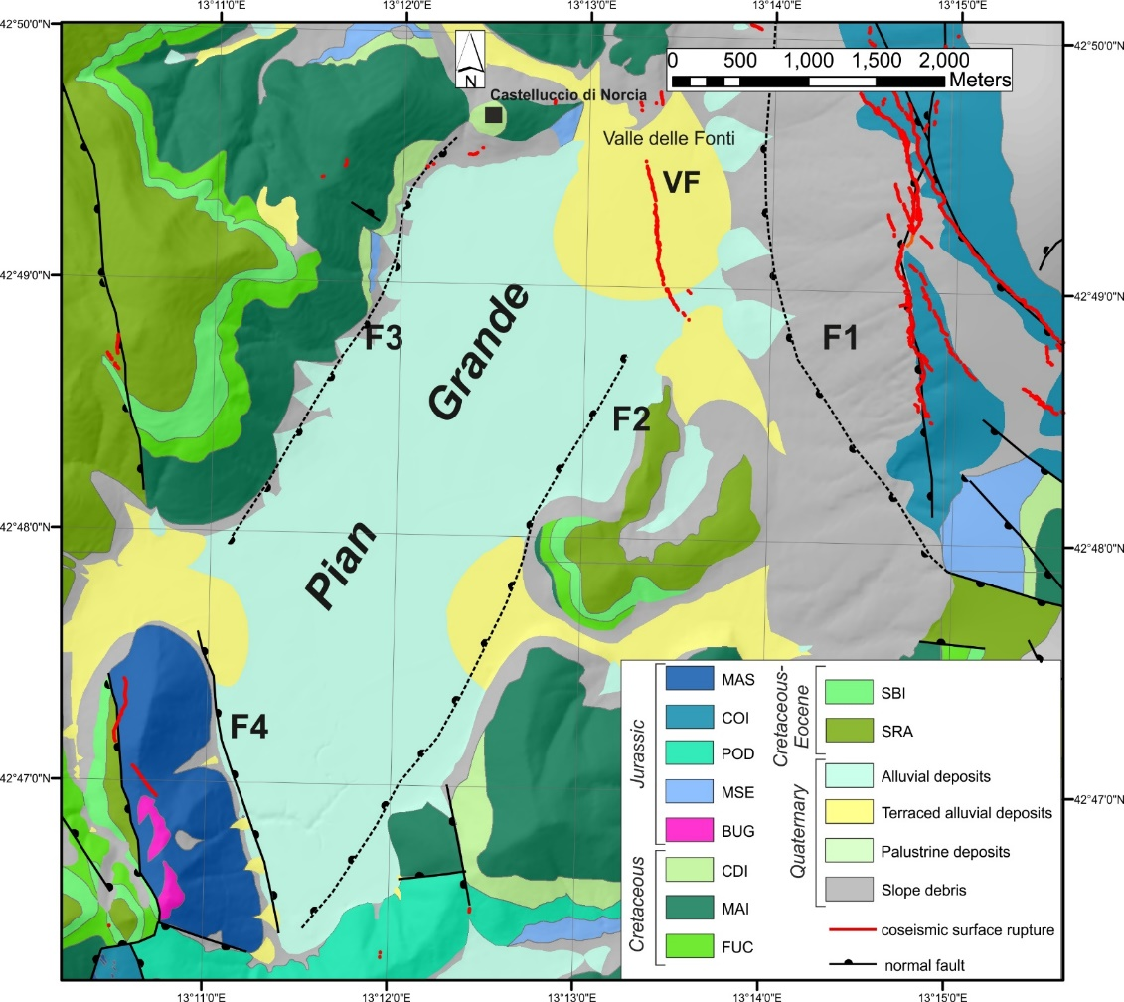
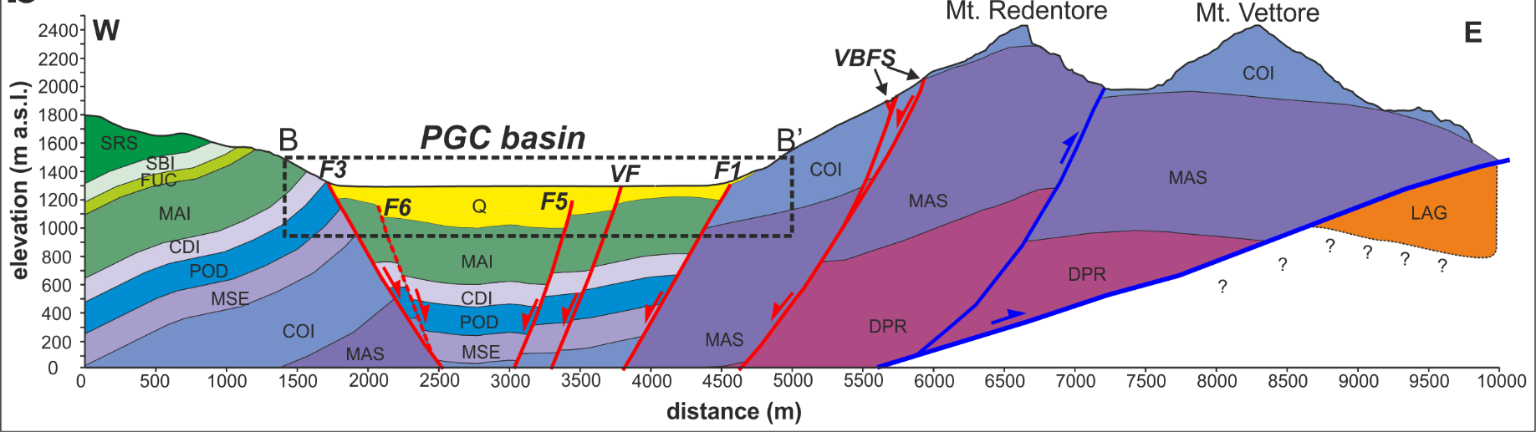
The PGC basin is a 20km²-wide Quaternary depression developed in the hangingwall of the VBFS.
It is surrounded by mountain ranges made of Meso-Cenozoic shallow-to-deep water marine limestones (Umbria-Marche multi-layer). A complex set of normal faults with dominant directions N150°-170° and N20° bounds the depression.
The subsurface structure of the PGC basin is still poorly known.
Surface faulting due to the 30 October 2016 Norcia earthquake (red lines) affected the northern part of the basin along the Valle delle Fonti – Parte Pala fault splay (VF).
We focused on this the portion of the basin to explore the near-surface of the 2016 coseismic ruptures and try to unravel the detailed structure of this active normal fault-zone.
Previous geophysical investigations we performed in the area (Villani et al., 2019) suggest the VF fault is a relatively young synthetic splay of the VBFS, likely developed in the last 0.4 Ma.

Slide 6
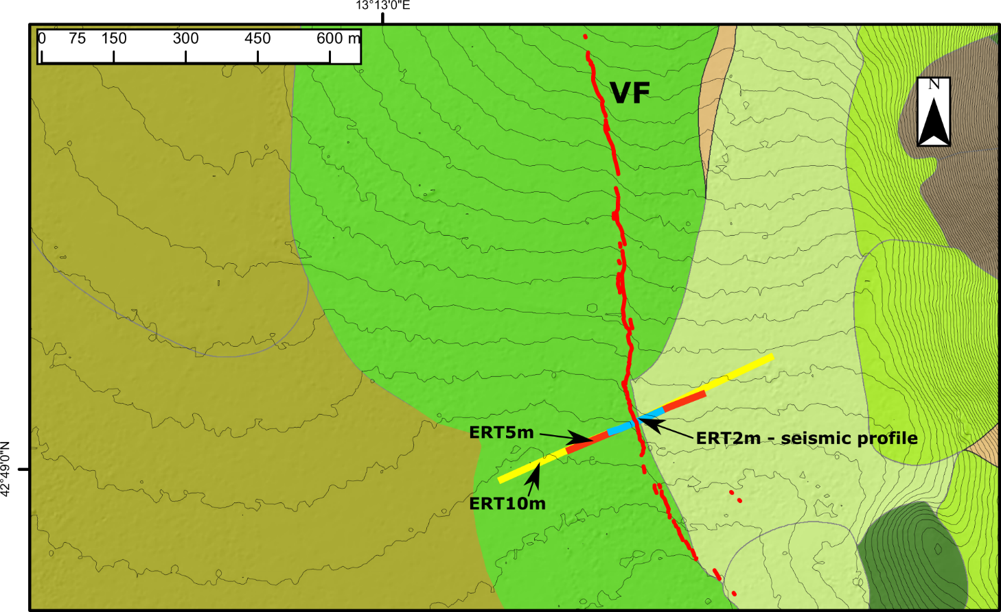
Surface faulting within the PGC basin (Valle delle Fonti – Prate Pala fault – VF)
Across the VF fault, and nearly orthogonal to the 2016 coseismic ruptures, we acquired 3 multi-scale ERT profiles and 1 very high-resolution seismic profile.
The survey site is characterized by a stack of different generations of alluvial fans (sands and gravels) ranging in age from the Middle Pleistocene to the Holocene.
We combine reflection processing with non-linear multi-scale refraction tomography to produce accurate 2-D reflectivity images and P-wave velocity models. We also compute a smoot pseudo 2-D Vs model through MASW technique. We then compare results obtained with ERT and analyze the multi-variate dataset.

Slide 7
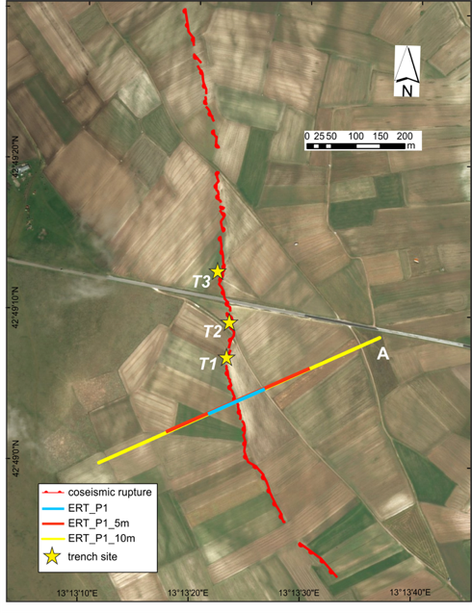
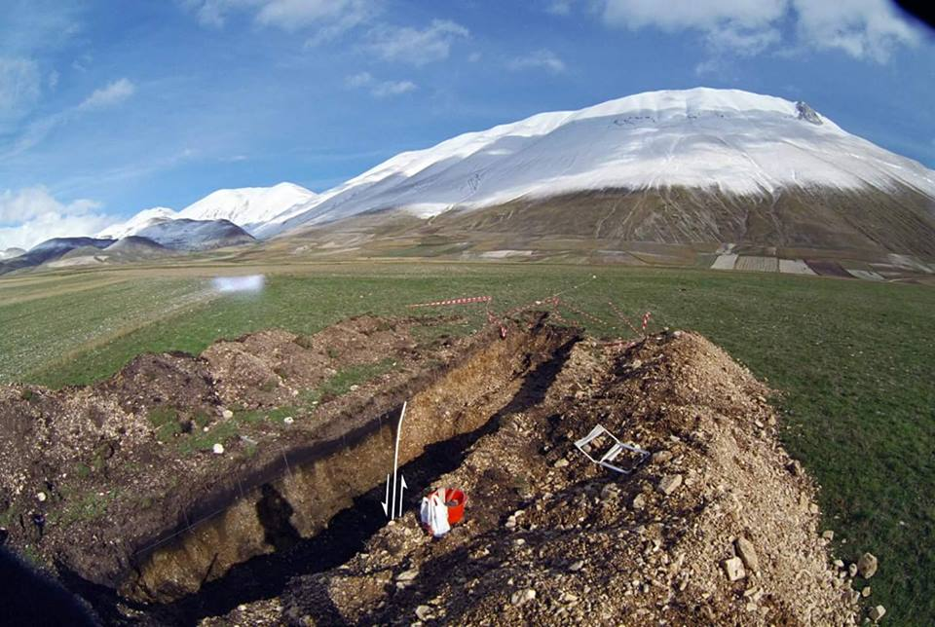
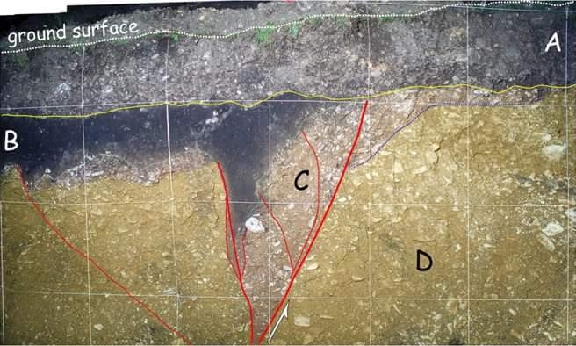
Surface faulting within the PGC basin (Valle delle Fonti – Prate Pala fault - VF): present-day and past evidence
Our geophysical profiling parallels 3 paleoseismic trenches (dug in 1998) showing evidence of late Holocene earthquakes
Villani & Sapia (2017)
Galadini & Galli (2003)
Notes:
All ERT profiles are purposely centred on the coseismic rupture and were acquired using an electrodes spacing of 2 m, 5 m and 10 m respectively, corresponding to profile lengths of 126 m, 315m and 630 m (panel A and B). For each profile, we acquired both dipole-dipole (DD) and Wenner-Schlumberger (WS) electrode arrays, in order to 1) reach different depths of investigation, 2) obtain a good compromise between vertical and horizontal resolution of the retrieved resistivity bodies. In panel C we show the results obtained for linearized inversions with smoothness constraints for the DD array. The quality of the obtained resistivity sections is then described by the root mean square (RMS) of residuals after the last iteration. On each smooth ERT model we classify the most significant resistivity changes as derived from the application of the steepest-gradient-method (SGM: Chambers et al., 2006; Sapia et al., 2017).
Superimposed to the sections are the main interfaces as computed by the SGM method applied to the inverted resistivity data (black and white dots in panel C).
The basic principle of the SGM is that the main interfaces are located in regions where a maximum increase or decrease in the resistivity at depth occurs, i.e. where the second derivative of a best-fit curve to a vertical array of resistivity data points (in this case, a polynomial curve) is null.
We interpret different units characterized by comparable range of resistivity values and bounded by correlative interfaces as representative of distinct electrical resistivity intervals that we labelled with capital letters, in order to simplify the description of the resistivity. The overall pattern of the subsurface resistivity picture as recovered from profile ERT 10 m is consistent with results obtained for profile ERT 5 m and ERT 2 m. Of course, the larger penetration depth of ERT 10 m allowed us to investigate the fault zone up to a depth of about 100 m, which shows an average width of about 10–15 m, and preserves a sub-vertical attitude at depth. The ERT 10 m also highlights the presence of deeper electrical units (Unit D and Unit E ) which were only roughly defined by the ERT 5 m. In addition, ERT 10 model provides us with useful information at depth to definitely constrain the thickness of the low-resistivity unit C

Slide 8
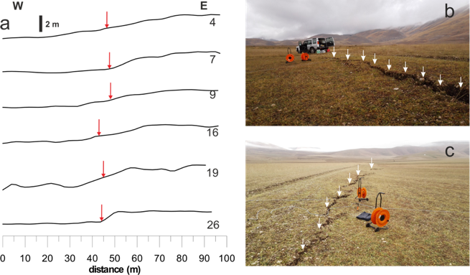
Active fault splay within the PGC basin (Valle delle Fonti – Prate Pala):
comparison between coseismic and short-term (10³ yr) fault throw
Villani & Sapia (2017)
Topographic profiles show the long-term fault scarp, and the coseismic ruptures (red arrows) are located at the scarp base.
Notes:
All ERT profiles are purposely centred on the coseismic rupture and were acquired using an electrodes spacing of 2 m, 5 m and 10 m respectively, corresponding to profile lengths of 126 m, 315m and 630 m (panel A and B). For each profile, we acquired both dipole-dipole (DD) and Wenner-Schlumberger (WS) electrode arrays, in order to 1) reach different depths of investigation, 2) obtain a good compromise between vertical and horizontal resolution of the retrieved resistivity bodies. In panel C we show the results obtained for linearized inversions with smoothness constraints for the DD array. The quality of the obtained resistivity sections is then described by the root mean square (RMS) of residuals after the last iteration. On each smooth ERT model we classify the most significant resistivity changes as derived from the application of the steepest-gradient-method (SGM: Chambers et al., 2006; Sapia et al., 2017).
Superimposed to the sections are the main interfaces as computed by the SGM method applied to the inverted resistivity data (black and white dots in panel C).
The basic principle of the SGM is that the main interfaces are located in regions where a maximum increase or decrease in the resistivity at depth occurs, i.e. where the second derivative of a best-fit curve to a vertical array of resistivity data points (in this case, a polynomial curve) is null.
We interpret different units characterized by comparable range of resistivity values and bounded by correlative interfaces as representative of distinct electrical resistivity intervals that we labelled with capital letters, in order to simplify the description of the resistivity. The overall pattern of the subsurface resistivity picture as recovered from profile ERT 10 m is consistent with results obtained for profile ERT 5 m and ERT 2 m. Of course, the larger penetration depth of ERT 10 m allowed us to investigate the fault zone up to a depth of about 100 m, which shows an average width of about 10–15 m, and preserves a sub-vertical attitude at depth. The ERT 10 m also highlights the presence of deeper electrical units (Unit D and Unit E ) which were only roughly defined by the ERT 5 m. In addition, ERT 10 model provides us with useful information at depth to definitely constrain the thickness of the low-resistivity unit C

Slide 9
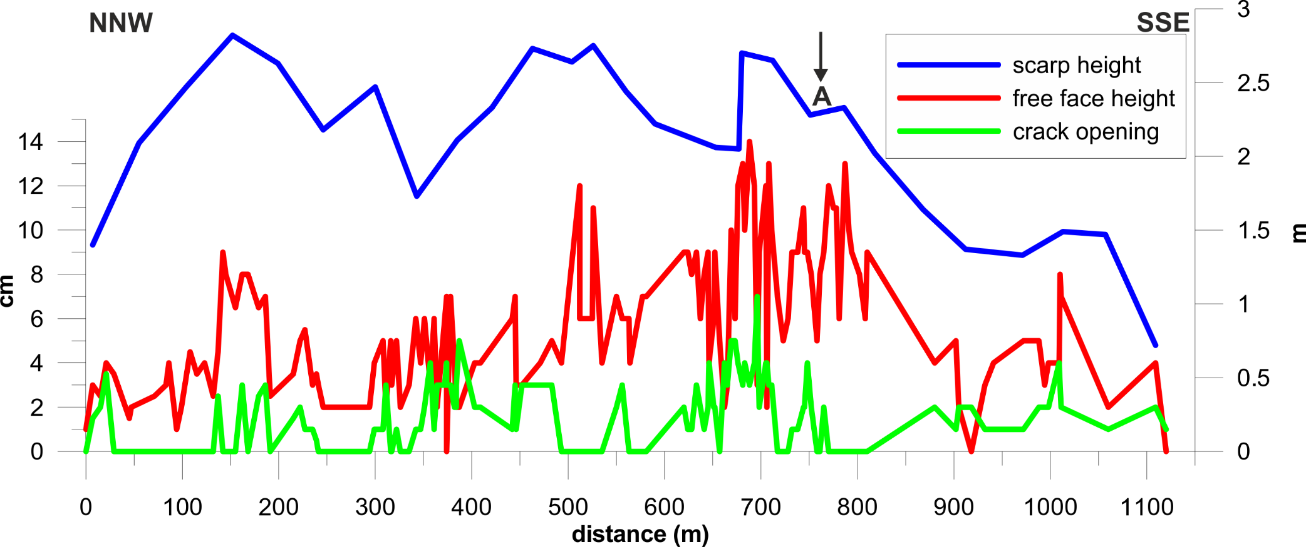
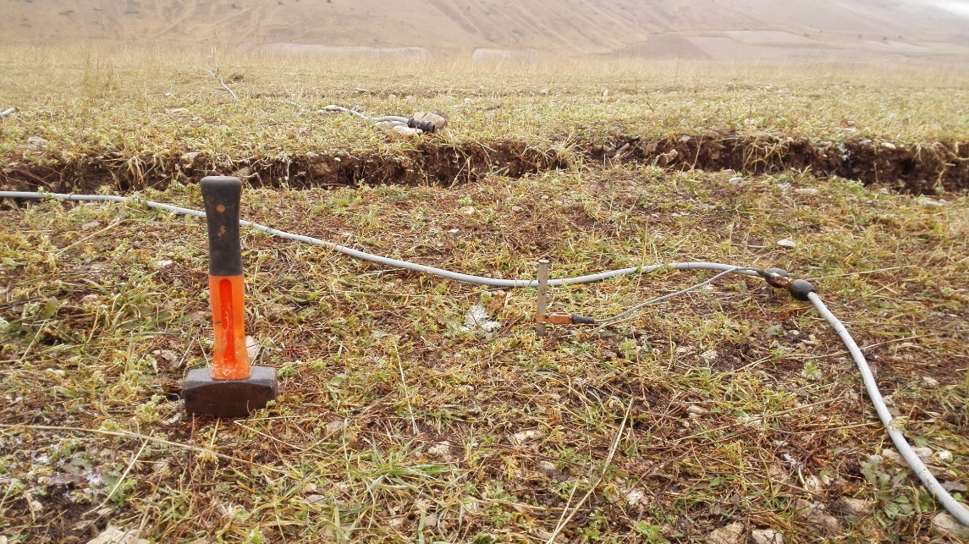
Survey site
Villani & Sapia (2017)
Coseismic throw peaks match long-term surface-offset maxima
Coseismic throw: max 0.14 m, average 0.05 m
Post-12 ka morphologic throw: 2.3-2.8 m (0.23 ± 0.08 mm/yr throw-rate)
hammer

Slide 10
High-resolution multi-scale ERT (December 2016):
2-m, 5-m and 10-m electrode spacings
Villani & Sapia (2017)
A low-resistivity anomaly characterizes the fault zone (FZ).
Displaced electrical horizons are consistent with surface offset and hint for incremental throw with depth.
Notes:
All ERT profiles are purposely centred on the coseismic rupture and were acquired using an electrodes spacing of 2 m, 5 m and 10 m respectively, corresponding to profile lengths of 126 m, 315m and 630 m (panel A and B). For each profile, we acquired both dipole-dipole (DD) and Wenner-Schlumberger (WS) electrode arrays, in order to 1) reach different depths of investigation, 2) obtain a good compromise between vertical and horizontal resolution of the retrieved resistivity bodies. In panel C we show the results obtained for linearized inversions with smoothness constraints for the DD array. The quality of the obtained resistivity sections is then described by the root mean square (RMS) of residuals after the last iteration. On each smooth ERT model we classify the most significant resistivity changes as derived from the application of the steepest-gradient-method (SGM: Chambers et al., 2006; Sapia et al., 2017).
Superimposed to the sections are the main interfaces as computed by the SGM method applied to the inverted resistivity data (black and white dots in panel C).
The basic principle of the SGM is that the main interfaces are located in regions where a maximum increase or decrease in the resistivity at depth occurs, i.e. where the second derivative of a best-fit curve to a vertical array of resistivity data points (in this case, a polynomial curve) is null.
We interpret different units characterized by comparable range of resistivity values and bounded by correlative interfaces as representative of distinct electrical resistivity intervals that we labelled with capital letters, in order to simplify the description of the resistivity. The overall pattern of the subsurface resistivity picture as recovered from profile ERT 10 m is consistent with results obtained for profile ERT 5 m and ERT 2 m. Of course, the larger penetration depth of ERT 10 m allowed us to investigate the fault zone up to a depth of about 100 m, which shows an average width of about 10–15 m, and preserves a sub-vertical attitude at depth. The ERT 10 m also highlights the presence of deeper electrical units (Unit D and Unit E ) which were only roughly defined by the ERT 5 m. In addition, ERT 10 model provides us with useful information at depth to definitely constrain the thickness of the low-resistivity unit C

Slide 11
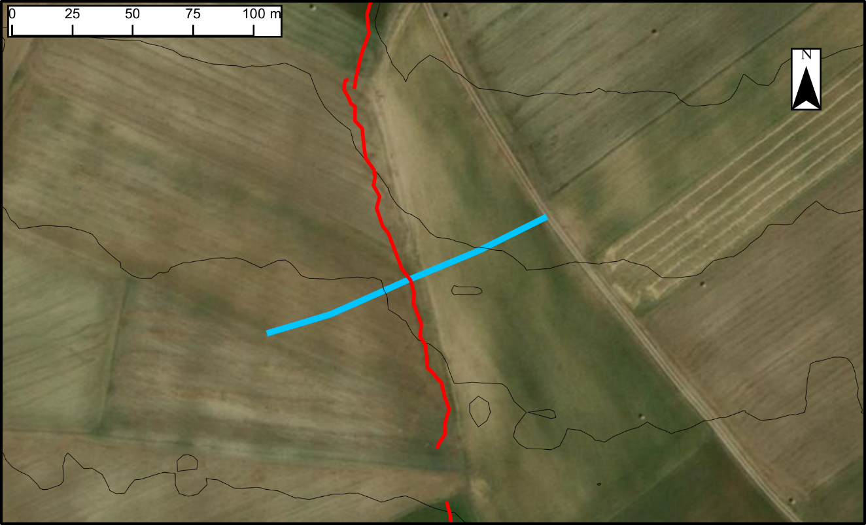
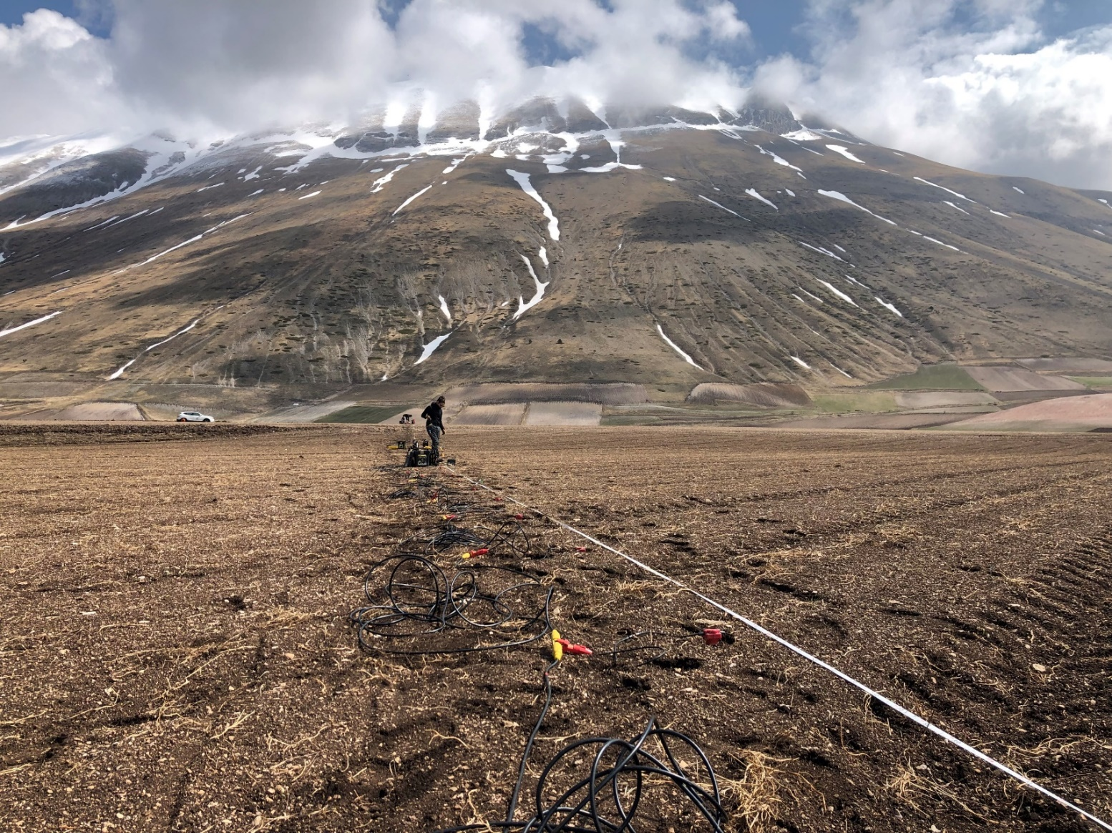
Very high-resolution seismic profiling across the VF fault
(April 2019)
190 m-long dense, wide-aperture seismic profile collinear with the ERT profiles;
96 vertical geophones (4.5 Hz eigen-frequency);
2 m receivers interval;
5 kg hammer source;
2 m source move-up.

Slide 12
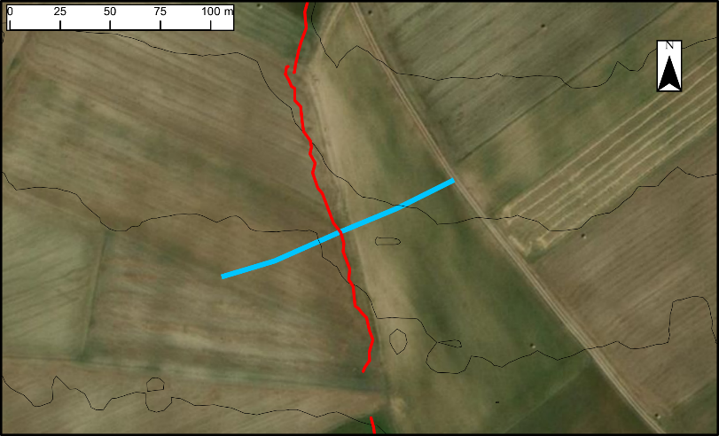
Data pre-processing
NMO correction & CMP Stacking
Depth converted stack section
Reflection seismology
8640 first arrival travel-times
Non-linear multi-scale inversion
2D Vp model and resolution tests
Refraction Tomography
Very high-resolution seismic profiling:
Processing flow and main outputs
Frequency-phase velocity spectrum
Dispersion curve inversion (1-D model)
Data interpolation (2D Vs pseudo-section)
MASW 2D
Dataset interpolation
Vp/Vs ratio model
Poisson coefficient model
Seismic parameters
computation
Multivariate dataset interpolation
K-means application
Optimal clustering assessment
Data integration
(Vp, Vs, Resistivity)

Slide 13
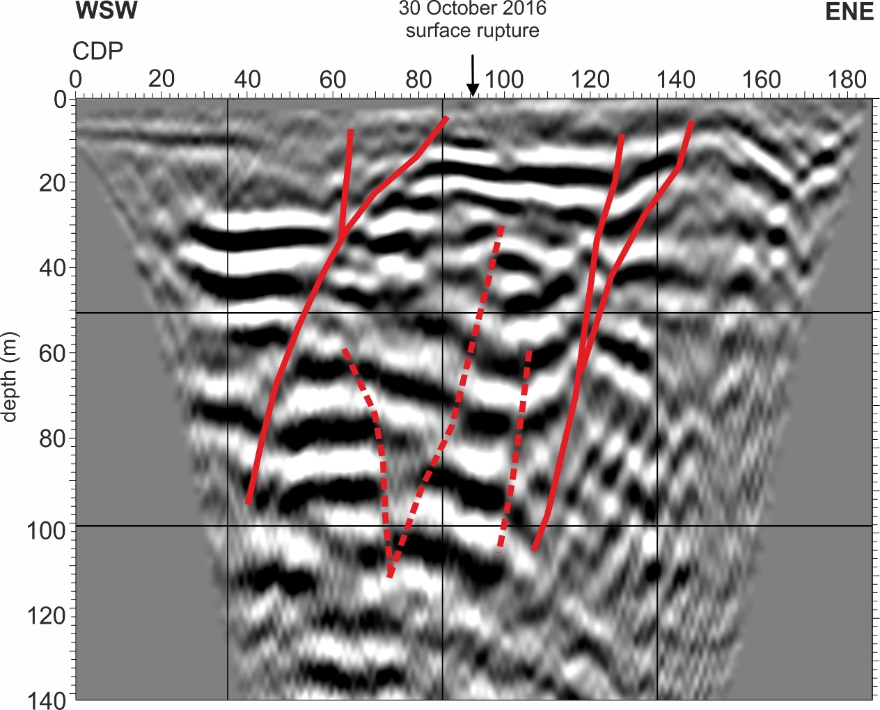
Reflection seismic stack and depth-converted section
Active fault-zone
Post-LGM syntectonic wedge
Top of pre-LGM fan (>30 ka).
Throw ~16 m
Very high-resolution imaging of a complex shallow normal-fault zone:
two main closely-spaced synthetic splays, the westernmost one active up to 30 October 2016

Slide 14
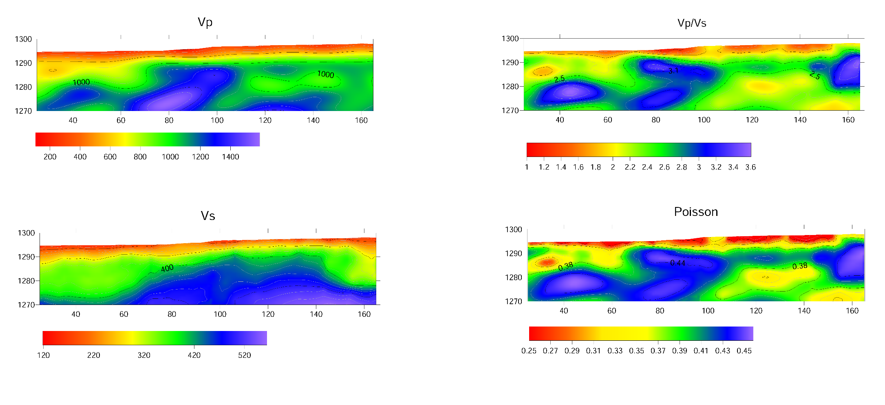
Results from Tomography and MASW
We obtained detailed Vp and Vs models from which we compute smooth Vp/Vs ratio and Poisson coefficient’s distributions.
Velocity models are then compared with the ERT model for the cluster analysis.

Slide 15
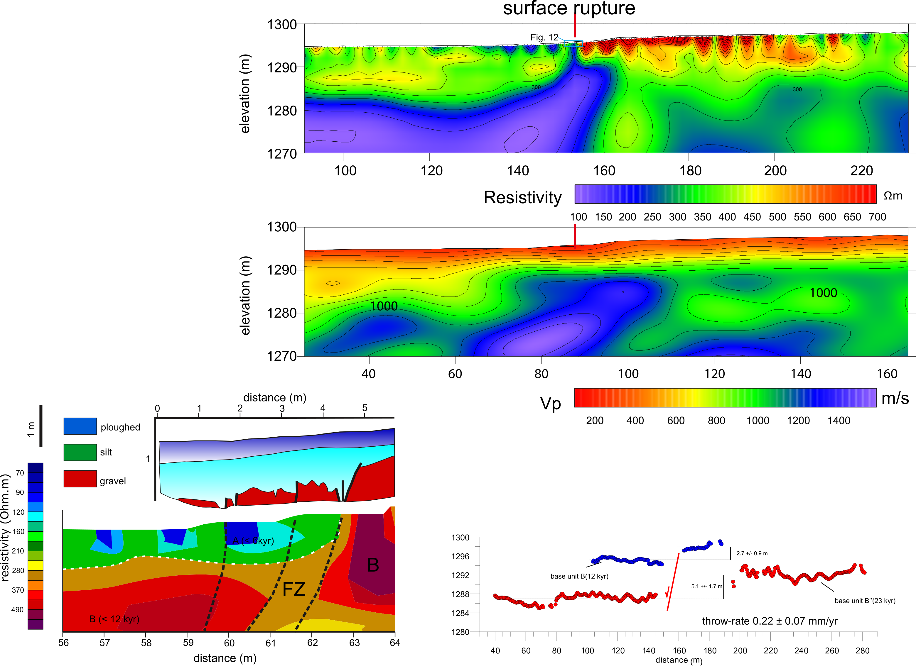
In the overlapping region, the 5-m ERT model (top) and the Vp tomographic model (bottom) show a striking similar pattern of subsurface resistivity and velocity.
There is a SW-dipping region of low-resistivity and high-Vp beneath the fault scarp.
Clear displacement of the shallow resistive layer is paired with thickening of low-Vp sediments in the hangingwall (colluvial packages due to several past surface-rupturing earthquakes).
fault zone
fault zone
When looked in detail, the ERT captures the width of the active fault zone as displayed in the trench log T1 by Galli & Galadini (2003)

Slide 16
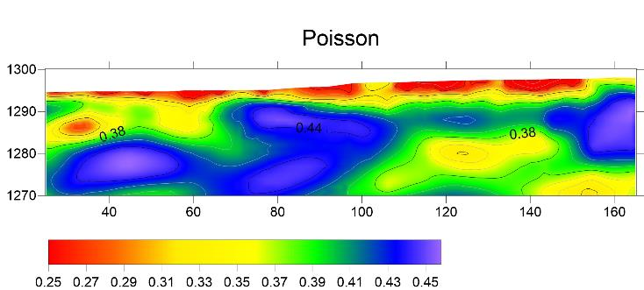
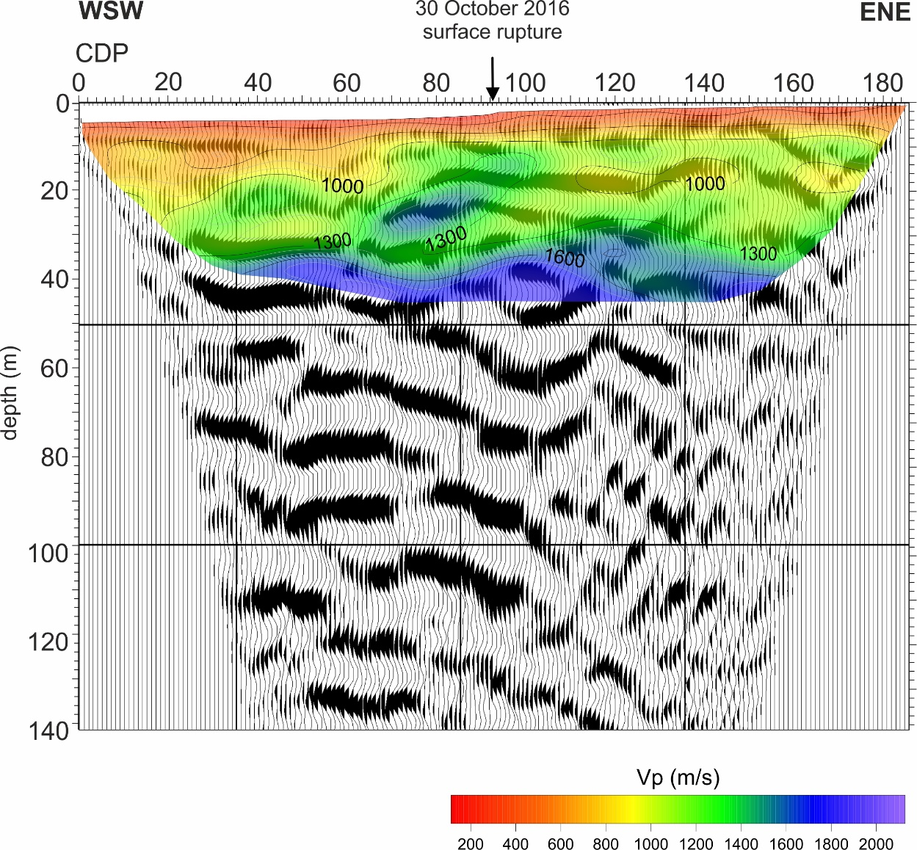
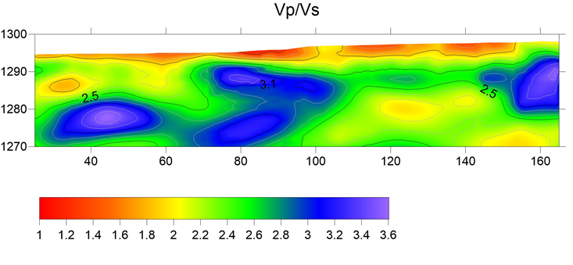
Vp/Vs ratio and Poisson coefficient distributions across the VF fault.
Fault zone
Fault zone
Fault zone
The high Vp/Vs (average 2.91) and Poisson’s coefficient (average 0.43) in the fault zone suggest this is a granular nearly-saturated medium, probably related to the increase of permeability due to fracturing and shearing. Low resistivity values also suggest high porosity (10-30%) likely related to the high fracture density within the damage zone and liquid-bearing saturated soils.
The thickened hangingwall sequence has lower Vp/Vs and Poisson’s ratio (2.25 and 0.36, respectively).

Slide 17
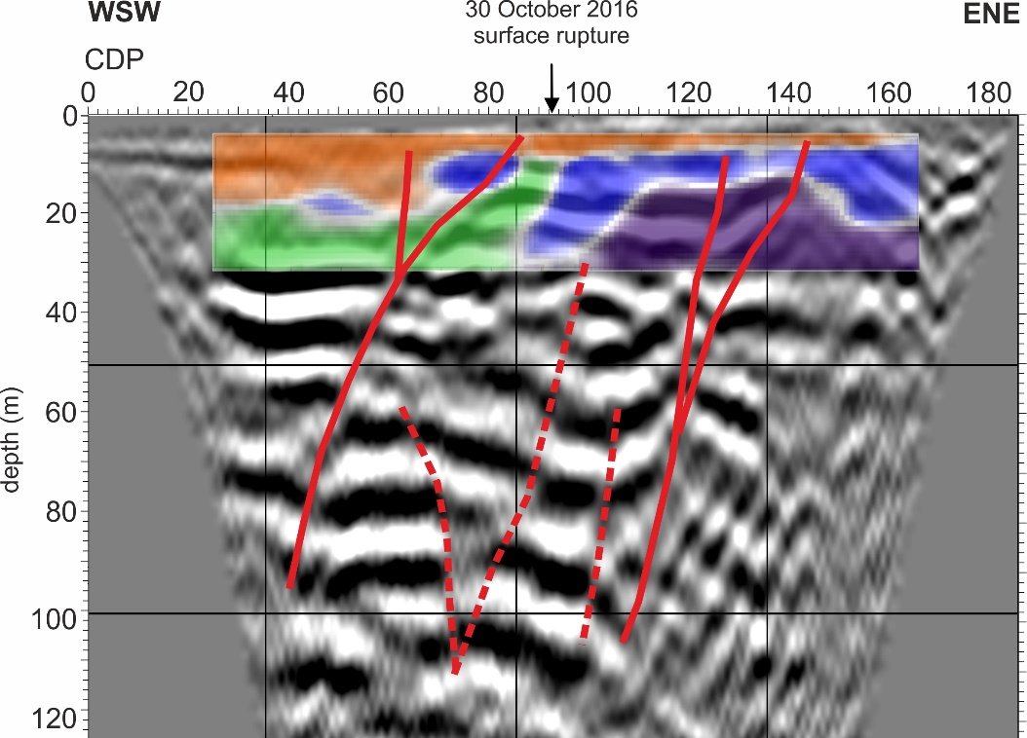
Cluster Analysis
K-means (Vp-Vs-Resistivity)
Fault zone
The results from the K-means cluster analysis also identify a homogeneous cluster in correspondence of the saturated active fault zone and in the thickened hangingwall sequence.
The spatial pattern of elastic moduli and resistivity is thus controlled primarily by porosity and water content.

Slide 18
Conclusions
Our multi-disciplinary geophysical investigation across the VF fault in the hangingwall of the 30 October 2016 Mw 6.5 earthquake fault revealed:
Complex fault zone architecture comprising two main principal synthetic splays dipping to the west;
Syn-tectonic thickening of clastic wedge in the hangingwall;
Throw affecting the pre-LGM fan in the order of 16 m;
Distintict properties of in the near-surface (< 30 m depth) of the active fault zone: relatively low resistivity (ρ 140 Ωm), high-Vp (1200 m/s), high Vp/Vs ratio (2.91) and Poisson coefficient (0.43);
High water content and high porosity likley characterizes the shallow active fault zone.

Slide 19
References
Published papers
Galadini, F., & Galli, P. (2003). Paleoseismology of silent faults in the Central Apennines (Italy): the Mt. Vettore and Laga Mts. Faults, Ann. Geophys. 46(5), 815-836, https://doi.org/10.4401/ag-3457
Villani, F., Sapia, V., (2017). The shallow structure of a surface-rupturing fault in unconsolidated deposits from multi-scale electrical resistivity data: the 30 October 2016 Mw 6.5 central Italy earthquake case-study, Tectonophysics, doi: 10.1016/j.tecto.2017.08.001
Villani, F., Pucci, S., Civico, R., De Martini, P.M., Cinti, F.R., Pantosti, D., (2018). Surface faulting of the 30 October 2016 Mw 6.5 earthquake in central Italy: detailed analysis of a complex rupture, Tectonics, doi: 10.1029/2018TC005175
Villani, F., Sapia, V., Baccheschi, P., Civico, R., Di Giulio, G., Vassallo, M., Marchetti, M., and Pantosti, D., (2019). Geometry and structure of a fault-bounded extensional basin by integrating geophysical surveys and seismic anisotropy across the 30 October 2016 Mw 6.5 earthquake fault (central Italy): the Pian Grande di Castelluccio basin, Tectonics, doi: 10.1029/2018TC005205
Conference abstracts
Villani F., Maraio S., Bruno P.P., Improta L., Wood K., Sapia V., Baccheschi P., Civico R., Pucci S., Brunori C.A., De Martini P.M., Pantosti D., Conti P., Doglioni C., (2019). Resolving long-term activity of the 30 October 2016 Mw 6.5 Norcia earthquake fault (central Italy) from multi-scale high-resolution seismic profiling and electrical resistivity tomography. Abstract T41H-0360 presented at 2019 Fall Meeting, AGU, San Francisco, CA, 9-13 Dec
Maraio S., Villani F. L., Serri, V, Sapia, L., Improta and P.P., Bruno (2019). Ultra-shallow imaging of a surface rupture fault of the 30 October 2016 Mw 6.5 central Italy earthquake from multidisciplinary geophysical approach, Convegno Congiunto SIMP-SGI-SOGEI, Parma 16-19 settembre 2019, S22-18
Maraio S., Villani F., P.P., Bruno L., Serri, V., Sapia, L., Improta and L., Bernardinetti (2019). The shallow structure of a surface fault of the 30 October 2016 Mw 6.5 central Italy earthquake from multidisciplinary geophysical approach. GNGTS, 38° Convegno, Roma 12-14 Novembre 2019, Session 1.1
Villani F., S. Maraio, P.P., Bruno, L., Improta, K., Wood, R., Civico, P., Baccheschi, V., Sapia, S., Pucci, C.A., Brunori, P.M., De Martini, D., Pantosti, P., Conti P. and C., Doglioni (2019). High-resolution seismic profiling in the Castelluccio basin: new constraints on the shallow subsurface of the 30 October 2016 Mw 6.5 Norcia earthquake fault (central Italy), Convegno Congiunto SIMP-SGI-SOGEI, Parma 16-19 September 2019, S22-10
Villani. F., S., Maraio, P.P., Bruno, L., Improta, K., Wood, R., Civico, P., Baccheschi, V., Sapia, S., Pucci, C.A., Brunori, P.M., De Martini, D., Pantosti, P., Conti P., and C., Doglioni (2019). High-resolution seismic profiling in the Castelluccio basin: new constraints on the shallow subsurface of the 30 October 2016 Mw 6.5 Norcia earthquake fault (central Italy), GNGTS, 38° Convegno, Roma 12-14 November 2019, Session 1.1
Villani, F., Sapia, V., Baccheschi, V., Civico, R., Di Giulio, G., Vassallo, M, Marchetti, M., Pantosti, D., (2018). Geometry and structure of a fault-bounded extensional basin by integrating geophysical surveys and seismic anisotropy across the 30 October 2016 Mw 6.5 earthquake fault (central Italy): the Pian Grande di Castelluccio basin. GNGTS, 37° Convegno, Bologna 20 November 2019, Session 1.1

