Slide 1
Geoeffectiveness of magnetosheath jets
Linus Norenius
Notes:
My name is Linus Norenius, PhD student at Umeå University
Looking at the geoeffectiveness of magnetosheath jets using ground based magnetometers
I will show a typical case and some preliminary results from this study

Slide 2
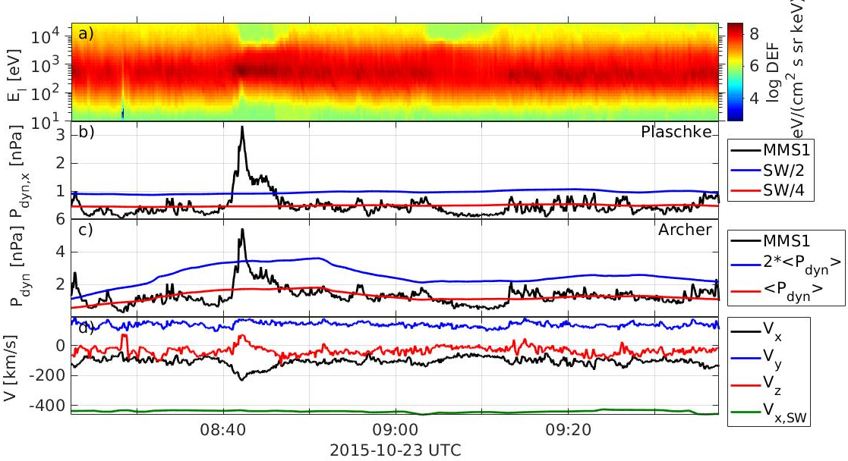
Event selection
MMS and ACE data from 2015-2017
Only jets within a 30 degree cone angle
2 selection criteria for jets, Plaschke (2013) and Archer (2013)
Tsyganenko T96 used to select ground based magnetometers
Notes:
MMS magnetosheath observations from 2015-2017
Event selection based on two criterias from Plascke et al. P_dx compared to solar wind P_dx
Archer compares P_dtot with background
Tsyganenko T96 to find impact point with MP and footpoint, GMAGs chosen in vicinity to the footpoint

Slide 3
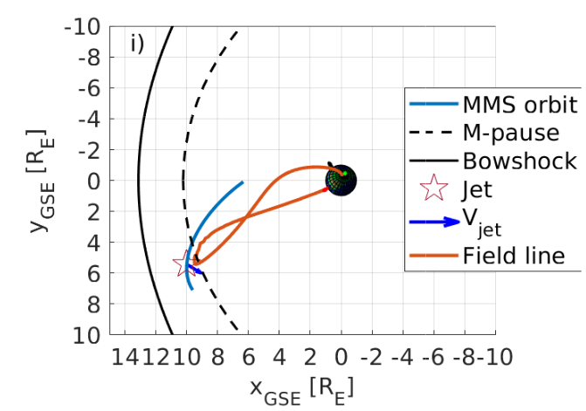
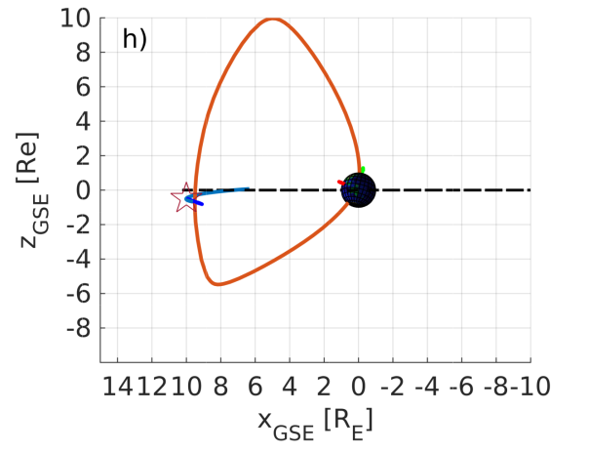
typical case
Data from MMS and ACE (GSE coordinates)
Notes:
Typical case, MMS and ACE data in GSE coords
From top to bottom
Ion energy time spectrogram
Pdx from MMS and ACE
Pd from MMS, +background
Electron density
Plasma velocity from MMS and ACE (sw)
B from MMS
IMF from ACE propagated to BS
Jet highlighted at 0820 UTC
Right, xyz proj of MMS orbit, detected jet marked as arrow, Shue et al. model MP, affected field line
If we zoom in around the jet

Slide 4
t₀ time of jet
t₁ time of first magnetometer response
VIZ E-component
t₂ time of later magnetometer response
t₀ – t₁ $\sim$ 80 s theoretical transfer time was about 50 s to 2 R_{E}
Notes:
And include the relevant GMAGs we see this
Spectrogram, Pdx, Pdtot, GMAG comps N, E & Z for different stations, IMF ACE
Time of centre of jet marked as t_0
Time of earliest GMAG response t_1 seen in VIZ (Vieze Island) E component
Time of later response t_2
Theoretical transfer time as estimated from plasma velocity and Alfvén speed ~50 s to 2 R_E above ground
Observed time about 80 s to earliest response
68 similar events

Slide 5
$$ΔB_{N}$$
$$ΔB_{E}$$
Maximum response after the jet
$$ΔB_{N}$$
Background

Slide 6
Preliminary results
Notes:
Preliminary results from those 68 events show that the time length of jets as well as total dynamic pressure seems to be important for GMAG response
Both corresponding to total energy

Slide 7
Conclusions
The time length (spatial size) and total dynamic pressure seems to be important for geoeffectiveness of jets
Agrees with Archer et al. regarding magnetopause acting as a low-pass filter
Notes:
Time length and dynamic pressure seems to be

Slide 8
thank you for listening
Linus Norenius

Slide 9
references
M. O. Archer et al., Magnetospheric response to magnetosheath pressure pulses: A low‐pass filter effect (2013)
H. Hietala and F. Plaschke, On the generation of magnetosheath high-speed jets by bow shock ripples (2013)
Notes:
Time length and dynamic pressure seems to be

