Slide 1
Deep Learning Neural Networks with Metaheuristic Optimization Algorithms for Groundwater Contamination Vulnerability Mapping in Miryang Aquifer, South Korea
Hussam Eldin Elzain · Sang Yong Chung Venkatramanan Senapathi · Kye-Hun Park
Pukyong National University, Korea

Slide 2
Research Scope
Assessment of groundwater contamination vulnerability
Using Deep learning neural networks: Artificial Neural Fuzzy Logic Inference System (ANFIS)
Combined with Genetic Algorithm (GA) and Particle Swarm Optimization (PSO)
Input data: DRASTIC 7 Factors + Landuse
Target (output) data: 95 NO₃-N concentrations
Study area: Miryang City, Korea (South)

Slide 3
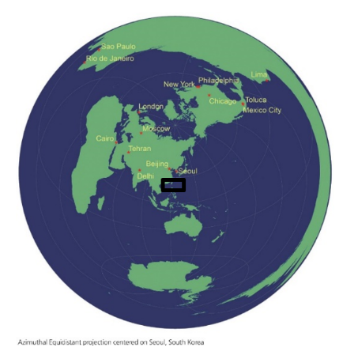
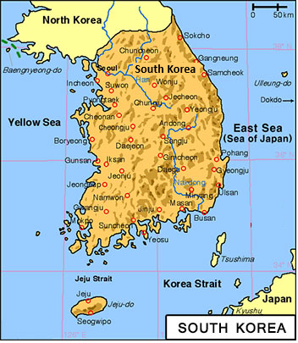
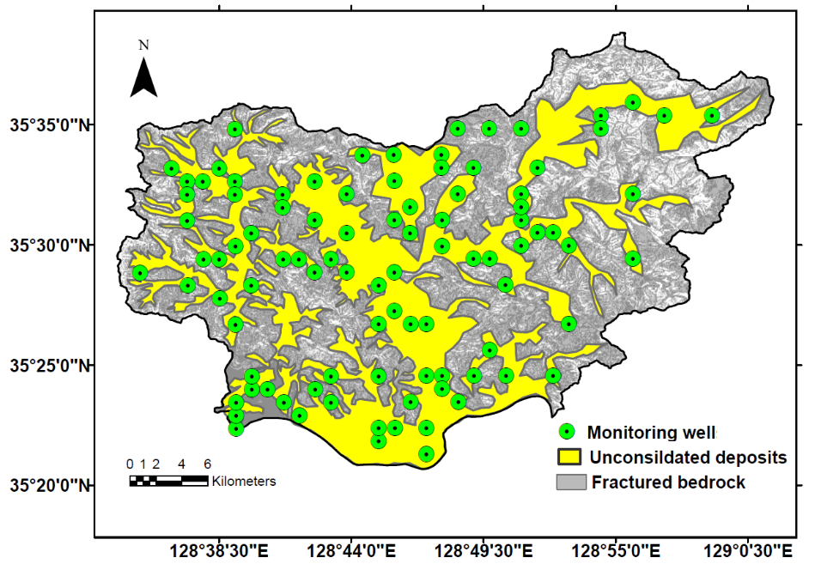
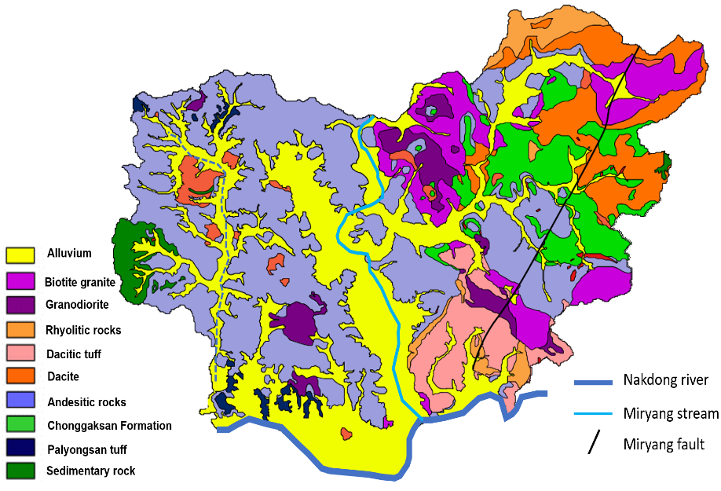
Study Area
(a)
(b)
(c)
Fig. 1. (a) Location map, (b) Sample points, (c) Geological map.

Slide 4
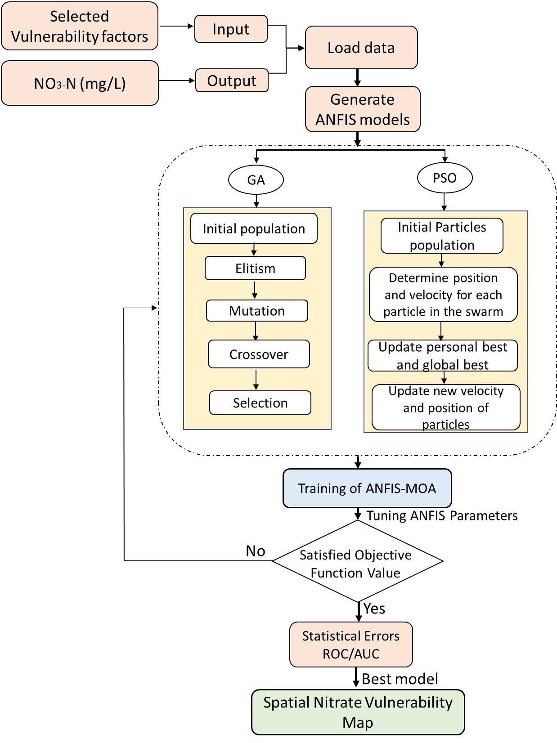
Flow Chart of VI Assessment

Slide 5
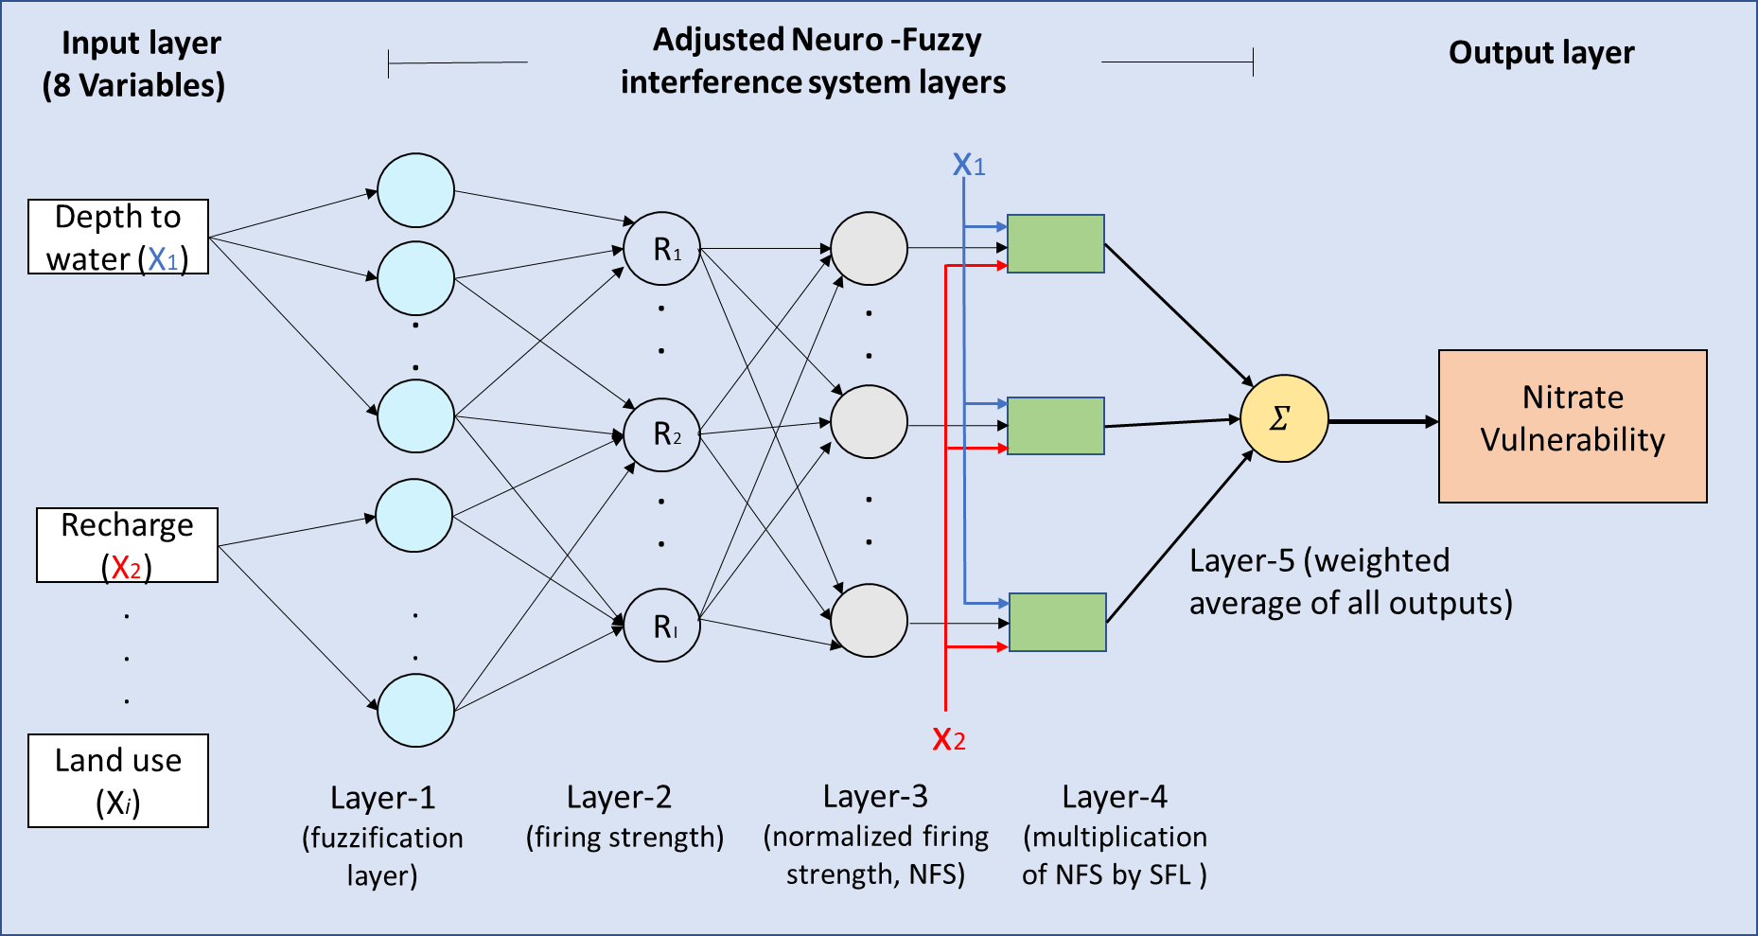
Artificial Neural Fuzzy Logic Inference System (ANFIS)

Slide 6
Evaluation of vulnerability factors using Pearson technique and collinearity statistics
DRASTIC Factors | Predictive Power | Collinearity Statistics
 |  | Tolerance | VIF
Depth to water | 0.551 | 0.512 | 1.951
Recharge | 0.454 | 0.574 | 1.739
Aquifer media | 0.566 | 0.374 | 2.672
Soil media | 0.460 | 0.534 | 1.872
Topographic slope | 0.338 | 0.619 | 1.389
Vadose zone | 0.595 | 0.376 | 2.657
Conductivity | 0.749 | 0.506 | 1.975
Land use | 0.671 | 0.584 | 1.710

Slide 7
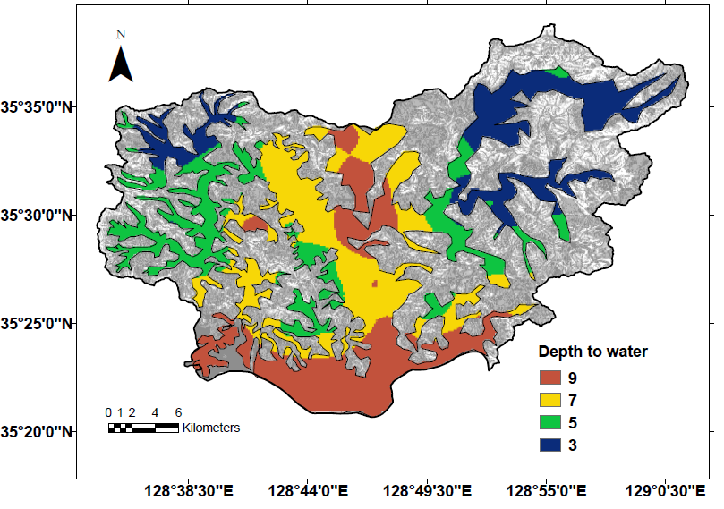
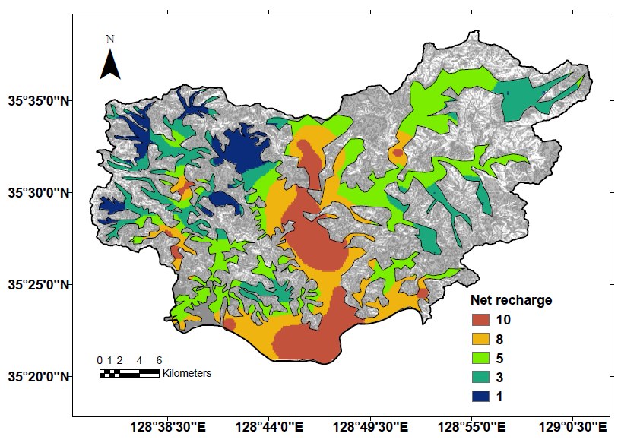
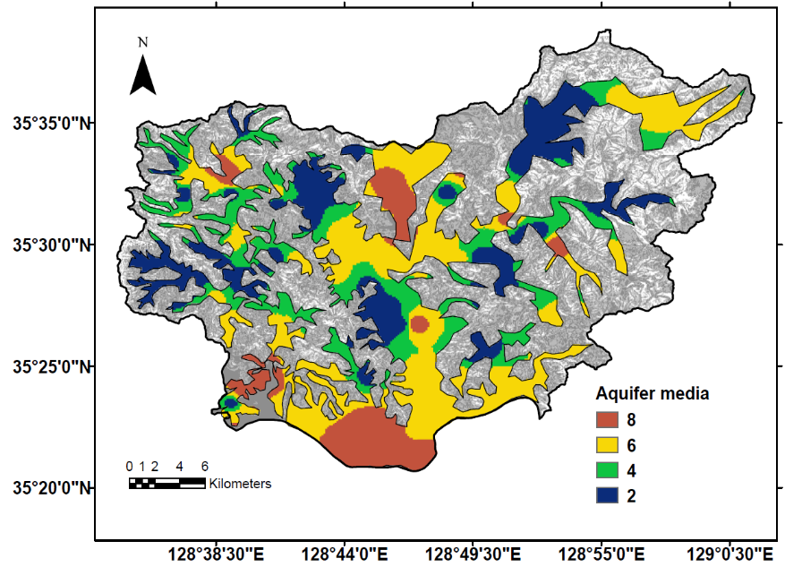
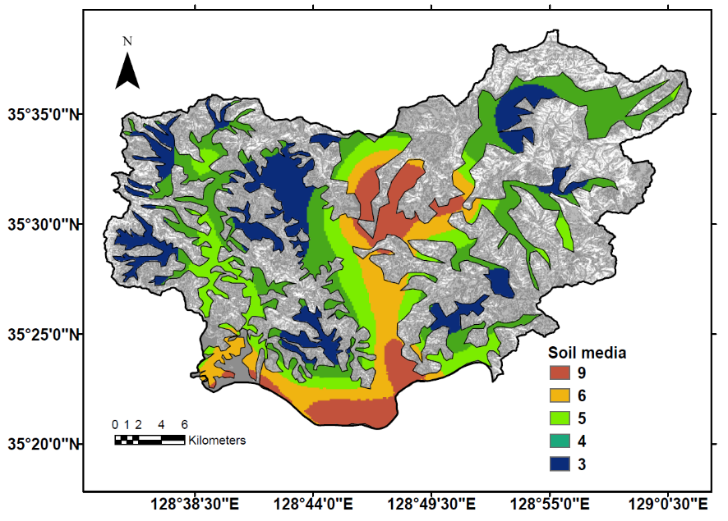
Thematic Maps of DRASTIC Factors (a) Depth to water (b) Recharge rate (c) Aquifer media (d) Soil media
(a)
(b)
(c)
(d)

Slide 8
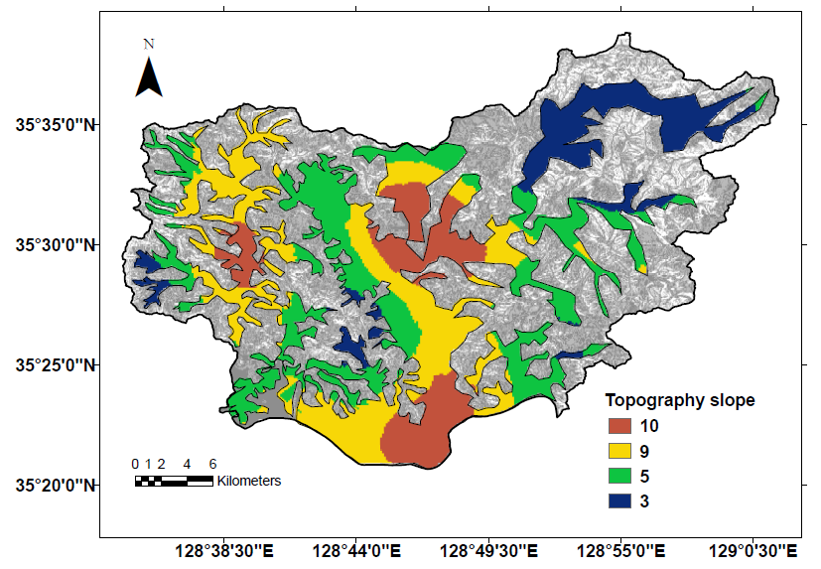
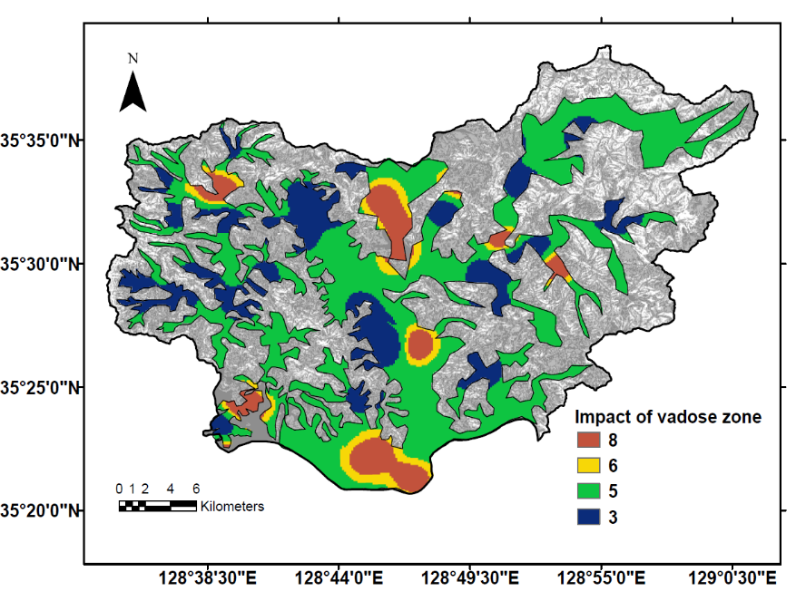
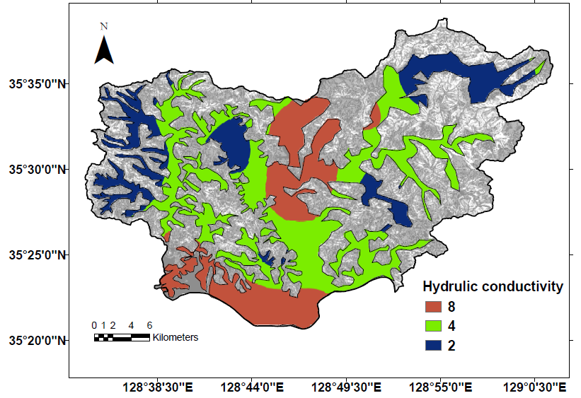
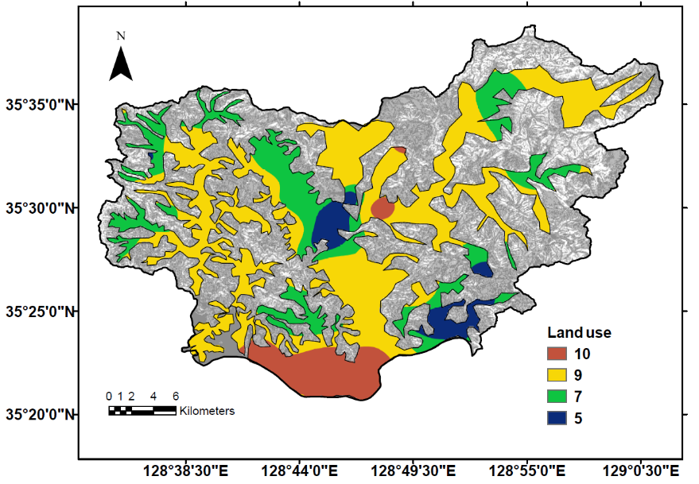
Thematic Maps of DRASTIC Factors (e)Topographic slope (f)Impact to vadose zone (g)Hydraulic Conductivity(h)Landuse
(e) | (e)
(e)
(f)
(g)
(h)

Slide 9
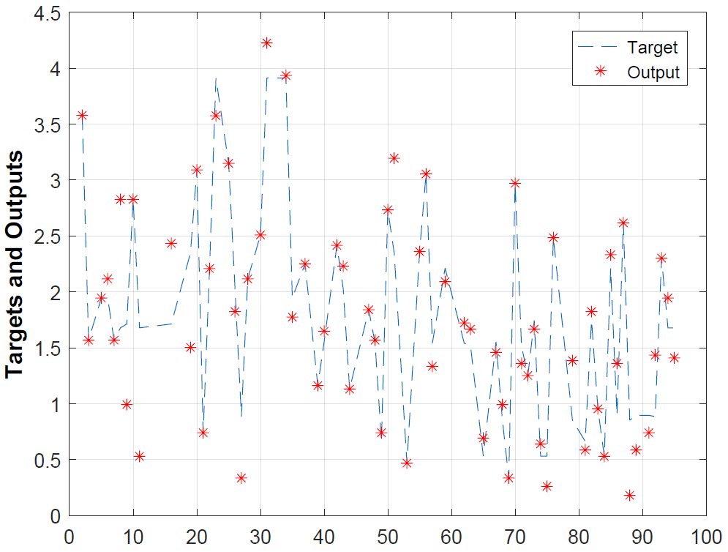
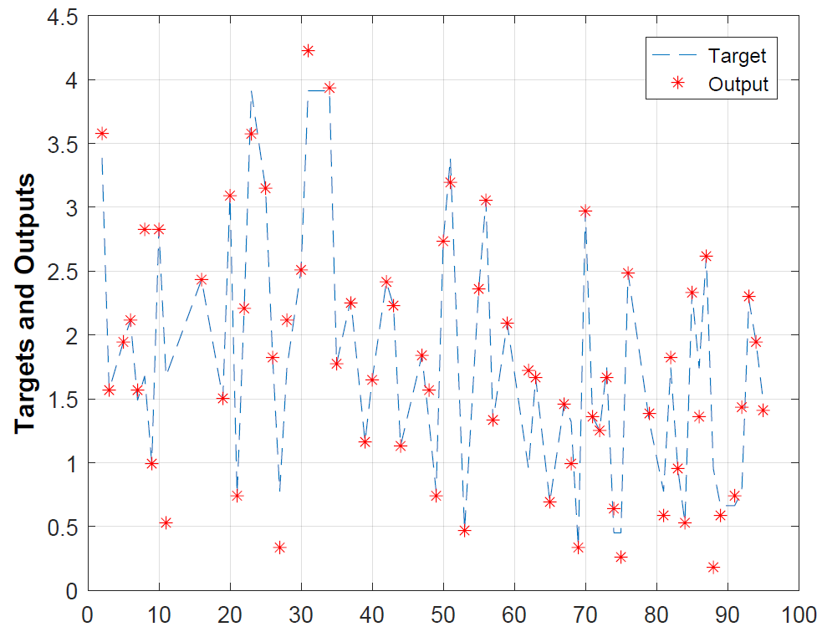
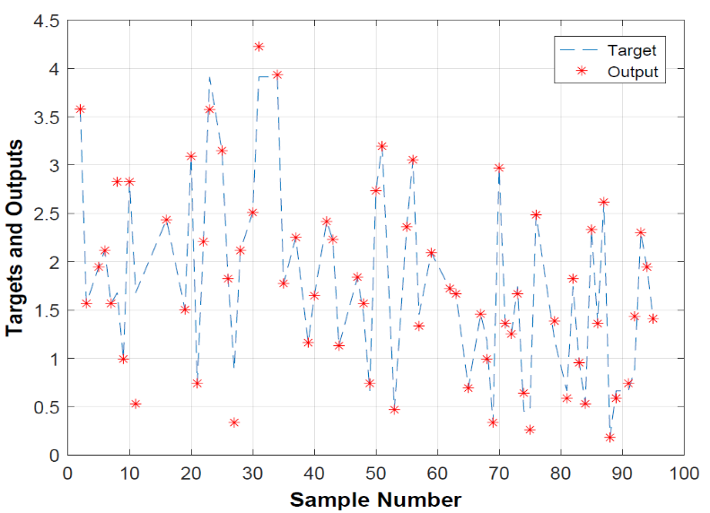
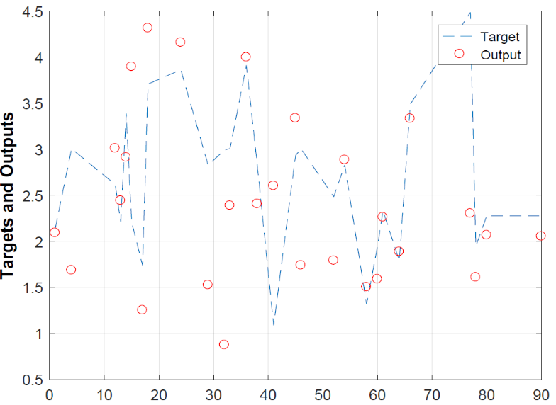
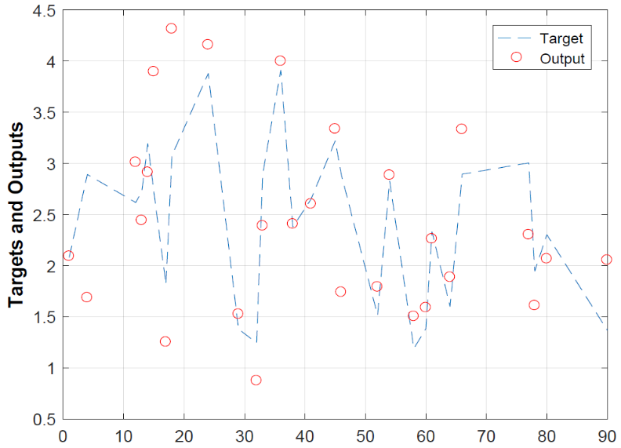
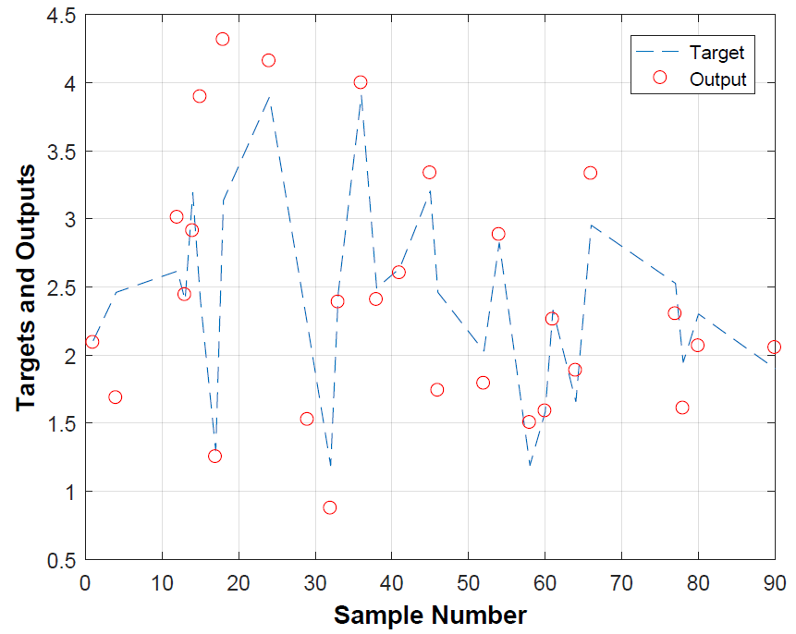
Graphical representations of training and testing performances for (a, d) Original ANFIS, (b, e) ANFIS-GA, and (c, f) ANFIS-PSO.
(a)
(b)
(c)
(d)
(e)
(f)

Slide 10
Statistical performance of ANFIS models
Statistical Factors | Original ANFIS |  | ANFIS-GA |  | ANFIS-PSO
 | Training | Testing | Training | Testing | Training | Testing
MAE | 0.190 | 0.637 | 0.103 | 0.333 | 0.100 | 0.318
RMSE | 0.338 | 0.890 | 0.319 | 0.491 | 0.234 | 0.478
$$R$$ | 0.931 | 0.493 | 0.935 | 0.717 | 0.971 | 0.851

Slide 11
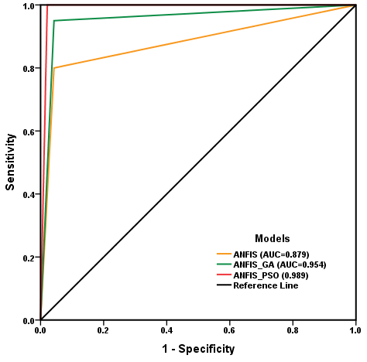
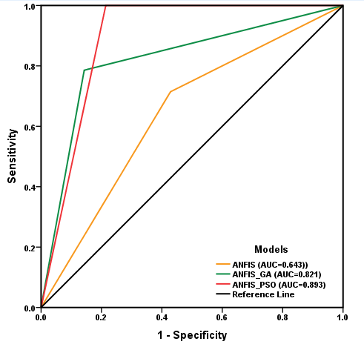
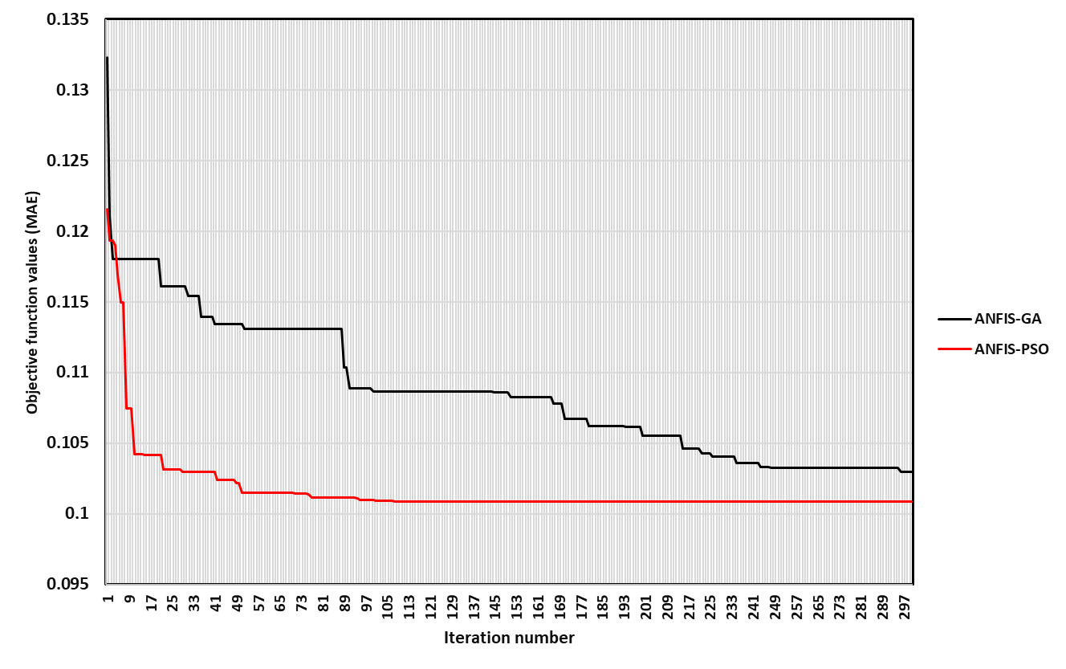
Validation of Models
AUC validation curves of ANFIS models for (a) training and (b) testing results
(a)
(b)
Variation curves of objective function values produced from ANFIS-MOA models.

Slide 12
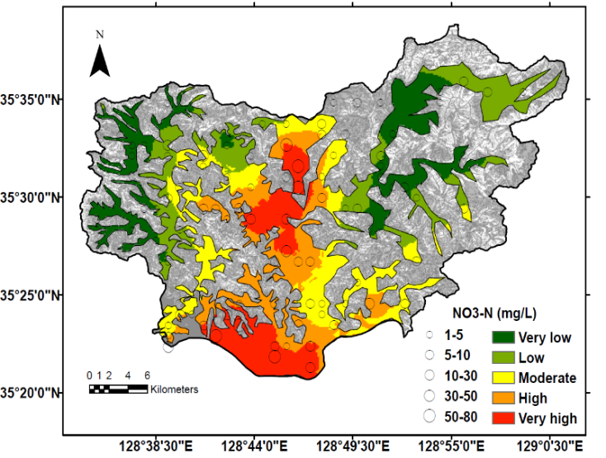
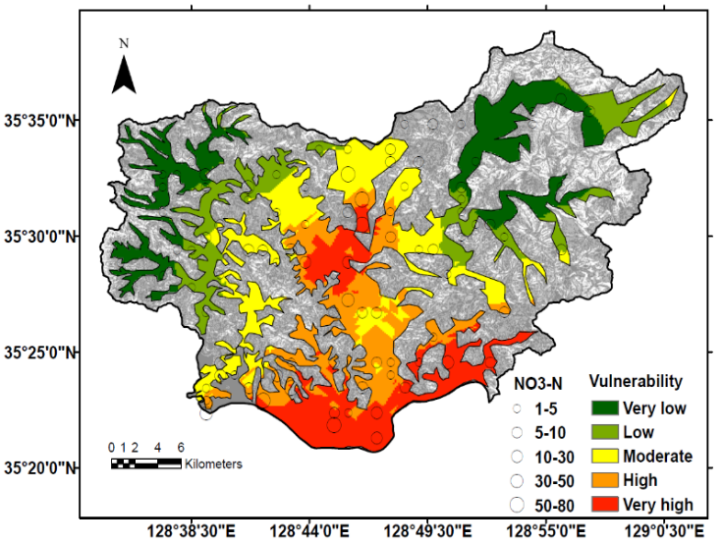
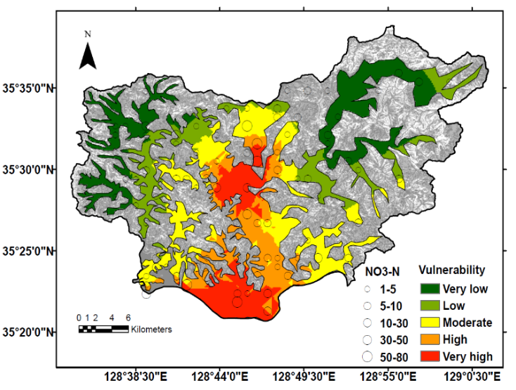
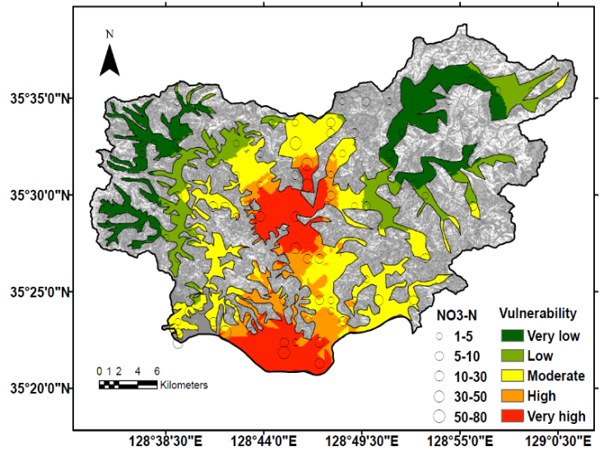
Groundwater contamination (nitrate) vulnerability maps (a) Original NO₃-N, (b) Original ANFIS, (c) ANFIS-GA, (d) ANFIS-PSO.
(a)
(b)
(c)
(d)

Slide 13
Conclusions (1)
This study used adaptive neuro-fuzzy inference system (ANFIS) combined with metaheuristic optimization algorithms (MOA) of genetic algorithm (GA) and particle swarm optimization (PSO) to assess groundwater contamination (NO₃-N) vulnerability in Miryang, City, South Korea.
8 parameters (Depth to water, net Recharge, Aquifer type, Soil media, Topographic slope, Impact to vadose zone, hydraulic Conductivity and Landuse) were classified into numerical ratings to be used as input variables of ANFIS-MOA models.
ANFIS, ANFIS-PSO and ANFIS-GA used 95 measured NO₃-N concentrations from monitoring wells for the training (70% data) and testing (30% data) purposes.

Slide 14
Conclusions (2)
The model performance was verified by the statistical data of MAE, RMSE and correlation coefficient, and it was also verified by ROC/AUC curve. ANFIS-PSO showed the highest performance in the testing results (MAE= 0.318; RMSE=0.478; R=0.851; AUC=0.893) in comparison with ANFIS-GA (MAE=0.333; RMSE=0.491; R=0.717; AUC=0.821) and Original ANFIS (MAE=0.637; RMSE=0.890; R=0493; AUC=0.643).
Integrated studies of statistical errors, objective function values, ROC/AUC curve and groundwater contamination (NO₃-N) vulnerability maps revealed that ANFIS-PSO model was the most superior in predicting groundwater contamination vulnerability in Miryang City of South Korea.

Slide 15
Thank You !

