Slide 1
Seismic Tomography using Variational Inference
Xin Zhang and Andrew Curtis

Slide 2
Contents
Variational inference
Automatic differential variational inference (ADVI)
Stein variational gradient descent (SVGD)
Synthetic tests + Application to data from Grane, North Sea
Variational full-waveform inversion

Slide 3
Bayesian Inference
Bayes’ theorem
$m=$ model , $d_{obs}=$ data

Slide 4
Variational Inference
Variational methods replace stochastic sampling with optimisation of probability distributions
Strategy 1: fit semi-analytic functions to $p(m|d)$
- Choose family of pdfs $q(m,φ)$, $φ$=parameters
- Optimise $φ$ s.t. $q(m|φ)≅p(m|d)$
Define a measure of difference between $q$ and $p$; then minimize it.
Strategy 2: generate a set of samples of $p(m|d)$ by optimisation
← optimisation
[e.g., Gaussian: $φ$=mean, covar]
Distributed according to $q$

Slide 5
Variational Inference
KL divergence measures difference between $q$ and $p$:
$$KL\left[q||p\right] =E_{q(m)}\left[\log{q(m|φ)}\right]−E_{q(m)}\left[\log{p\left(m,d\right)}\right]+\log{p(d)}$$
KL $≥0$ and KL $=0$ when $q=p$.
$$KL\left[q||p\right]+E_{q(m)}\left[\log{p\left(m,d\right)}\right]−E_{q\left(m\right)}\left[\log{q\left(m | φ\right)}\right]=\log{p(d)}$$
Evidence lower bound (ELBO)
$$ELBO\left(q\right)= E_{q(m)}\left[\log{p\left(m,d\right)}\right]−E_{q\left(m\right)}\left[\log{q\left(m | φ\right)}\right]$$
➔ Maximise ELBO ➔ minimises KL divergence (difference) between $q$ and $p$.
log(evidence) : intractable
Rearrange…
log(evidence) : constant w.r.t. $q$
Expectations w.r.t. $q$ which we choose

Slide 6
Automatic Differential Variational Inference (ADVI)
Transform constrained parameter $m$ to real space: $θ=T(m)$
In transformed space assume a Gaussian distribution:
$$q\left(θ;φ\right)=Normal(θ|μ,LL^{T})$$
Standardize the normal distribution: $η=S_{φ}(θ)$ (simplify math)
$$q\left(η\right)=Normal(η|0,I)$$
Gradient of ELBO w.r.t. pdf parameters can be calculated:
$$∇_{μ}ℒ=E_{N(η)}[∇_{m}logp\left(d,m\right)∇_{θ}T^{−1}\left(θ\right)+∇_{θ}\log\left|detJ_{T^{−1}}\left(θ\right)\right|]$$
$$∇_{L}ℒ=E_{N(η)}\left[(∇_{m}logp\left(d,m\right)∇_{θ}T^{−1}\left(θ\right)+∇_{θ}\log\left|detJ_{T^{−1}}\left(θ\right)\right|)η^{T}\right]+{(L}^{−1})^{T}$$
Maximize ELBO $ℒ$ w.r.t $μ$ and $L$ using gradient ascent
Standard gradients (as used in linearised inversion)
Kucukelbir et al., 2017 JMLR

Slide 7
Automatic Differential Variational Inference (ADVI)
Transform constrained parameter $m$ to real space: $θ=T(m)$
In transformed space assume a Gaussian distribution:
$$q\left(θ;φ\right)=Normal(θ|μ,LL^{T})$$
Standardize the normal distribution: $η=S_{φ}(θ)$ (simplify math)
$$q\left(η\right)=Normal(η|0,I)$$
Gradient of ELBO w.r.t. pdf parameters can be calculated:
$$∇_{μ}ℒ=E_{N(η)}[∇_{m}logp\left(d,m\right)∇_{θ}T^{−1}\left(θ\right)+∇_{θ}\log\left|detJ_{T^{−1}}\left(θ\right)\right|]$$
$$∇_{L}ℒ=E_{N(η)}\left[(∇_{m}logp\left(d,m\right)∇_{θ}T^{−1}\left(θ\right)+∇_{θ}\log\left|detJ_{T^{−1}}\left(θ\right)\right|)η^{T}\right]+{(L}^{−1})^{T}$$
Maximize ELBO $ℒ$ w.r.t $μ$ and $L$ using gradient ascent
Expectations calculated by MC. But sampling N(0,1) → low number of samples (even 1)
Kucukelbir et al., 2017 JMLR

Slide 8
Automatic Differential Variational Inference (ADVI)
Parameters m
Unconstrained variable θ
Standardized variable η
Parameters m
Unconstrained variable θ

Slide 9
Transform
$$θ_{i}=\log\left(m_{i}−a\right)−log⁡(b−m_{i})$$
where $a$ and $b$ are lower and upper bounds

Slide 10
Variational Inference based on Invertible Transforms
Approximate posterior p using a series of transforms:
$q_{n}=T_{n}⋯T_{1}T_{0}(q_{0})$
Optimize transform by minimizing KL divergence between $q_{n}$ and posterior $p\left(m|d\right)$

Slide 11
Stein Variational Gradient Descent(SVGD)
Assume a transformation $T\left(m\right)=m+εφ(m)$
$$∇_{ε}KL[q_{\left[T\right]}|\left|p\right]|_{ε=0}=−E_{m\sim q}[trace\left(A_{p}φ\left(m\right)\right)]$$
where $A_{p}φ\left(m\right)=∇_{m}logp\left(m|d\right){φ(m)}^{T}+∇_{m}φ(m)$
$φ^{∗}$ that maximizes the negative gradient:
$$φ_{q,p}^{∗}\left(m\right)=E_{m^{′}\sim q}[k\left(m^{′},m\right)∇_{m^{′}}logp\left(m^{′}|d\right)+∇_{m^{′}}k\left(m^{′},m\right)]$$
where k is a kernel, e.g. a radial basis function kernel:
$k\left(m,m^{′}\right)=exp⁡(−\frac{1}{h}{\left\|m−m^{′}\right\|}^{2}$)
m
$$φ^{∗}$$
Standard gradients (as used in linearised inversion)
Liu and Wang, 2016 arXiv.

Slide 12
Stein Variational Gradient Descent(SVGD)
Input: A target distribution $p(m)$ and a set of initial particles ${\{m_{i}^{0}\}}_{i=1}^{n}$
for iteration j do
$$m_{i}^{j+1}←m_{i}^{j}+ε_{j}φ^{∗}(m_{i}^{j})$$
where
$$φ^{∗}\left(m\right)=\frac{1}{n}\sum_{k=1}^{n}{[k\left(m_{k}^{j},m\right)∇_{m_{k}^{j}}logp\left(m_{k}^{j}\right)+∇_{m_{k}^{j}}k(m_{k}^{j},m)]}$$
Output: A set of particles ${\{m_{i}\}}_{i=1}^{n}$whose density approximates the target distribution
Found by optimisation rather than stochastic sampling.
- Faster, parallelizable, more scalable
→
→
Liu and Wang, 2016 arXiv.

Slide 13
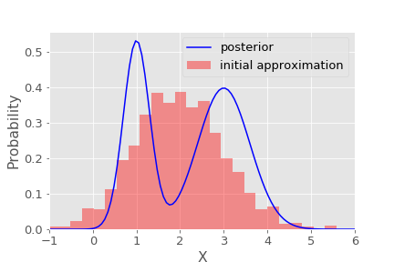
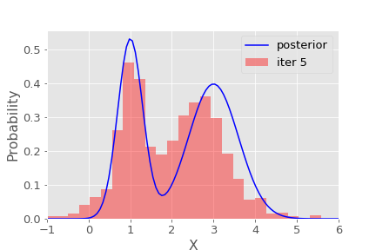
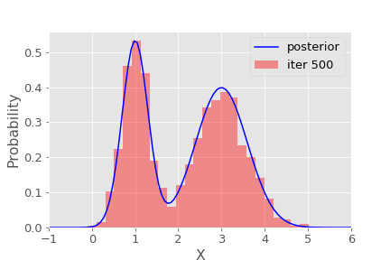
SVGD
(a)
Initial
500 particles
(b)
Target probability
Iteration 5
Histogram of particles
(c)
Iteration 500

Slide 14
Metropolis-Hastings

Slide 15
SVGD

Slide 16
SVGD
Samples distributed to represent
posterior pdf optimally

Slide 17
Synthetic tests

Slide 18
Synthetic tests
Each receiver is treated as a virtual source
Fast marching method for forward modelling travel times

Slide 19
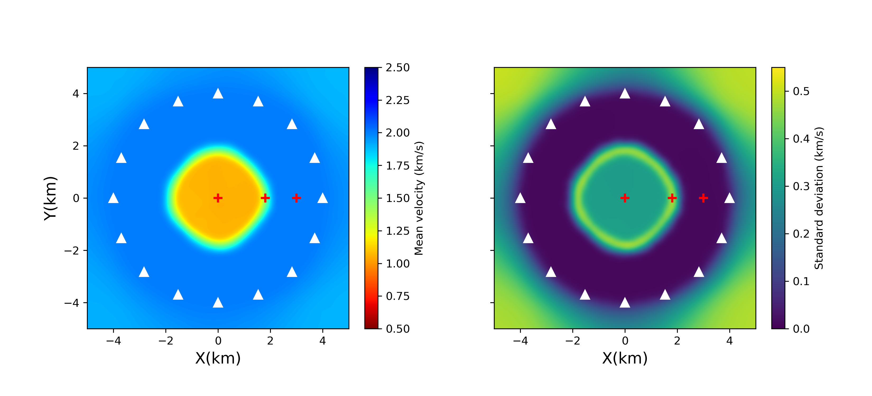
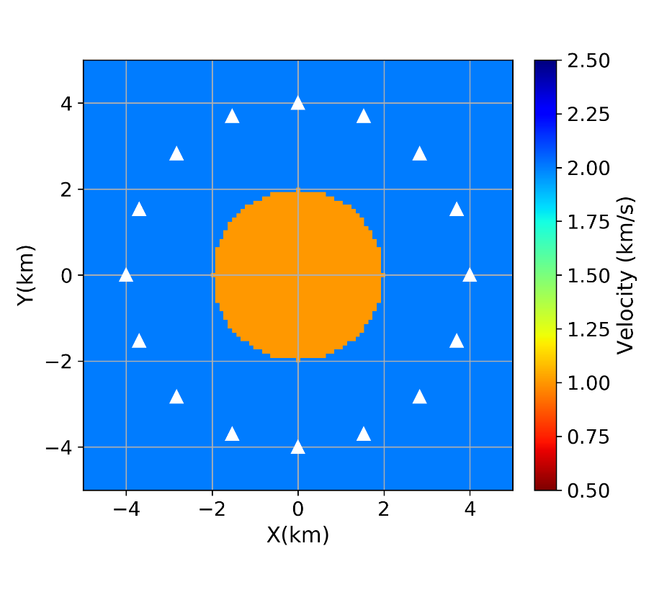
Reversible jump McMC
True model
Mean
Stdev
Parameterized by Voronoi cells

Slide 20
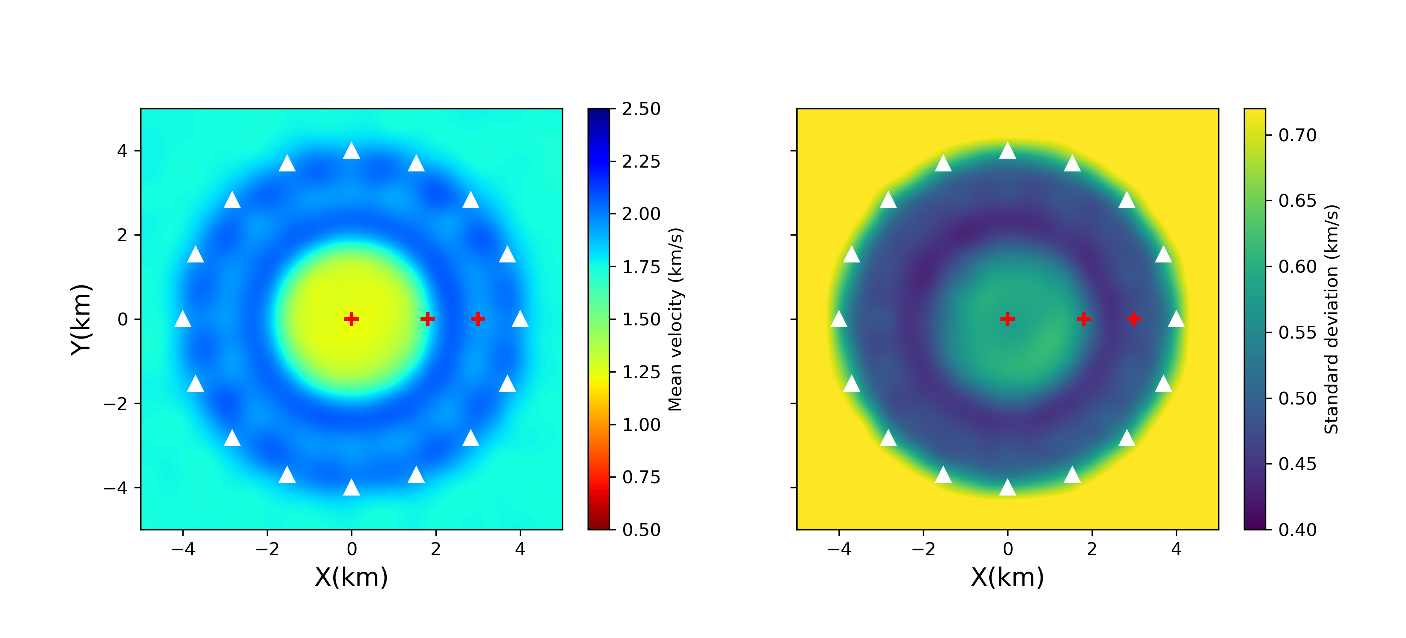
ADVI results
➔ Find the family of all models that fit travel time data
True model
Mean
Stdev
Parameterized by 21*21 grid

Slide 21
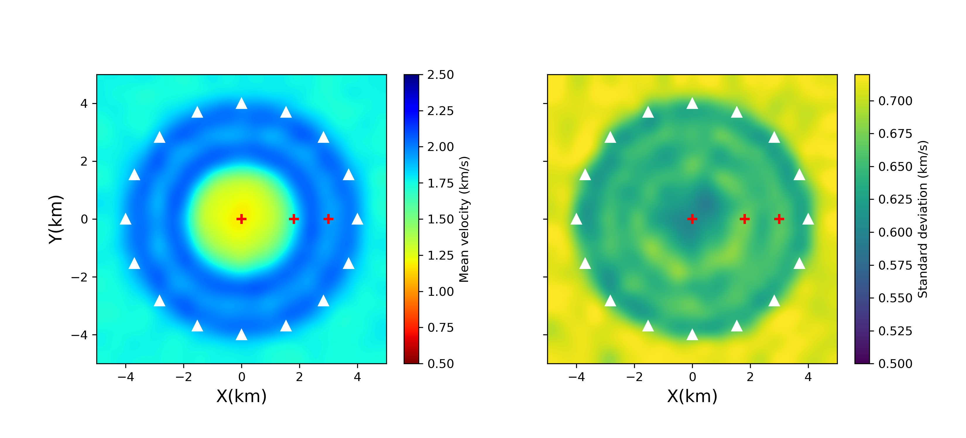
SVGD results
True model
Mean
Stdev
Parameterized by 21*21 grid

Slide 22
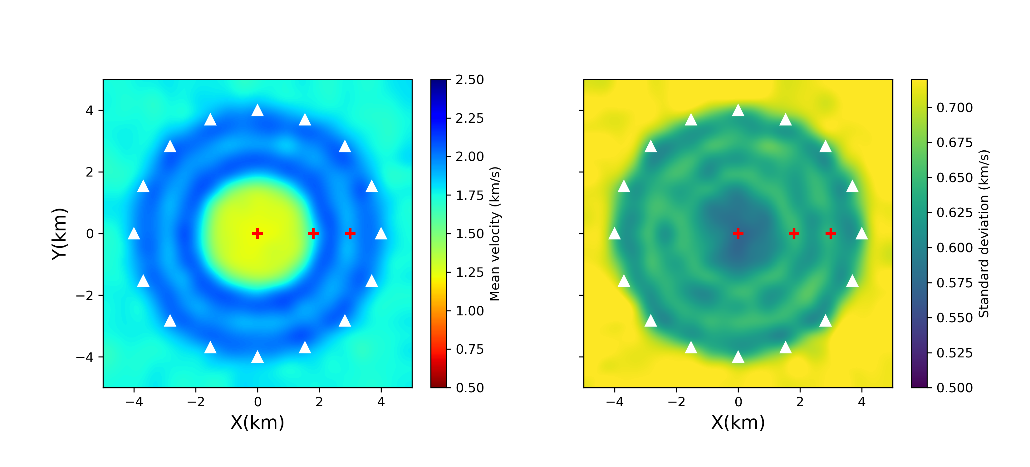
Metropolis-Hastings McMC
True model
Mean
Stdev
Parameterized by 21*21 grid

Slide 23
Reversible jump McMC
True model
Mean
Stdev
Parameterized by Voronoi cells

Slide 24
Reversible jump McMC
Prior info: Earth piecewise smooth!
True model
Model
Stdev
Parameterized by Voronoi cells

Slide 25
Reversible jump McMC
True model
Mean
Stdev
Parameterized by Voronoi cells

Slide 26
Marginal distribution

Slide 27
Marginal distribution
ADVI
SVGD
MH-McMC
rj-McMC
Interior Point (0.0,0)
Boundary Point (1.8,0)
Exterior
Point (3.0,0)

Slide 28
Computational cost
Methods | Number of simulations | CPU hours
ADVI | 10,000 | 0.45 (variational ADVI)
SVGD | 400,000 | 8.53 (variational SVGD)
MH-McMC | 6,000,000 | 410.3 (Metropolis-Hastings)
Rj-McMC | 3,000,000 | 102.6 (rj-McMC)

Slide 29
Application to Grane field
346 receivers
35 virtual sources
Phase velocity map at 0.9 s

Slide 30
ADVI
Mean
Stdev
10,000 forward modelling runs, 5.1 hours

Slide 31
SVGD
Mean
Stdev
500,000 forward modelling runs, 12.1 hours parallelized using 12 cores

Slide 32
rj-McMC
Mean
Stdev
Uncertainies much lower
for rj-McMC
(mostly dark blue)
Prior info: Earth piecewise smooth!
This is very informative.
But not true!
12,800,000 forward modelling runs, 5 days running on 16 cores

Slide 33
Computational cost
Methods | Number of simulations | CPU hours
ADVI | 10,000 | 5.1 (variational ADVI)
SVGD | 500,000 | 141.8 (variational SVGD)
Rj-McMC | 12,800,000 | 1,866.1 (rj-McMC)

Slide 34
Summary
Introduced two variational inference methods to seismic tomography
Automatic differential variational inference (ADVI)
Stein variational gradient descent (SVGD)
Compared with Metropolis-Hastings method and reversible jump method
Variational methods provide efficient alternatives to McMC
Comparison between 4 methods reveals: rj-McMC uncertainties are very different
Applied variational methods to Grane field
Higher resolution than rj-McMC

Slide 35
Variational Full-Waveform Inversion (VFWI)

Slide 36
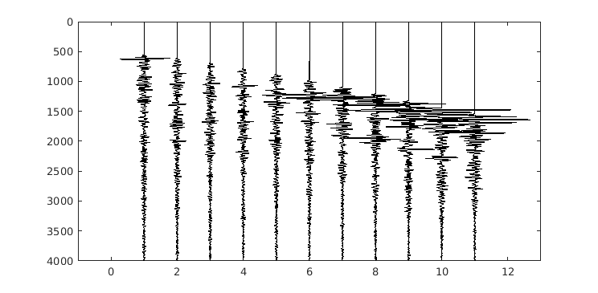
Full-waveform Inversion
Forward
Inversion
Choose m to minimize: $\left\|F\left(m\right)−d\right\|$

Slide 37
Bayesian Solution
Bayes’ theorem
$m=$ model , $d_{obs}=$ data
$p\left(d_{obs} | m\right)∝ e^{−φ(m)}$, where $φ(m)$is a misfit function

Slide 38
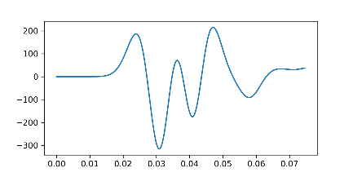
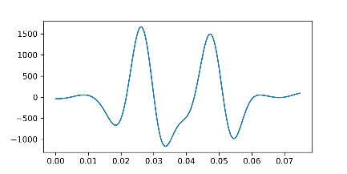
Synthetic examples
Fully elastic model
Two component data (x,z)
7 earthquake sources, 19 receivers
180*60*3 free parameters (Vp, Vs, density)
Uniform priors
Vp: 2000 $±100 m/s$
Vs: 800 $±50 m/s$
Density: 1500 $±100 kg/m^{3}$
Test case chosen for comparison with previous Hamiltonian-MC study
50 Hz
Vp
50 Hz
Vs
Density
Gebraad et al., 2019 EarthArXiv

Slide 39
Synthetic examples
X-component Data
Likelihood: (L2 norm in time domain)
$$p\left(d_{obs} | m\right)∝ e^{−φ(m)}$$
$$φ\left(m\right)=\frac{1}{2}\sum_{i,j}{{\left(\frac{d_{ij,obs}−d_{ij}(m)}{σ_{ij}}\right)}^{2}}$$
where i is receiver number and j denotes time samples and $σ_{ij}=1$.

Slide 40
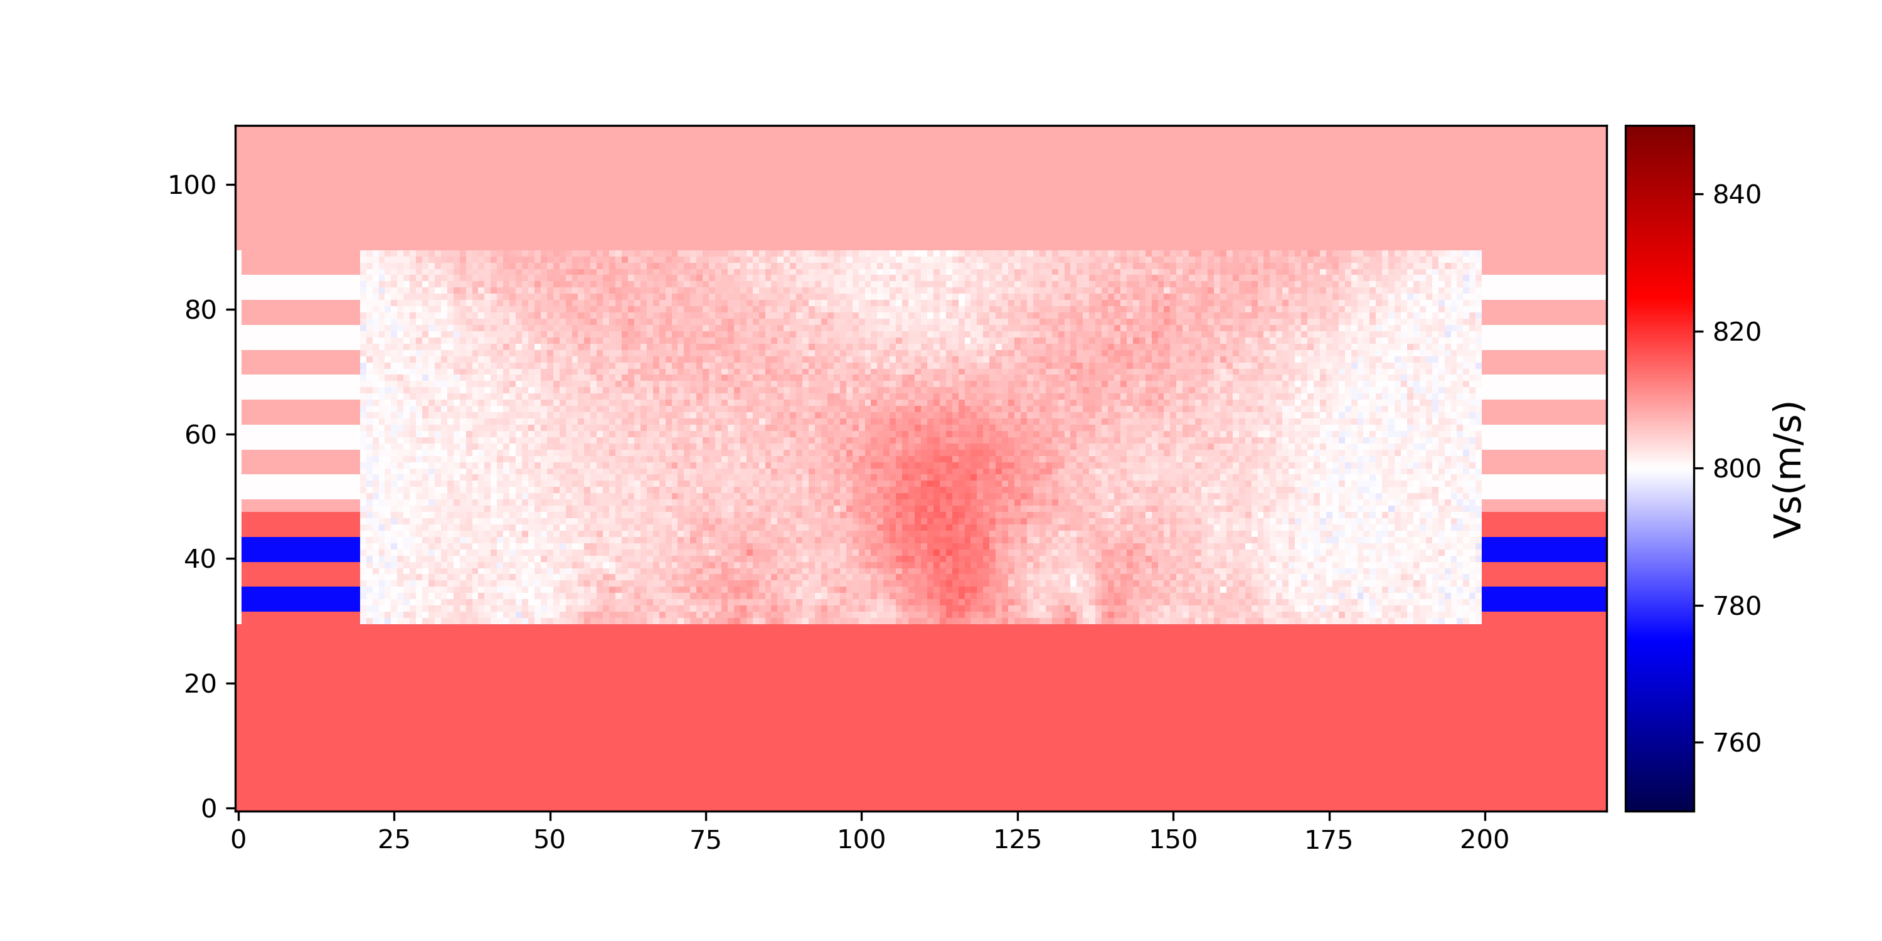
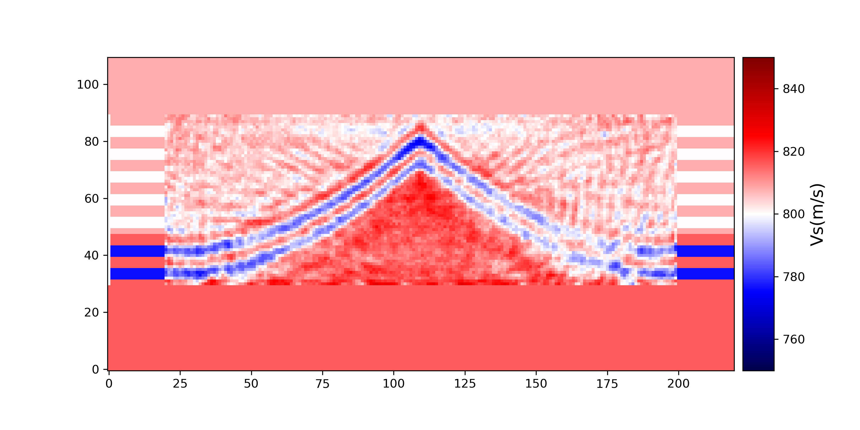
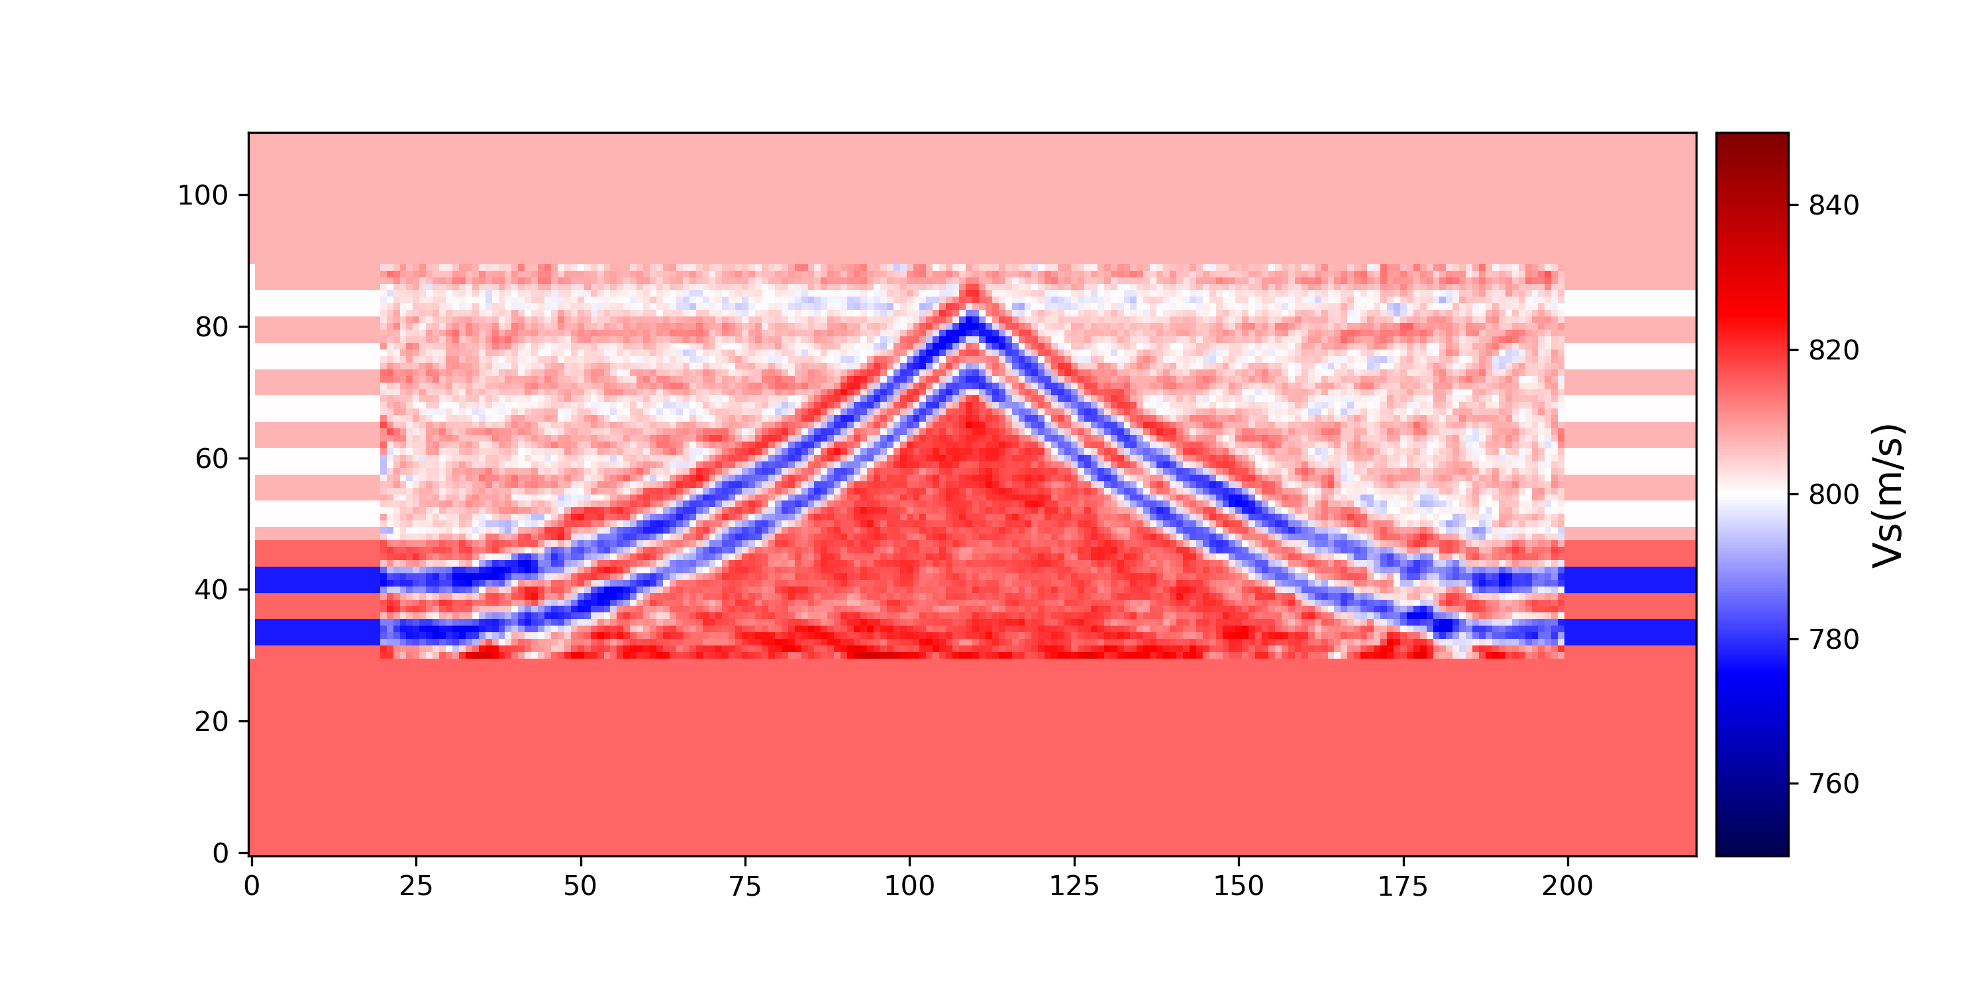
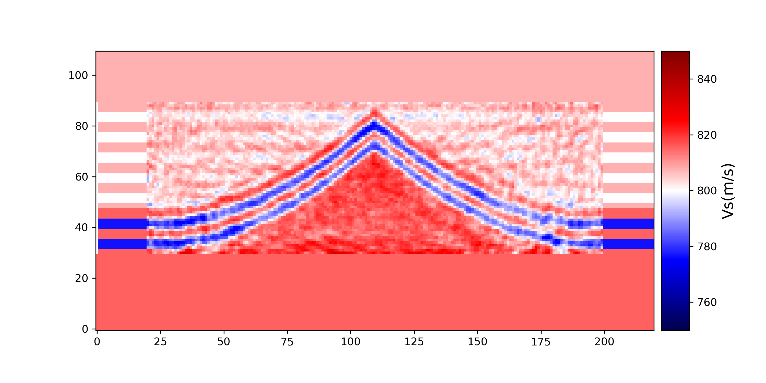
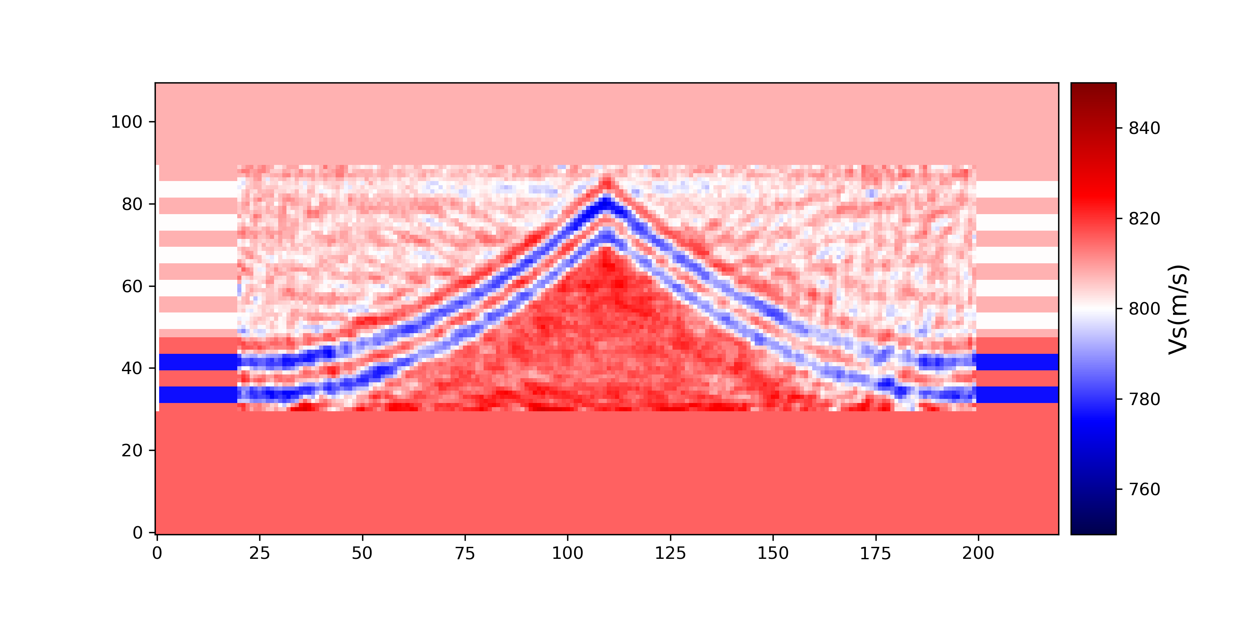
Iterations of SVGD
Prior Vs mean
Vs mean of iteration 100
Vs mean of iteration 200
Vs mean of iteration 600
Vs mean of iteration 400
Vs mean of iteration 300
Mean of 600 particles

Slide 41
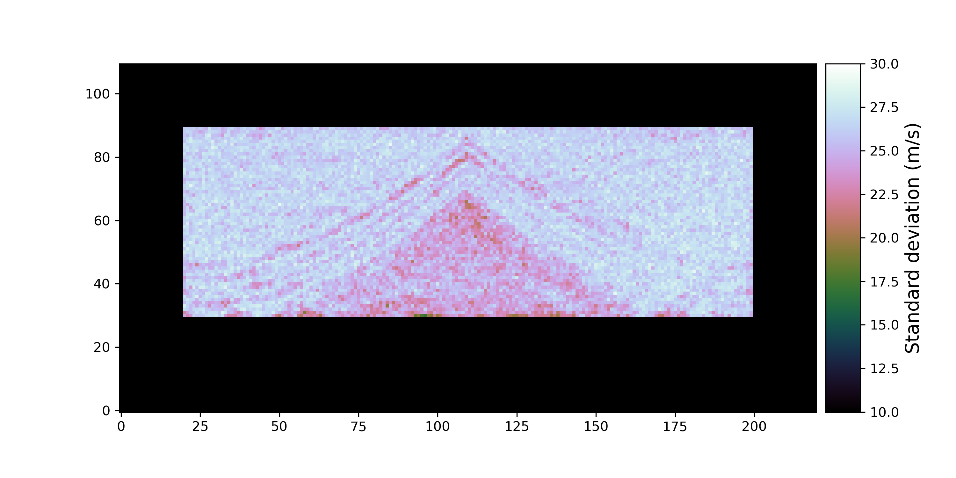
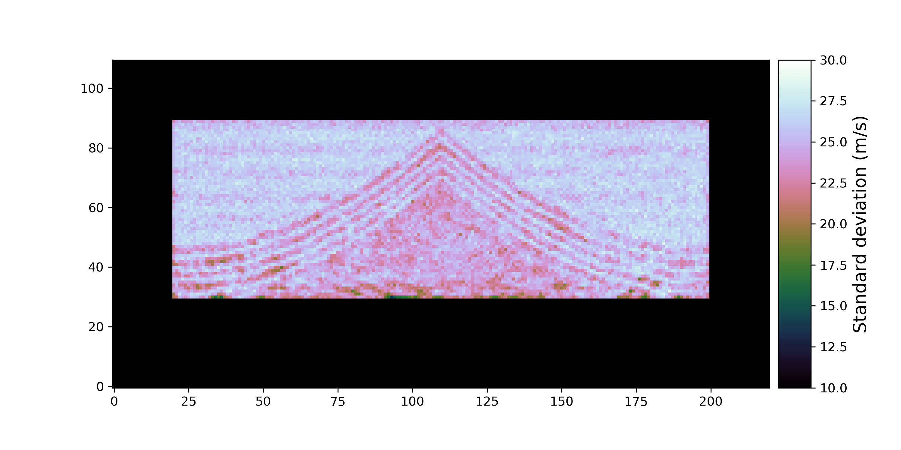
Number of particles
400 particles
600 particles
Mean Vs
Stdev Vs

Slide 42
Particles of SVGD

Slide 43
Results of SVGD
True model
Means
Standard deviation
Vp
Vs
Density
600 particles, 600 iterations, parallelized using 16 cores

Slide 44
Results of Hamiltonian Monte Carlo
True model
Means
Standard deviation
Vp
Vs
Density
1 chain, about 100,000 simulations, not parallelized
Gebraad et al., 2019 EarthArXiv

Slide 45
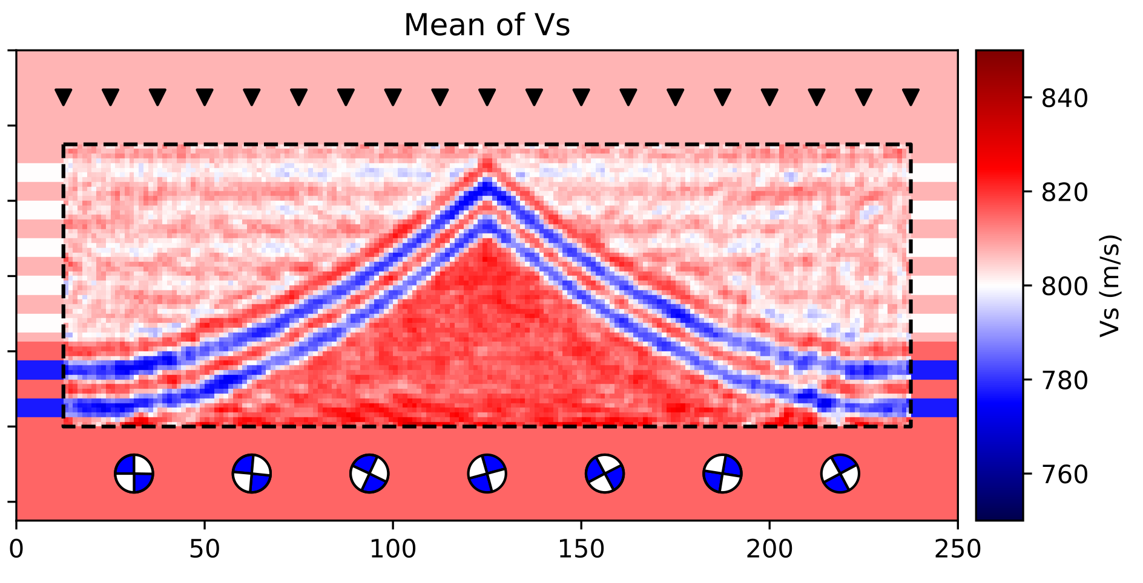
Comparison
Mean Vs from HMC
Mean Vs from SVGD
10,000 samples
600 samples

Slide 46
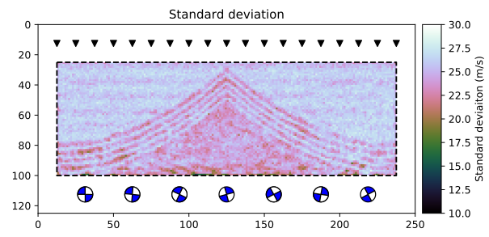
Comparison
Stdev Vs from HMC
Stdev Vs from SVGD
10,000 samples
600 samples
Random samples
Optimal samples

Slide 47
Comparison between SVGD and HMC
SVGD | HMC
Gradient based | Gradient based
Optimisation | Sampling
Accurate (converges asymptotically) | Accurate (converges asymptotically)
Easily parallelized | Cannot be fully parallelized within one chain
Can be applied to large data sets - minibatch optimisation | Cannot use minibatches
Easy to tune | Hard to tune [true number of samples likely >> quoted (100,000)]

Slide 48
Conclusion
Applied Stein variational gradient descent (SVGD) to full waveform inversion
Compared the results with HMC
SVGD provides accurate approximations to the results of HMC
HMC definitely has not converged
SVGD can be applied to larger data sets
Parallelization
Minibatches
Provides optimal samples to represent posterior pdf

Slide 49
Thank you

