Slide 1
Whistler precursor waves at quasi-perpendicular shocks.
Ahmad Lalti^{1,2}, Yuri Khotyaintsev¹, Daniel Graham¹, Andris Vaivads³, Andreas Johlander⁴, Roy Torbert⁵, Barbara Giles⁶, Chris Russell⁷, and Jim Burch⁸
¹Swedish Institute of Space Physics, Uppsala, Sweden
²Department of Physics and Astronomy, Uppsala University, Uppsala, Sweden
³Space and Plasma Physics, School of Electrical Engineering and Computer Science, KTH Royal Institute ofTechnology, Stockholm, Sweden
⁴Department of Physics, University of Helsinki, Helsinki, Finland
⁵University of New Hampshire, Durham, USA
⁶NASA Goddard Space Flight Center, Greenbelt, USA
⁷University of California, Los Angeles, USA
⁸Southwest Research Institute, San Antonio, USA
© Authors

Slide 2
Introduction:
The interaction between waves and particles, is proposed to be one of the main mechanisms for energy dissipation at collisionless shocks.
A particular type of waves that’s believed to play a major role in shock dynamics are whistler waves. They fall in a frequency range that allows interactions with both electrons and ions, making them important for energy transfer between the two species. They are also of dispersive character, which allows them to run upstream of the shock and interact with the solar wind beam heating it before reaching the shock.
The exact role of those whistler in shock dynamics is still under investigation.
And this was the motivation of the following project, to further explore the effect of whistle waves on quasi-perpendical collisionless shocks using data from the magnetospheric multiscale (MMS) spacecrafts.

Slide 3
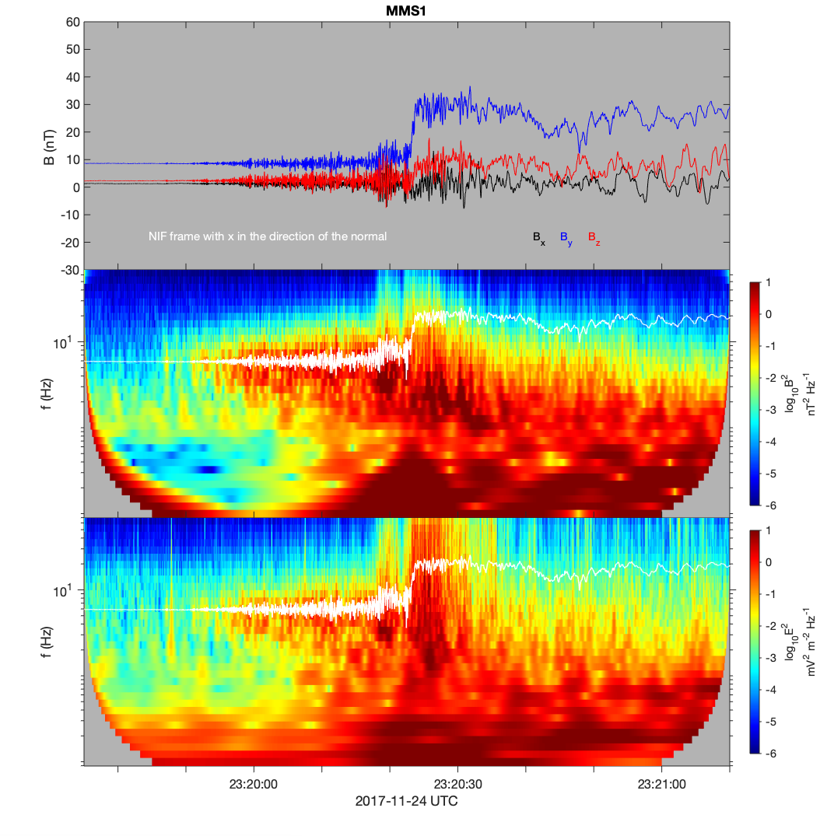
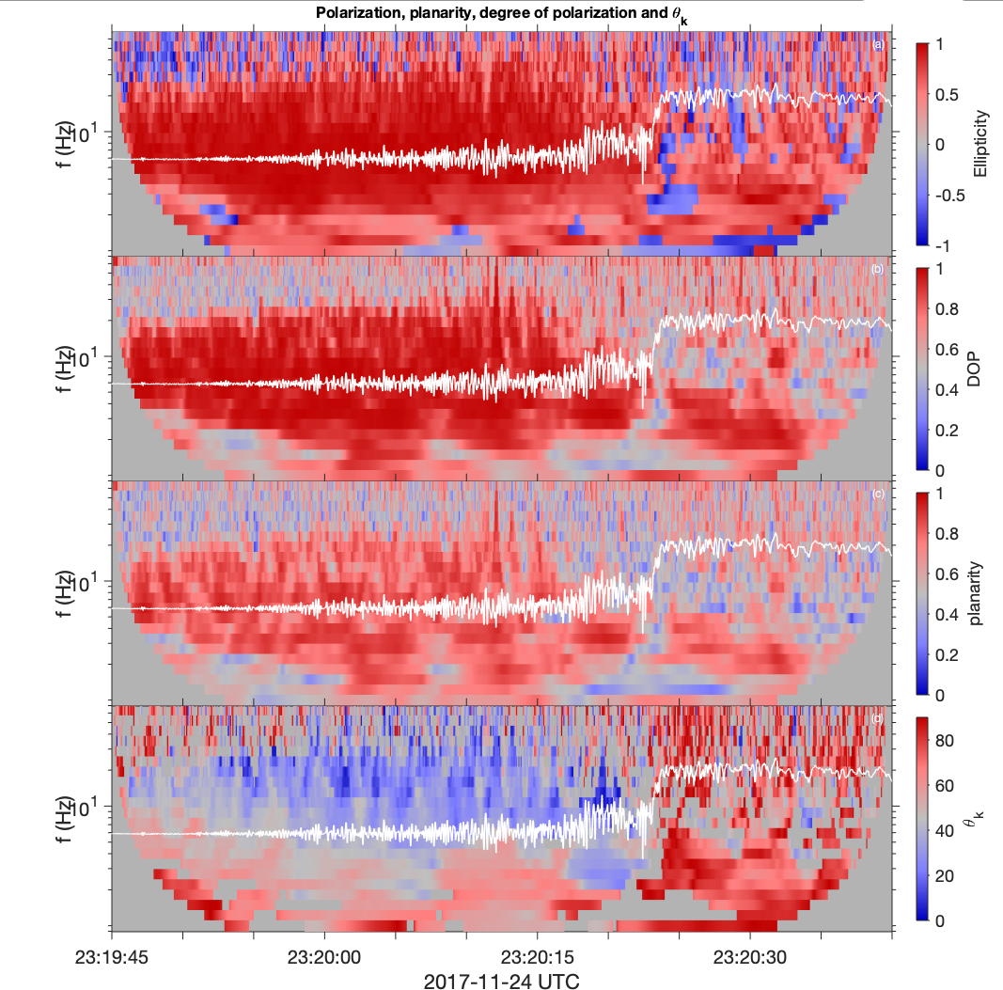
Example shock event:
Shock parameters:
From polarization analysis shown below, these waves are in the frequency range between the ion cyclotron and electron cyclotron frequencies.
$$f_{ci}<f_{wh}<f_{ce}$$
They are highly polarized, planar and right hand polarized.
From this it is clear that they are whistler waves.
n (in GSE) | [0.84 0.5 0.23]
$$θ_{Bn}$$ | 82º
$$M_{a}$$ | 3.25
B (nT)
Ellipticity
Lower hybrid frequency
Degree of polarization
B power spectrum
planarity
E power spectrum
$$θ_{k}$$

Slide 4
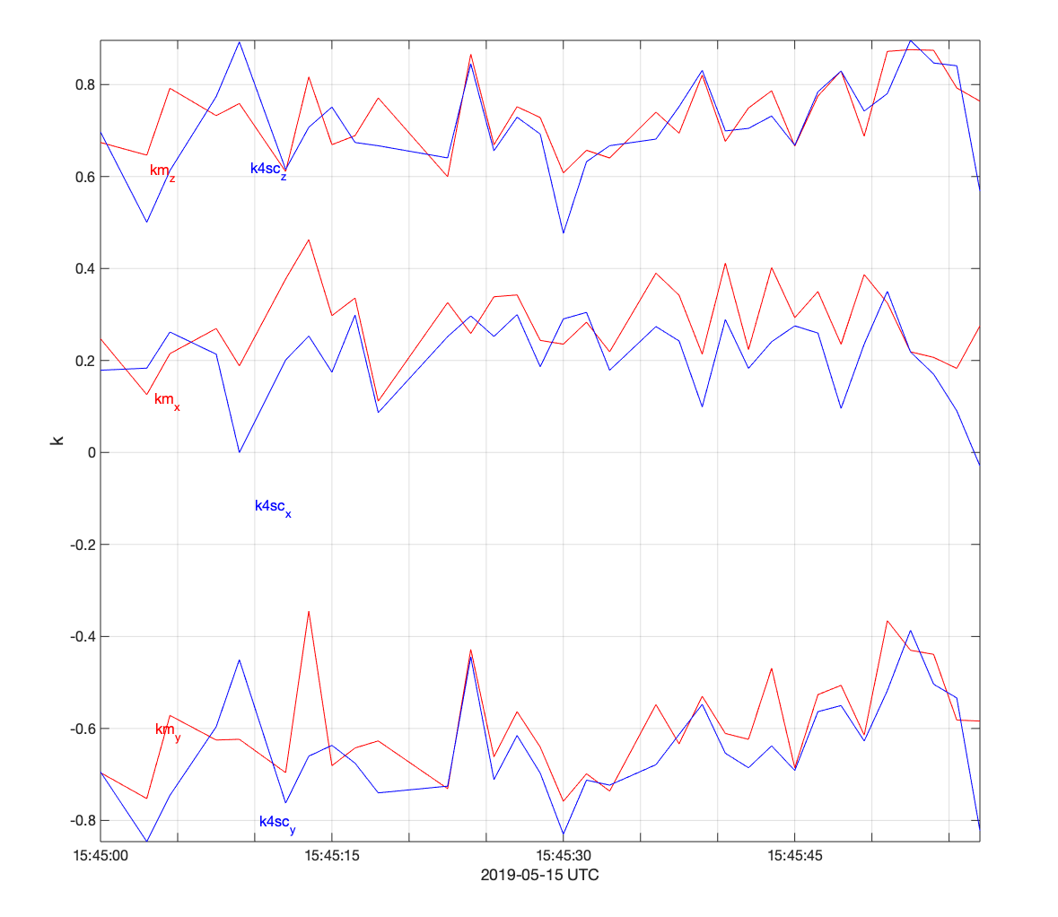
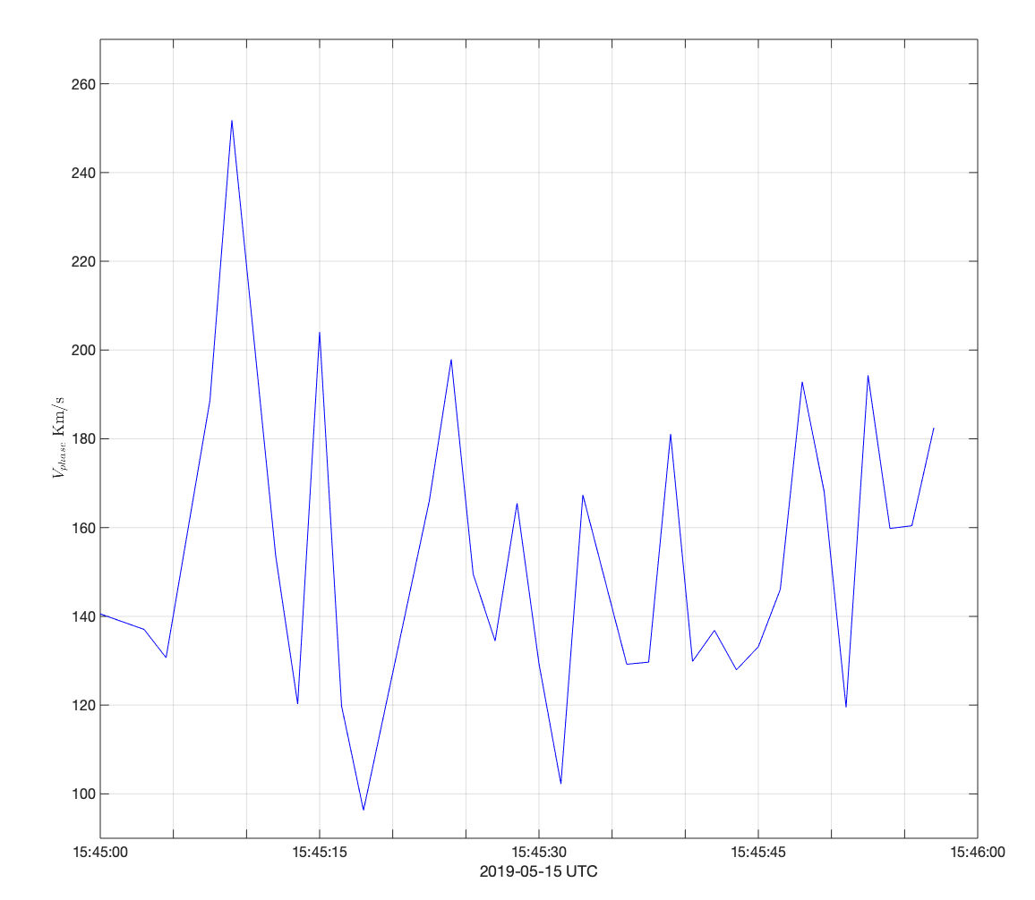
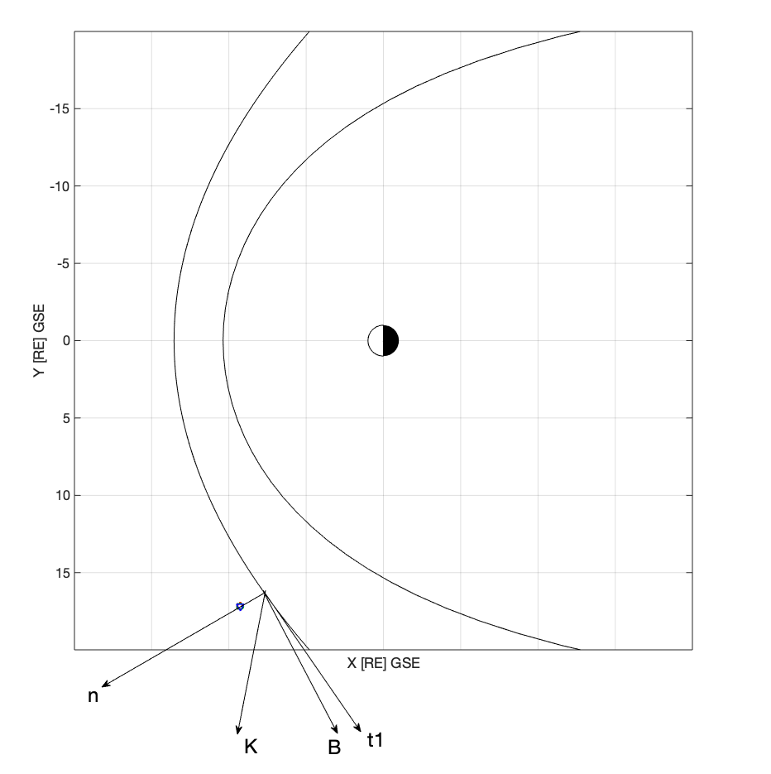
Spacecraft separation and instrumentations on board of MMS spacecrafts are suitable to fully characterize the observed waves.
Wave normal vector and phase velocity calculated from 4 spacecraft timing and from minimum variance for successive time intervals in the whistler region.
K_{z}
Resulting orientation of K in the shock coordinates
K_{x}
K components
V_{phase} [Km/s]
K_{y}
Using the above method we can, to very high confidence, get the following characteristics of the observed waves.
$$λ$$ | 77 [Km]
$$V_{p}$$ | 401 [Km/s]
$$θ_{Bk}$$ | 40º
F_{observed} | 5.57 [Hz]
Doppler Shift | -3.4 [Hz]
F_{plasma frame} | 8.97 [Hz]
$$t2=(\hat{n}×\vec{B})/\left|\vec{B}\right|$$
$$t1=(\hat{n}×\hat{t2})$$

Slide 5
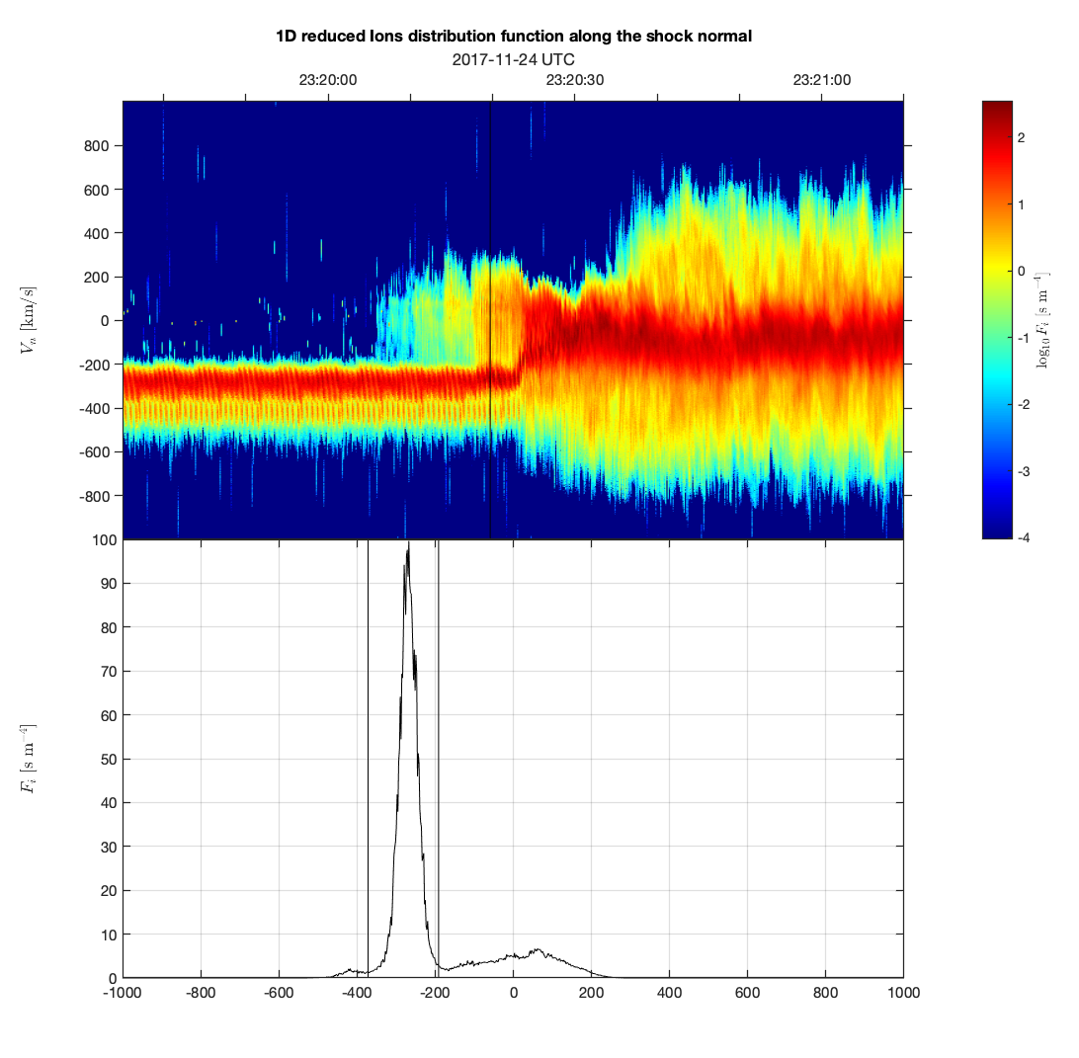
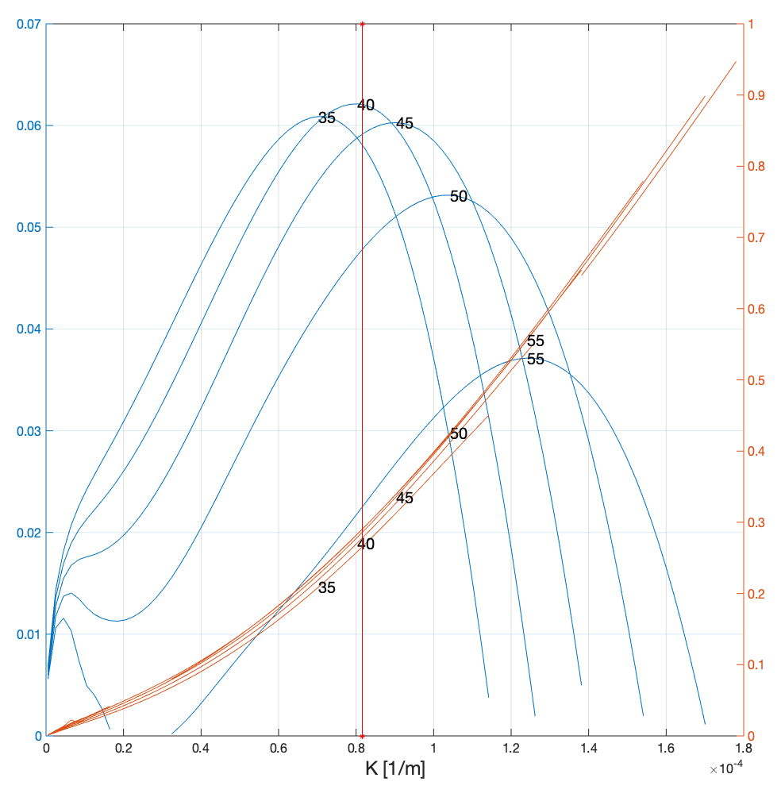
Source of the waves:
Next step is to explore the source of these waves, which will allow us to further understand what role they play in the energetics of the shock
From the reduced distribution function in the normal direction we can see a clear reflected ion component on top of the incoming solar wind beam.
In Wu 83 it was shown that an incoming ion beam and a reflected ion beam on top of a stationary electron beam is unstable under certain plasma conditions, and can generate oblique whistler waves.
To study the stability of such a system under the plasma conditions of the shock event we used Bo [Xie2016], a general kinetic dispersion relation solver.
Using the parameters of the shock we get the highest growth rate of a wave with:
$$θ_{kB}={40}^{o} , λ=78.5 Km, f_{r}=1.64 Hz$$
Reproducing those gotten from measurement ( shown in the previous slide) except for the frequency of the waves. Further investigation of the parametric dependence of this instability are underway.
Normalized growth rate and real frequency vs wave number for different wave normal angle $θ_{kb}$
$k_{observed}=8.16 × {10}^{−5}$[1/m]
$V_{n}$[Km/s]
$$γ/ω_{lh}$$
$$ω_{r}/ω_{lh}$$
$F_{ni} [s{.m}^{−4}]$
$V_{n}$[Km/s]

Slide 6
Summary
We are able to calculate, with high confidence, the wave normal angle${ θ}_{kB}$, phase velocity, wavelength and the doppler shift of whistler waves observed upstream of multiple shock crossing events observed by MMS.
Primary results shows that the kinetic cross field instability, describing the dynamics of an incoming solar wind ion beam, an incoming solar wind electron beam, and a reflected ion beam, is a possible source for the observed whistlers.

