Slide 1
A new similarity model for the stratified under-ice boundary layer in lakes and its application to ice-covered Lake Baikal
Georgiy Kirillin^{1*}, Ilya Aslamov², Nikolai Granin², and Roman Zdorovennov³
¹Leibniz-Institute of Freshwater Ecology and Inland Fisheries (IGB), Berlin, Germany; ²Limnological Institute, Siberian Branch of RAS, Irkutsk, Russia; ³Northern Water Problems Institute, Karelian Research Center RAS, Petrozavodsk, Russia

Slide 2
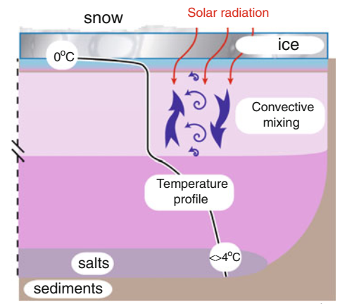

Slide 3
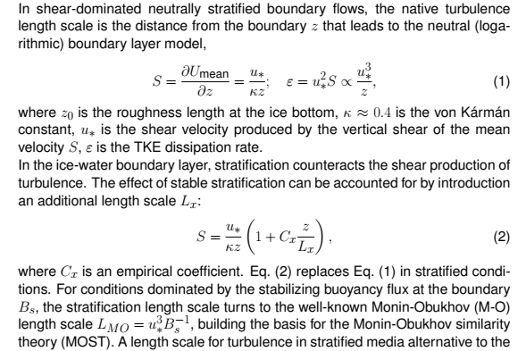
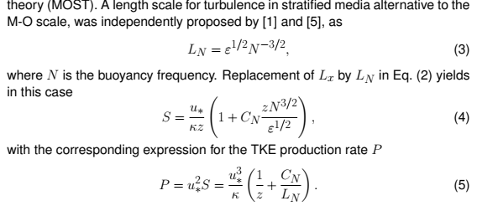

Slide 4
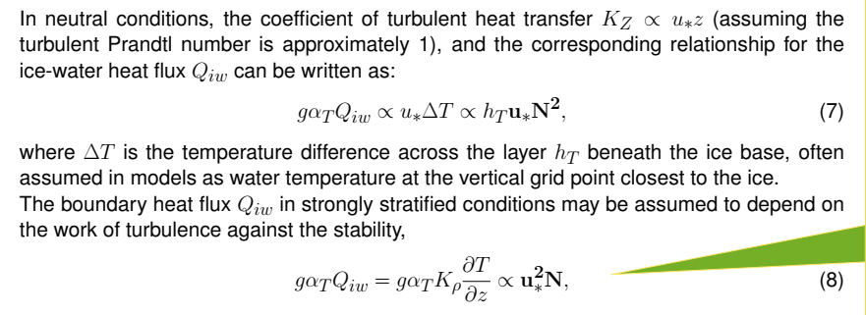

Slide 5
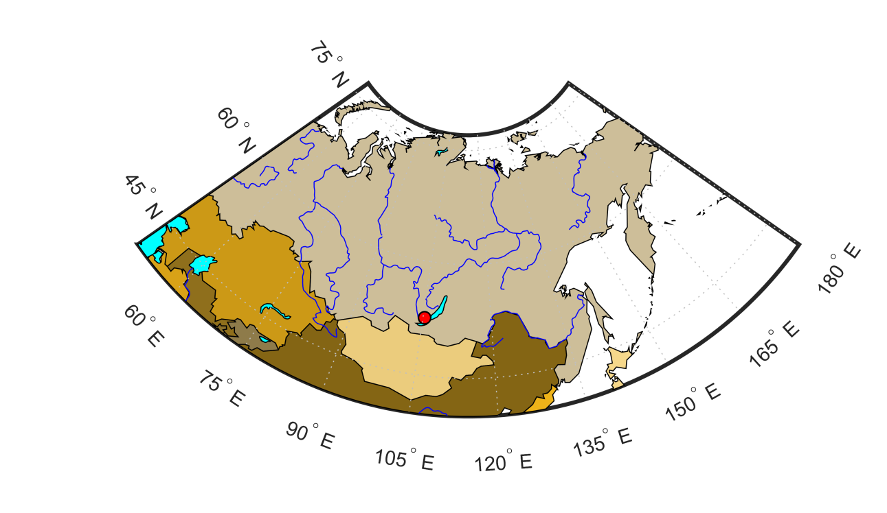
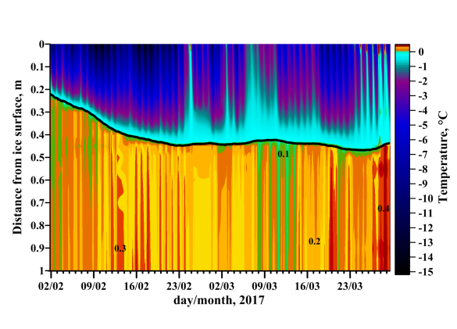
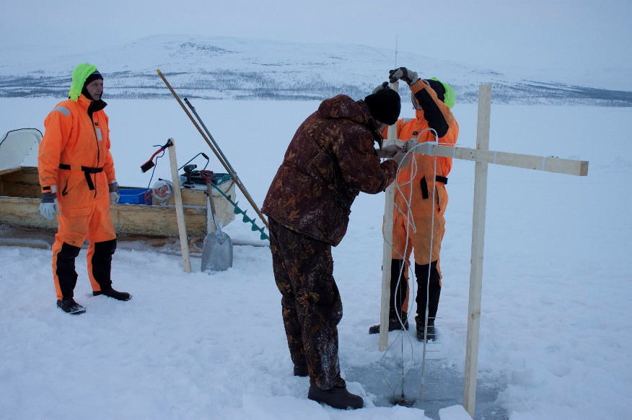
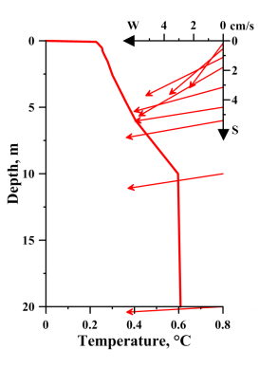
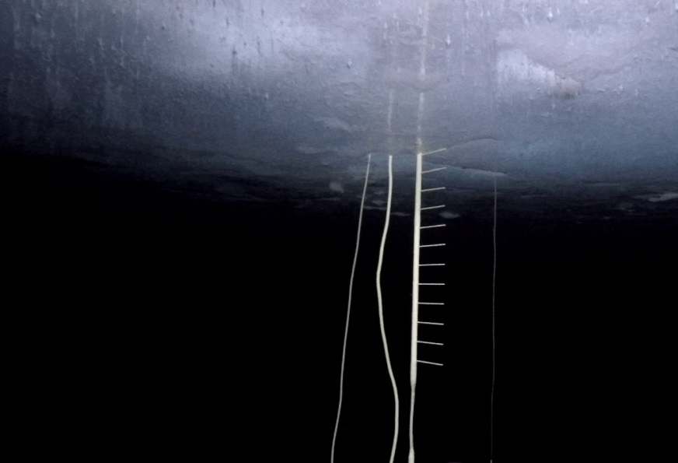
Study site
Installation of station on the ice cover and its underwater view.

Slide 6
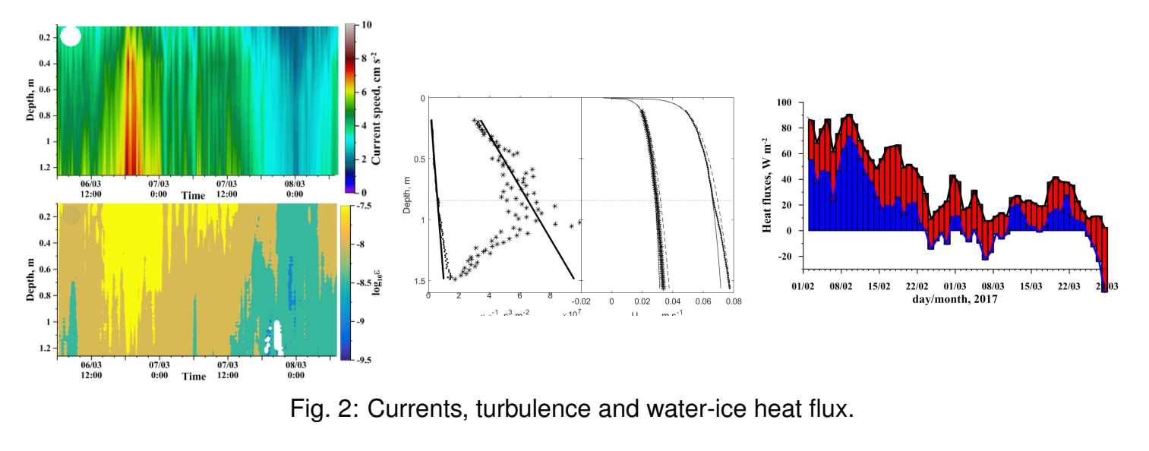
Mean current speed
Vertical profiles of ε and current speed in the boundary layer
Heat flux.
TKE dissipation rate ε

Slide 7
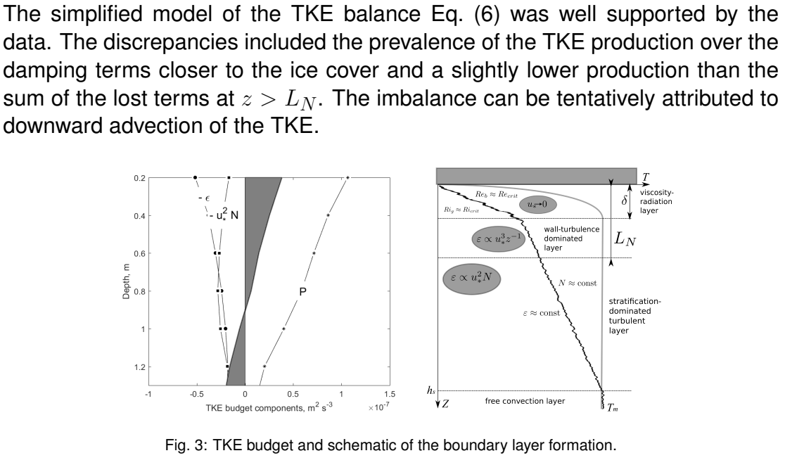

Slide 8
An important result!

Slide 9
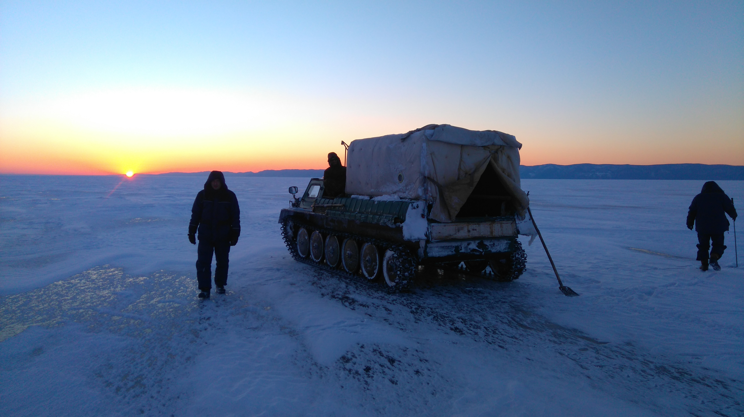
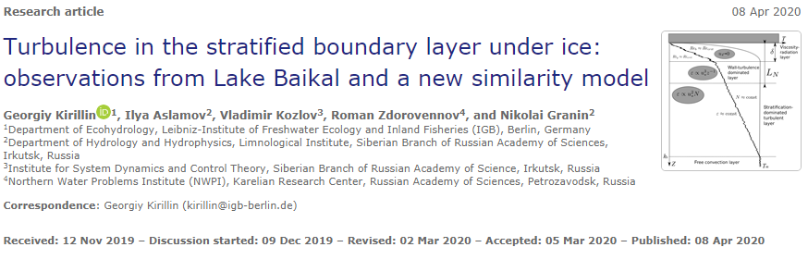
Conclusion
Hydrol. Earth Syst. Sci., 24, 1691–1708, 2020 https://doi.org/10.5194/hess-24-1691-2020

