Slide 1
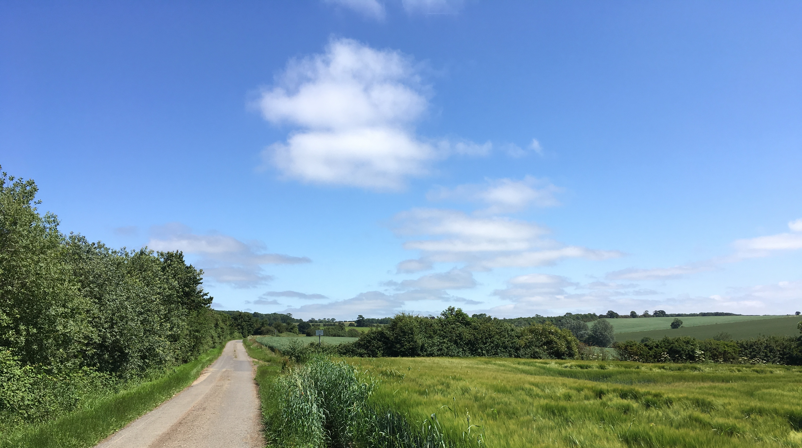
Do awareness-focussed approaches to mitigate diffuse pollution work? A study on combined behavioural and water quality evidence
Murat Okumah*, Pippa J. Chapman, Julia Martin-Ortega, Paula Novo, and Marie Ferré
ee15sa@leeds.ac.uk
European Geosciences Union – General Assembly (EGU2020)
8th May 2020

Slide 2
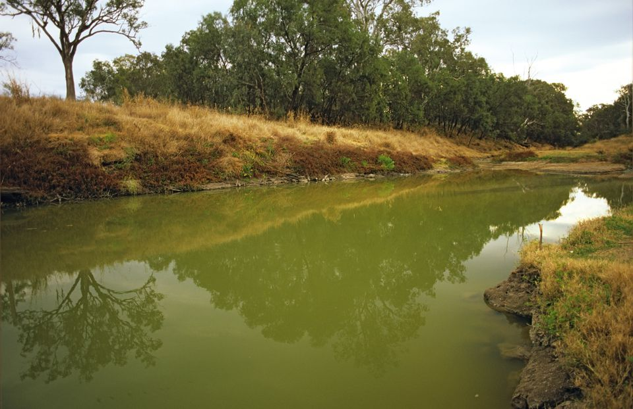
The problem
Diffuse water pollution from agriculture (DWPA) remains a key environmental problem.
DWPA is linked to management practices.
Understanding and influencing farmers’ behaviour is key to address management practices.
“Compared to treatment, preventing water pollution at source can have a cost-benefit ratio as high as 1:65”.
Notes:
BMPs = Best management practices

Slide 3
Problem continued....
Awareness
Uptake of BMPs
Improvement in water quality
Awareness-behaviour-water quality pathway?
Limited research examining the awareness-behaviour-water quality path.
This knowledge is urgently needed to support the development of effective policies.

Slide 4
Research questions
Does awareness affect farmers’ behaviour regarding uptake of BMPs?
Does uptake of BMPs lead to an improvement in water quality?
How does awareness interact with other factors that potentially influence uptake of BMPs?

Slide 5
Case study: Welsh Water’s weed wiper trial
In 2013, Welsh Water found that MCPA (2-methyl-4-chlorophenoxyacetic acid) concentrations were increasing in drinking water sources.
In 2015, weed wiper trial in 3 catchments in Wales (UK).
Free weed wiper hires; 167 farmers hired the weed wipers.
463 information packs distributed; 72% of total in the targeted catchments.
To increase farmers’ awareness on safe use of pesticides; encourage adoption of BMPs.
Ultimate goal is to prevent pesticides from entering into drinking water sources; improve water quality.
©Daltons ATV Ltd.
Notes:
Welsh Walter is the regional water utility operating in Wales (UK) and responsible for the continuous supply of high quality drinking water to over three million people as well as treating and properly disposing of the wastewater that is produced.
A weed wiper is a technology where a wick wetted with herbicide is suspended from a boom and dragged or rolled across the tops of the taller weed plants. This allows treatment of taller grassland weeds by direct contact, without affecting related but desirable shorter plants in the grassland sward beneath.
Compared to MCPA which takes 15 – 25 days to break down in water, glyphosate takes considerably less time (3 days) so it has less impact on watercourses (Welsh Water, 2014).

Slide 6
Methods
Mixed-methods approach consisting of:
Analysis of water quality data obtained from Welsh Water:
Data on MCPA concentration (3 treatment and 3 control catchments) from 2005 to 2019.
Catchments are of similar climate and land characteristics.
Factorial analysis of variance (ANOVA).
A content analysis of in-depth interviews:
6 institutional stakeholders.
16 farmers (8 participants of the trial and 8 non-participating farmers).

Slide 7
Results
MCPA concentration for both treatment and control catchments had reduced: treatment catchments (38.9%), control catchments (10%).
Difference between treatment and control catchments was statistically significant.
Significant difference in MCPA response post intervention between catchments.
Notes:
Catchments with more information packs also recorded more weed wiper hires and higher decline in MCPA concentration.

Slide 8
Results continued...
Psychosocial factors
Time and availability of resources
Agronomic factors
Finance/cost
Extent of adoption
Duration of adoption
External interventions
Differences in land uses
Awareness
Adoption of BMPs
MCPA concentration

Slide 9
Key conclusions
There is evidence on the awareness-behaviour-water quality pathway
However, the pathway is influenced by other psychosocial, agronomic factors and catchment characteristics
Awareness focussed approaches work!
But policy makers and catchment managers need to consider the role of other variables in their interventions
Limitations: some unknowns related to MCPA concentration
Despite existing limitations, this study opens a so far unexplored avenue in which water quality is explicitly linked to awareness and behaviour change
Notes:
Some unknowns that could have influenced MCPA concentration:
How much pesticide was used in the different catchments.
Number of farms in each catchment that swapped MCPA for other pesticides (including glyphosate).
Land use for each catchment - especially area of pasture.
Number of fields on which the weed wiper was used.
More data needed to help unpack the complexity of the pathway. Further research, involving large sample sizes, experimental designs and multivariate analytical techniques will be needed.

Slide 10
This research was funded by the University of Leeds International Doctoral Scholarship (LIDS) (2017-2020).
Many thanks to water@leeds and Welsh Water.
Thank you
Email: ee15sa@leeds.ac.uk

