Slide 1


The missing pieces for better future predictions in subarctic ecosystems: a Torneträsk case study
Didac Pascual, Jonas Åkerman, Marina Becher, Terry V. Callaghan, Torben R. Christensen, Ellen Dorrepaal, Urban Emanuelsson, Reiner Giesler, Dan Hammarlund, Edward Hanna, Annika Hofgaard, Hongxiao Jin,, Cecilia Johansson, Christer Jonasson, Jonatan Klaminder, Jan Karlsson, Erik Lundin, Anders Michelsen, David Olefeldt, Andreas Persson, Gareth K. Phoenix, Zofia Rączkowska, Riikka Rinnan, Lena Ström, Jing Tang, Ruth K. Varner, Philip A. Wookey & Margareta Johansson
Lund University
Department of Physical Geography and Ecosystem Science

Slide 2
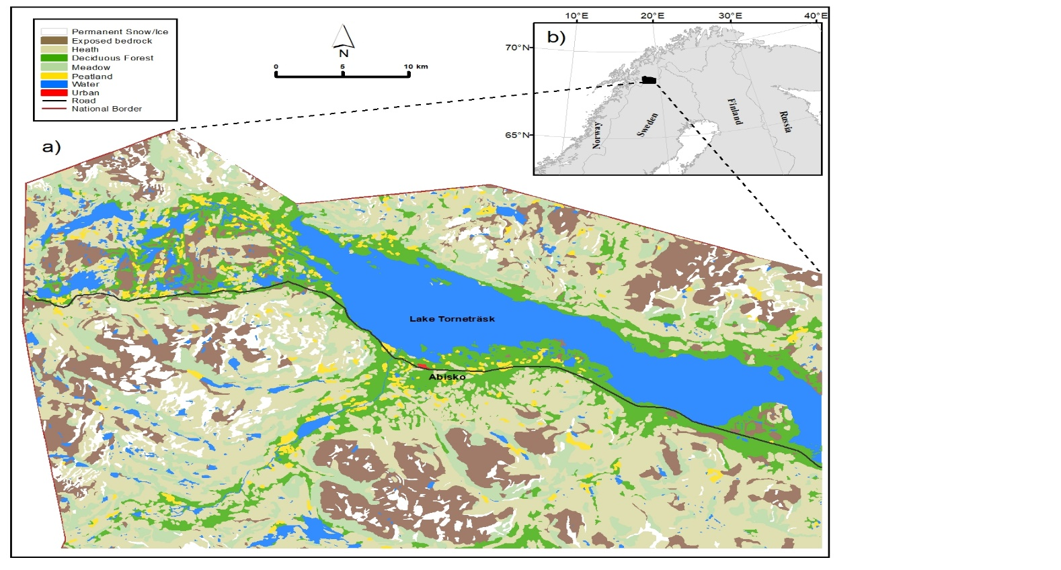
RESEARCH AIM
In the present study, we aim, based on expert opinion, to:
i) summarize and rank, in perceived importance, the direct and indirect drivers of ecosystem change in the Torneträsk area.
ii) identify research priorities, and propose studies that can help improve future predictions of ecosystem change in the study area and, potentially, in other arctic ecosystems.

Slide 3
METHODS. LITERATURE REVIEW
Five ecosystem components were explored: Local climate – Permafrost – Hydrology – Vegetation – Carbon Cycle
  Field and laboratory studies, modelling papers, and synthesis of multiple studies conducted in the Torneträsk area, were examined to identify:
  1) drivers (measurable variables) that are changing and having an impact on the ecosystem components above, and
  2) the underlying processes, or causal pathways, by which a driver could affect a specific ecosystem component.
  OUTCOME → A total of 30 drivers and >700 processes were identified.

Slide 4
METHODS. EXPERT ASSESSMENT
Online survey: 4 questions for each of the 30 drivers, answered by each expert concerning the ecosystem component they had expertise in:
  Q1 and Q2. IMPORTANCE → rank (1-9) the impact of each driver on the component concerned, for the period 2020-2040 (Q1) and 2040-2100 (Q2).
  Q3. NOVELTY → How well studied (1-9) are the impacts of a driver on the component concerned?
  Q4. EXPERTISE → Rank (1-5) your expertise in the previous questions.
  Suggestions of important studies were allowed.

Slide 5
METHODS. EXPERT ASSESSMENT
Table 1. Overview of the groups (n=5) of experts (n=27) participating in the Expert Assessment.

Slide 6
METHODS. DATA ANALYSIS
Responses by experts with expertise <2 were excluded.
All remaining responses for importance and novelty were normalized (0-10), and aggregated by averaging the normalized scores.
Drivers holding high perceived importance (>6) and novelty (>5) → Research Priorities.

Slide 7
Table 2. Summary of the most important drivers (with mean importance estimates calculated based on the experts’ responses from all groups; n=5), and research priorities (identified by number of components).
RESULTS. MOST IMPORTANT DRIVERS AND RESEARCH PRIORITIES

Slide 8
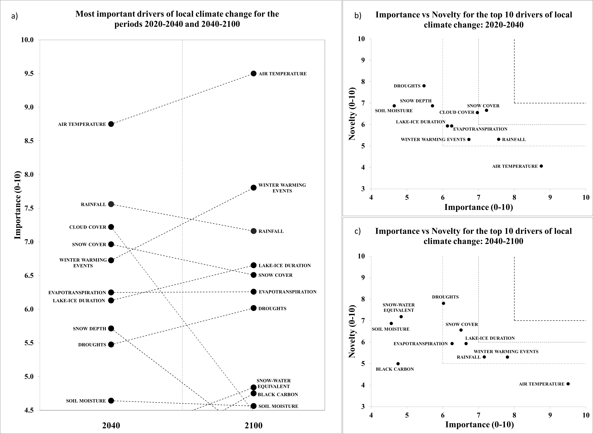
RESULTS. LOCAL CLIMATE

Slide 9
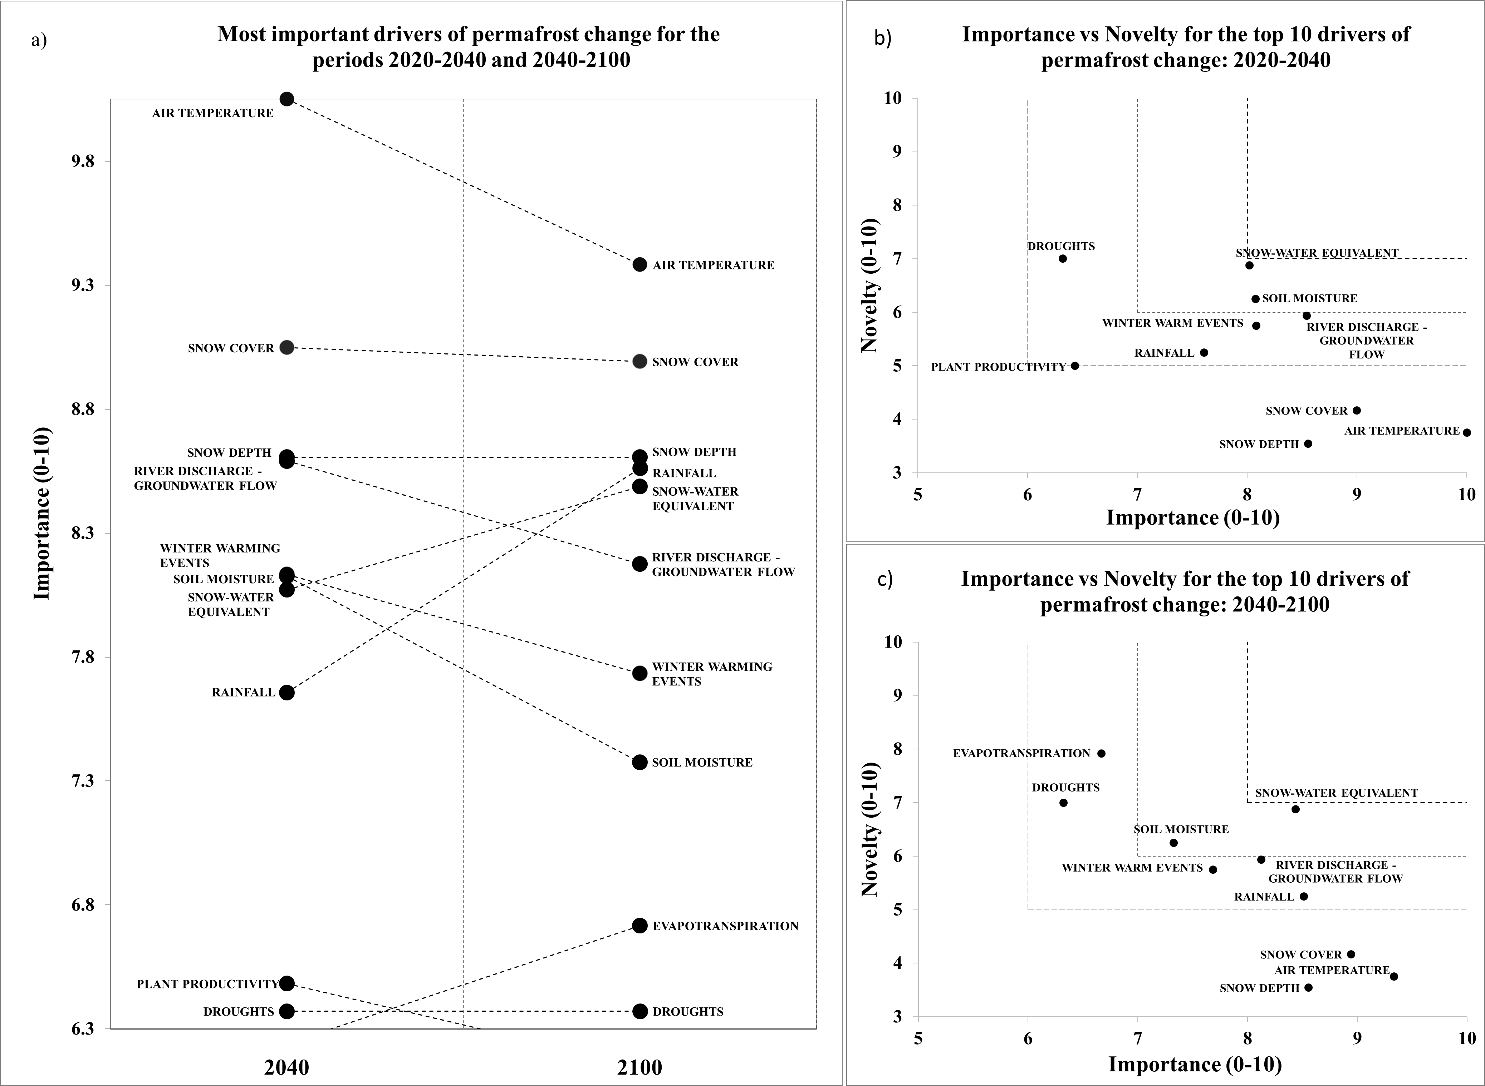
RESULTS. PERMAFROST

Slide 10
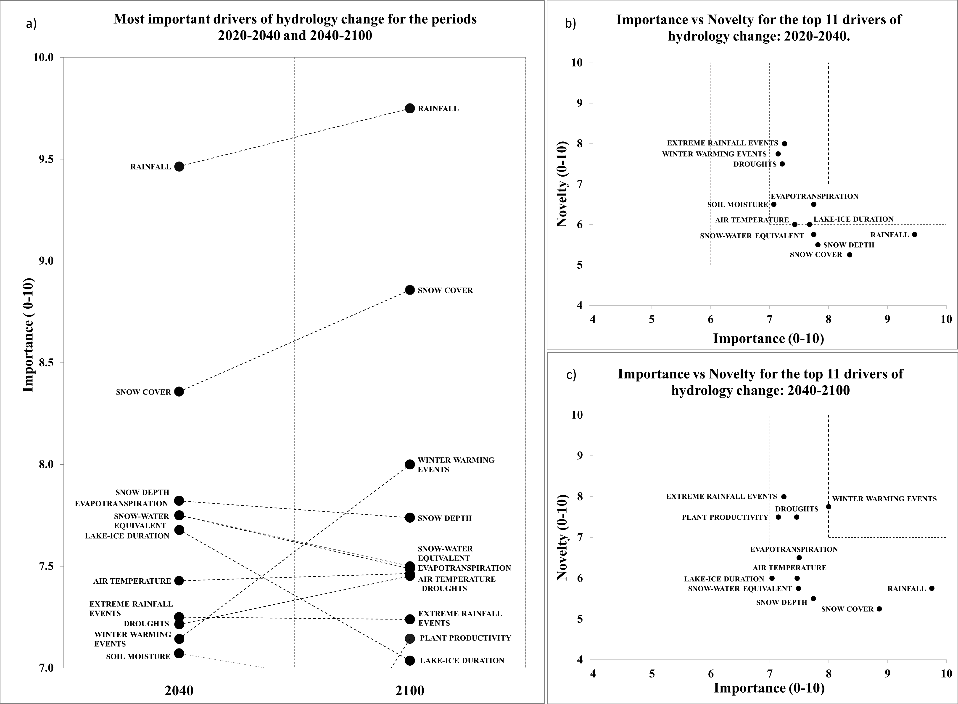
RESULTS. HYDROLOGY

Slide 11
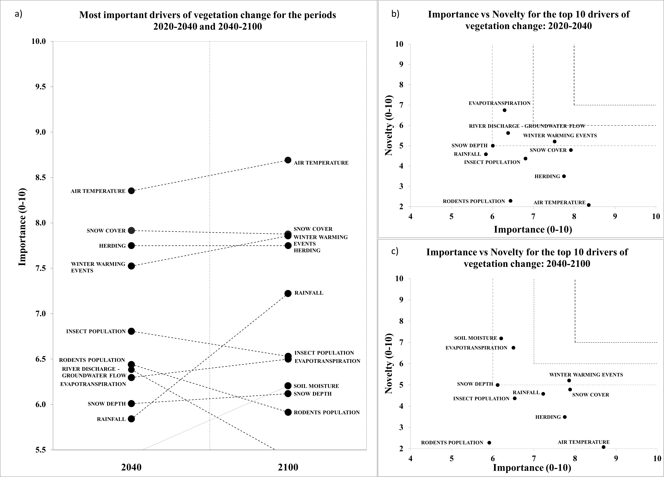
RESULTS. VEGETATION

Slide 12
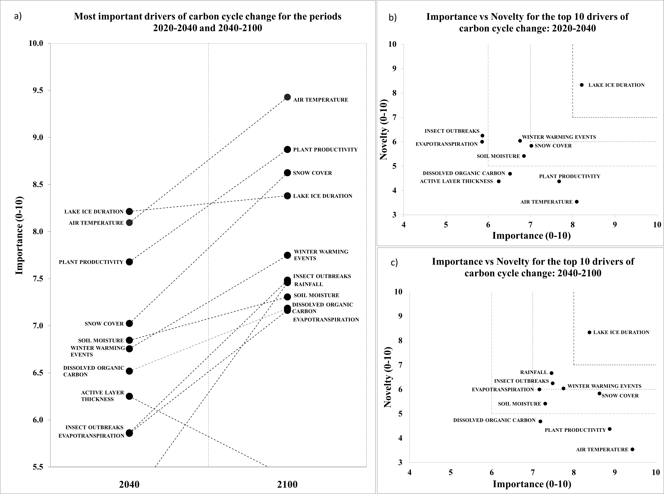
RESULTS. CARBON CYCLE

Slide 13
RESULTS. RESEARCH PRIORITIES AND WAYS FORWARD
…continues in the next slide.

Slide 14
RESULTS. RESEARCH PRIORITIES AND FUTURE STUDIES
…continues in the next slide.

Slide 15
RESULTS. RESEARCH PRIORITIES AND FUTURE STUDIES
…continues in the next slide.

Slide 16
RESULTS. RESEARCH PRIORITIES AND FUTURE STUDIES

Slide 17
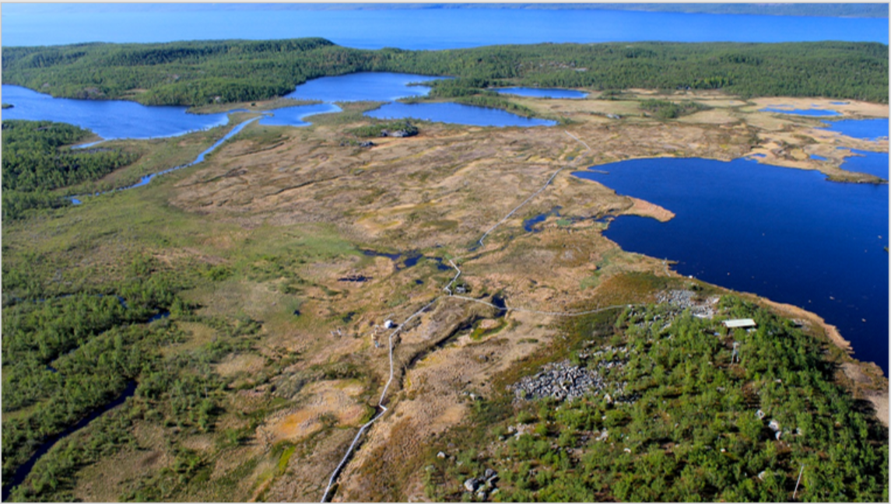
THANKS FOR YOUR ATTENTION!

