Slide 1
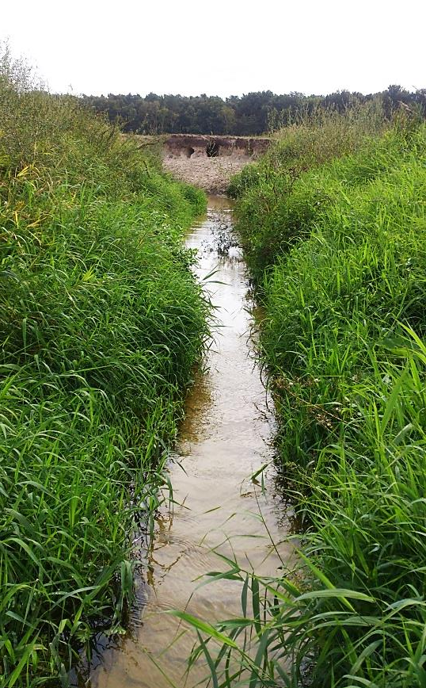
This presentation contains audio explanations.
To listen to them, please click on the speaker symbols.
Simultaneous fate of
trace organic compounds and dissolved organic matter
Surface water and the hyporheic zone of an urban river
Birgit Maria Müller (b.mueller@igb-berlin.de)
Hanna Schulz, Anke Putschew, Joerg Lewandowski

Slide 2
Introduction
Trace organic compounds
Pharmaceuticals, hormones
Industrial compounds
Pesticides
Cosmetics
Artificial sweeteners
Wastewater treatment plant
DOM
DOM
Dissolved organic matter
→ Compound classes, e.g.
Lignins, proteins, tannins, carbohydrates, …
DOM

Slide 3
Introduction
Surface
water
DOM
?
DOM
DOM
Hyporheic
zone
DOM
DOM
?
Simultaneous attenuation of & → Co-metabolism or prevention by presence of ?
Where? → Compare surface water and hyporheic zone
DOM
DOM

Slide 4
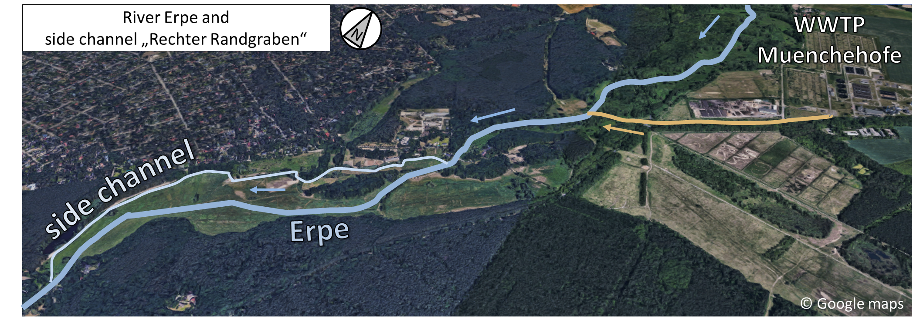
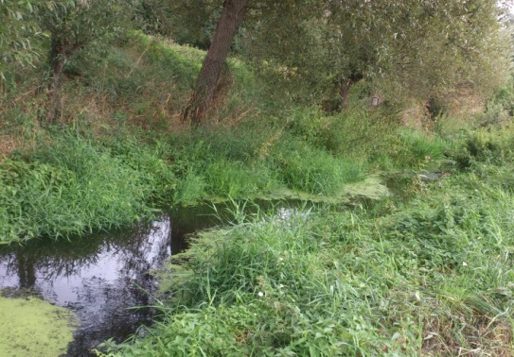
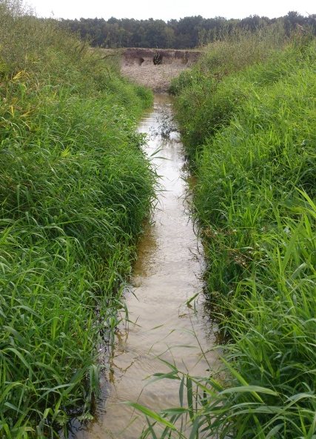
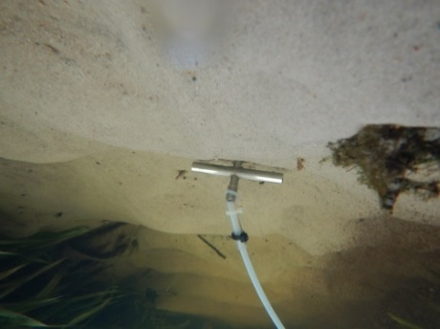
48 hours sampling campaign
500 m
SW
SW
HZ
Image © 2020 CNES / Airbus,
GeoBasis-DE/BKG, Maxar Technologies
September 2018 48 h, sampling every 3 h
Surface water (SW), Hyporheic zone (HZ, 25 cm sediment depth)
DOM (FT-ICR-MS), 17 trace organics (HPLC-MS/MS)
DOM

Slide 5
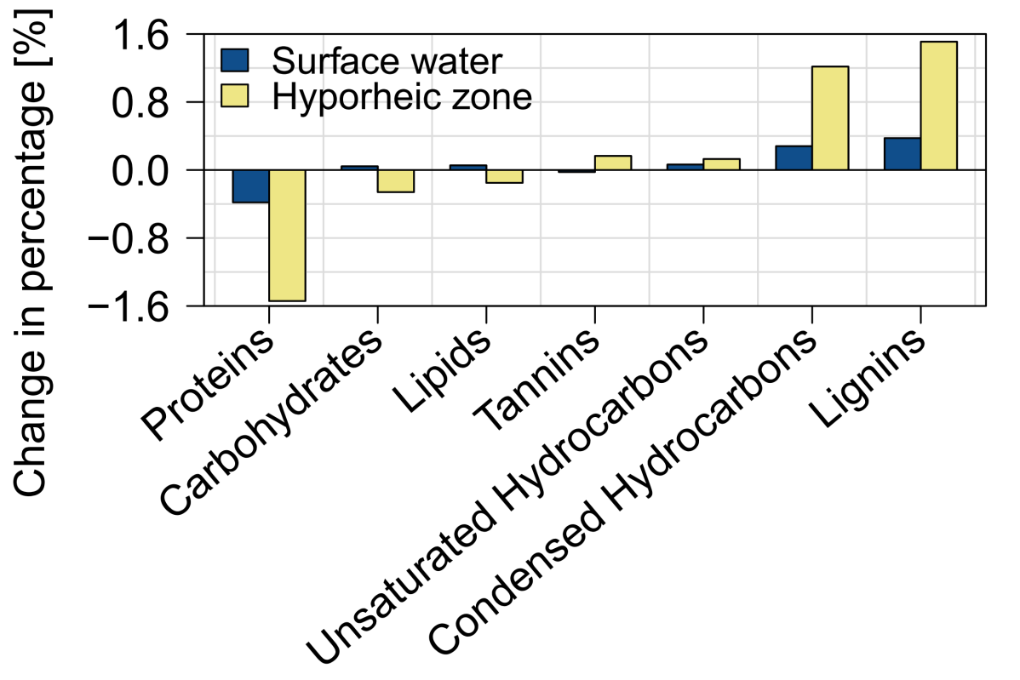
Attenuation of
DOM
Relative increase of poorly bioavailable
Largest changes in hyporheic zone
DOM

Slide 6
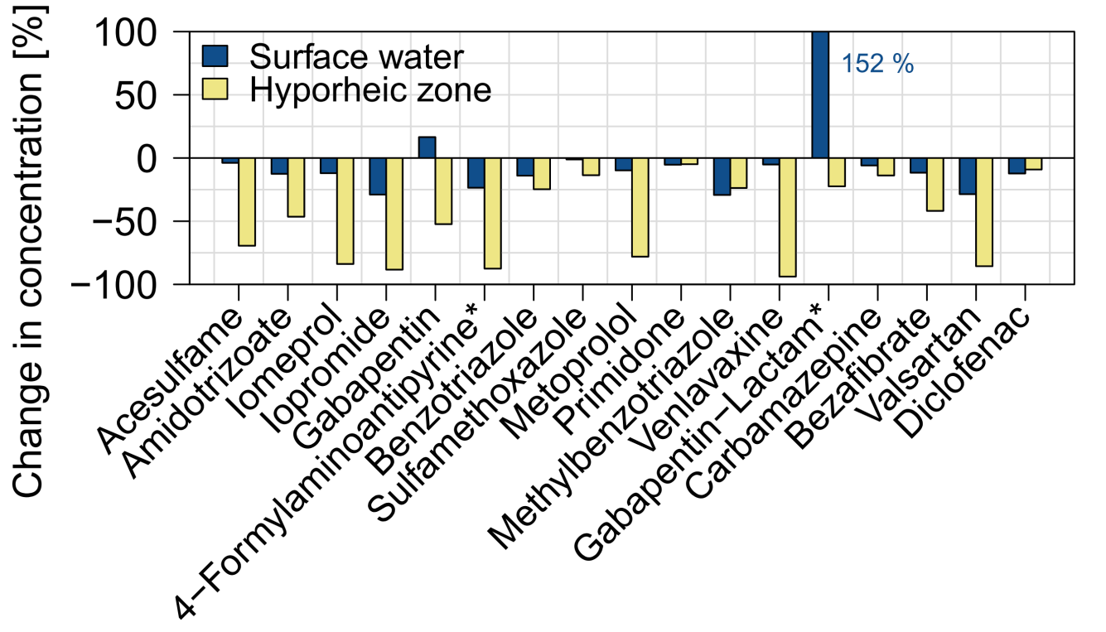
Attenuation of
Attenuation of most TrOCs
Transformation product (*) gabapentin-lactam formed
Most attenuation in hyporheic zone

Slide 7
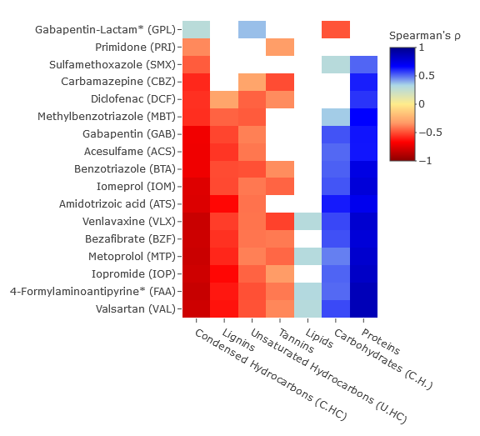
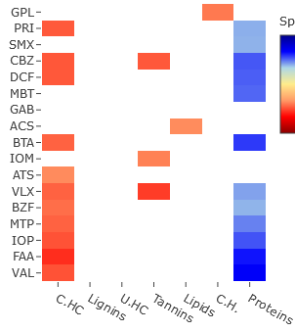
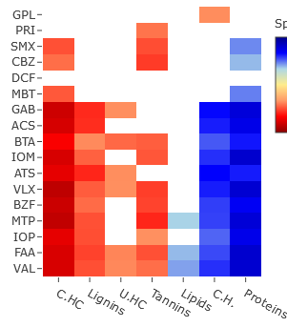
Simultaneous attenuation of & : Correlation
DOM
Surface water and hyporheic zone
Surface water
not
significant
Hyporheic zone
Strong correlations of & due to processes in hyporheic zone
DOM

Slide 8
Summary
Simultaneous attenuation of & for most substances:
Attenuation of & relative decrease in bioavailability of
Change and correlation of & stronger in hyporheic zone
DOM
DOM
DOM

Slide 9
Thank you
for your attention!
Birgit Maria Müller
b.mueller@igb-berlin.de

