Slide 1
Stock change of soil moisture under crop cultivation
A relevant indicator and low cost indicator to assess hydrological performance of agricultural land use systems in Tigray, northern Ethiopia
Richard Kraaijvanger
Van Hall Larenstein University of Applied Sciences, Velp, The Netherlands

Slide 2
Problem context
Soil erosion is a complex problem
Measures are not always effective
Need for local-specific approaches
Why approaches work or don’t work isn’t always clear
Information on hydrological performance of land use systems is essential

Slide 3
Case study: Tigray
Serious and long term problems with soil erosion
Measures taken are not always fully effective
Sustainability is severly affected: crop production, food security, environmental degradation

Slide 4
Event of about half an hour resulted in massive run off

Slide 5
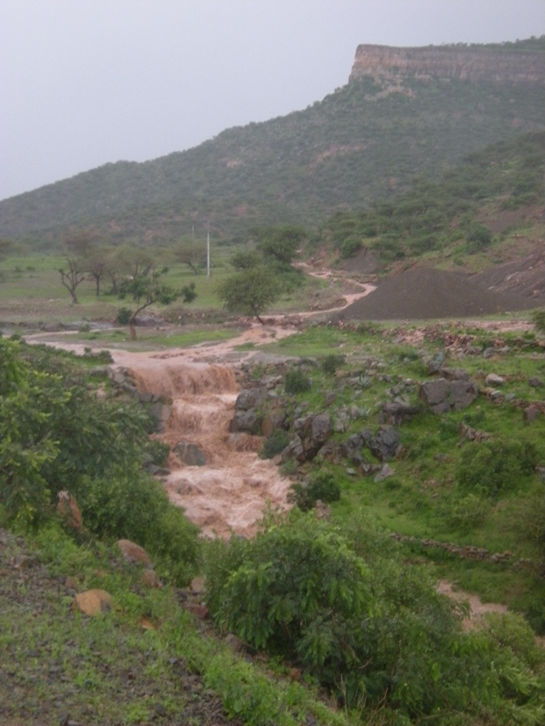
Massive run off

Slide 6
Study area
Four years (2010-2013)
16 locations (distributed over 4 woredas)
Four sites per location
64 observed sites (of which some were repeated for more years; in total 43 different sites were involved)

Slide 7
What are trends in hydrological performance of agricultural land use systems in Tigray, northern Ethiopia?
Data collected to support crop growth modelling were available:
Gravimetric soil moisture data (different depths; throughout the growing season for four years)
Moisture retention (field capacity, wilting point), porosity, bulk density, granular composition
Crop productivity
Indicative rainfall data

Slide 8
Starting point: Moisture stored in the soil
Result of infiltration (as a complement to run off)
Available for plant growth
Measured gravimetrically (sampling at different depths by auger; oven dried at 105 ºC)
Depth and moisture content provide soil moisture stock
Change of moisture stock over the growing period

Slide 9
Additional data
Indicative rainfall data for each location
Moisture retention data (pF), bulk density and porosity on the basis of core samples
Granular composition (stone% by sieving; estimation textural class by feel method and reference samples)
Crop production data (for recommended practice)

Slide 10
Analysis
Available soil moisture (for plants): soil depth*(actual %-WP)
Maximum infiltration capacity for 1 hour: using the concept of sorptivity (on the basis of soil moisture content, porosity and tabulated data) and conductivity (Van Keulen and Wolf, 1986)*
*Van Keulen and Wolf, 1986: Modelling of agricultural production: weather, soils and crops; Pudoc, Wageningen, the Netherlands.

Slide 11
Soil data (selected data)
 |  |  |  | topsoil |  |  | subsoil
site | texture topsoil | stones topsoil | stones subsoil | porosity | FC | WP | porosity | FC | WP
adigudat | clayloam | 16,9 | 24,6 | 46,77 | 34,37 | 17,18 | 39,9 | 32,83 | 16,01
tikuz | clay | 13,8 | 5,2 | 47,33 | 43,03 | 23,05 | 53,27 | 49,53 | 31,97
adikolagol | clay | 9,7 | 8,9 | 52,93 | 40,57 | 18,81 | 59,43 | 54 | 31,68
adowro | clayloam | 25,7 | 30,3 | 48,2 | 34,97 | 13,79 | 45,47 | 34,9 | 12,95
dingelat | clay | 14,1 | 17,5 | 60,3 | 41,33 | 18,42 | 60,23 | 50,33 | 26,62
gudowro | clayloam | 46,7 | 29,7 | 47,57 | 29,8 | 13,25 | 54,5 | 45,93 | 20,3
awadu | loamy sand | 26,7 | 25,1 | 37,17 | 15,93 | 2,82 | 28,5 | 18,77 | 8,66
hadishadi | loamy sand | 4,8 | 1,5 | 36,9 | 21,97 | 5,74 | 32,17 | 30,37 | 16,75
mayzagra | silty clay | 10,8 | 4,5 | 42,77 | 36,63 | 8,87 | 43,63 | 39,33 | 14,2
machalawi | sandy loam | 23,4 | 38,9 | 45,07 | 27,43 | 10,65 | 37,23 | 27,67 | 11,61
zonghi | clayloam | 12,7 | 19,2 | 42,4 | 37,5 | 16,7 | 40,13 | 34,17 | 14,75

Slide 12
Stored moisture and infiltration (selected data)
site | year | Max storage (mm) | indicative rainfall (mm) | % stored of total rainfall | max infiltration 1 hour in august (mm) | events > 5mm/hour
tikuz | 2010 | 220 | 438 | 50 | 1 | 27
mayzagra | 2010 | 157 | 404 | 39 | 1,5 | 12
zalaweni | 2010 | 98 | 404 | 24 | 24,2 | 12
machalawi | 2010 | 50 | 377 | 13 | 27,1 | 17
mymisham | 2010 | 164 | 377 | 44 | 1,6 | 17
zonghi | 2010 | 98 | 377 | 26 | 3,9 | 17
mayzagra | 2011 | 87 | 323 | 27 | 20,2 | 17
awadu | 2012 | 98 | 352 | 28 | 24,4 | 16
hadishadi | 2013 | 118 | 370 | 32 | 24,9 | 22
biherawi | 2013 | 63 | 353 | 18 | 8,4 | 15
zonghi | 2013 | 87 | 353 | 25 | 3,9 | 15

Slide 13
Crop production and growing period (selected data)
site | year | crop | max ASM before 15/9 | max ASM after 15/9 | growing period weeks (full) | estimated growing period av. moist | seeds dm (kg/ha) | biomass dm (kg/ha)
adigudat | 2010 | wheat | 67 | 61 | 16 | 12 | 1812 | 6476
munguda | 2010 | teff | 64 | 48 | 15 | 12 | 1040 | 5629
adowro | 2010 | hanfets | 69 | 19 | 18 | 14 | 1992 | 5831
dingelat | 2010 | wheat | 56 | 0 | 16 | 11 | 2347 | 5226
awadu | 2010 | hanfets | 46 | 17 | 16 | 13 | 910 | 4519
hadishadi | 2010 | wheat | 69 | 52 | 16 | 14 | 2259 | 6362
mymisham | 2010 | hanfets | 66 | 27 | 15 | 14 | 1786 | 7649
adigudat | 2011 | wheat | 92 | 95 | 14 | 14 | 2757 | 12117
endamariam | 2011 | wheat | 70 | 47 | 15 | 11 | 2008 | 5674
adigudat | 2012 | wheat | 71 | 62 | 15 | 15 | 2588 | 6518
adigudat | 2013 | teff | 77 | 22 | 13 | 11 | 405 | 3186
adowro | 2013 | wheat | 108 | 112 | 18 | 18 | 3549 | 8733
dingelat | 2013 | wheat | 83 | 42 | 17 | 16 | 2322 | 6216
mymisham | 2013 | wheat | 66 | 23 | 16 | 16 | 3903 | 8966

Slide 14
Discussion
Storage is limited ( much less than 50% of total rainfall)
Relatively high water content for the duration of the rainy period; when the rains have stopped followed by quick depletion
Plant available moisture is often limited due to limited depth and textural composition
Short growing season (fully depending on rainfall)
Infiltration capacity is low due to high moisture content en low conductivity

Slide 15
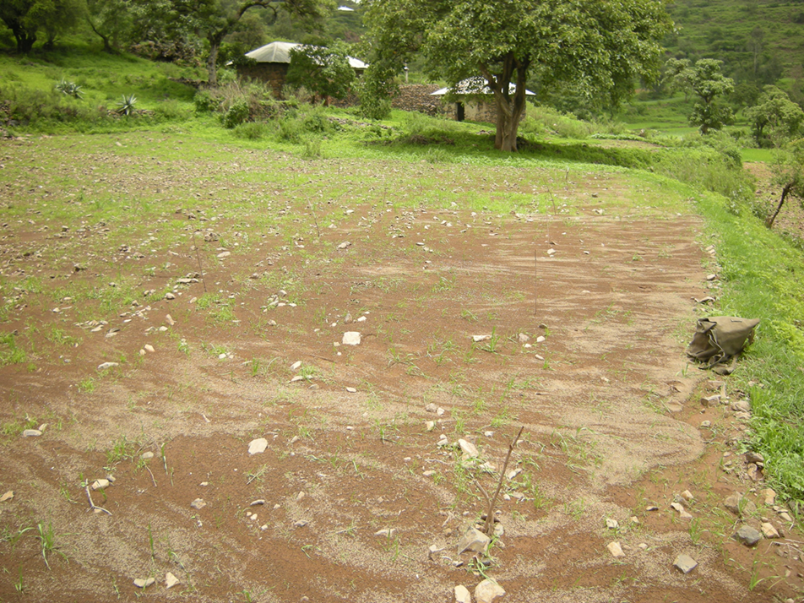
Limited infiltration capacity also in the growing season

Slide 16
Conclusion en recommendations (case study)
SWC-measures should aim at increasing storage capacity, while at the same time increasing time for precipitation to infiltrate.
Approaches that address these requirements include, for example, tied ridging, the use of vegetation grass strips and controlled drainage of excess water.

Slide 17
Conclusion (methodology)
Gravimetric soil moisture data are effective to monitor the hydrological performance of land use systems.
A rather complete picture can be provided in combination with additional meteorological data (rainfall; evaporation) and hydrological data (moisture retention; soil composition).

