Slide 1
Small Electric Field Sensor (sEFS) for
Small Unmanned Aerial Vehicles (sUAV)
Stefan Chindea: sc684@bath.ac.uk

Slide 2
Overview:
1) Introduction to the atmospheric electric field (DC)
2) The focus of my research
3) Concept behind Atmospheric E-field measurements
4) Work to date
5) Output
6) Next steps
Notes:
(optional)
This is what I would like to skim over in this short presentation.
1) Very brief introduction to the areas of the atmospheric electricity that influence my work the most.
2) Expand a bit on the focus of my research. So I plan on building a tool: a sensor and a platform for it.
3-4-5) Zooming into the concept behind atmospheric e-field measurements, the work I have done so far and an example of data out of the tool
6) A glimpse at my to-do list as I see it at the moment

Slide 3
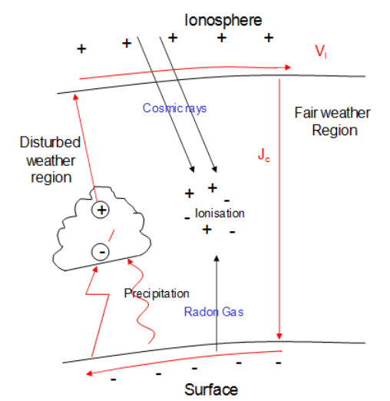
1) Introduction to the atmospheric electric field (DC)
Atmosphere is electrified
Atmosphere ~ leaky capacitor
Ionospheric potential is a global parameter
When Jc (conduction current) flow down through higher resistivity regions (like clouds, pollution), electric charge deposition can occur on the vertical boundaries of the low conductivity layer
Figure1. Global electric circuit ¹
1. K. Nicoll Coupling Between the Global Atmospheric Electric Circuit and Clouds, 2010
Notes:
All starts from the fact that the atmosphere is electrified. We all know this and maybe the easiest example is the seeing storms with lightning strikes.
If you can now please imagine the ionosphere as a conductive sphere, up-top, with a net positive charge (optional – the charged particles appear mainly due to GCR, solar radiation and natural radiation from radioactive rocks like Rd). And the Earth’s surface down-below, with a measured slightly negative charge (optional – measured by Peltier in the 1800s). As you can see in Figure 1, difference in potential was generated. This is a global property of the atmosphere, observed everywhere around the surface of the Earth (optional – as recorded by CTR Wilson’s research cruises aboard The Carnegie - papers from 1920s). The difference in potential leads to a small leakage current to flow from the ionosphere towards the surface of the earth. This is called Jc – the conduction current and I will come back to it in a few slides. The observed electric field, varies in intensity with height, and Figure2 from Imyanitov and Chubarina shows an example of this variation during clear days over Leningrad.
The most important aspect of this plot is that you can notice that most of the variation in intensity of the Electric field is concentrated in the lower 5km of the atmosphere. This is due to the higher density of particles that impede the flow of Jc and thus act as a sponge for electric charge carriers.

Slide 4
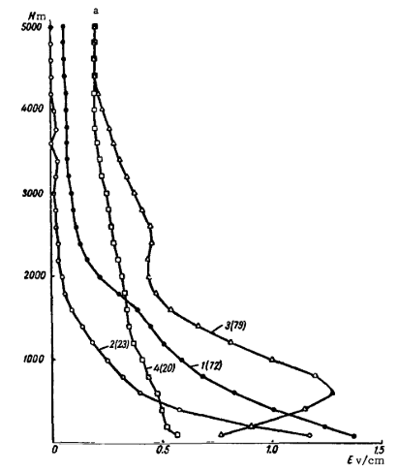
1) Introduction to the atmospheric electric field (DC)
Electric field intensity varies with height
These observations are in line with the approximation of atmosphere to a capacitor
Most variation happens in the lower 5km of atmosphere as the electric resistivity increases the most in this region
Focused effort in characterizing this region is expected to yield concentrated results
Figure2. Variation of the electric field intensity with height, as measured on clear days over Leningrad ²
2. M. Imyanitov and E. V. Chubarina, “Electricity of the free atmosphere,” Isr. Progr. Sci. Transl. , 1967
Notes:
The observed electric field, varies in intensity mainly with height, and Figure2 from Imyanitov and Chubarina shows an example of this variation during clear days over Leningrad.
The most important aspect of this plot is that you can notice that most of the variation in intensity of the Electric field is concentrated in the lower 5km of the atmosphere. This is due to the higher density of particles that impede the flow of Jc and thus act as a sponge for electric charge carriers.

Slide 5
2) What am I trying to do during my PhD?
small UAVs have become widely available
I propose to use them as scientific platform
What is there to be gained?
monitor ionospheric potential
aerosol concentration
non-thunderstorm cloud charge and its effects
engineering roadmap for developing and integrating complex
atmospheric research sensing platforms and identify pitfalls
Notes:
So, what am I trying to do during my PhD, and more importantly, why?
I want to build a small Electric Field Sensor that can be mounted onto a small UAVs or free balloons. Small UAVs have become a common sight in everyday life (some would call them a nuisance) and they seem an ideal platform for atmospheric research. The advantage of small UAVs (as defined by the UK CAA meaning UAVs <7kg) is their ease of deployment, maintenance and low cost. With such a tool, new measurement data sets can be obtained and further understanding of our atmosphere can be achieved. The challenge is to find a suitable sUAV, to develop the sensing payload, to integrate both and to prove the functionality of the sensing system in flight trials.
Why do I care/should you care?
Because among these new data sets, there is potential to
a) monitor the ionospheric potential (remember that most of the variation in Electric field happens in the lower atmosphere, where we can reach with a sUAV);
b) monitor aerosol concentration (as aerosols impede the flow of Jc, a local increase in the Electric field is linked to higher air pollution; as PM sensors discriminate by size, observing the electric field can give information for a broader sizes range);
Main!!! c) study the impact of electric charges onto the cloud properties (at the moment it is known that once a non-thunderstorm cloud happens in the way of Jc, positive charges will deposit on the top layer of the cloud, while negative ones will concentrated on the lower boundary, but it is not yet fully understood what the effect of this local electric field has on cloud droplet formation rate, cloud base height, or droplet size)
Also, my work is aimed to establish a roadmap for complex atmospheric sensor integration with an autonomous platform for scientific purposes. There are currently many groups pioneering the use of UAVs (and sUAVs) for atmospheric research, but as all early endeavours, the sensing packages I have found during my literature review are limited to temperature, pressure, humidity and a few PM aerosol ones. What I am proposing is a more complex platform integrating the EFS, the above mentioned atmospheric sensing packages, an optical cloud detection sensor (developed by G Harrison and K Nicoll), and space charge density sensor (also developed by KN).

Slide 6
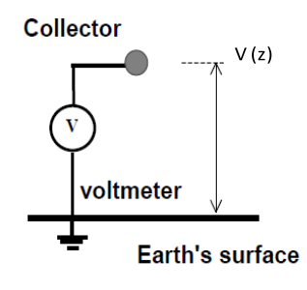
3) Concept of operation of Electric Field Sensors
Passive probe
Pro: Simple
Con: long response time
it requires a ground connection
a)
Notes:
There are many methods for sensing the electric field, but in the area of atmospheric electricity measurements there are 3 main types of sensor that I have found in literature:
The simplest of them all is the Passive probe (using an electrode situated 1m above the earth surface and measuring the voltage between the earth and the probe. Due to the low conductivity of air, this sensor has a time constant of about 30 minutes, and this lead to enhancements of this sensing family using radioactive probes, burning fuse or water droppers to greatly improve the response time of the unit)
(OPTIONAL: The second family is the Corona probe, or the Point discharge sensor (a conducting needle concentrates the electric field around it and once breakdown is reached, the current pushed through is monitored. These sensors have a typical E-field threshold ov 1-5 kV/m. )

Slide 7
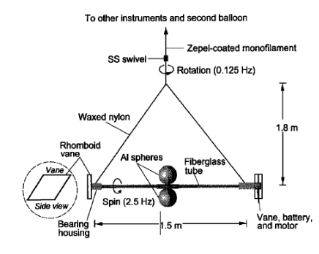
3) Concept of operation of Electric Field Sensors
Differential probes (airborne)
Pro: doesn’t need ground connection
Con: long response time
bulky and difficult to miniaturize
b)³
3 W. D. MacGorman, D. R and Rust, The electrical nature of storms. New York, Oxford University Press, 1998
Notes:
Differential in balloon (image taken from MacGorman and Rust, quoting Marshal et all 1995
This method is using two stacked passive probes that are spinning in the horizontal axis. This leads to a difference between the two of them and it eliminates the need for a fixed ground connection. The “slope” of the potential difference between the two electrodes is what gives the intensity of the electric field at that location along the vertical axis.
The concern with using this technology is that the mechanism occupies a large volume and it is difficult to miniaturize if at all possible. The sensitivity of the measurement is directly related to the surface of the spherical electrodes.

Slide 8
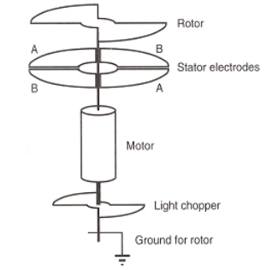
3) Concept of operation of Electric Field Sensors
Electric Field Mill (EFM)
Pro: common
allows miniaturization
Con: gyroscopic effect
no commercially available compact versions
noise through the rotor electrical connection
c)¹
1. K. Nicoll Coupling Between the Global Atmospheric Electric Circuit and Clouds, 2010
Notes:
The most common EFS is the Electric Field Mill. The sensor has 2 electrodes that are exposed/shielded alternatively. Once an electrode is exposed to the external E-field, electric charge carriers move (push) through the electrode. Once the sensing patch is shielded, the charge carriers relax back in place. By measuring these 180* out of phase signals and subtracting them, the amplitude of the signal is corelated to the amplitude of the external electric field. There are variants of this sensor in which the exposed area is milled in the horizontal plane or a cylindrical setup is implemented.
The disadvantage of this technology is that it involves a rotating mass which in airborne platforms can cause to instability via delayed response and also it can reduce the efficiency of the aircraft flight characteristics. Although it allow for miniaturization (a great advantage over the differential probe example), it need redevelopment as there are no commercially available examples that are already in a small form factor.

Slide 9
3) Concept of operation of Electric Field Sensors
Electric Field Mill (EFM)
Pro: proven technology
no gyroscopic effect
allows miniaturization
Con: lower cover/uncover frequency
requires in house development
d)
Notes:
My choice of sensor is part of the EFM family,
Mainly due to a concerns regarding the ability to integrate a rotating EFM with a small UAV platform, a linear translational movement of the shield adaptation was implemented. The key problems identified that this solution would address are the gyroscopic effect, size (it allows reducing the height of the instrument without affecting the sensing electrode area), electric noise on shield connection.
The main concerns still standing would be the speed at which the shield can move translationally and the requirement for in house development of the whole system. The last point can be considered an advantage as well as it would allow considerations of the integration with the aircraft to be included from the earliest stages of development.

Slide 10
3) Concept of operation of Electric Field Sensors
a)
b)³
c)¹
d)
3 W. D. MacGorman, D. R and Rust, The electrical nature of storms. New York, Oxford University Press, 1998

Slide 11
4) Sensing system development process
Driver | Criteria | Requirement
Platform | Altitude | Typical below 2.5km in UK
 | MTOW | 6 - 7 kg (sensor weight <250g)
 | Mission complexity | 2 - 3 ground crew; minimal/no special permit/CAA request
Sensor | Typical E-field intensity range | From 0V/m to ~1.5 kV/m
 | Response time | 1 - 2 s
 | Running time | 30 - 40 min
Common | Materials; Power; Disturbances; Size
Notes:
When tackling the sensing system design, there were 2 main drivers that required attention.
Firstly, the testing scenario in which the platform was to operate: What altitude it would fly, MTOW, complexity of flight mission, maintenance of platform,
Secondly, the parameters that the sensor would need to measure: What typical Electric Field intensities, time constant, operational time, materials/location of platform.
After careful consideration of these criteria, the proposed platform is a small UAV (to allow for low operational complexity). In order to achieve the desired altitude while maintaining low operational risk, a fixed wing aircraft was chosen.

Slide 12
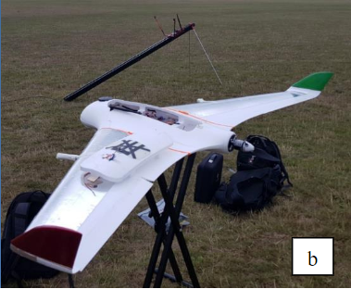
Skywalker X8
Commercially available aircraft body
Commonly used by hobbyists and researchers
Wingspan of 2.1m
Maximum Take Off Weight 5kg
Catapult launch/belly landing capable
Prior experience
Build (2) / Maintenance(6) / Field trials (10+)
a)
Notes:
Two alternative platforms were selected. Both of them using pusher prop thrust to avoid disturbing the air ahead of the measurement (one of the other concerns that disqualified quad copters).
Skywalker X8 can be seen, with a wingspan of 2.1m and an MTOW of 5kg, also catapult launch. This is an aircraft where there is experience in building (2), maintenance (6) and field trials (10+).

Slide 13
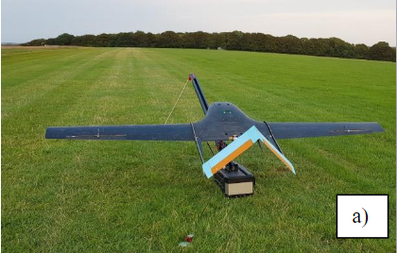
Atmos
In house design and build by University of Bath students
Wingspan of 2.3m
Maximum Take off Weight 6kg
Catapult launch/belly landing
Carbon infused fibre glass skin
Prior experience:
Flight trial (2)
b)
Notes:
b) bespoke aircraft was designed by colleagues of mine from UoB; The aircraft called Atmos has a 2.3m wingspan and an MTOW of 6 kg; carbon infused fiber glass composite skin and can be launched from a catapult. I was acting ground control station for 2 test flights.
On the top right, a Skywalker X8 can be seen, with a wingspan of 2.1m and an MTOW of 5kg, also catapult launch. This is an aircraft where there is experience in building (2), maintenance (6) and field trials (10+). Less powerful than the Atmos, but more familiar, reducing the operational risk to the project.
On the bottom left, a CAD with the sensor embedded into the wing of an X8.
On the bottom right, the CAD blow up of the latest prototype of the small EFS can be seen. The integration between the wing spars should reduce to minimum the impact on wing integrity. The wing resonance frequency would be shifted and there would be an impact on maximum/operational speed of the aircraft and agility, but initial risk assessments passed.

Slide 14
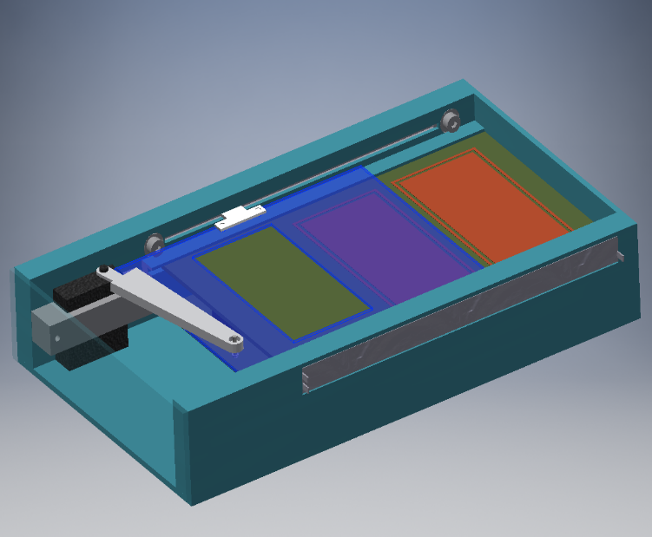
sEFS CAD
Electrode surface: 6cm^2
Screen cover/uncover frequency: 1-3Hz
Control voltages available for respective field intensity of approximately:
+/- 800;400;200 V/m
c)
Notes:
c) A CAD blow up of the latest prototype of the small EFS can be seen. The electrode sensing surface is 6cm2/patch. The screen covers/uncovers the electrodes at 1-3Hz and there are control voltages that can be applied to the shield in order to calibrate the unit in flight.

Slide 15
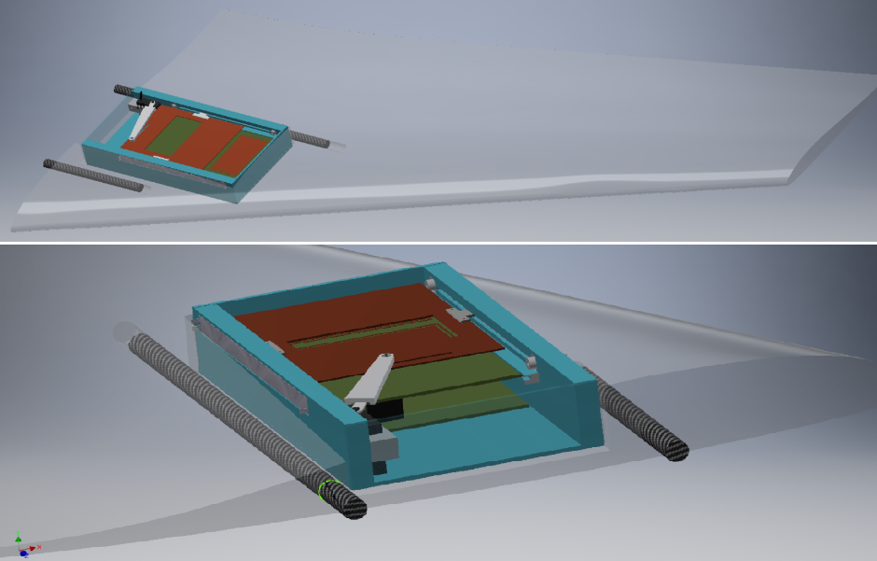
Physical location within the wing due to consideration for:
surrounding field distortions (COMSOL modelling)
symmetry of mass distribution and sensor orientation
impact on structural integrity and flight performance
d)
Notes:
d) A CAD with the sensor embedded into the wing of an X8.
Electrostatical modelling indicated that the wings present least distortion, especially during attitude changes of the aircraft.
In order to compensate for changes in attitude during flight, a minimum of a pair of sensors would be needed that would point in opposite directions.
The integration between the wing spars should reduce to minimum the impact on wing integrity. The wing resonance frequency would be shifted and there would be an impact on maximum/operational speed of the aircraft and agility, but initial risk assessments passed.

Slide 16
a)
b)
c)
d)

Slide 17
5) Full system architecture
Aircraft body
sEFS body
Front end
Differencing and amplification
Micro-controller
Position of shield
Shield Voltage
Real Time clock
SD card logging
Complementary sensors
Aircraft autopilot
Telemetry
Avionics; control surfaces; propulsion
Parachute
Notes:
The sEFS senses the external electric field using the front end circuitry. The 2 opposing signals are differenced and amplified prior to ADC sampling and logging by the uController.
The microcontroller drives the shield and decides what voltage is applied to the shield (wrt local ground) and logs these variables along with the signal and a timestamp obtained from and RTC.
The complementary sensors (without dedicated loggers) also pass the signal to the microcontroller.
The autopilot is in constant contact with the GCS via telemetry over 868MHz (a link tested to 1.5 km line of sight horizontally) and has a parachute deployment system as a fall back.
Optical cloud droplet sensor
Space charge density

Slide 18
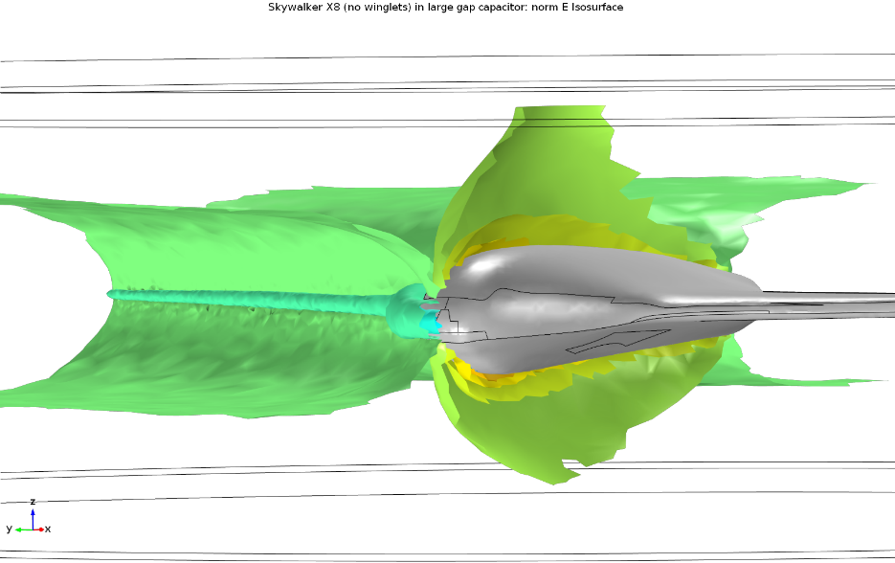
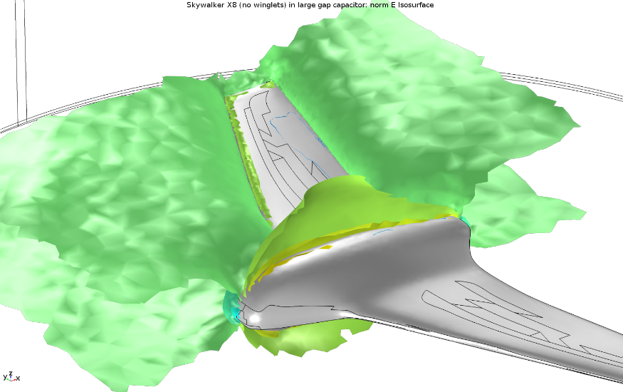
6) Electrostatic modelling – E-field intensity iso-surfaces
a)
b)
A uniform vertical electric field is disturbed by the aircraft geometry
The distortions concentrate on the leading edge and around the body of the aircraft.
This confirms the optimal location for the sensor being embedded in the wing
Notes:
Using the COMSOL Multiphysics package, a uniform electric field was simulated with an intensity of 100V/m (representative for fair weather atmospheric conditions). The aircraft was considered made uniformly of foam with a relative dielectric constant of 2.4 (representative for expanded foam). The aircraft antennas and small features (control rods; GPS unit; hatch latches; tail propeller; tail motor; winglets) were omitted in order to reduce the complexity.
a) and b) show iso-surfaces of the electric field intensity while the aircraft is horizontal in the electric field (straight flying).

Slide 19
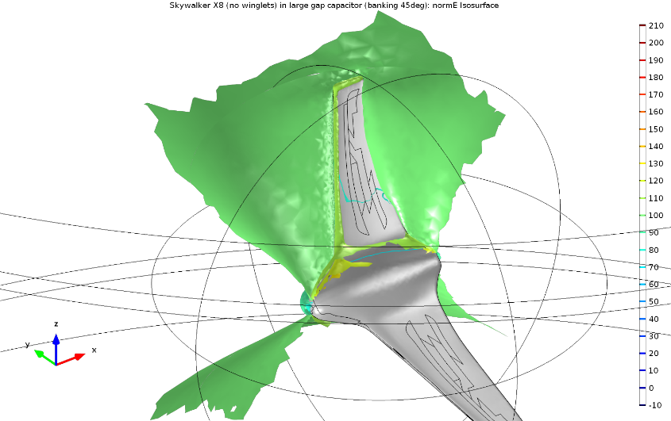
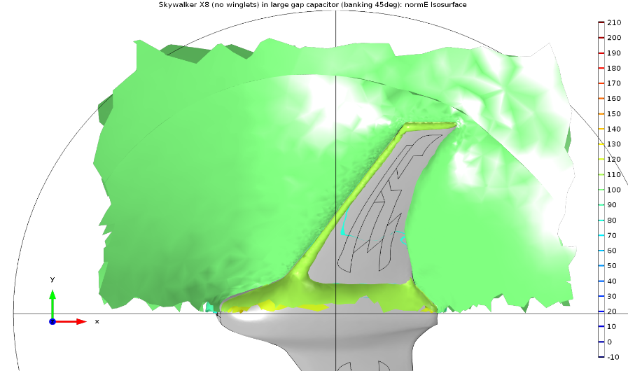
6) Electrostatic modelling
Even during a steep roll (45degrees), the wing of the aircraft presents the least disturbed region.
Effect of charge deposition on leading edge elements is yet to be performed, but the application of a conductive skin is expected to redistribute the charge and minimise the effects.
c)
d)
Notes:
c) and d) show the same conditions, but with the aircraft banking 45 degrees within the electric field. This is the maximum banking angle recorded while the aircraft was performing a holding pattern circling around a rally point with a 50m radius. Although the aircraft is permitted to bank sharper (60degree), that limit is for aircraft safety, not for the scientific profile of the flights which will include wide circling patterns.
The main concern is the variation of the iso-surface lines with time as the aircraft would fly. The minimal slope of distortion indicates that the optimal location for the sensor is on the wings, at a slight distance from the main body of the aircraft. A pair of sensors, one pointing up and one down would allow for post processing normalisation of the distortion due to charge deposition on the aircraft. The triboelectric charging of the small UAV is expected to be much less than on a manned aircraft and a conductive skin would help redistribute the charge in a manner that would keep the distortion slope as low as possible.

Slide 20
6) Future work
Mount it on the aircraft
Acquire test measurements
Electrostatic modelling of charge deposition effects
Planning flight campaign
Run final platform validation campaign
Notes:
Where to next?
I intend to acquire test measurements with the working prototype fully integrated into an X8 platform.
The main purpose is to record background platform induce noise and motion induced noise. In case field experiments are impossible in the short term, an alternative is being considered with electrostatic modelling of the sensor mounted in the wing inside a wind tunnel and confirming the results with wind tunnel testing.
Finally, the validation flight campaign can be planned and new data sets can be generated in order to confirm the functionality of the new sensing system.

Slide 21
Thank you for your time and attention!

