Slide 1
IG CAS
Prague
Growth and evolution of continental lithosphere by cycles of oceanic subductions – Evidence from seismic anisotropy supported by petrologic and geochemical findings
V. Babuška, J. Plomerová, L. Vecsey and H. Žlebčíková
Institute of Geophysics, Czech Academy of Sciences, Prague
EGU 2020, GD4.2 “40 years with ILP” May 5

Slide 2
IG CAS
Prague
We present independent findings from seismology, petrology and geochemistry to support our 3D anisotropic model of continental mantle lithosphere with tilted symmetry axes, derived from data of passive seismic experiments organized in tectonically different domains of the Archean, Proterozoic and Phanerozoic provinces of Europe.
The extent of the lithosphere domains and their boundaries are delimited according to changes in orientation of the large-scale anisotropy, associated with a systematic preferred orientation of olivine (LPO).
The systematically oriented dipping fabrics in the continental mantle lithosphere can be created by successive subductions of ancient oceanic plates and their accretions enlarging primordial continent cores (Babuška and Plomerová, 1989).
Consequent continental break-ups and assemblages of wandering micro-plates preserve “frozen” anisotropic fabrics and created patchwork structures of the present-day continents.
V. Babuška and J. Plomerová, Solid Earth Sciences 5 (2020)
https://doi.org/10.1016/j.sesci.2019.12.003

Slide 3
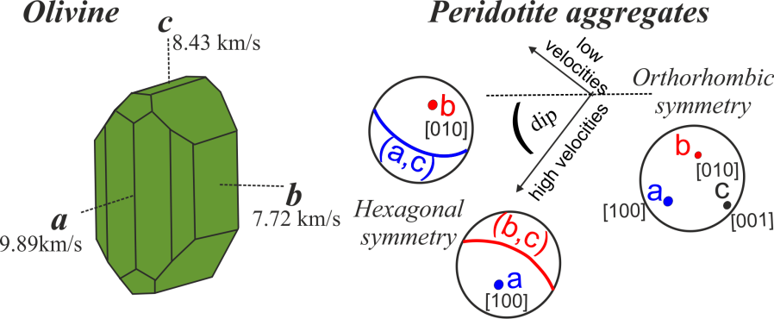
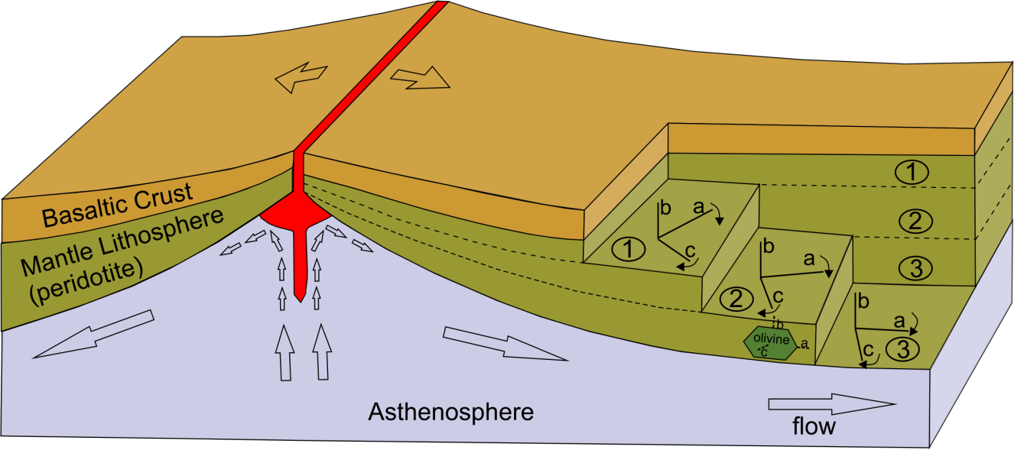
IG CAS
Prague
Compressional velocities (Kumazawa and Anderson, 1969) in a monocrystal of olivine of orthorhombic symmetry and peridotite aggregates with two types of hexagonal (transversally isotropic) symmetry with dipping symmetry axes. High-velocity directions along the a axis (lineation) or foliation (plane (a,c)) are in blue; low-velocity directions along the b axis or (plane (b,c)) are in red (lower-hemisphere projection).
Schematic representation of variable orientations of seismic anisotropy in different depths of the oceanic mantle lithosphere based on the anisotropic plate thickening model originally proposed by Ishikawa (1984). Fabrics of the oceanic mantle lithosphere are shown in three depth slices: in the upper (1) and middle (2) parts and at the bottom of the mantle lithosphere (3). Varying directions of the asthenosphere flow re-orient the a and c axes in the thickening oceanic plate and thus give rise fabrics, which can be approximated by a hexagonal model with the sub-vertical b axis and the high-velocity (a,c) plane.
V. Babuška and J. Plomerová, Solid Earth Sciences 5 (2020)
https://doi.org/10.1016/j.sesci.2019.12.003

Slide 4
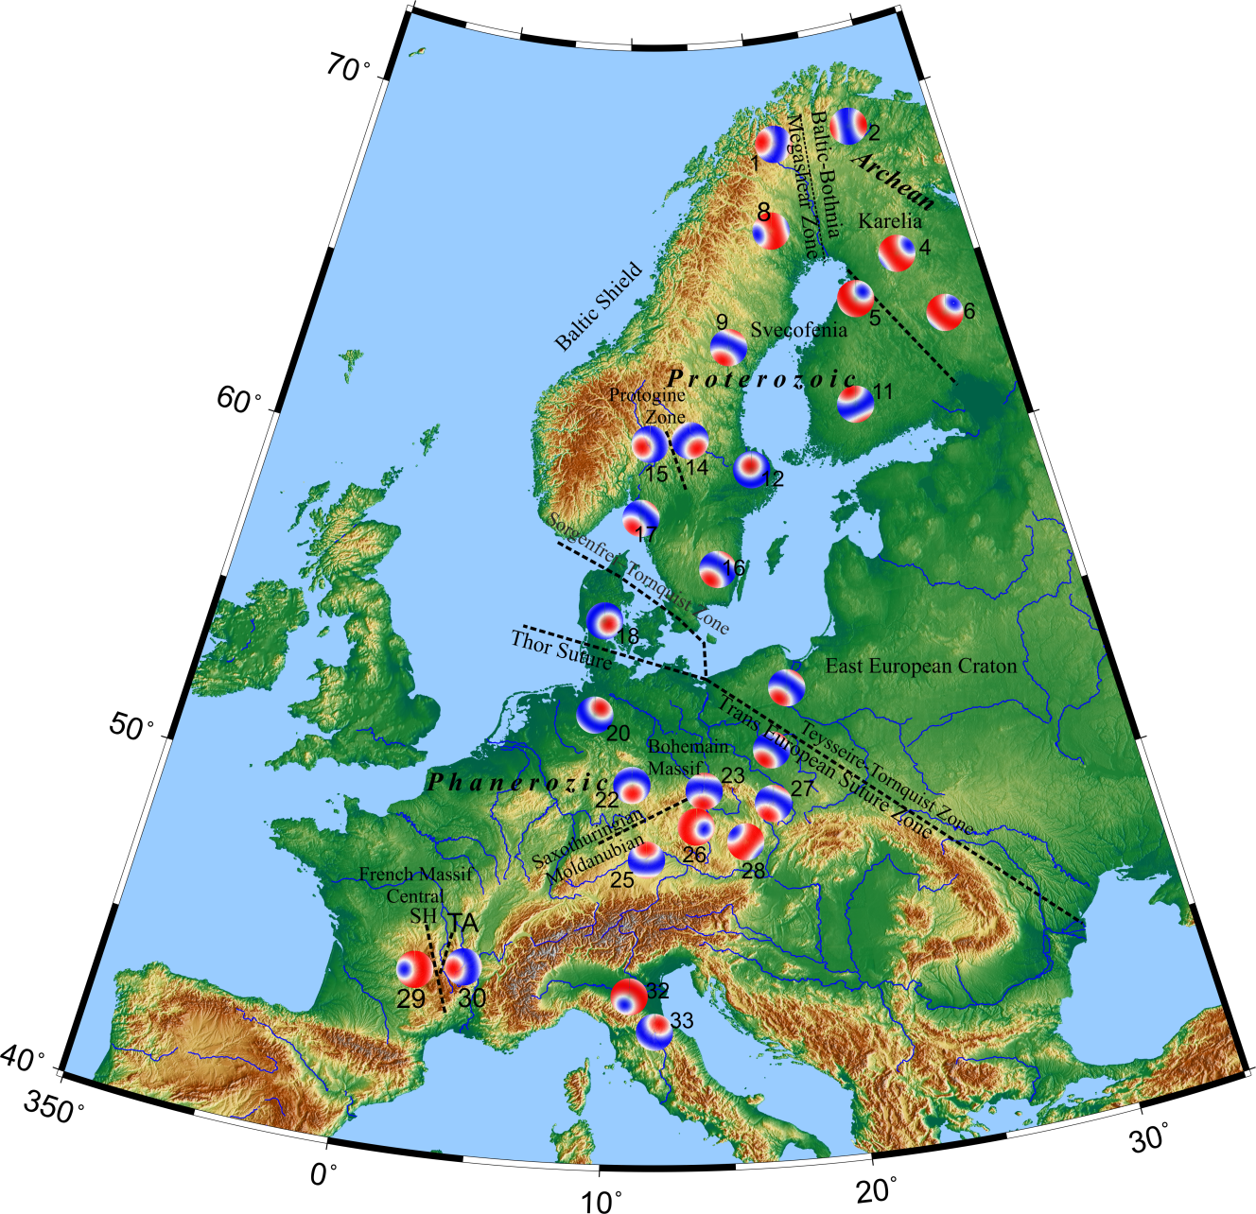
IG CAS
Prague
Examples of mantle lithosphere fabrics modelled from body-wave anisotropy evaluated in 3D. Orientation of dipping axes and type of hexagonal symmetry (‘fast’ a or ‘slow’ b axis) retrieved from joint inversion of P-wave (directional travel time variations) and S-wave (SKS splitting) anisotropy.
For the complete set of models and their parameters see Table 1 in V. Babuška and J. Plomerová, Solid Earth Sciences 5 (2020)
https://doi.org/10.1016/j.sesci.2019.12.003
High-velocity directions along the a axis (lineation) or foliation (plane (a,c)) are in blue; low-velocity directions along the b axis or plane (b,c) are in red (lower-hemisphere projection).

Slide 5
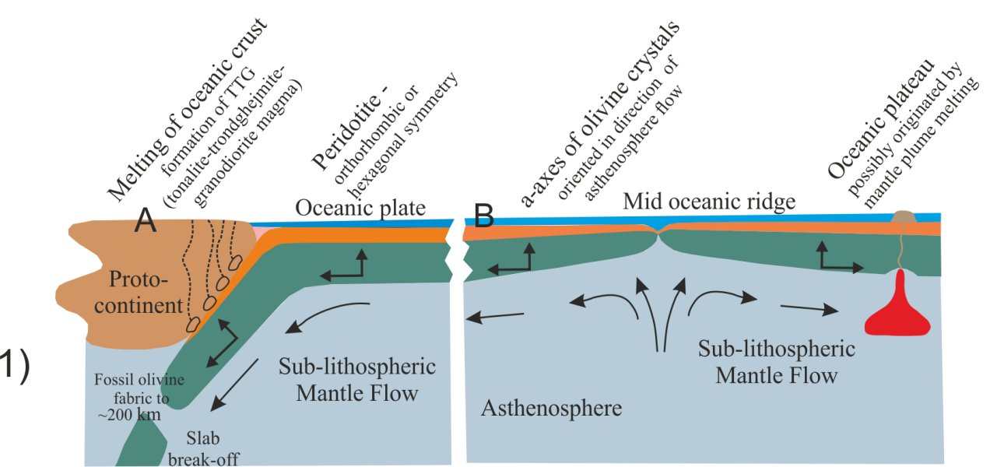
IG CAS
Prague
Scenario of the suggested origin and growth of the continental lithosphere
Stage 1
The first subduction ceased.
V. Babuška and J. Plomerová, Solid Earth Sciences 5 (2020)
https://doi.org/10.1016/j.sesci.2019.12.003

Slide 6
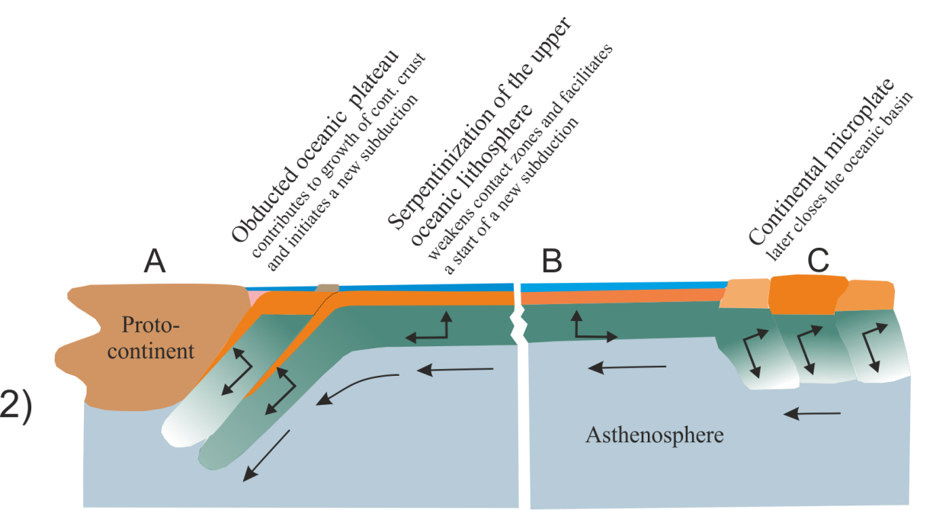
IG CAS
Prague
Scenario of the suggested origin and growth of the continental lithosphere
Stage 2
….. new subduction has started outboard of the enlarged continent
V. Babuška and J. Plomerová, Solid Earth Sciences 5 (2020)
https://doi.org/10.1016/j.sesci.2019.12.003

Slide 7
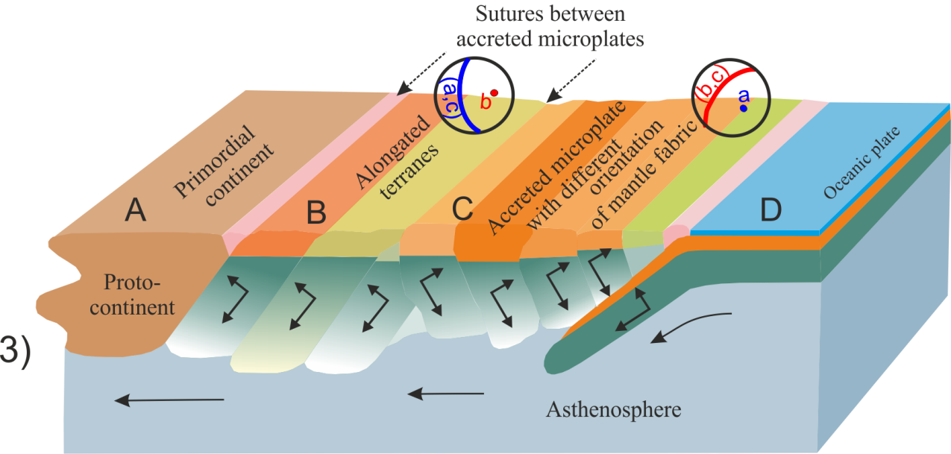
IG CAS
Prague
Scenario of the suggested origin and growth of the continental lithosphere
Stage 3
The process of continental building continued and resulted in a series of subductions accompanied by an assembly of elongated terranes paralleling strikes of the subductions.
V. Babuška and J. Plomerová, Solid Earth Sciences 5 (2020)
https://doi.org/10.1016/j.sesci.2019.12.003

Slide 8
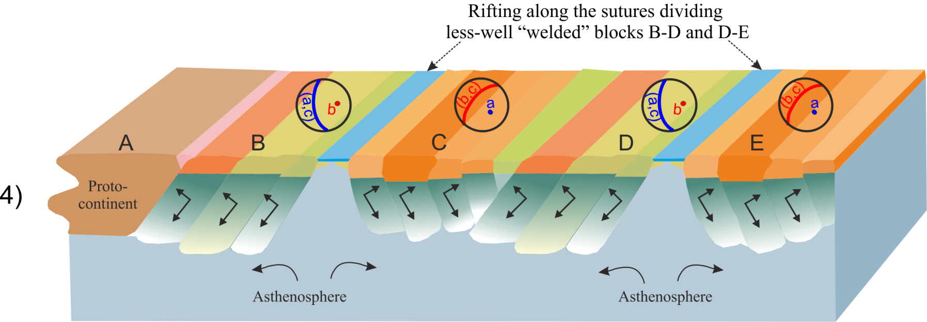
IG CAS
Prague
Scenario of the suggested origin and growth of the continental lithosphere
Stage 4
C
The large elongated parts of continents were subsequently separated into micro-plates and later dispersed.
V. Babuška and J. Plomerová, Solid Earth Sciences 5 (2020)
https://doi.org/10.1016/j.sesci.2019.12.003

Slide 9
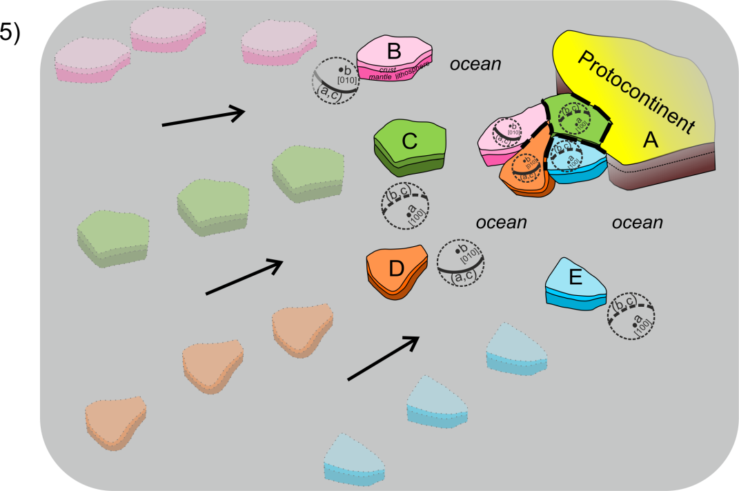
IG CAS
Prague
Scenario of the suggested origin and growth of the continental lithosphere
Stage 5
The process continued by a wander of microplates, later amalgamated into a new continent.
Mantle lithosphere with fossil olivine fabrics acts as a raft carrying the crust on top. The process resulted in a patchwork of microplates with their own fabrics and history assembled into a new continent.
V. Babuška and J. Plomerová, Solid Earth Sciences 5 (2020)
https://doi.org/10.1016/j.sesci.2019.12.003

Slide 10
IG CAS
Prague
Examples of independent findings from petrology and geochemistry supporting the presented model
continental lithosphere originally formed at hot oceanic ridges – in accord with our model derived from seismic anisotropy observations
composition of depleted peridotites that build the mantle lithosphere of the cratons requires formation at shallower depths than they currently reside; the peridotites originally formed in oceanic or arc environments (Lee et al., 2011; Servali and Korenaga, 2018)
Trace element data from silicate and sulphide inclusions in diamonds from beneath the Archean cratons (southern Africa, Yakutia, Brazil) suggest that the Archean continental lithosphere evolved by tectonic stacking of oceanic lithosphere during intra-oceanic collisions (Hart et al., 1997).
Timing of diamond formation examined in relation to the lithosphere evolution reveals that cratonic peridotites formed within Archean subduction zones (Pearson and Wittig, 2008), providing thus a compelling support for continental lithosphere construction via tectonic stacking of oceanic plates.
V. Babuška and J. Plomerová, Solid Earth Sciences 5 (2020)
https://doi.org/10.1016/j.sesci.2019.12.003

Slide 11
IG CAS
Prague
Conclusions
Olivine preferred orientation (LPO), formed by mantle convection in the oceanic mantle lithosphere due to its spreading on both sides of the mid-ocean ridges, is a prerequisite for the tilted anisotropies that we model in the continents.
We explaine the systematically oriented dipping fabrics in the continental mantle lithosphere by successive subductions of ancient oceanic plates and their accretions enlarging primordial continent cores.
Consequent continental break-ups and assemblages of wandering micro-plates preserve “frozen” anisotropic fabrics and create patchwork structures of the present-day continents.
Supporting arguments for such model arise from petrological and geochemical studies indicating that continental mantle peridotites formed in oceanic environments and became “continental” after significant thickening or underthrusting.
Combining seismological, petrologic and geochemical findings can help to bridge the gulf between the different viewpoints and evoke further discussions on possible growth mechanisms of the continental lithosphere.
V. Babuška and J. Plomerová, Solid Earth Sciences 5 (2020)
https://doi.org/10.1016/j.sesci.2019.12.003

