Slide 1
GPS/IMU/Odometer based train positioning
Qing Li, Robert Weber
Department Geodesy&Geoinformation
Research Division Höhere Geodäsie
TU Vienna

Slide 2
KF filtering of GPS/IMU/Odometer data
Nowadays, reliable train positioning in real-time as well as in post-processing can be based on
GNSS and IMU sensor fusion. The sensor fusion allows to combine the advantages of GNSS
long term stability and INS short term stability. Moreover GNSS outages can be compensated.
An additional aiding source: Odometer
Odometer data are counts of impulses, which relate the wheel’s circumference to the velocity and the distance traveled by the train.
In case of GPS outages, the integrated system can switch from GPS/IMU to IMU/Odometer mode.
In the presented work an IMU device, a GPS receiver and an Odometer provide the data input for a loosely coupled Kalman Filter integration algorithm.
The quality of our solution was tested against trajectories obtained with the software iXCOM-CMD (iMAR) as reference.

Slide 3
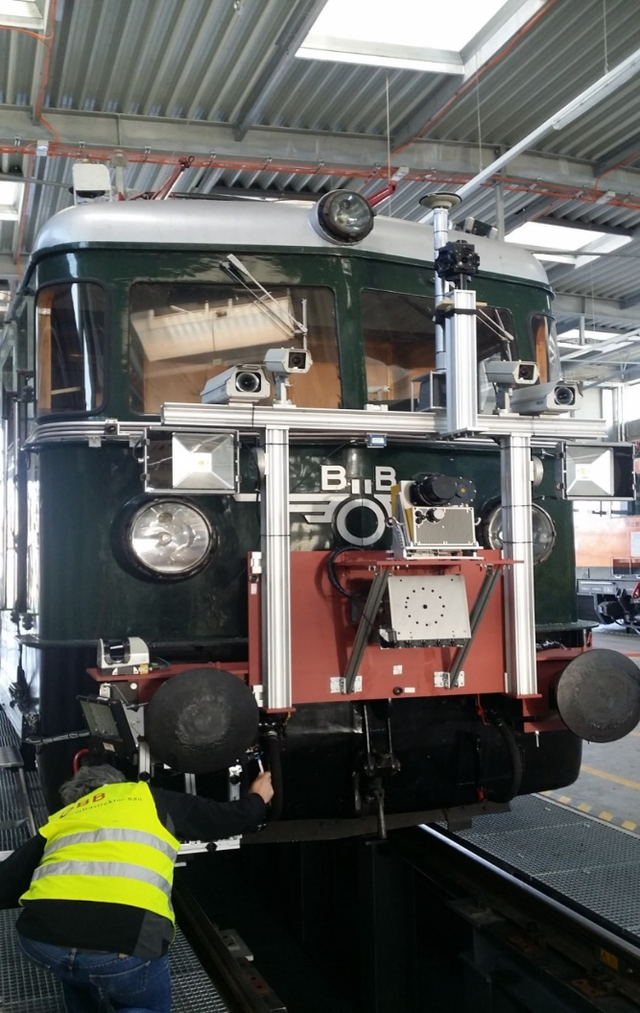
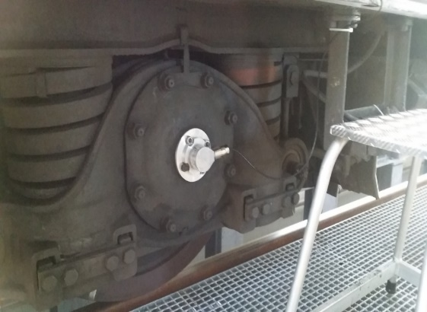
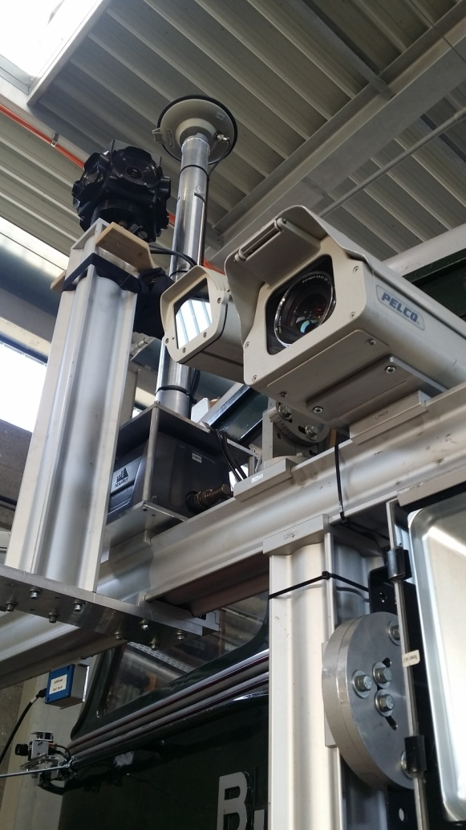
Equipment onboard
Odometer
(Velocity, Orientation (YAW))
GNSS-Antenne
(position)
IMU
(Orientation)
Panoramacamera
Camera
( Stereo,RGB&SIW)
Laserscanner
Gleisbettscanner

Slide 4
f,ω
Structure of algorithm (Loosely coupled)
δp, δv,ε
IMU
IMU processer (matlab)
p ,v ,R (estimated)
p,v,R(IMU)
Kalman Filter (Matlab) Sensor Fusion
GPS available
δrp δv,ε
GNSS receiver
p,v
GNSS processor (GrafNav)
p,v (GNSS), Qll
δp, δv,ε
IMU
IMU process0r (matlab)
p ,v ,R (estimated)
$$f_{ib,}^{b}w_{ib}^{b}$$
p,v, $R_{b}^{n}$ (IMU)
Kalman Filter (Matlab) Sensor Fusion
Outage of GPS
ODO
$$R_{b}^{n}$$
δp δv,ε
$$V_{odo}$$
Odometer calibration
v (Dead reckoning)

Slide 5
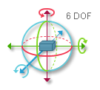
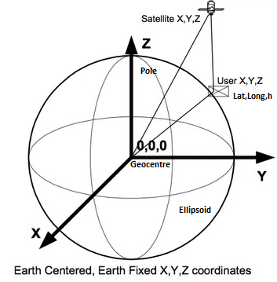
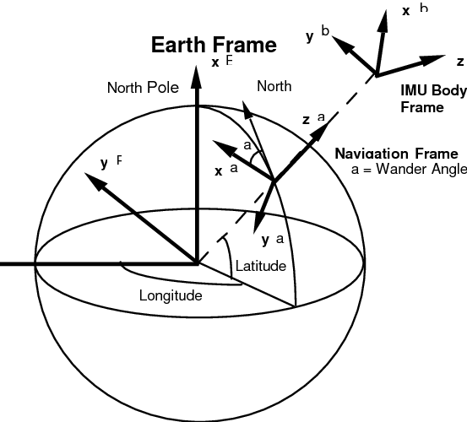
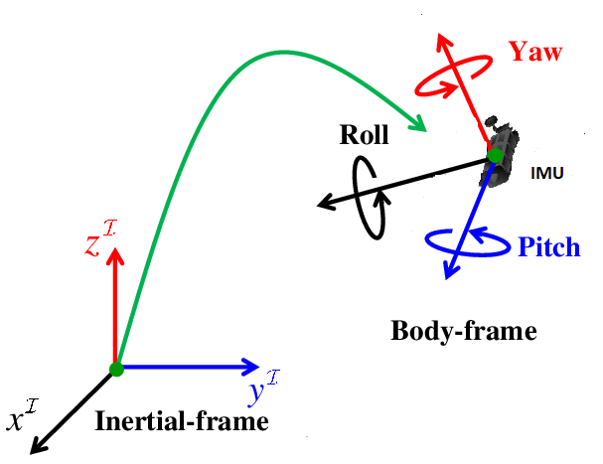
Navigation frame
GPS
Odometer
IMU
Navigationsframe

Slide 6
Concept of Kalman Filter
IMU Initialization
Update
${\tilde{x}}_{k}= {\tilde{x}}_{k}$+k($z_{k}−H_{k}{\tilde{x}}_{k}$)
$P_{k}$=($I−{kH}_{k}{\tilde{x}}_{k}$) ${\tilde{P}}_{k}$
$$k=P_{k}H_{k}{[{H_{k}P}_{k}H_{k}^{T}+R_{k}]}^{−1}$$
Update
𝑥 ̃_𝑘= 𝑥 ̃_𝑘+k(𝑧_𝑘−𝐻_𝑘 𝑥 ̃_𝑘)
𝑃_𝑘=(𝐼−〖𝑘𝐻〗_𝑘 𝑥 ̃_𝑘) 𝑃 ̃_𝑘
𝑘=𝑃_𝑘 𝐻_𝑘 〖[〖𝐻_𝑘 𝑃〗_𝑘 𝐻_𝑘^𝑇+𝑅_𝑘]〗^(−1)
Prediction
${\tilde{x}}_{k+1}= F_{k}{\tilde{x}}_{k}$+$G_{k}w_{k}$
${\tilde{P}}_{k+1}$= $F_{k}P_{k}F_{k}^{T}$ + $Q_{k}$
Prediction
𝑥 ̃_(𝑘+1)= 𝐹_𝑘 𝑥 ̃_𝑘+𝐺_𝑘 𝑤_𝑘
𝑃 ̃_(𝑘+1)= 𝐹_𝑘 𝑃_𝑘 𝐹_𝑘^𝑇 + 𝑄_𝑘
$x_{k}$ is the state vector estimated at time $t_{k}$
$P_{k}$ is the state covariance matrix
$F_{k}$ denotes the transition matrix, it relates ${\tilde{x}}_{k+1}$ and ${\tilde{x}}_{k}$ in the absence of a forcing function
$G_{k}$ is the processing noise matrix
$w_{k}$ is disturbance sequence: noise are from IMU specification (iNAT-M200/SLN from Imar)
$Q_{k} is the$ disturbance covariance matrix: diag($w_{k}$)
$z_{k}$ is the measurement vektor at time $t_{k}$
$H_{k}$ is the measurement matrix, it relates $z_{k}$ and $x_{k}$
k is the Kalman Gain matrix
$R_{k}$ is the measurement noise matrix

Slide 7
GPS/IMU data processing
Data rate: IMU 500Hz, GPS 1Hz, Odometer 10Hz
15 state vector: ${σx}_{φ,λ,h}$, ${ σv}_{e,n,d} , {σε}_{r,y,p},{ σB}_{f},{ σB}_{w,}$
z = : $\left(\begin{matrix}{ P∗(Xr}_{imu}−{Xr}_{GPS}) \\ { V}_{imu}−V_{GPS}\end{matrix}\right) P$ = $\left(\begin{matrix}´(M+h) & 0 & 0 \\ 0 & \left(N+h\right)∗cos⁡(φ) & 0 \\ 0 & 0 & 1\end{matrix}\right)$
$V_{GPS}$: 3D Velocity from the GPS solution
H Matrix : $\left(\begin{matrix}P∗I & 0 & 0 \\ 0 & I & 0\end{matrix} \begin{matrix}0 & 0 & 0 \\ 0 & 0 & 0\end{matrix}\right)$
Change to 16 state vector: ${σx}_{φ,λ,h}$, ${ σv}_{e,n,d} , {σε}_{r,y,p},{ σB}_{f},{ σB}_{w,}{σmb}_{odo} (Scale factor error of odometer)$
Velocity : 1D Odometer measurement
z = $\left(\begin{matrix}{ V}_{imu}−V_{odo}\end{matrix}\right)$
H Matrix : $\left(\begin{matrix}0 & I & Vl_imu_× & 0 & 0 & −Vl_imu\end{matrix}\right)$
$Vl_imu_×$ is a skew-symmetric matrix (bases on the 3D Velocity components calculated by IMU)
in case of GPS signal blocking we switch to IMU/ODO processing
$V_{odo}$ =$C_{b}^{n}∗\left(1−δmb\right)∗\left(\begin{matrix}V_{odo} \\ 0 \\ 0\end{matrix}\right)$

Slide 8
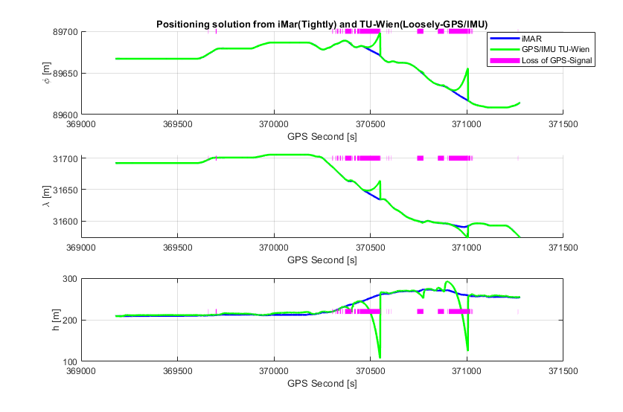
Position solution from TU-Wien Software(GPS/IMU)
Problem: loss of GPS Signal
${σr}_{gps}$ and ${σv}_{gps}$ are the measurement noise obtained from the GPS solution
Rr_gps = $C_{e∗}^{n}\left(\begin{matrix}{σr}_{gps}^2 & 0 & 0 \\ 0 & {σr}_{gps}^2 & 0 \\ 0 & 0 & {σr}_{gps}^2\end{matrix}\right)$
Rv_gps = $C_{e∗}^{n}\left(\begin{matrix}{σv}_{gps}^2 & 0 & 0 \\ 0 & {σv}_{gps}^2 & 0 \\ 0 & 0 & {σv}_{gps}^2\end{matrix}\right)$
Measurement covariance matrix
R = $\left(\begin{matrix}Rr_gps & 0 \\ 0 & Rv_gps\end{matrix}\right)$
Reference Solution : Software iXCOM-CMD from iMar (Tightly coupled processing with integration of GPS/IMU/ODO )

Slide 9
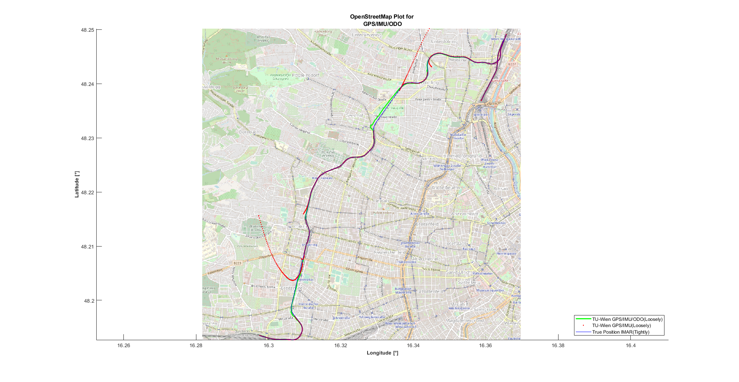
Position solution from TU-Wien Software(GPS/IMU/ODO)
The coordinate solution bases on GPS/IMU sensor fusion, as soon as the GPS signal fails, the system changes to IMU/ODO processing.
Measurement covariance matrix with IMU/ODO
Rv_odo = $C_{b∗}^{n}\left(\begin{matrix}{σv}_{odo}^2 & 0 & 0 \\ 0 & {σv}_{odo}^2 & 0 \\ 0 & 0 & {σv}_{odo}^2\end{matrix}\right)$
The test track covers a distance of 11.8km.

Slide 10
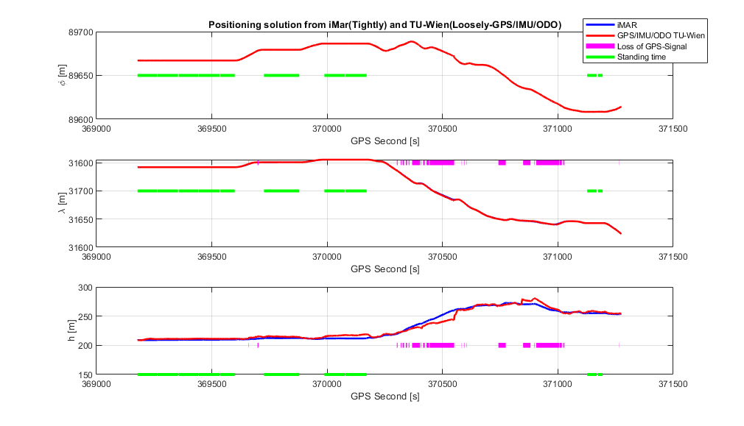
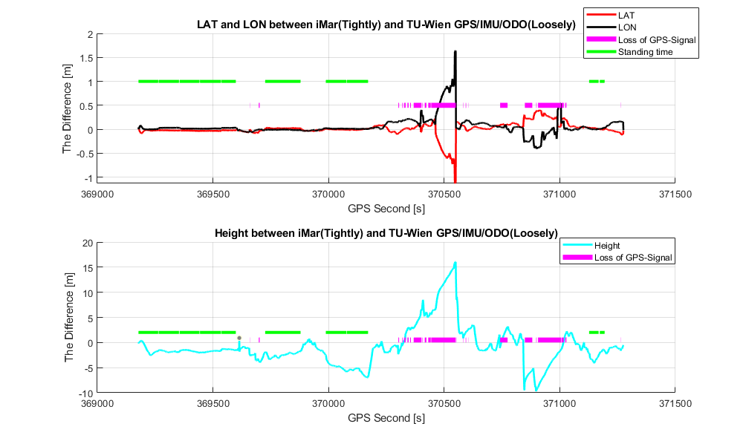
Position solution from TU-Wien Software(GPS/IMU/ODO)
Difference in positioning

Slide 11
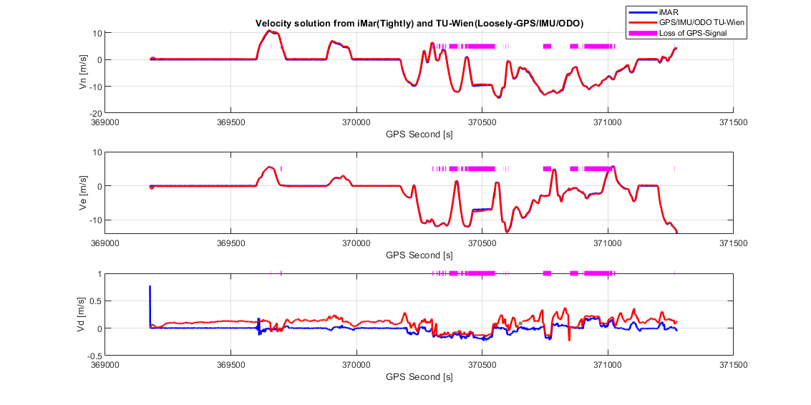
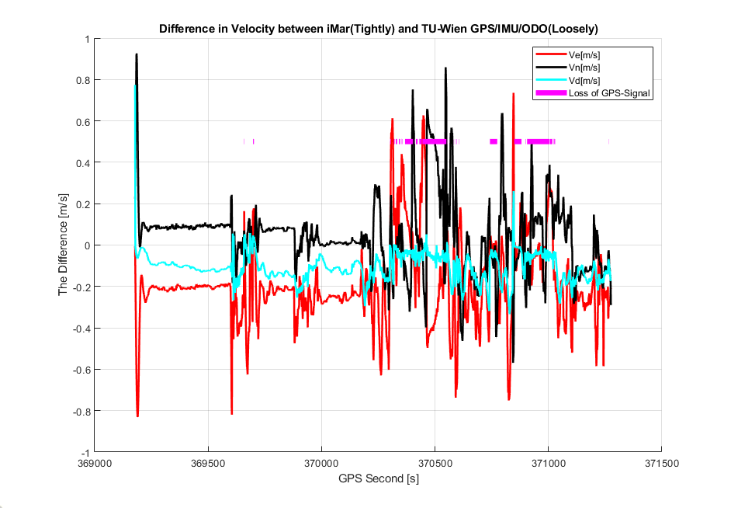
Velocity solution from TU-Wien Software(GPS/IMU/ODO)

Slide 12
Conclusions
3 GPS outages of 522 sec, 147 sec and 183 seconds had to be compensated by INS and odometer data
In case of GPS outages position and velocity differences of the combined INS/Odometer solution w.r.t. the reference solution are significantly smaller than those of the INS alone solution. In the worst case, the plain position differences between the GPS/IMU/ODO trajectory calculated in our Software and the reference trajectory are about 1,5 m in the presence of GPS signal blockages.
The aiding of an GPS/INS solution by odometer data can minimize growing INS errors and can bridge even long
GPS signal outages. It provides a continuous train PNT.
04.05.2020
EGU 2020 Session G1.3

