Slide 1
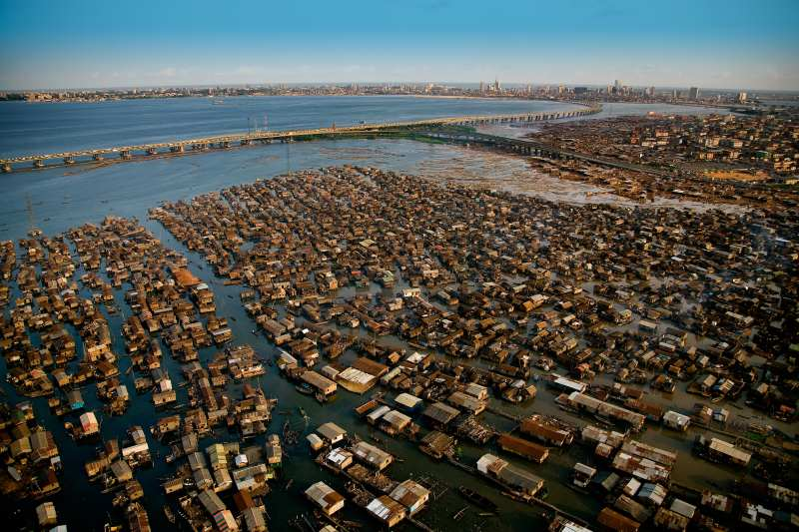
Composition, structure, diversity and abundance gradients of benthic foraminifera in the Lagos Lagoon (Nigeria) as tracers of environmental perturbations
Olugbenga T. Fajemila¹ , Nisan Sariaslan² and Martin R. Langer²
¹Department of Geological Sciences, Osun State University, Osogbo, Nigeria
²Institut für Geowissenschaften, Abteilung Paläontologie, Rheinische Friedrich-Wilhelms Universität, Nussallee 8, 53115 Bonn, Germany.

Slide 2
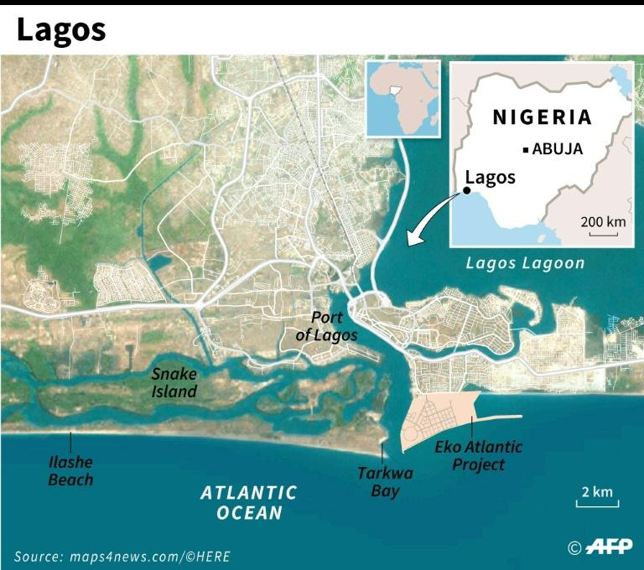
Location and Geology of the Lagos Lagoon
3º 23'
3º 40'
6º 22'
6º 38'

Slide 3
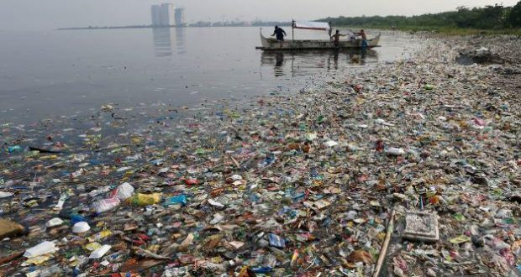
Current Situation in the Lagos Lagoon
Lagos Lagoon is situated in the largest megacity in the African continent, which has a population of more than 20M people.
Among all the megacities in the world, it is the only one that also harbors a lagoon.
Lagos Lagoon Environment ranks first among the most polluted African ecosystems (data from WHO and Africa UN Environment).
Basin-wide planning is a must for sustainable development in Lagos (Eruola et al., 2011).

Slide 4
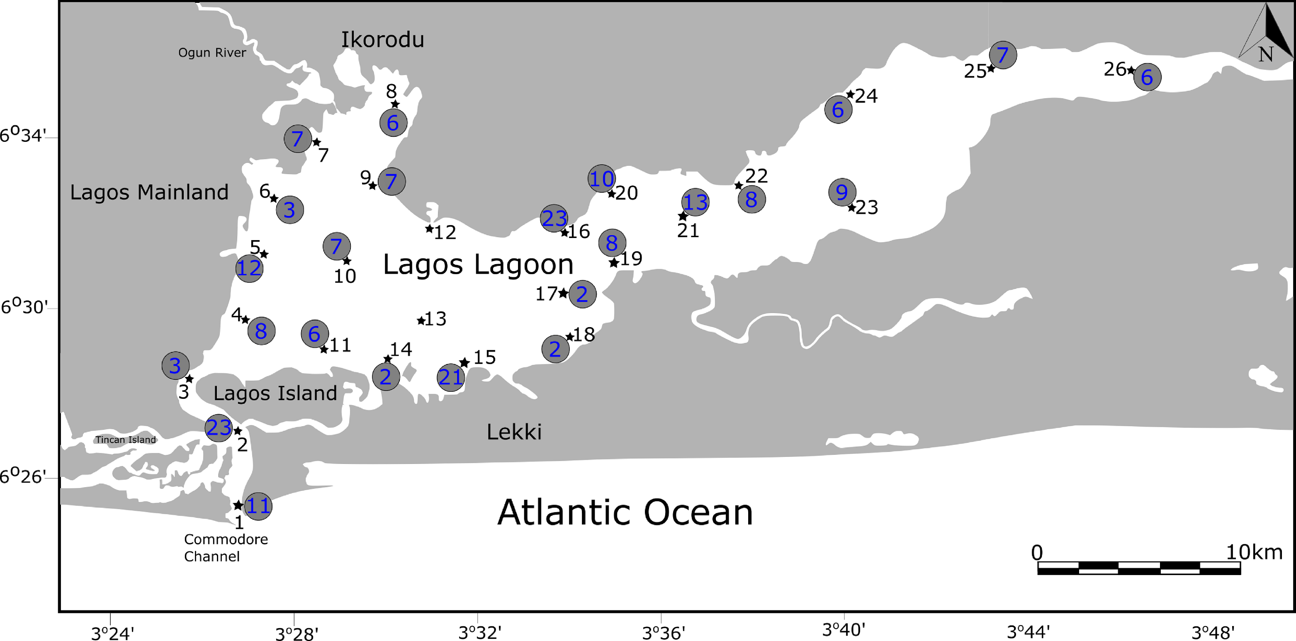
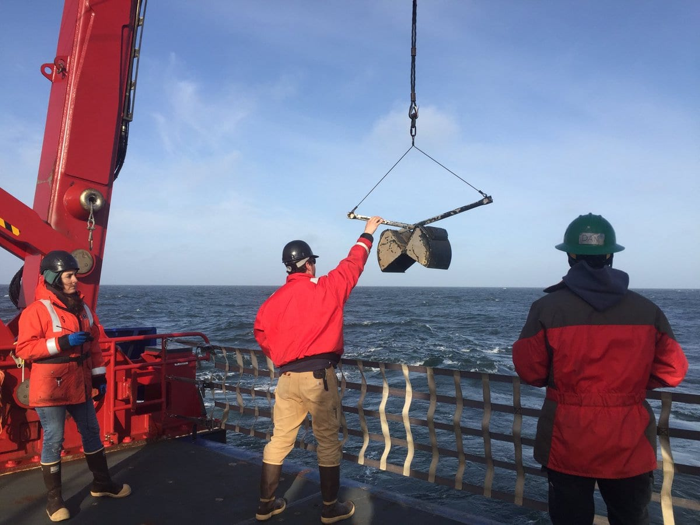
Distribution of the Sampling Sites

Slide 5
Distribution of the Sampling Sites

Slide 6
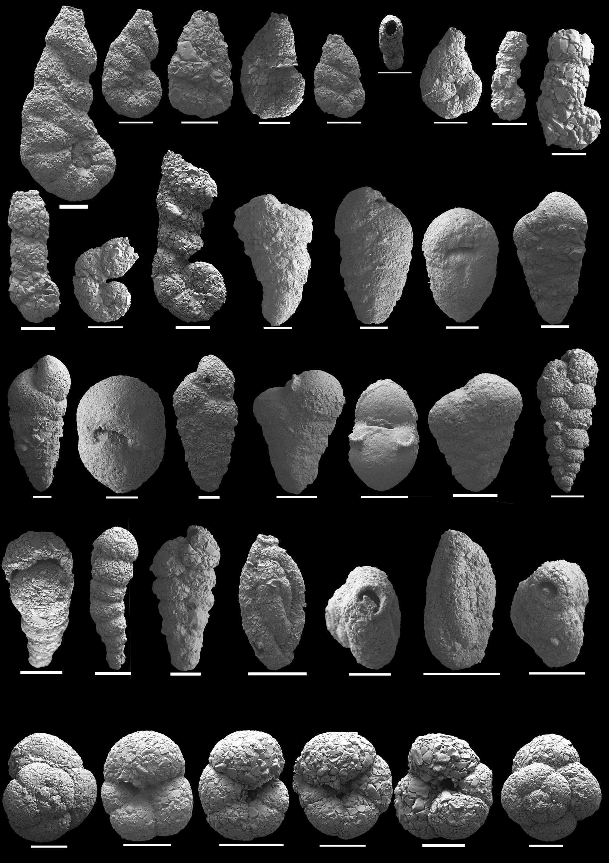
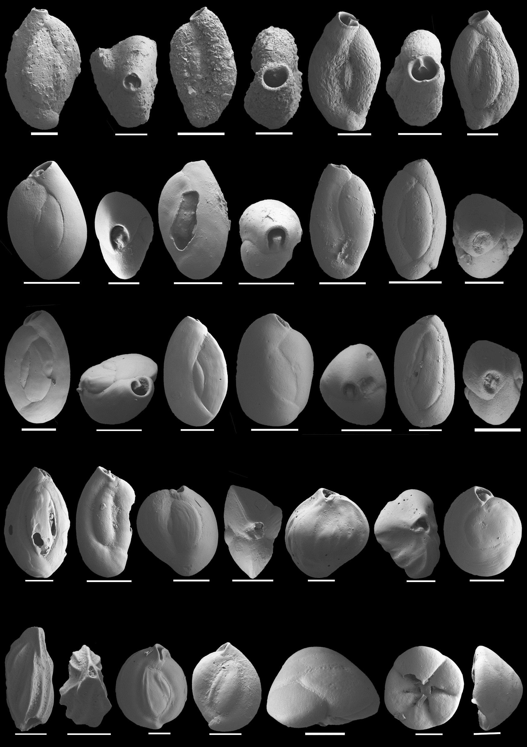
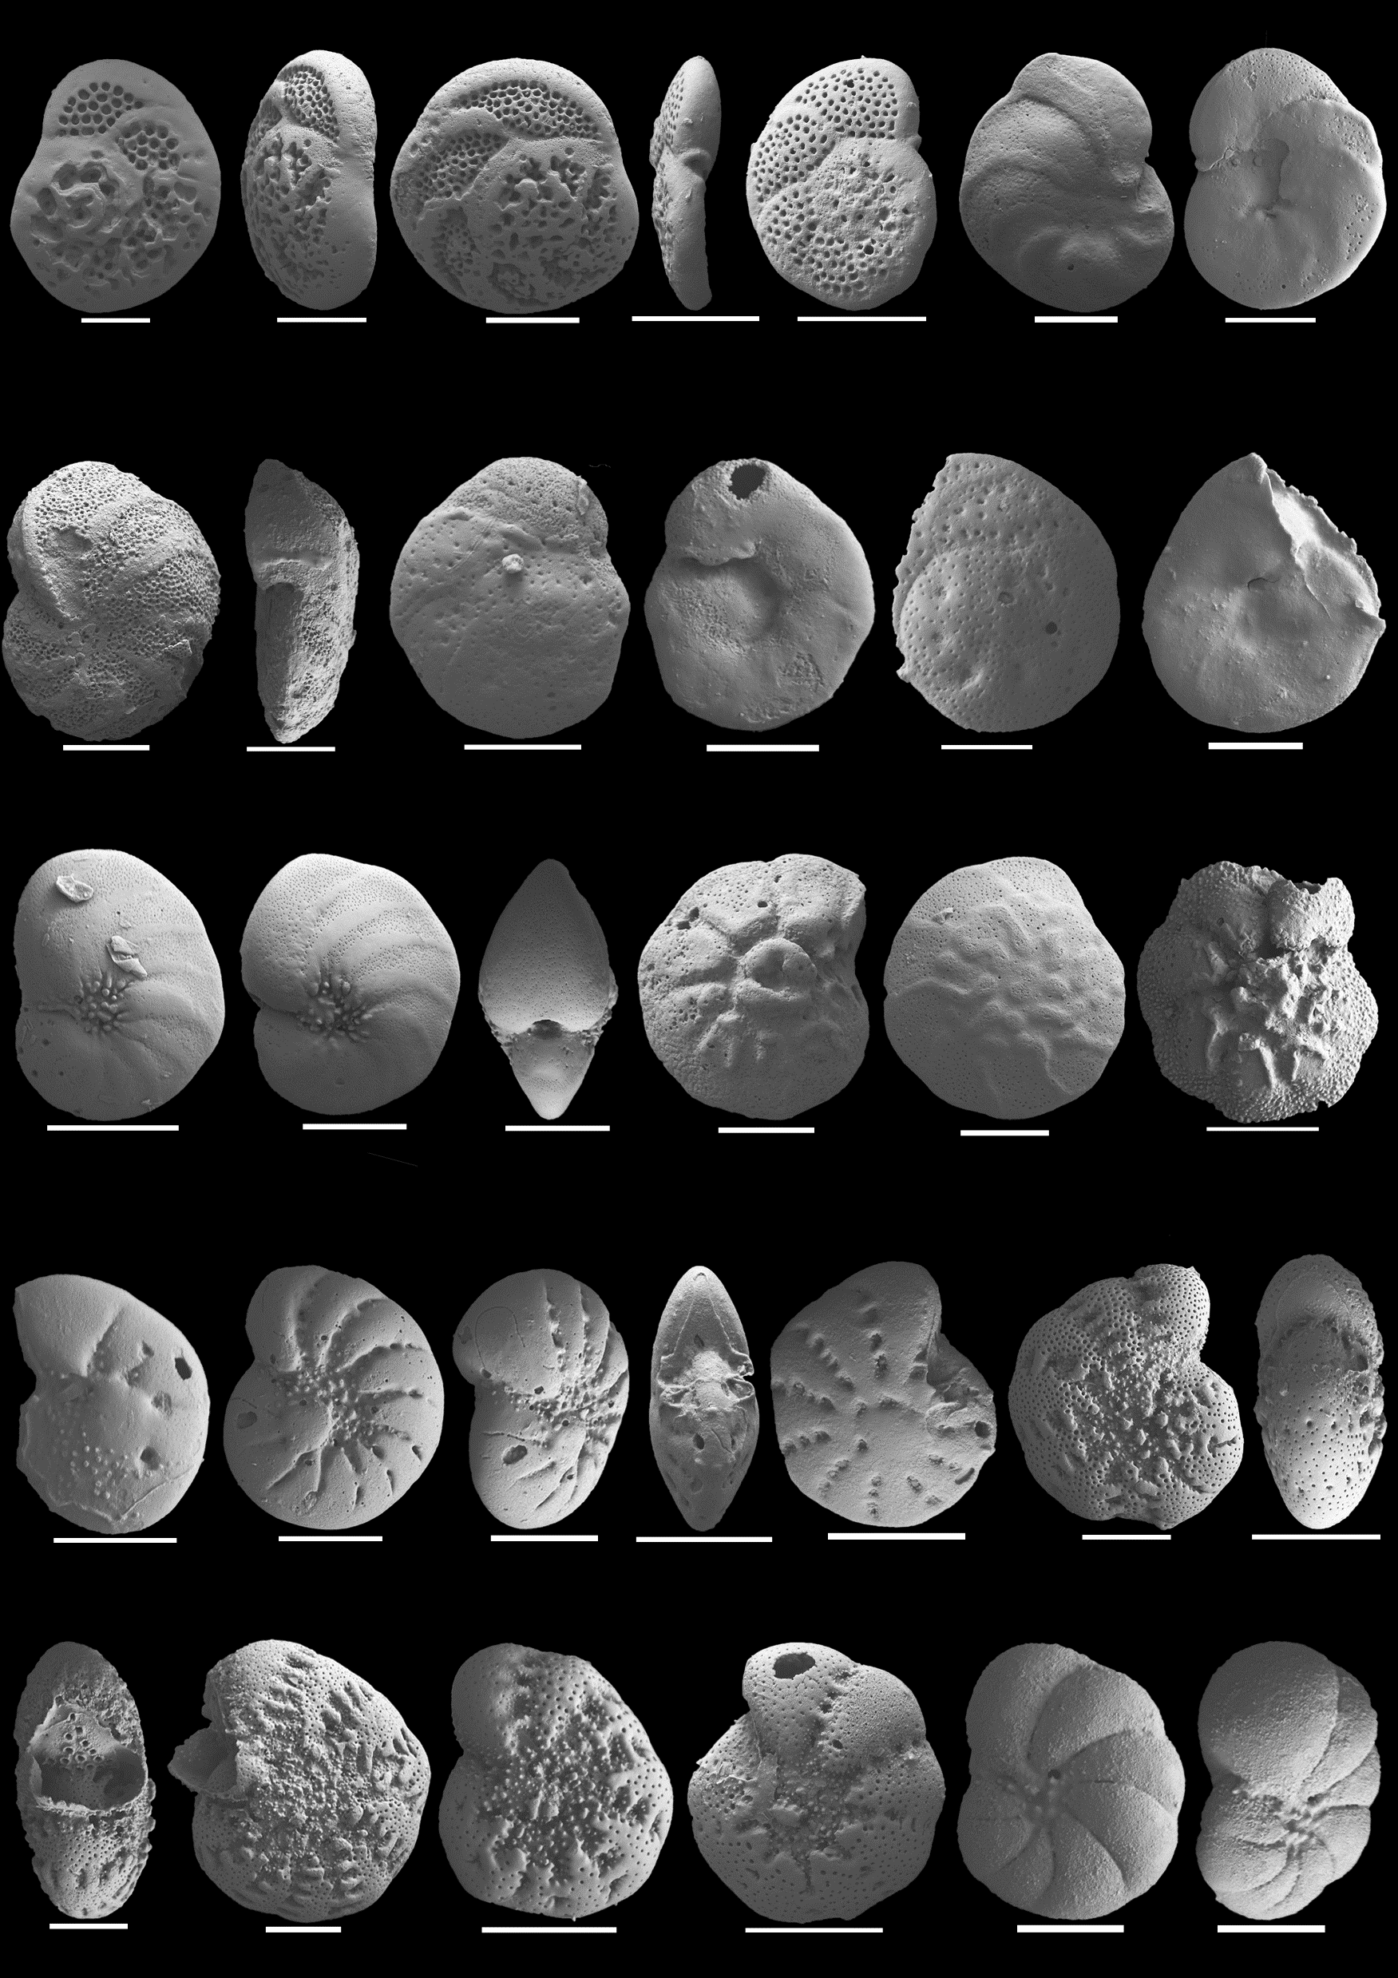
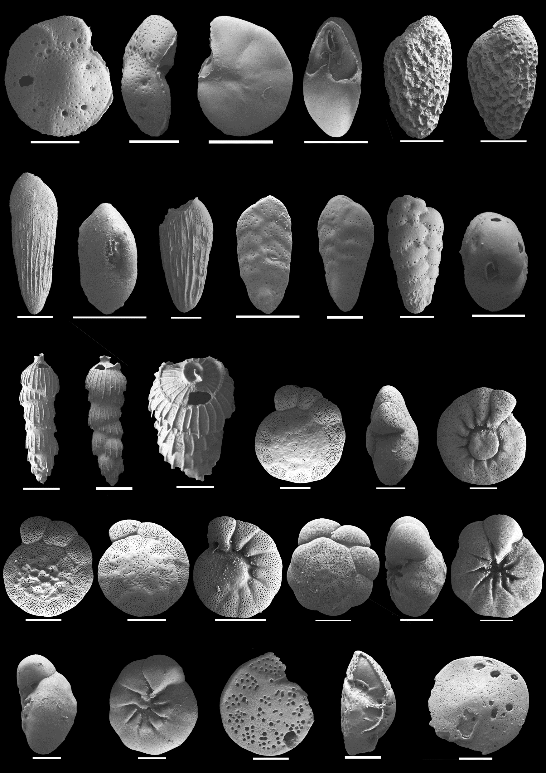
Analysis of the Foraminifera in the Lagos Lagoon
Total assemblages adding up to 3872 individuals were analysed.
All specimens were identified to species level, and illustrated by SEM and presented as a catalogue.

Slide 7
Analysis of the Foraminifera in the Lagos Lagoon
Foraminiferal Diversity Map: Species richness
Number of
species
Areas of high diversity are in non- or less polluted areas and at the entrance to the lagoon
Low diversity areas are near the oil refineries, the river outlets and the textile industry

Slide 8
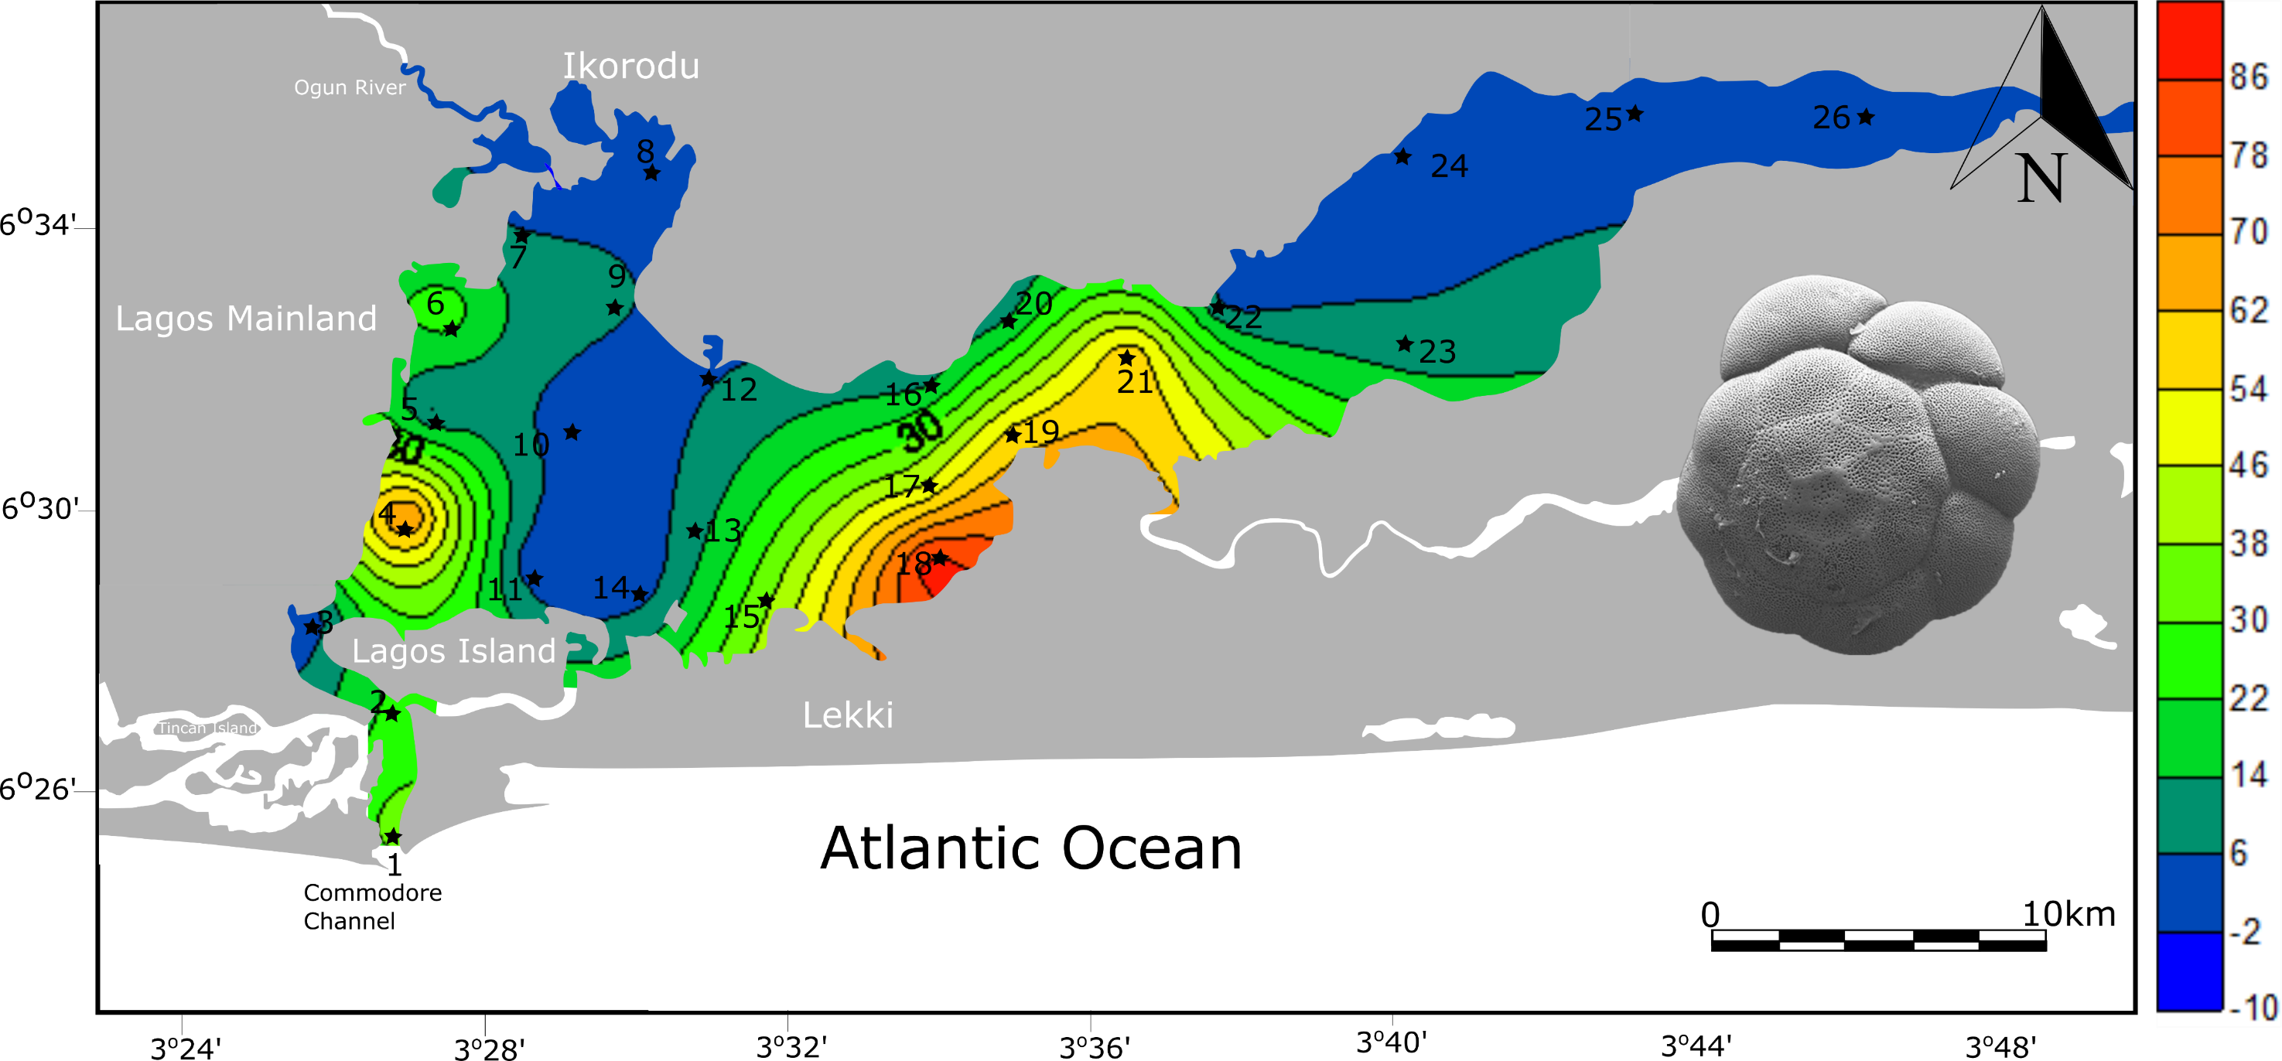
Analysis of the Foraminifera in the Lagos Lagoon
Abundance patterns of the most frequent and abundant species were plotted over the lagoon to identify specific tolerance levels to pollution:
Ammonia tepida
% of the
total assemblage
Ammonia tepida is rare in the most polluted lagoon areas and in fresh water areas in the east, but tolerates urban runoff.

Slide 9
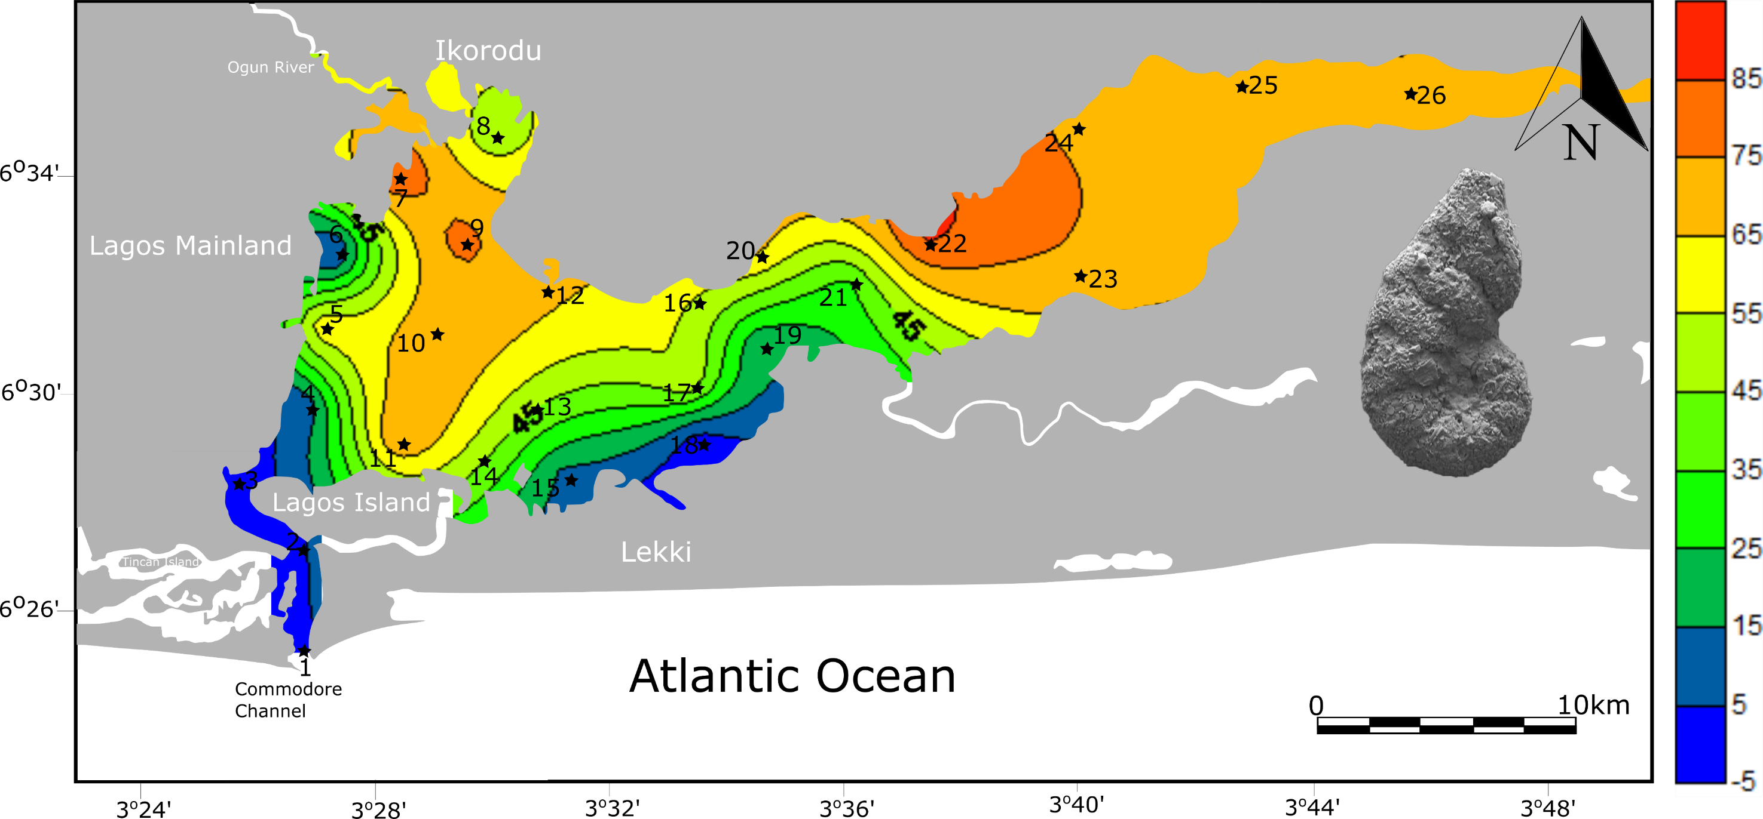
Analysis of Foraminifera in the Lagos Lagoon
Abundance patterns of the most frequent and abundant species were plotted over the lagoon to identify specific tolerance levels to pollution:
Ammotium salsum
% of the
total assemblage
Ammotium salsum is abundant in low salinity areas and also near the textile industry outlets.

Slide 10
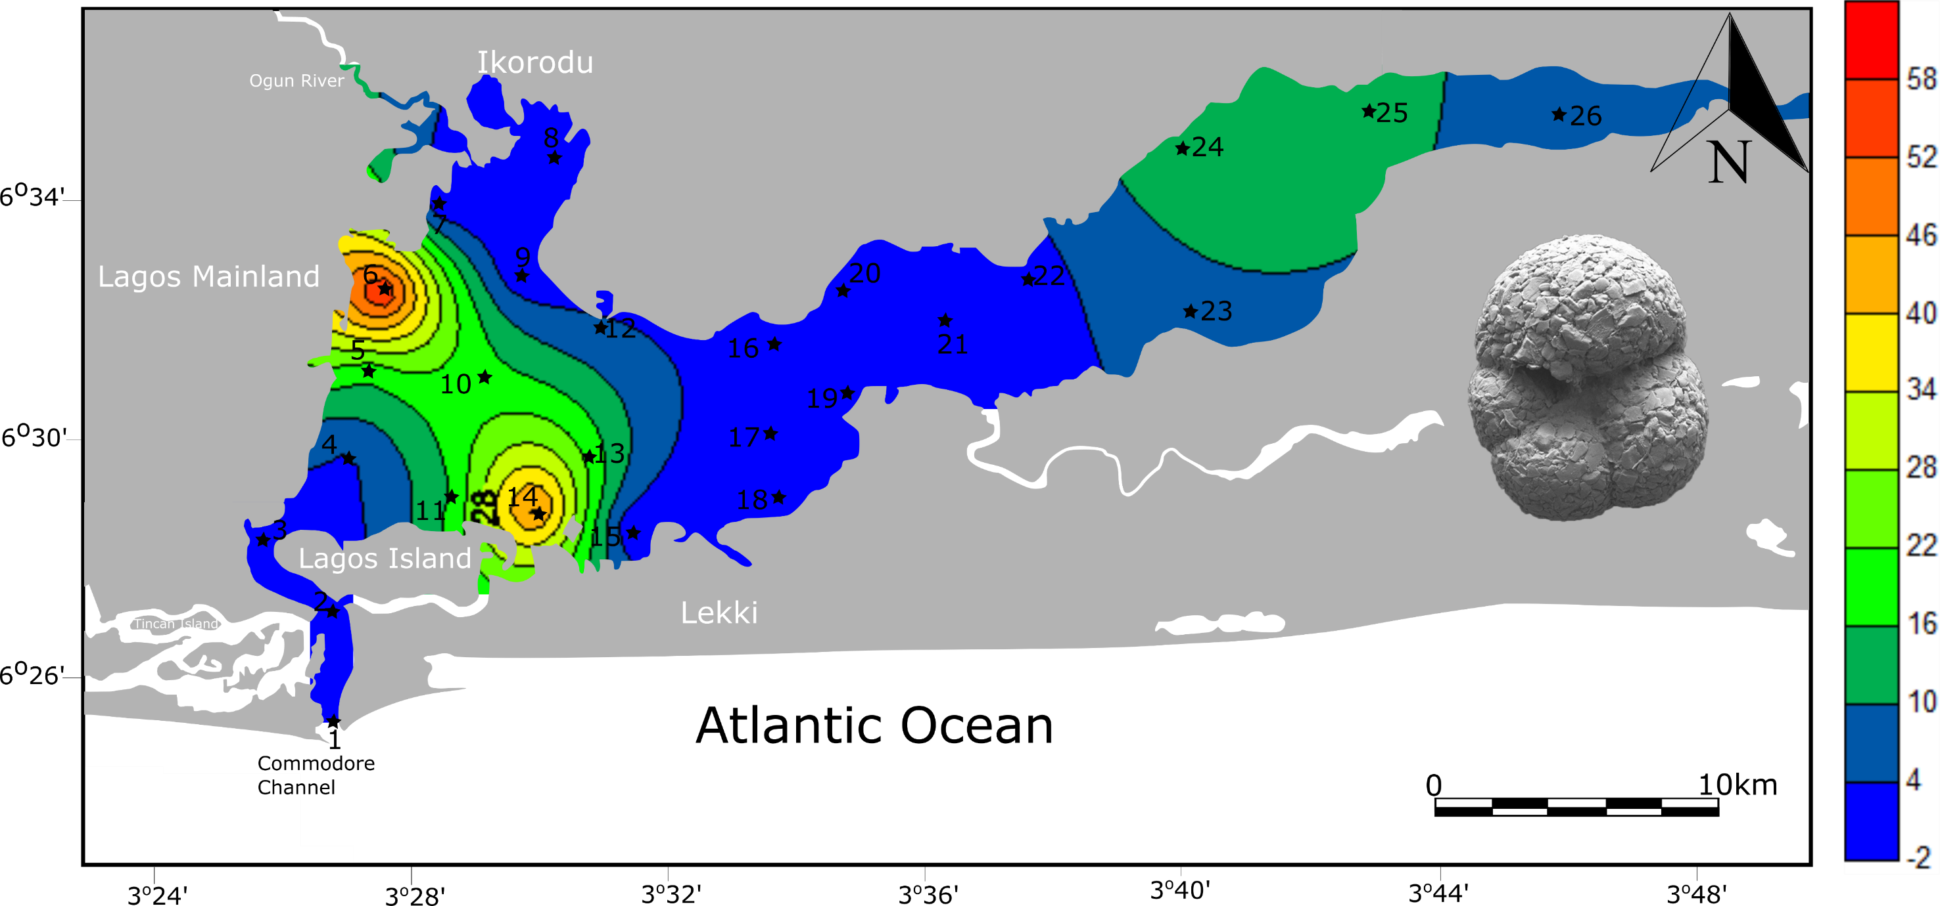
Analysis of the Foraminifera in the Lagos Lagoon
Abundance patterns of the most frequent and abundant species were plotted over the lagoon to identify specific tolerance levels to pollution:
Trochammina sp. 1
% of the
total assemblage
Trochammina sp. 1 is abundant near urban sewage areas.

Slide 11
Analysis of the Foraminifera in the Lagos Lagoon
Statistical Analyses of distribution patterns have been done to associate certain assemblages and/or species with certain environmental and ecological parameters:
via Cluster and Principal Component Analyses…

Slide 12
Analysis of the Foraminifera in the Lagos Lagoon
Cluster Analysis
R and Q modes of cluster analyses were performed on the most frequent 13 species (98.3 % of the whole population).
Subgroups:
R1→ dominated by Trochammina and Miliammina
R2→ dominated by Ammonia tepida and calcareous species representing the marine realm, as Quinqueloculina seminulum, Discorbinella rhodiensis, Elphidium gunteri, Nonion fabum, Neoeponides sp. etc.
Q1 → dominated by Ammotium salsum and agglutinated species
Q1A: high abundance of Ammotium species
Q1B: high abundance of Ammotium species
Q1C: high abundance of Ammotium salsum and Trochammina sp.
Q2: dominated by Ammonia tepida
Group I
Group II

Slide 13
Analysis of the Foraminifera in the Lagos Lagoon
Principal Component Analysis
Principal component analysis (PCA) was performed on the most frequent 13 species (98.3 % of the whole population).
PCA is a dimension-reduction tool that can be used to reduce a large set of variables to a small set that still contains most of the information in the large set, which helps us to describe and classify our extensive foraminiferal occurrence dataset.
Its aim is simply, data visualization.
2 major groups are identified:
Agglutinated group, which is prevalent in the eastern lagoon, strongly related to Ammotium salsum
Hyaline perforate and porcellaneous species of the western lagoon strongly related to Ammonia tepida
Group I
Group II
Group II

Slide 14
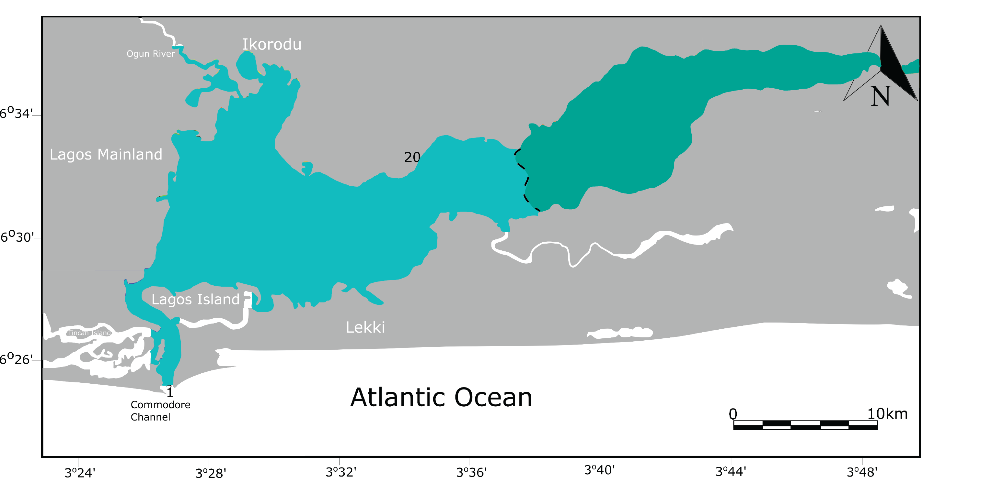
Conclusions
Group I
A. salsum dominated by
agglutinated taxa;
adapted to more fresh- and
clean waters
Group II
A. tepida dominated by
hyaline perforated and
porcellaneous taxa;
adapted to extremely
polluted waters
For the first time, the complete foraminiferal fauna from Lagos Lagoon is identified, illustrated and described to species level.
Species specific distribution patterns were recognized, with individual taxa showing selective tolerance levels to various forms
of pollution.
A species-richness map covering the entire Lagos Lagoon was generated and serves as a baseline dataset for future studies.
Individual taxa may serve as bioindicators of pollution, with potential applications for other areas around Africa.
Work in progress: Lagoon-wide analysis of trace elements, to identify individual tolerance levels to specific forms of pollution…

