Slide 1
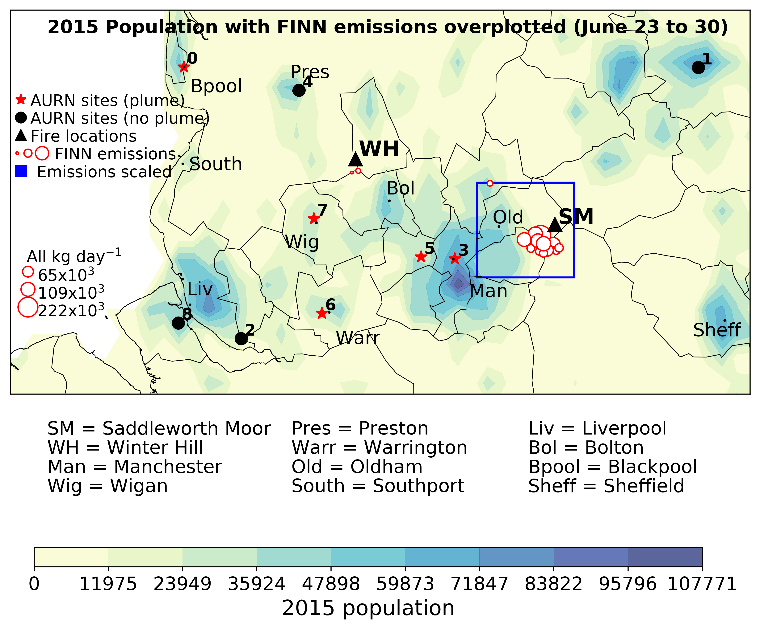
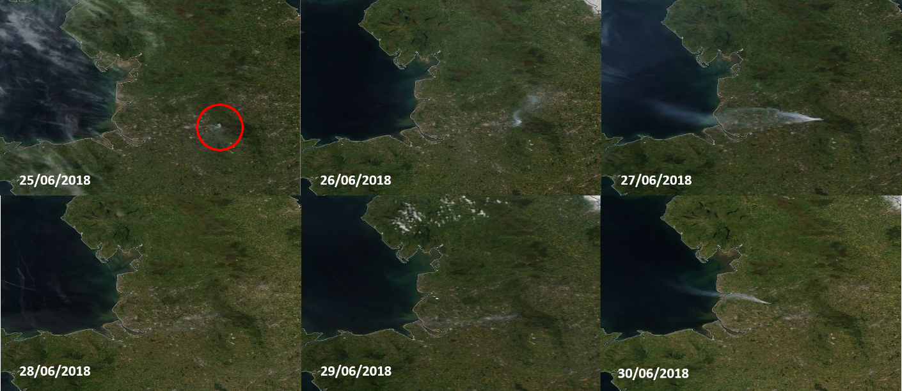
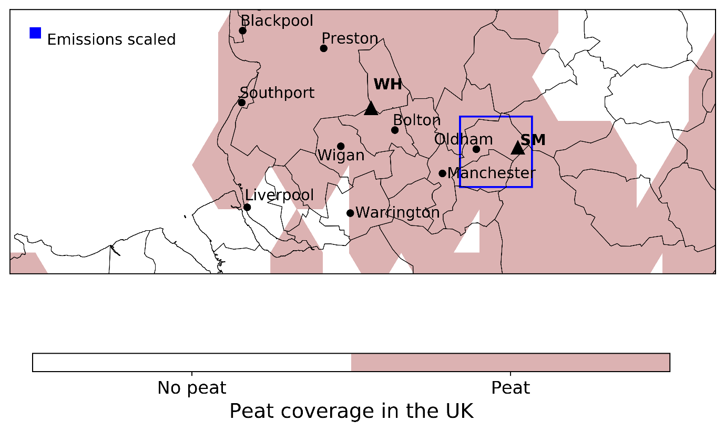
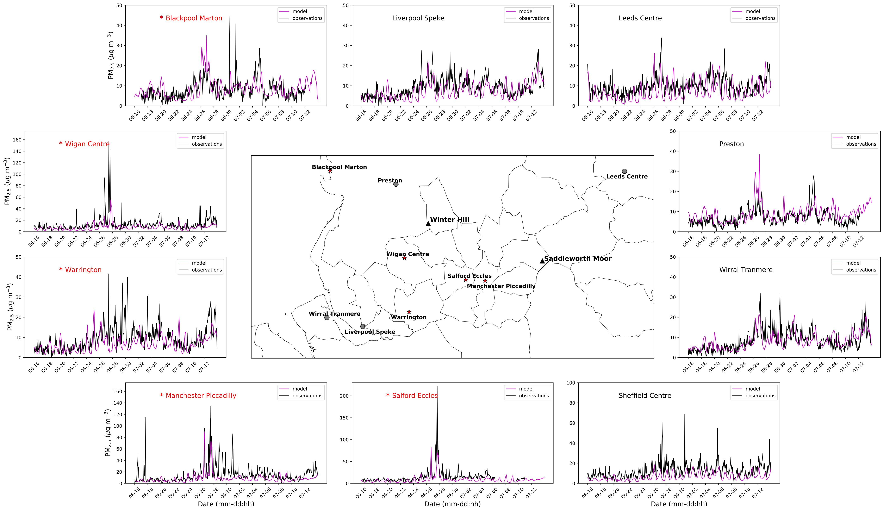
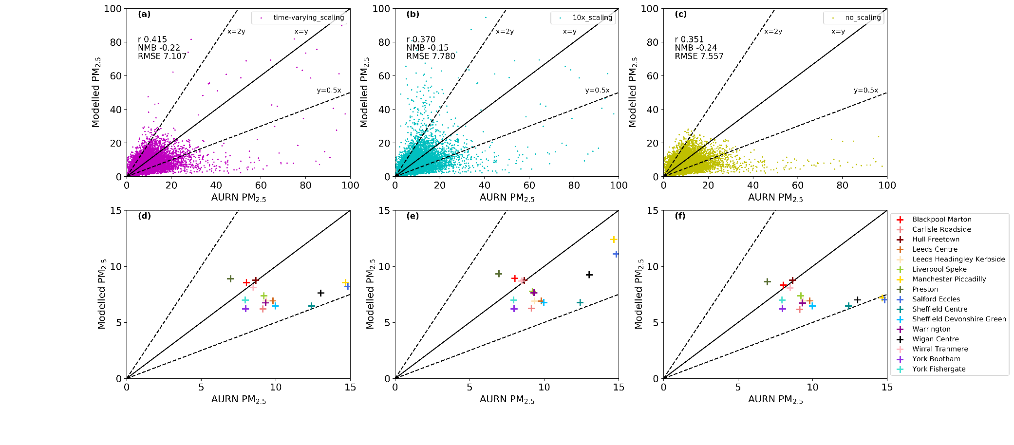
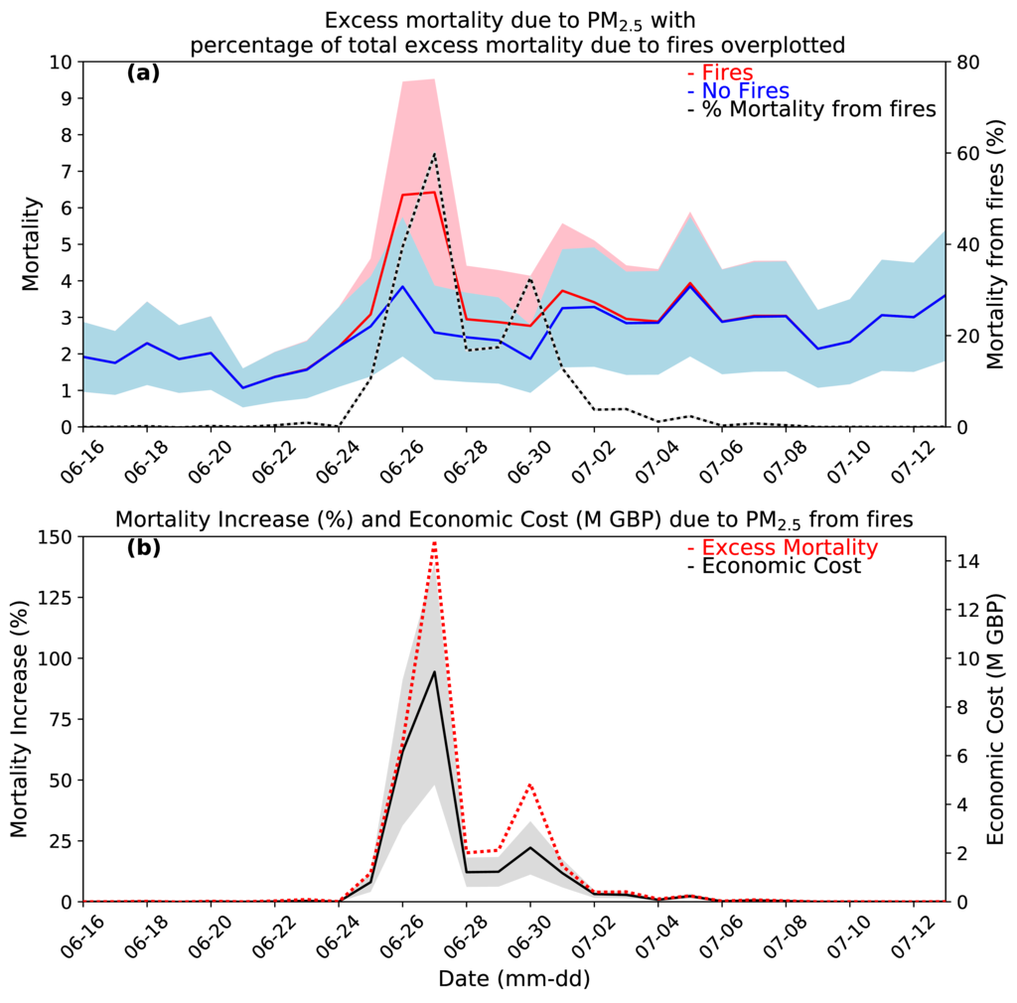
Impact of the 2018 Saddleworth Moor wildfires
on Air Quality and Health
Ailish M. Graham¹, Pope RJ^{1,2}, McQuaid JB¹, Bruno AG^{3,4}, Moore DP^{3,4}, Harrison JJ^{3,4}, Chipperfield MP^{1,2}, Arnold SR¹, Pringle K¹, Conibear L¹, Butt E¹, Reddington C¹, Keily L¹, Rigby, R⁵, Lee, J^{6,7} and Wilde, S⁶
1: Institute for Climate and Atmospheric Science, School of Earth and Environment, University of Leeds. 2: National Centre for Earth Observation, University of Leeds, Leeds, 3: Department of Physics and Astronomy, University of Leicester, Leicester, UK. 4: National Centre for Earth Observation, University of Leicester, Leicester, UK 5: Centre for Environmental Modelling and Computing, School of Earth and Environment, University of Leeds 6: Department of Chemistry, University of York, York. 7: National Centre for Atmospheric Science, University of York, York.
Contact: ee15amg@leeds.ac.uk
CO
Air Quality Impact
Up to 300% PM_{2.5} due to fires
4.5 million people exposed above WHO 24hrs PM_{2.5} limit
150% short-term Excess Mortality (E_{mPM2.5})
Up to 60% of E_{mPM2.5} from fires
Economic cost of mortality £21.1m
O₃
NO₂
Health Impact
Background
Simulation Domain
24th June
Fires break out on Saddleworth Moor
27th June
Peak size (8km²)
>100 firefighters and army tackling blaze
Local residents evacuated
30th June
Winter Hill fire begins
a)
b)
Figure 1.a) Drone images of the Saddleworth Fires (from the BBC) b) MODIS visible images, from both NASA’s Aura and Terra satellites, of the Saddleworth Moor and Winter Hill fires between 25th-30th June. The red circle highlights the location of Saddleworth Moor when the fires first became visible from space
Scaling FINN emissions
WRF-Chem Simulated PM_{2.5}
Fire emissions for 2018 only available from FINN
They don’t include burning of peat
Therefore we have to scale emissions on Saddleworth Moor as the moor lies on peat soils
We find time-varying scaling agrees best with observations
Likely because surface vegetation is burnt first (FINN includes this) before the peat below begins to burn (FINN doesn’t include this)
Figure 3. Peat coverage in simulation domain (Xu et al., 2018) and location scaling was applied (blue)
Peat coverage in domain
Time-varying 10x scaling No scaling
scaling
Daily Evaluation Statistic | Time-varying Scaling | 10x Scaling | No Scaling | No Fire Emissions
r | 0.77 | 0.74 | 0.69 | 0.62
RMSE | 4.27 | 4.31 | 5.06 | 5.30
MB | -1.59 | -0.95 | -1.84 | -1.98
NMB | -0.19 | -0.10 | -0.22 | -0.24
MAE | 2.30 | 2.22 | 2.48 | 2.59
NMAE | 0.31 | 0. 31 | 0.33 | 0.34
Figure 4. Model performance against AURN observations for a) time varying scaling b) 10x scaling and c) no scaling of FINN emissions over Saddleworth Moor
Air Quality Impact
Health and Economic Impact
We use the Daily Air Quality Index (DAQI), used by the government to provide advice on air pollution, and the WHO 24-hour safe limit (25 µg m⁻³) with population data to calculate exposure between June 23-30th
Up to a 300% increase in PM_{2.5} due to fires (Fig. c)
4.7 million people exposed to moderate, high and very high DAQI values (> 35 µg m⁻³) on at least one day (Fig. a)
4.5 million people exposed above the WHO safe-limit on at least one day (Fig. b).
Using a short-term concentration response function we can calculate the number of deaths brought forward due to exposure to PM_{2.5} from the fires (Fig. a). From this we can calculate the economic cost of the mortalities (Fig. b).
165% increase excess mortality due to fires (Fig b red dashed line)
Up 60% of deaths brought forward due to fires (Fig a black dashed line)
Economic cost of mortality from fires £21.1 million (Fig b black line)
Wildfires in the UK have the potential to have a significant impact on AQ and health
Surface observations are from AURN (uk-air.defra.gov.uk). Satellite data is from https://scihub.copernicus.eu/ and http://www.temis.nl/airpollution/no2.html. Reanlysis data is from ECMWF (FRP and ERA-Interim) (https://apps.ecmwf.int/datasets/data/). Aircraft data from FAAM is from CEDA (https://old.faam.ac.uk/index.php/data)

