Slide 1
An Approach To Accommodate And Estimate Antecedent Moisture In Runoff Curve Number Methodology- An Experimental Study
HS2.2.1: Models and Data: Understanding and Representing Spatio-Temporal Dynamics of Hydrological Processes
Surendra K. Mishra¹, Ishan Sharma¹ Ashish Pandey¹ and Shailendra Kumre²
¹Department of water Resources Development & Management
Indian Institute of Technology Roorkee, India
²National Institute of Hydrology (NIH) Roorkee, India

Slide 2
OUTLINE
Historical Background
Introduction
Methodology
Study Area
Results
Discussions & Conclusions
References

Slide 3
HISTORICAL BACKGROUND
The Soil Conservation Service Curve Number method was originally developed by the SCS now renamed as Natural Resource Conservation Service (NRCS) under United States Department of Agriculture (USDA) (SCS, 1956; NRCS, 1997) to estimate the volume of direct surface runoff for given rainfall events.
The SCS-CN technique is a conceptual model of hydrologic abstraction of storm rainfall, supported by empirical data dedicated to estimate direct runoff volume from storm rainfall depth based on a single numeric parameter CN.
It accounts for the major runoff producing watershed characteristics, viz., soil type, land use/treatment, surface condition, and antecedent moisture conditions (AMCs).
The SCS-CN method has been a topic of much discussion in hydrologic literature, especially in the last three decades because it is easy, simple and easy to understand especially for ungauged catchments.

Slide 4
INTRODUCTION
IMPORTANCE OF ANTECEDENT SOIL MOISTURE (M)
In rainfall–runoff modeling, characterization of soil moisture variability is vital for the determination of the association between the hydrologic response of a watershed and the land–atmosphere interaction.
Western et al. (1998) demonstrated that surface runoff is controlled by soil moisture, with some of the threshold depending on the depth over which the soil moisture is average.
Incorporating the physical soil moisture accounting (SMA) procedure can increase the model’s runoff prediction capabilities.
The CN model uses the previous five-day rainfall (P₅) depth to differentiate the watershed initial losses. See table below (Source: SCS 1956)
AMC | Total 5-day antecedent rainfall (cm)
 | Dormant Season | Growing Season
I | Less than 1.3 | Less than 3.6
II | 1.3 to 2.8 | 3.6 to 5.3
III | More than 2.8 | More than 5..3

Slide 5
METHODOLOGY
Existing SCS-CN Method
$Q=\frac{{(P−I_{a})}^{2}}{P−I_{a}+S} ….\left(1\right)$
$S=254\left(\frac{100}{CN}−100\right) ….(2)$
Here P is the total rainfall, I_{a} is the initial abstraction, Q is the direct runoff, S is the potential maximum retention, and λ is the initial abstraction coefficient.
In the existing SCS-CN method, λ = 0.2 for practical applications. Hawkins (1993) suggested S-computation from the following equation:
$S=5\left[P+2Q−\sqrt{Q\left(4Q+5P\right)}\right] ….(3)$
Modified Mishra and Singh Model (2002)
$Q=\frac{\left(P−I_{a}\right)(P−I_{a}+M)}{(P−I_{a}+S+M)} ….\left(4\right)$
$M=\frac{(P_{5}−0.2S_{I})S_{I}}{(P_{5}+0.8S_{I})} ….\left(5\right)$
P₅ is the antecedent 5-d rainfall amount and S_{I} is the potential maximum retention corresponding to Antecedent Moisture Condition (AMC I).

Slide 6
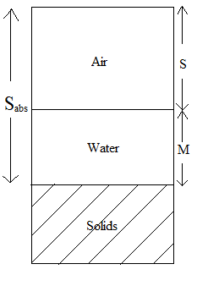
METHODOLOGY CONTINUED…
From Fig. 1, using the volumetric concept we can draw an analogy that S_{abs} in magnitude equals the volume of voids (V_{v}), S equals volume of air and M equals volume of water. This analogy will help in developing a new model to include M and S_{abs} in SCS-CN methodology to eliminate quantum jumps for ungauged catchments and also to compute antecedent moisture content.
$S=5\left(P+2Q+\frac{M}{2}−\sqrt{{(2Q+\frac{M}{2})}^{2}+Q(5P+M)}\right) ….(6)$
M can be substituted as S_{abs} - S into equation 6 to obtain N1:
$S=\frac{\left(7P−Q+S_{abs}\right)−\sqrt{({5P+Q)}^{2}+S_{abs}(S_{abs}−10P+22Q)}}{2.4} ….(N1)$
Fig. 1 Three-Phase system of soil mass showing S, S_{abs}, and M.

Slide 7
METHODOLOGY CONTINUED…
Remember equation N1 is derived for I_{a} = 0.2S, for I_{a} = λS the same equation can be re-written as:
$S=\frac{\left(2P−Q+S_{abs}\right)+\frac{P}{λ}−\sqrt{{(\frac{P}{λ}+Q)}^{2}+S_{abs}(S_{abs}+2Q−\frac{2P}{λ}+\frac{4Q}{λ})}}{2(λ+1)} …(7)$
From Fig. 1, it can be further seen that S_{abs} in magnitude equals volume of voids (V_{v}) and it can be further related with soil porosity (n) as$n=\frac{V_{v}}{V}$
where, V is total volume of soil profile respectively. Also, from Fig.1, volumetric moisture content can be expressed as M / V and replacing V by S_{abs} / n, w (in %) can be expressed as:
$w=\frac{100nM}{S_{abs}} …(N2)$
If S_{abs} is known, M can simply be computed as S_{abs} - S. Here, S_{abs} either can be taken as the maximum of all the S values computed from the Hawkins (1993) equation (Eq. 3) denoted as S_{max} or it can be optimized for a particular watershed using large rainfall-runoff datasets denoted as S_{opt.}. Henceforth, by measuring the moisture content and porosity at the site, the applicability of the modified Mishra-Singh model can be verified.

Slide 8
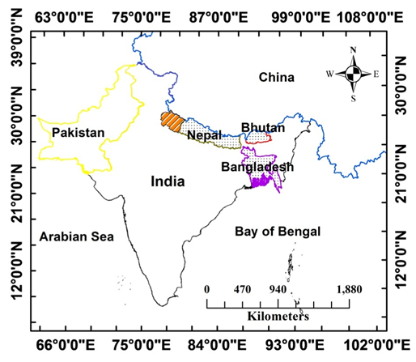
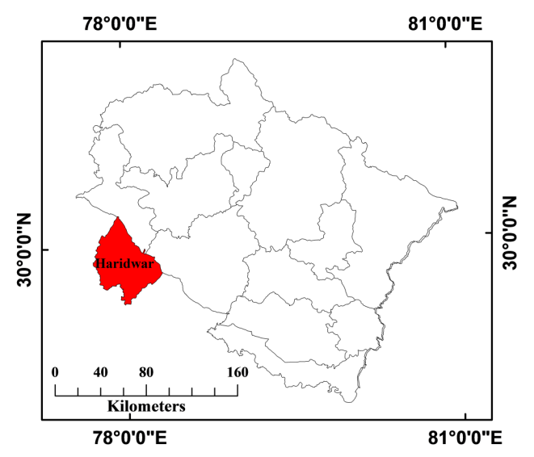
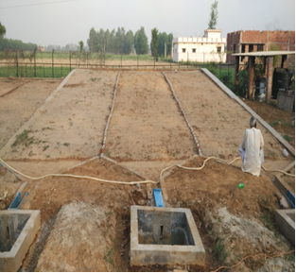
STUDY AREA
The rainfall-runoff data were derived from experimental farms situated at 29°50’09” N and 77°55’21” E in Roorkee city of Uttarakhand State (India).
This study includes records of P, Q and ASM from 6 plots with different land-use viz. Maize, Finger Millet, and Fallow land, all having slope 8% and similar Hydrologic Soil group (HSG) i.e HSG-A (McCuen, 1982). The observations were recorded from April 2016 to November 2018. Hence, all other conditions remain same besides the land use.
‘M’ was measured at site using Time domain Reflectometry(TDR) 300 manufactured by “Field Scout” with probe 20 cm. Average porosity was assumed as 0.45 which is in the range of silty sand (Geotechdata.info, 2013).
Fig.2 Location of the Experimental Farm (Lal et al. 2019)
Fig.3 Plot having 8% slope with Collecting Tank

Slide 9
RESULTS
Comparison of Moisture Content (w) – Antecedent Soil Moisture (M) Relationship
In this study, w_{theoretical} is computed for optimized λ & S_{abs} values. The plots of w_{theoretical} and w_{observed} are shown in figures 4 to 6. The optimization is carried out minimizing RMSE.
$RMSE=\sqrt{\frac{\sum_{i=1}^{N}{{(w_{observed}−w_{theoretical})}^{2}}}{N}}$
The optimized value of λ and S_{abs} for different cases and the comparison between RMSE in ‘w’ computation using optimized λ and S_{abs} or using λ=0.2 and S_{max} is shown in Table 1.
Table 1. Optimized value of λ and S_{abs} for different slopes
S.No | Land use | λ(opt.) | S_{abs}(opt.)( mm) | RMSE(%) | RMSE(%) (after opt.)
1 | Finger Millet | 0.09 | 325.40 | 11.02 | 7.87
2 | Maize | 0.06 | 340.16 | 10.93 | 7.26
3 | Fallow Land | 0.08 | 378.48 | 11.11 | 8.41

Slide 10
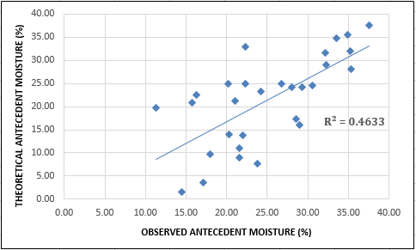
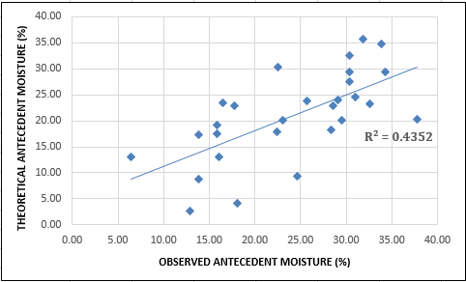
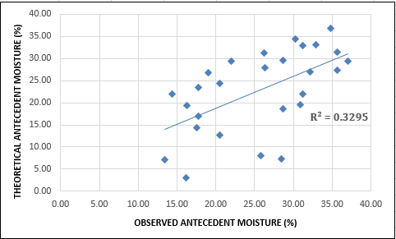
RESULTS
Fig.4 w_{observed} vs w_{theoretical} derived from P-Q data of plot having finger millet
Fig.5 w_{observed} vs w_{theoretical} derived from P-Q data of plot having maize
Fig.6 w_{observed} vs w_{theoretical} derived from P-Q data of plot having fallow land

Slide 11
DISCUSSION AND CONCLUSION
‘M’ is an important source for the variability in CN, which is incorporated in the modified Mishra-Singh model (N1 & N2) that physically verifies the existence and influence of antecedent moisture in curve number hydrology.
The theoretical water content shows a good correlation with the observed (or measured) moisture (or water) content at site having land use finger millet and maize.
For fallow land, although the relationship is not strong enough, it has a potential to indicate the physical existence of the parameter (S) and, in turn, (S_{abs}). Also, the optimized value of λ has the least error in computing M than the λ = 0.2.
The existence of the fair relationship can, for example, be attributed to the inadequacy of data, i.e. the rainfall-runoff record is of only 2 years and thus, the value of S_{abs} may not be representative of all seasons/climate.
Hence, further research with adequate data and experimental work in more automated and controlled environment may be carried out to have a better correlation between the measured and theoretical water contents. Thus SCS-CN method can also be used to estimate ‘M’ which has widens its application.

Slide 12
REFERENCES
Ajmal, M., Waseem, M., Wi, S., & Kim, T. W. (2015). Evolution of a parsimonious rainfall–runoff model using soil moisture proxies. Journal of hydrology, 530, 623-633.
Geotechdata.info, Soil void ratio, http://geotechdata.info/parameter/soil-void-ratio.html (as of
November 16, 2013).
Hawkins, R. H. (1993). Asymptotic determination of runoff curve numbers from data. Journal of Irrigation and Drainage Engineering, 119(2), 334-345.
Jain, M. K., Mishra, S. K., Suresh Babu, P., Venugopal, K., & Singh, V. P. (2006). Enhanced runoff curve number model incorporating storm duration and a nonlinear I a-S relation. Journal of Hydrologic Engineering, 11(6), 631-635.
Lal, M., Mishra, S. K., & Kumar, M. (2019). Reverification of antecedent moisture condition dependent runoff curve number formulae using experimental data of Indian watersheds. Catena, 173, 48-58
Michel, C., Andréassian, V., & Perrin, C. (2005). Soil conservation service curve number method: How to mend a wrong soil moisture accounting procedure?. Water Resources Research, 41(2).
Mishra, S. K., & Singh, V. P. (2002a). SCS-CN-based hydrologic simulation package (pp. 391-464). Water Resources Publications: Littleton, CO.
Mishra, S. K., & Singh, V. P. (2013). Soil conservation service curve number (SCS-CN) methodology (Vol. 42). Springer Science & Business Media.Mishra, S. K., Jain, M. K., & Singh, V. P. (2004). Evaluation of the SCS-CN-based model incorporating antecedent moisture. Water resources management, 18(6), 567-589.
NRCS, U. (2007). Chapter 10, part 630–hydrology. Estimation of direct runoff from storm rainfall. In ‘National engineering handbook’. (Eds V Mockus, AT Hjelmfelt, HF Moody) pp. 1–79. US Department of Agriculture, Natural Resources Conservation Service, Washington, DC.
SCS. (1956). National engineering handbook, section 4: Hydrology. Washington, DC.

Slide 13
THANK YOU

