Slide 1
Post-earthquake changes in debris flow susceptibility in the Upper Minjiang catchment (Sichuan, China), as revealed by meteorological and hydro-meteorological thresholds
Roberto Greco^{1,2}, Pasquale Marino¹, Siva Srikrishnan², and Xuanmei Fan²
¹Dipartimento di Ingegneria, Università degli Studi della Campania ‘Luigi Vanvitelli’ (Aversa, Italy)
²State Key Laboratory of Geohazard Prevention and Geoenvironment Protection, Chengdu University of Technology (Chengdu, People's Republic of China)

Slide 2
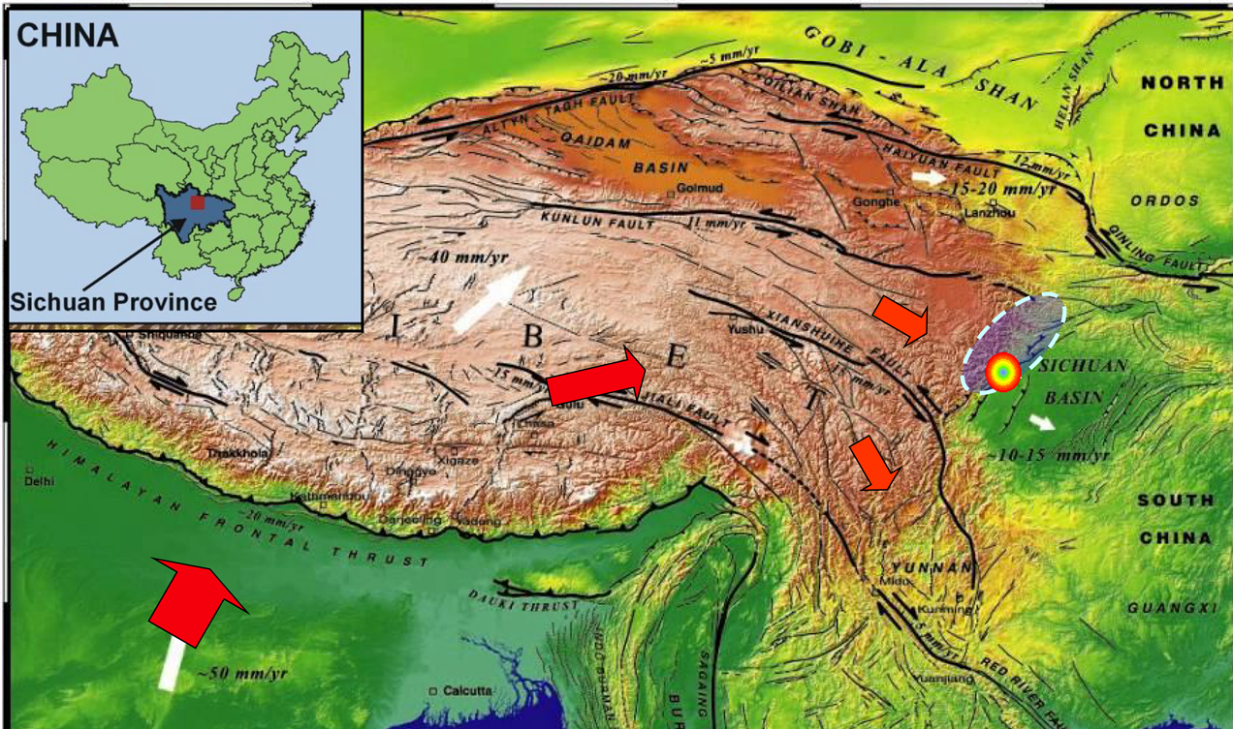
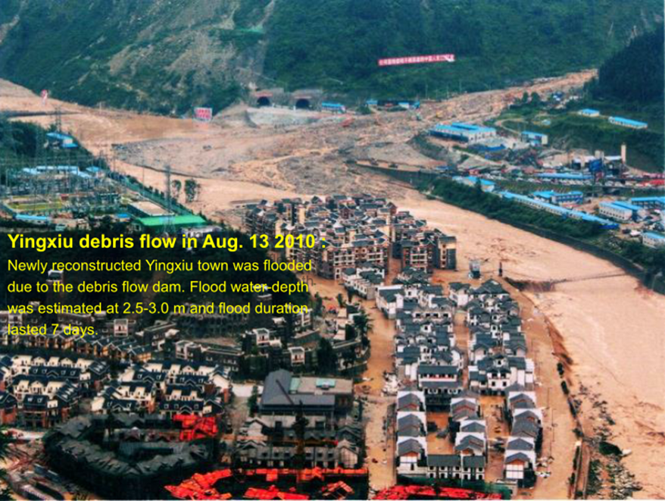
«Post-earthquake changes in debris flow susceptibility in the Upper Minjiang catchment (Sichuan, China), as revealed by meteorological and hydro-meteorological thresholds»
Background:
On May 12, 2008, a magnitude Mw 7.9 earthquake struck Wenchuan, in the Longmen Shan mountains, in the western part of Sichuan (China)
The Wenchuan earthquake triggered almost 200000 co-seismic landslides, leading to the accumulation of large volumes of loose debris material on the slopes or in gullies
After the earthquale, first a huge increase of debris flow frequency was observed, while in the following years slope response seems to go back to normality.
Outline:
To quantify the change in slopes response to rainfall and to develop empirical thresholds, both meteorological and hydro-meteorological, to predict debris flows occurrence throughout the catchment after the earthquake

Slide 3
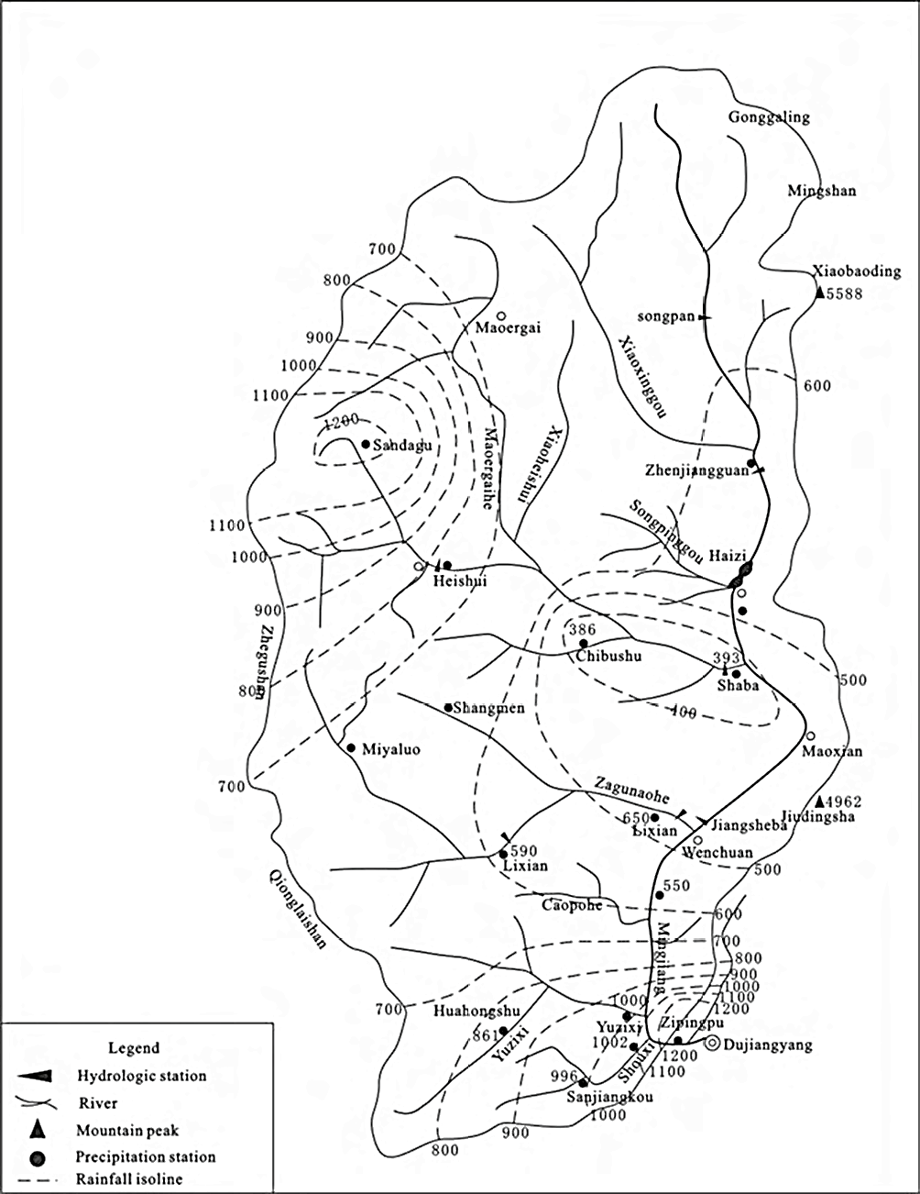
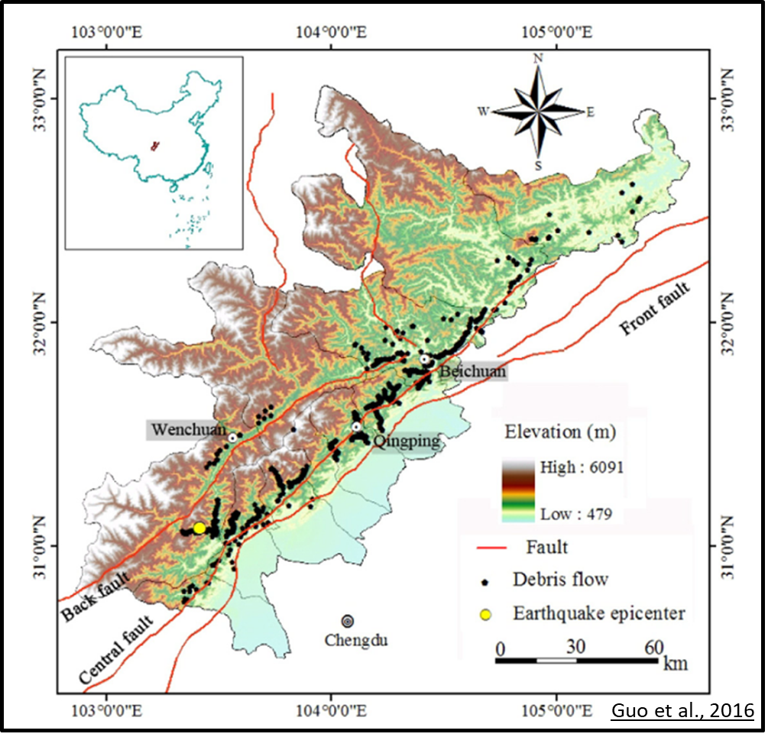
«Post-earthquake changes in debris flow susceptibility in the Upper Minjiang catchment (Sichuan, China), as revealed by meteorological and hydro-meteorological thresholds»
Study area:
Hairong et al. (2017), J. Earth Syst. Sci. (2017)
Yingxiu
Minjiang river
Drainage area = 23 000 km²
Yearly average precipitation = 600 - 1200 mm
PET = 389.4 mm/year
Gullies = 133
Debris flows from 2008 to 2015 = 257

Slide 4
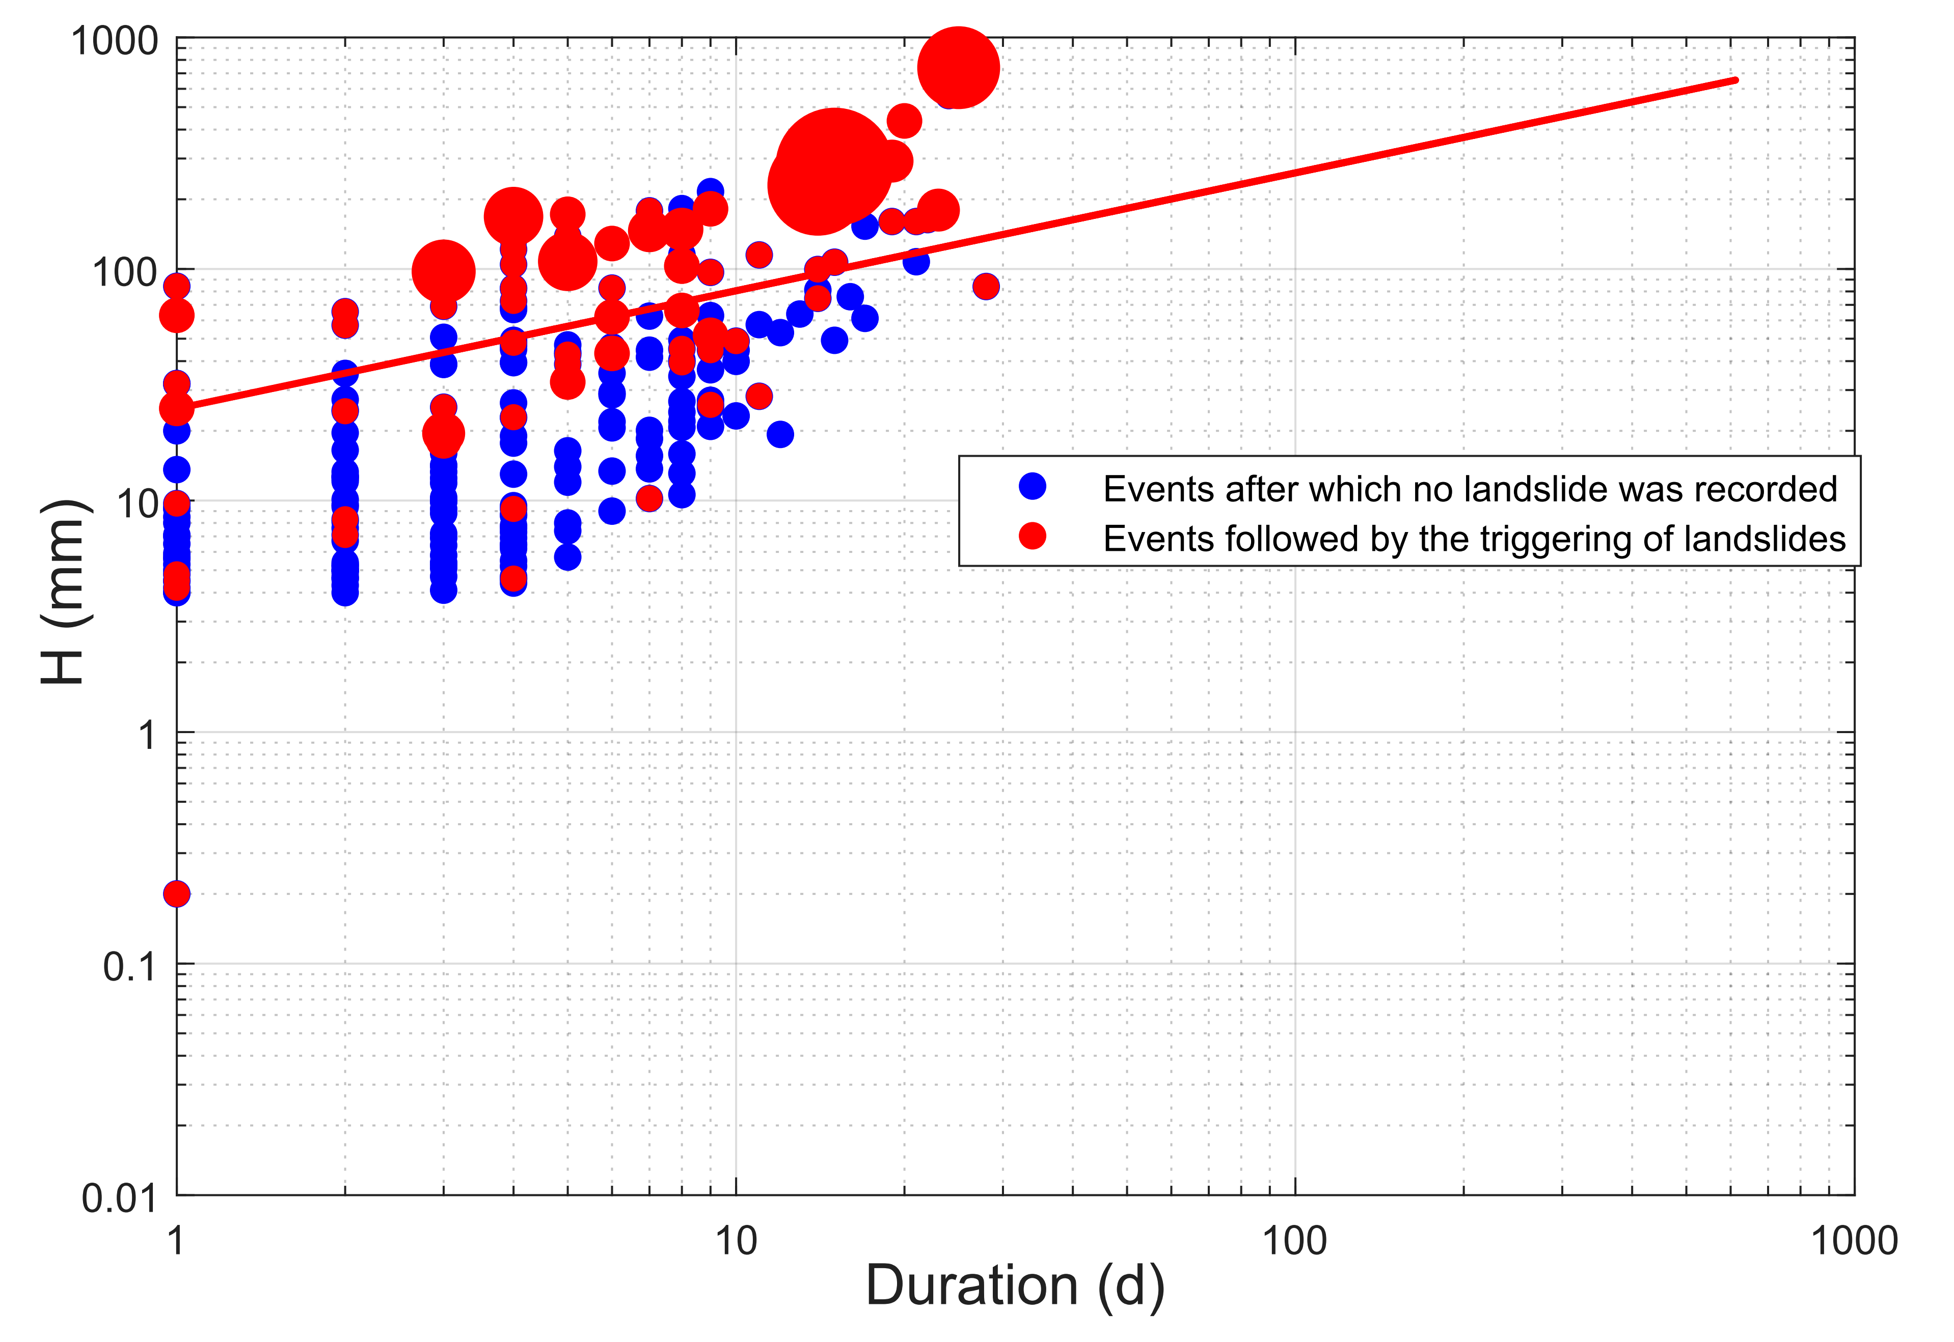
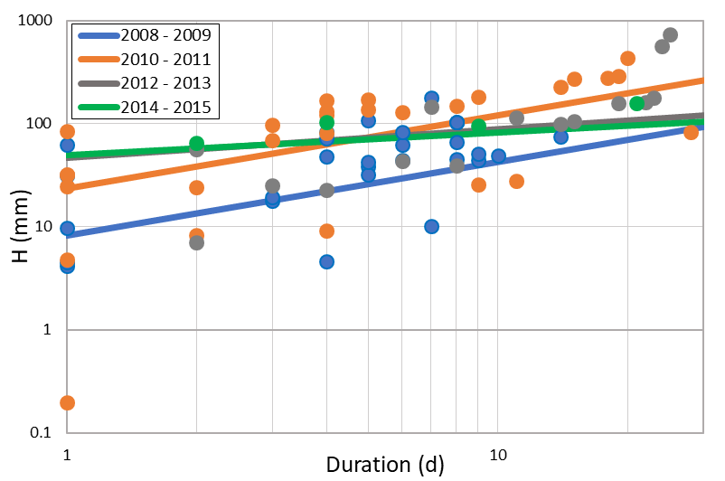
Post-earthquake changes in debris flow susceptibility in the Upper Minjiang catchment (Sichuan, China), as revealed by meteorological and hydro-meteorological thresholds
Meteorological threshold [$Y=A X^{B}$] :
$TSS=1−\frac{MA}{P}−\frac{FA}{N},$ $−1< TSS<1$
Performance of tested meteorological (period 2008-2015)
Post-earthquake variation of optimal values of the performance index TSS
 | Total occured landslides (P) = 257, Rainfall events* without any landslides (N) = 155
Empirical thresholds | Treu Skill statistic | Missed Alarms | False Alarms | Total events | A | B
H (D) | 0.81 | 38 | 7 | 231 | 24.977 | 0.504
I (D) | 0.81 | 38 | 7 | 231 | 24.926 | -0.492
I max (D) | 0.79 | 28 | 16 | 231 | 51.422 | -0.100
Empirical thresholds | 2008 - 2009 | 2010- 2011 | 2012 - 2013 | 2014 - 2015
H (D) | 0.69 | 0.96 | 0.76 | 0.98
I (D) | 0.69 | 0.96 | 0.76 | 0.98
I max (D) | 0.73 | 0.94 | 0.74 | 0.91
*Rainfall events in the available record (2008 – 2015) have been defined as separated by intervals of at least 4 days with less than 4 mm rain

Slide 5
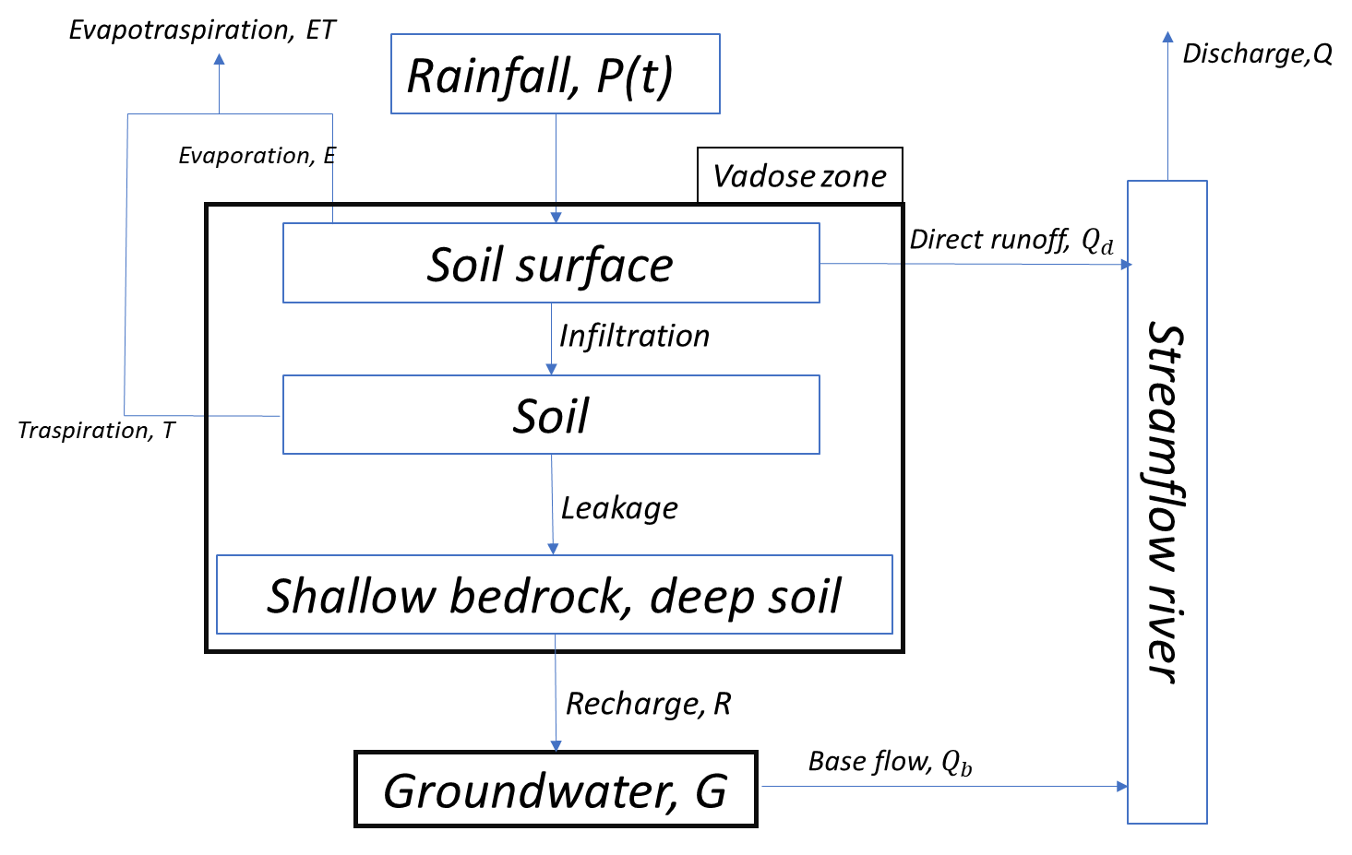
«Post-earthquake changes in debris flow susceptibility in the Upper Minjiang catchment (Sichuan, China), as revealed by meteorological and hydro-meteorological thresholds»
Lumped hydrological model for the evaluation at catchment scale of the effects of hydrological processes on the predisposing conditions for debris flow occurrence

Slide 6
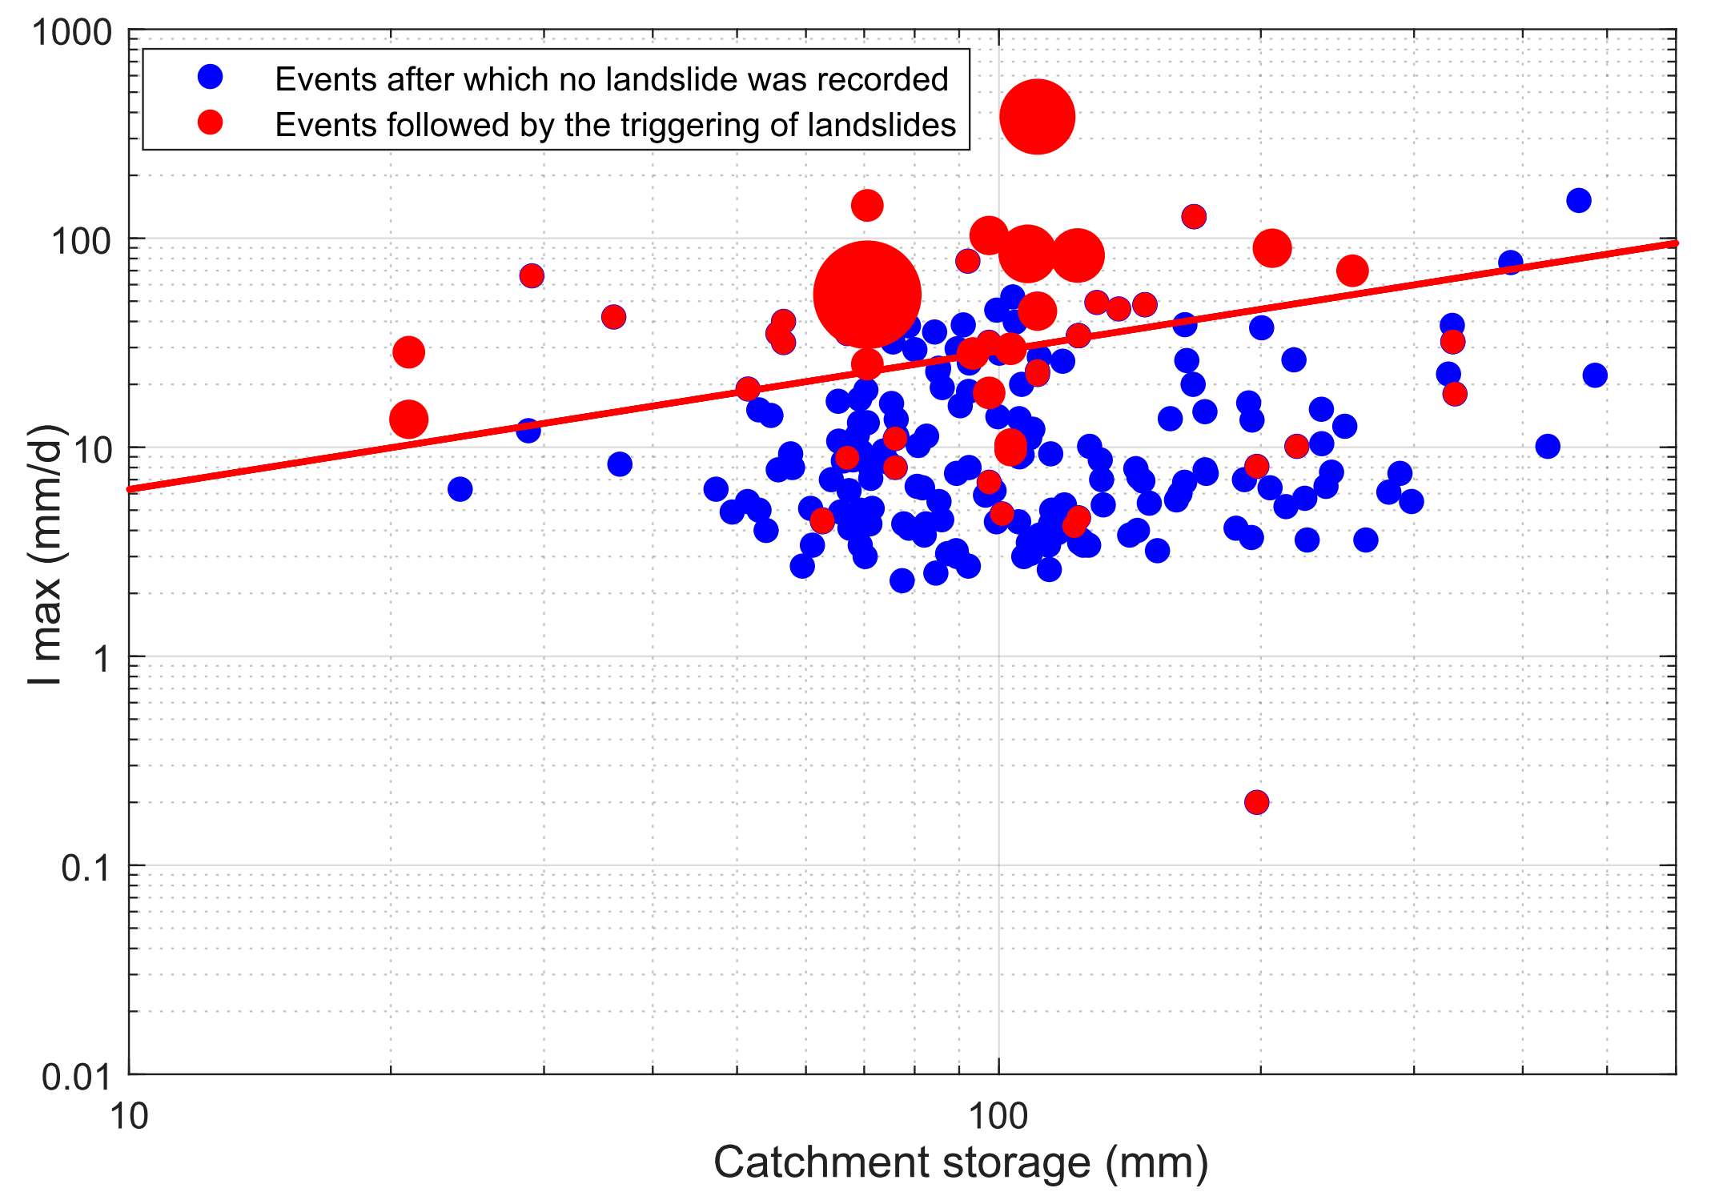
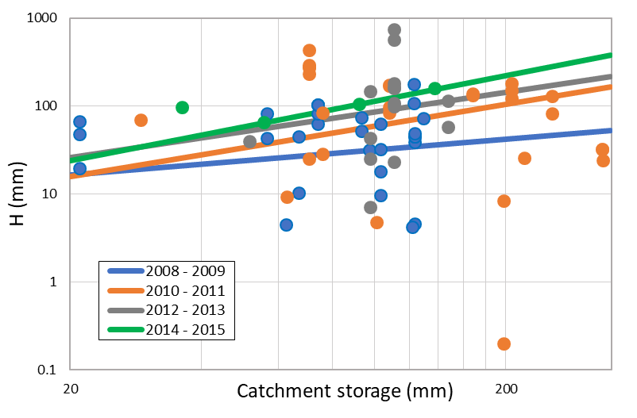
«Post-earthquake changes in debris flow susceptibility in the Upper Minjiang catchment (Sichuan, China), as revealed by meteorological and hydro-meteorological thresholds»
Hydro-meteorological threshold [$Y=A X^{B}$]:
$TSS=1−\frac{MA}{P}−\frac{FA}{N},$ $−1< TSS<1$
Performance of tested hydro-meteorological (period 2008-2015)
Post-earthquake variation of optimal values of the performance index TSS
 | Total occured landslides (P) = 257, Rainfall events* without any landslides (N) = 155
Empirical thresholds | Treu Skill statistic | Missed Alarms | False Alarms | Total events | A | B
H (C*) | 0.8 | 35 | 10 | 231 | 1.485 | 0.805
I (C) | 0.78 | 46 | 7 | 231 | 2.738 | 0.358
I max (C) | 0.82 | 26 | 13 | 231 | 1.366 | 0.663
Empirical thresholds | 2008 - 2009 | 2010- 2011 | 2012 - 2013 | 2014 - 2015
H (C) | 0.62 | 0.93 | 0.77 | 1
I (C) | 0.65 | 0.92 | 0.74 | 0.82
I max (C) | 0.8 | 0.93 | 0.79 | 0.96
*Cathcment storage = soil storage + groundwater storage

Slide 7
«Post-earthquake changes in debris flow susceptibility in the Upper Minjiang catchment (Sichuan, China), as revealed by meteorological and hydro-meteorological thresholds»
Conclusion:
The results show that both meteorological and hydro-meteorological thresholds indicate the post-earthquake recovery of stability of the debris deposits, as they identify increasing thresholds in the years from 2008 onward.
Specifically, the hydro-meteorological thresholds, especially the one based on catchment storage and event precipitation depth, are able to quantitatively describe the progressive recovery of stability of the deposits much more clearly than the meteorological thresholds.
THANK YOU FOR READING!!!
CONTACT US IN CHAT FOR ANY QUESTION

