Slide 1
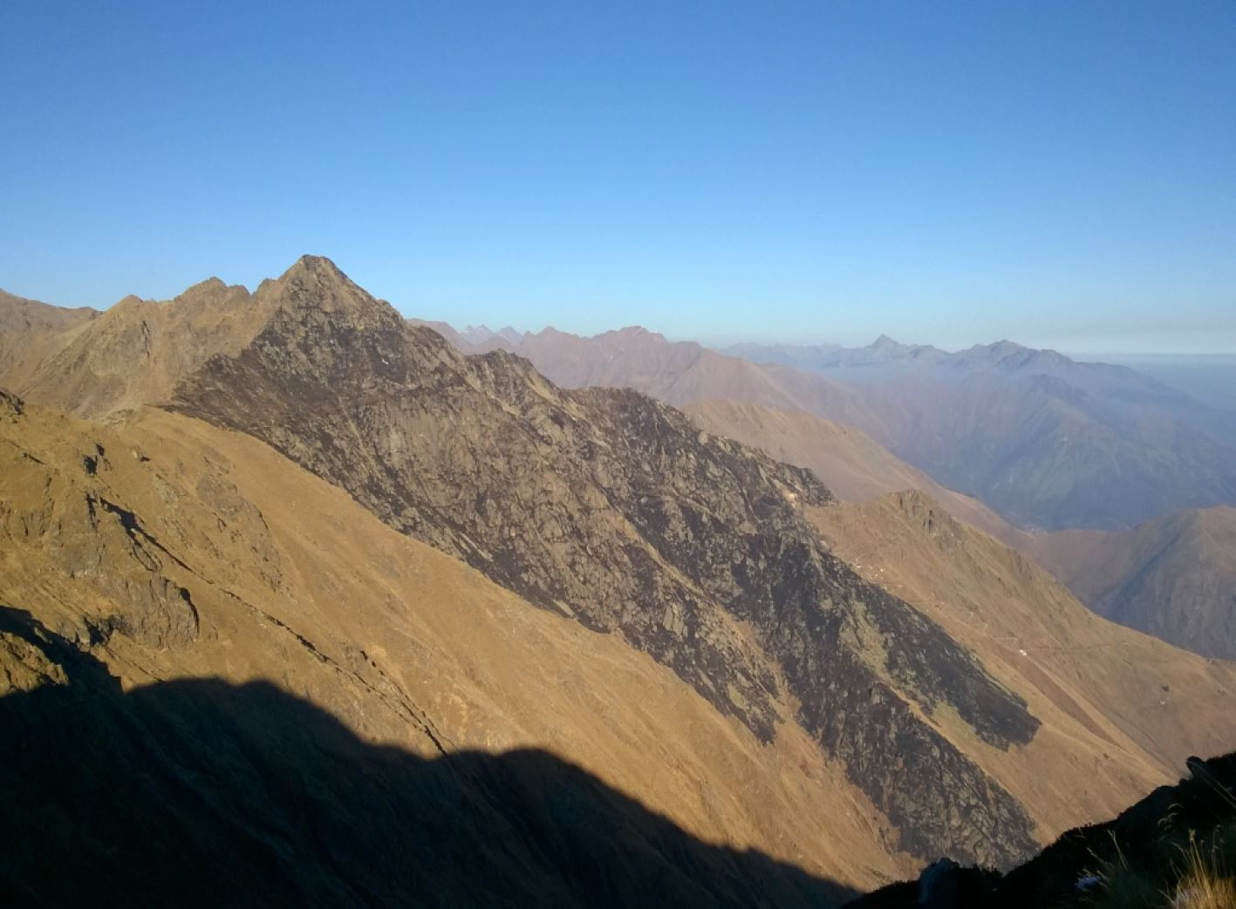
- Grey areas are high altitude grassland (between 1500 and 3000 m altitude); - Tiles show the small areas analysed; - Green dots show the Standard meteorological stations locations.
Calibrationless water model (CSWM) for mountain natural grassland actual evapotranspiration and soil moisture computation
Soil model forced by simple meteorological data and DTM data, with parameter values taken from reference international literature CAN PROVIDE RELIABLE RESULTS
30 km

Slide 2
Years 2014 and 2015 daily time series comparison between daily AET data, observed (blue line), measured by the eddy covariance station (dashed) and modelled by the model (blackline). Cumulative rainfall data are shown in grey. Red triangles represent the METRIC model evapotranspiration.

Slide 3
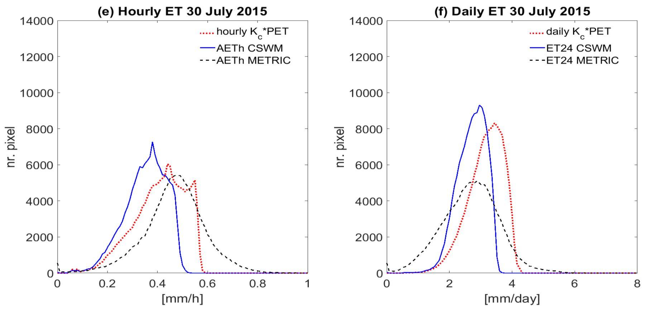
Spatial frequency distributions of evapotranspiration. Red dotted line: $K_{c} PET$; blue soild line: CSWM actual evapotranspiration (ET); black dashed line: METRIC actual evapotranspiration (ET).

