Slide 1

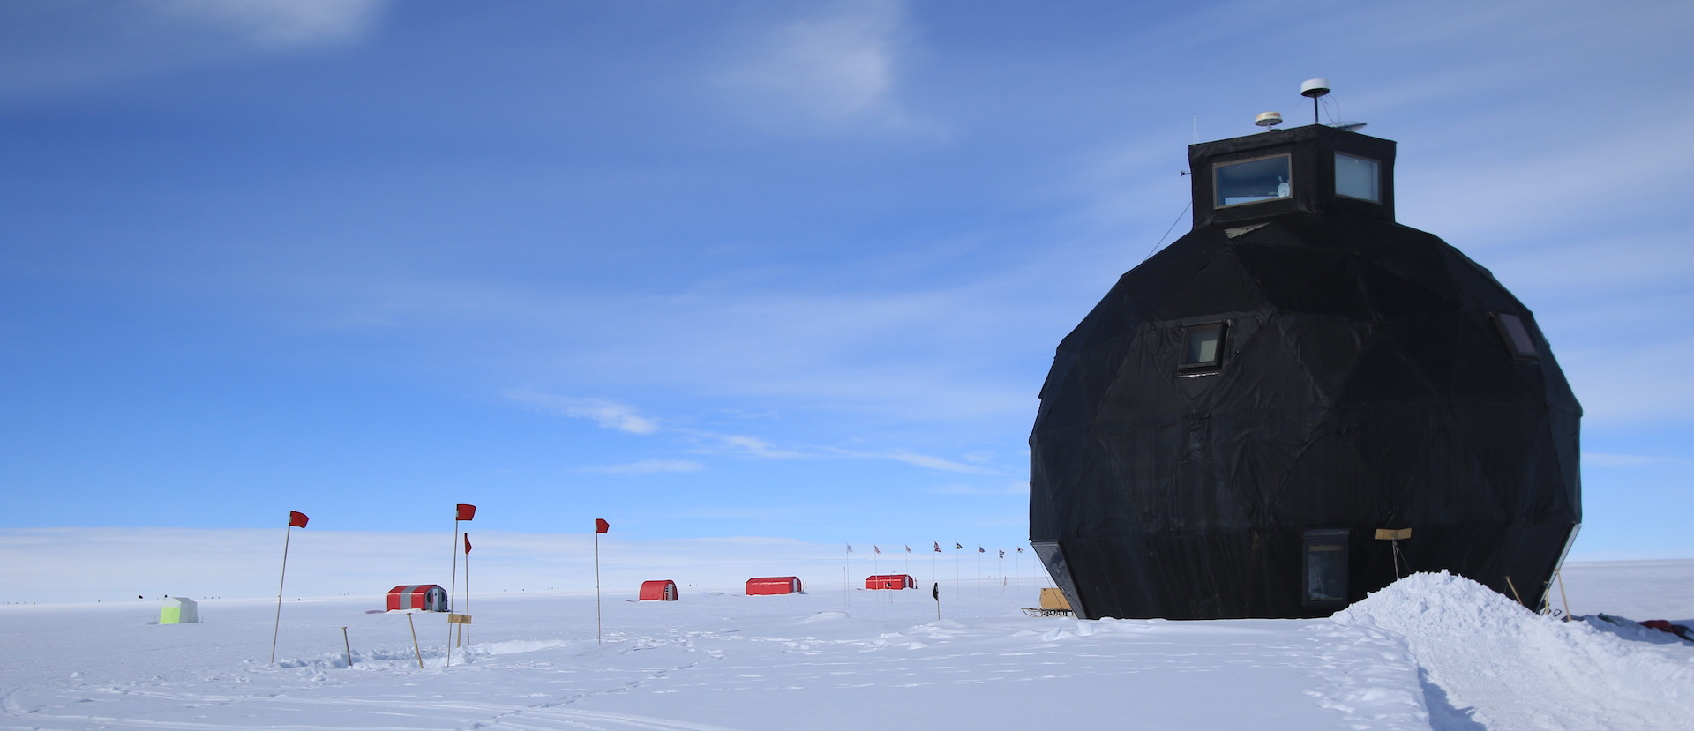


Nicolas Stoll¹, Ilka Weikusat^{1,2}, Johanna Kerch¹, Ina Kleitz¹, Jan Eichler¹, Wataru Shigeyama^{3,4}, Tomoyuki Homma⁵, Daniela Jansen¹, Maddalena Bayer-Giraldi¹, Steven Franke¹, Ernst-Jan Kuiper^{1,6}, David Wallis^{1,6}, Julien Westhoff⁷, Tomotaka Saruya⁵, Sérgio Henrique Faria^{5,8,9}, Sepp Kipfstuhl¹, Kumiko Goto Azuma^{3,4}, Nobuhiko Azuma⁵, Dorthe Dahl-Jensen^{7,10}
The upper 2121m at EastGRIP – Results from physical properties of NEGIS
¹Alfred Wegener Institute Helmholtz Centre for Polar and Marine Research, Bremerhaven, Germany ²Department of Geosciences, Eberhard Karls University, Tübingen, Germany ³Department of Polar Science, SOKENDAI | The Graduate University for Advanced Studies, Tokyo, Japan 4National Institute of Polar Research, Tokyo, Japan ⁵Nagaoka University of Technology, Nagaoka, Japan ⁶Utrecht University, Utrecht, Netherlands ⁷Physics of Ice, Climate and Earth, Niels Bohr Institute, University of Copenhagen, Copenhagen, Denmark ⁸Basque Centre for Climate Change (BC3), Bilbao, Spain ⁹Ikerbasque Basque Foundation for Science, Spain ¹⁰Centre for Earth Observation Science, University of Manitoba, Canada

Slide 2
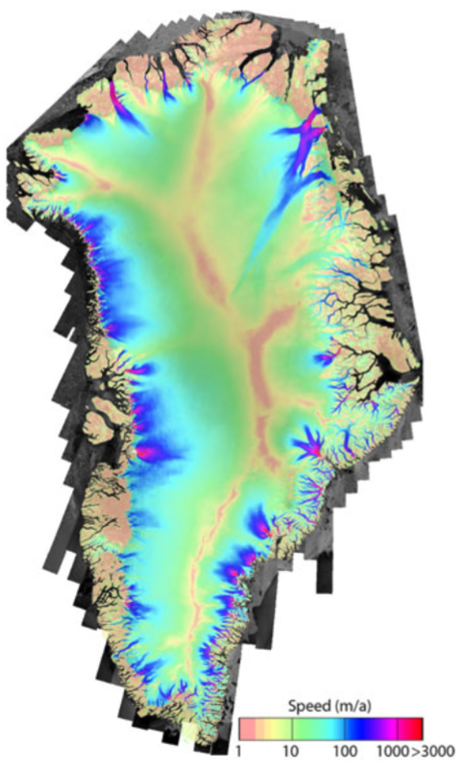
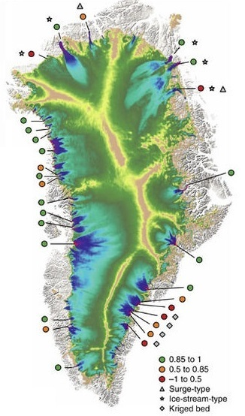

Introduction
Measured
velocities
Modelled
velocities
IPCC 5 (2013)
Models do not predict solid ice discharge well enough
Significant uncertainties remain regarding the magnitude and rate of ice stream contribution towards future sea-level rise
IPCC (2013). “IPCC 13 Observations: Cryosphere”. In: Climate Change 2013: The Phys- ical Sci- ence Basis. Contribution of Working Group I to the Fifth Assessment Report of the Intergovernmental Panel on Climate Change, pp. 317–382. ISSN: ISBN 978-1-107- 66182-0. DOI: 10.1017/CBO9781107415324.012.
Joughin, Ian, Ben E. Smith, and Ian M. Howat (2017). “A complete map of Green- land ice velocity derived from satellite data collected over 20 years”. In: Journal of Glaciology 64.243, pp. 1–11. ISSN: 00221430. DOI: 10.1017/jog.2017.73.
Modified from Aschwanden, Andy, Mark A. Fahnestock, and Martin Truffer (2016). “Complex Green- land outlet glacier flow captured”. In: Nature Communications 7.May 2015, pp. 1– 8. ISSN: 20411723. DOI: 10.1038/ncomms10524. URL: http://dx.doi.org/10. 1038/ncomms10524.

Slide 3
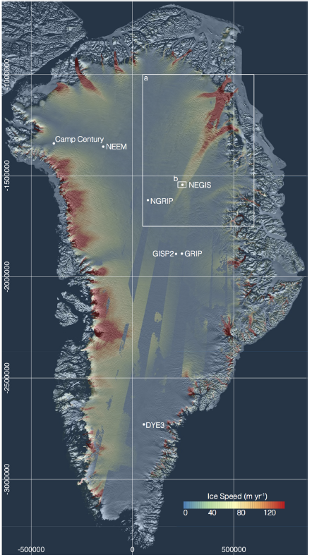
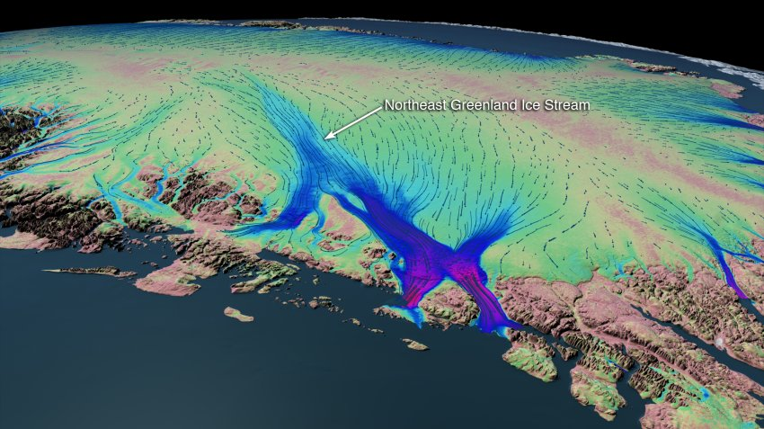
Introduction
  EastGRIP ice core
First physically-motivated ice core → new insights into:
Deformation mechanisms
Size and shape of grains
Subgrain structures
C-axis orientation
  Inclusions/ impurities
  Large scale structures and folding
Modified from Vallelonga, P. et al. (2014). “Initial results from geophysical surveys and shallow cor- ing of the Northeast Greenland Ice Stream (NEGIS)”. In: Cryosphere 8.4, pp. 1275– 1287. ISSN: 19940424. DOI: 10.5194/tc-8-1275-2014.
NASA (2016)

Slide 4
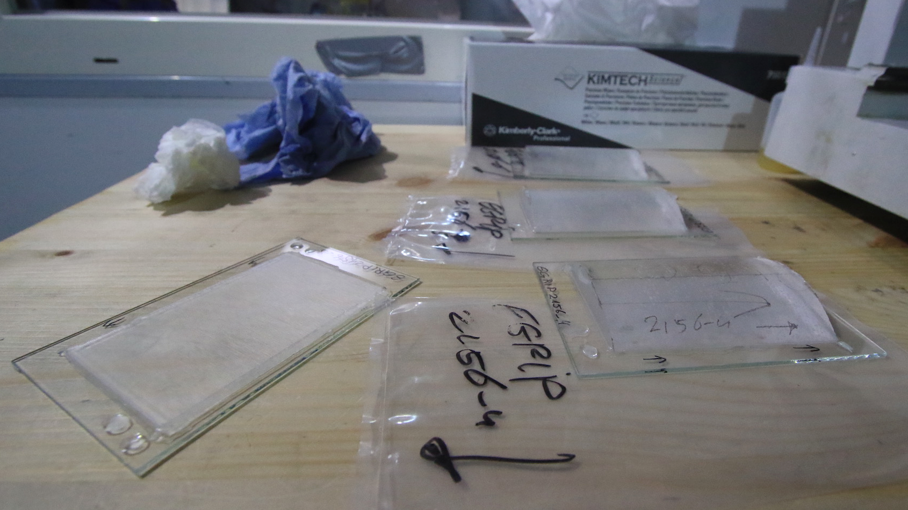
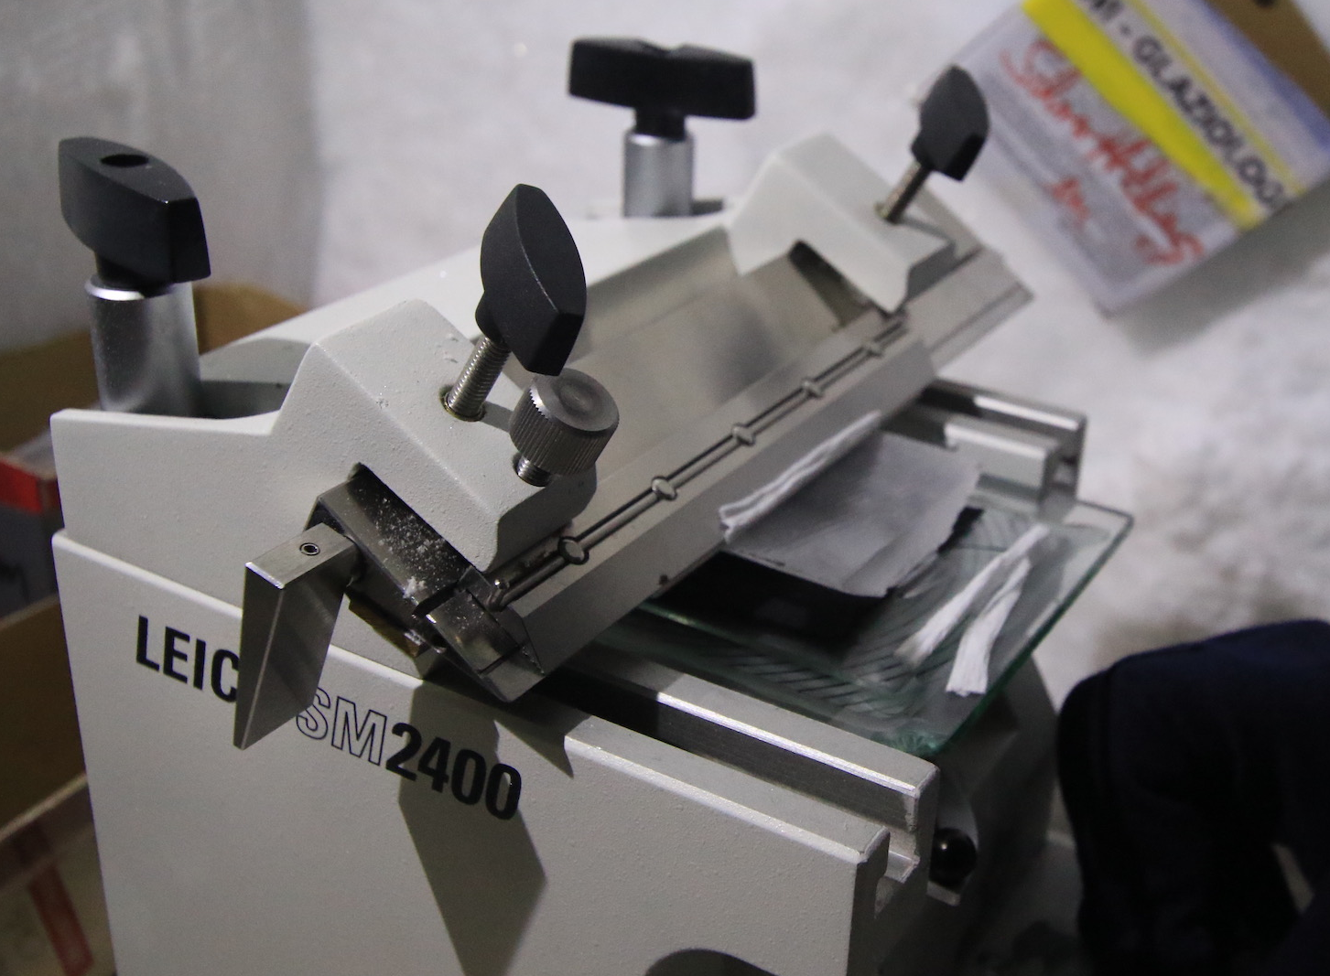
Methods
1097 thick & thin sections measured
in-situ over 3 field seasons
Microtome -> polished ice surface

Slide 5
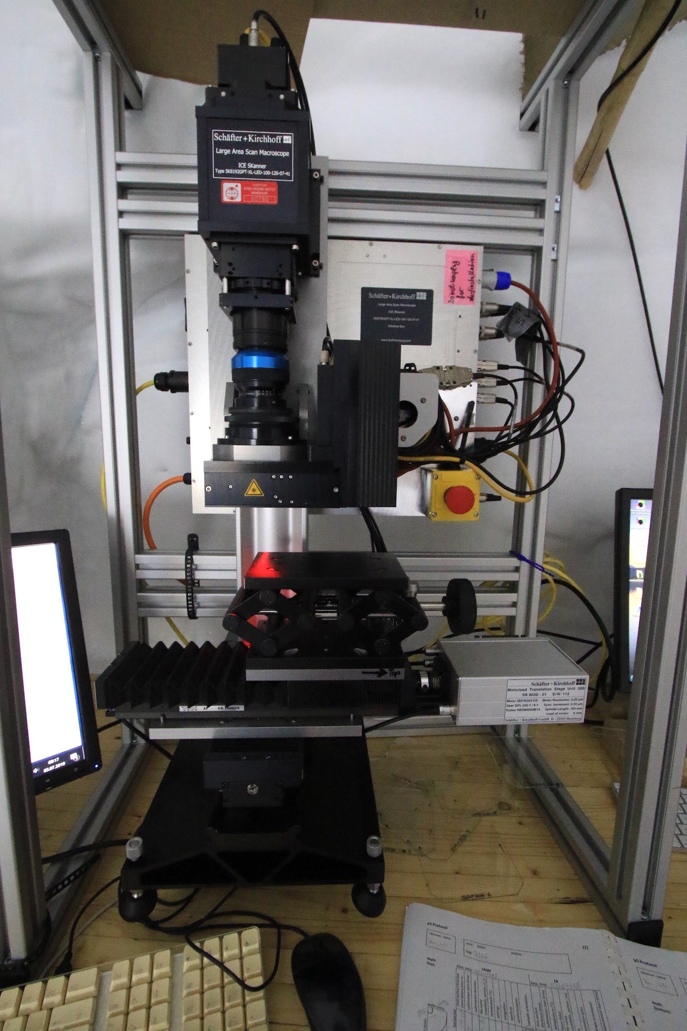
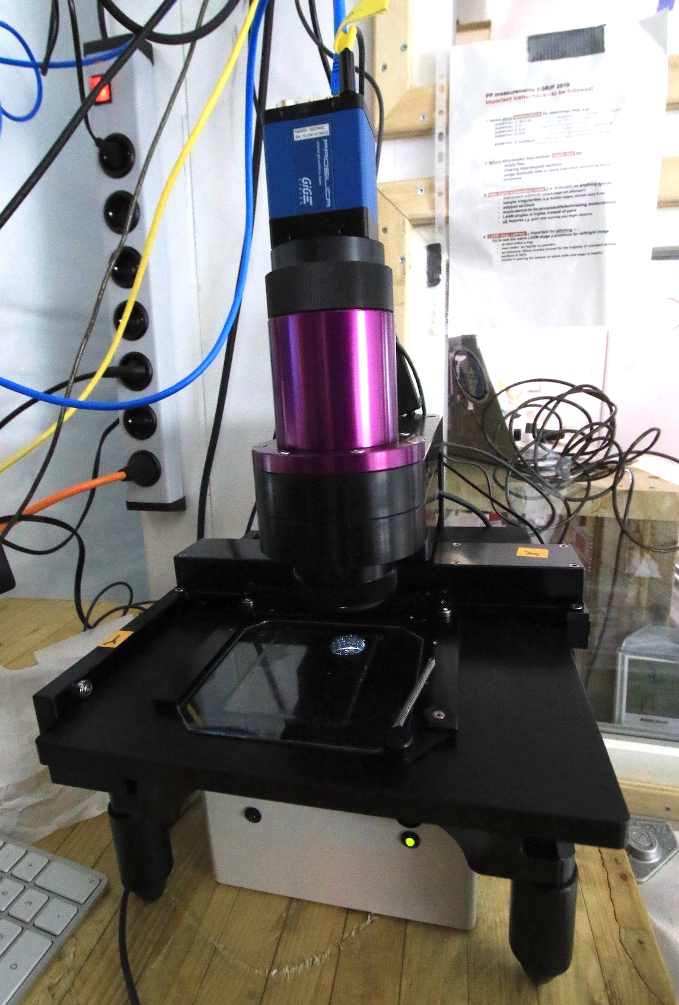
Large Area
Scanning Macroscope
Automated
Fabric Analyser
grain shape
grain size
(sub-) grain boundaries
Crystal orientations
grain size

Slide 6
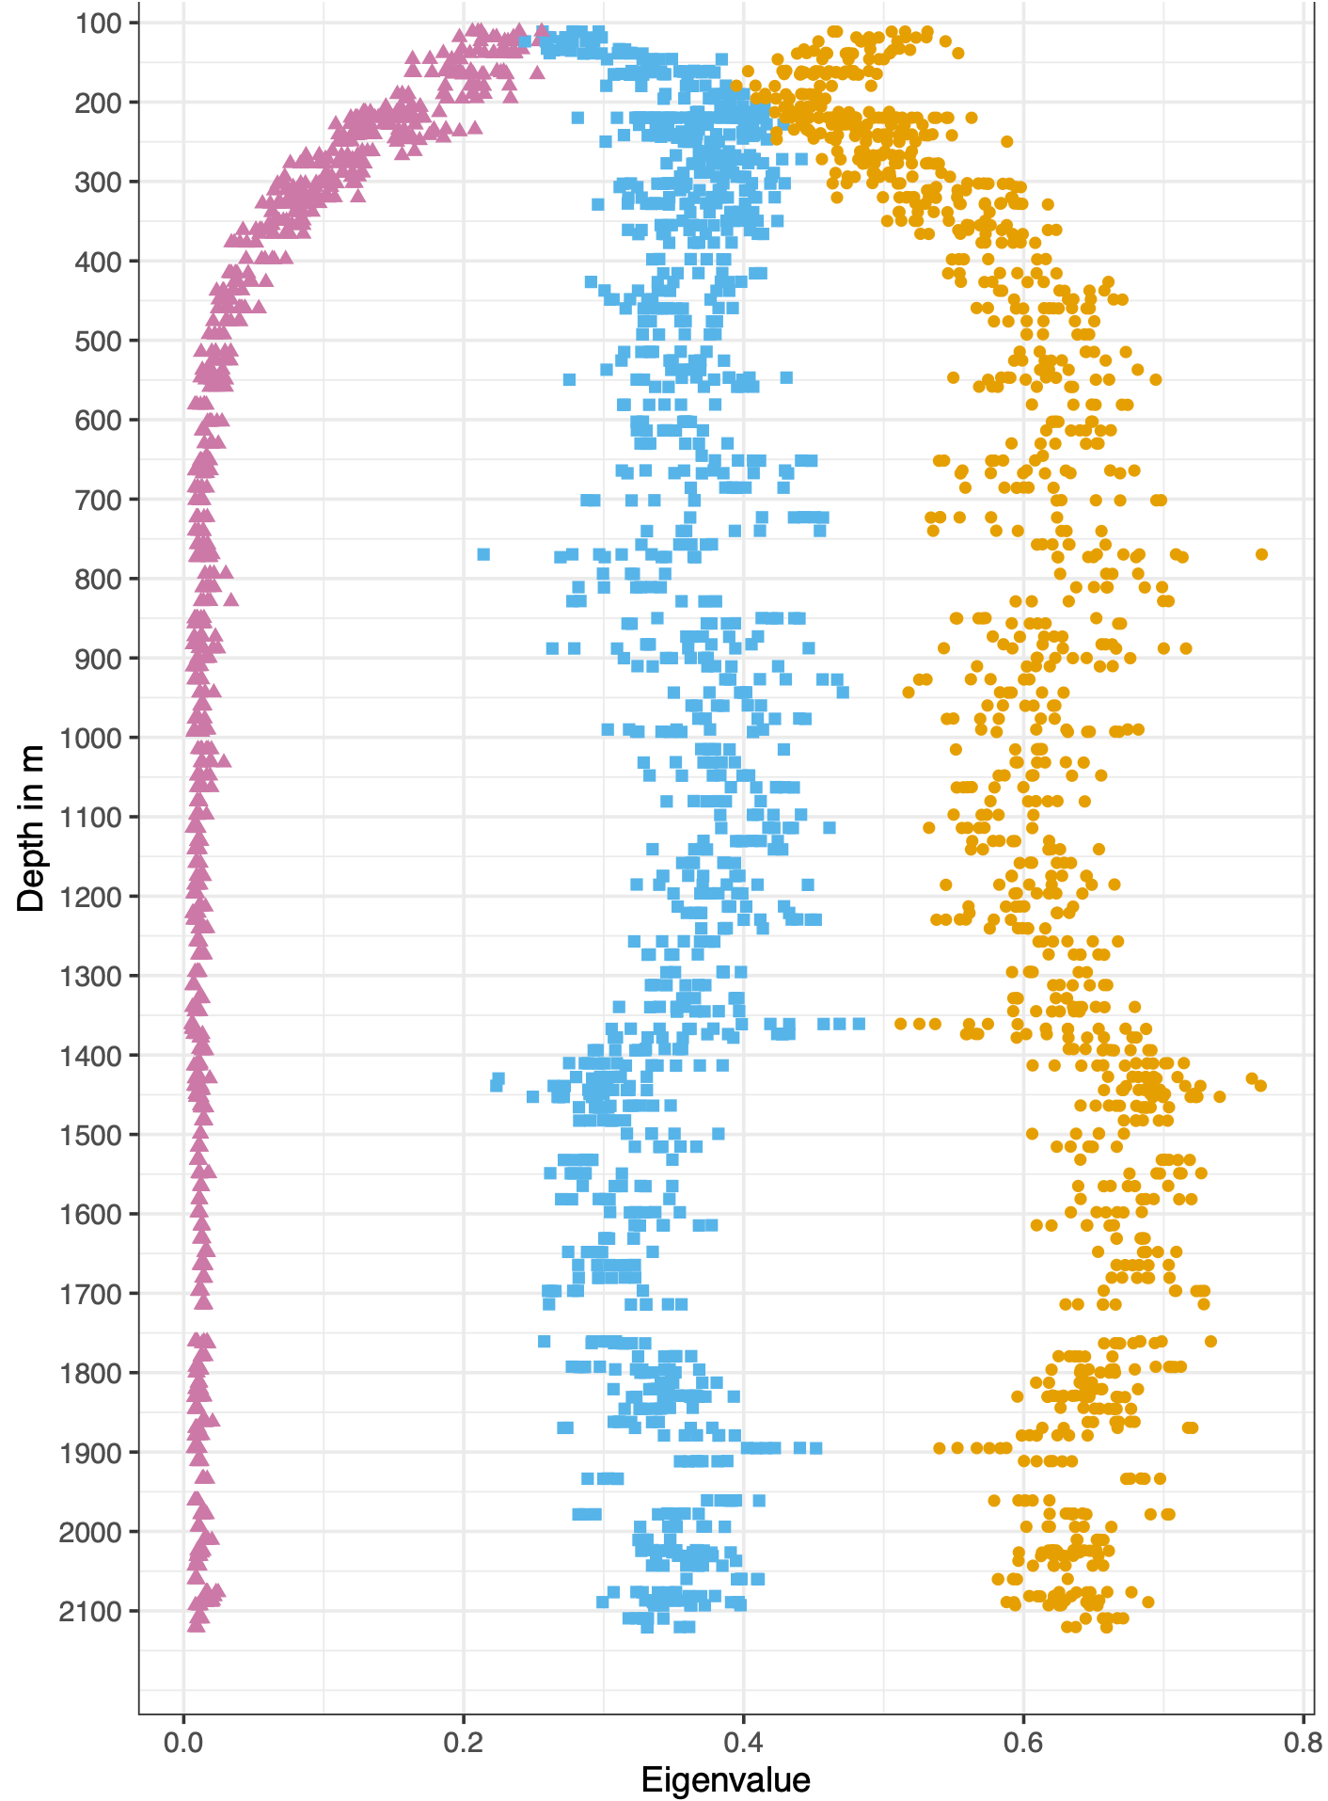
Eigenvalues
e1
e2
e3
Rapid evolution
of anisotropy
Wavy eigenvalue
pattern

Slide 7
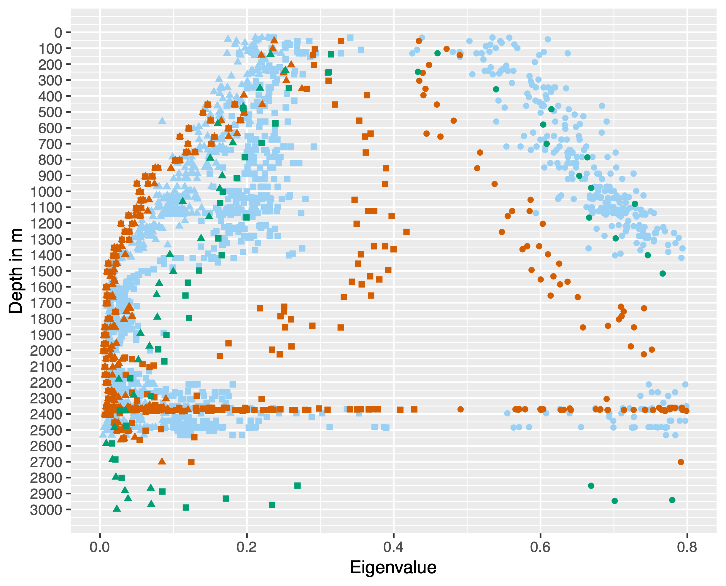
Eigenvalues
e1
e2
e3
Studies before EGRIP
NEEM (Eichler, 2013, Montagnat, 2014)
GRIP (Thorsteinsson et al., 1997)
EDML (Weikusat et al., 2017)
Eichler, Jan (2013). “C-axis analysis of the NEEM ice core: an approach based on digital image processing”. PhD thesis. Freie Universität Berlin, p. 73.
Montagnat, M., N. Azuma, D. Dahl-Jensen, J. Eichler, S. Fujita, F. Gillet-Chaulet, S. Kipfstuhl, D. Samyn, A. Svensson, and I. Weikusat (2014). “Fabric along the NEEM ice core, Greenland, and its comparison with GRIP and NGRIP ice cores”. In: Cryosphere 8.4, pp. 1129–1138. ISSN: 19940424. DOI: 10.5194/tc-8-1129-2014.
Thorsteinsson, Thorsteinn, Josef Kipfstuhl, and Heinz Miller (1997). “Textures and fabrics in the GRIP ice core”. In: Journal of Geophysical Research: Oceans 102.C12, pp. 26583–26599. ISSN: 21699291. DOI: 10.1029/97JC00161.
Weikusat, Ilka et al. (2017). “Physical analysis of an Antarctic ice core—towards an integration of micro- and macrodynamics of polar ice”. In: Philosophical Transac- tions of the Royal Society A: Mathematical, Physical and Engineering Sciences 375.2086, p. 20150347. ISSN: 1364-503X. DOI: 10.1098/rsta.2015.0347. URL: http://rsta. royalsocietypublishing.org/lookup/doi/10.1098/rsta.2015.0347.

Slide 8
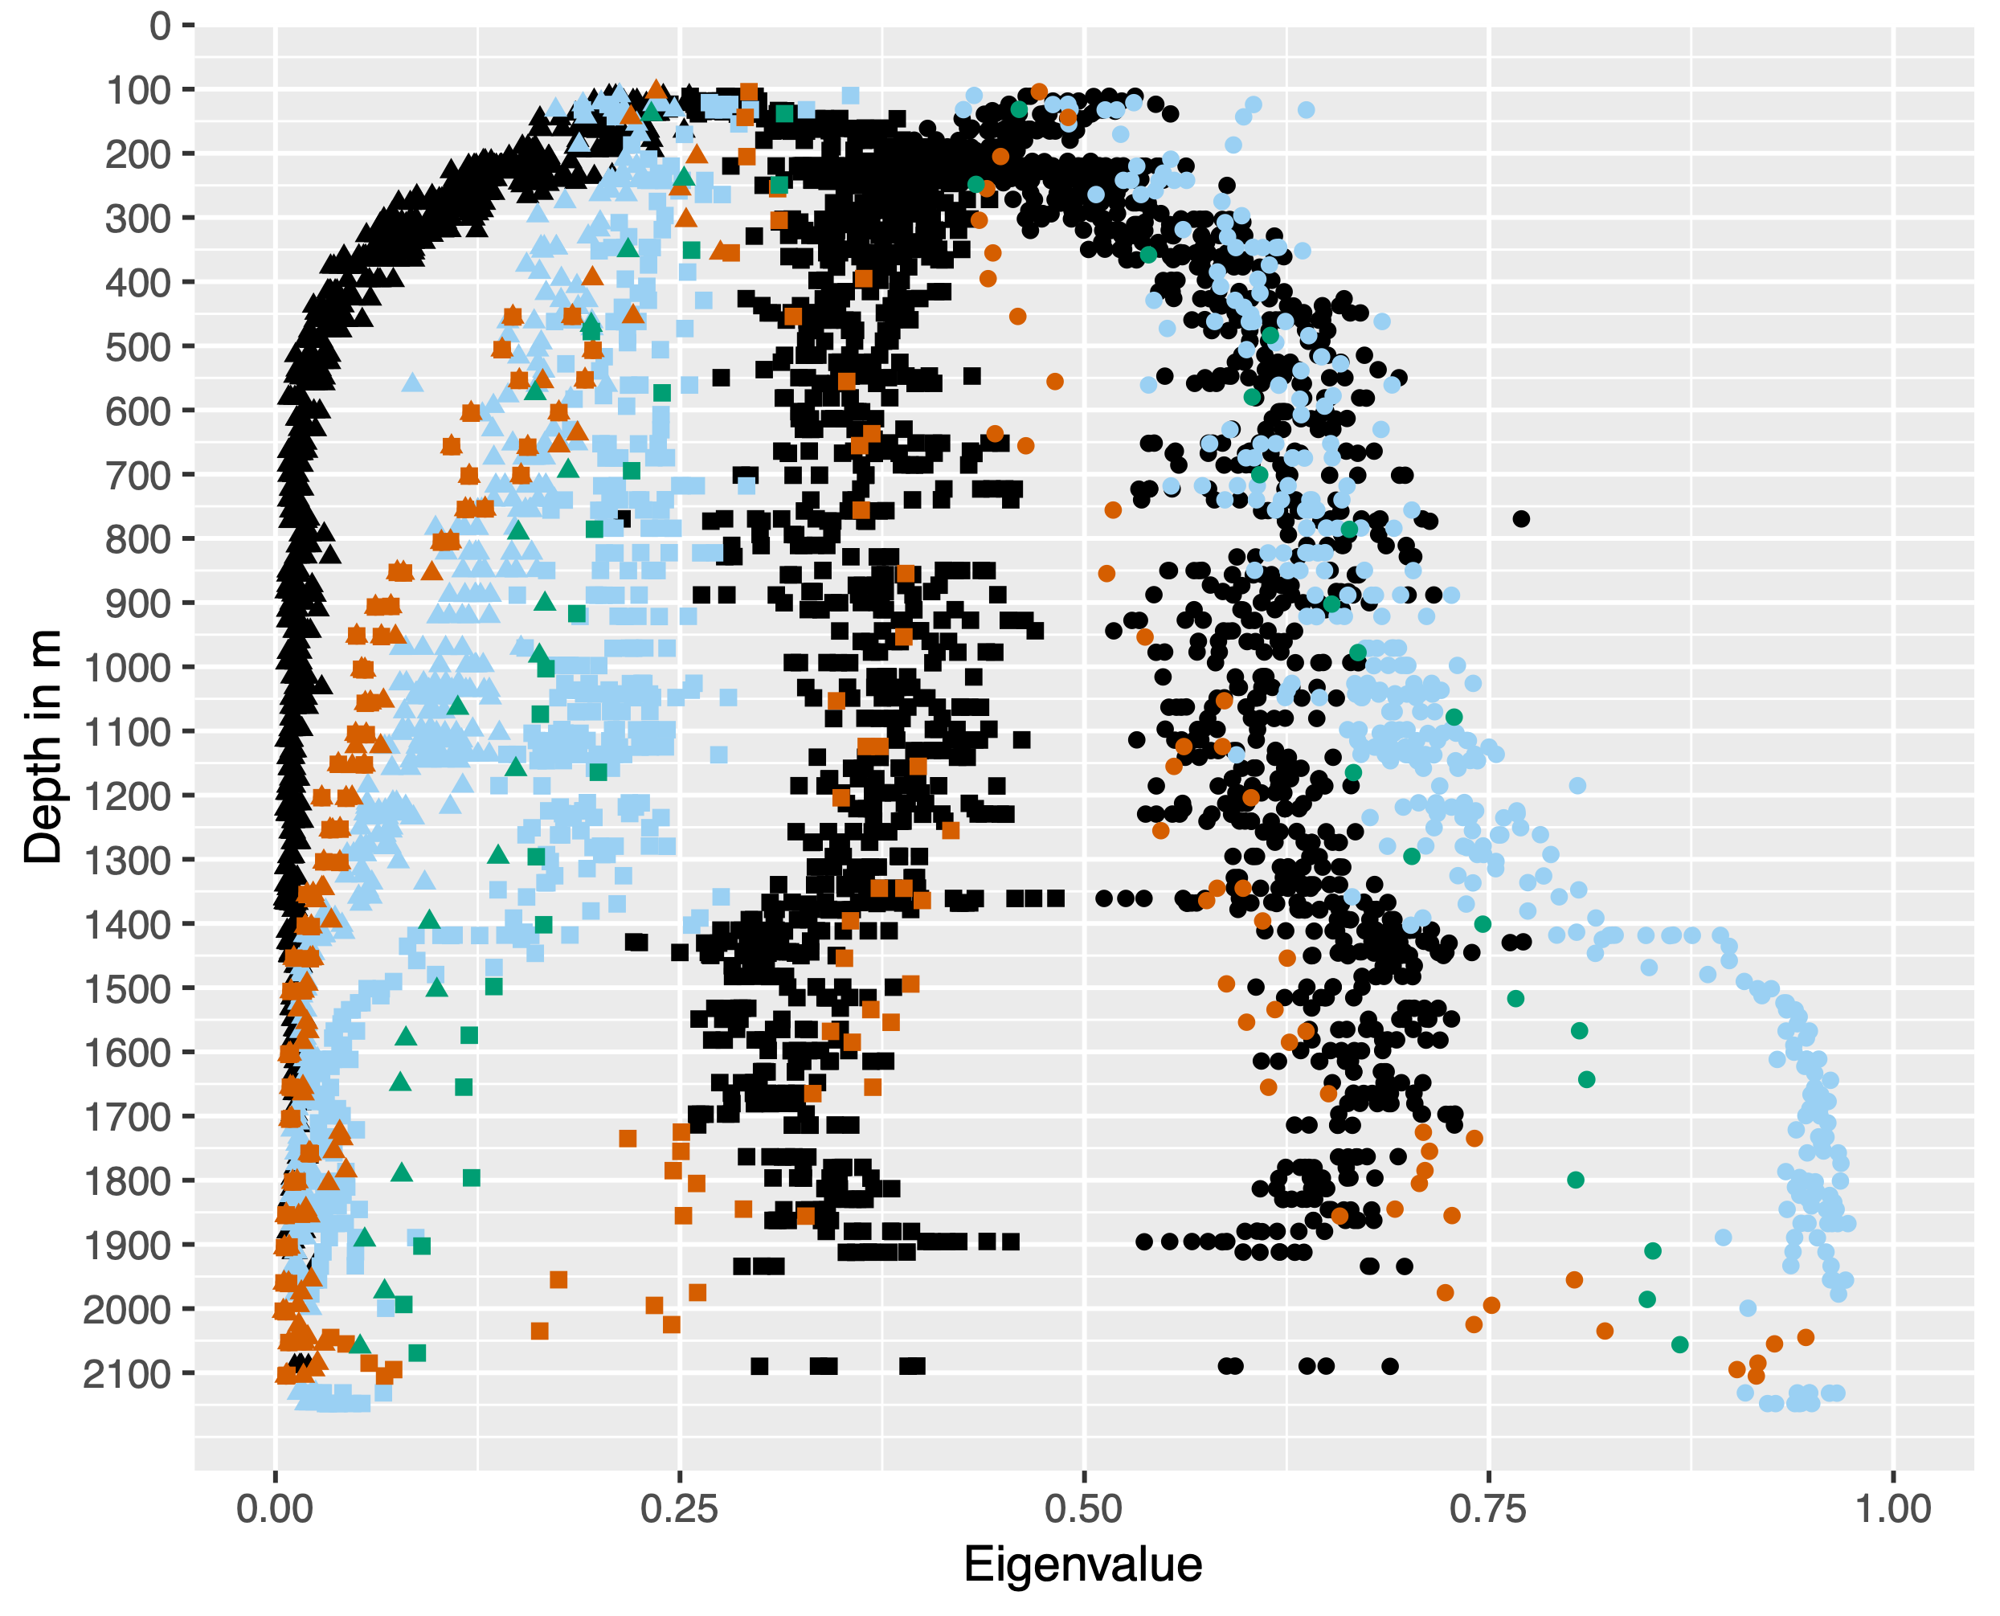
Eigenvalues
e1
e2
e3
NEEM (Eichler, 2013, Montagnat, 2014)
GRIP (Thorsteinsson et al., 1997)
EDML (Weikusat et al., 2017)
EGRIP
Eichler, Jan (2013). “C-axis analysis of the NEEM ice core: an approach based on digital image processing”. PhD thesis. Freie Universität Berlin, p. 73.
Montagnat, M., N. Azuma, D. Dahl-Jensen, J. Eichler, S. Fujita, F. Gillet-Chaulet, S. Kipfstuhl, D. Samyn, A. Svensson, and I. Weikusat (2014). “Fabric along the NEEM ice core, Greenland, and its comparison with GRIP and NGRIP ice cores”. In: Cryosphere 8.4, pp. 1129–1138. ISSN: 19940424. DOI: 10.5194/tc-8-1129-2014.
Thorsteinsson, Thorsteinn, Josef Kipfstuhl, and Heinz Miller (1997). “Textures and fabrics in the GRIP ice core”. In: Journal of Geophysical Research: Oceans 102.C12, pp. 26583–26599. ISSN: 21699291. DOI: 10.1029/97JC00161.
Weikusat, Ilka et al. (2017). “Physical analysis of an Antarctic ice core—towards an integration of micro- and macrodynamics of polar ice”. In: Philosophical Transac- tions of the Royal Society A: Mathematical, Physical and Engineering Sciences 375.2086, p. 20150347. ISSN: 1364-503X. DOI: 10.1098/rsta.2015.0347. URL: http://rsta. royalsocietypublishing.org/lookup/doi/10.1098/rsta.2015.0347.

Slide 9
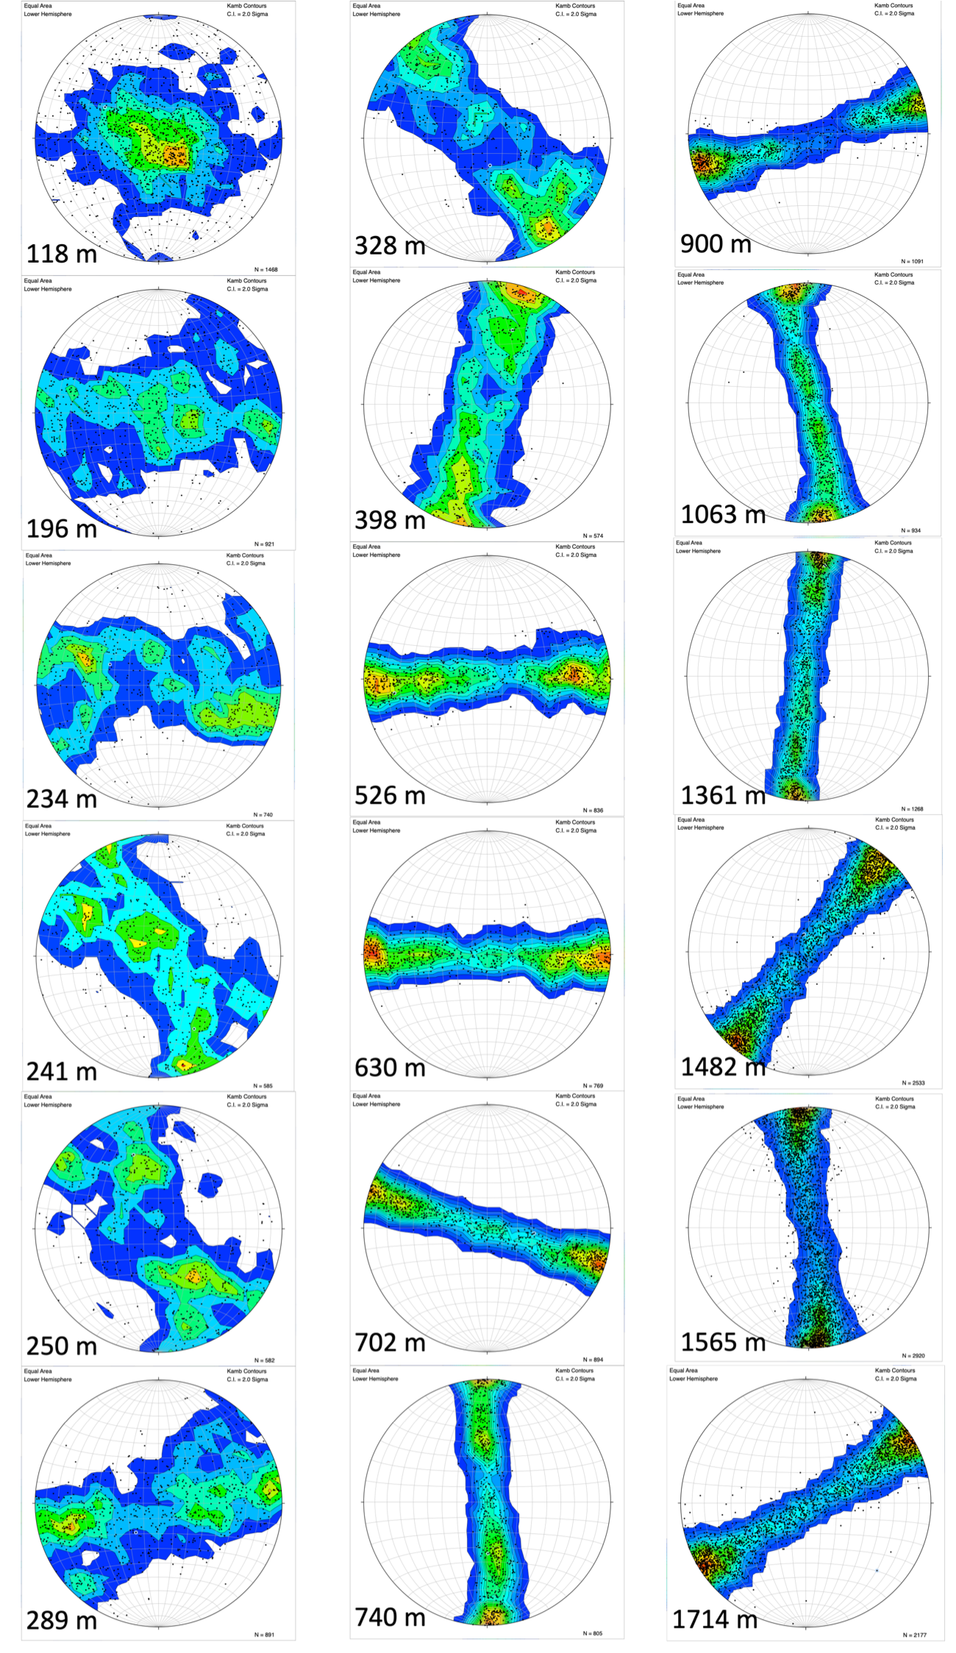
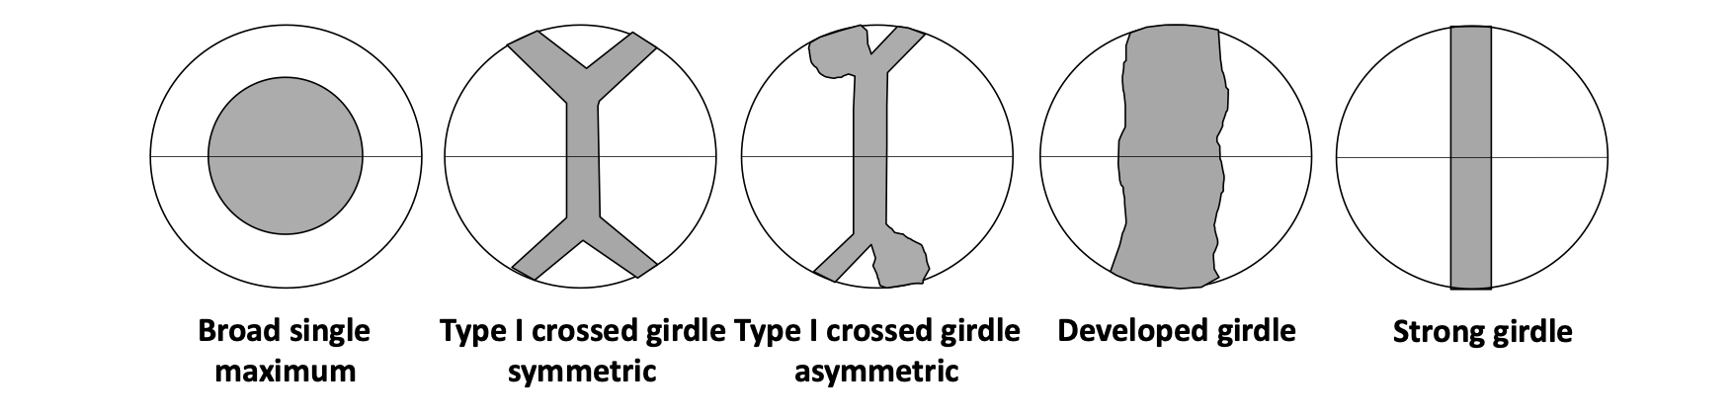
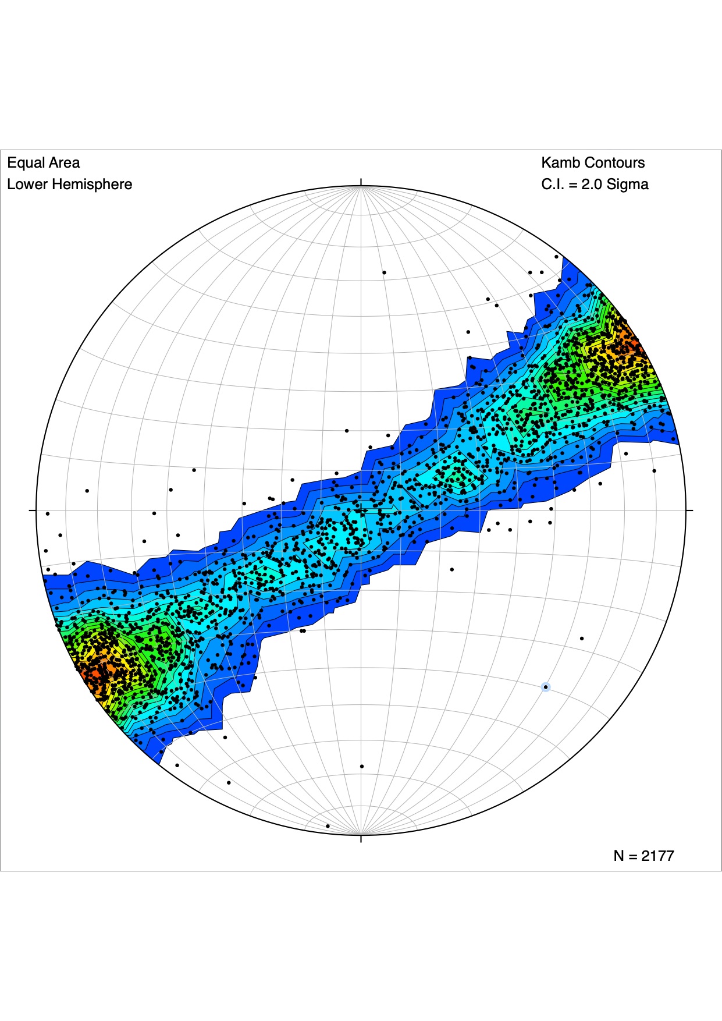
CPO development with depth
110-196m
196-296m
196-296m
296-500m
500-1230m
Horizontal
maxima
1230-2121m

Slide 10
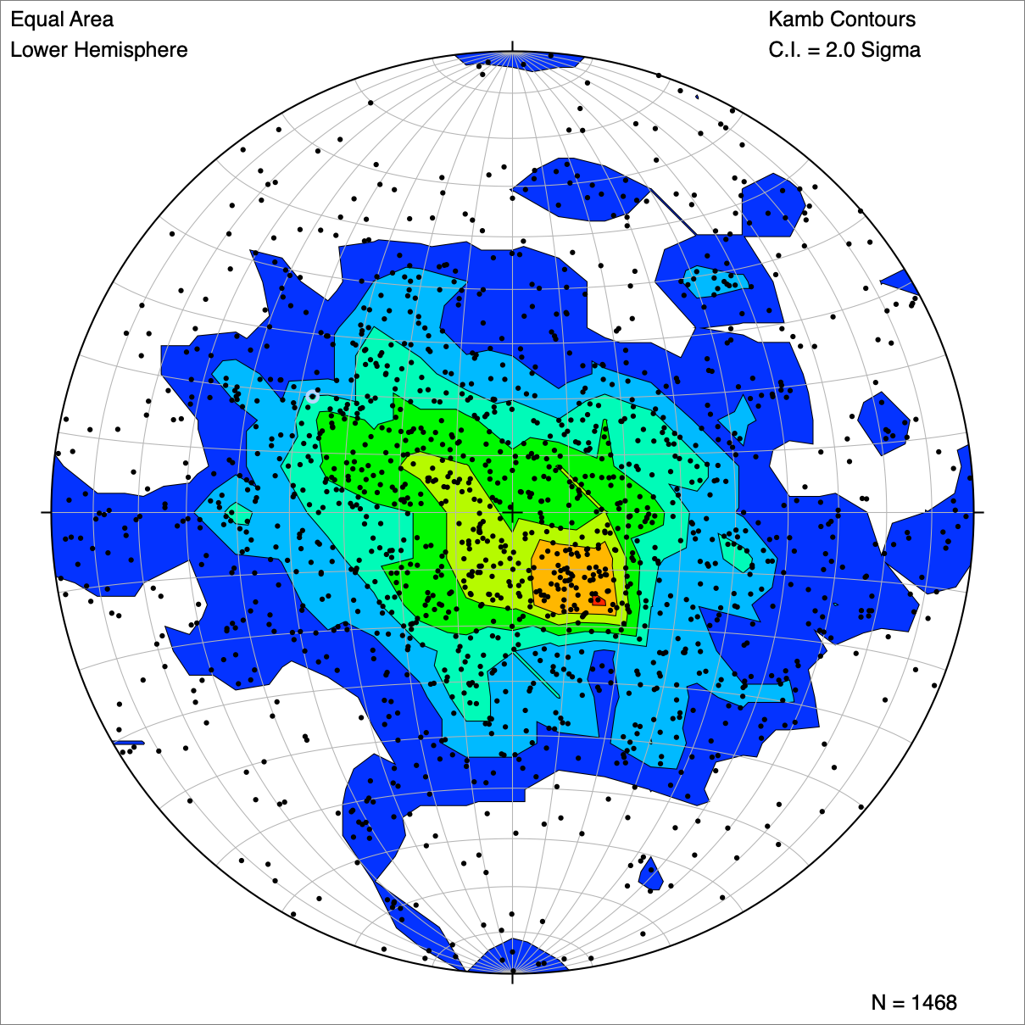
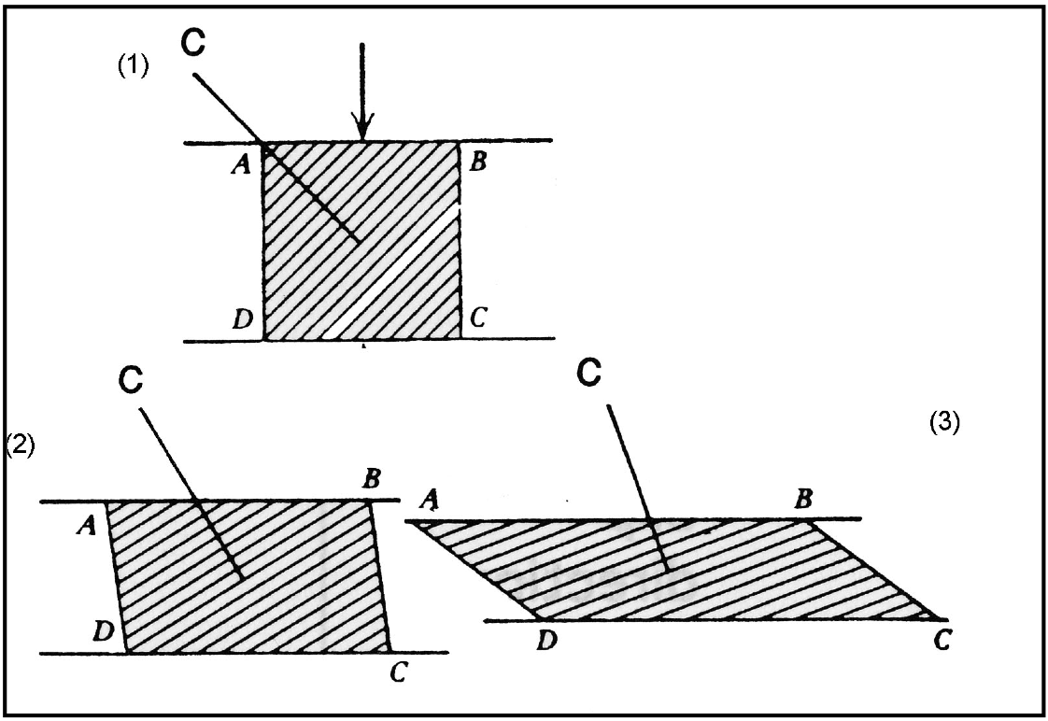
Crystal preferred orientations
Broad Single Maximum -> Vertical Compression from above
Thorsteinsson, Thorsteinn, Josef Kipfstuhl, and Heinz Miller (1997). “Textures and fabrics in the GRIP ice core”. In: Journal of Geophysical Research: Oceans 102.C12, pp. 26583–26599. ISSN: 21699291. DOI: 10.1029/97JC00161.

Slide 11
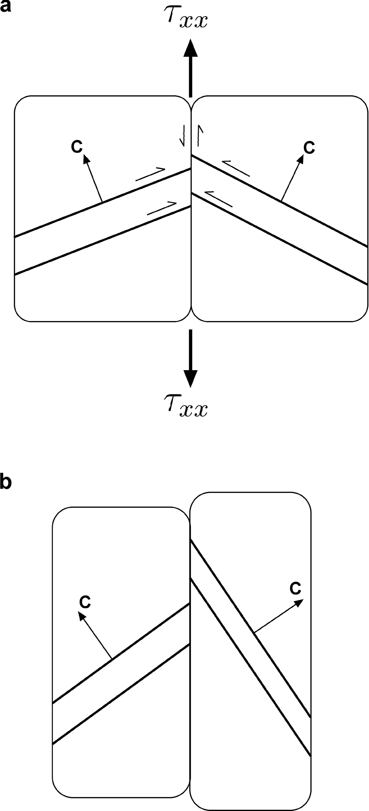
Crystal preferred orientations
Girdle -> Extensional deformation
K.M. Cuffey and W.S.B. Paterson. 2010. The physics of glaciers. Fourth edition. Amsterdam, etc., Academic Press. 704pp. ISBN-10: 0-123694-61-2, ISBN-13: 978-0-123-69461-4

Slide 12
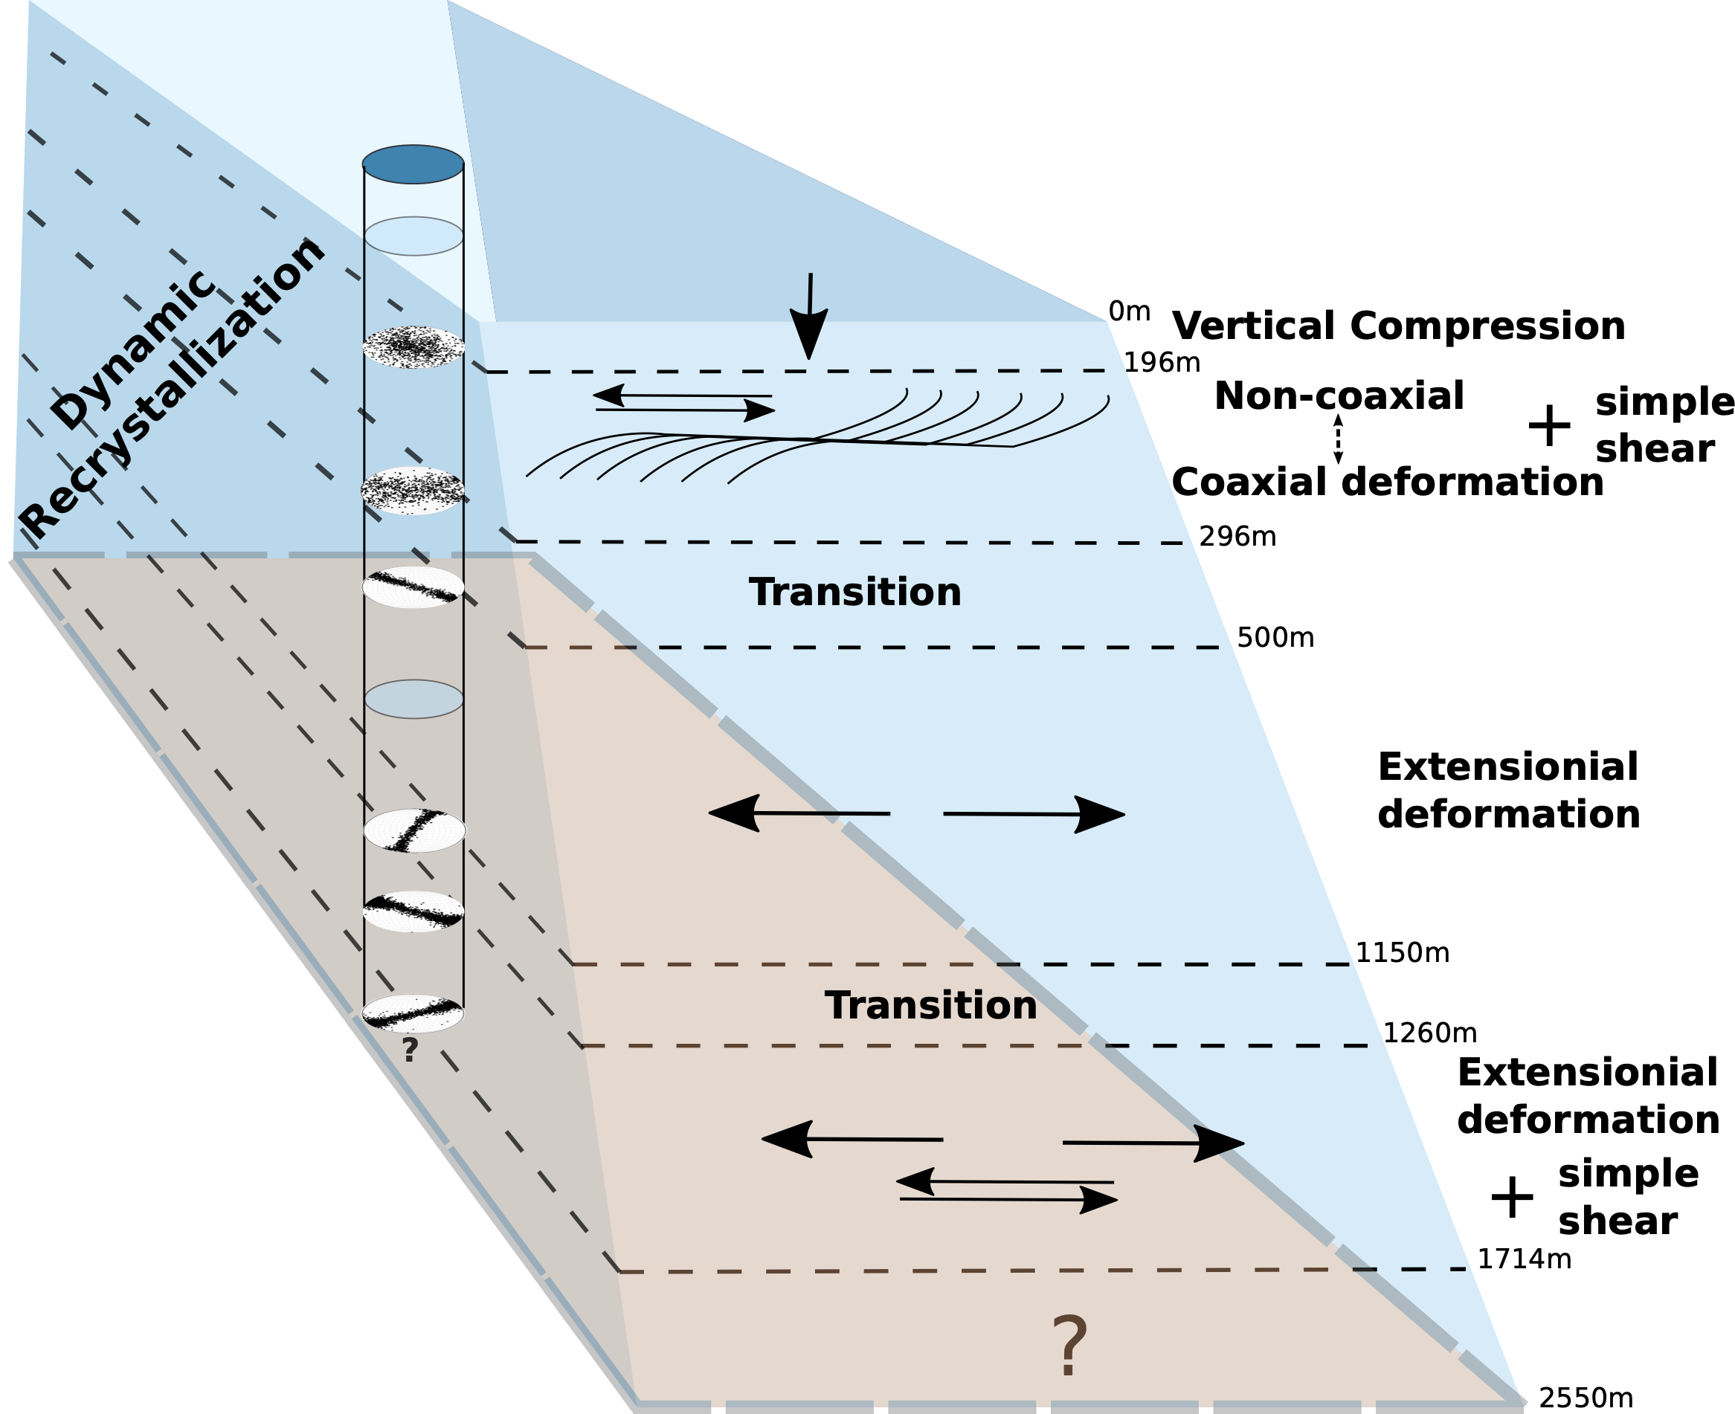
Proposed main deformation modes
Extensional deformation
down to 2121 m

Slide 13
Grain size
Grain size variability
Increase
Decrease
Constant
Increase
= Mean Grain area of
one thin section

Slide 14
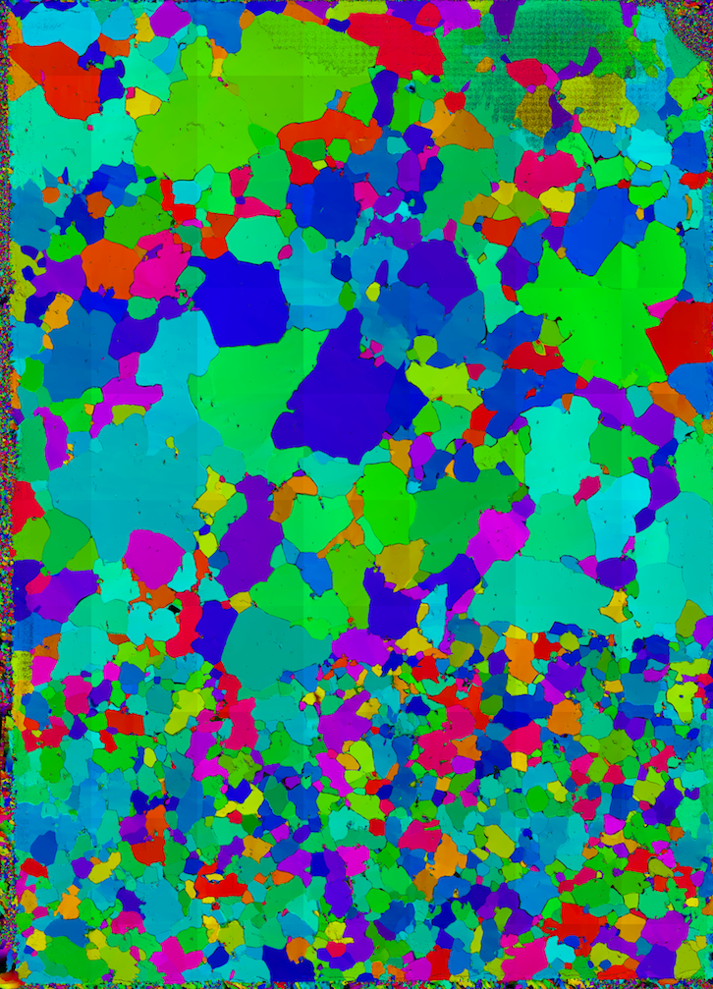
Grain size variability
828 m
1444 m
1 cm
1 cm

Slide 15
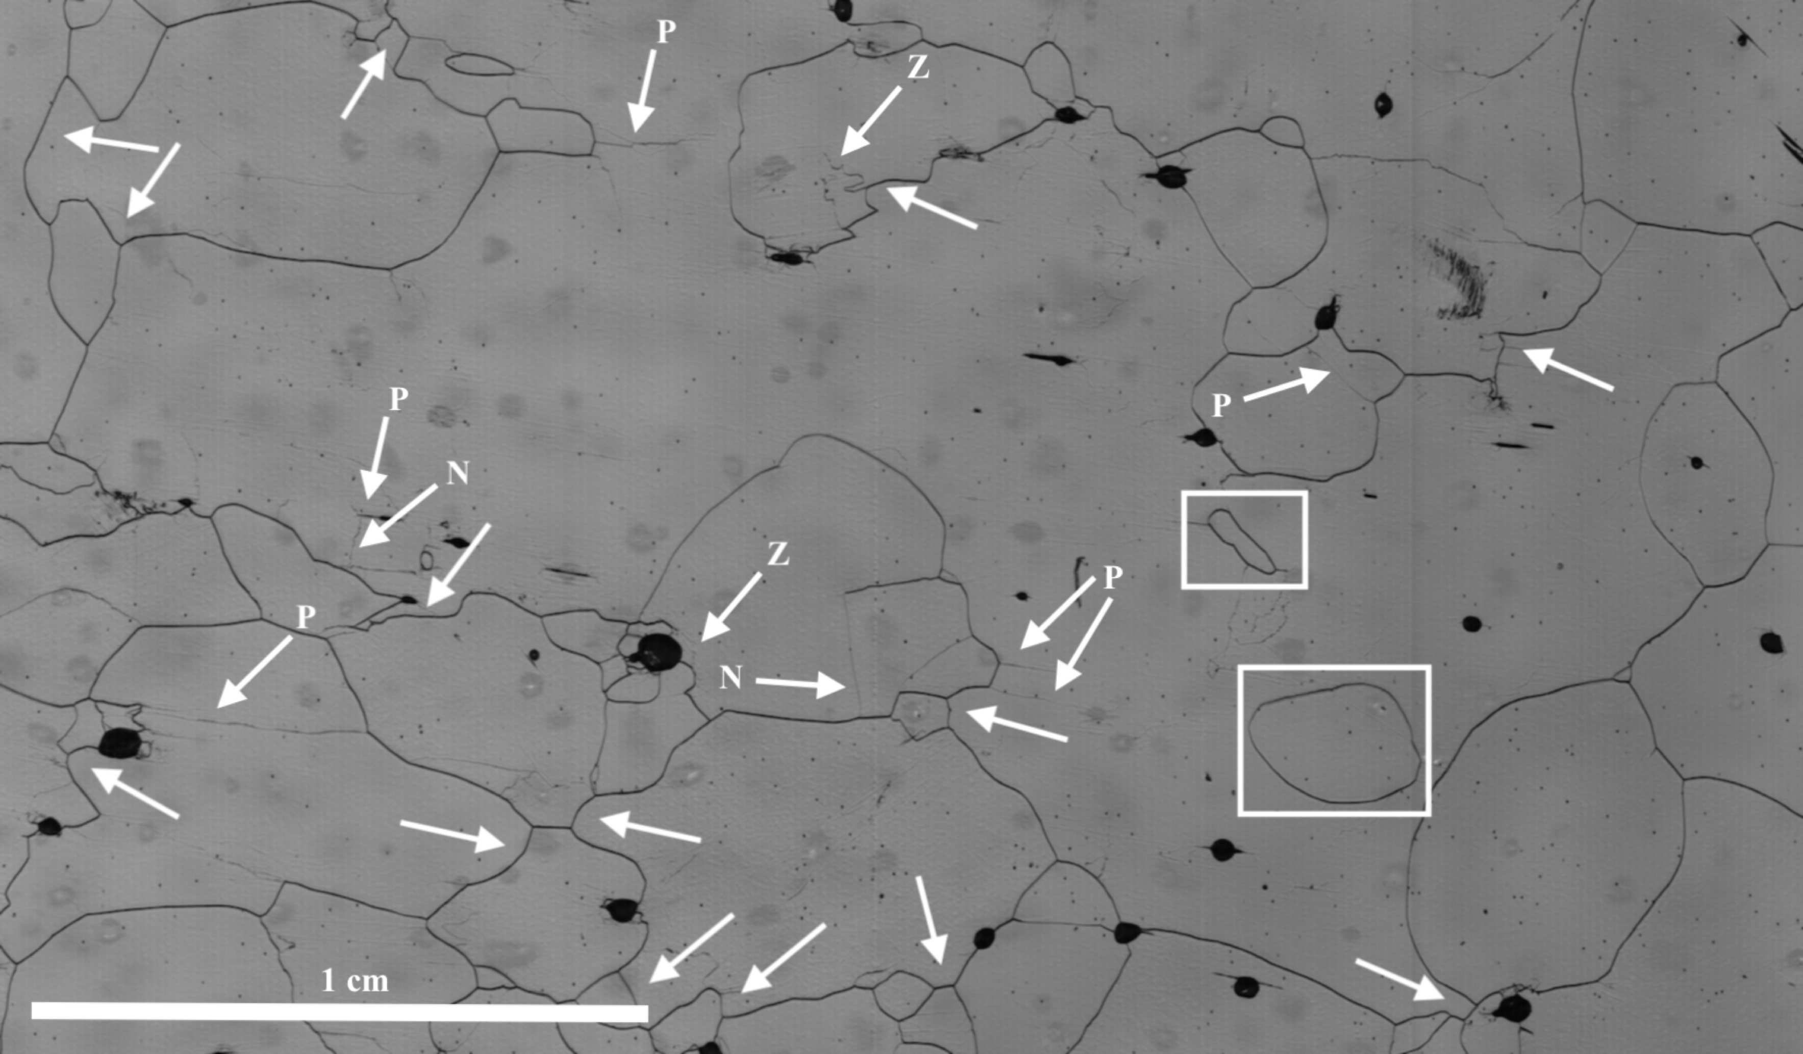
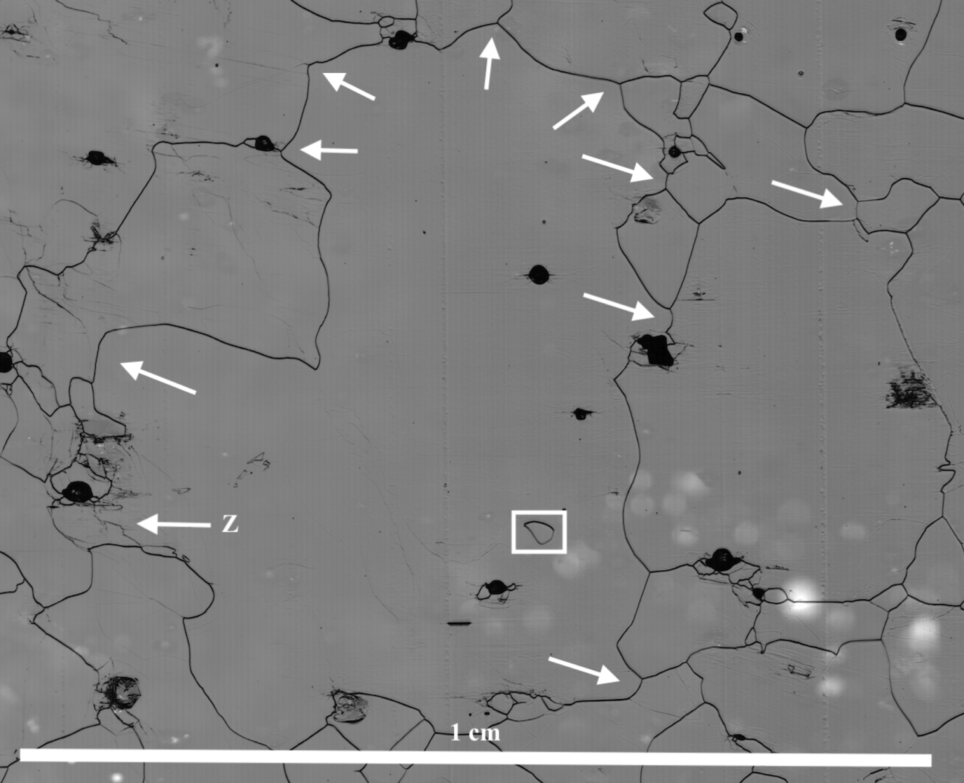
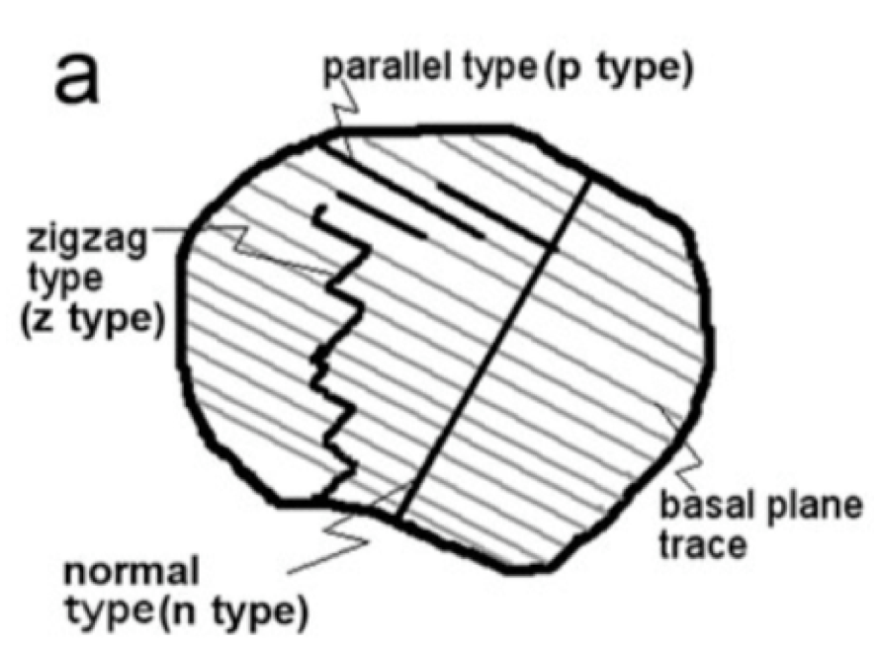
Indications of Dynamic Recrystallisation
426 m
723 m
Weikusat, Ilka, Sepp Kipfstuhl, Sérgio H. Faria, Nobuhiko Azuma, and Atsushi Miyamoto (2009). “Subgrain boundaries and related microstructural features in EDML (Antarctica) deep ice core”. In: Journal of Glaciology 55.191, pp. 461–472. ISSN: 00221430. DOI: 10.3189/002214309788816614.

Slide 16
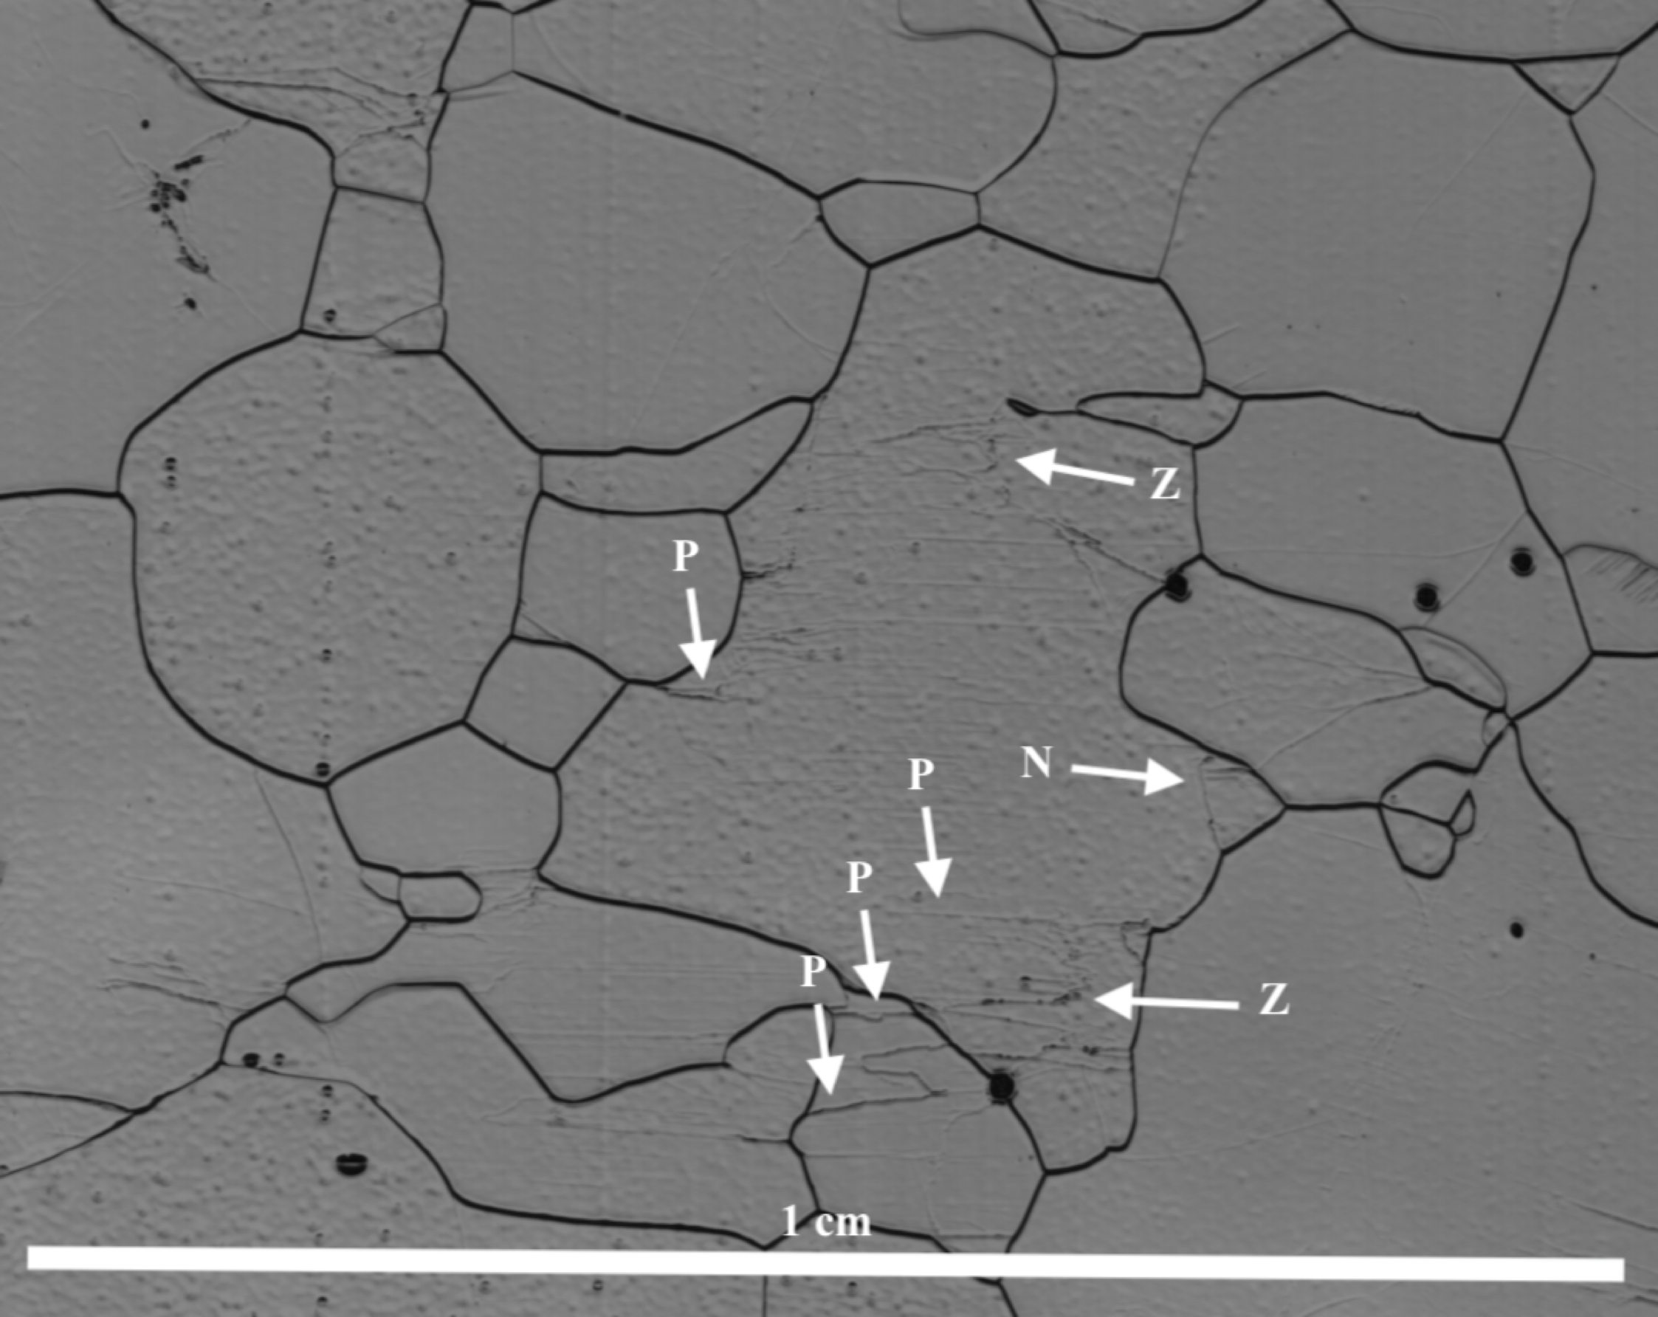
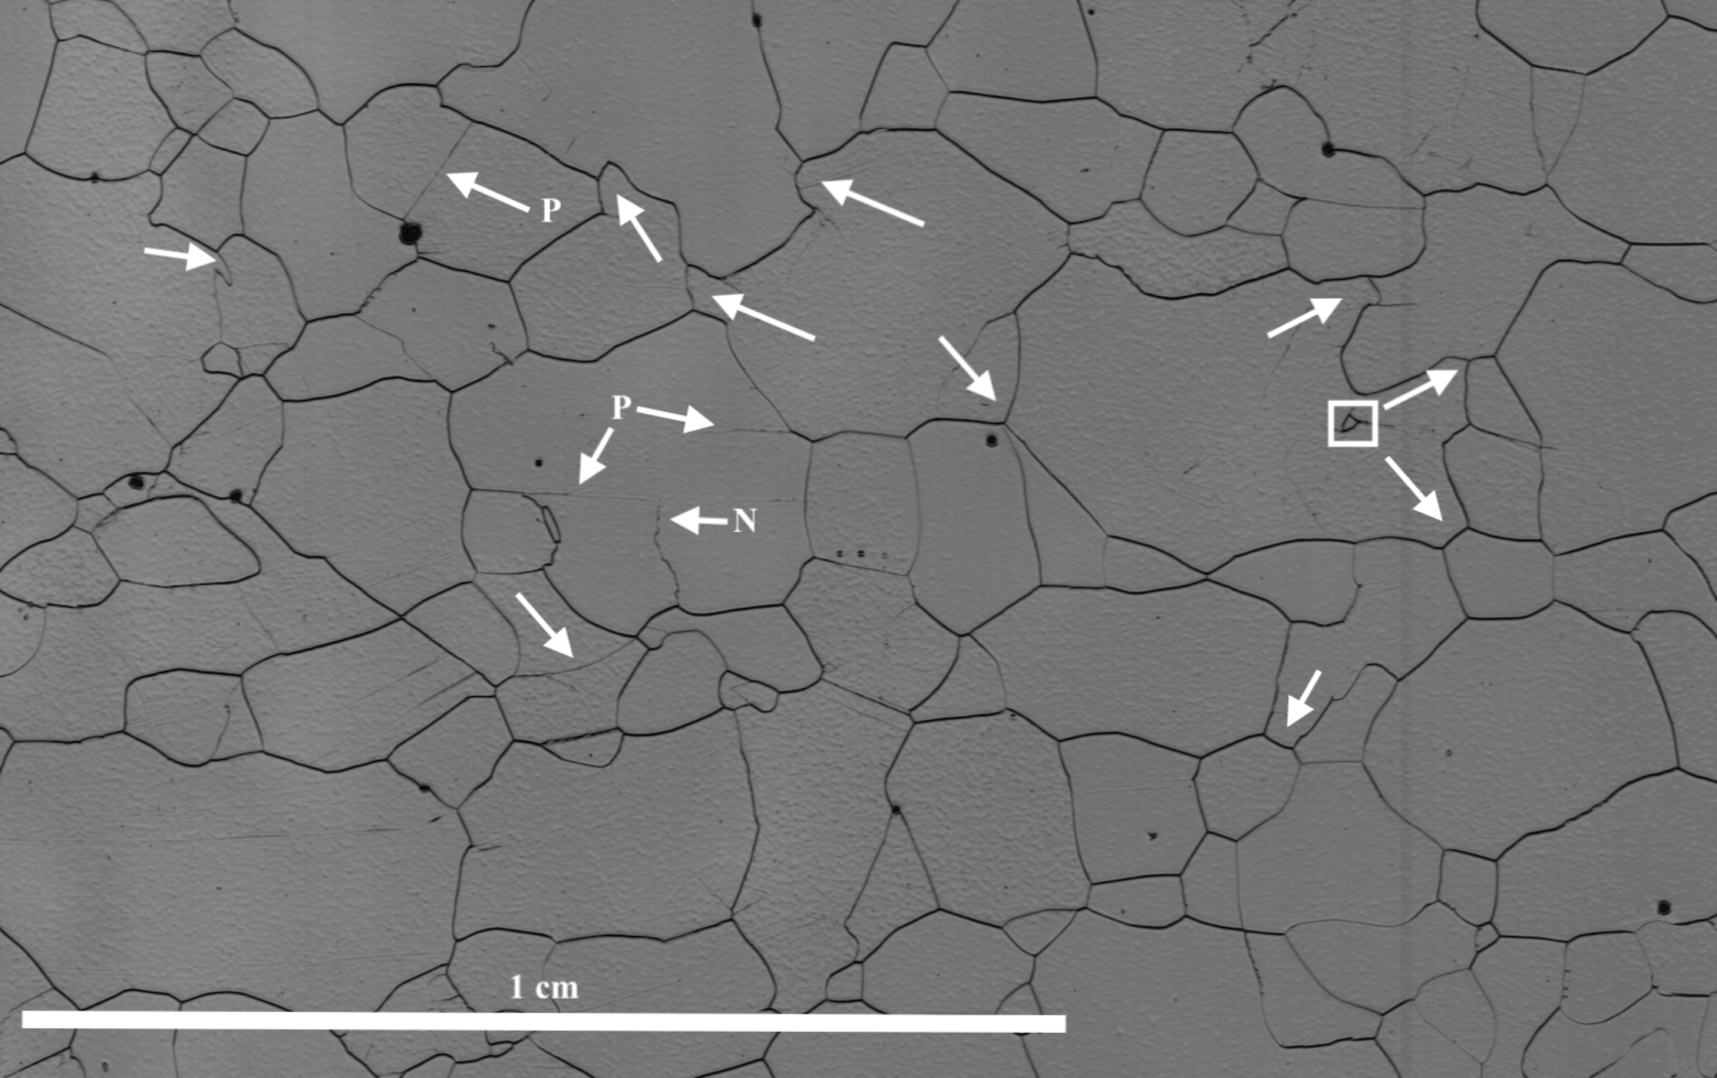
Indications of Dynamic Recrystallisation
1361 m
1378 m

Slide 17
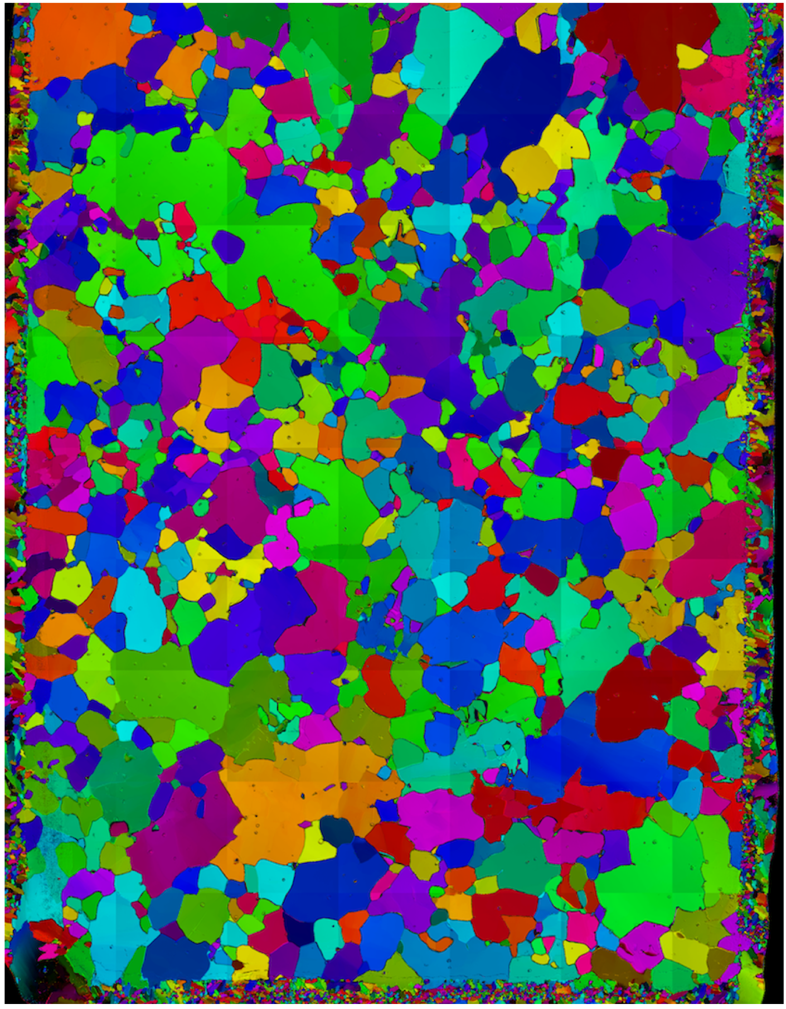
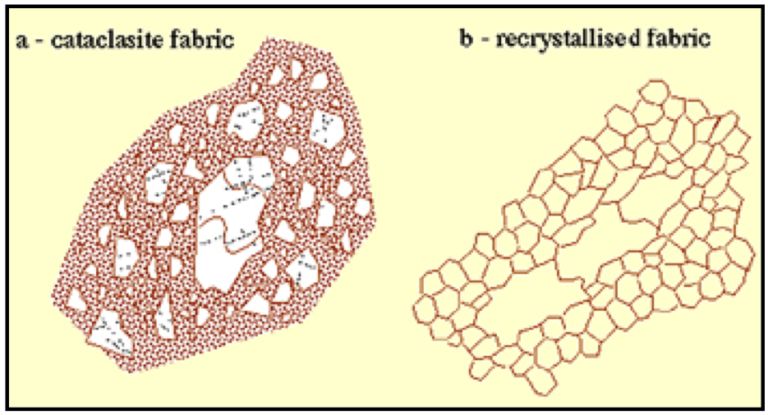
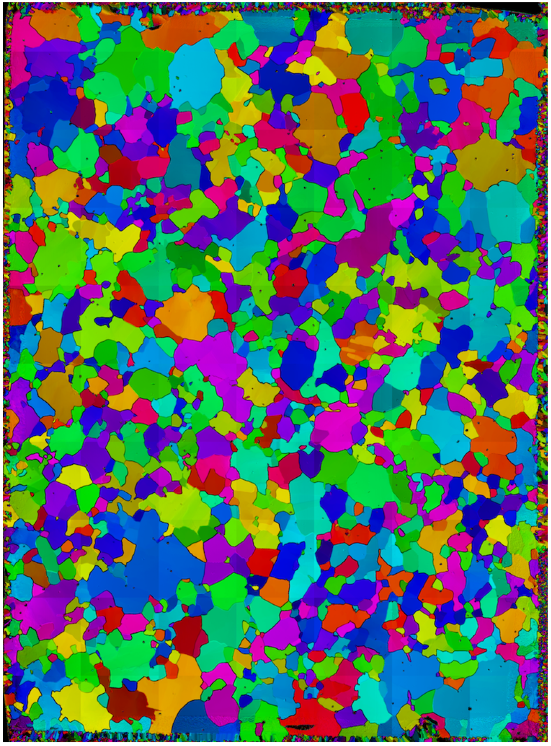
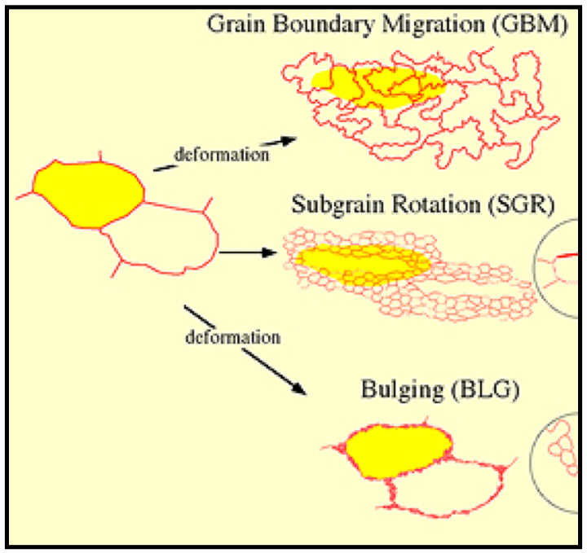
Indications of Dynamic Recrystallisation
277 m
338 m
Passchier & Trouw (2005)
1 cm
1 cm

Slide 18
Take-home message
1097 thin sections from upper 2121m of EGRIP ice core analysed regarding microstructure and fabric
emphasis on CPO, grain size, grain shape and indications of dynamic recrystallisation

Slide 19

Take-home message
more rapid evolution of anisotropy with depth compared to lower dynamic sites
  different deformation modes with depth + novel CPOs
  occurrence of dynamic recrystallisation throughout entire core
small step towards an enhanced understanding of NEGIS and ice stream flow in general
Nicolas Stoll
nicolas.stoll@awi.de
@stoll_nico

