Slide 1
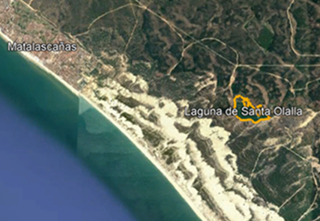
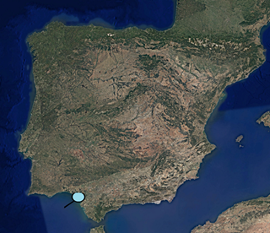
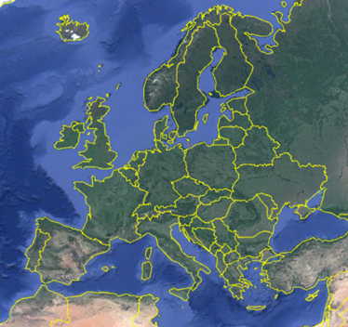
Evaluation of pond/aquifer flow exchanges using local discretization and contrasting different boundary condition in MODFLOW. Case of Santa Olalla pond (SW Spain). Serrano-Hidalgo, C., Heredia-Díaz J., Guardiola-Albert C. and Elorza-Tenreiro F.J.
EGU 2020
Santa Olalla Lagoon is the largest of the natural coastal lagoons of Doñana Natural Park (RAMSAR Reserve). The Almonte-Marismas aquifer discharges into the lagoon and this is responsible for the permanent water regime that exists.
PSO1
METODOLOGY
To identify the adequate numerical representation of the lagoon using a finer spatial discretization.
The implementation of different boundary conditions in the model.
Figure 1. Location of Santa Olalla Lagoon
OBJECTIVE
To identify the adequate numerical representation of the lagoon in the steady regional flow model.
CHALLENGE
To simulate numerically at local scale the exploitation effect on the lagoon, by using a regional model.

Slide 2
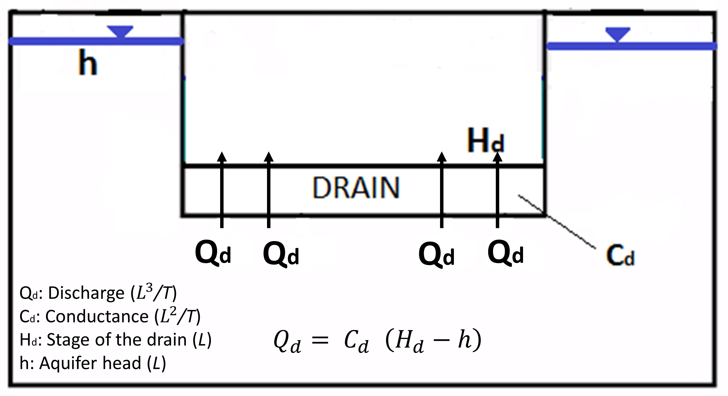
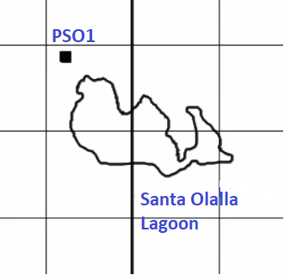
HOW…?
EGU 2020
Software/Parent Model | Packages
ModelMuse interface (Winston, 2009) Steady Regional Flow Model (Fig. 2) Grid: 2 layers, 500x500m grid cells (174 rows x 154 columns) Piezometric data heads of 1 Observation Point “PSO1”(Fig. 3). Originally relationship between the aquifer and the Santa Olalla lagoon was not considered. | Child Discretization | Boundary Condition
 | Local Grid Refinament-2 (LGR-2) (Mehl et al, 2013) | DRAIN+EVT (Harbaugh et al, 2000)
 |  | LAKE (Merrit et al., 2000)
Horizontal: Subdivision in 10 x 10 grids cells (Fig.4)
Vertical: Subdivision in 4 (Fig.5)
Figure 6. Concepts used in estimating seepage flux between drain and an aquifer
Figure 4. Horizontal discretization.
Figure 5. Vertical discretization 4 layers
Figure 2. Regional model of Almonte-Marismas aquifer
Figure 3. Location of observation point in the regional model grid (parent).
Figure 7. Concepts used in estimating seepage flux between lake and an aquifer

Slide 3
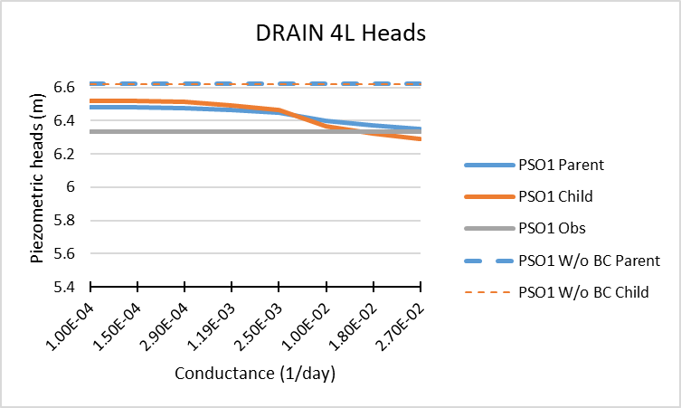
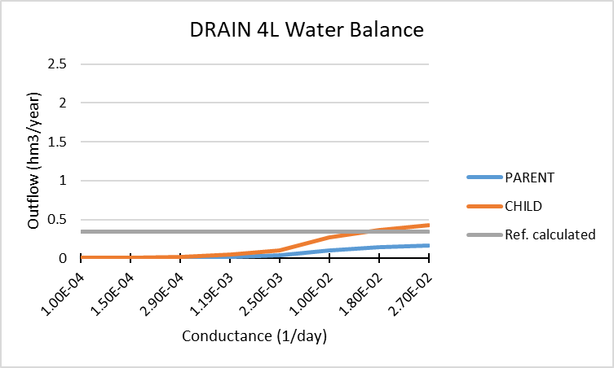
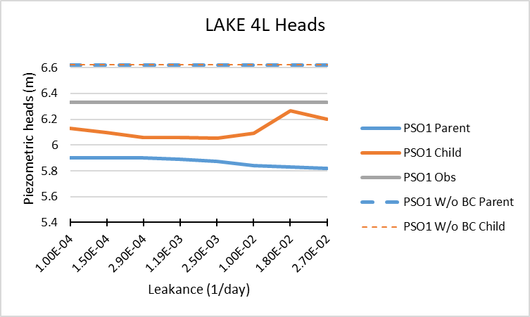
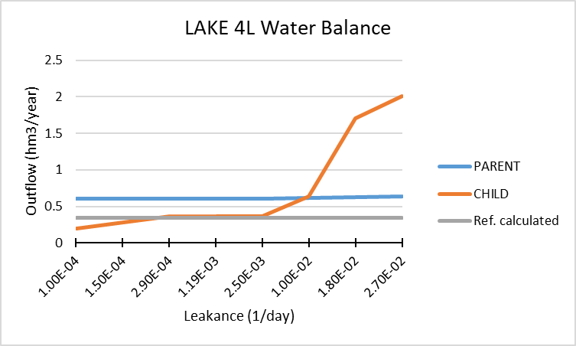
RESULTS
EGU 2020
Figure 8. Piezometric Heads using the DRAIN boundary condition and a discretization of 4 layers.
Figure 10. Water Balance using the DRAIN boundary condition and a discretization of 4 layers with different values of conductance.
Figure 9. Piezometric Heads using the LAKE boundary condition and a discretization of 4 layers.
Figure 11. Water Balance using the LAKE boundary condition and a discretization of 4 layers with different values of conductance.

Slide 4
After having obtained results of simulated heads values and Water Balances…. Some conclusions are:
EGU 2020
It was possible to perform a fine model around the Santa Olalla lagoon within the regional groundwater model by using MODFLOW-LGR.
The calibration presents difficulties because the heads and output flow behave inversely fitted when modifying the value of the conductance.
A different incidence of the hydraulic conductance on each boundary condition is presented. This happens because the Cauchy Condition is implemented in a different way in each boundary condition. In the case of DRAIN, it applies the direct implementation of Cauchy condition and in the case of LAKE, the conductance is a composition of the permeability of the lakebed and its thickness, the permeability of the aquifer and the dimension of the cell.

Slide 5
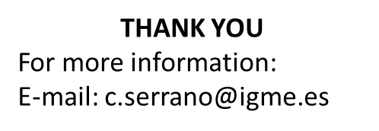
Acknowledgements
EGU 2020
This research has been funded by the grant to the execution of Industrial PhDs within the Autonomous Region of Madrid (Spain) IND2018/AMB-9553.
CLIGRO project (MINECO, CGL2016-77473-C3-1-R) of the Spanish National Plan for Scientific and Technical Research and Innovation.

