Slide 1

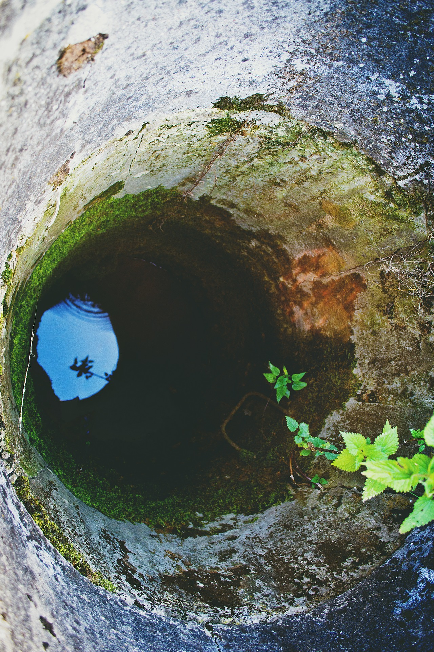



EGU General Assembly 2020, Online
Sharing Geoscience Online, 4-8 May, 2020
Comparison of two methods for optimizing existing groundwater monitoring networks:
Application to the real case of the
Bacchiglione Basin (Veneto, Italy)
Andrea Sottani¹, Mara Meggiorin^{1,2}, Luís Ribeiro³, Andrea Rinaldo^{2,4}
¹ Sinergeo Srl – Vicenza, Italy, info@sinergeo.it
² Dipartimento di Ingegneria Civile, Edile e Ambientale, Università di Padova
³ CERIS, Instituto Superior Técnico, Lisbon University, Av. Rovisco Pais, Lisboa Codex, Portugal
⁴ Laboratory of Echohydrology (ECHO/IIE/ENAC), École Polytechnique Fédérale de Lausanne, Switzerland
!!! Session HS8.2.9 - Live chat on Tuesday, 05 May 2020, 14:00-15:45
Watch the video of the presentation HERE !!!
EGU2020 - Online, 4-8 May 2020

Slide 2
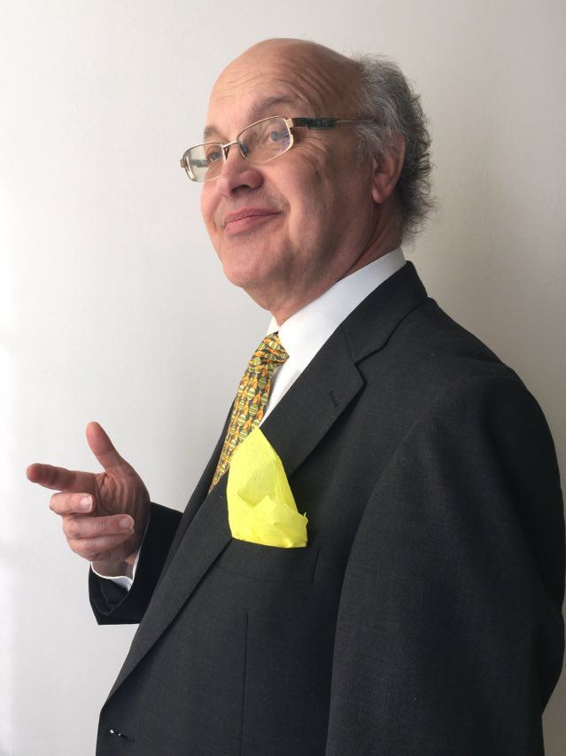
I’d like to thank
Professor Luìs Ribeiro
who unfortunately passed away on April 3rd, 2020
My professor and master thesis co-supervisor:
he was a great teacher who made me discover, enjoy and get passionate
in groundwater
I thank him for his help with this paper and guidance
on theoretical development, results comprehension and evaluation,
particularly on the Hierarchical clustering method
Some of his major contributions to sciences are:
Evaluation of an intrinsic and a specific vulnerability assessment method in comparison with groundwater salinisation and nitrate contamination in two agricultural regions in the south of Portugal
Application of a groundwater quality index as an assessment and communication tool in agro-environmental policies–Two Portuguese case studies
Probably his major contribution remains
his strong international commitment, particularly in Latin American countries,
where he devoted himself to the social implications of water management
EGU2020 - Online, 4-8 May 2020

Slide 3
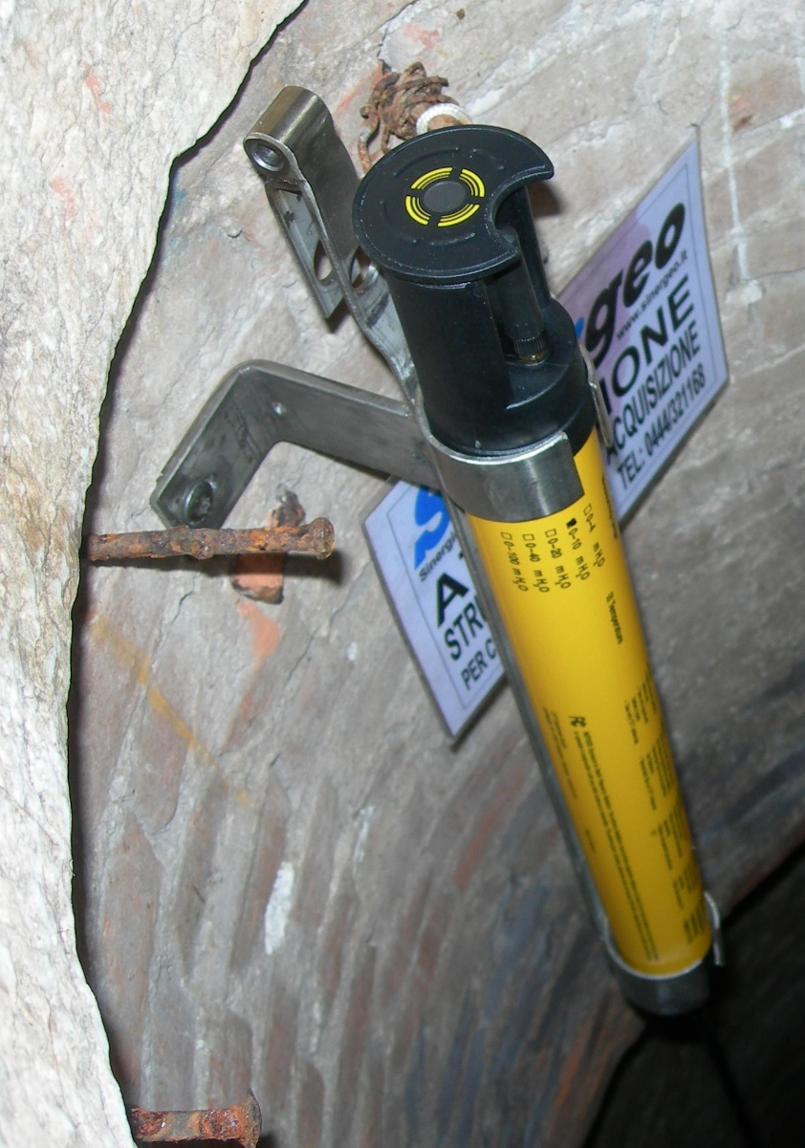
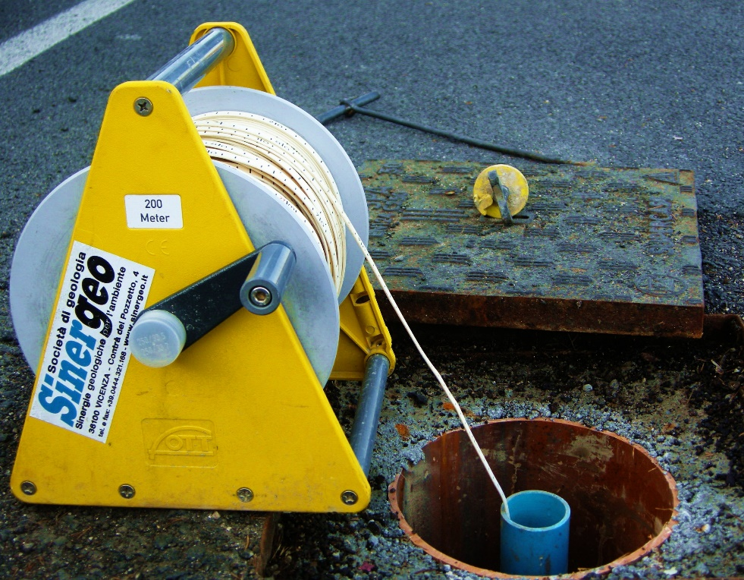
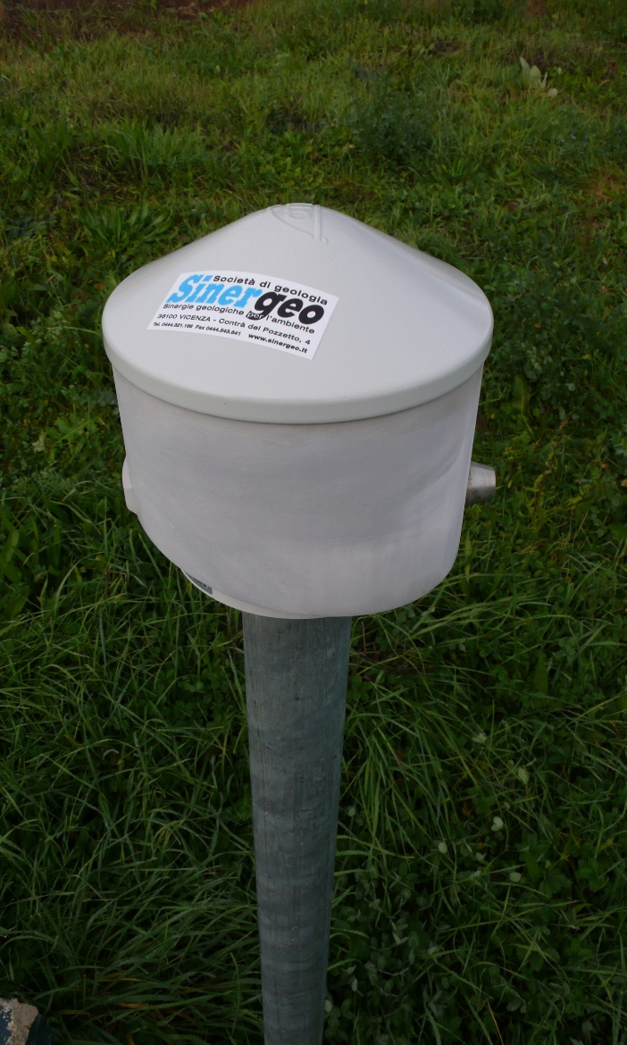
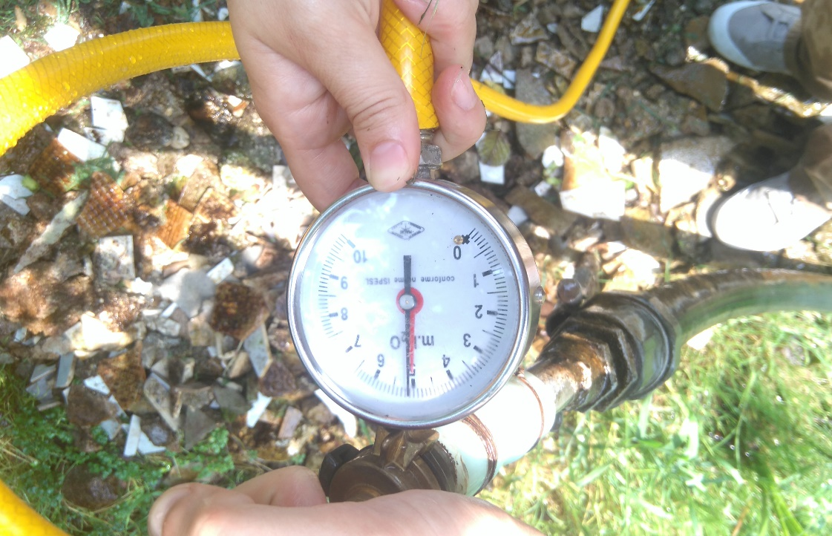
Groundwater Level Monitoring Networks (GLMNs)
Collect crucial information
for evaluating groundwater sustainability,
for implementing an integrated water resources management
But
Monitoring is expensive
Economic considerations influence the number of monitoring wells
Designing a GLMN is a compromise between
prediction accuracy
cost minimization
To reduce costs:
Less sensors
Lower sampling frequency
EGU2020 - Online, 4-8 May 2020

Slide 4
Optimization of Groundwater Level Monitoring Networks
The statistical analysis of recorded measurements
from existing groundwater monitoring networks can:
Improve the knowledge of the groundwater system
Evaluate the
existing network
Optimize and enhance
its efficiency
Comparison of two statistical optimization methods:
Oscillations correlation method
Hierarchical clustering of
Average yearly hydrograph
Principal Components
Monthly trends
EGU2020 - Online, 4-8 May 2020

Slide 5
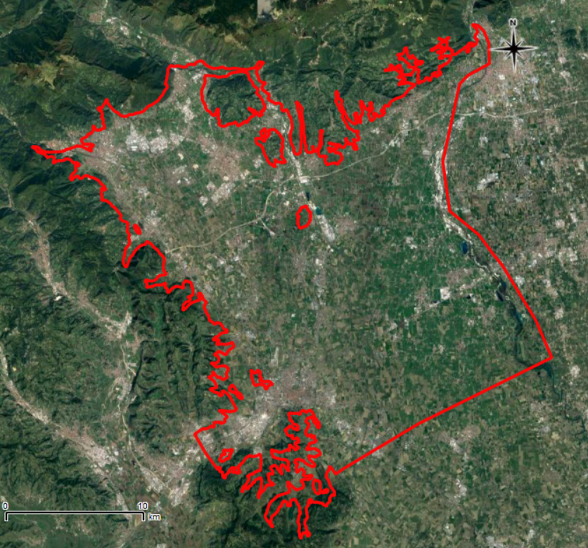
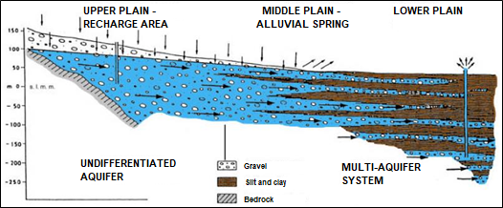
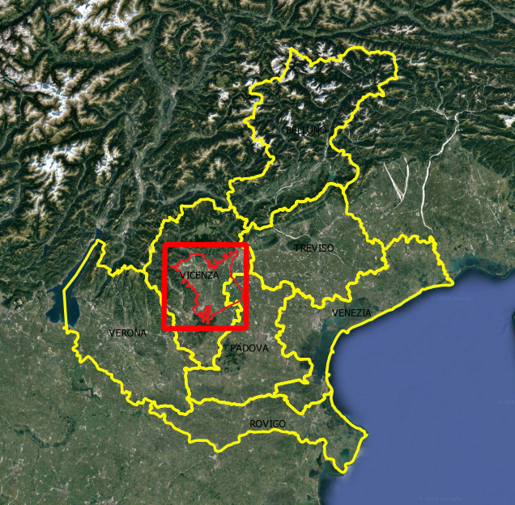
Case study – Bacchiglione Basin
N
Asiago
Remarkable water asset:
drinkable water to people in Vicenza and part of Padua
dense network of residential, industrial and agricultural areas
Important to preserve, protect and rationally use the groundwater resource
Brenta
Monti Lessini
VICENZA
N
S
S
L. Altissimo, A. Dal Prà and G. Scaltriti, 1999 - Modified
EGU2020 - Online, 4-8 May 2020

Slide 6
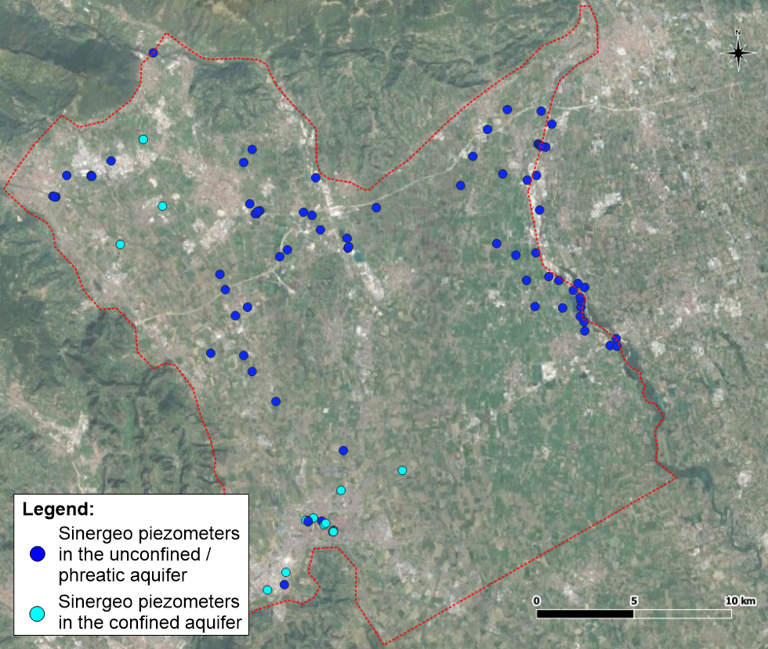
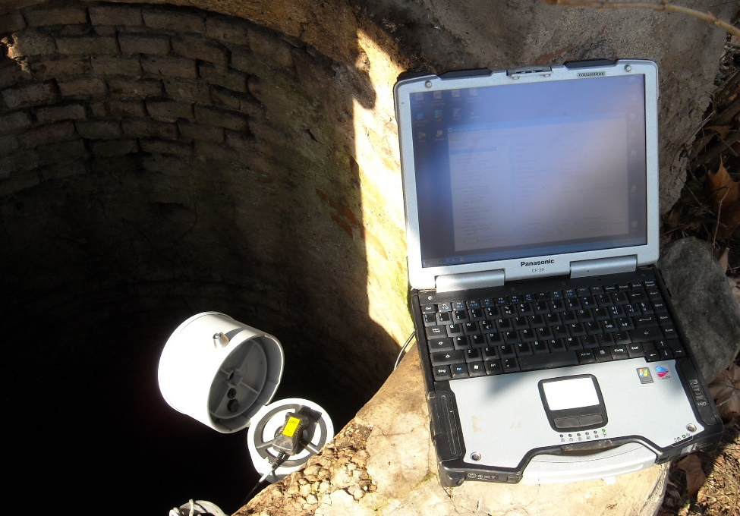
Sinergeo’s Groundwater Level Monitoring Network
BASSANO DEL GRAPPA
102 sensors
(many with CPRS module)
Not homogeneous series:
Not uniformly distributed in space
Recording periods not simultaneous
    outliers removal
        hourly to daily data
        check of series length
        interpolation
        check of stationarity
        79 timeseries
SCHIO
THIENE
VICENZA
EGU2020 - Online, 4-8 May 2020

Slide 7
Oscillation correlation - Steps
1
Estimate detrended timeseries
2
Evaluate oscillations timeseries correlation two by two
Pearson correlation coefficient
3
Kolmogorov-Smirnov test for highly correlated series
4
Group intercorrelated couples
Produce a group map
EGU2020 - Online, 4-8 May 2020

Slide 8
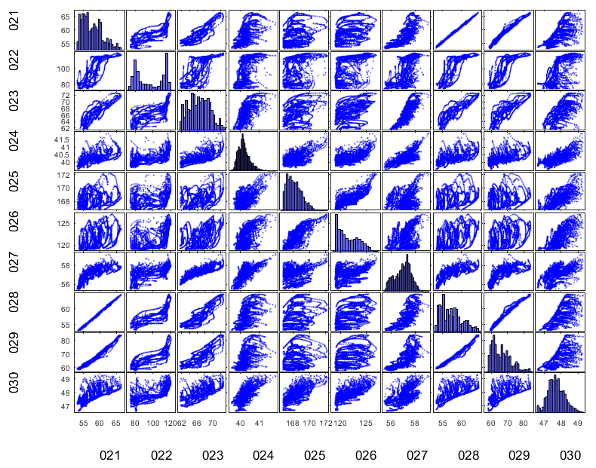
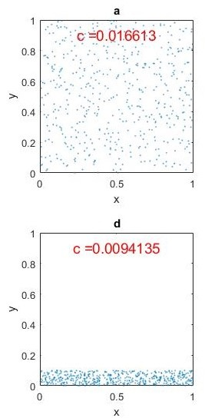
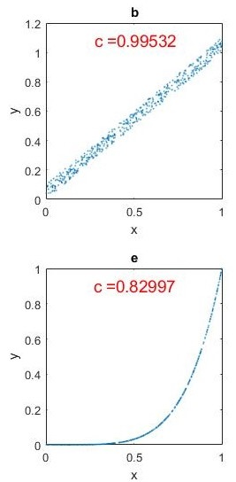
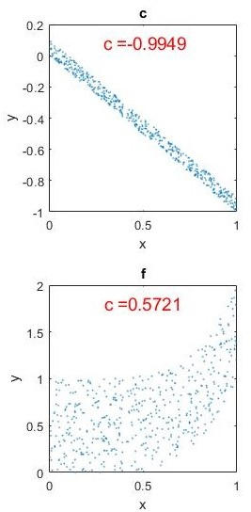

Oscillation correlation method
1
Estimate detrended timeseries
2
Evaluate oscillations timeseries correlation two by two
Pearson correlation coefficient
For linear correlation $\text{c}=\frac{C_{XY}}{σ_{x}σ_{y}}$
If timeseries are correlated they seem to be linearly correlated
Easy to use but
poor statistic for variables
not linearly correlated
EGU2020 - Online, 4-8 May 2020

Slide 9
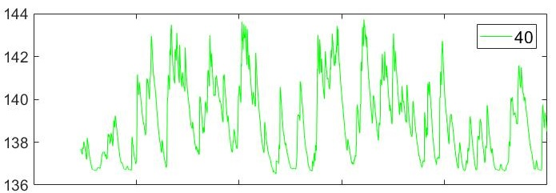
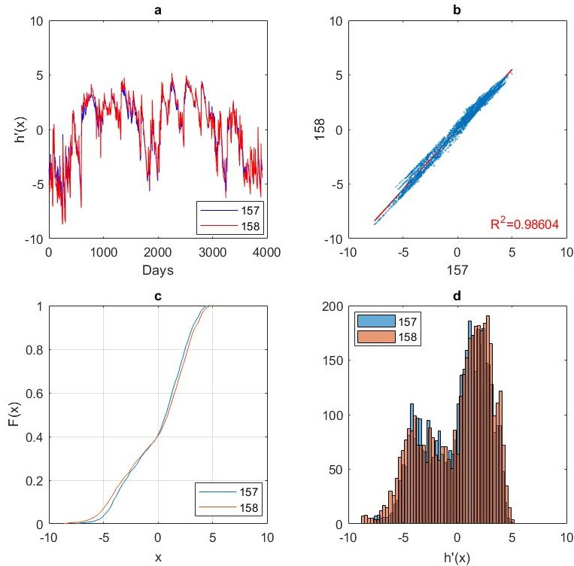
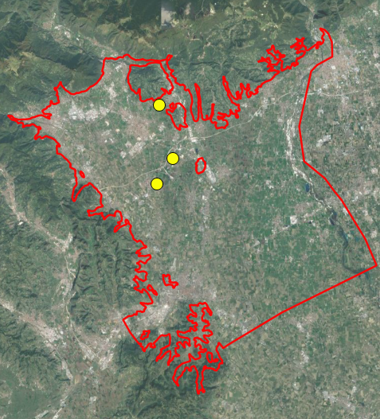
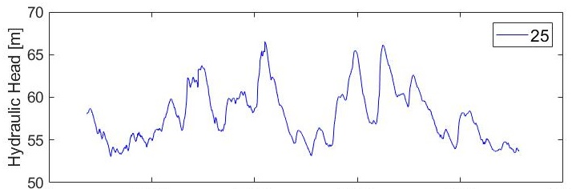
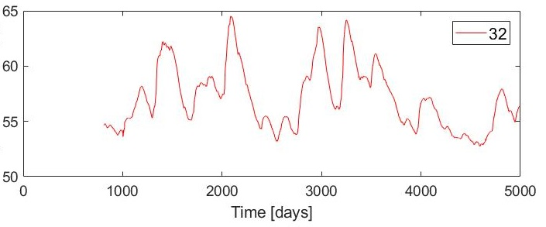
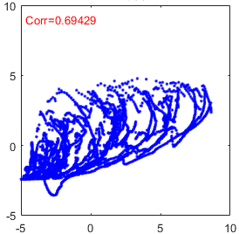
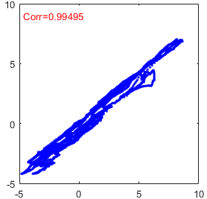
Oscillation correlation
2
Pearson correlation coefficient
3
Kolmogorov-Smirnov test
Example
25 vs 40
Corr=0.694
25 vs 32 Corr=0.995
For highly correlated timeseries
Their sample distribution functions are compared
No assumptions are made on variables or sampling
error distributions
EGU2020 - Online, 4-8 May 2020

Slide 10
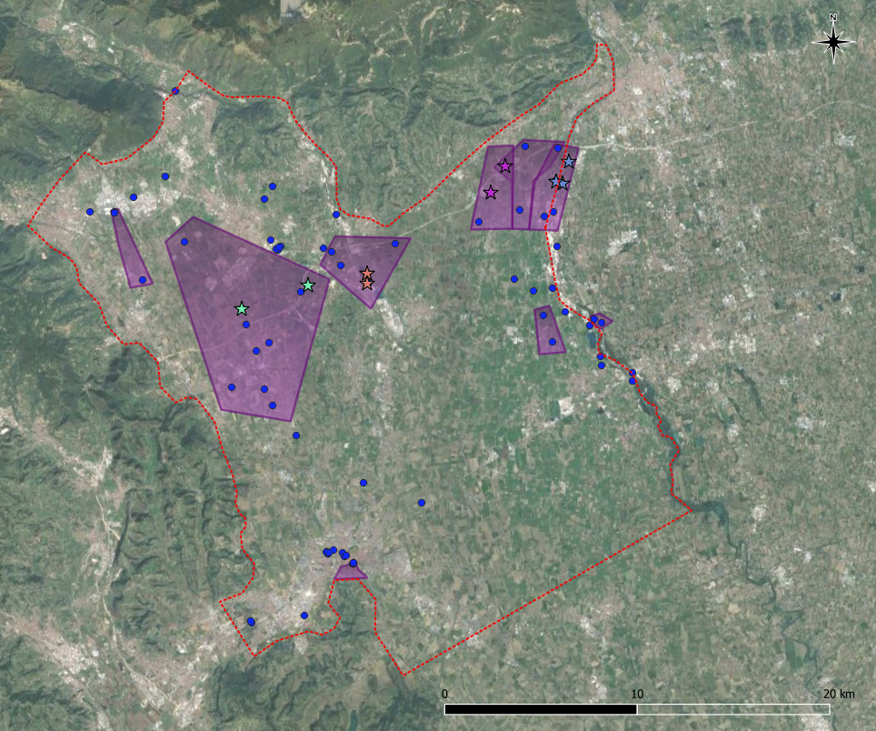
Oscillation correlation
4
Group intercorrelated couples
Correlation map
All sensors inside an area
have highly correlated
hydraulic head timeseries
(c>0.95)
Similar hydrgeological behavior
9 clusters
42 not clustered sensors
EGU2020 - Online, 4-8 May 2020

Slide 11
Hierarchical clustering - Steps
1
Define type of the input data
For each sensor:
Yearly average hydrograph
Complete timeseries of 5 years
only 60 sensors
Seasonal trends
Mann-Kendall test
Sen’s slope estimator
2
PCA
PCA
PCA – Principal Component Analysis
3
Hierarchical clustering
Seasonal trends
Yearly average hydrograph
PCA components
All previous variables
EGU2020 - Online, 4-8 May 2020

Slide 12
Hierarchical clustering – Detailed Steps
no assumptions on data
reduces dataset dimensionality losing as less information as possible
is simply an orthogonal transformation of original variables into few linearly uncorrelated variables, principal components (PCs)
first PC accounts for most of the data variability and following PCs have the highest left variability
here selected first n PCs explaining more than 80%
remaining PCs contain much less information and may be considered as noise
useful for detecting patterns
Hierarchical clustering groups data over a variety of scales by creating a cluster tree
it is an unsupervised technique with multiple choices
1
2
3
Input data
3 PCA with different inputs data
Hierarchical clustering
Yearly hydrograph
Complete series
Seasonal trends
4 clustering with different input data
Mann-Kendall
Non-parametric test,
statistically determines if a variable has increasing or decreasing values
Yearly hydrograph
Seasonal trends
All together
Sen’s slope
Estimates the trend slope,
robust against outliers
PCs
1 overall cluster
gathering sensors
together 3 times out of 4
EGU2020 - Online, 4-8 May 2020

Slide 13
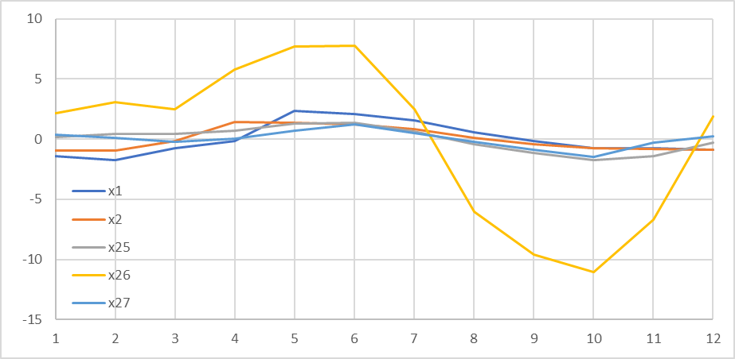
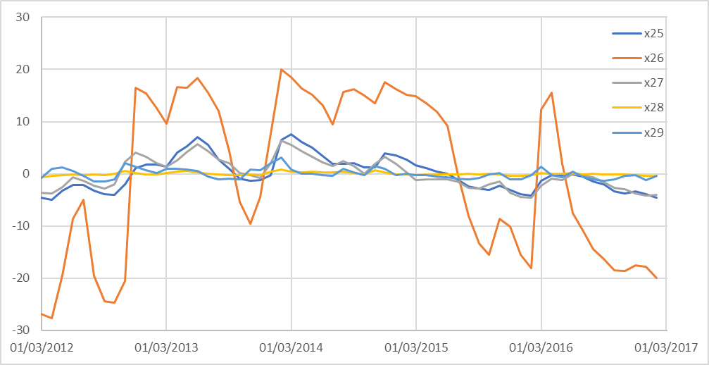
Hierarchical clustering
1
Input data
Yearly average hydrograph
Complete timeseries of 5 years
Timeseries of monthly medians
Subtraction of the year average level
For each month: month mean
Homogeneous dataset: 79sensors x 12months
Timeseries of monthly medians
Selection of the time period where most of the sensor are continuously recording – 5years
Subtraction of the period average level
Homogeneous dataset: 60sensors x 60months
EGU2020 - Online, 4-8 May 2020

Slide 14
Hierarchical clustering
1
Input data
Seasonal trends
Mann-Kendall test
Sen’s slope estimator
Timeseries of monthly medians
For each month: there is a statistically significant trend?
There is an overall significant trend?
Homogeneous dataset: 79sensors x (12+1)
Timeseries of monthly medians
For each month: estimation of the seasonal trend slope?
Estimation of the overall trend slope
Homogeneous dataset: 79sensors x (12+1)
Many sensors are recording an overall decreasing trend of the water table
→ important to monitor the gw system
EGU2020 - Online, 4-8 May 2020

Slide 15
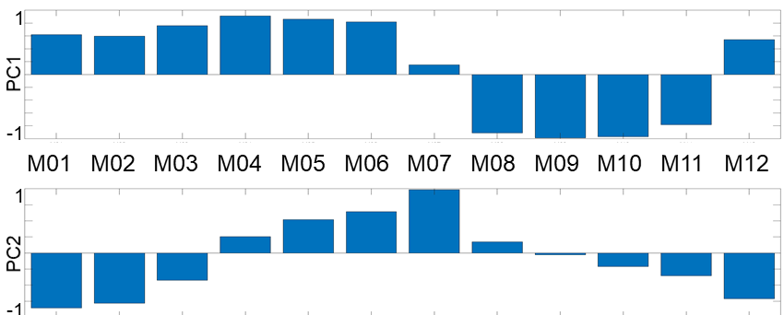
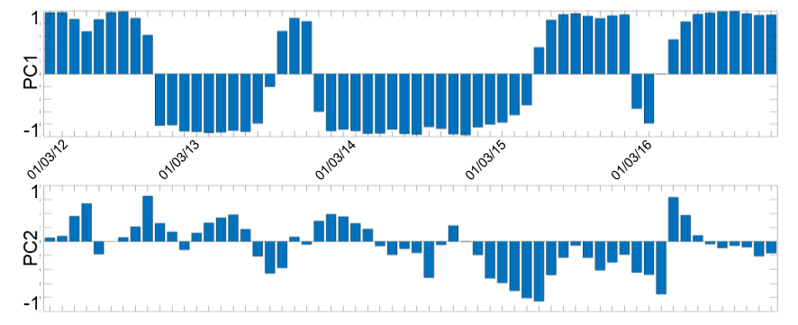
Hierarchical clustering
2
PCA
Yearly average hydrograph
Complete timeseries of 5 years
PCs meaning:
2 typical hydrograph
PC1: dry or wet years
Principal components
PC2: kind of seasonality
PC2
PC2
PC1
PC1
EGU2020 - Online, 4-8 May 2020

Slide 16
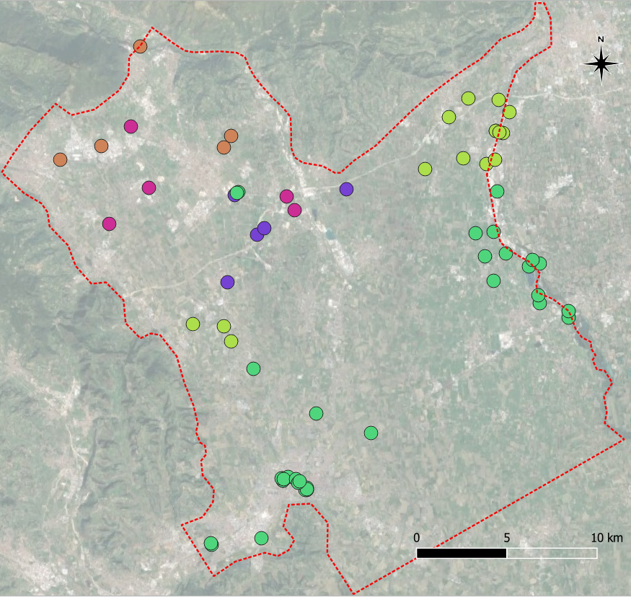
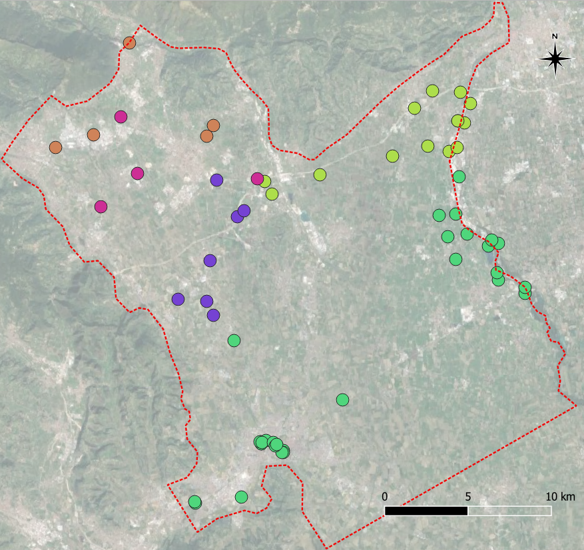
Hierarchical clustering
2
PCA
Yearly average hydrograph
Complete timeseries of 5 years
Previously identified clusters,
in map
0
1
2
3
4
General agreement:
Only yearly hydrograph following used because it considers all dataset sensors
EGU2020 - Online, 4-8 May 2020

Slide 17
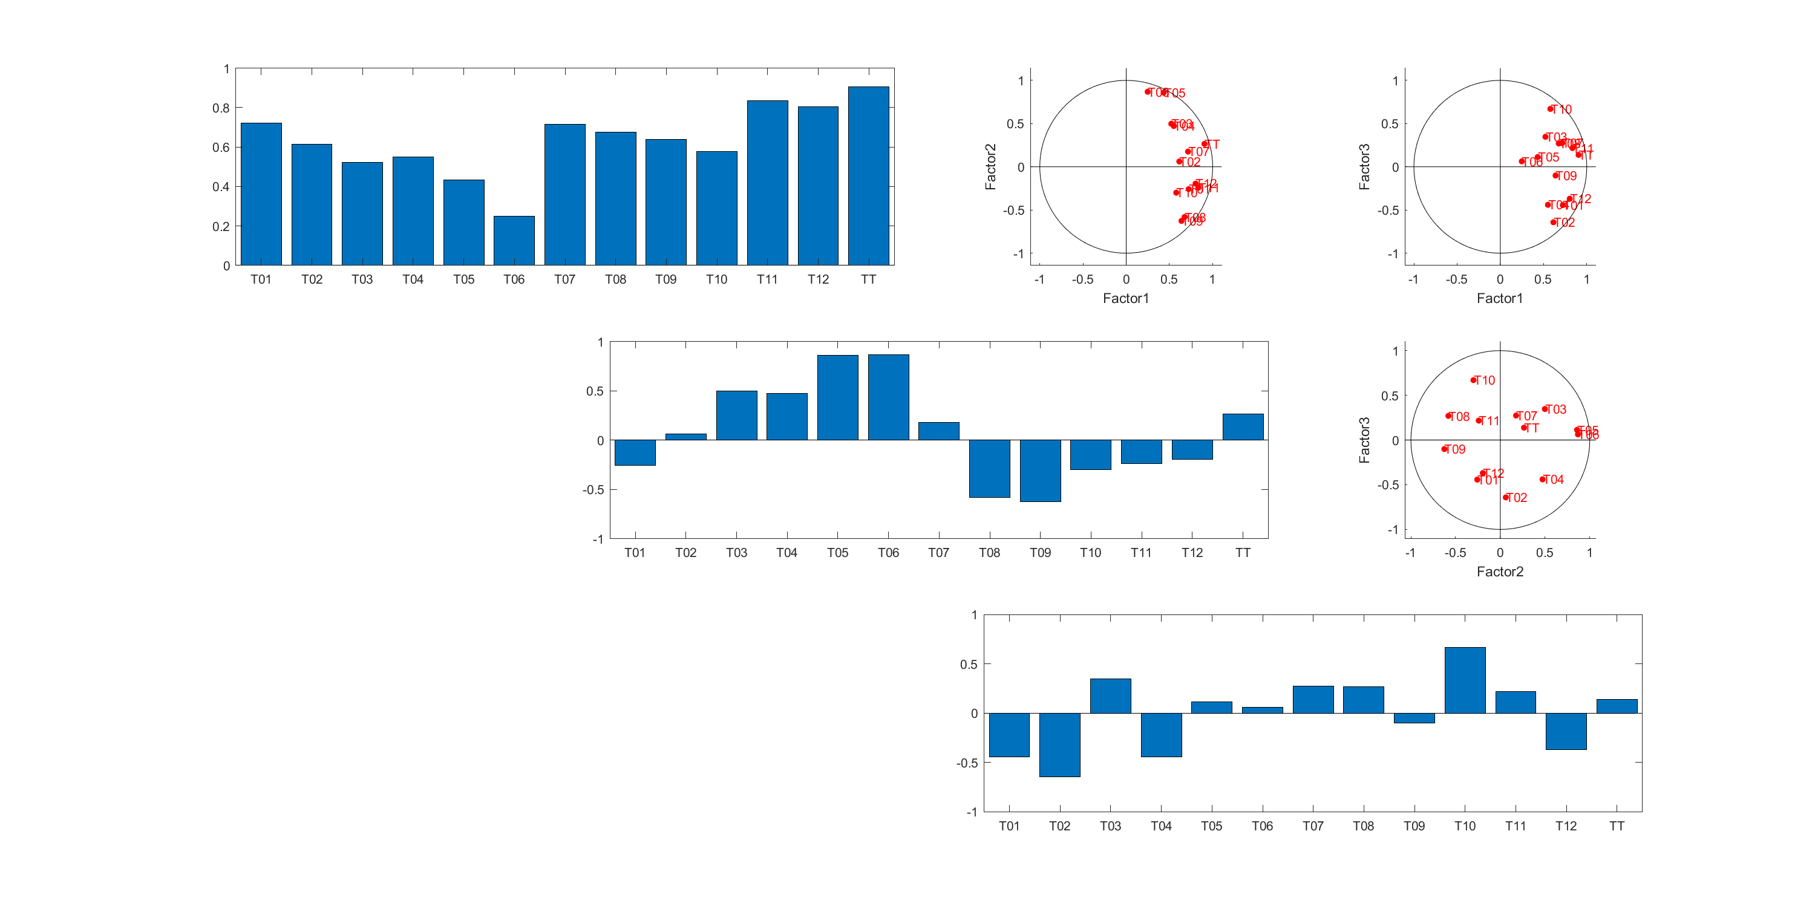
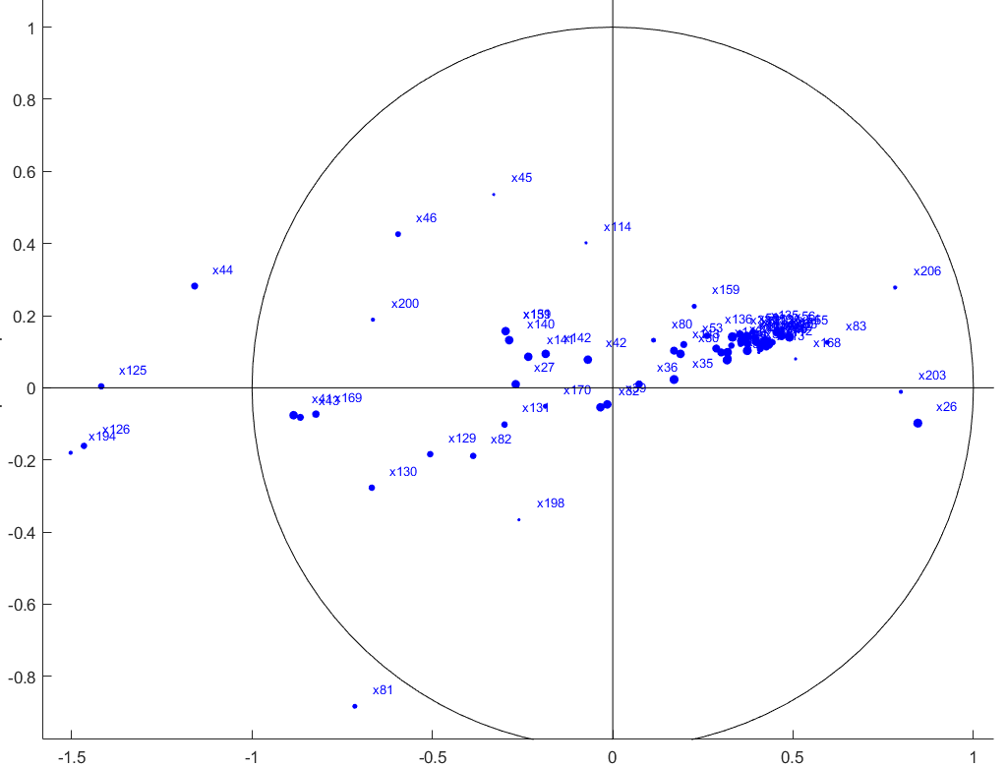
Hierarchical clustering
2
PCA
Seasonal trends - Sen’s slope estimator
PC1: general increasing trend
PC2
PC2: spring increasing trend
PC1
PC3: fall increasing trend
Clusters not
as easily identifiable
as before
3rd PC seems to be already noisy
EGU2020 - Online, 4-8 May 2020

Slide 18
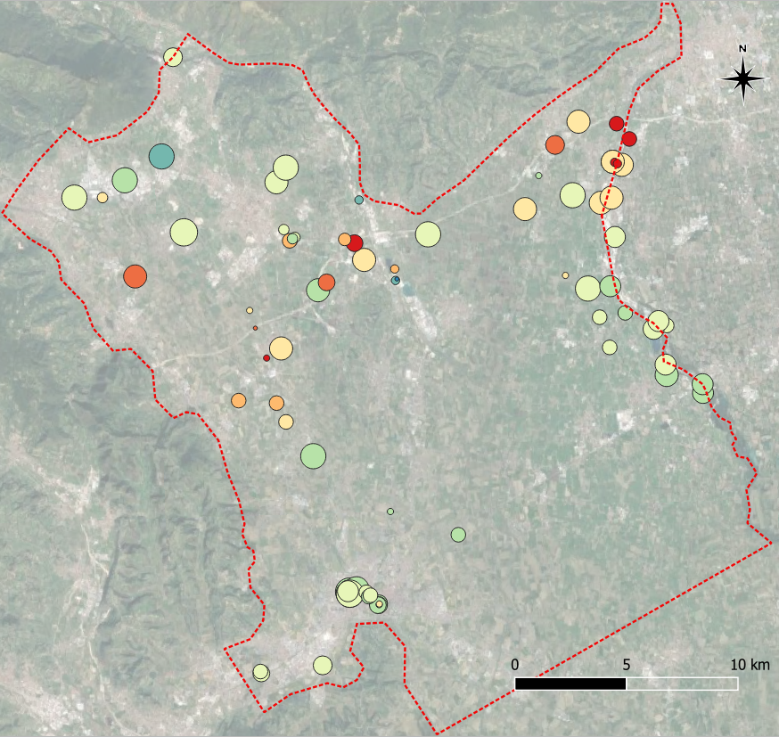
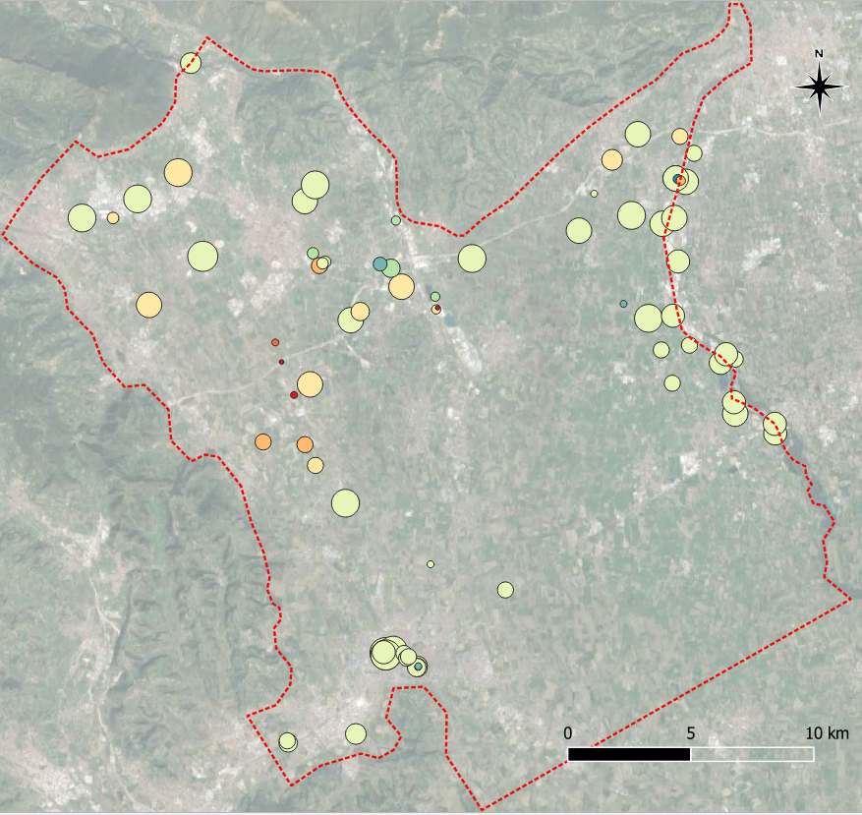
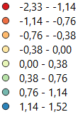
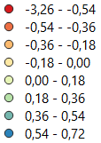
Hierarchical clustering
2
PCA
Seasonal trends - Sen’s slope estimator
PC1
General negative PC1 in the central belt
PC2
Not a clear trend or gathering
EGU2020 - Online, 4-8 May 2020

Slide 19
Hierarchical clustering
3
Hierarchical clustering
Multiple choices for applied methods:
How to define the distance to find the similarity between every pair of objects
How to link objects to group them into a binary, hierarchical cluster tree (distance between clusters)
Where to cut the hierarchical tree to split clusters
All methods combinations have been tried
Dissimilarity has been verified by comparing the cophenetic distances with the original distance data
Few combinations with highest cophenetic correlation coefficient are identified
For all input data type, one combination is always one of the best
The hierarchical tree has been cut basing on links relative consistency
Euclidean - Unweighted average has been selected
EGU2020 - Online, 4-8 May 2020

Slide 20
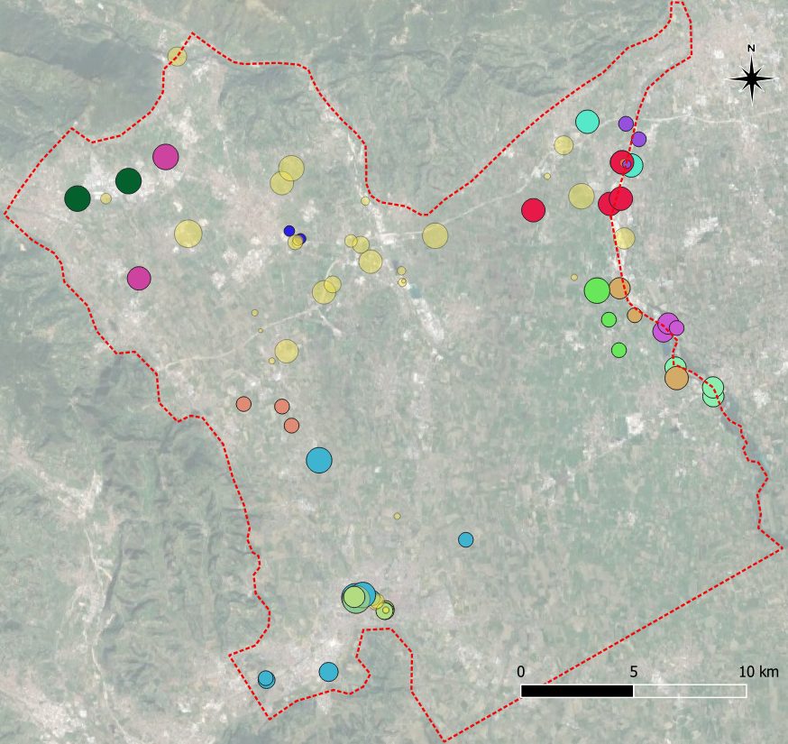
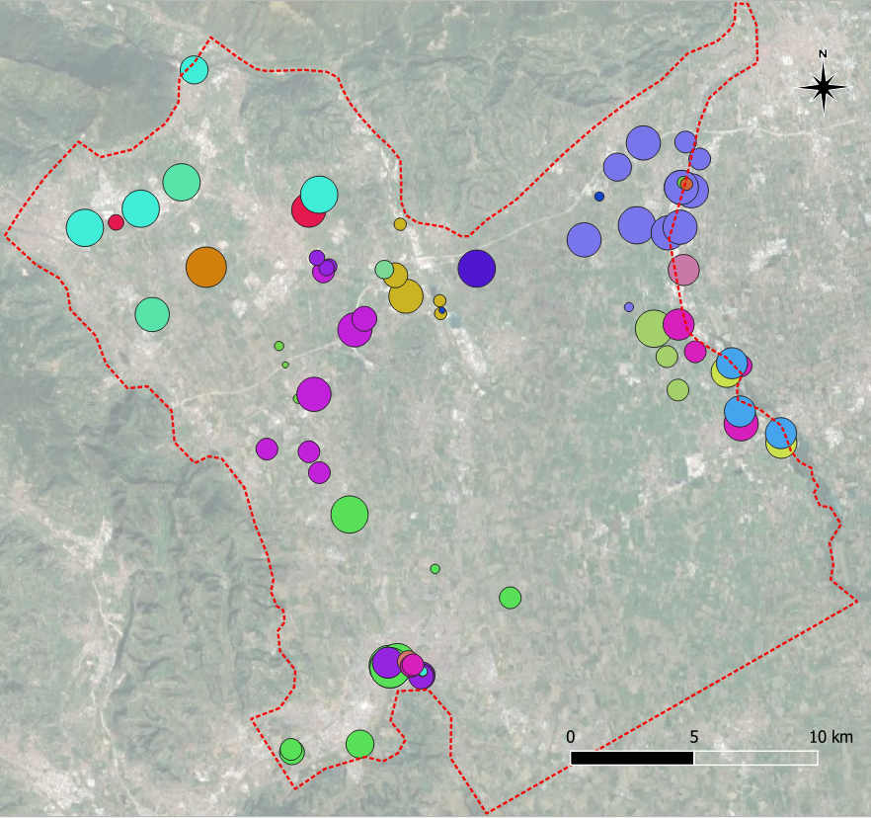
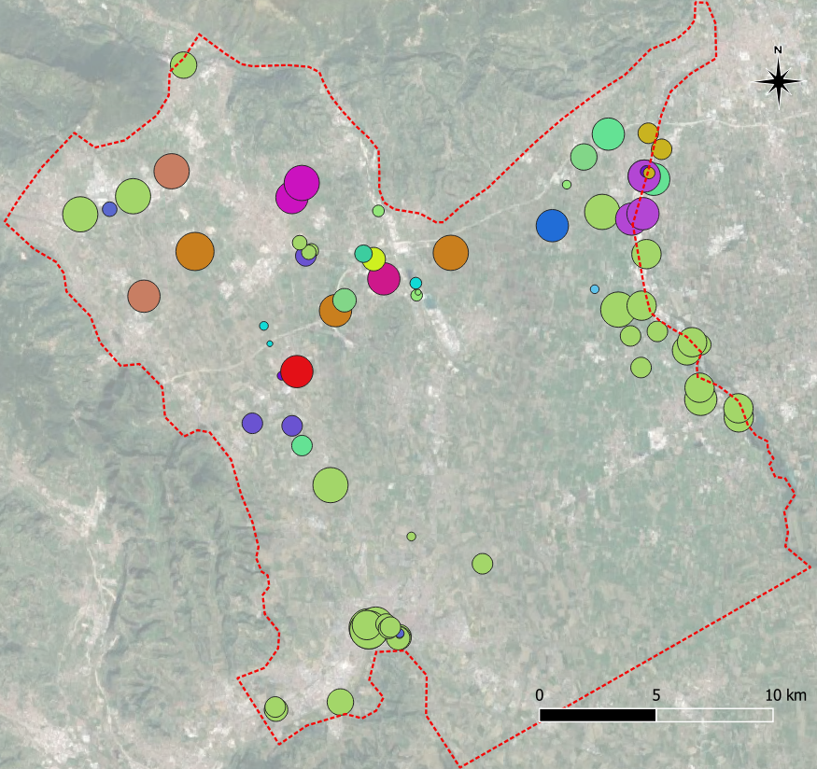
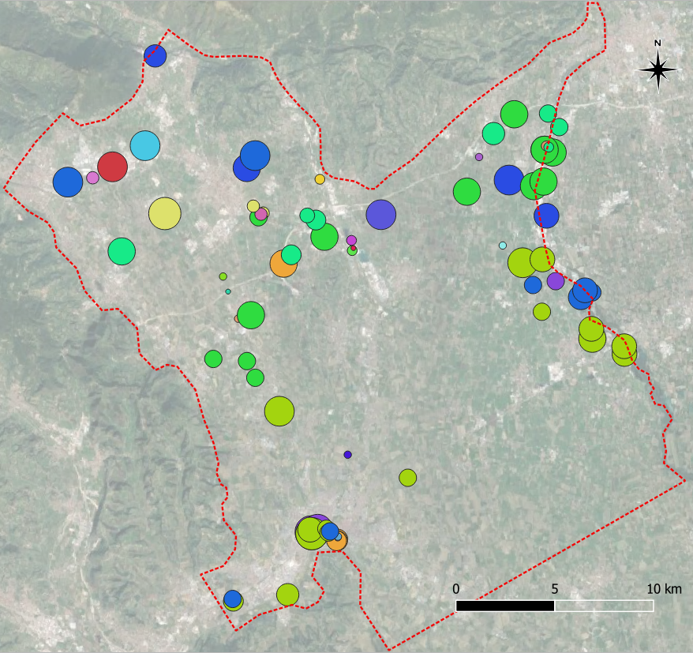
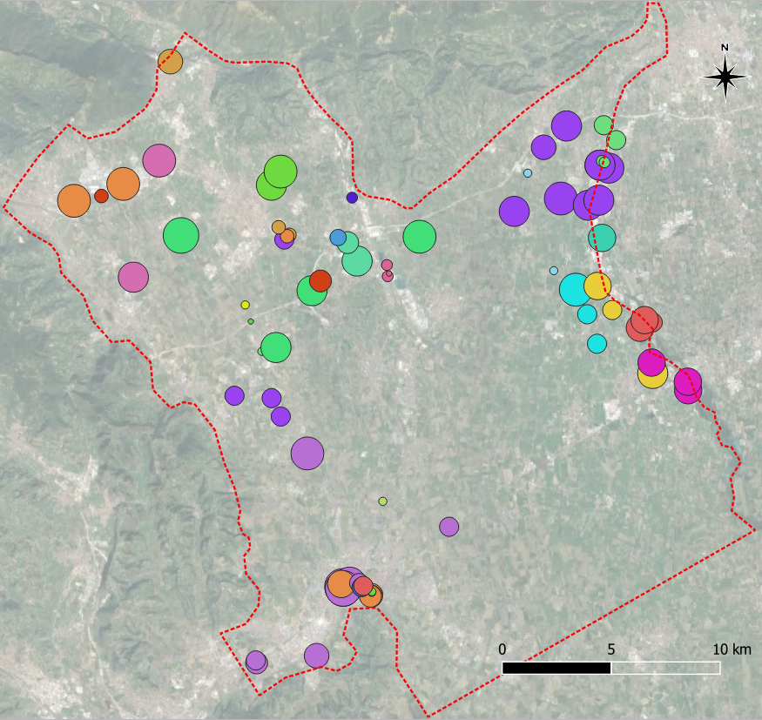
Hierarchical clustering
3
Hierarchical clustering
Yearly av. hydrograph
PCA components
Seasonal trends
All previous variables
Overall cluster
grouping sensors in same clusters 3 times out of 4
13 clusters
35 not clustered sensors
EGU2020 - Online, 4-8 May 2020

Slide 21


Methods comparison
Oscillation correlation (OC)
Hierarchical clustering (HC)
9 clusters (37 sensors)
42 not clustered sensors
Easy technique
Fast application
Not subjective choices
13 clusters (44 sensors)
35 not clustered sensors
Complicated and longer
With multiple choices that affect results
e.g. input data,
clustering parameters
Possibly, more insights on the gw system thanks to Mann-Kendall, Sen’s slope and PCA
Different sensors are grouped together
Area | OC | HC | Notes
Astico | 1 big cl + 1 | Mostly not clustered sensors | OC big cl: where there are paleochannels HC shows similar hydrographs but different trends and PCA components (slide 18)
Brenta – north | Different but comparable cl |  | OC cluster are correlated between themselves
Brenta – south | 2 small cl | 4 cl | OC clusters are maintained and enlarged in HC
Leogra- Timonchio | 1 cl | 2 cl | Few sensors, different couples OC cluster never together in HC
Vicenza | 1 small cl | 2 cl | The small OC cluster is recognized also in HC
EGU2020 - Online, 4-8 May 2020

Slide 22
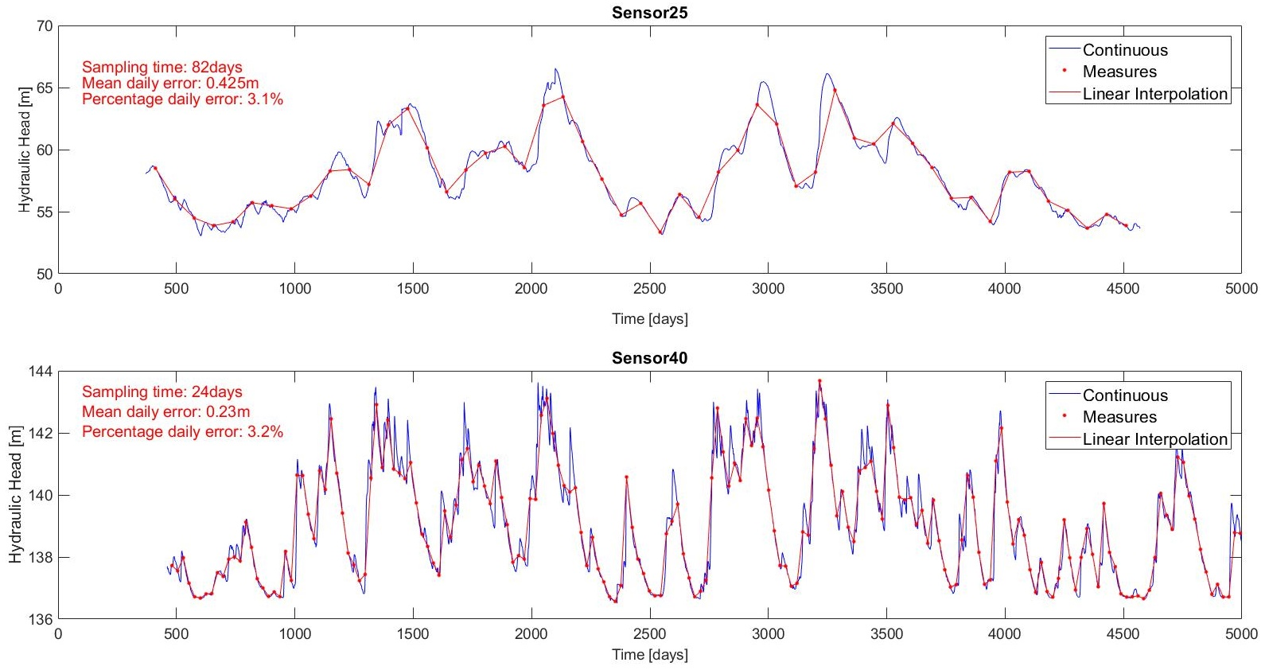
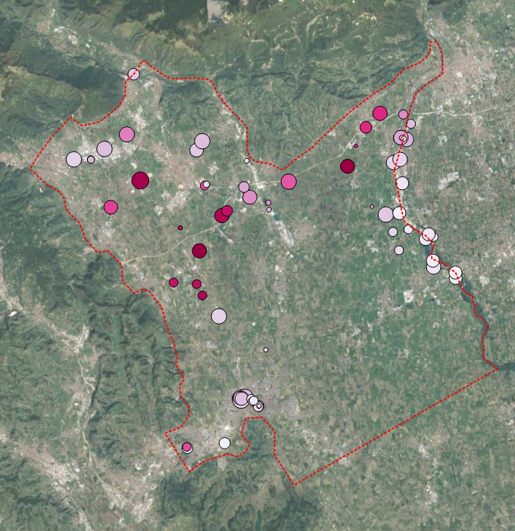
Oscillation correlation
Last
Integral scale
Microscale
Time interval in which
hydraulic heads
are perfectly correlated
Using the evaluated microscale as sampling time
For the dataset,
Percentage daily error ranges between 1.7 and 7.3%
with a mean error of 3.5%
80
days
5
EGU2020 - Online, 4-8 May 2020

Slide 23

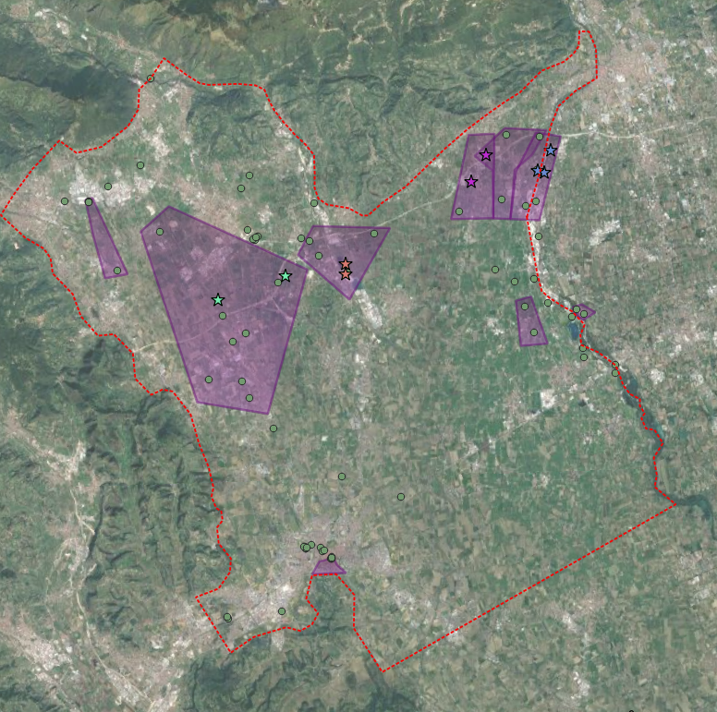
Optimization of existing
Groundwater Level Monitoring Network
Procedure
Hierarchical clusters
2- Other points: manually with longer sampling time
3- Sampling time defined with microscale
4- Extra sensors to uncovered areas
1- Only one sensor for each area
Correlation map
areas with similar behavior
EGU2020 - Online, 4-8 May 2020

Slide 24
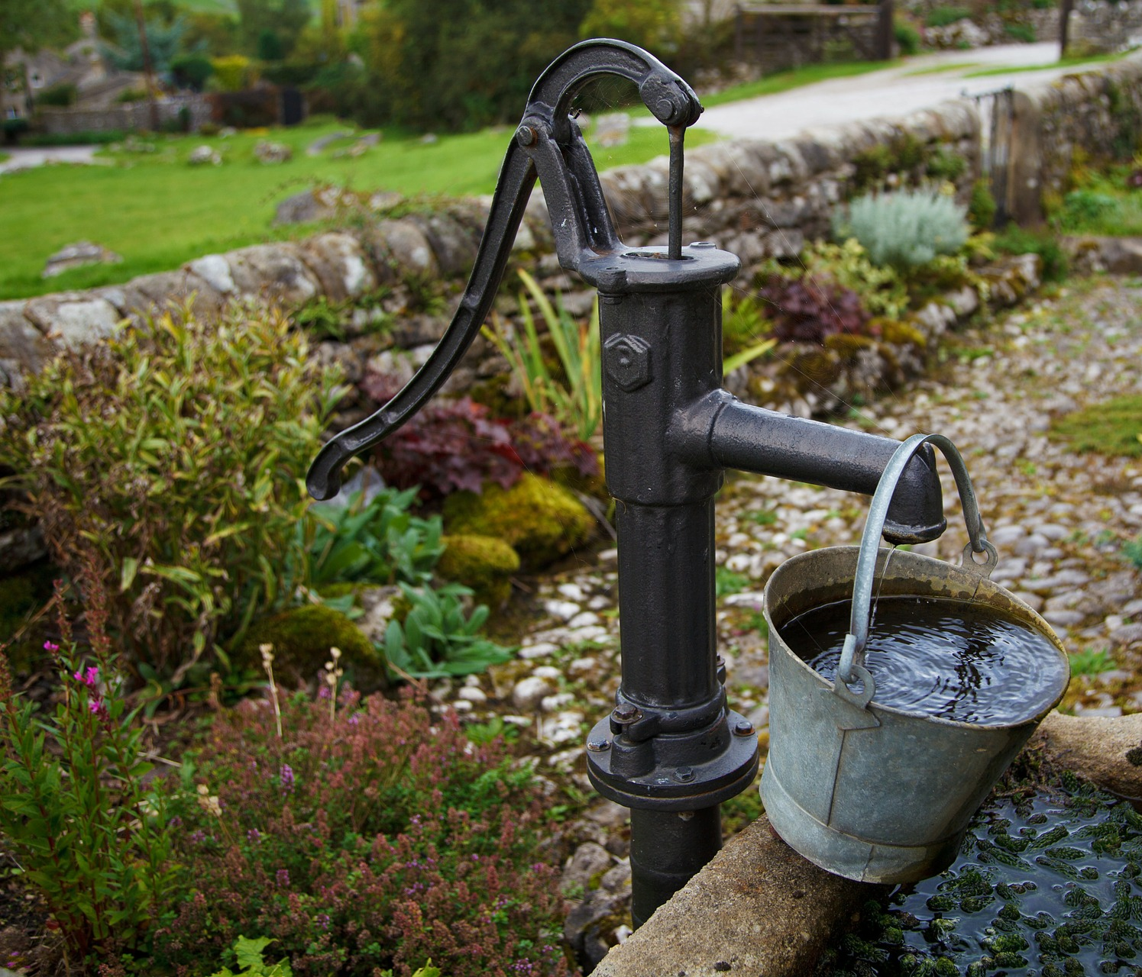
EGU General Assembly 2020, Online
Sharing Geoscience Online, 4-8 May, 2020
FOR FURTHER
QUESTIONS
mara.meggiorin@dicea.unipd.it
mmeggiorin@sinergeo.it
EGU2020 - Online, 4-8 May 2020

