Slide 1
A Deep Learning Technique for Automated Detection of ULF Waves in Swarm Time Series
A. Antonopoulou, C. Papadimitriou, G. Balasis, A. Z. Boutsi, K. Koutroumbas, A. Rontogiannis, and O. Giannakis
National Observatory of Athens, IAASARS, Athens, Greece

Slide 2
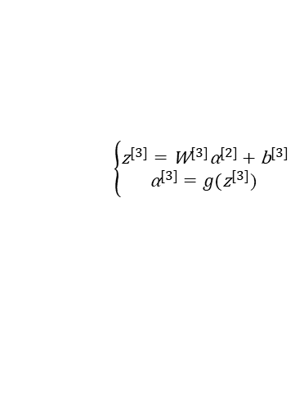
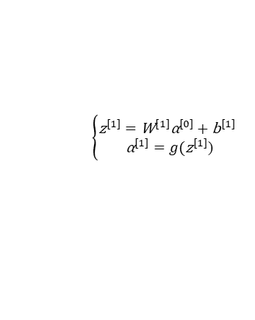
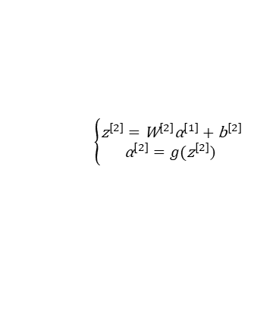
Neural Nets & main steps of algorithm
Composition of l parametric functions referred to as layers (Papernot & McDaniel, 2018), where each layer consists of a different number of units (neurons) with trainable weights and biases
All neurons are fully connected to the neurons in previous and post layers. To go from one layer to the next, a set of units compute a weighted sum of their inputs from the previous layer ($z=Wx+b$) and pass the result through a non-linear function (activation function $α=g(z)$) to compute the next layer’s output.
Input layer
$$W^{[1]},b^{[1]}$$
$W^{[2]}$, $b^{[2]}$
$W^{[3]}$, $b^{[3]}$
Output layer
$$ℒ(y,\hat{y})$$
$$⋮$$
$$⋮$$
$$⋮$$
$${\text{α}}^{[3]}=\hat{y}$$
$$\left\{\begin{aligned}{\text{z}}^{[3]}={\text{W}}^{[3]}{\text{α}}^{[2]}+{\text{b}}^{[3]} \\ {\text{α}}^{[3]}=g({\text{z}}^{[3]}\text{) }\end{aligned}\right.$$
X=${\text{α}}^{[0]}$
$$\left\{\begin{aligned}{\text{z}}^{[1]}={\text{W}}^{[1]}{\text{α}}^{[0]}+{\text{b}}^{[1]} \\ {\text{α}}^{[1]}=g({\text{z}}^{[1]}\text{)}\end{aligned}\right.$$
$$\left\{\begin{aligned}{\text{z}}^{[2]}={\text{W}}^{[2]}{\text{α}}^{[1]}+{\text{b}}^{[2]} \\ {\text{α}}^{[2]}=g({\text{z}}^{[2]}\text{) }\end{aligned}\right.$$
Define the model structure
Initialize the parameters $W^{[1]},b^{[1]}$
Forward prop (left-to-right pass)
Compute the loss $ℒ(y,\hat{y})$ where $\hat{y}$ the predicted and $y$ the actual value (label) of a single training example
The Cost is then computed by summing over all training examples, $J=\frac{1}{m}\sum_{i=1}^{m}{ℒ^{(i)}}$
Backward prop (right-to-left pass)
Compute the derivatives of $ℒ$ wrt each variable
Based on the chain rule of calculus, e.g. $\frac{dℒ}{dz^{[3]}}=\frac{dℒ}{da^{[3]}}\frac{da^{[3]}}{dz^{[3]}}$
Optimization method (e.g. Gradient Descent):$\min_{Θ}{\text{J}}$
Learn the model’s parameters $Θ=(W, b)$ by minimizing the Cost
Use the learned parameters to make predictions (on the test set)

Slide 3
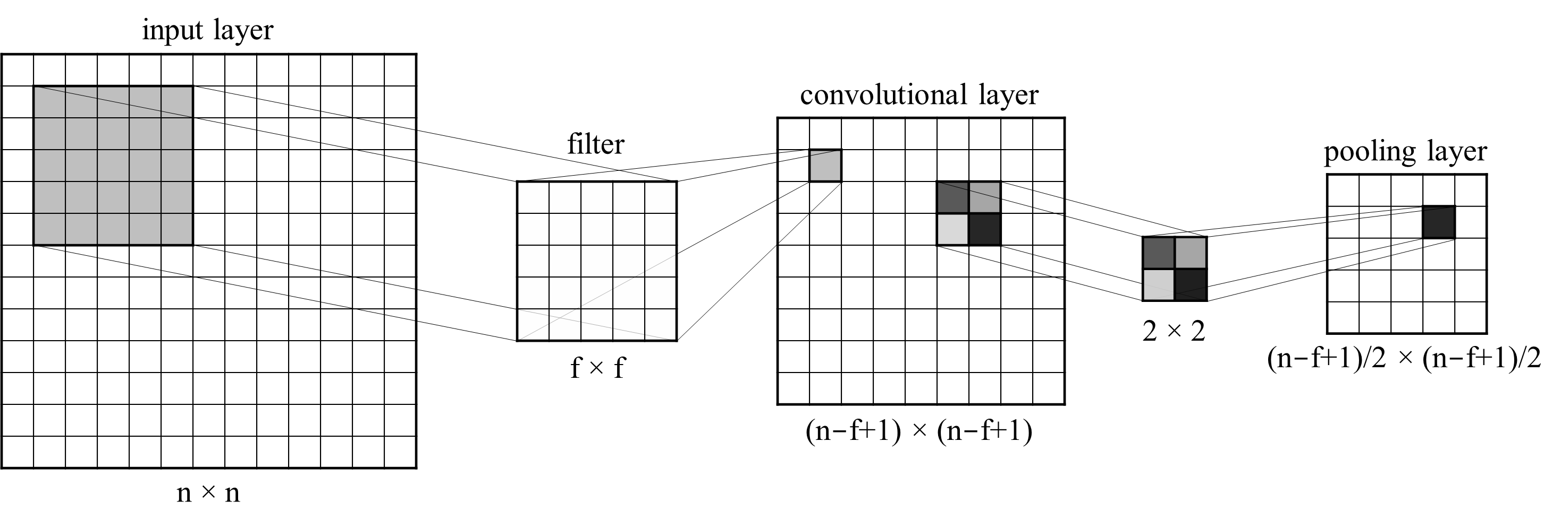
Convolutional Neural Nets
Based on regular neural nets. They are trainable architectures composed of multiple stages
Each stage is composed of two major layers:
the Convolutional Layer: a number of trainable filters perform discrete convolution operations on local patches of the input wrt its dimensions. The result of this local weighted sum is then passed through a non-linear function such as ReLU, relu(x) = max(x, 0). The hyper-parameters of this layer include filter size f and stride s
Flattening Process: the outputs of the topmost convolutional layer is converted into a 1D feature vector The top layer is always fully connected, with one output unit per class label (Ciresan et al., IJCAI-11).
Backpropagating gradients through a CNN is same as through a regular neural network, allowing all the weights in all the filters to be trained.
the Pooling Layer: its role is to merge semantically similar features into one (LeCun et al., Nature 2015). It takes small rectangular blocks from the convolutional layer and subsamples it. Max and average pooling are special kinds of pooling where the maximum and average value is taken, respectively

Slide 4
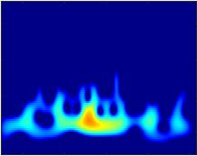
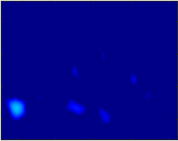
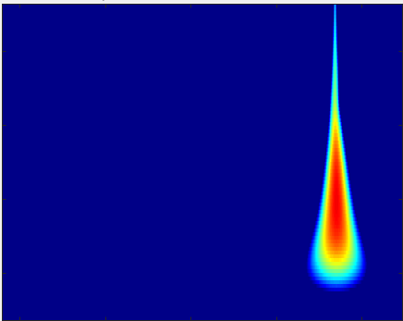
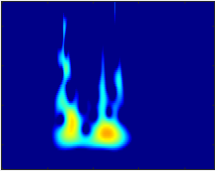
Data & pre-processing
Data from Swarm magnetic field measurements (total magnitude, extracted from Swarm Magnetic Field Vector, NEC frame, 1s sampling rate), for the year 2015.
Segmented into mid-latitudinal tracks (i.e., -45 to +45 deg. latitude), to exclude the influence of polar FACs that might affect the measurements.
Filtered using a high-pass Butterworth filter with a cutoff frequency of 16 mHz.
Wavelet analysis on the filtered time series.
The wavelet spectrum images are then used as the input data in the CNN model.
“Event”
“Non-Event”
“False Positive”
“Plasma Instabilities”
Training and test dataset: data divided in 4 classes, namely
Pc3 (20 - 100 mHz) ULF wave events,
non-ULF signals i.e., background noise without significant wave activity,
False Positives (FP), e.g., anomalous signals due to spikes, discontinuities, etc.,
Plasma Instabilities i.e., events that are influenced or caused by Equatorial Spread F (ESF) irregularities (Stolle et al., JGR 2006; Park et al., EPS 2013) or in general by other, unclassified anomalies in the ionosphere, in near-equatorial, night-side areas.

Slide 5
The CNN model
Input: Wavelet spectrum images
Training – Test set: 80 – 20%
Layers: 2 convolutional, 2 pooling, 1 fully connected
Activation function: ReLU, Softmax
Cost function: Cross-entropy (Log Loss)
Optimizer: Adam
Extra: Batch Normalization, Dropout Regularization
Layers | Details
Conv1 | 8 filters, f = 4, s = 1
Pool1 | f = 8, s = 8
Conv2 | 16 filters, f = 2, s = 1
Pool2 | f = 4, s = 4
Stage 1
Stage 2
Stage 3
INPUT
Convolution + ReLU
Max Pooling
Fully Connected
Convolution + ReLU
Max Pooling
$$a^{[2]}$$
$$z^{[3]}$$
$$a^{[3]}$$
4-neuron output vector
$$\hat{y}∈ℝ^{4}$$
flattening
Softmax
$$x=a^{[0]}$$
$$a^{[1]}$$

Slide 6
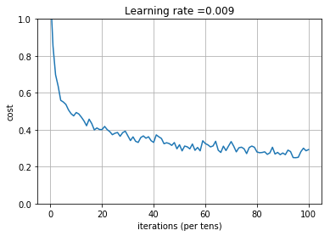
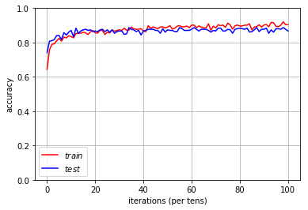
Results & Conclusions
The CNN model shows promising results, recognizing ULF wave events with almost 90% accuracy on the test set
Due to the large number of parameters of the model, it is crucial to build much larger training/test sets, of at least 50,000 input images
Future work
Introduce a cross-validation step into our model to optimize some hyper-parameters such as the number of filters and the dropout rate
Re-training with larger dataset by analyzing Swarm data from the mid-2014 onwards, necessary for optimal performance

