Slide 1

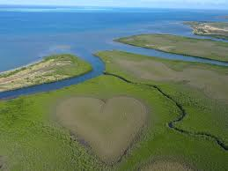




Influence of salinity gradient on nickel complexation by Fluorescent Dissolved Organic Matter (FDOM) and dispersal across estuaries in New Caledonia
EGU2020-8929
Cécile Dupouy¹, Farid Juillot², Hugues Lemonnier³, Marie Bessard¹, Laura Boher⁴, Leocadie Jamet⁵ , Philippe Gérard¹, and Stéphane Mounier¹
Aix-Marseille Univ., Université de Toulon, CNRS, IRD, Mediterranean Institute of Oceanography MIO UM 110, UMR IRD 235, Marseille, France
IMPMC Institut de Mineralogie, de Physique des Materiaux et de Cosmochimie, Sorbonne Universités, ERL IRD 206, UMR CNRS 7590, Museum National d’Histoire Naturelle, Paris, France
3. IFREMER, LEAD, Noumea, New Caledonia
CRESICA, Nouvelle-Calédonie
LAMA Laboratoire des Moyens Analytiques, US IMAGO IRD, Noumea, New Caledonia

Slide 2
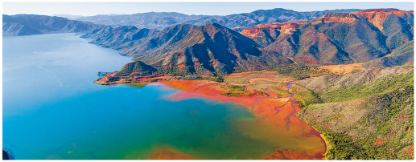
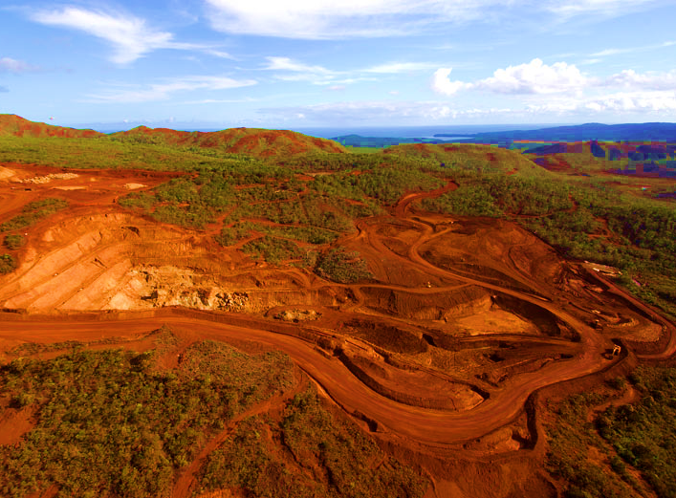
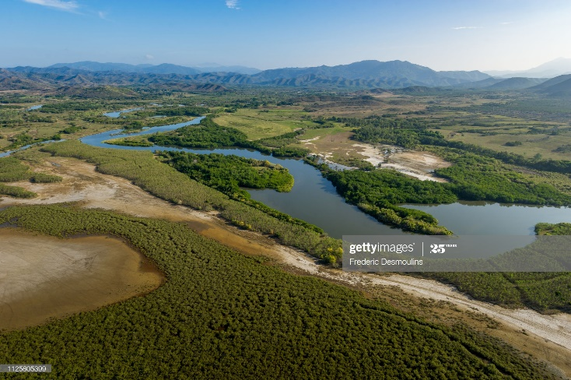

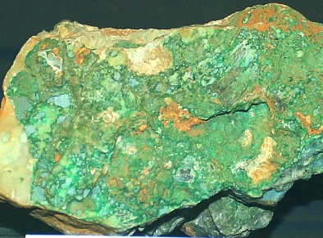
Context
New Caledonia is the
5th largest nickel
producer in the world
© P.-A. Pantz
Mining site at Nakéty (East Coast)
2 types of Ni-ores
Laterite
Garnierite
Usine
Temala river crossing mangroves
(West Coast)
Notes:
Dissolved organic matter (DOM) is ubiquitous in the environment. Its composition and properties depend on water type (freshwater, estuarine, brackish, marine) and are influenced by the geological nature (ultramafic, volcano-sedimentary, metamorphic) and occupancy (mangrove, forest, agriculture, urbanized) of the upstream catchment.

Slide 3
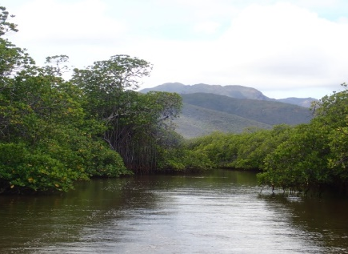
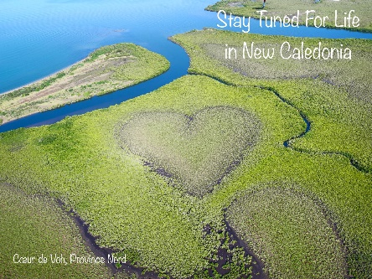
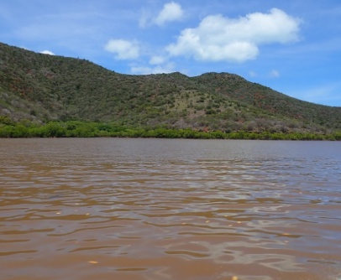
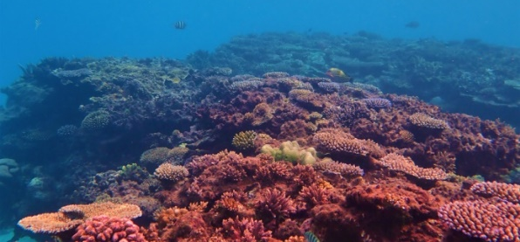
Context
Dissolved and particulate trace metals dispersal
Laterite
River
Mangrove
Estuarine/lagoon
Coral reff
Dissolved organic matter (DOM) ubiquitous in the environment.
Can form complexes with dissolved trace metals.
Can render them hardly available to living organisms, and thus limit their toxicity.
Can significantly contribute to the dispersal of trace metals in aquatic ecosystems.

Slide 4
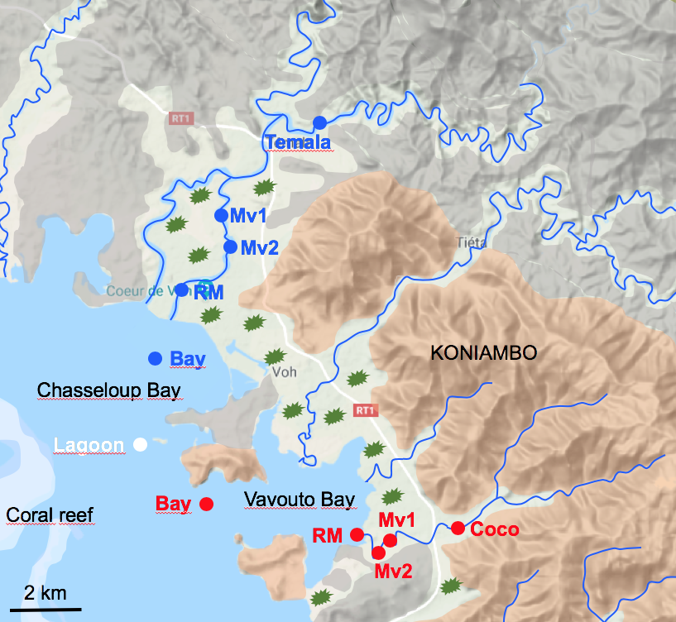
Objective
Geomorphological setting
Ultramafic
To characterize FDOM (a fraction of DOM with specific fluorescence properties) and its complexing capacity towards trace metals across a salinity gradient downstream of two contrasted catchments:
Ultramafic : COCO river
Volcano-sedimentary : TEMALA river
Volcano-sedimentary
Alluvial
Mangrove

Slide 5
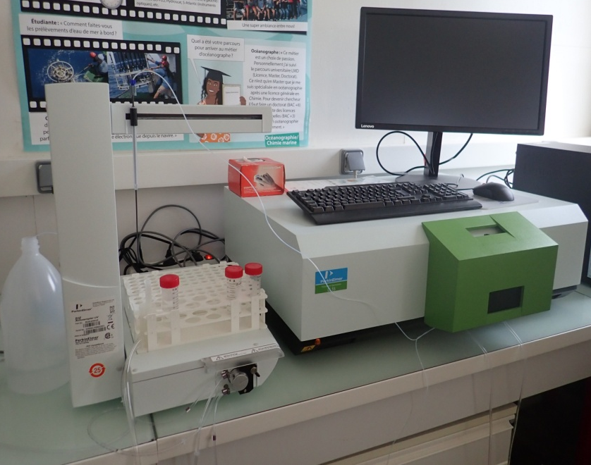
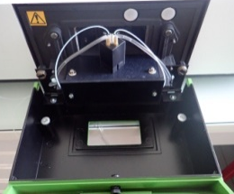
Methods
3D Spectrofluorimetry
+ Trace metals concentrations (ICP-MS)
First step:
Excitation-Emission Matrix (EEMs) on 0.2 µm filtered water samples + parallel factor analysis (PARAFAC) + identification of the different FDOM components
Parameters | Values
Scanning speed | 1200 nm/min
Width of excitation and emission slots | 5 nm
Response time | 0.5 s
Step between two wavelengths | 5 nm
λ_{em} range | 280-550 nm
λ_{ex} range | 200-500 nm
Second step:
Fluorescence quenching experiments to measure the complexing capacity of the different FDOM components towards dissolved Ni
Notes:
Les fluorophores caractérisé par grand famille spectre en fonction de λ_{em} et λ_{ex}

Slide 6
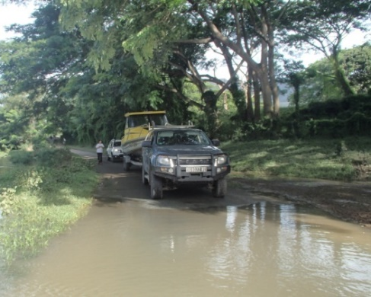
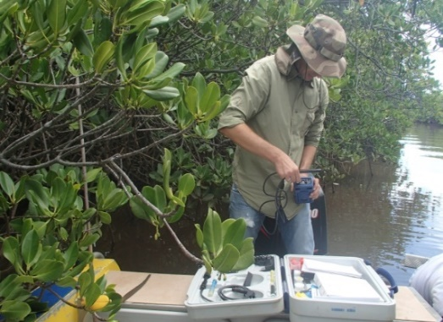
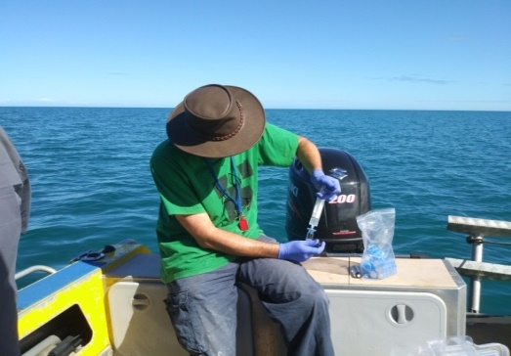
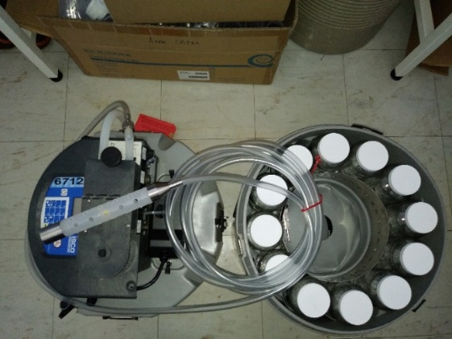
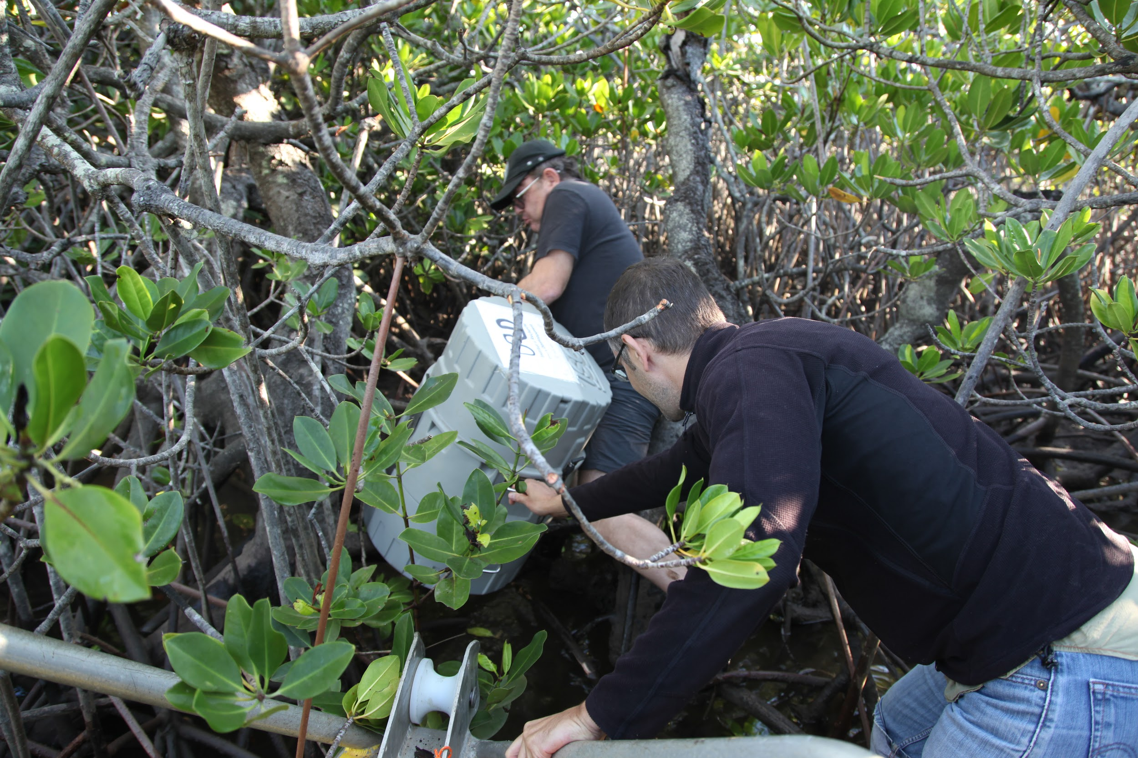
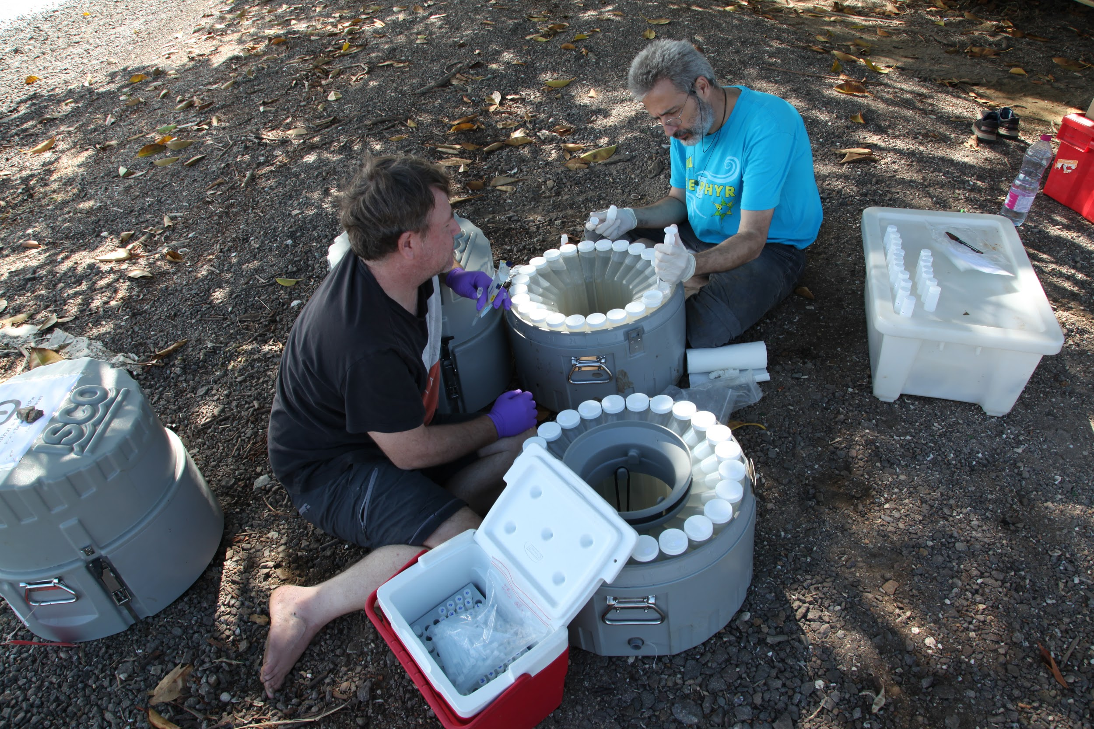
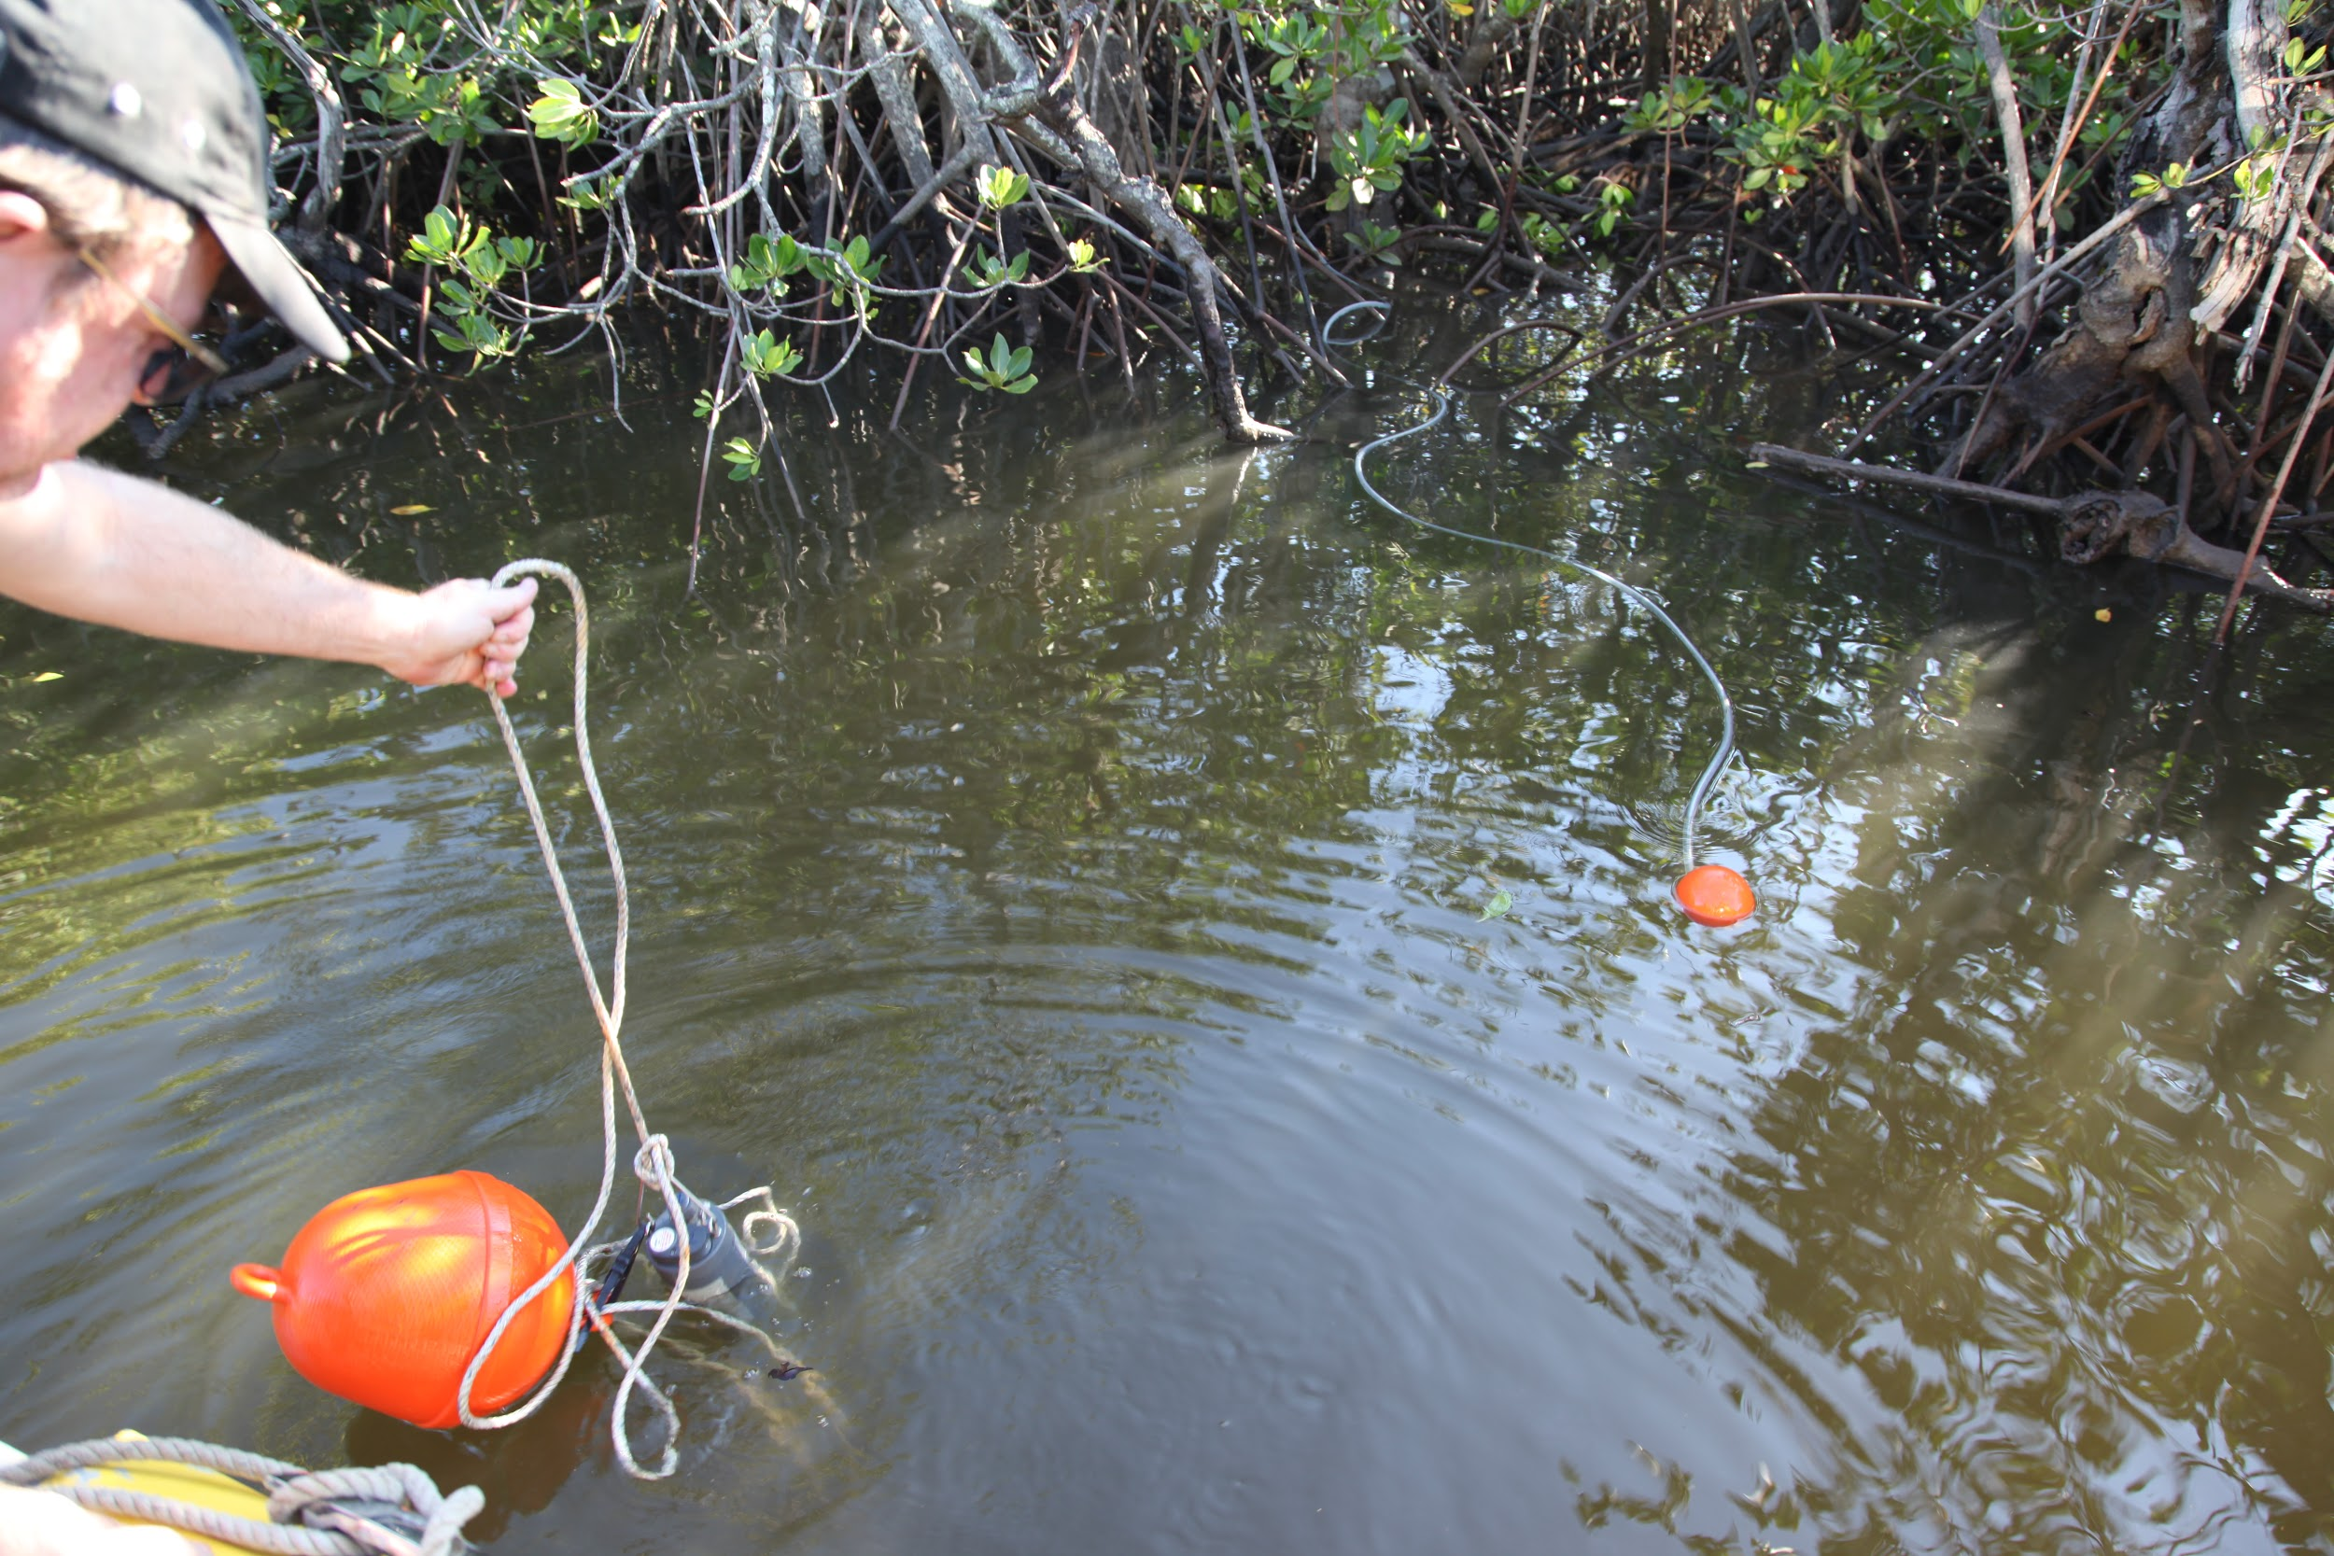
Sampling
Gradient sampling from river to bay (5 stations) + (1 in lagoon)
March 2019
Tide sampling at Mangrove (MV2) station
July 2019

Slide 7
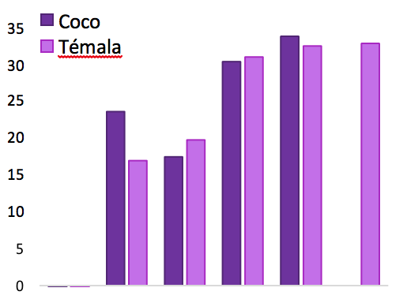
Nickel and salinity
Nickel and salinity gradient from river to lagoon
March 2019
Mangrove
Mangrove
Nickel (µg/L)
Salinity
Riv Mv1 Mv2 RM Bay Lagoon
Riv Mv1 Mv2 RM Bay Lagoon
Station
Station
For both rivers, higher nickel content at mangrove stations (Mv1 and 2)

Slide 8
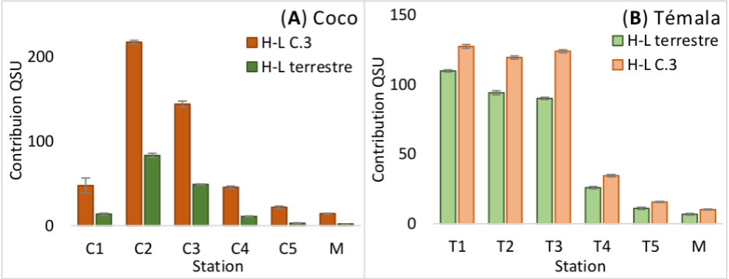
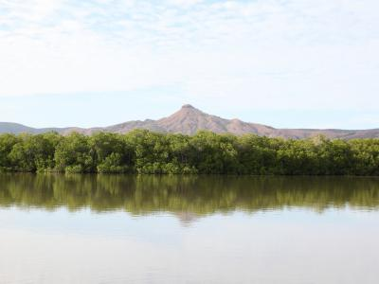
FDOM
FDOM gradient from river to lagoon
March 2019
Mangrove
COCO
Mangrove
TEMALA
H-L C3
H-L terrestrial
H-L terrestrial
H-L C3
Riv Mv1 Mv2 RM Bay Lagoon
Source Mang.1 2. Riv.Mouths1 2 Lagoon
Riv Mv1 Mv2 RM Bay Lagoon
Station
Station
Mangrove COCO (Mv1 & 2): Higher FDOM than in low-DOM upstream river (autochthonous production)
Mangrove TEMALA (Mv1 & 2): No difference with rich-DOM upstream river (inheritance from volcano-sedimentary catchment)

Slide 9
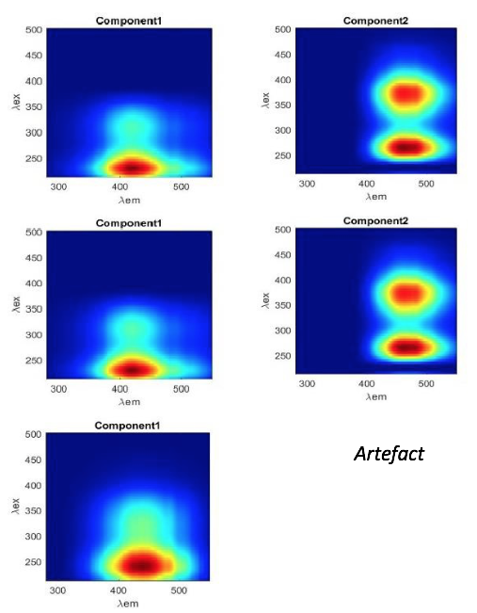
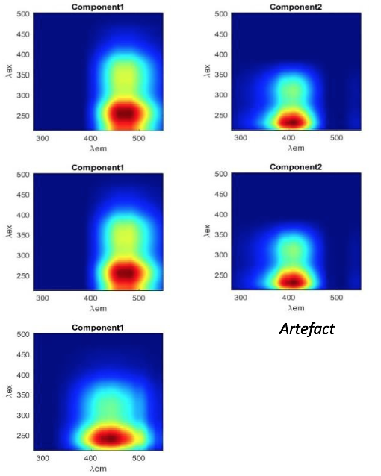
FDOM compounds
COCO
TEMALA
H-L C3
H-L terrestrial
H-L terrestrial
H-L C3
All stations
River, Mv1 & Mv2 stations
RM, bay & lagoon stations
H-L C3 <230 418 ref. 1 Autochthonous. Biological degradation (phytoplankton) of terrestrial humic-like
H-L terrestrial 265(370) 460 ref. 2 Photo-resistant product 1
1 : Su et al. (2017)
2 : Yamashita et al. (2010)

Slide 10
FDOM gradient
FDOM gradient from river to lagoon
March 2019
Mangrove
COCO
Mangrove
TEMALA
H-L C3
H-L terrestrial
H-L terrestrial
H-L C3
Riv Mv1 Mv2 RM Bay Lagoon
Source Mang.1 2. Riv.Mouths1 2 Lagoon
Riv Mv1 Mv2 RM Bay Lagoon
Station
Station
Mangrove COCO & TEMALA (Mv1 & 2): Higher FDOM than in downstream bay
(dilution or aggregation/floculation upon salinity increase ?)

Slide 11
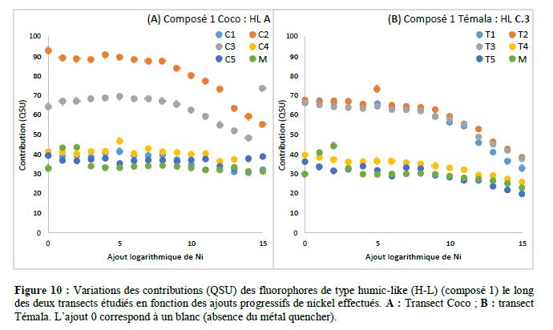
Fluorescence quenching with Ni
Fluorescence quenching
COCO
H-L C3
TEMALA
H-L C3
Contribution (QSU)
Contribution (QSU)
Log Ni adding
Log Ni adding
The two common fluorophores have similar complexing properties towards nickel.
Quenching of both COCO and TEMALA H-L terrestrial FDOM still to be done.

Slide 12
Conclusion
Nickel concentrations are higher downstream ultramafic catchments than downstream volcano-sedimentary catchments (FDOM quenching capacity) COCO Ni > TEMALA Ni
Downstream the ultramafic catchment (COCO), FDOM is higher in mangrove than in low-DOM upstream river (autochthonous production)
Downstream the volcano-sedimentary catchment (TEMALA), FDOM shows no significant difference in mangrove with rich-DOM upstream river (inheritance from volcano-sedimentary catchment)
For both catchments, FDOM is higher in mangrove than in downstream bay (dilution or aggregation/floculation upon salinity increase and influence on FDOM dispersal ?)
The dispersal capacity of FDOM might be hampered in estuaries due to the suspected aggregation-flocculation across the salinity gradient
Together with the geological setting of the upstream catchment, salinity might thus be a major driver of nickel dynamics across estuaries through FDOM-Ni complexes

Slide 13
Aknowledgements
The TREMOR (Transfer of trace metals by coloured dissolved organic matter) project is a 3y project funded by INSU EC2CO and CRESICA for (https://www.cresica.nc/projet/tremor)
We aknowledge M.I.O. and IRD for their additional support. The IRD Center of Noumea was helpful and supported the project.
We thank Christophe and Giovanni for the river and lagoon sampling in the Koné lagoon, Northern Province of New Caledonia.

