Slide 1
Formation of complex organosulfur compounds by sulfur implantation in astrophysical ice analogs – implications for the chemical evolution of the surface of icy objects
Alexis Bouquet, Alexander Ruf, Philippe Boduch, Philippe Schmitt-Kopplin, Vassilissa Vinogradoff, Fabrice Duvernay, Riccardo Giovanni Urso, Rosario Brunetto, Louis Le Sergeant d'Hendecourt, Olivier Mousis, and Grégoire Danger

Slide 2
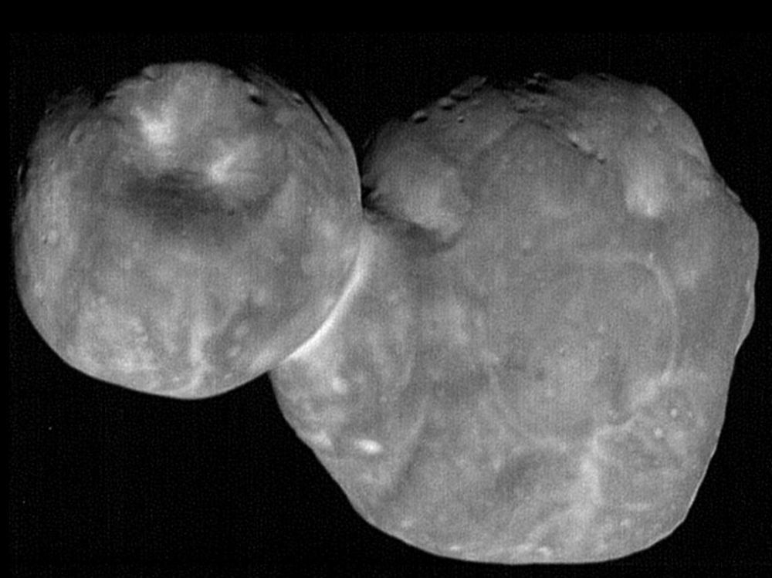
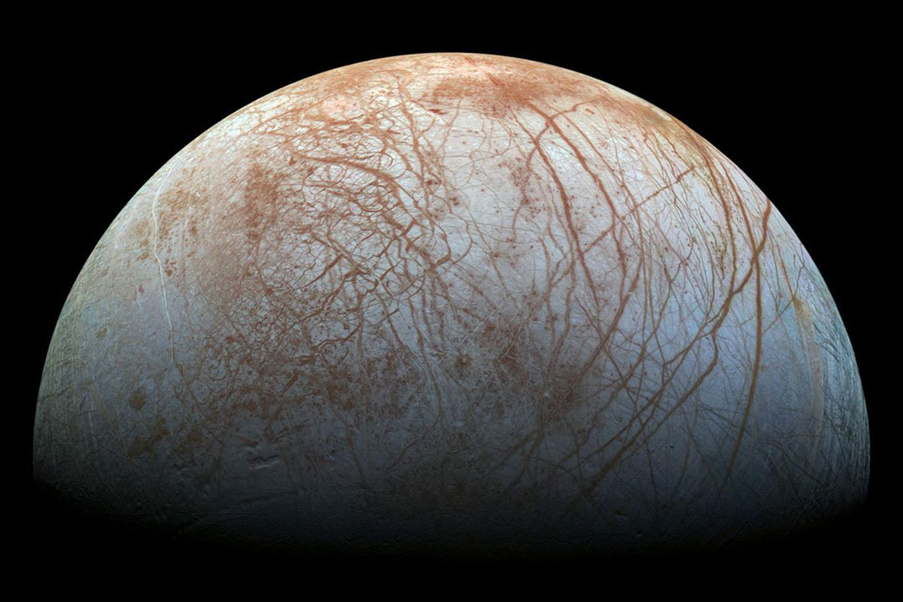
Motivations
Irradiation of ice: ubiquitous cause of chemical evolution in the solar system
(solar wind, magnetospheres)
Many experiments performed, but often without capability to detect high mass products
Implantation of sulfur is challenging to perform
…But relevant!
Our experiments: these two things

Slide 3
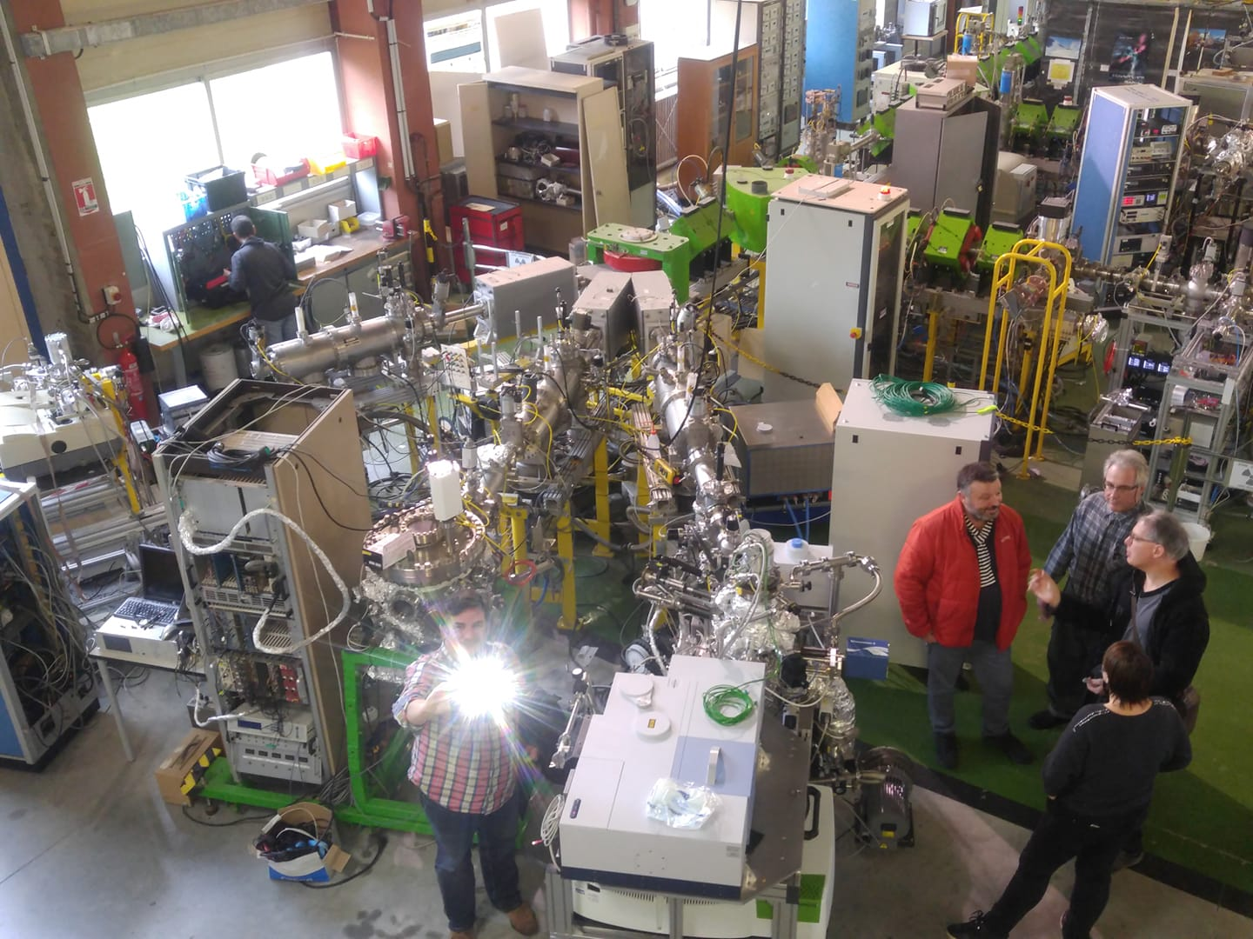
Experiments
Sulfur or Argon beam at 105 keV / nucleus
Flux at ~1E11 cm⁻².s⁻¹
Performed at the GANIL facilities in Caen, France
Irradiation of Water:Methanol:Ammonia ice (2:1:1)
At 10 K
Reheat to 300K to create residue

Slide 4
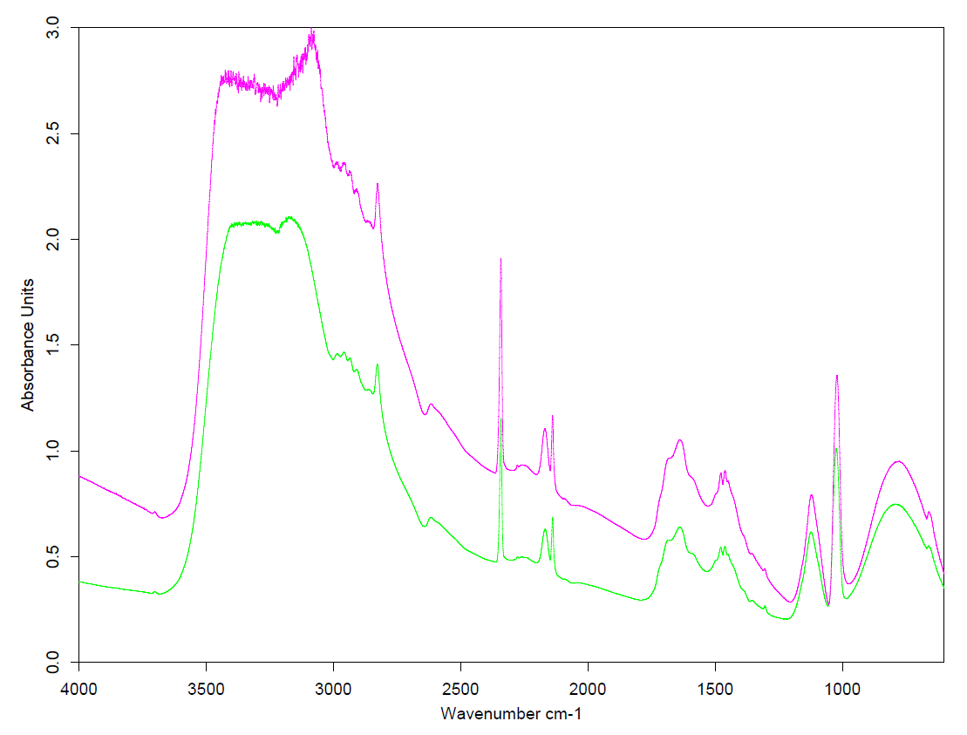
Infra-red spectra: no surprise
The usual suspects
No qualitative difference between Ar-irradiated and S-irradiated
Ruf et al. (2019)

Slide 5
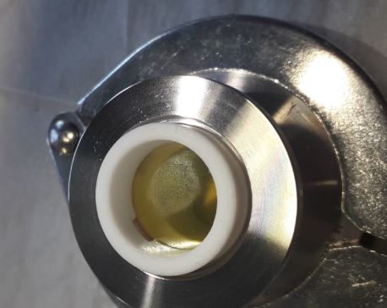
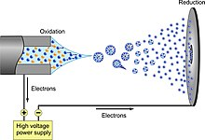
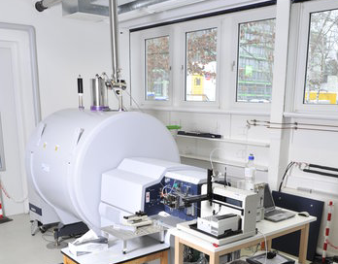
Off-site analysis of the residue
Performed at the Helmholtz Zentrum München, Germany
Electro-spray ionization
FT-ICR mass spectrometry (R> 10⁶, mass accuracy < 200 ppb, 147 to 1000 amu)
Dilution in methanol
(negative mode)
Ultra-high resolution allows to distinguish CHO, CHNO, CHNOS compounds

Slide 6
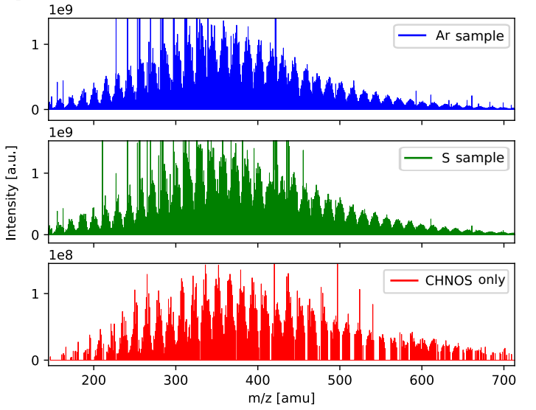
Raw mass spectra
Ruf et al. (2019)
Large diversity of compounds
Difference between
S-irr and Ar-irr?

Slide 7
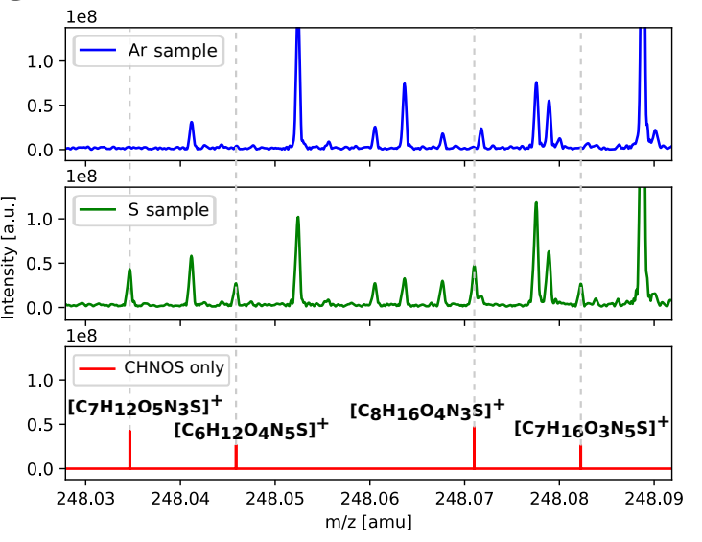
Raw mass spectra (2)
Ruf et al. (2019)
Unique CHNOS compounds in the S-irradiated (12% of all ~10000 identified peaks)

Slide 8
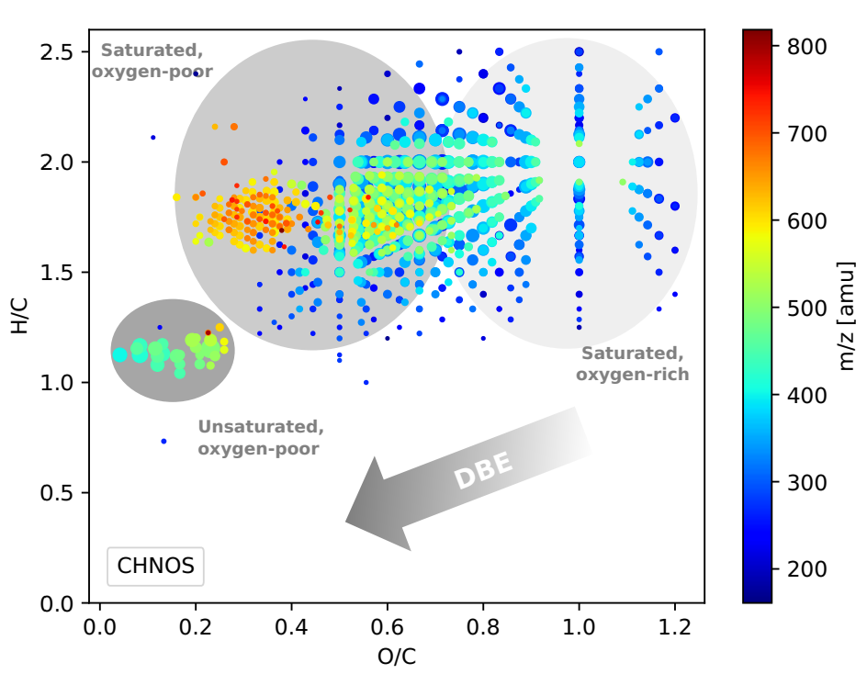
Properties of the unique CHNOS compounds
Ruf et al. (2019)
Double-Bond Equivalent (DBE) is low: mostly aliphatic compounds (esp. Oxygen-rich)
Mass up to 800+ amu
Vast majority of organosulfur bears one S

Slide 9
Astrophysical implications
Most direct applicability: TNO, KBO or comets exposed to solar wind
Presence of water/methanol/ammonia
Comparable T
Solar wind S: ~32 keV
20 mn of irradiation ~ 2 Myrs at 50 AU
Cryovolcanism exposing NH₃ + solar wind: possible complex chemistry
Sulfur implantation complementary with sulfur ice chemistry?
Early solar system: objects irradiated at large distance, then warmed up

Slide 10
Way forward
And next…
Conditions relevant to Europa: T= 80 to 130 K
What form of nitrogen (if any)?
More complicated organic compounds: Acetic acid, glycine, targeted MS analysis
20 mn in the chamber ~ several days on Europa’s surface
Dissolution of the residue into hydrothermal reactors (conditions?)

Slide 11
Takeaway
Irradiation of 10K water:methanol:ammonia ice with 105 keV sulfur ions
Infra-red spectra : no difference between S-irr and Ar-irr
Residue shows rich variety of CHNOS compounds
Mass up to ~ 800 amu
Mostly aliphatic compounds
Fluence, composition, temperature relevant to TNO/KBO/comets exposed to solar wind
Way forward: Europa-like conditions
Results in: Ruf et et al., "Organosulfur Compounds Formed by Sulfur Ion Bombardment of Astrophysical Ice Analogs: Implications for Moons, Comets, and Kuiper Belt Objects."
The Astrophysical Journal Letters 885.2 (2019): L40.
https://doi.org/10.3847/2041-8213/ab4e9f

Slide 12
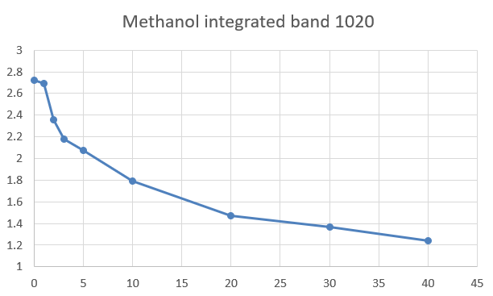
Multi-layer deposition/irradiation
Down with the thickness
Deposit ~0.5 microns of water:methanol:ammonia
Irradiate
0.3 microns projectile range into the ice
We want:
implantation
+
as much residue as possible
Repeat until volatile mixture or experimenter is exhausted
Reach steady state
(about 30 mn: ~1 S monolayer)
Heat up to 300 K to create residue
10-15 layers of irradiated ice contribute to the residue

Slide 13
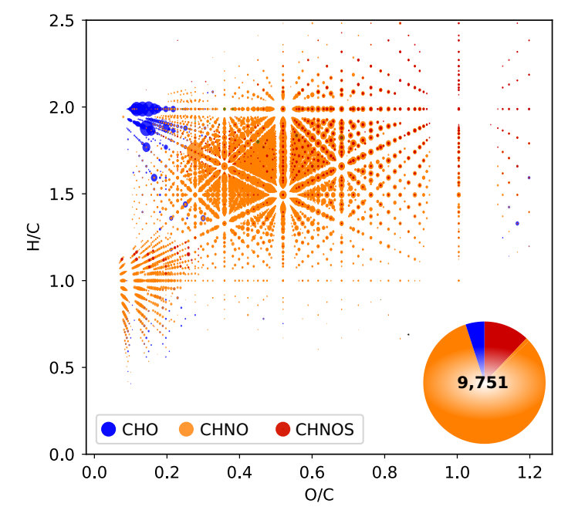
What kind of compounds do we get?
Huge diversity of compounds
CHNO dominates in both sample: crucial role of NH₃ in the chemistry
Significant minority of CHNOS compounds
No CHOS detected
Ruf et al. (2019)

Slide 14
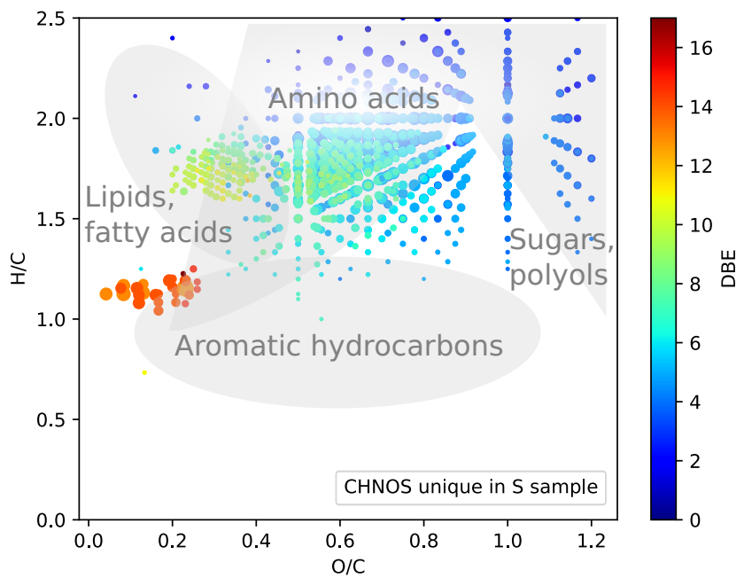
Properties of the unique CHNOS compounds (1)
Presence of sugar-like compounds (O/C =1)
Amino acids-like, fatty acid-like
Double-Bond Equivalent (DBE) is low: mostly aliphatic compounds
Hard to say: high DBE and low H/C: unsaturated, “aromatic-like”
Ruf et al. (2019)

Slide 15
Infra-red spectras: no surprise
H₂CO
The usual suspects: CO₂, CO, CH₄, C=O bonds (HCOOH?), formaldehyde
CO₂
CH₃OH
CO
NH₃
NH₄⁺
NH₃
HOCN
C=O
OCN⁻
CH₄
Ruf et al. (2019)
No qualitative difference between Ar-irradiated and S-irradiated

