Slide 1
A statistical analysis method estimating dust aerosol-ice cloud interactions using global circulation model and satellite data
Part of project KliSAW
Thomas Offenwanger DLR-DFD
Thomas Popp DLR-DFD
Christoph Beck Institute for Geography, University of Augsburg
Johannes Hendricks DLR-IPA
Mattia Righi DLR-IPA

Slide 2
Contents
Data Overview
Statistical analysis of dust aerosol-ice cloud interactions
Downscaling model data
Results and discussion

Slide 3
1. Data Overview
Data restricted to tropical atlantic [-70°to -10° Longitude, 10° to 40° Latitude]
Monsoon season 2008, July-October
Variables: Dust aerosol optical depth (DAOD), Ice cloud optical depth (COD), Ice cloud crystal effective radius (CRE), Ice water path (IWP)

Slide 4
1. Data Overview
IMARS Retrieval: L. Klüser et al. 2015: Information content of space-borne hyperspectral infrared observations with respect to mineral dust properties. Remote Sensing of Environment.
Analysis, data setup: L. Klüser, T. Popp 2017: Large-Scale Analysis of Relationships between Mineral Dust, Ice Cloud Properties, and Precipitation from Satellite Observations Using a Bayesian Approach: Theoretical Basis and First Results for the Tropical Atlantic Ocean. Advances in Meteorology.
Model: P. Jöckel et al. 2010: Development cycle 2 of the Modular Earth Submodel System(MESSy2). Geoscientific model development.
EMAC-MADE3 sub model: Kaiser et al. 2019: Global aerosol modeling with MADE3 (v3.0) in EMAC (based onv2.53): model description and evaluation. Geoscientific model development.
IASI-IMARS
EMAC-MADE3

Slide 5
2. Statistical analysis of dust aerosol-ice cloud interactions
Goal: How does dust load influence cloud characteristics quantitatively and qualitatively?
Categorising of cloud variables into histograms by DAOD-loads
Removal of atmospheric influence by constraining variable (IWP)
Accentuation of DAOD-influence by substraction of bayes-deduced DAOD-free state

Slide 6
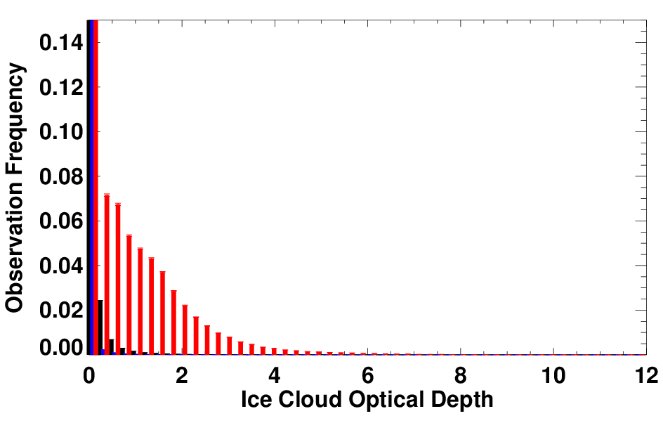
1
Categorise DAOD class-limits
2
Create cloud variable histograms split by DAOD classes
3
Background, low, high dust load histograms
Example picture for visual aid. Each pixel gets an DAOD load class assigned and histograms encompass the entire data set.

Slide 7
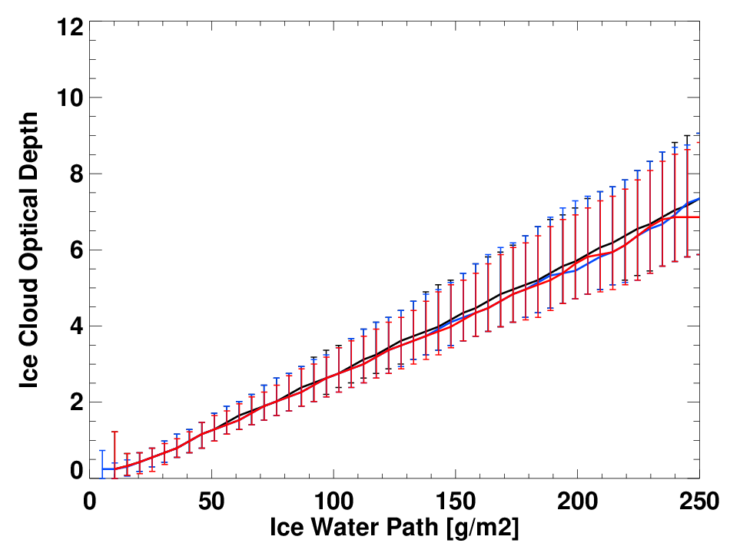
Class histogram statistics still contain influences from the meteorogical state. The constraining variable IWP is used to represent atmospheric influence from all other processes.
The joint distributions of the observed cloud and constraining variable are basis for setting up a bayesian conditional probablity formula. In this, the histograms are taken as probabilites of the cloud variable being dependent on the meteorological state.
To calculate the DAOD effect a difference to a dust-free state has to be taken within the histogram classes. Utilising the same bayesian conditional probability function the background class can be projected for the other dust load classes and then substracted.
For a detailed description see L. Klüser, T. Popp 2017.
1
COD dust class based distribution
1
2
Joint distributions IWP-COD
2

Slide 8
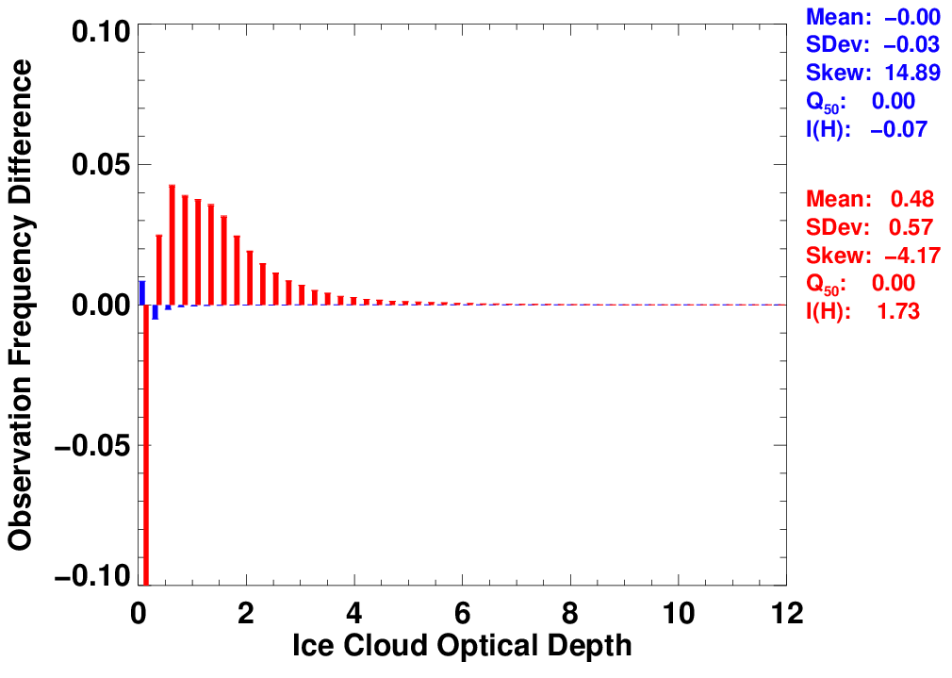
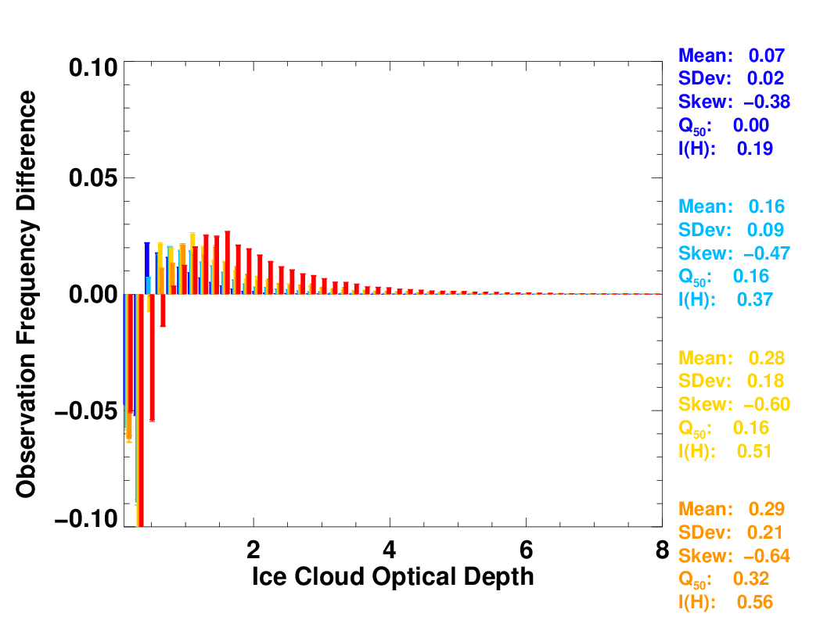
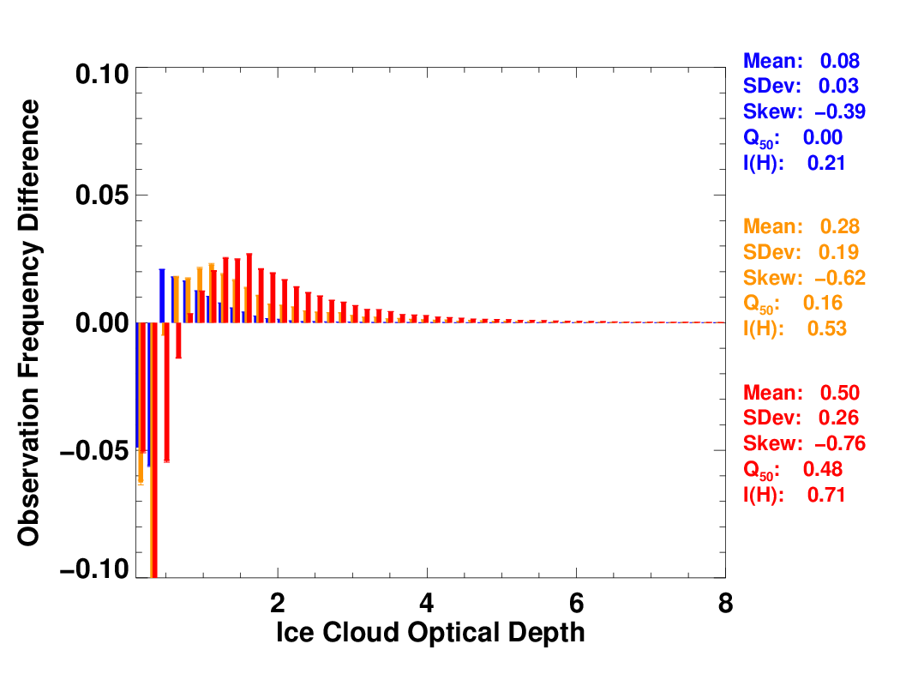
Resulting histogram differences have quantifyable statistics that are used to describe the aerosol load effect on cloud properties.
One addition of this work to prior instances of this analysis is the categorisation into dynamically defined DAOD classes which can be tailored to highlight specific dust characteristics.
1
COD deviation, 2 classes
1
2
3
COD deviation, 5 classes
COD deviation, 3 classes
3
2

Slide 9
The grid resolution has an effect on the analysis results, which makes it necessary to only compare results between different data sets on identical base grids.
To also be able to gain the most information comparing satellite and model data analysing on both grid resolutions is desired. Averaging satellite data to a lower resolution is doable enough.
Bringing model data to a higher resolution proves more challenging and we developed a new method utilising principle component analysis and linear regression to accomplish that.
1
2
3
EMAC-MADE3
0.25° grid
IASI-IMARS
0.25° grid
original
Average satellite data
3
Statistical downscaling
2
1
EMAC-MADE3
2.50° grid
Scale mis-match between originals
IASI-IMARS
2.50° grid
original

Slide 10
3. Downscaling model data
Goal: How can model data be scaled to a higher resolution without overwriting its information content with foreign data?
! Downscaling as transformation of a data set to a finer grid, not climatological downscaling from global parameters to local ones !
Scale mismatch as reason to only compare results within the same resolution
Extraction of geographical information from satellite data to fill model data gaps

Slide 11
3. Downscaling model data Find relation of spatial patterns
First we de-termine the eigenvectors representing the wide grid from satellite data by performing a principle component analysis.
Those are interpreted as statistically significant geographical patterns that form the data underneath. By linearily regressing them to the original model data, we get the transformation factors that are needed to translate them to be compatible with the model data.
IASI-IMARS Eigenvectors
1, 2,…,n
2
Mult. Linear regression
1
EMAC-MADE3
2.50° grid
2
3
1
Principal Component Analysis, S-mode
p1, p2, …, pn
IASI-IMARS
2.50° grid
3
Gain regression parameters

Slide 12
3. Downscaling model data Apply relation to fine scale data
2
Transform with parameters
Now the eigenvectors, or spatial patterns, underlying the fine gridded data are combined with the transformation parameters from the last step.
The resulting anomaly data is being imprinted onto the standardised model data. Mean and stddev. of the original model data have been extracted beforehand and are being added again afterwards.
IASI-IMARS Eigenvectors
1, 2,…,n
Imprint on model data to fill fine scale information
1
2
3
EMAC-MADE3
2.50° grid
p1, p2, …, pn
3
1
Determine spatial patterns on fine grid
IASI-IMARS
0.25° grid
EMAC-MADE3
0.25° grid

Slide 13
3. Downscaling model data Downscaling examples
Method consistently true to input data
r² of downscaled vs. original model data 0.89-0.96 for all variables
Overall consistent bias between downscaled and original model data of about 3-7%
Downscaled model
Original model
Original satellite

Slide 14
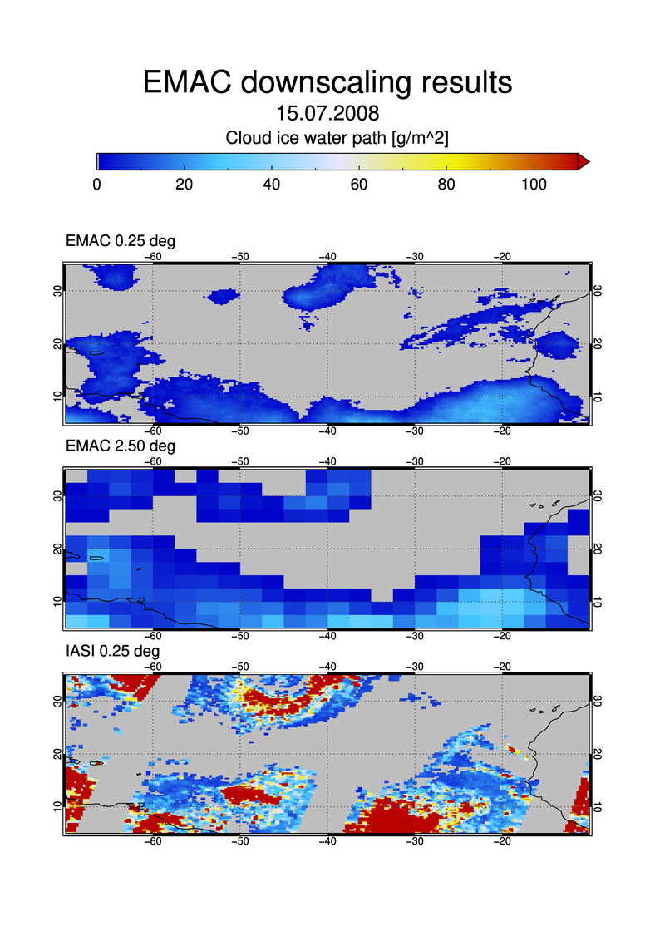
Downscaled model
Downscaled model
Original model
Original model
Original satellite
Original satellite

Slide 15
4. Results and discussion
Analysis results from model and satellite data comparable in all resolutions
DAOD effects roughly represented in both fine and large resolution data sets
Fine scale data, including downscaled model, with better readability and consistency

Slide 16
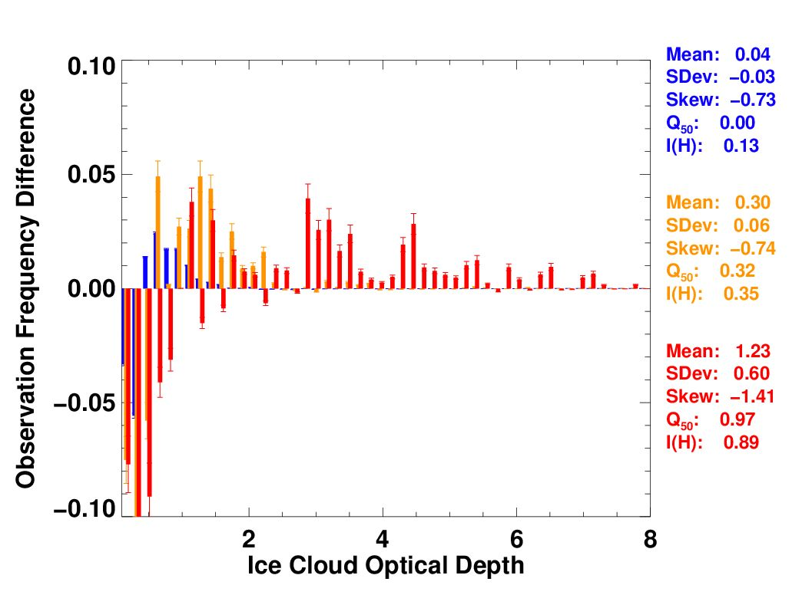
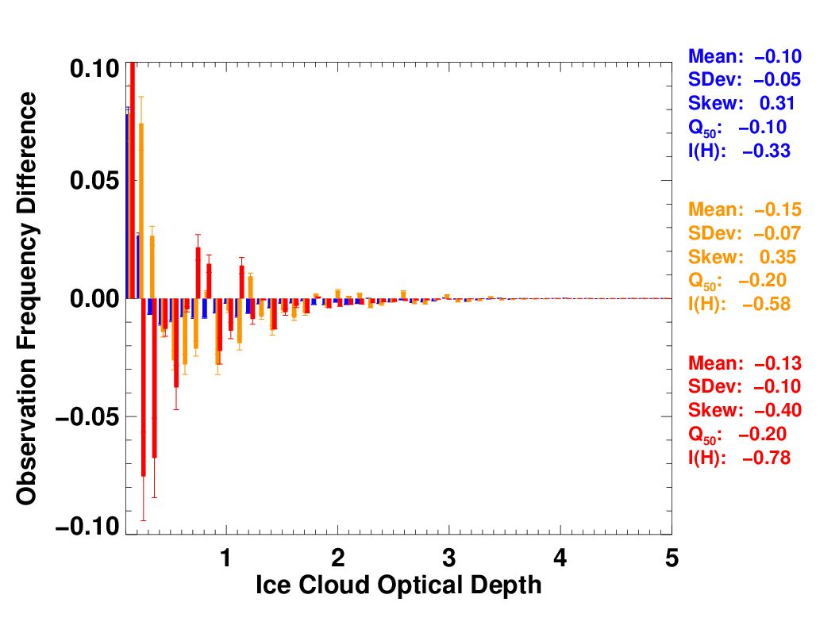
Results COD – 2.50° IASI EMAC
With only 1/100th of data points uncertainties are higher vs. 0.25°
averaged satellite
original model
Curious strong positive change peak in COD near zero. Possibily result of high model coverage vs. satellite?
High dust load shows strong positive trend; less low COD, more high COD
Statistical values conflicting, indicator for high noise
Shannon Information content
2.50° | Mean |  |  | SD |  |  | Skew |  |  | Q50 |  |  | I(H)
IASI | 0.04 | 0.30 | 1.23 | -0.03 | 0.06 | 0.60 | -0.73 | -0.74 | -1.41 | 0.00 | 0.32 | 0.97 | 0.13 | 0.35 | 0.89
EMAC | -0.10 | -0.15 | -0.13 | -0.05 | -0.07 | -0.10 | 0.31 | 0.35 | -0.40 | -0.10 | -0.20 | -0.20 | -0.33 | -0.58 | -0.78
Class mean effect
Class standard deviation
Bin Function Skewness
Median of bins

Slide 17
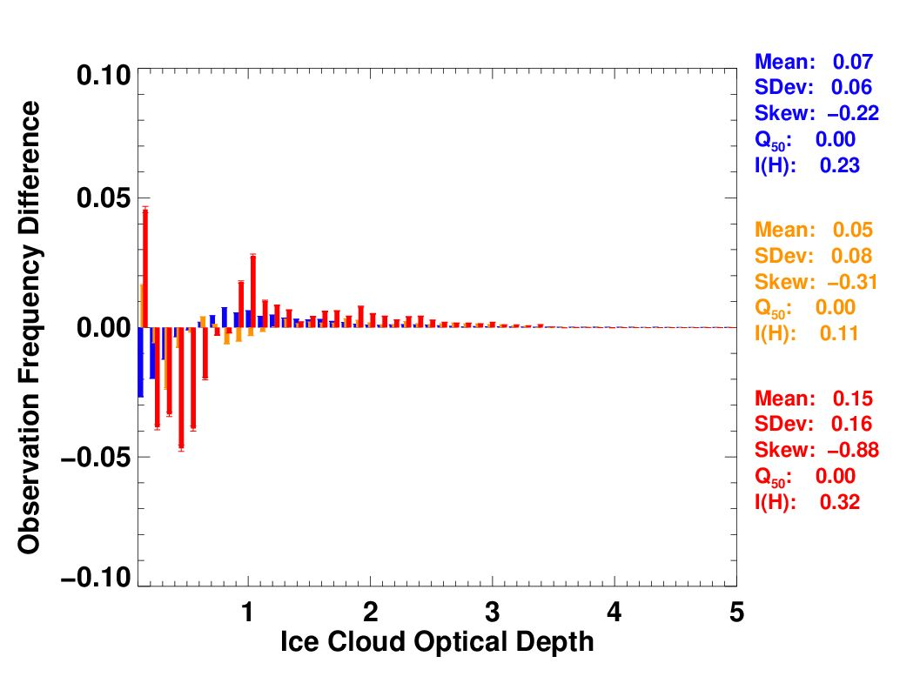
Results COD – 0.25° IASI EMAC
original satellite
downscaled model
Peaks indicate possible function and positive shift with dust load
COD between 0.6 and 0.9 relatively little change due to dust load, almost identical points in both data sets
Dust load classes show comparable shift and peaks after downscaling, medium load being except.
Statistical values agree on trend
0.25° | Mean |  |  | SD |  |  | Skew |  |  | Q50 |  |  | I(H)
IASI | 0.08 | 0.28 | 0.50 | 0.03 | 0.19 | 0.26 | 0.39 | -0.62 | -0.76 | 0.00 | 0.16 | 0.48 | 0.21 | 0.53 | 0.71
EMAC | 0.07 | 0.05 | 0.15 | 0.06 | 0.07 | 0.16 | -0.22 | -0.31 | -0.88 | 0.00 | 0.00 | 0.00 | 0.23 | 0.11 | 0.32
AOD 0.15-0.60

Slide 18
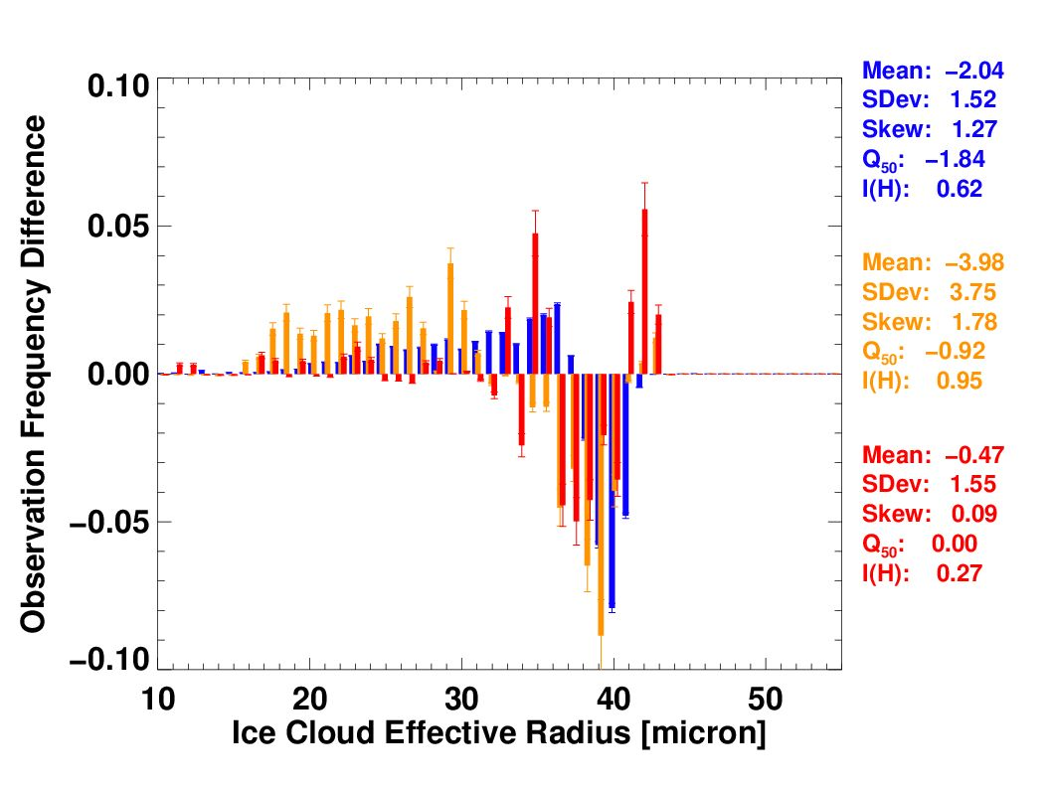
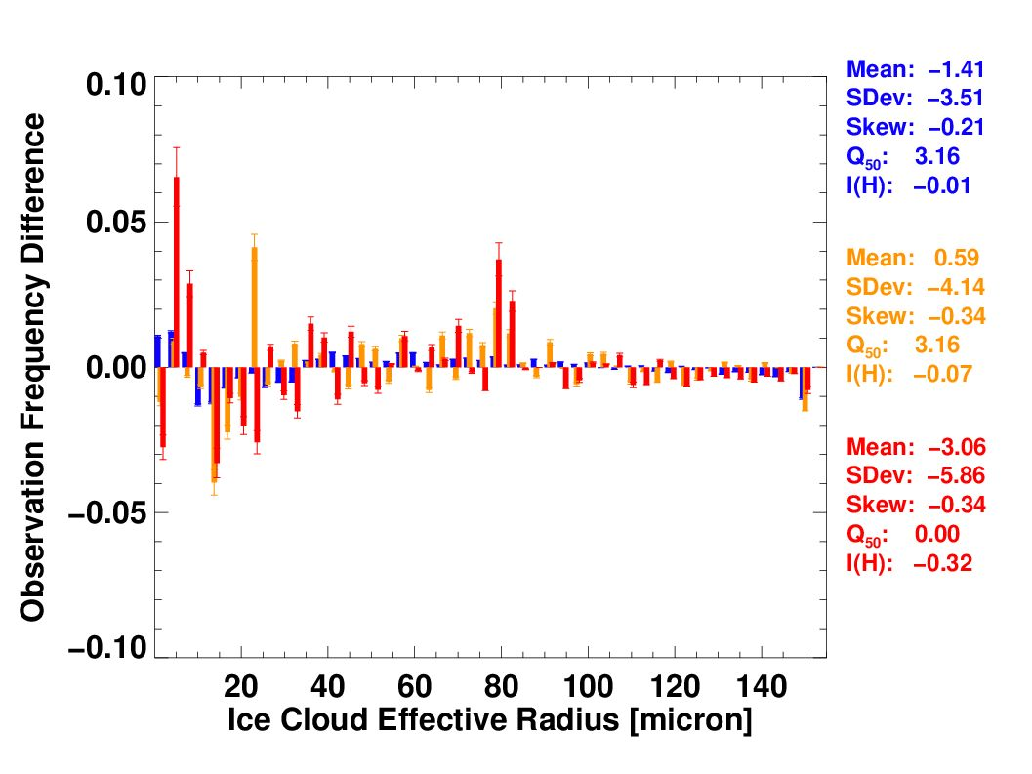
Results CRE – 2.50° IASI EMAC
Especially with CRE 2.50° model analysis results are seemingly impacted with noise
Noticeable negative change for subset between 15-40 µm
averaged satellite
original model
Attention to data values, differing acquisition methods make comparison tricky
0.25° | Mean |  |  | SD |  |  | Skew |  |  | Q50 |  |  | I(H)
IASI | -2.04 | -3.98 | -0.47 | 1.52 | 3.75 | 1.55 | 1.27 | 1.78 | 0.09 | -1.84 | -0.92 | 0.00 | 0.62 | 0.95 | 0.27
EMAC | -1.41 | 0.59 | -3.06 | -3.51 | -4.14 | -5.86 | -0.21 | -0.34 | -0.34 | 3.16 | 3.16 | 0.00 | -0.01 | -0.07 | -0.32

Slide 19
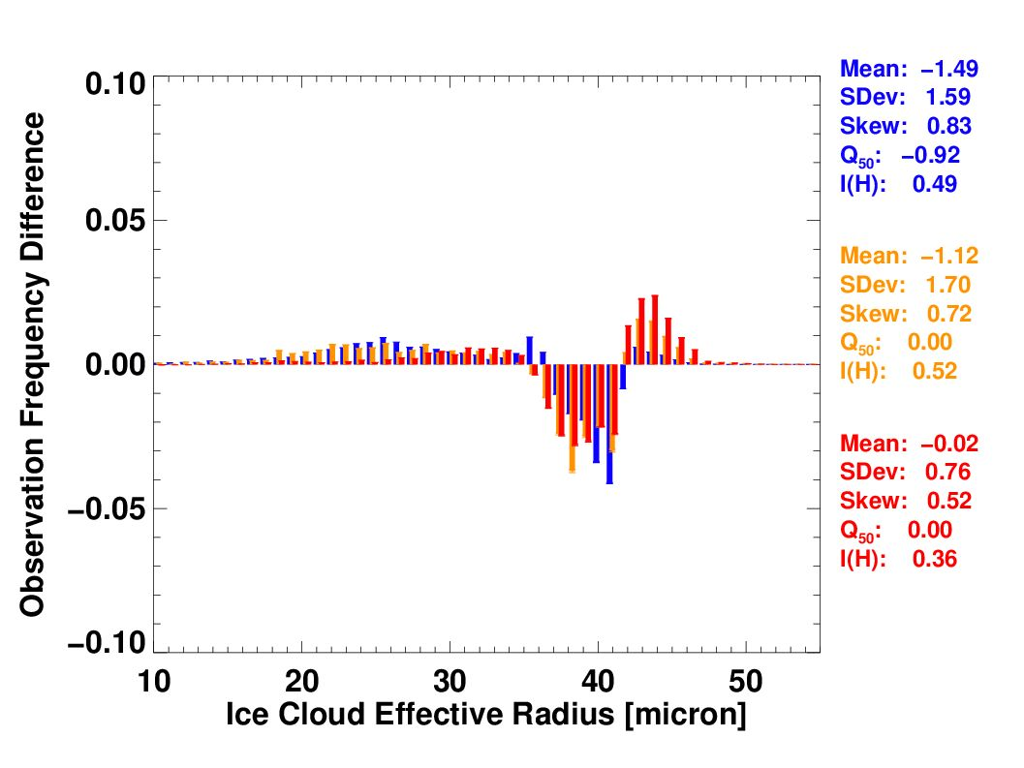
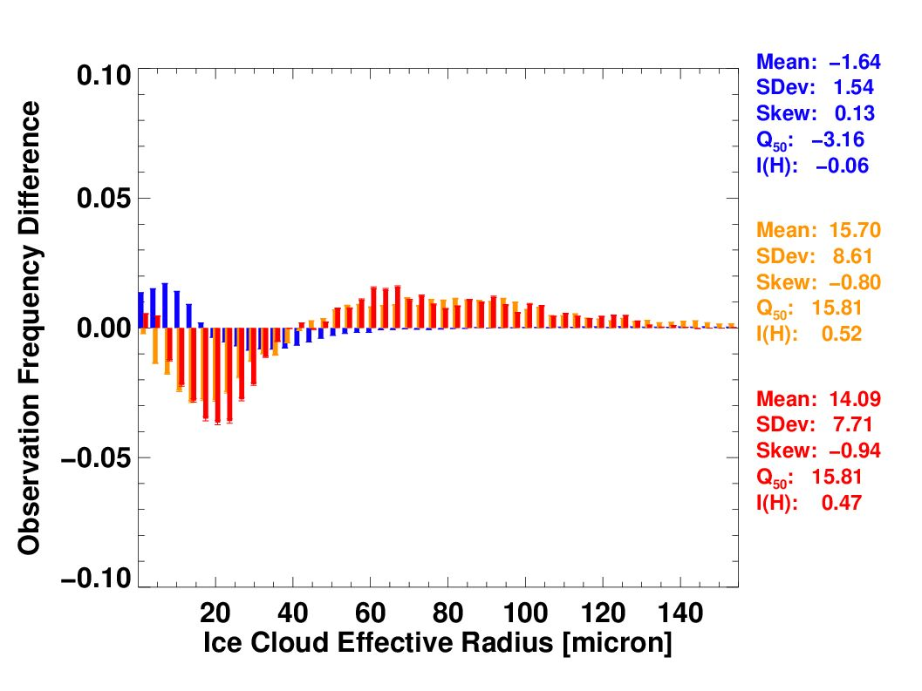
Results CRE – 0.25° IASI EMAC
Negative dip now even more pronounced in fine scale for both data sets, seems to follow a function
original satellite
downscaled model
Opposite to satellite data, low dust load class does not follow structure of the other classes
0.25° | Mean |  |  | SD |  |  | Skew |  |  | Q50 |  |  | I(H)
IASI | -1.49 | -1.12 | -0.02 | 1.59 | 1.70 | 0.76 | 0.83 | 0.72 | 0.76 | -0.92 | 0.00 | 0.00 | 0.49 | 0.52 | 0.36
EMAC | -1.64 | 15.70 | 14.09 | 1.54 | 8.61 | 7.71 | 0.13 | -0.80 | -0.94 | -3.16 | 15.81 | 15.81 | -0.06 | 0.52 | 0.47

Slide 20
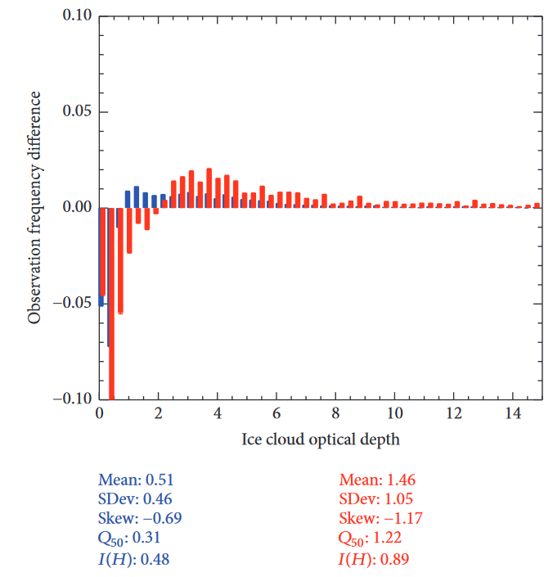
IASI-IMARS v6.0
Overall structure of dust load classes is comparable, showing higher, further shifted peaks for higher dust loads.
Magnitude of retrieval ice cloud optical depth has since decreased. Other literature and EMAC model values rarely show cirrus ice COD above 5
L. Klüser, T. Popp 2017: Large-Scale Analysis of Relationships between Mineral Dust, Ice Cloud Properties, and Precipitation from Satellite Observations Using a Bayesian Approach: Theoretical Basis and First Results for the Tropical Atlantic Ocean. Advances in Meteorology. Fig. 6, p. 10.
downscaled model
Region and time frame presented here are identical to the published work. The satellite retrieval has since been updated to v6.0 with better dust coverage. Additionally, 0.25° gridded data has been used compared to the published 0.50°.

Slide 21
Summary
Advances
Prototype of new downscaling method
Application of statistical analysis to model data
Consolidation of comparability between satellite and model data
Expansion of histogram classes for statistical analysis
Dynamic definition of histogram classes with respect to DAOD characteristics
Results
Dust load mean effect on cirrus cloud optical depth more positive for higher loads, consistent between model and satellite
Tranquil point of little to no dust effect on cirrus cloud optical depth seems to be 0.6-0.9 COD
Dust load effect on cirrus ice crystal effective radius with strong minimum between 15-40 µm in all load classes
Disparity between satellite retrieval and model cloud variable values, especially ice crystal effective radius

Slide 22
Outlook
Data
Expand time frame from 6 to 18 months over the span of the 2008-2010 monsoon seasons
Expand information density in satellite data by incorporating height layered processing
Analysis
Application of updated analysis handling/plotting for more than 10 dust load classes
Testing feasibility of expressing dust effect as function based on dust load classes
Prototyping of comparative analysis with in-situ plane based measurements
Joint analysis of satellite and model data to better understand aerosol-cloud interaction (ACI) processes
Conduct sensitivity studies with specified changes to model parameterizations to evaluate different ACI processes

